Slide 1
RNA-seq data analysis
2017-02-25

Slide 2
The statistics of the aligned reads to mouse reference genome (mm10)
Sample | Raw reads | Clean reads | Mapped reads | Mapped rate
WT1 | 84,890,710 | 64,271,920 | 53,383,180 | 83.06%
WT2 | 85,386,318 | 69,677,495 | 58,904,383 | 84.54%
HO1 | 95,894,794 | 59,440,919 | 45345718 | 75.20%
HO2 | 97,264,858 | 67590951 | 45345718 | 67.09%
All genome data have been download from ftp://ftp.sanger.ac.uk/pub/gencode/Gencode_mouse/release_M9/

Slide 3
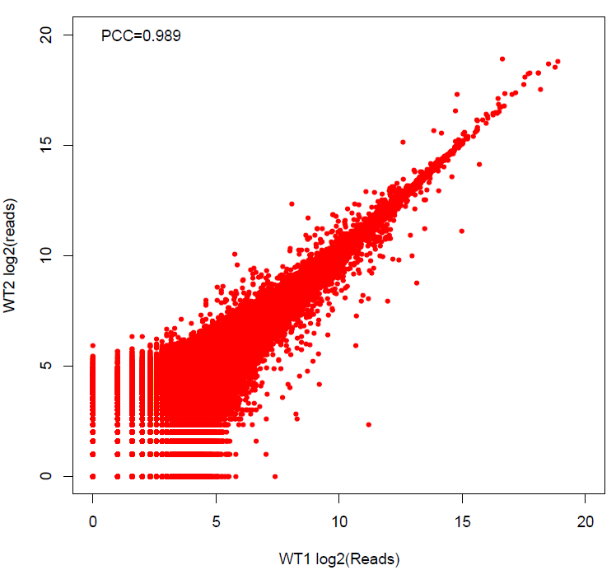
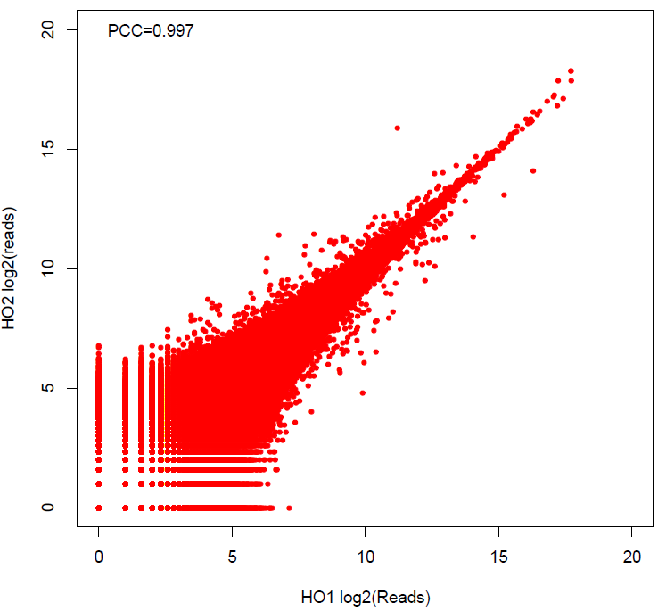
Pearson correlation of two sample

Slide 4
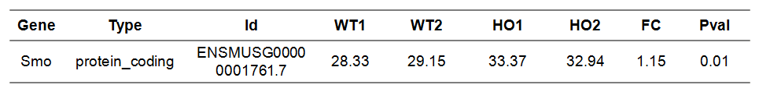
The expression pattern of Smo gene

Slide 5
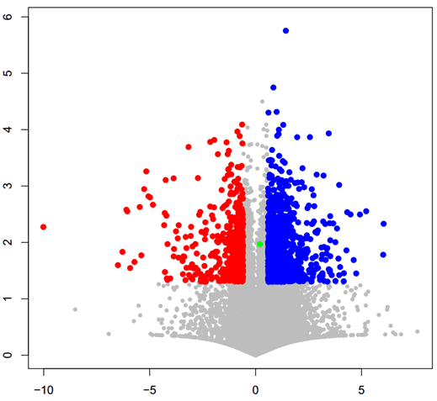
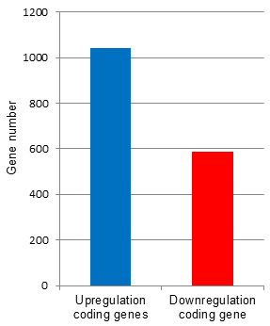
Smo regulated protein coding genes
1044
-Log10(P-val)
588
Log2 (fold change of HO/WT)

Slide 6
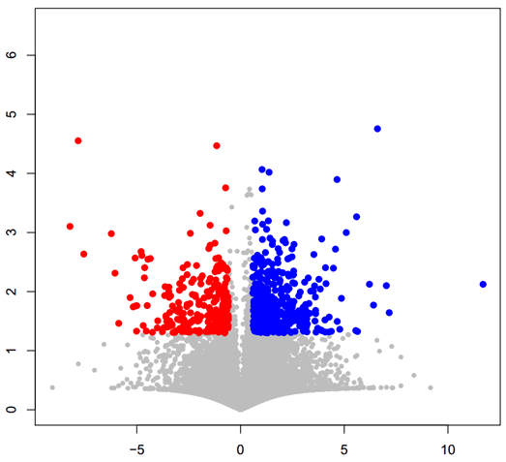
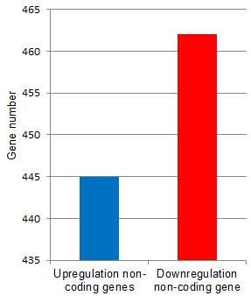
Smo regulated non-coding genes
462
-Log10(P-val)
445
Log2 (fold change of HO/WT)

Slide 7
Differential Expressed Genes
 | Coding gene | Non –coding gene
Up regulation | 1044 | 445
Down regulation | 588 | 462
Total DE genes | 1632 | 907

Slide 8
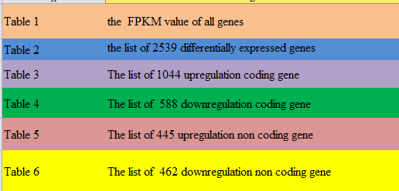
Supplemental information

