Slide 1
the interaction between PTBP3 and 14-3-3

Slide 2
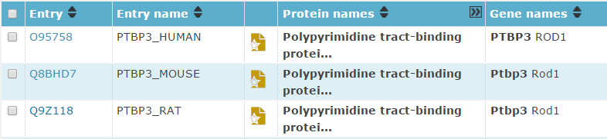
Goal: study the interaction between PTBP3 and 14-3-3
Step 1: Search in UniProt server www.uniprot.org/
For AID
For PTBP3

Slide 3
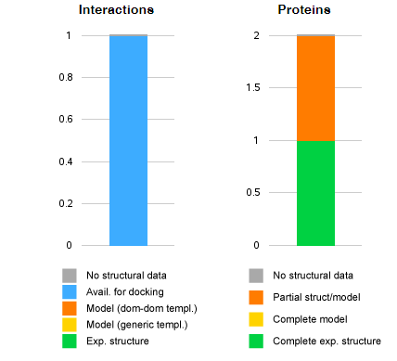
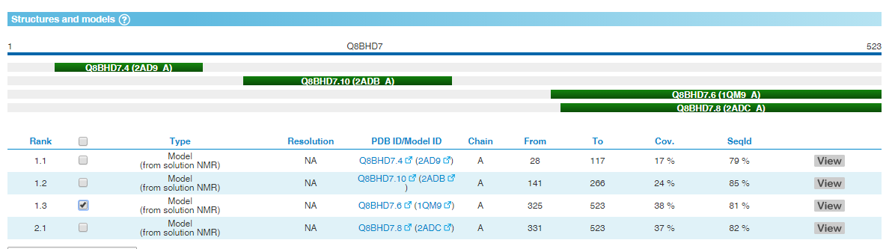
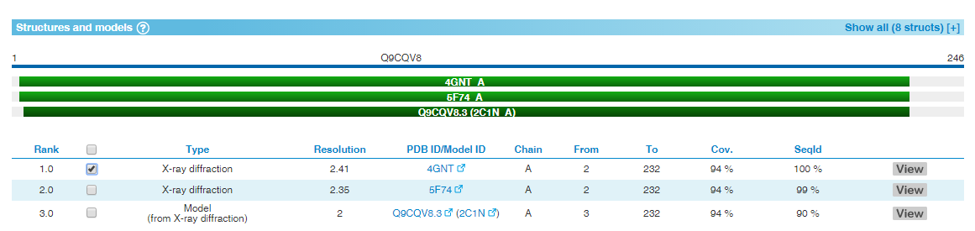
Interaction of PTBP3-AID
Step 2: Search in Interactome3D
http://interactome3d.irbbarcelona.org/
Submit interaction “Q8BHD7 Q9CQV8” that are for the PTBP3 and AID proteins in mouse.
Notes:
Select covarage biggest model

Slide 4
Interaction of PTBP3-AID
Step 2: (continued)
The two structural models downloaded from Interactome3D are in folder “ptbp3_bind_aid”:
PTBP3-Q8BHD7-MDL-Q8BHD7.6-1qm9_A.pdb
14-3-3-Q9CQV8-EXP-4gnt_A.pdb
Step 3: Protein docking using PRISM 2.0 server
http://cosbi.ku.edu.tr/prism/index.php
Upload the two PDB files and submit

Slide 5
Interaction of PTBP3-AID
Step 3: (continued)
Docked PDB:
Interfaces residues:
Fix PDB file by
>python fix_chain_id.py [input.pdb] [output.pdb]
Step 4: Virtualization by PyMol (v1.7.2.1)
Hide all
Show cartoon
Color by chain
Background to white Ray

Slide 6
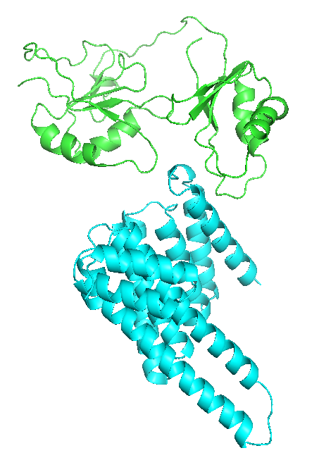
the interaction between PTBP3 and 14-3-3beta/alpha

Slide 7
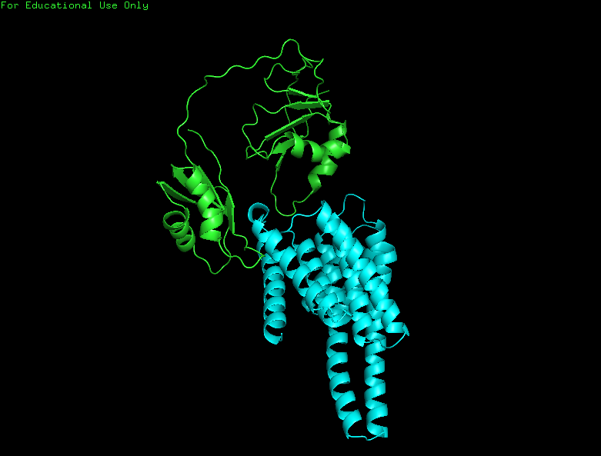
the interaction between PTBP3 and 14-3-3 gamma

