Slide 1
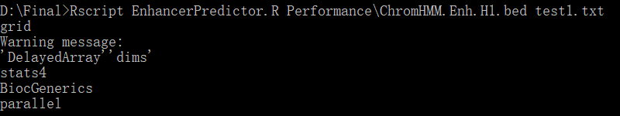
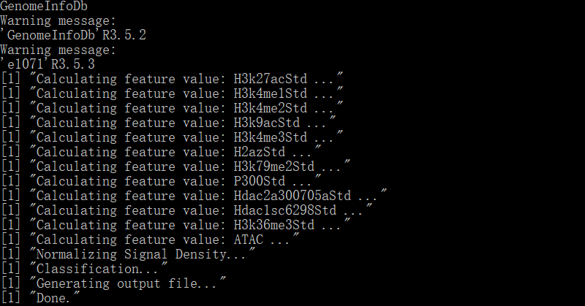

Slide 2
Model Training
Prediction
21 Features
12 Features
bed file for prediction
Train Set
Positive Enhancer
（ChromHMM）
Enhancer
Predictor
SVM
Learn
Calculate
Feature Value
All genome regions
With 21 features
Split
Test Set
Negative Enhancer
（Random）
bed file with feature value and prediction results
Chr22

Slide 3
Data Preparation
Model Training
Prediction
21 Features
12 Features
Random
Forest
bed file for prediction
Train Set
Positive Enhancer
（ChromHMM）
Enhancer
Predictor
ANN
Learning
Calculate
Feature Value
All genome regions
With 21 features
Split
Test Set
Negative Enhancer
（Random）
bed file with feature value and prediction results
Chr22

Slide 4
Data Preparation
Model Training
Prediction
21 Features
12 Features
Random
Forest
bed file for prediction
Train Set
Positive Enhancer
（ChromHMM）
Enhancer
Predictor
SVM
Learning
Calculate
Feature Value
All genome regions
With 21 features
Split
Test Set
Negative Enhancer
（Random）
bed file with feature value and prediction results

Slide 5
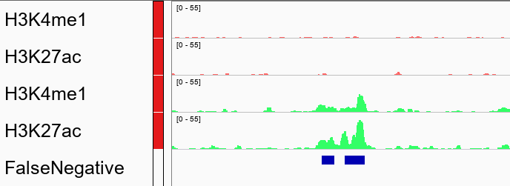
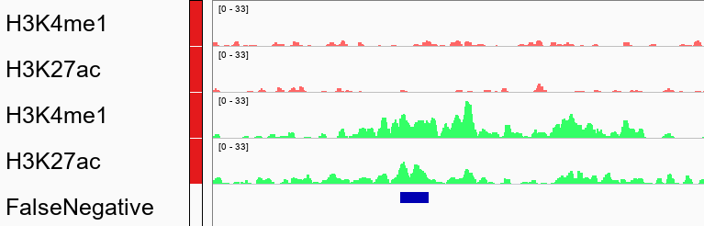
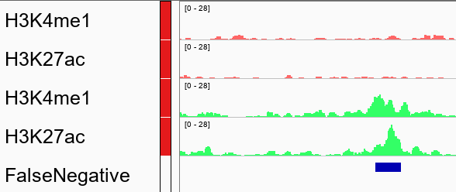
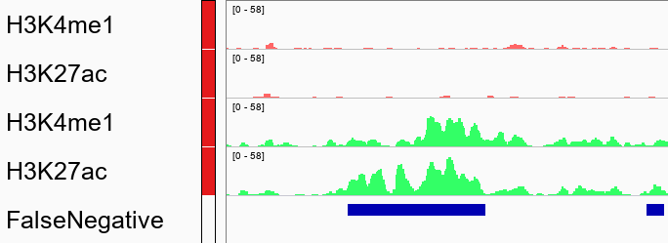
K562
H1
chr7: 28,930kb-28,940kb
chr11: 34,200kb-34,220kb
chr15: 48,725kb-48,735kb
chr2: 120,545kb-120,555kb

