Slide 1


Mobility-Aware Dynamic Taxi Ridesharing
Zhidan Liu, Zengyang Gong, Jiangzhou Li, Kaishun Wu
Shenzhen University, Shenzhen, China

Slide 2
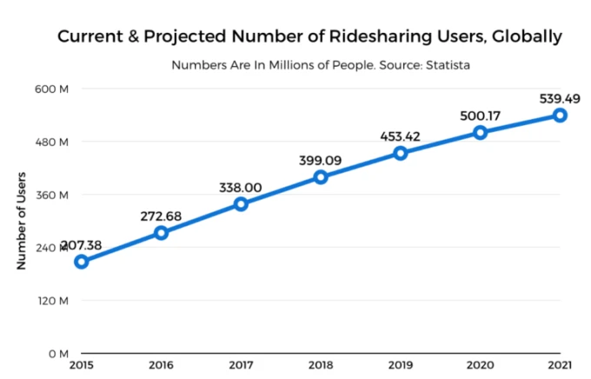

Ridesharing
Ridesharing allows multiple passengers with the similar itineraries and time schedules to share a vehicle.
E.g., alleviating traffic congestion, reducing energy consumption, etc.
Ridesharing has become popular worldwide.
Notes:
[1]https://www.poparide.com/blog/ridesharing-vs-ridehailing/
https://techcrunch.com/2017/08/17/can-didi-out-network-uber-to-win-the-global-ridesharing-market/

Slide 3

Taxi Ridesharing
Taxi ridesharing becomes promising ^{[1-3]} .
Taxi is an important transportation mode in all cities.
Taxis are widely available in a city, and are operating in 7x24.
Taxis can be either booked online, or hailed along the street.
[1] S. Ma, Y. Zheng, O. Wolfson, et al. Real-time city-scale taxi ridesharing. IEEE Transactions on Knowledge and Data Engineering, 27(7):1782–1795, 2015.
[2] Q. Ma, Z. Cao, K. Liu, and X. Miao. QA-Share: toward an efficient QoS-aware dispatching approach for urban taxi-sharing. ACM Transactions on Sensor Networks, 16(2):1–21, 2020.
[3] W. Zhang, A. Shemshadi, Q. Z. Sheng, Y. L. Qin, X. Xu, and J. Yang. A user-oriented taxi ridesharing system with large-scale urban GPS sensor data. IEEE Transactions on Big Data, 1(1):1–14, 2019.

Slide 4
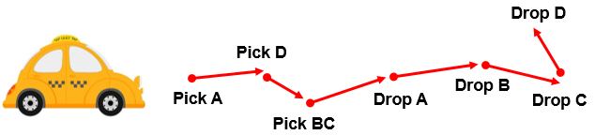

Modeling of taxi ridesharing systems
Road network graph $G=(V, E)$
Ride request $r_{i}=<t_{r_{i}},o_{r_{i}},d_{r_{i}},e_{r_{i}}>$
$o_{r_{i}},d_{r_{i}}$: origin and destination
$t_{r_{i}}$, $e_{r_{i}}$: release time and delivery deadline
Taxi status $t_{j}=<loc_{t_{j}},S_{t_{j}},R_{t_{j}}>$
$loc_{t_{j}}$: current location
$S_{t_{j}}$ : taxi schedule, a sequence of origins and destinations
$R_{t_{j}}$ : taxi travel route
Taxi ridesharing is dynamic and challenging, since requests are generated on the fly and taxi schedules are continuously updated.

Slide 5
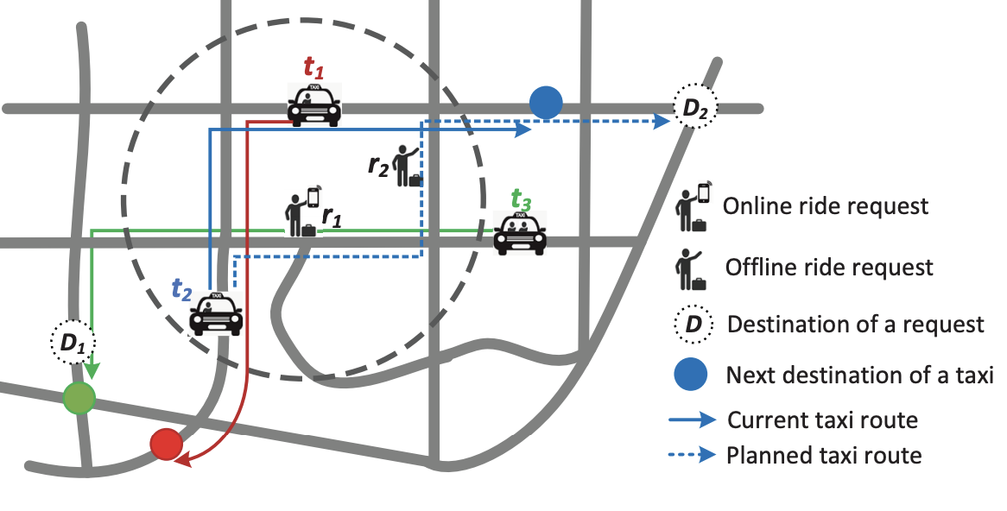

Existing solutions
Existing solutions ^{[1-5]} process a ride request in two stages
Candidate taxi searching
E.g., $t_{1}$ and $t_{2}$ for $r_{1}$
Ridesharing routing
Updating schedule/route
[1] S. Ma, Y. Zheng, O. Wolfson, et al. Real-time city-scale taxi ridesharing. IEEE Transactions on Knowledge and Data Engineering, 27(7):1782– 1795, 2015.
[4] N. Ta, G. Li, T. Zhao, J. Feng, H. Ma, and Z. Gong. An efficient ridesharing framework for maximizing shared route. IEEE Transactions on Knowledge and Data Engineering, 2018.
[5] Y. Xu, Y. Tong, Y. Shi, Q. Tao, K. Xu, and W. Li. An efficient insertion operator in dynamic ridesharing services. In IEEE ICDE, 2019.

Slide 6

Limitations of existing solutions
Inefficient passenger-taxi matching
E.g., $t_{2}$ travels inversely with $r_{1}$, and $t_{3}$ is better
Omitting the offline passengers
$t_{2}$ may serve offline $r_{2}$ if possible
55.39% requests like $r_{2}$ may be offline ^{[6]}
[6] Taxi service research report. http://www.transformcn.com/Topics/ 2018-08/02/b7944fb3-1b99-4840-89d7-eecaaec67bea.pdf.

Slide 7
Problem statement
Mobility-aware taxi ridesharing (MTR) problem
Given:
A road network G
A set of taxis T
A set of requests R, including online and offline requests to predict
Properly schedule taxis to serve requests, so as to
Maximize the number of served requests
Minimize the total detour cost
Constraints:
Capacity of each taxi
Delivery deadline of each request

Slide 8
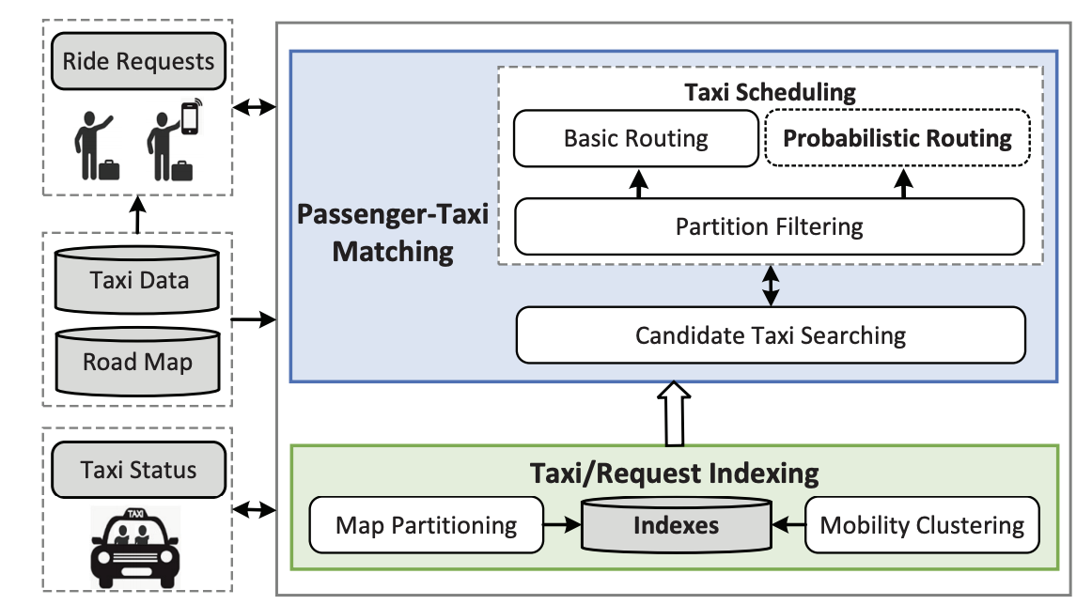
Our solution: mT-Share

Slide 9

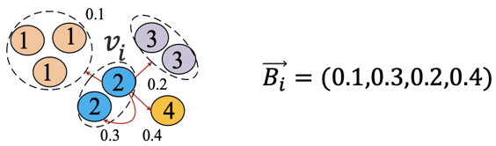
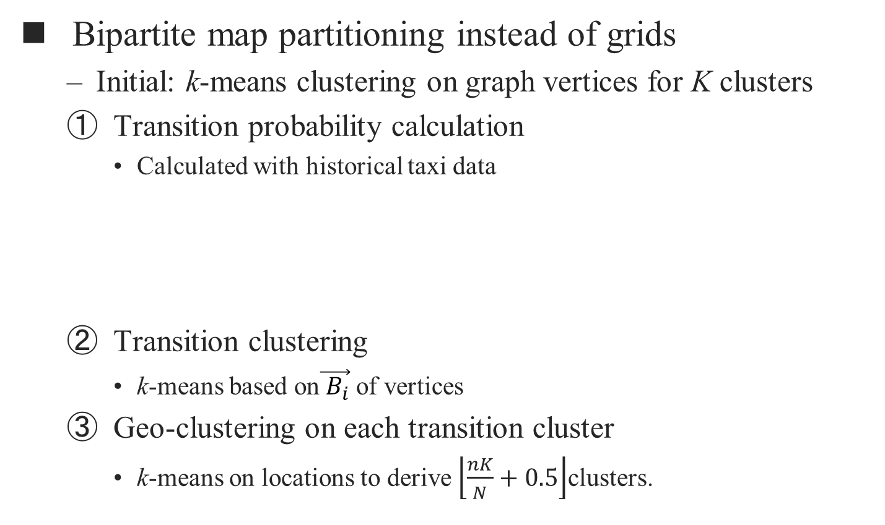
Taxi/request indexing
Bipartite map partitioning instead of grids
Initial: k-means clustering on graph vertices for K clusters
Transition probability calculation
Calculated with historical taxi data
Transition clustering
k-means based on$\vec{{ B}_{i}}$ of vertices
Geo-clustering on each transition cluster
k-means on locations to derive $\left\lfloor \frac{nK}{N}+0.5\right\rfloor$clusters.

Slide 10

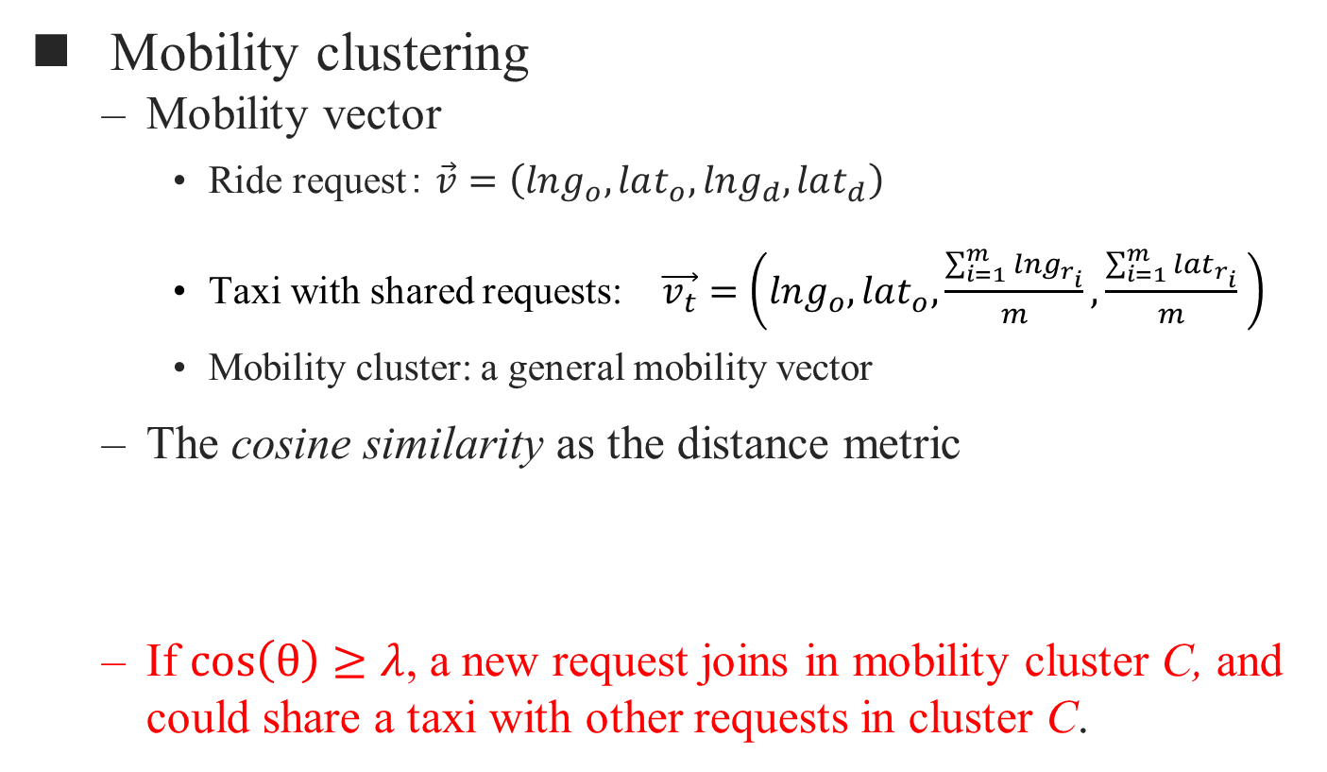
Taxi/request indexing
Mobility clustering
Mobility vector
Ride request： $\vec{v}=\left(lng_{o}, lat_{o},lng_{d}, lat_{d}\right)$
Taxi with shared requests: $\vec{v_{t}}=\left(lng_{o},lat_{o},\frac{\sum_{i=1}^{m}{{lng}_{r_{i}}}}{m},\frac{\sum_{i=1}^{m}{{lat}_{r_{i}}}}{m} \right)$
Mobility cluster: a general mobility vector
The cosine similarity as the distance metric
If $\cos\left(θ\right)$ $≥$ $λ$, a new request joins in mobility cluster C, and could share a taxi with other requests in cluster C.

Slide 11
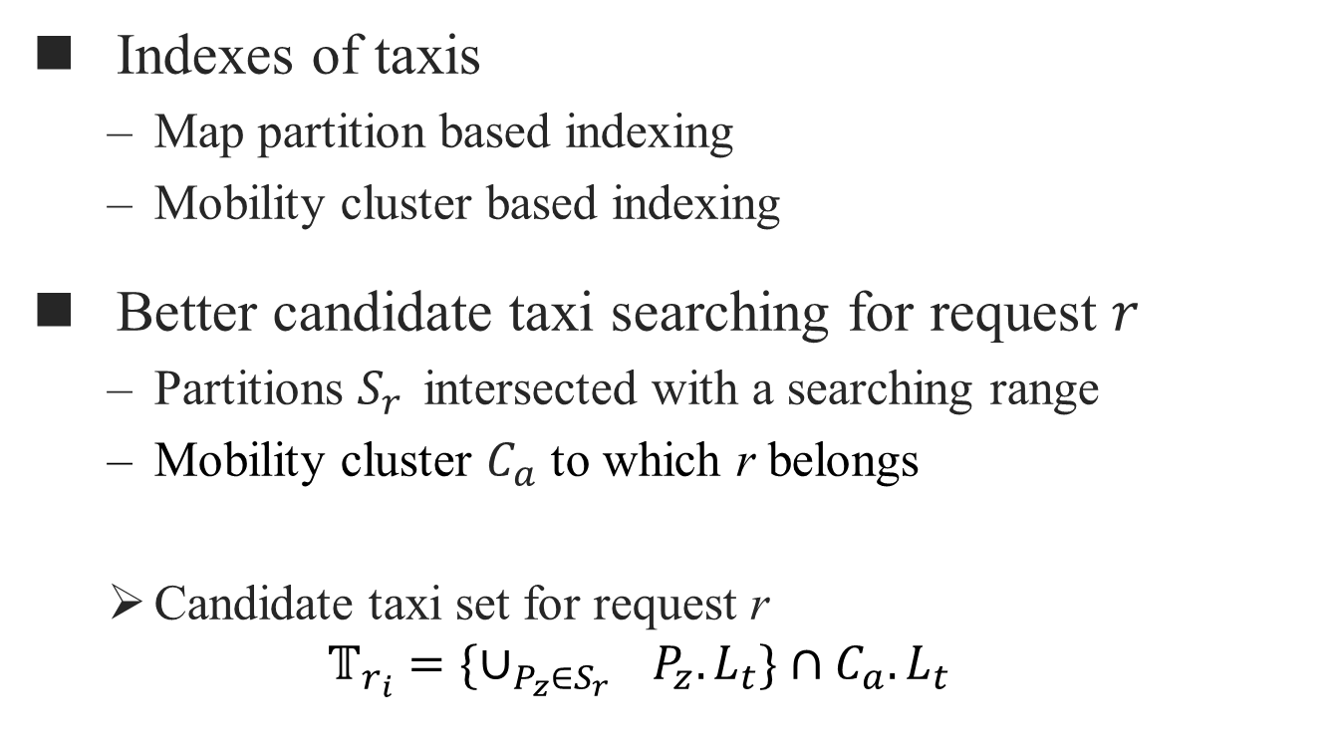
Candidate taxi searching
Indexes of taxis
Map partition based indexing
Mobility cluster based indexing
Better candidate taxi searching for request $r$
Partitions $S_{r}$ intersected with a searching range
Mobility cluster $C_{a}$ to which r belongs
Candidate taxi set for request r
$$𝕋_{r_{i}}=\{∪_{P_{z}∈S_{r_{}}}P_{z}.L_{t}\}∩C_{a}.L_{t}$$

Slide 12
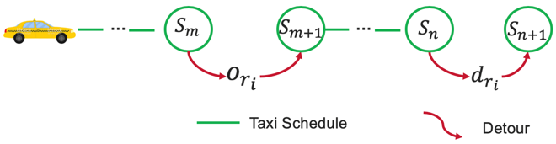
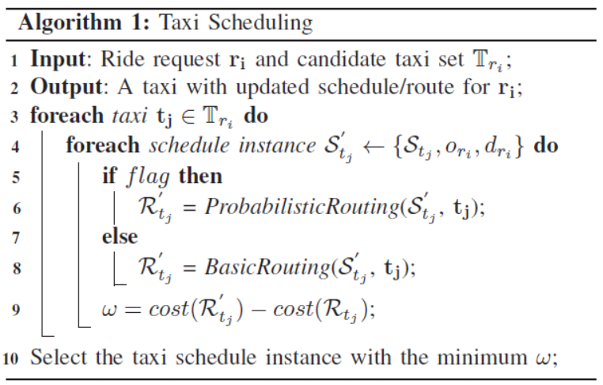
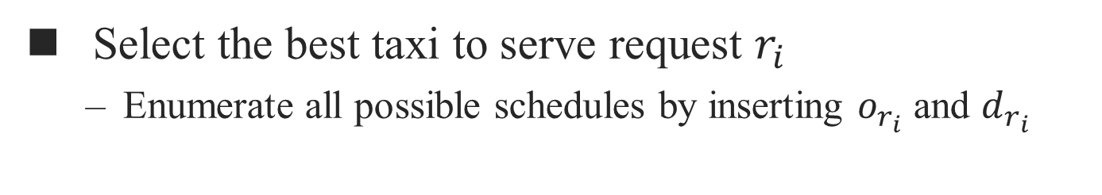
Taxi scheduling
Select the best taxi to serve request $r_{i}$
Enumerate all possible schedules by inserting $o_{r_{i}}$ and $d_{r_{i}}$
Run in non-peak hours
Run in peak hours

Slide 13
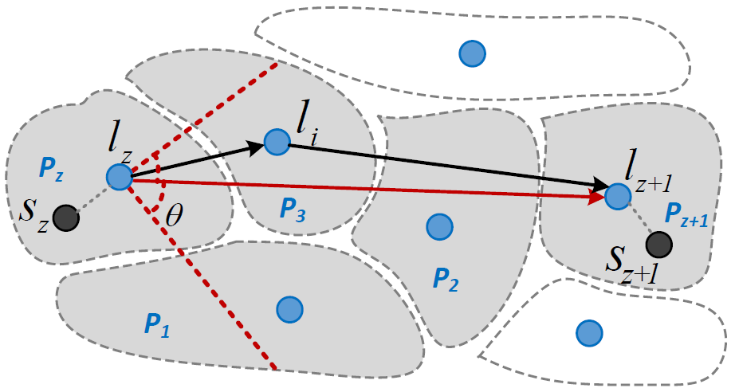
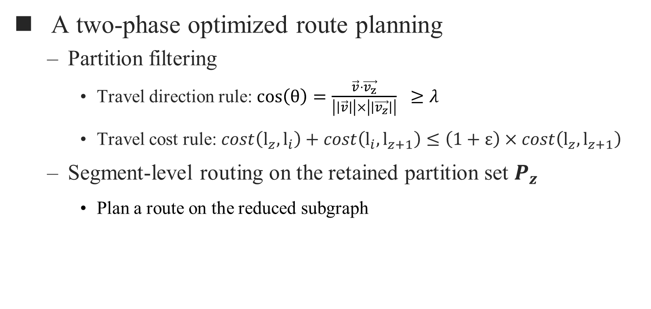
Route planning
A two-phase optimized route planning
Partition filtering
Travel direction rule: $\cos\left(θ\right)=\frac{\vec{v}⋅\vec{v_{z}}}{\left|\left|\vec{v}\right|\right|×\left|\left|\vec{v_{z}}\right|\right|} ≥λ$
Travel cost rule: $cost\left(l_{z},l_{i}\right)+cost\left(l_{i},l_{z+1}\right)≤\left(1+ε\right)×cost\left(l_{z},l_{z+1}\right)$
Segment-level routing on the retained partition set $P_{z}$
Plan a route on the reduced subgraph

Slide 14
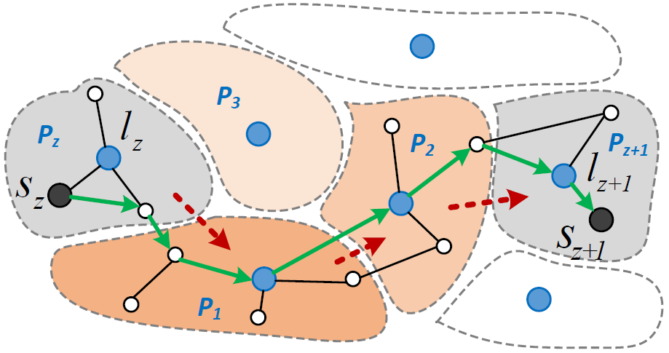
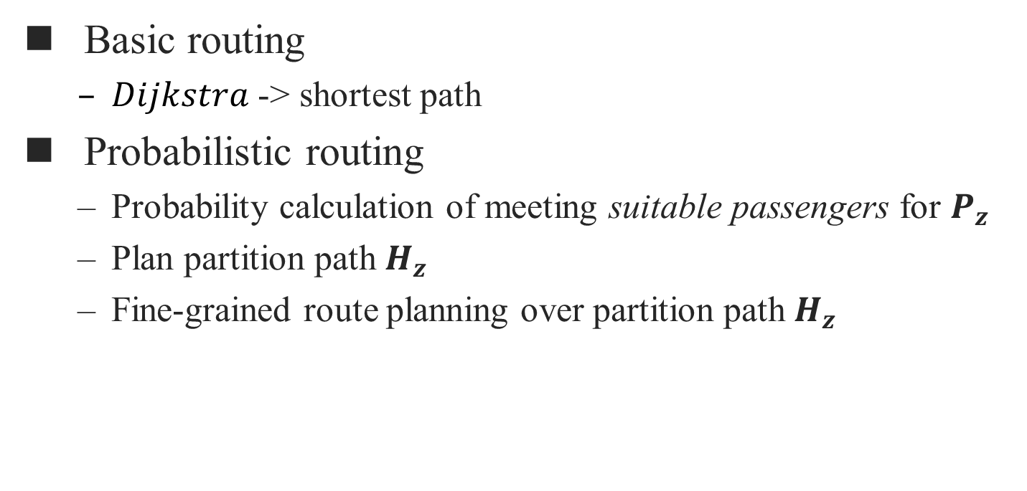
Segment-level routing
Basic routing
$Dijkstra$ -> shortest path
Probabilistic routing
Probability calculation of meeting suitable passengers for $P_{z}$
Plan partition path $H_{z}$
Fine-grained route planning over partition path $H_{z}$

Slide 15
Experimental setup
Dataset
Taxi data
7,065,907 taxi transactions from Chengdu City, Nov. 2016
Released by Didi GAIA^{[7]}
Road network graph from OpenStreetMap
214,440 vertices & 466,330 edges
Simulation scenarios
Peak scenario
8:00AM-9:00AM in a workday with the most requests, i.e., 29,534.
Non-peak scenario
10:00AM-11:00AM in a weekend with 15,480 requests, among which 5,000 are randomly selected to be the offline requests.
[7] Gaia initiative. https://outreach.didichuxing.com/research/opendata.

Slide 16
Experimental setup
Compared schemes
No-Sharing
T-Share ^{[1]}
pGreedyDP ^{[8]}
mT-Sharepro (with enabled probabilistic routing)
Performance metrics
# of served requests
Response time
Detour time
[1] S. Ma, Y. Zheng, O. Wolfson, et al. Real-time city-scale taxi ridesharing. IEEE Transactions on Knowledge and Data Engineering, 27(7):1782– 1795, 2015.
[8] Y. Tong, Y. Zeng, Z. Zhou, L. Chen, J. Ye, and K. Xu. A unified approach to route planning for shared mobility. Proceedings of the VLDB Endowment, 11(11):1633–1646, 2018.

Slide 17
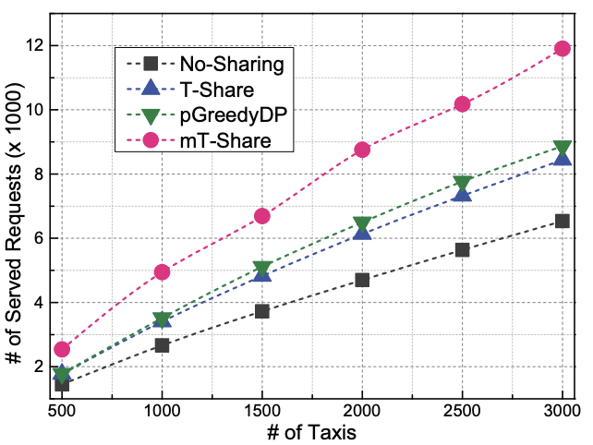
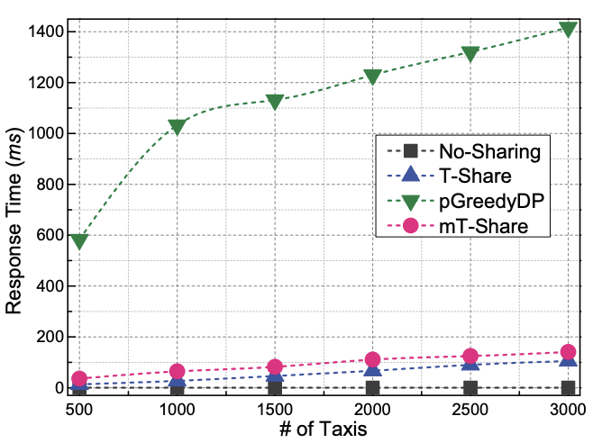
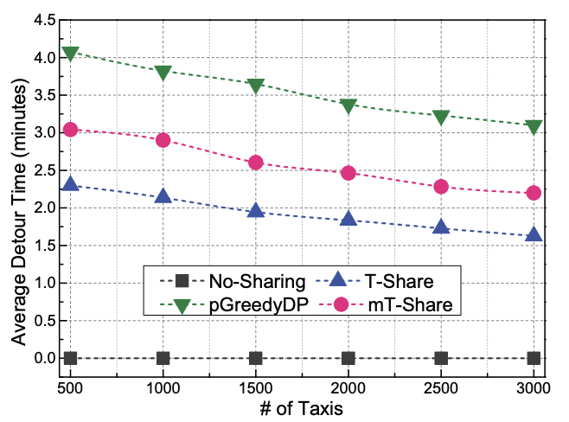
Results in peak-scenario
# of served requests
Response time
Detour time
In peak hours, mT-Share responds a request within 200 ms, and serves 42% and 36% more requests than T-Share and pGreedyDP, respectively.

Slide 18
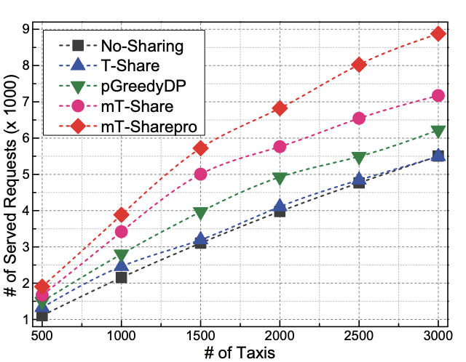
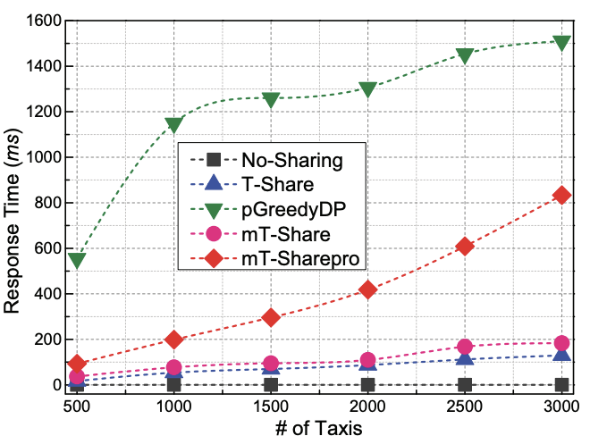
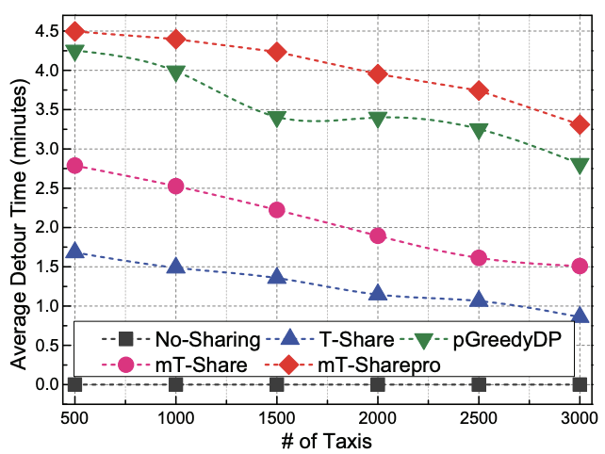
Results in non-peak scenario
# of served requests
Response time
Detour time
Because of the probabilistic routing, mT-Sharepro can serve 13% ~ 24% more offline requests than the competitors.

Slide 19
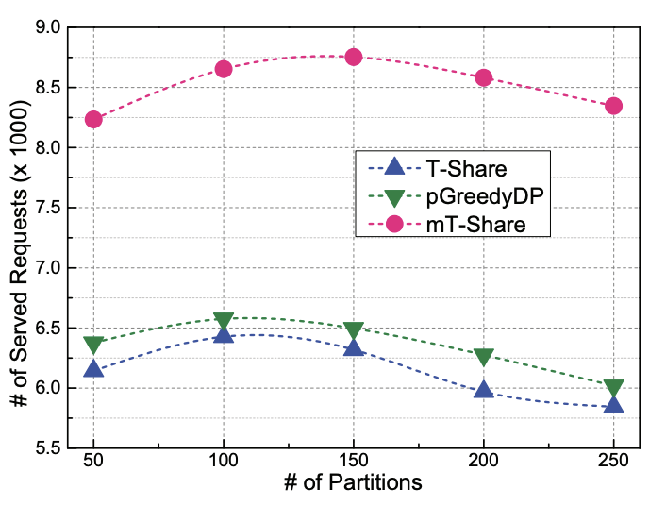
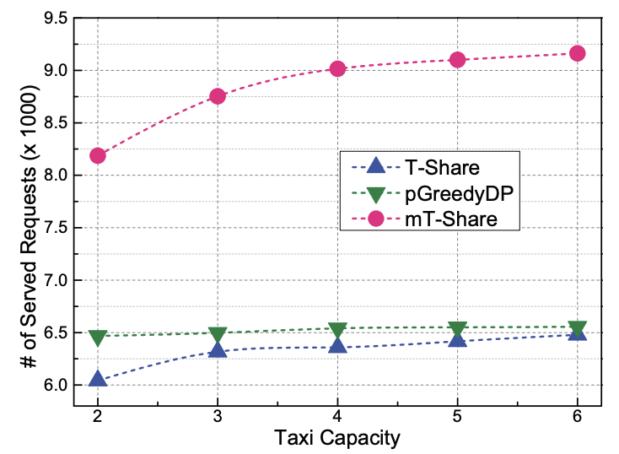
Experiments on parameter settings
Impact of partition number
Impact of capacity
Both too small or oversize partition number will result in a reduced candidate taxi set, and thus affect the ridesharing performance.
mT-Share benefits more from the larger taxi capacity.

Slide 20
Conclusion
We consider a novel moility-aware taxi ridesharing (MTR) problem to serve both online and offline ride requests.
We propose a novel scheme named mT-Share by fully exploiting the mobility information of taxis and requests.
Experiments on real-world taxi data show that mT-Share can serve 42% and 62% more requests in the peak and non-peak hours than state-of-the-art solutions, respectively.

Slide 21

Thank You! Dr. Zhidan Liu lizhidan@szu.edu.cn http://liuzhidan.github.io/

Slide 22
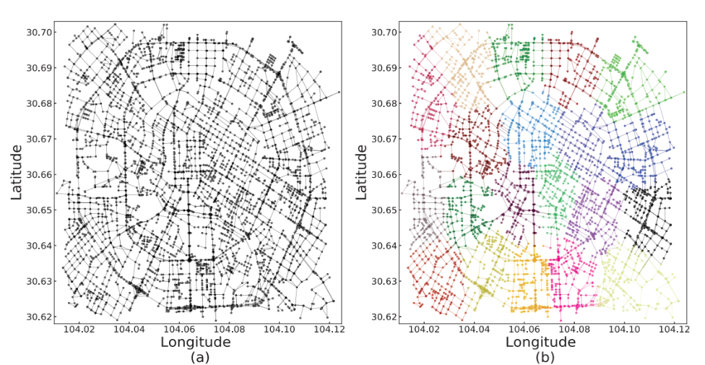
Backup: road network and map partitions
Road network of Chengdu city from OSM

Slide 23
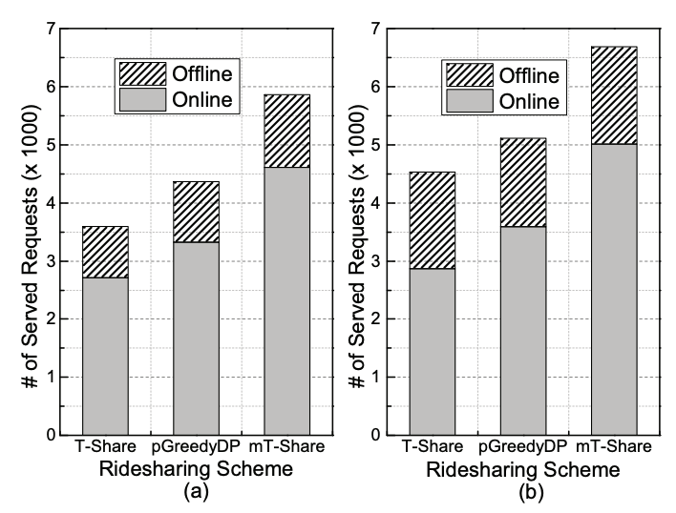
Backup: impact of routing scheme
Combine basic routing or probabilistic routing with T-Share, pGreedyDP, and mT-Share
With probabilistic routing, T-Share, pGreedyDP, and mT-Share can serve 89%, 46%, and 34% more offline requests.

