Slide 1

Path Reconstruction in Dynamic Wireless Sensor Networks Using Compressive Sensing
Zhidan Liu, Zhenjiang Li, Mo Li, Wei Xing, Dongming Lu
Zhejiang University, China
Nanyang Technological University, Singapore

Slide 2
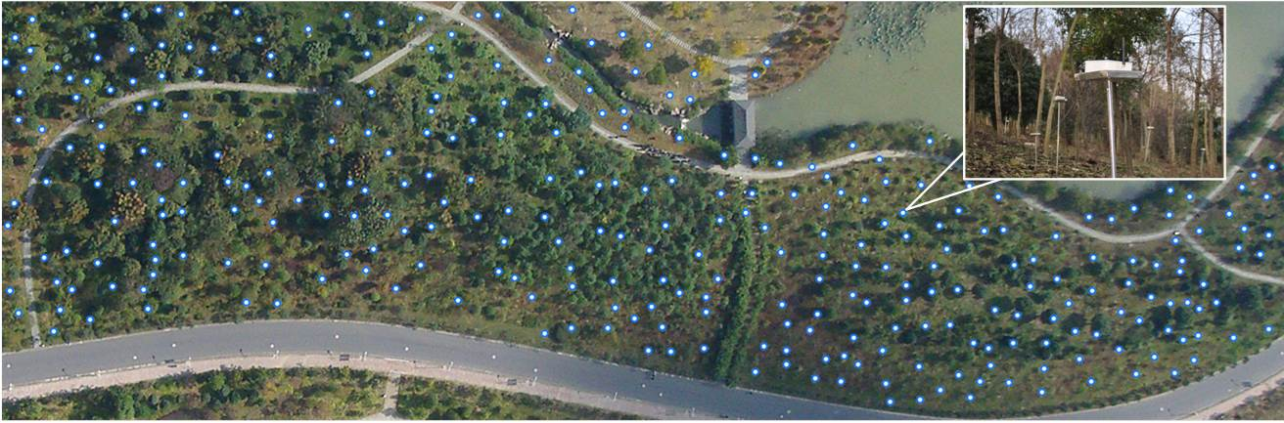

Problem Statement
Wireless sensor networks
  Multi-hop data collection
  Maintenance and diagnosis
    Routing dynamics, packet loss holes, delay, …

Slide 3
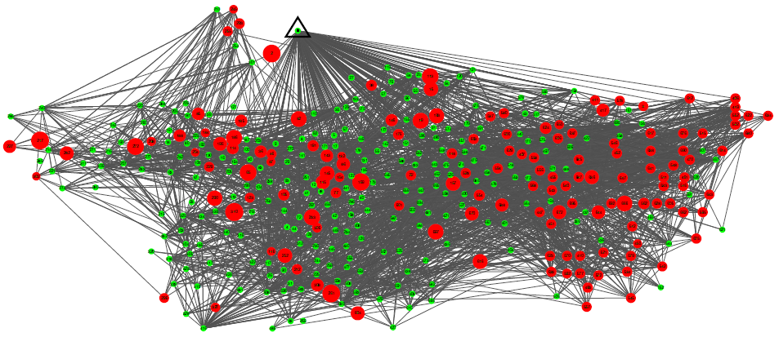
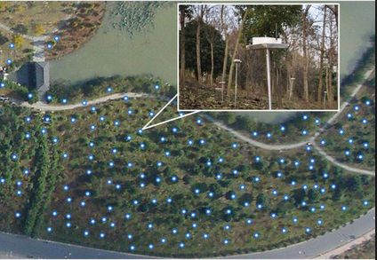

Problem Statement
Wireless sensor networks
  Limited visibility
  Limited information in packets
Source address
Seq.
number
Fst-hop
receiver
Hop
counter
+ payload

Slide 4

Problem Statement
Per-packet routing path information
  Fine-grained meta-information
Sink
Sink
1
2
Path reconstruction
4
5
3
10
9
6
8
7
7

Slide 5

Related Works
Sink
2
MNT (SenSys’12)
  Inter-packet correlation
Pathfinder (ICNP’13)
  Inter-packet correlation
  Explicit inconsistence recording
5
10
9
b
7
a
8
7
Path bit vector
a
10
0 | 0 | 0
7
8
7
7
Path container
0 | 0 | 1
9 | -
7
9

Slide 6
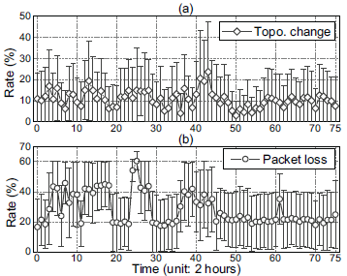
Related Works
CitySee trace
  1200 nodes, one week
Topology changes
  Avg.: 12%
  Max: 48%
  Avg. of all nodes: 10%
Packet loss
  Avg.: 17%
  Max: 69%
  Avg. of all nodes: 22%
59% and 36% packet path reconstruction failure for MNT and Pathfinder, respectively.

Slide 7

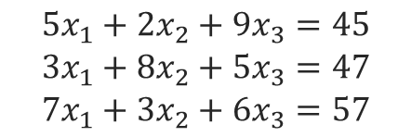
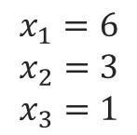
Design Overview
S = 0
S += 5x6
S += 9x1
S = 45
7
6
3
1
Sink
S += 2x3

Slide 8
Design Overview
Motivation
  Path sparse representation
    Encode hop count
P1 (5)
1
2
P3 (12)
 | n1 | n2 | n3 | n4 | n5 | n6 | n7 | n8 | n9 | n10
s1 | 3 | 0 | 2 | 0 | 0 | 1 | 0 | 0 | 0 | 0
s2 | 0 | 4 | 0 | 0 | 3 | 0 | 0 | 1 | 0 | 2
s3 | 0 | 4 | 0 | 0 | 3 | 0 | 0 | 1 | 2 | 0
P2 (3)
4
5
3
10
9
6
8
7

Slide 9

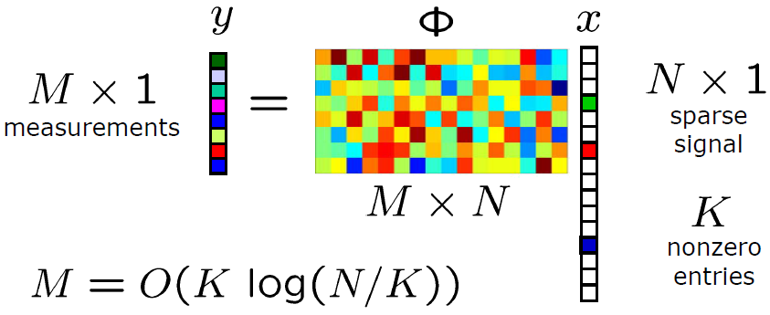
Design Overview
Compressive sensing
  Measurement vector
Recovery
  x = arg min ||x||_{L1}, subject to

Slide 10
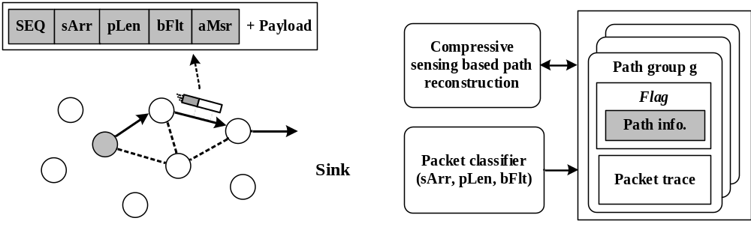
CSPR Design
In-network path information encoding
  3-tuple < sArr, pLen, bFlt > to classify a path
Server side path reconstruction
  Compressive sensing based reconstruction
Bloom filter
measurement

Slide 11
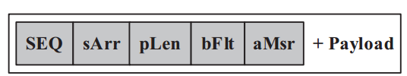
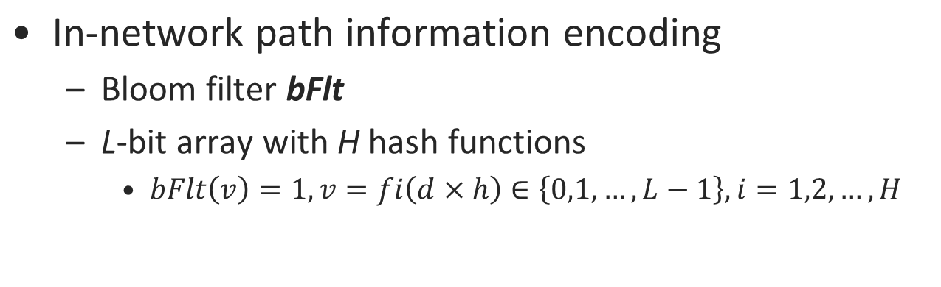
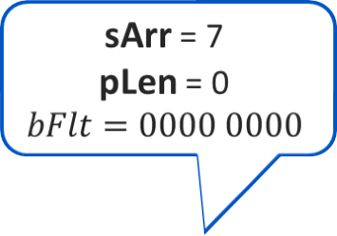
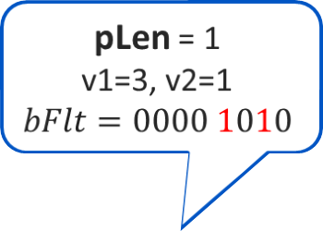
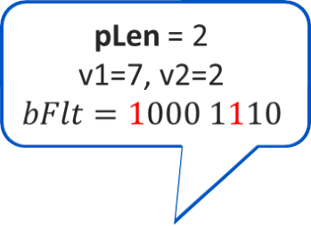
CSPR Design
7
8
9
Source node
(L=8, H=2)

Slide 12
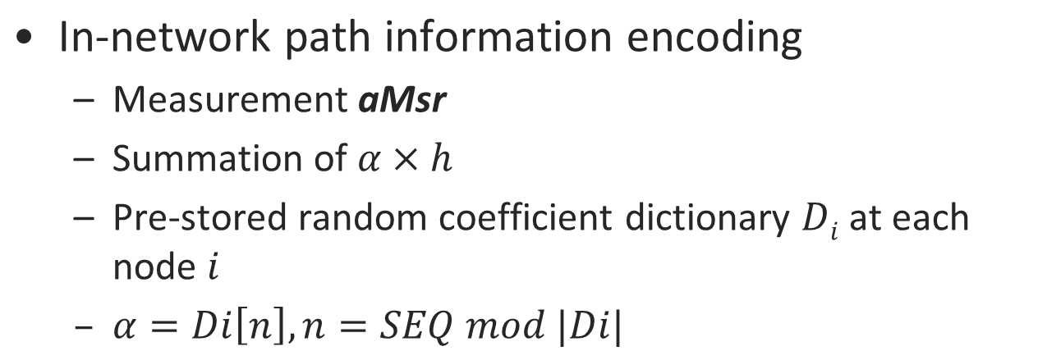
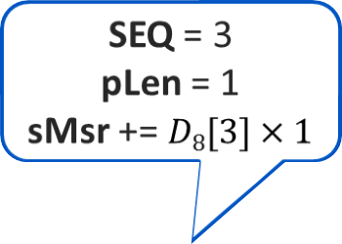
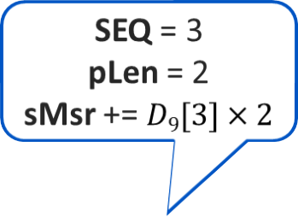
CSPR Design
SEQ = 3
pLen = 0
sMsr = 0
7
8
9
Source node

Slide 13
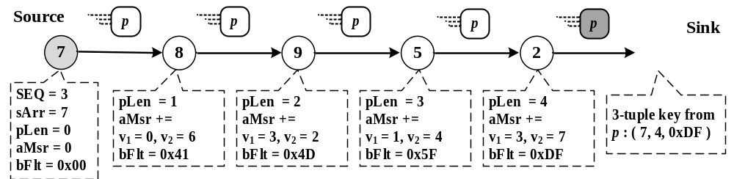
CSPR Design
2
In-network path information encoding
  Example
    7 - 8 - 9 - 5 - 2 - Sink
5
9
8
7

Slide 14
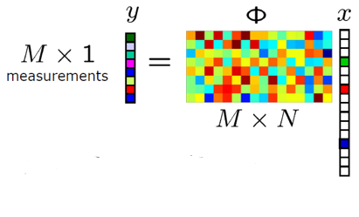
CSPR Design
Server side reconstruction
  Packet classification
    Via 3-tuple <sArr, pLen, bFlt>
  Path reconstruction
    Recover
    CS solver: CoSaMP
  Path verification via aMsr
    Packet and recovered path

Slide 15
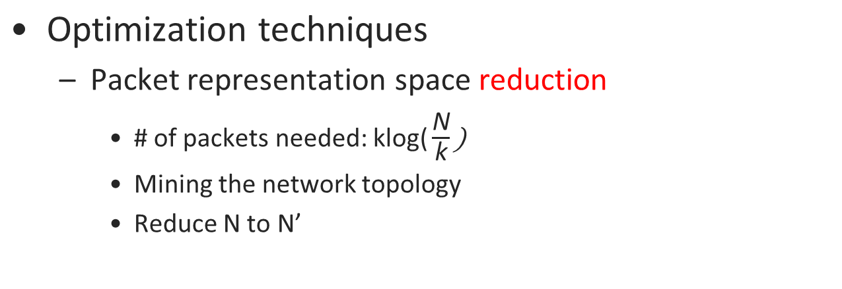
CSPR Design
Sink
1
2
2
5
4
5
3
N
n1, n2, n3, n4, n5, n6, n7, n8, n9, n10
10
10
9
9
N’
n2, n5, n8, n9, n10
6
8
8
7

Slide 16
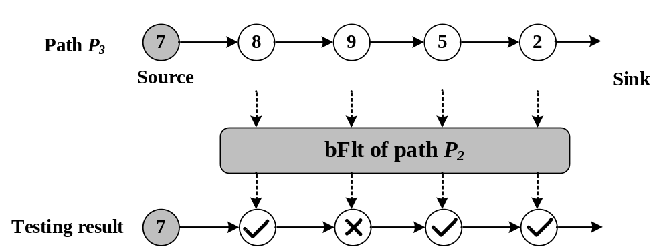
CSPR Design
Optimization techniques
  Path vector sparsity reduction
    Infer the path
Sink
2
P3 (12)
5
P2 (3)
10
9
8
7

Slide 17
CSPR Design
Summary of CSPR
  Constant and low overhead
    Communication & computation
  Does NOT require inter-packet correlation
  Does NOT require to recover for each packet
Lightweight
Robust
Flexible

Slide 18

Evaluation
Tested-based experiments
  29 TelosB nodes
Benchmarks
  MNT (SenSys’12)
  Pathfinder (ICNP’13)
Remedy component
  Exhaust search
  XOR field

Slide 19
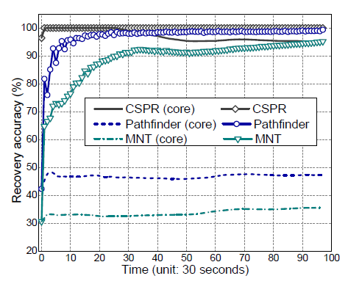
Evaluation
Path recovery accuracy
Core method only
  CSPR: >95%
  MNT: 36%
  Pathfinder: 47%
with Remedy method
  CSPR: 100%
  MNT: 95%
  Pathfinder: >95%

Slide 20
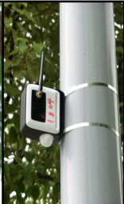
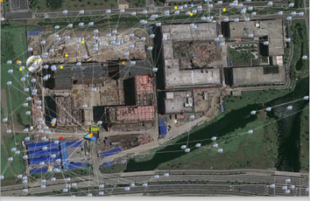
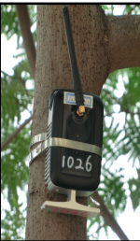
Evaluation
Trace-driven evaluation
  1200 nodes in Wuxi, China
  7 days

Slide 21
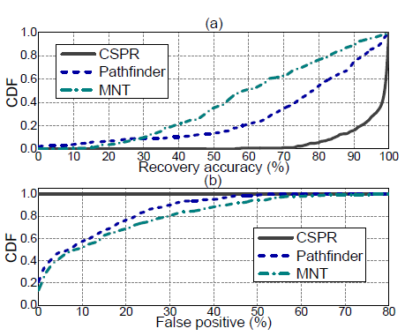
Evaluation
Path recovery accuracy
Accuracy
  CSPR: 95.6%
  MNT: 60.3%
  Pathfinder: 72.8%
False positive
  CSPR: 0%
  MNT: 11%
  Pathfinder: 15%
No false positives due to strong path verification of CSPR.

Slide 22
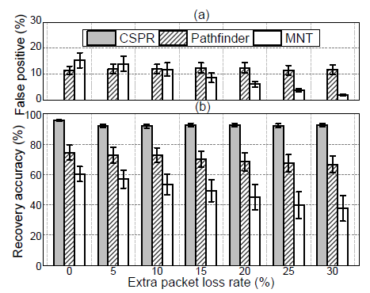
Evaluation
Path recovery with different packet loss rates
CSPR with accuracy > 90%
Obvious performance drop for MNT and Pathfinder (w.r.t. 22% and 8% decrease)
Robust to inter-packet correlations makes CSPR insensitive to network dynamics and lossy links.

Slide 23
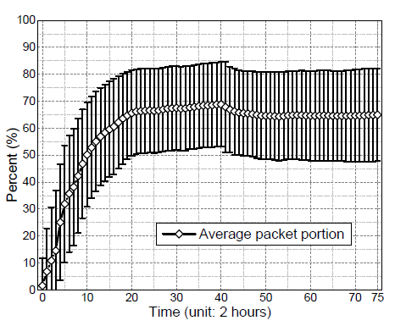
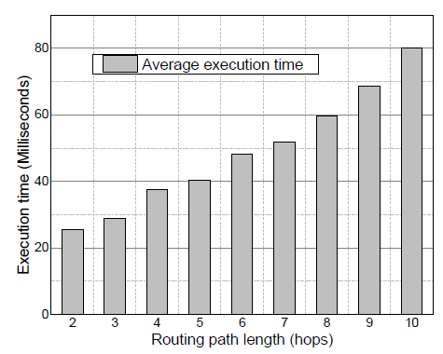
Evaluation
Self-evaluation of CSPR
Quick path recovery > 65%
Lightweight computation overhead
Flexible path reconstruction with lightweight computational overhead.

Slide 24

Thank You!

Slide 25
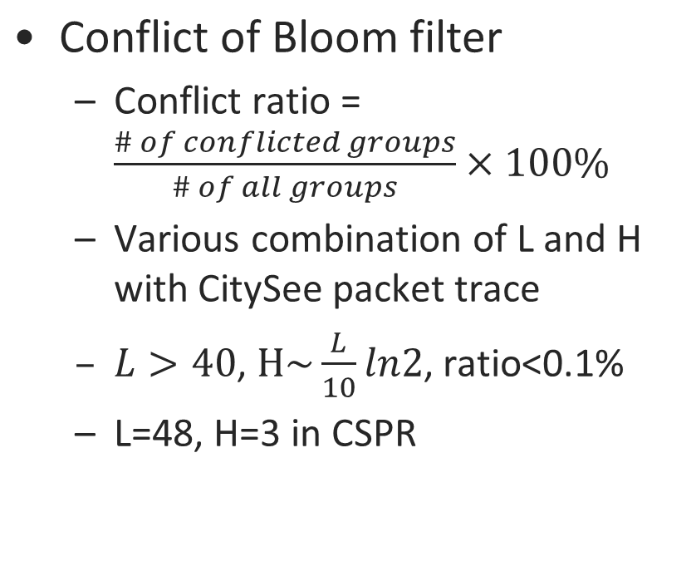
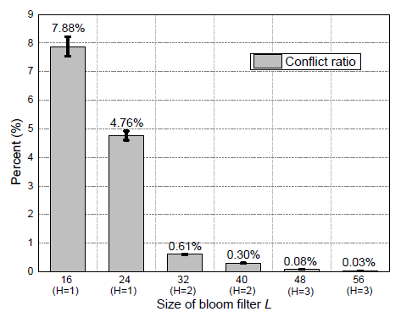
Backup

