Slide 1

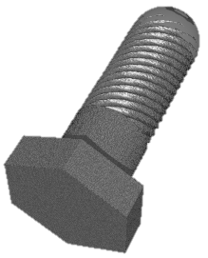
A Nuts and Bolts Puzzle
Comparisons in worst-case:
N + (N – 1) + (N – 2) + … 1 = O(N²)

Slide 2
Straightforward Divide and Conquer?
Subproblems may not be solvable:
May contain mismatched nuts and bolts

Slide 3
How to Divide and Conquer?
Both subproblems solvable!
Pivot around a randomly chosen nut and corresponding bolt.

