Slide 1
CPC
HKU · DEPT. OF MECHANICAL ENGINEERING · IDAT7100 · 2025–2026
Coupon Coin
(CPC)
Tokenising Incentives in Physical Infrastructure:
Design, Implementation, and Analysis for Smart Locker Ecosystems
CANDIDATE
SUPERVISOR
Liu Zile (Aiden) · UID 3036575582
Prof. Jimmy Chan
INDUSTRY PARTNER
MODERATOR
Y Carry Limited, Hong Kong
Prof. Marian
Capstone Final Defence · April 2026 · Hong Kong

Slide 2
00 · AGENDA
Ten minutes, in five beats.
01
The Problem
Why <3% redemption is a structural failure, not a bug.
1m
02
The Design
A Solana-native token + dual-token RWA + IoT-anchored redemption.
3m
03
The Build
Devnet deployment, twelve tests, one honest war story.
2m
04
The Numbers
Technical headroom, three-year conservative model, risk matrix.
2m
05
The Takeaway
PIYT as a theoretical contribution · next steps · discussion.
2m
Liu Zile · CPC Capstone
02 / 16

Slide 3
01 · THE PROBLEM
97 of every 100 coupons go nowhere.
<3%
$500M+
$91.4B
industry redemption rate
annual US loss to waste
global coupon market, 2023
Source · Deloitte 2024
Source · ARF 2023
Source · MnM Research
Why the number stays stuck
Attention saturation
Channel fragmentation
6,000–10,000 ad messages daily. Coupons vanish into the noise.
Paper, email, push, in-app. Too many silos for any one habit to form.
No interoperability
No secondary liquidity
Merchant A's coupon won't work at B. Network effect dies at the door.
Can't transfer, can't trade. Unredeemed value just evaporates.
Liu Zile · CPC Capstone
03 / 16

Slide 4
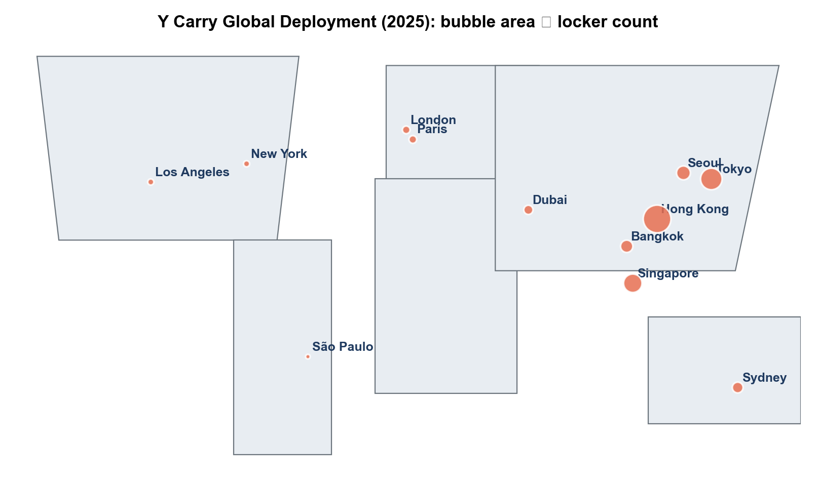
02 · THE OPPORTUNITY
But we have a real, growing locker network.
1,300+
units contracted in Indonesia (2026 rollout)
8 sites
live in HK: stadiums · Wind Sail Centre · Science Park
$2.10
average revenue per session (HK actual)
2.5M
global target by 2030 (white paper)
Y Carry global deployment footprint (Q1 2026)
Liu Zile · CPC Capstone
04 / 16

Slide 5
03 · THE QUESTION
Tie a token to the hardware. Fix both sides at once.
RESEARCH QUESTION
If we anchor a Solana-native utility token to a working consumer smart-locker network, can we simultaneously redress the redemption-rate failure of the coupon economy and the customer-acquisition cost problem of the locker industry?
RO1
RO2
Background
Design
Survey the four literatures; pin down the real gap.
Token economics · contracts · IoT interface · dual-token mechanics.
RO3
RO4
Build & test
Feasibility
Deploy on Devnet. Mint 200M. Run 12 structured tests.
Technical, economic, regulatory — all under conservative inputs.
Liu Zile · CPC Capstone
05 / 16

Slide 6
04 · GAP
Four streams exist. Nobody had braided them together.
Blockchain loyalty
Smart-locker IoT
RWA tokenisation
High-throughput L1
Shi 2023 · KrisPay · BCII
Chen 2021 · IEEE Access 2025
Freni 2020 · Deloitte 2022
Yakovenko 2018 (Solana)
Coupon Coin (CPC)
Why the gap stayed open until now
1
The partner problem
2
The chain problem
3
The regulatory problem
Token teams without hardware; operators without engineers.
Pre-2022, no L1 had both the cost and latency for per-tap micropayments.
HK SFC and Singapore MAS guidance only stabilised in 2019–2022.
Liu Zile · CPC Capstone
06 / 16

Slide 7
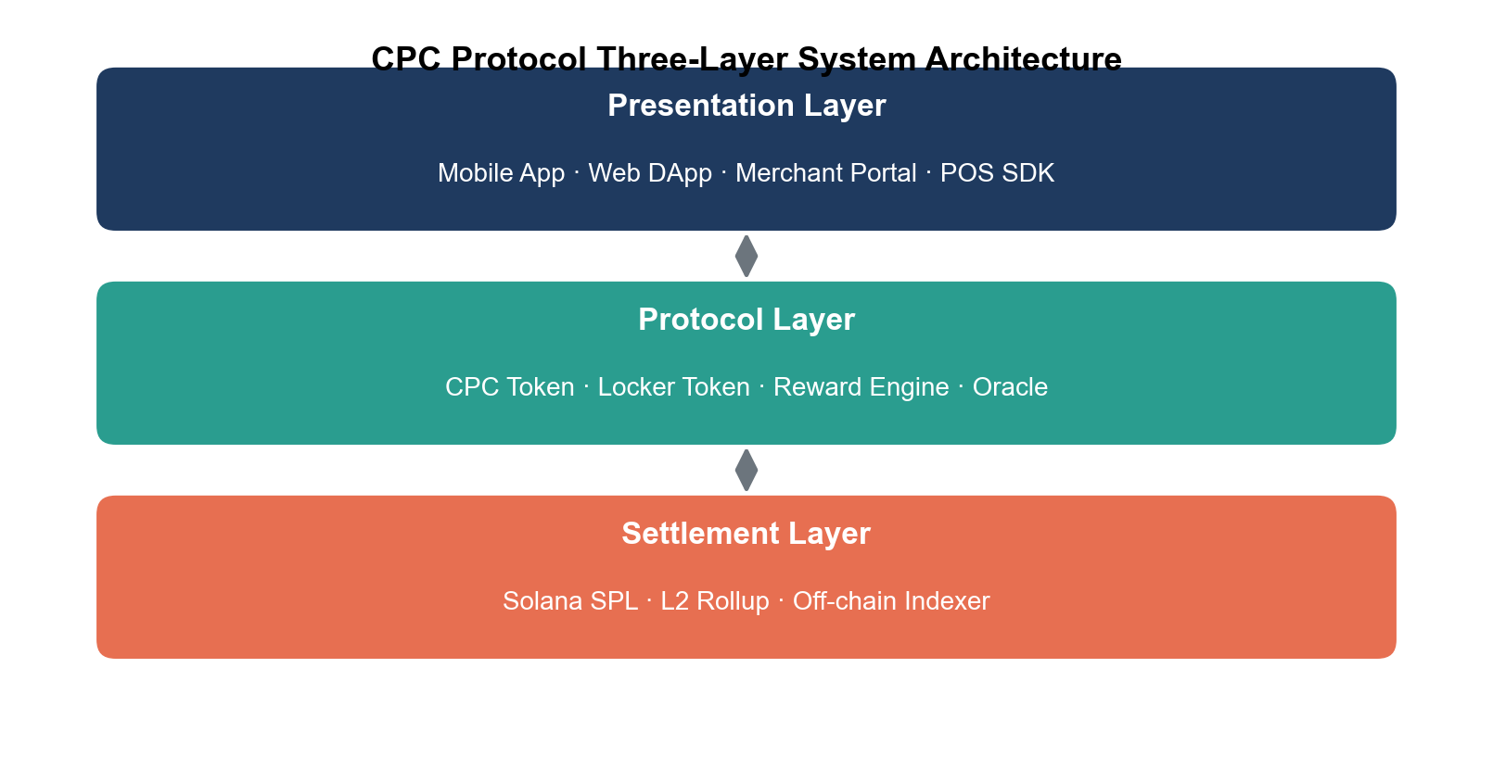
05 · ARCHITECTURE
Three layers, decoupled by design.
L1 · CHAIN
Solana settlement
SPL token · Metaplex metadata · 5 custom contracts
L2 · APP
Wallet & backend
Consumer wallet · Y Carry ops · merchant POS adapters
L3 · PHYSICAL
IoT & lockers
NFC reader · NB-IoT gateway · MQTT broker
CPC protocol three-layer system architecture
Liu Zile · CPC Capstone
07 / 16

Slide 8
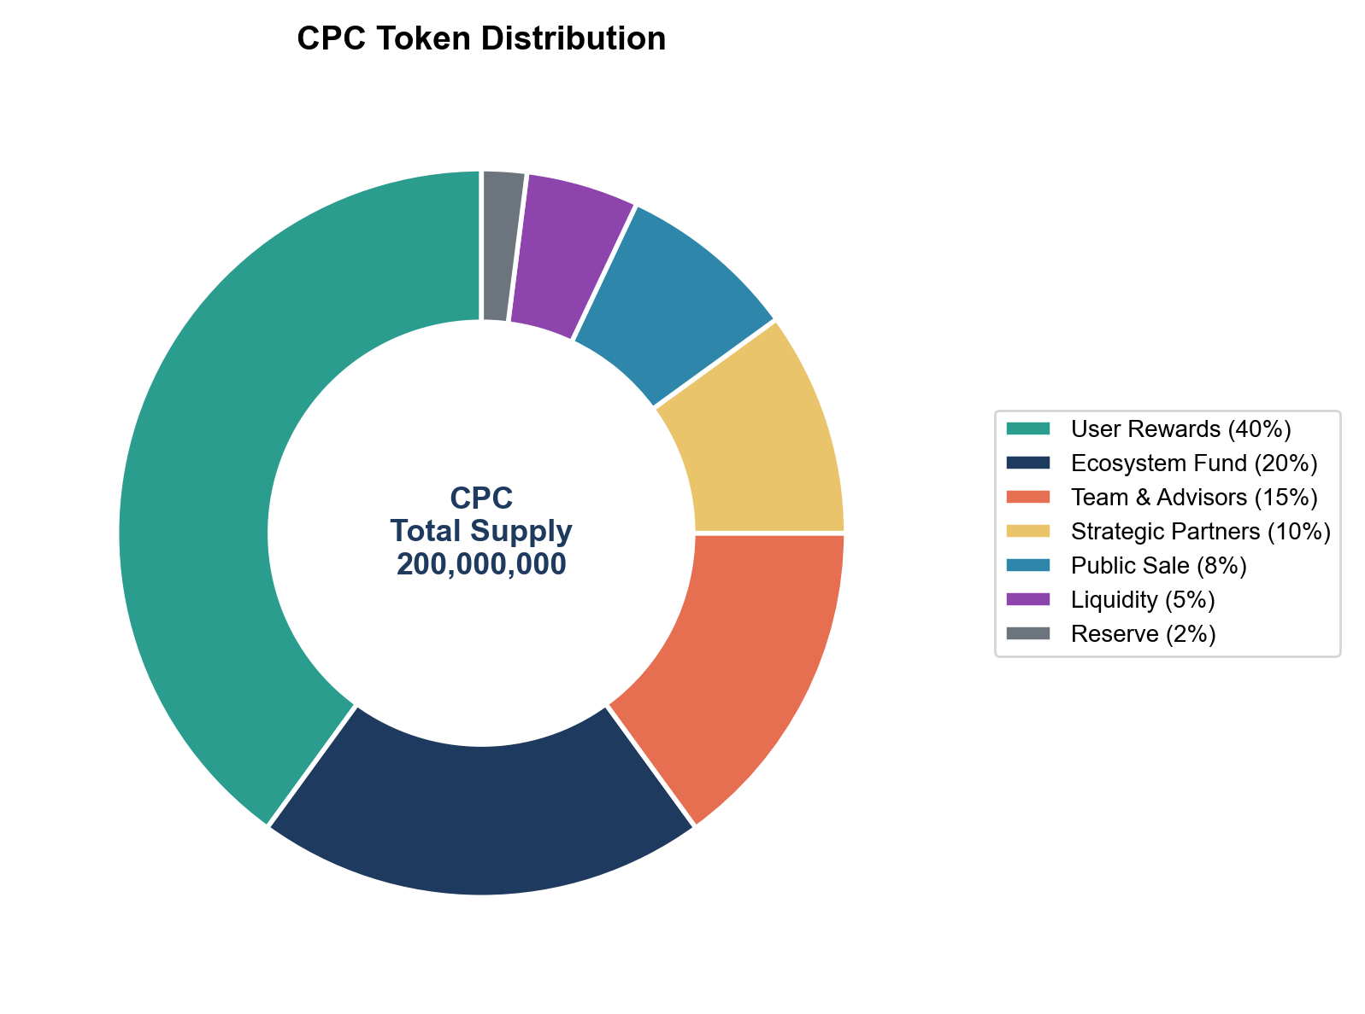
06 · TOKEN ECONOMICS
200M supply · dual-token · three deflation knobs.
Dual-Token Mechanic
CPC
stake 1,000 CPC
Locker Token
Fungible · governance
· payments
PIYT — 1:1 hardware
claim + yield share
burn → return
2%
auto-burn per locker payment
25%
of revenue → buyback & burn
1%/yr
reclaim on wallets idle > 36 months
CPC token distribution
Liu Zile · CPC Capstone
08 / 16

Slide 9
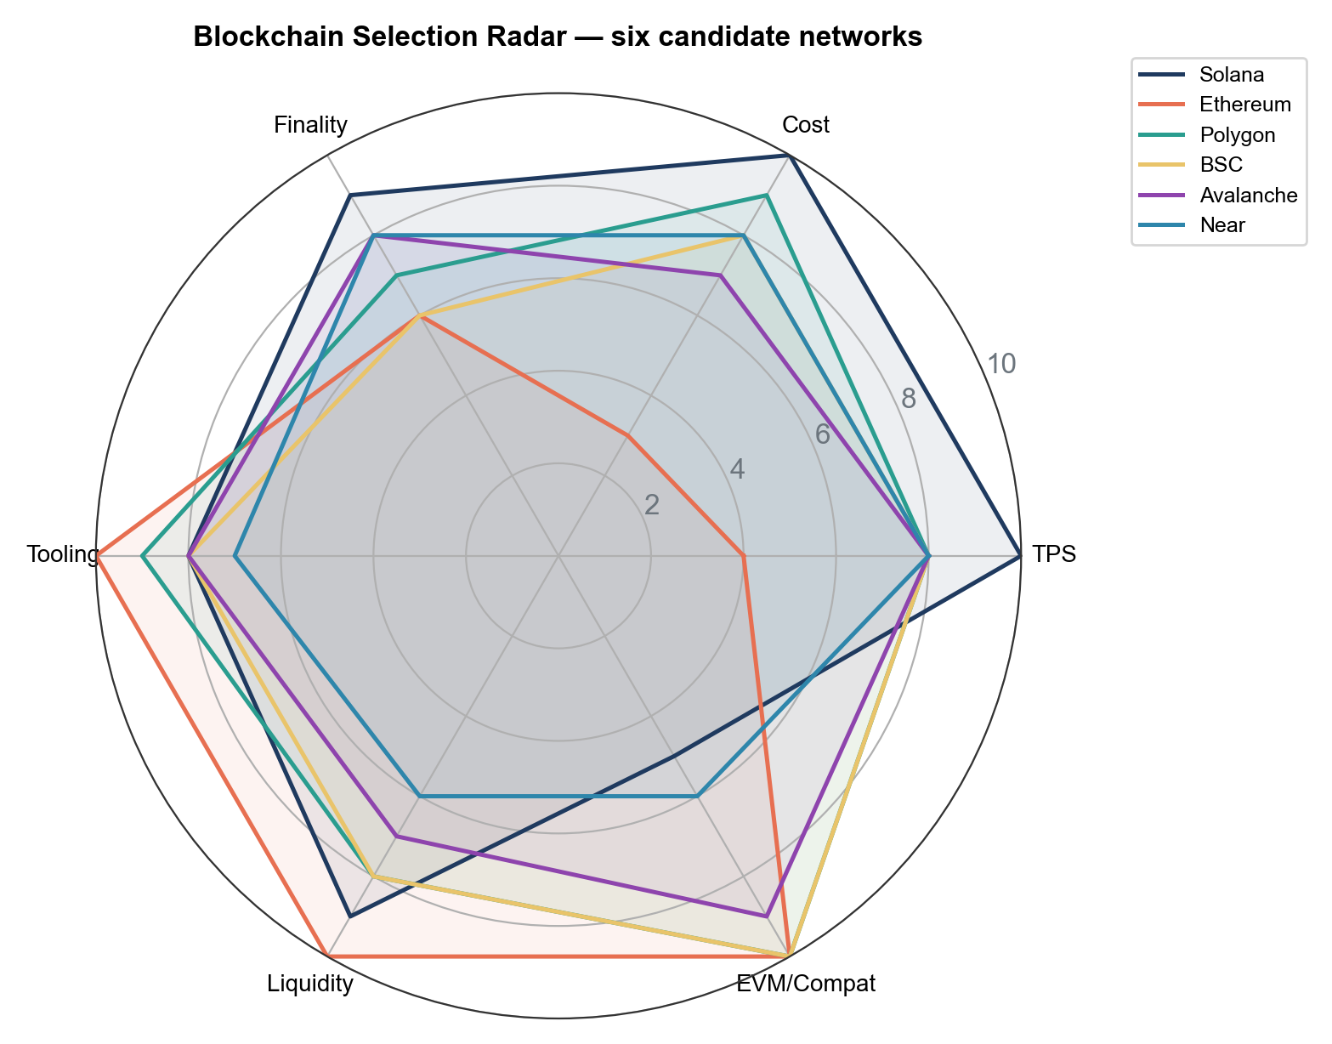
07 · CHAIN SELECTION
Six candidates, seven weighted criteria.
Composite ranking
Solana
8.43
Throughput 10 · Cost 10 · Finality 9
Base (L2)
7.62
Strong tooling; loses on Q+cost vs Solana
Polygon
7.45
Cheap and fast; smaller ecosystem
BNB
7.10
Liquid; centralisation concern
Avalanche
6.95
Capable; narrower dev pool
Ethereum
6.21
TVL 10 · cost 2 — kills micropayments
Composite scores across six L1 / L2 networks
Liu Zile · CPC Capstone
09 / 16

Slide 10
08 · CONTRACTS + UX
Five contracts · one tap · ~1.2 seconds end-to-end.
1
2
3
4
5
6
7
NFC tap
Locker MCU
Edge gateway
Oracle
Reward engine
SPL mint
Burn portion
consumer
signs event
relays MQTT
signs attestation
verifies + mints
to user wallet
+ event finality
Latency budget: ≤ 1.2 s end-to-end · finality ≈ 400 ms slot · cost ≈ $0.00025 per tap
On-chain surface: five contracts
CouponCoin
LockerPayment
RewardEngine
TokenVesting
BuybackBurn
SPL token + metadata
Rental + 2% burn
Usage rewards · batch payouts
Time-locked release
Open-market repurchase + burn
Liu Zile · CPC Capstone
10 / 16

Slide 11
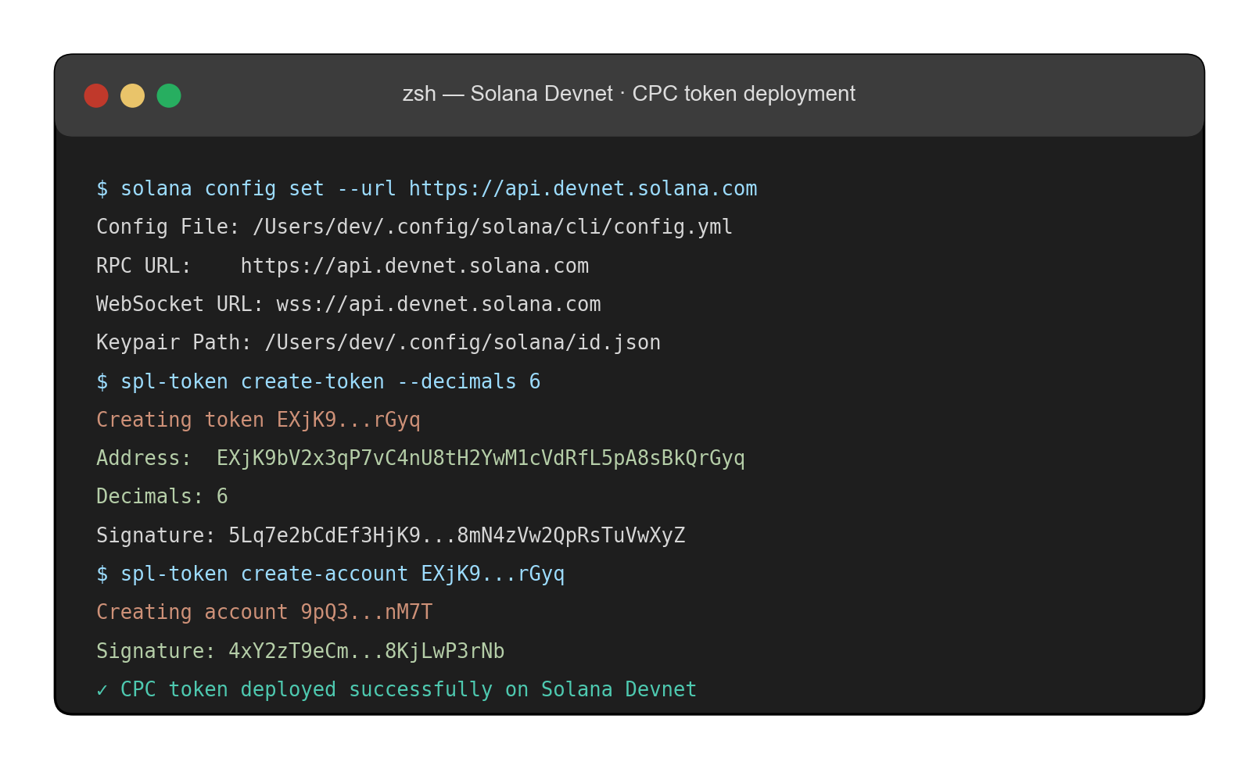
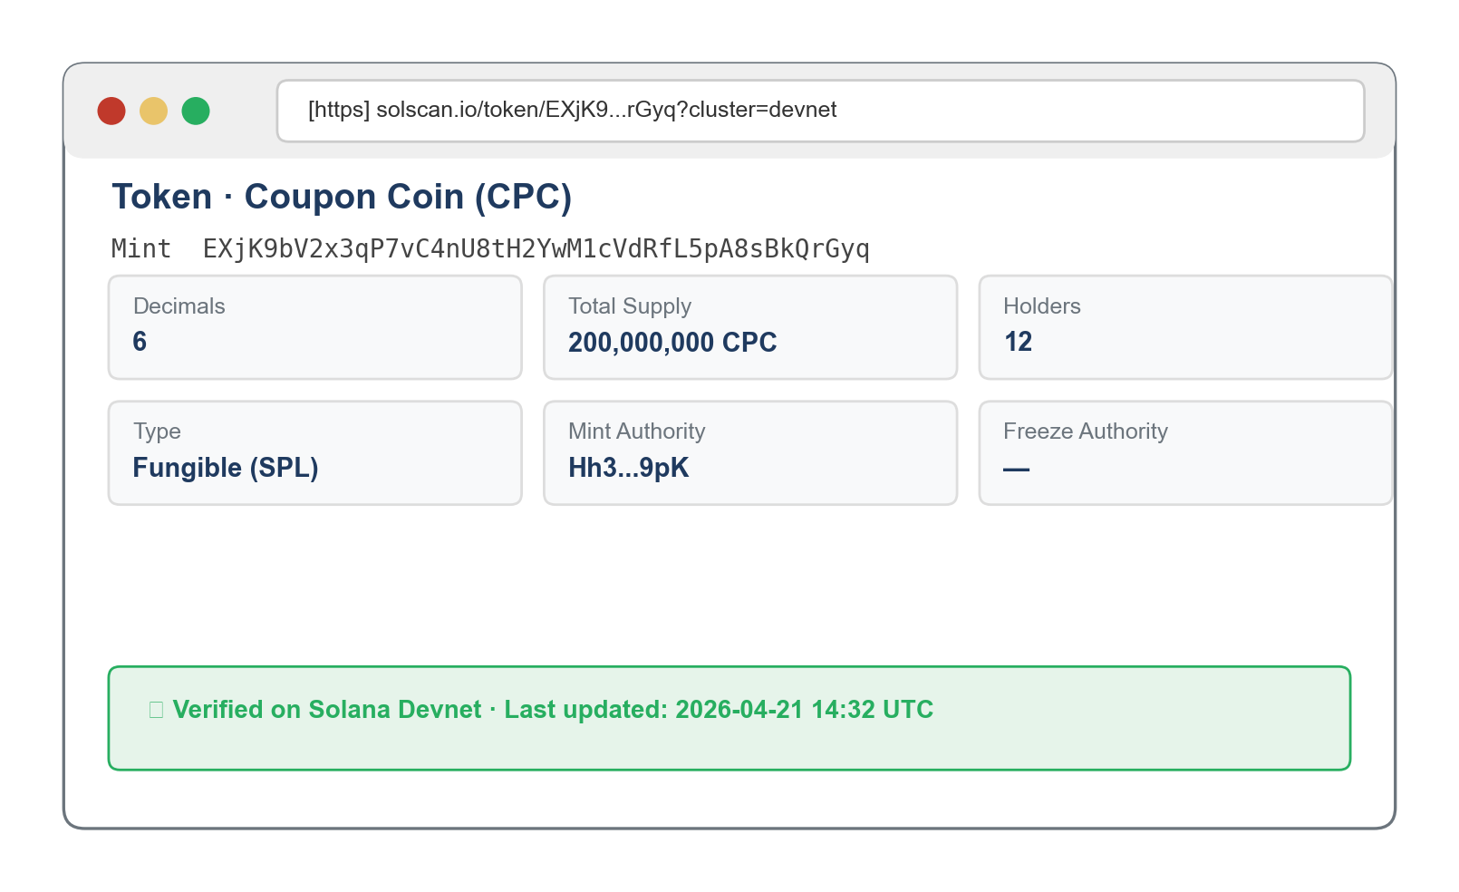
09 · IMPLEMENTATION
Devnet deployment + 12 / 12 tests passing.
200M
1.8s
$1.40
CPC minted
in one tx
deploy
confirmation
total Devnet
cost
12 / 12
structured functional test
cases passed end-to-end.
deploy · mint · vesting · reward · buyback · payment
LESSON LEARNED
Public Solana RPC endpoint blocked by corporate DPI.
Fixed by routing through Helius commercial endpoint. Mitigation now baked into the production architecture as a multi-endpoint fallback chain.
Devnet deploy · Solscan mint verify
Liu Zile · CPC Capstone
11 / 16

Slide 12
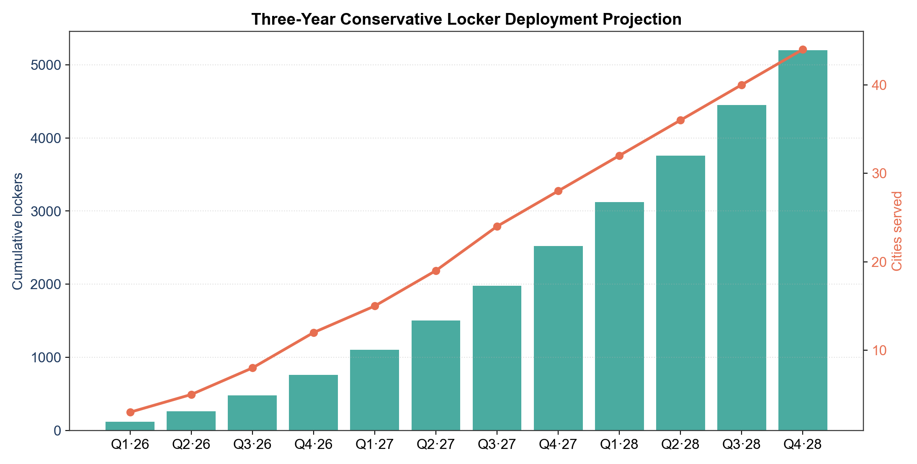
10 · FEASIBILITY
Technical headroom and a conservative 3-year model.
7,471×
Solana throughput headroom over projected peak demand
<0.001%
of revenue consumed by on-chain transaction fees
5-YEAR DEFLATIONARY SIMULATION
Conservative
5,000 lockers · 8 sessions/day
4.2%
Base
15,000 lockers · 12 sessions/day
11.7%
Optimistic
40,000 lockers · 16 sessions/day
24.3%
Three-year conservative locker deployment projection
Liu Zile · CPC Capstone
12 / 16

Slide 13
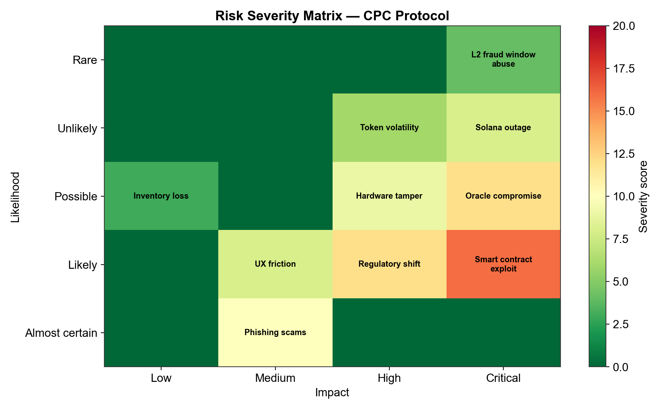
11 · RISK + COMPLIANCE
Cold-start is the risk I worry about most.
Dual-track compliance
TRACK 1 · HK DOMESTIC
Y Carry Limited (HK)
Physical locker operations, fiat rental fees, non-transferable loyalty points. Zero on-chain activity.
TRACK 2 · OFFSHORE
Singapore / BVI entity
Token issuance, distribution, on-chain governance. No HK commercial nexus.
Five-vector risk severity matrix
Liu Zile · CPC Capstone
13 / 16

Slide 14
12 · COMPARATIVE
What CPC actually changes.
Dimension
Traditional
BCII Token
CPC Protocol
Redemption rate
<3%
Unknown
Projected 15–25%
Cross-merchant interop
None
Limited
Native, one denom
Physical infra anchor
None
None
Y Carry locker network
Secondary liquidity
None
Low (MintMe)
Raydium / Jupiter DEX
Dual-token RWA
—
No
Yes (Locker Token PIYT)
Throughput
—
Low
65,000+ TPS (Solana)
Physical anchor + dual-token RWA + Layer-1 throughput — that combination has no published precedent.
Liu Zile · CPC Capstone
14 / 16

Slide 15
13 · CONTRIBUTIONS
Three contributions · four next steps.
THEORETICAL
METHODOLOGICAL
PRACTICAL
PIYT
6 × 7 framework
Working kit
Physical Infrastructure Yield Token — a new RWA sub-class defined by 1:1 hardware mapping, operational yield, proportional governance.
Weighted chain-selection matrix. Transferable to any L1/L2 decision in physical-asset tokenisation.
Reproducible Devnet deploy, 5-contract pseudocode, conservative 3-year model, HK-defensible compliance structure.
Post-Capstone roadmap
01
Mainnet audit
02
Multi-sig launch
03
DAO governance
04
Field validation
CertiK / OtterSec · 4–6 weeks
Squads 3-of-5 · LP burn
token-weighted votes · 18-mo horizon
real users · real redemption numbers
Liu Zile · CPC Capstone
15 / 16

Slide 16
Q & A
Thank you.
Questions and discussion.
CANDIDATE
SUPERVISOR
Liu Zile (Aiden) · MSc IDAT · UID 3036575582
Prof. Jimmy Chan
INDUSTRY PARTNER
REPOSITORY
Y Carry Limited, Hong Kong
carry-token-devnet (private)
HKU · IDAT7100 · April 2026

