Slide 1
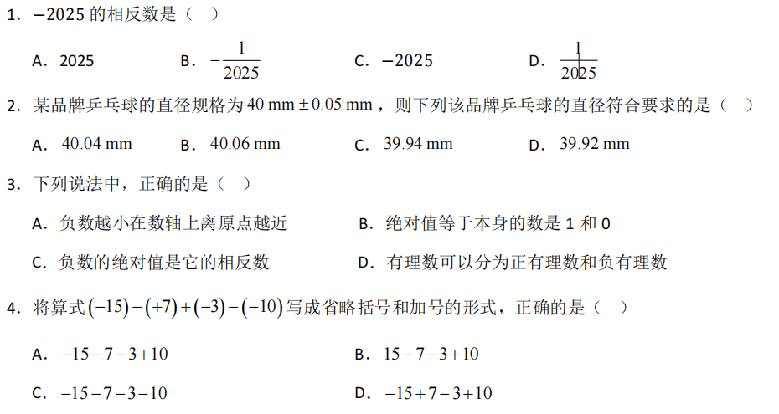
A
A
C
A

Slide 2
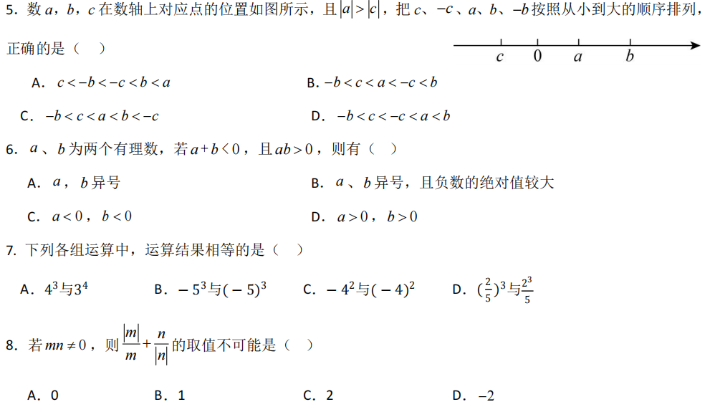
D
C
B
B

Slide 3
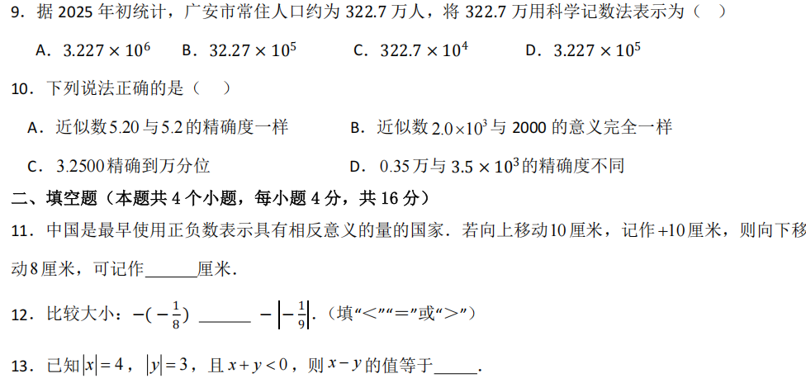

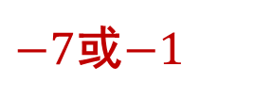

A
C
$$−8$$
$$＞$$
$−7$或$−1$

Slide 4
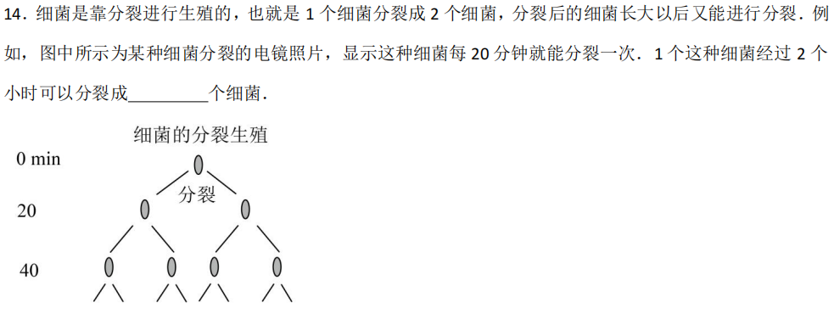

$$64$$

Slide 5

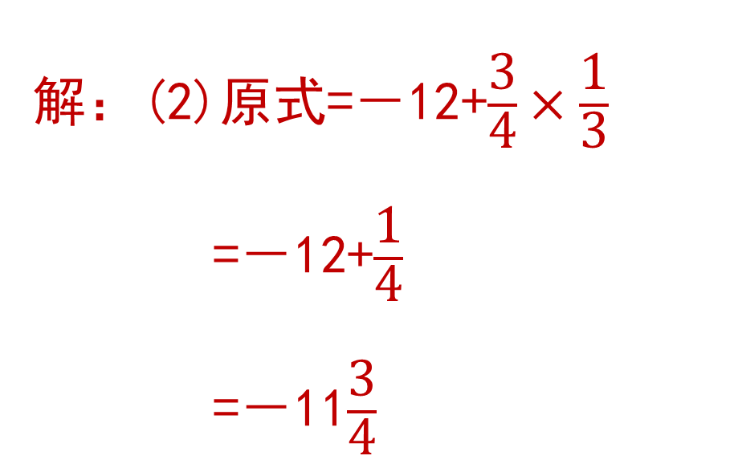
解：(2)原式=－12+$\frac{\text{3}}{\text{4}}×\frac{\text{1}}{\text{3}}$
=－12+$\frac{\text{1}}{\text{4}}$
=－11$\frac{\text{3}}{\text{4}}$
解：(1)原式=18+12－24－6
=30－30
=0

Slide 6
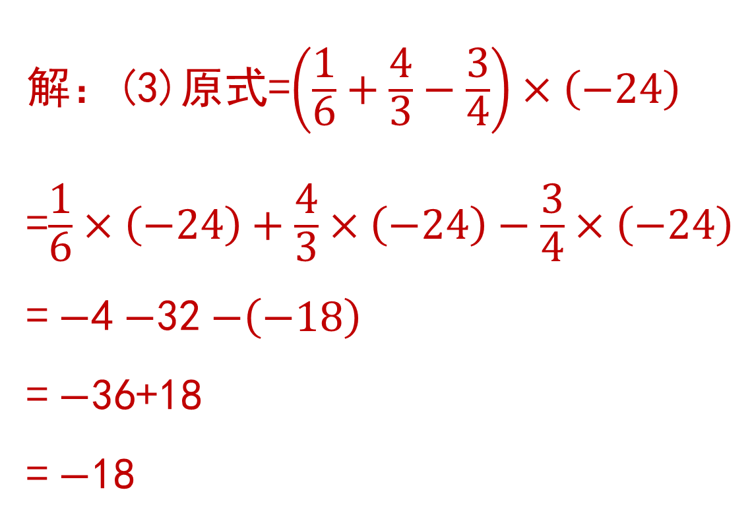

解：(3)原式=$\left(\frac{\text{1}}{\text{6}}+\frac{\text{4}}{\text{3}}−\frac{\text{3}}{\text{4}}\right)×\left(−24\right)$
=$\frac{\text{1}}{\text{6}}×\left(−24\right)+\frac{\text{4}}{\text{3}}×\left(−24\right)−\frac{\text{3}}{\text{4}}×\left(−24\right)$
= $−$4 $−$32 $−\left(−18\right)$
= $−$36+18
= $−$18
解：(4)原式=－1－$\frac{\text{1}}{\text{6}}×\left(2−4\right)$
=－1－$\frac{\text{1}}{\text{6}}×\left(−2\right)$
=$−1−\left(−\frac{\text{1}}{\text{3}}\right)$
=$−\frac{\text{2}}{\text{3}}$

Slide 7
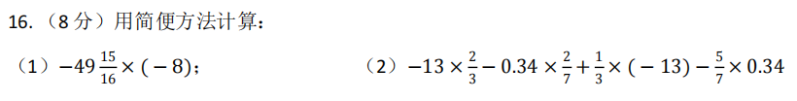
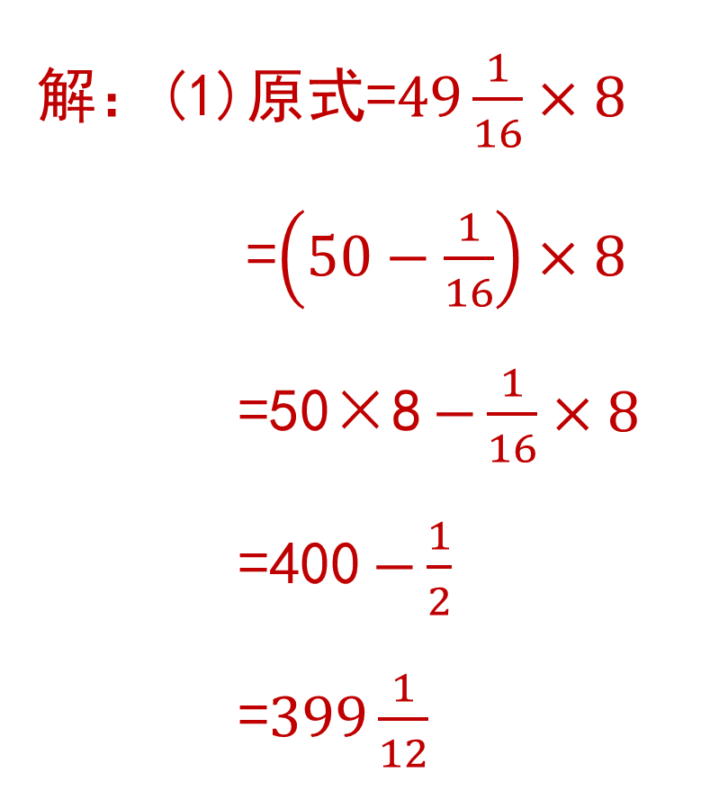
解：(1)原式=$49\frac{1}{16}×8$
=$\left(50−\frac{1}{16}\right)×8$
=50×8 $−\frac{1}{16}×8$
=400 $−\frac{1}{2}$
=$399\frac{1}{12}$

Slide 8
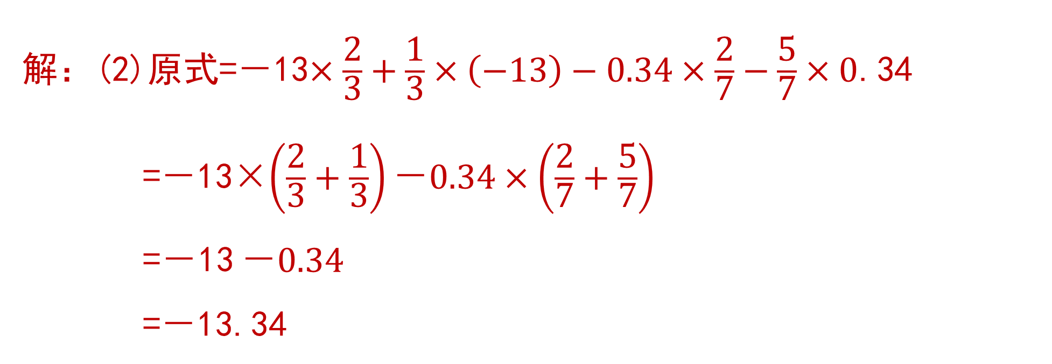
解：(2)原式=－13$×\frac{\text{2}}{\text{3}}+\frac{\text{1}}{\text{3}}×\left(−13\right)−0.34×\frac{\text{2}}{\text{7}}−\frac{\text{5}}{\text{7}}×0$.34
=－13×$\left(\frac{\text{2}}{\text{3}}+\frac{\text{1}}{\text{3}}\right)\text{－}0.34×\left(\frac{\text{2}}{\text{7}}+\frac{\text{5}}{\text{7}}\right)$
=－13 $\text{－}0.34$
=－13.34

Slide 9
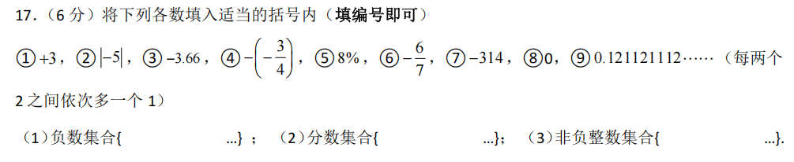
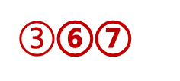
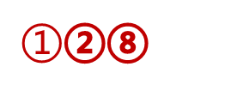
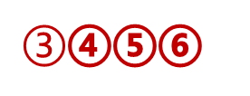
$③$⑥⑦
$③$④⑤⑥
$①$②⑧

Slide 10
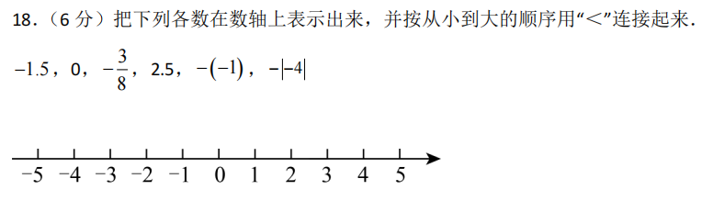
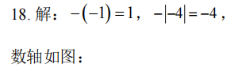
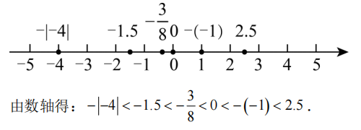

Slide 11
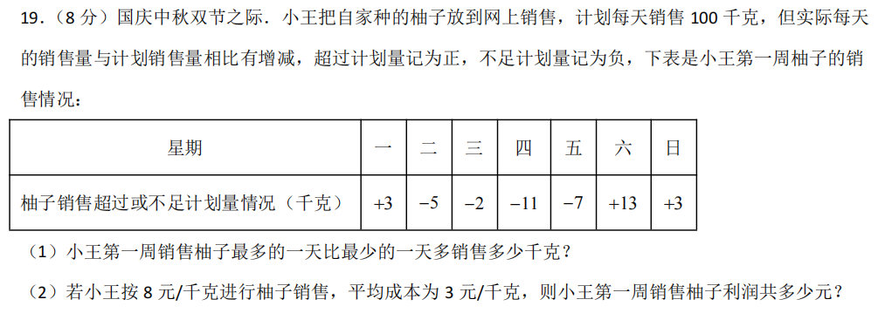
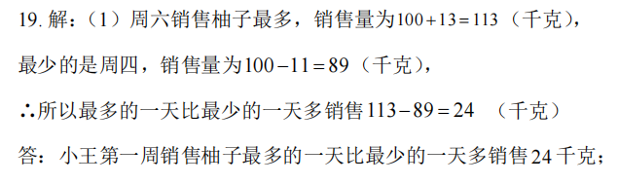
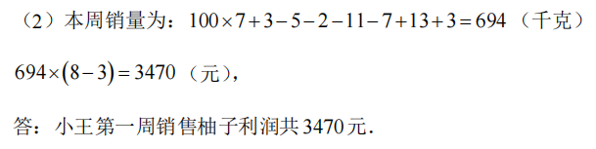

Slide 12
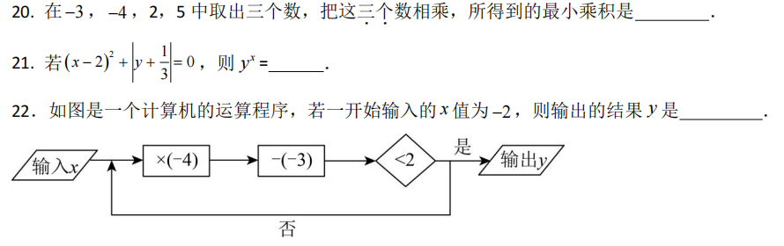




$$−40$$
$$\frac{\text{1}}{\text{9}}$$
$$−41$$
$$−15$$

Slide 13
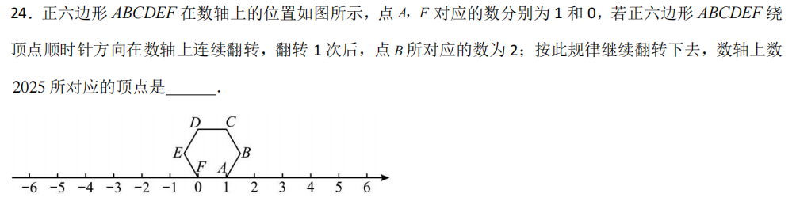
C

Slide 14
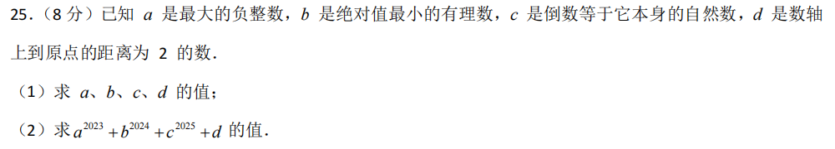
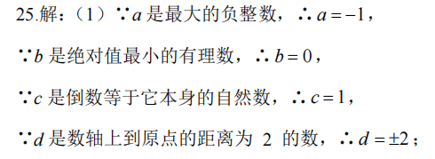
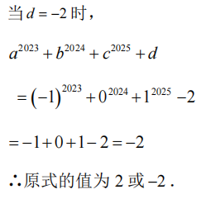
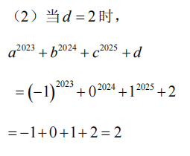

Slide 15
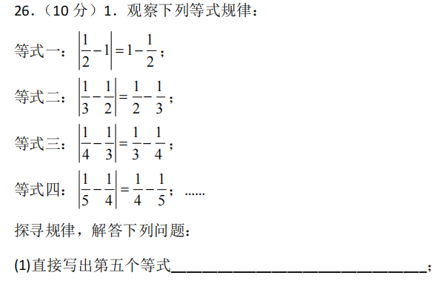

$\left|\frac{\text{1}}{\text{6}}−\frac{\text{1}}{\text{5}}\right|$=$\frac{\text{1}}{\text{5}}−\frac{\text{1}}{\text{6}}$

Slide 16

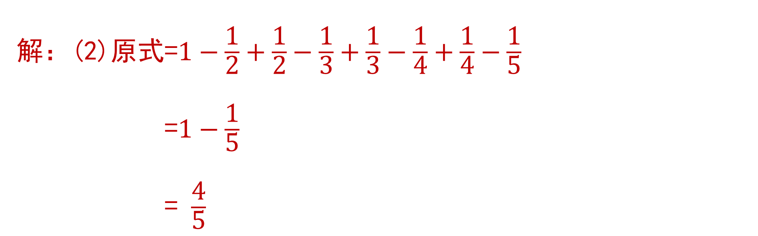
解：(2)原式=$1−\frac{\text{1}}{\text{2}}+\frac{\text{1}}{\text{2}}−\frac{\text{1}}{\text{3}}+\frac{\text{1}}{\text{3}}−\frac{\text{1}}{\text{4}}+\frac{\text{1}}{\text{4}}−\frac{\text{1}}{\text{5}}$
=$1−\frac{\text{1}}{\text{5}}$
= $\frac{\text{4}}{\text{5}}$

Slide 17
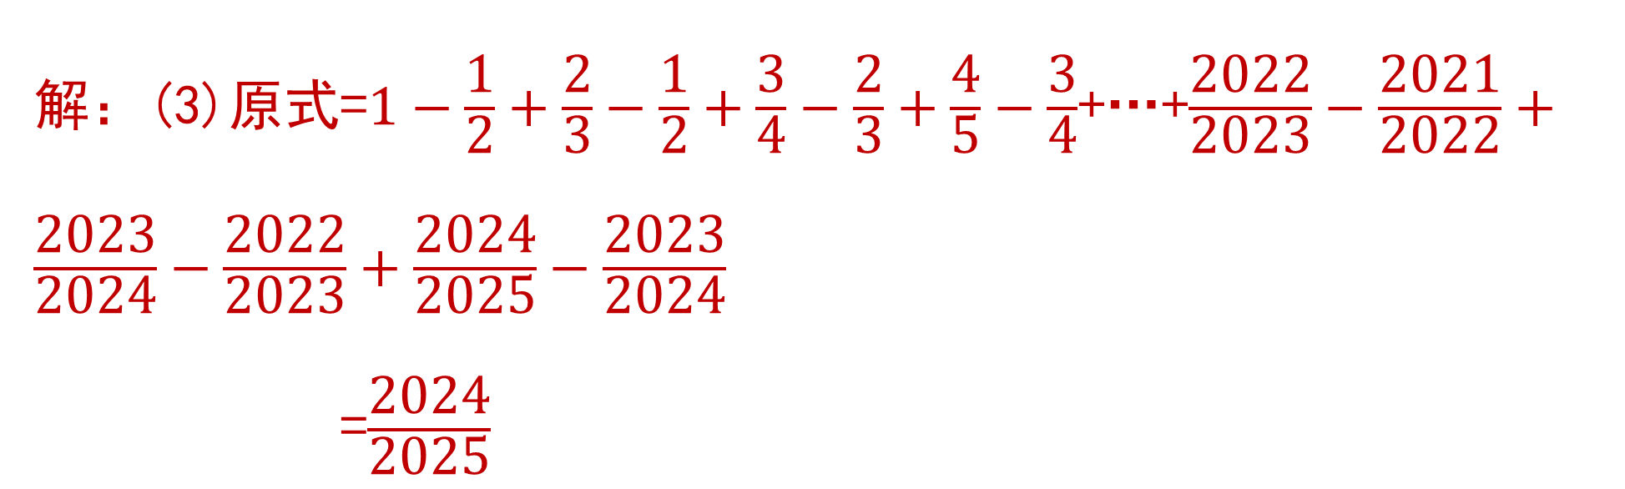
解：(3)原式=$1−\frac{\text{1}}{\text{2}}+\frac{\text{2}}{\text{3}}−\frac{\text{1}}{\text{2}}+\frac{\text{3}}{\text{4}}−\frac{\text{2}}{\text{3}}+\frac{\text{4}}{\text{5}}−\frac{\text{3}}{\text{4}}$+…+$\frac{\text{2}\text{0}\text{2}\text{2}}{\text{2}\text{0}\text{2}\text{3}}−\frac{\text{2}\text{0}\text{2}\text{1}}{\text{2}\text{0}\text{2}\text{2}}+\frac{\text{2}\text{0}\text{2}\text{3}}{\text{2}\text{0}\text{2}\text{4}}−\frac{\text{2}\text{0}\text{2}\text{2}}{\text{2}\text{0}\text{2}\text{3}}+\frac{\text{2}\text{0}\text{2}\text{4}}{\text{2}\text{0}\text{2}\text{5}}−\frac{\text{2}\text{0}\text{2}\text{3}}{\text{2}\text{0}\text{2}\text{4}}$
=$\frac{\text{2}\text{0}\text{2}\text{4}}{\text{2}\text{0}\text{25}}$

Slide 18
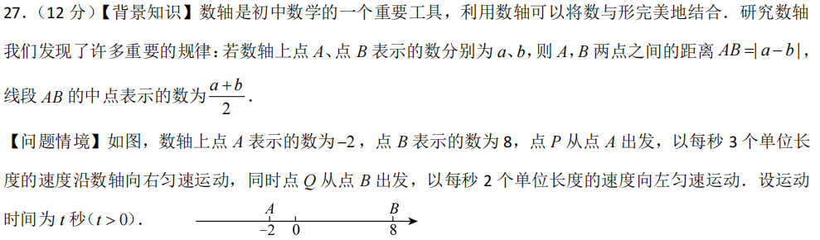
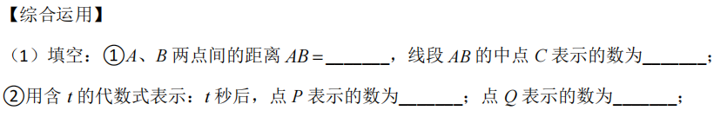

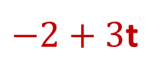


$$10$$
$$3$$
$−2+3$t
$$8−2t$$

Slide 19

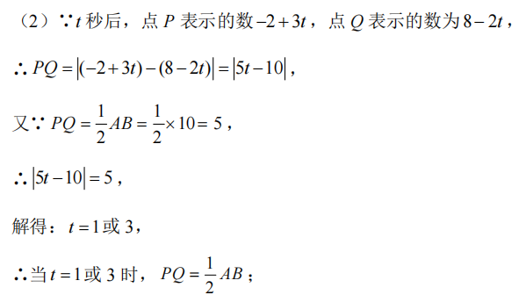

Slide 20
