Slide 1
Introduction to Parallel I/O and MPI-IO
Rajeev Thakur
Mathematics and Computer Science Division
Argonne National Laboratory

Slide 2
Outline
Introduction to parallel I/O
  Mainly software
  From a users perspective
Details of MPI-IO with examples
  How to use it
  How to get performance with it
Run example programs on IBM DataStar
5 min. break somewhere in the middle

Slide 3
Parallel I/O Tools
Collections of system software and libraries have grown up to address I/O issues
  Parallel file systems
  MPI-IO
  High level libraries
Relationships between these are not always clear
Choosing between tools can be difficult

Slide 4
Application View of Data
Applications have data models appropriate to domain
  Multidimensional typed arrays, images composed of scan lines, variable length records
  Headers, attributes on data
Parallel file system API is an awful match
  Bytes
  Blocks or contiguous regions of files
  Independent access
Need more software!

Slide 5
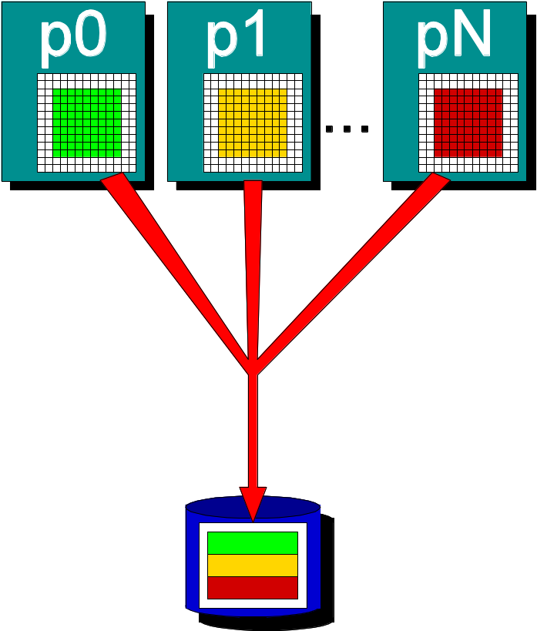
Supporting Application I/O
Provide mapping of app. domain data abstractions
  API that uses language meaningful to app. programmers
Coordinate access by many processes
  Collective I/O, consistency semantics
Organize I/O devices into a single space
  Convenient utilities and file model
And also
  Insulate applications from I/O system changes
  Maintain performance!!!

Slide 6
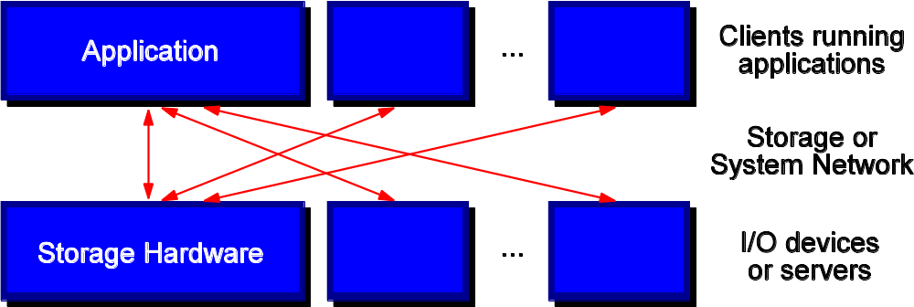
What about Parallel I/O?
Focus of parallel I/O is on using parallelism to increase bandwidth
Use multiple data sources/sinks in concert
  Both multiple storage devices and multiple/wide paths to them
But applications don't want to deal with block devices and network protocols,
So we add software layers

Slide 7
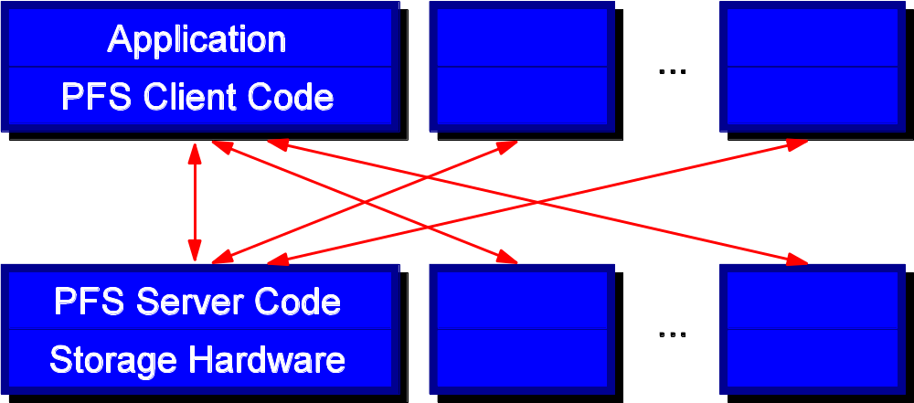
Parallel File Systems (PFSs)
Organize I/O devices into a single logical space
  Striping files across devices for performance
Export a well-defined API, usually POSIX
  Access data in contiguous regions of bytes
  Very general
This is only 1/3 of what we said we needed!

Slide 8
I/O Stacks
Idea: Add some additional software components to address remaining issues
  Coordination of access
  Mapping from application model to I/O model
These components will be increasingly specialized as we add layers
Bridge this gap between existing I/O systems and application needs

Slide 9
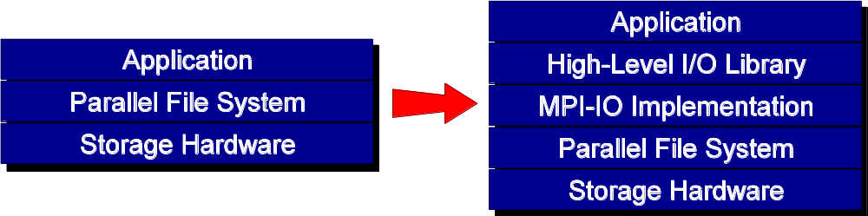
I/O for Computational Science
Break up support into multiple layers:
  High level I/O library maps app. abstractions to a structured, portable file format (e.g. HDF5, Parallel netCDF)
  Middleware layer deals with organizing access by many processes (e.g. MPI-IO, UPC-IO)
  Parallel file system maintains logical space, provides efficient access to data (e.g. PVFS, GPFS, Lustre)

Slide 10
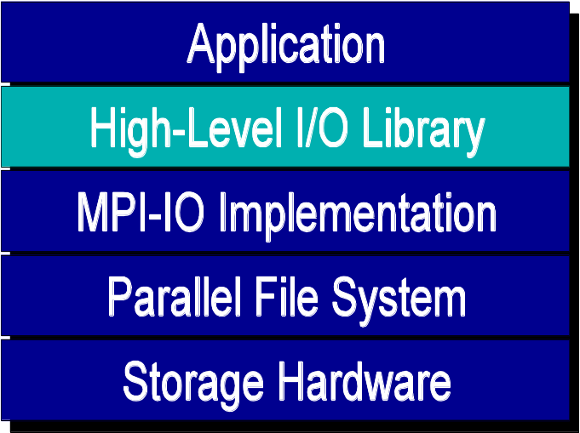
High Level Libraries
Provide an appropriate abstraction for domain
  Multidimensional datasets
  Typed variables
  Attributes
Self-describing, structured file format
Map to middleware interface
  Encourage collective I/O
Provide optimizations that middleware cannot

Slide 11
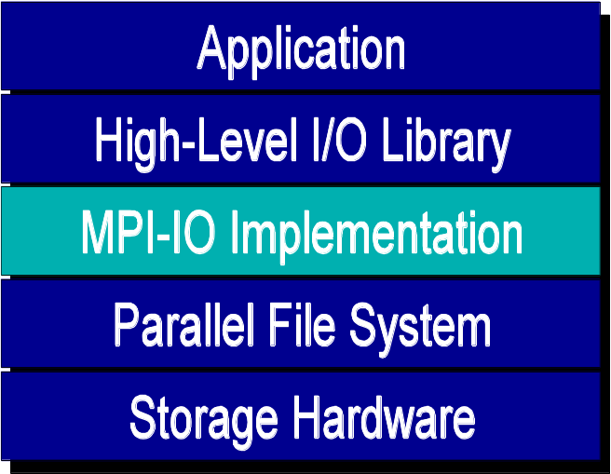
I/O Middleware
Facilitate concurrent access by groups of processes
  Collective I/O
  Atomicity rules
Expose a generic interface
  Good building block for high-level libraries
Match the underlying programming model (e.g. MPI)
Efficiently map middleware operations into PFS ones
  Leverage any rich PFS access constructs

Slide 12
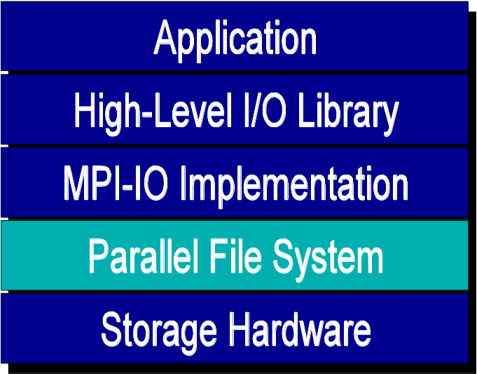
Parallel File System
Manage storage hardware
  Present single view
  Focus on concurrent, independent access
  Knowledge of collective I/O usually very limited
Publish an interface that middleware can use effectively
  Rich I/O language
  Relaxed but sufficient semantics

Slide 13
POSIX I/O Interface
Standard I/O interface across many platforms
Mechanism almost all serial applications use to perform I/O
No way of describing collective access
Warning: semantics differ between file systems!
  NFS is the worst of these, supporting API but not semantics
  Determining FS type is nontrivial

Slide 14
Simple POSIX I/O: Writing
#include <fcntl.h>
#include <unistd.h>
int main(int argc, char **argv)
{
  int fd, ret;
  char buf[13] = "Hello World\n";
  fd = open("myfile", O_WRONLY | O_CREAT, 0755);
  if (fd < 0) return 1;
  ret = write(fd, buf, 13);
  if (ret < 13) return 1;
  close(fd);
  return 0;
}

Slide 15
Under the PFS Covers
Parallel file system software has to get data from user buffers into disk blocks (and vice versa)
Two basic ways that PFSs manage this
  Block-oriented access
  Region-oriented access
The mechanism used by the PFS does have a significant impact on the performance for some workloads
  Region-oriented is more flexible

Slide 16
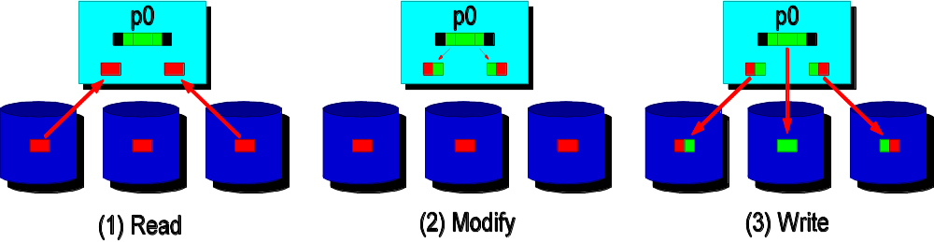
PFS Write: Block Accesses
Block-oriented file systems (e.g. ones using SANs) must perform operations in terms of whole blocks
Can require read-modify-write
  Imagine lots of processes needing to modify the same block...

Slide 17
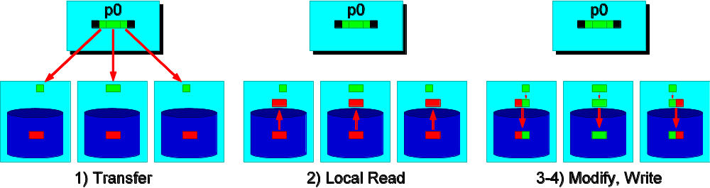
PFS Write: Region Accesses
Some file systems can access at byte granularity
Move less data over the network
Manage modification of blocks locally
In some cases they can handle noncontiguous accesses as well (e.g. PVFS, PVFS2)

Slide 18
POSIX Wrap-Up
POSIX interface is a useful, ubiquitous interface for building basic I/O tools
No constructs useful for parallel I/O
Should not be used in parallel applications if performance is desired

Slide 19
Parallel I/O Reference
John May, Parallel I/O for High Performance Computing, Morgan Kaufmann, 2000.
  Good coverage of basic concepts, some MPI-IO, HDF5, and serial netCDF

Slide 20
On-Line References (2)
PVFS and PVFS2 (open source)
  www.parl.clemson.edu/pvfs/
  www.pvfs.org/pvfs2/
Lustre
  www.lustre.org
GPFS
  www.almaden.ibm.com/storagesystems/file_systems/GPFS/

Slide 21
MPI-IO

Slide 22
Introduction
Goals of this session
  introduce the important features of MPI-IO in the form of example programs, following the outline of the Parallel I/O chapter in Using MPI-2
  focus on how to achieve high performance
What can you expect from this session?
  learn how to use MPI-IO and, hopefully, like it
  be able to go back home and immediately use MPI-IO in your applications
  get much higher I/O performance than what you have been getting so far using other techniques

Slide 23
Common Ways of Doing I/O in Parallel Programs
Sequential I/O:
  All processes send data to rank 0, and 0 writes it to the file

Slide 24
Pros and Cons of Sequential I/O
Pros:
  parallel machine may support I/O from only one process (e.g., no common file system)
  Some I/O libraries (e.g. HDF-4, NetCDF) not parallel
  resulting single file is handy for ftp, mv
  big blocks improve performance
  short distance from original, serial code
Cons:
  lack of parallelism limits scalability, performance (single node bottleneck)

Slide 25
Another Way
Each process writes to a separate file
Pros:
  parallelism, high performance
Cons:
  lots of small files to manage
  difficult to read back data from different number of processes

Slide 26
What is Parallel I/O?
Multiple processes of a parallel program accessing data (reading or writing) from a common file
FILE
P0
P1
P2
P(n-1)

Slide 27
Why Parallel I/O?
Non-parallel I/O is simple but
  Poor performance (single process writes to one file) or
  Awkward and not interoperable with other tools (each process writes a separate file)
Parallel I/O
  Provides high performance
  Can provide a single file that can be used with other tools (such as visualization programs)

Slide 28
Why is MPI a Good Setting for Parallel I/O?
Writing is like sending a message and reading is like receiving
Any parallel I/O system will need a mechanism to
  define collective operations (MPI communicators)
  define noncontiguous data layout in memory and file (MPI datatypes)
  Test completion of nonblocking operations (MPI request objects)
I.e., lots of MPI-like machinery

Slide 29
Using MPI for Simple I/O
FILE
P0
P1
P2
P(n-1)
Each process needs to read a chunk of data from a common file

Slide 30
Using Individual File Pointers
MPI_File fh;
MPI_Status status;
MPI_Comm_rank(MPI_COMM_WORLD, &rank);
MPI_Comm_size(MPI_COMM_WORLD, &nprocs);
bufsize = FILESIZE/nprocs;
nints = bufsize/sizeof(int);
MPI_File_open(MPI_COMM_WORLD, "/pfs/datafile",
MPI_MODE_RDONLY, MPI_INFO_NULL, &fh);
MPI_File_seek(fh, rank * bufsize, MPI_SEEK_SET);
MPI_File_read(fh, buf, nints, MPI_INT, &status);
MPI_File_close(&fh);

Slide 31
Using Explicit Offsets
include 'mpif.h'
integer status(MPI_STATUS_SIZE)
integer (kind=MPI_OFFSET_KIND) offset
C in F77, see implementation notes (might be integer*8)
call MPI_FILE_OPEN(MPI_COMM_WORLD, '/pfs/datafile', &
MPI_MODE_RDONLY, MPI_INFO_NULL, fh, ierr)
nints = FILESIZE / (nprocs*INTSIZE)
offset = rank * nints * INTSIZE
call MPI_FILE_READ_AT(fh, offset, buf, nints,
MPI_INTEGER, status, ierr)
call MPI_GET_COUNT(status, MPI_INTEGER, count, ierr)
print *, 'process ', rank, 'read ', count, 'integers'
call MPI_FILE_CLOSE(fh, ierr)

Slide 32
Writing to a File
Use MPI_File_write or MPI_File_write_at
Use MPI_MODE_WRONLY or MPI_MODE_RDWR as the flags to MPI_File_open
If the file doesn’t exist previously, the flag MPI_MODE_CREATE must also be passed to MPI_File_open
We can pass multiple flags by using bitwise-or ‘|’ in C, or addition ‘+” in Fortran

Slide 33
Using File Views
Processes write to shared file
MPI_File_set_view assigns regions of the file to separate processes

Slide 34
File Views
Specified by a triplet (displacement, etype, and filetype) passed to MPI_File_set_view
displacement = number of bytes to be skipped from the start of the file
etype = basic unit of data access (can be any basic or derived datatype)
filetype = specifies which portion of the file is visible to the process

Slide 35
File View Example
MPI_File thefile;
for (i=0; i<BUFSIZE; i++)
buf[i] = myrank * BUFSIZE + i;
MPI_File_open(MPI_COMM_WORLD, "testfile",
MPI_MODE_CREATE | MPI_MODE_WRONLY,
MPI_INFO_NULL, &thefile);
MPI_File_set_view(thefile, myrank * BUFSIZE * sizeof(int),
MPI_INT, MPI_INT, "native",
MPI_INFO_NULL);
MPI_File_write(thefile, buf, BUFSIZE, MPI_INT,
MPI_STATUS_IGNORE);
MPI_File_close(&thefile);

Slide 36
MPI_File_set_view
Describes that part of the file accessed by a single MPI process.
Arguments to MPI_File_set_view:
  MPI_File file
  MPI_Offset disp
  MPI_Datatype etype
  MPI_Datatype filetype
  char *datarep
  MPI_Info info

Slide 37
Fortran Version
PROGRAM main
use mpi
integer ierr, i, myrank, BUFSIZE, thefile
parameter (BUFSIZE=100)
integer buf(BUFSIZE)
integer(kind=MPI_OFFSET_KIND) disp
call MPI_INIT(ierr)
call MPI_COMM_RANK(MPI_COMM_WORLD, myrank, ierr)
do i = 0, BUFSIZE
buf(i) = myrank * BUFSIZE + i
enddo
* in F77, see implementation notes (might be integer*8)

Slide 38
Fortran Version contd.
call MPI_FILE_OPEN(MPI_COMM_WORLD, 'testfile', &
MPI_MODE_WRONLY + MPI_MODE_CREATE, &
MPI_INFO_NULL, thefile, ierr)
call MPI_TYPE_SIZE(MPI_INTEGER, intsize)
disp = myrank * BUFSIZE * intsize
call MPI_FILE_SET_VIEW(thefile, disp, MPI_INTEGER, &
MPI_INTEGER, 'native', &
MPI_INFO_NULL, ierr)
call MPI_FILE_WRITE(thefile, buf, BUFSIZE, MPI_INTEGER, &
MPI_STATUS_IGNORE, ierr)
call MPI_FILE_CLOSE(thefile, ierr)
call MPI_FINALIZE(ierr)
END PROGRAM main

Slide 39
C++ Version
// example of parallel MPI read from single file
#include <iostream.h>
#include "mpi.h"
int main(int argc, char *argv[])
{
int bufsize, *buf, count;
char filename[128];
MPI::Status status;
MPI::Init();
int myrank = MPI::COMM_WORLD.Get_rank();
int numprocs = MPI::COMM_WORLD.Get_size();
MPI::File thefile = MPI::File::Open(MPI::COMM_WORLD,
"testfile",
MPI::MODE_RDONLY,
MPI::INFO_NULL);

Slide 40
C++ Version contd.
MPI::Offset filesize = thefile.Get_size();
filesize = filesize / sizeof(int);
bufsize = filesize / numprocs + 1;
buf = new int[bufsize];
thefile.Set_view(myrank * bufsize * sizeof(int),
MPI_INT, MPI_INT, "native",
MPI::INFO_NULL);
thefile.Read(buf, bufsize, MPI_INT, &status);
count = status.Get_count(MPI_INT);
cout << "process " << myrank << " read " << count
<< " ints" << endl;
thefile.Close();
delete [] buf;
MPI::Finalize();
return 0;
}

Slide 41
Other Ways to Write to a Shared File
MPI_File_seek
MPI_File_read_at
MPI_File_write_at
MPI_File_read_shared
MPI_File_write_shared
Collective operations
like Unix seek
combine seek and I/O
for thread safety
use shared file pointer

Slide 42
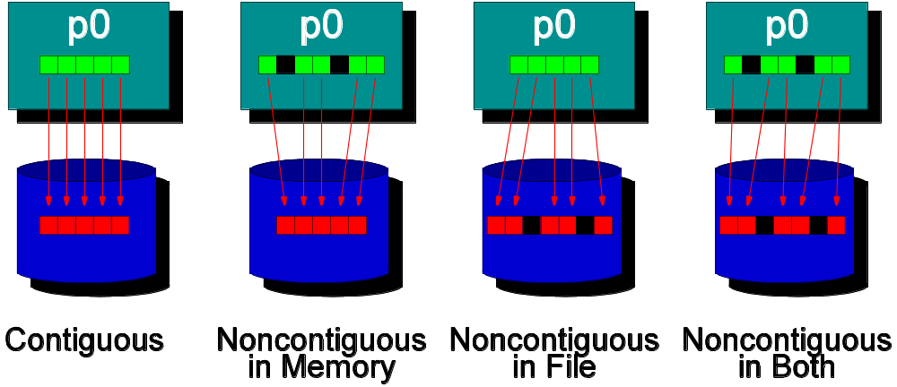
Noncontiguous I/O
Contiguous I/O moves data from a single block in memory into a single region of storage
Noncontiguous I/O has three forms:
  Noncontiguous in memory, noncontiguous in file, or noncontiguous in both
Structured data leads naturally to noncontiguous I/O

Slide 43
Example:
Distributed Array Access
2D array distributed among four processes
P0
P1
P2
P3
File containing the global array in row-major order

Slide 44
A Simple Noncontiguous File View Example
etype = MPI_INT
filetype = two MPI_INTs followed by
a gap of four MPI_INTs
head of file
FILE
displacement
filetype
filetype
and so on...

Slide 45
File View Code
MPI_Aint lb, extent;
MPI_Datatype etype, filetype, contig;
MPI_Offset disp;
MPI_Type_contiguous(2, MPI_INT, &contig);
lb = 0; extent = 6 * sizeof(int);
MPI_Type_create_resized(contig, lb, extent, &filetype);
MPI_Type_commit(&filetype);
disp = 5 * sizeof(int); etype = MPI_INT;
MPI_File_open(MPI_COMM_WORLD, "/pfs/datafile",
MPI_MODE_CREATE | MPI_MODE_RDWR, MPI_INFO_NULL, &fh);
MPI_File_set_view(fh, disp, etype, filetype, "native",
MPI_INFO_NULL);
MPI_File_write(fh, buf, 1000, MPI_INT, MPI_STATUS_IGNORE);

Slide 46
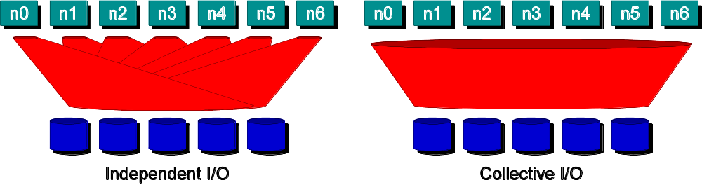
Collective I/O (1)
Many applications have phases of computation and I/O
During I/O phases, all processes read/write data
  We can say they are collectively accessing storage
Collective I/O is coordinated access to storage by a group of processes
  Collective I/O functions must be called by all processes participating in I/O
  Allows I/O layers to know more about access as a whole
Independent I/O is not organized in this way
No apparent order or structure to accesses

Slide 47
Collective I/O (2)
MPI_File_read_all, MPI_File_read_at_all, etc
_all indicates that all processes in the group specified by the communicator passed to MPI_File_open will call this function
Each process specifies only its own access information -- the argument list is the same as for the non-collective functions

Slide 48
Under the Covers of MPI-IO
MPI-IO implementation is given a lot of information in this case:
  Collection of processes reading data
  Structured description of the regions
Implementation has some options for how to obtain this data
  Noncontiguous data access optimizations
  Collective I/O optimizations

Slide 49
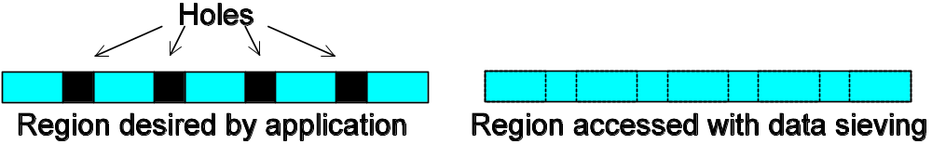
Data Sieving
Data sieving is used to combine lots of small accesses into a single larger one
  Remote file systems (parallel or not) tend to have high latencies
  Reducing # of operations important
Generally very effective, but not as good as having a PFS that supports noncontiguous access

Slide 50
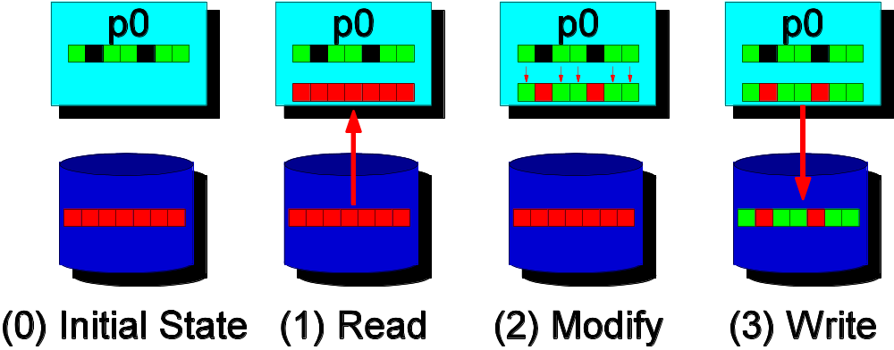
Data Sieving Writes
Using data sieving for writes is more complicated
  Must read the entire region first
  Then make our changes
  Then write the block back
Requires locking in the file system
  Can result in false sharing (interleaved access)
  PFS supporting noncontiguous writes is preferred

Slide 51
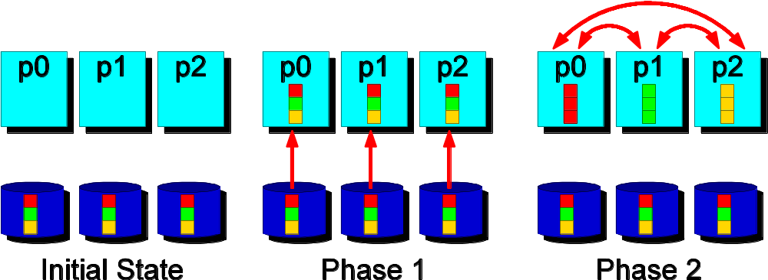
Two-Phase Collective I/O
Problems with independent, noncontiguous access
  Lots of small accesses
  Independent data sieving reads lots of extra data
Idea: Reorganize access to match layout on disks
  Single processes use data sieving to get data for many
  Often reduces total I/O through sharing of common blocks
Second ``phase'' moves data to final destinations

Slide 52
Two-Phase Writes
Similarly to data sieving, we need to perform a read/modify/write for two-phase writes if combined data is noncontiguous
Overhead is substantially lower than independent access to the same regions because there is little or no false sharing
Note that two-phase is usually applied to file regions, not to actual blocks

Slide 53
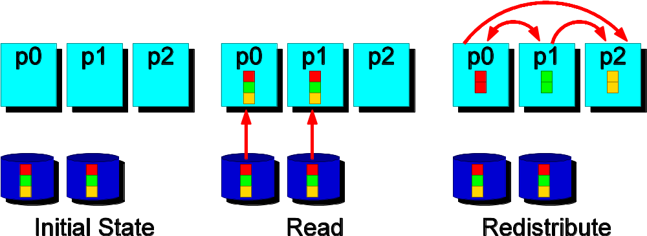
Aggregation
Aggregation refers to the more general application of this concept of moving data through intermediate nodes
  Different #s of nodes performing I/O
  Could also be applied to independent I/O
Can also be used for remote I/O, where aggregator processes are on an entirely different system

Slide 54
Accessing Arrays Stored in Files
n columns
P0
P1
P2
coords = (0,0)
coords = (0,1)
coords = (0,2)
m
rows
P3
P4
P5
coords = (1,0)
coords = (1,1)
coords = (1,2)
nproc(1) = 2, nproc(2) = 3

Slide 55
Using the “Distributed Array” (Darray) Datatype
int gsizes[2], distribs[2], dargs[2], psizes[2];
gsizes[0] = m; /* no. of rows in global array */
gsizes[1] = n; /* no. of columns in global array*/
distribs[0] = MPI_DISTRIBUTE_BLOCK;
distribs[1] = MPI_DISTRIBUTE_BLOCK;
dargs[0] = MPI_DISTRIBUTE_DFLT_DARG;
dargs[1] = MPI_DISTRIBUTE_DFLT_DARG;
psizes[0] = 2; /* no. of processes in vertical dimension
of process grid */
psizes[1] = 3; /* no. of processes in horizontal dimension
of process grid */

Slide 56
Darray Continued
MPI_Comm_rank(MPI_COMM_WORLD, &rank);
MPI_Type_create_darray(6, rank, 2, gsizes, distribs, dargs,
psizes, MPI_ORDER_C, MPI_FLOAT, &filetype);
MPI_Type_commit(&filetype);
MPI_File_open(MPI_COMM_WORLD, "/pfs/datafile",
MPI_MODE_CREATE | MPI_MODE_WRONLY,
MPI_INFO_NULL, &fh);
MPI_File_set_view(fh, 0, MPI_FLOAT, filetype, "native",
MPI_INFO_NULL);
local_array_size = num_local_rows * num_local_cols;
MPI_File_write_all(fh, local_array, local_array_size,
MPI_FLOAT, &status);
MPI_File_close(&fh);

Slide 57
A Word of Warning about Darray
The darray datatype assumes a very specific definition of data distribution -- the exact definition as in HPF
For example, if the array size is not divisible by the number of processes, darray calculates the block size using a ceiling division (20 / 6 = 4 )
darray assumes a row-major ordering of processes in the logical grid, as assumed by cartesian process topologies in MPI-1
If your application uses a different definition for data distribution or logical grid ordering, you cannot use darray. Use subarray instead.

Slide 58
Using the Subarray Datatype
gsizes[0] = m; /* no. of rows in global array */
gsizes[1] = n; /* no. of columns in global array*/
psizes[0] = 2; /* no. of procs. in vertical dimension */
psizes[1] = 3; /* no. of procs. in horizontal dimension */
lsizes[0] = m/psizes[0]; /* no. of rows in local array */
lsizes[1] = n/psizes[1]; /* no. of columns in local array */
dims[0] = 2; dims[1] = 3;
periods[0] = periods[1] = 1;
MPI_Cart_create(MPI_COMM_WORLD, 2, dims, periods, 0, &comm);
MPI_Comm_rank(comm, &rank);
MPI_Cart_coords(comm, rank, 2, coords);

Slide 59
Subarray Datatype contd.
/* global indices of first element of local array */
start_indices[0] = coords[0] * lsizes[0];
start_indices[1] = coords[1] * lsizes[1];
MPI_Type_create_subarray(2, gsizes, lsizes, start_indices,
MPI_ORDER_C, MPI_FLOAT, &filetype);
MPI_Type_commit(&filetype);
MPI_File_open(MPI_COMM_WORLD, "/pfs/datafile",
MPI_MODE_CREATE | MPI_MODE_WRONLY,
MPI_INFO_NULL, &fh);
MPI_File_set_view(fh, 0, MPI_FLOAT, filetype, "native",
MPI_INFO_NULL);
local_array_size = lsizes[0] * lsizes[1];
MPI_File_write_all(fh, local_array, local_array_size,
MPI_FLOAT, &status);

Slide 60
Local Array with Ghost Area in Memory
(0,0)
(0,107)
(4,4)
(4,103)
local data
ghost area for storing
off-process elements
(103,4)
(103,103)
(107,0)
(107,107)
Use a subarray datatype to describe the noncontiguous layout in memory
Pass this datatype as argument to MPI_File_write_all

Slide 61
Local Array with Ghost Area
memsizes[0] = lsizes[0] + 8;
/* no. of rows in allocated array */
memsizes[1] = lsizes[1] + 8;
/* no. of columns in allocated array */
start_indices[0] = start_indices[1] = 4;
/* indices of the first element of the local array
in the allocated array */
MPI_Type_create_subarray(2, memsizes, lsizes,
start_indices, MPI_ORDER_C, MPI_FLOAT, &memtype);
MPI_Type_commit(&memtype);
/* create filetype and set file view exactly as in the
subarray example */
MPI_File_write_all(fh, local_array, 1, memtype, &status);

Slide 62
Accessing Irregularly
Distributed Arrays
Process 0’s data array
Process 1’s data array
Process 2’s data array
Process 0’s map array
Process 1’s map array
Process 2’s map array
0
3
8
11
2
4
7
13
1
5
10
14
The map array describes the location of each element
of the data array in the common file

Slide 63
Accessing Irregularly
Distributed Arrays
integer (kind=MPI_OFFSET_KIND) disp
call MPI_FILE_OPEN(MPI_COMM_WORLD, '/pfs/datafile', &
MPI_MODE_CREATE + MPI_MODE_RDWR, &
MPI_INFO_NULL, fh, ierr)
call MPI_TYPE_CREATE_INDEXED_BLOCK(bufsize, 1, map, &
MPI_DOUBLE_PRECISION, filetype, ierr)
call MPI_TYPE_COMMIT(filetype, ierr)
disp = 0
call MPI_FILE_SET_VIEW(fh, disp, MPI_DOUBLE_PRECISION, &
filetype, 'native', MPI_INFO_NULL, ierr)
call MPI_FILE_WRITE_ALL(fh, buf, bufsize, &
MPI_DOUBLE_PRECISION, status, ierr)
call MPI_FILE_CLOSE(fh, ierr)

Slide 64
Nonblocking I/O
MPI_Request request;
MPI_Status status;
MPI_File_iwrite_at(fh, offset, buf, count, datatype,
&request);
for (i=0; i<1000; i++) {
/* perform computation */
}
MPI_Wait(&request, &status);

Slide 65
Split Collective I/O
A restricted form of nonblocking collective I/O
Only one active nonblocking collective operation allowed at a time on a file handle
Therefore, no request object necessary
MPI_File_write_all_begin(fh, buf, count, datatype);
for (i=0; i<1000; i++) {
/* perform computation */
}
MPI_File_write_all_end(fh, buf, &status);

Slide 66
Shared File Pointers
#include "mpi.h"
// C++ example
int main(int argc, char *argv[])
{
int buf[1000];
MPI::File fh;
MPI::Init();
MPI::File fh = MPI::File::Open(MPI::COMM_WORLD,
"/pfs/datafile", MPI::MODE_RDONLY, MPI::INFO_NULL);
fh.Write_shared(buf, 1000, MPI_INT);
fh.Close();
MPI::Finalize();
return 0;
}

Slide 67
MPI-IO Implementations
There are a collection of different MPI-IO implementations
Each one has its own set of special features
Three better-known ones are:
  ROMIO from Argonne National Laboratory
  MPI-IO/GPFS from IBM
  MPI/SX and MPI/PC-32 from NEC
Quick overview of these

Slide 68
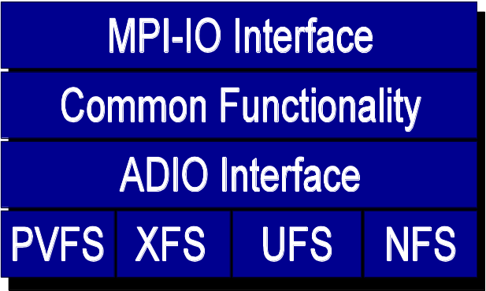
ROMIO MPI-IO Implementation
ANL implementation
Leverages MPI communication
Layered implementation supports many storage types
  Local file systems (e.g. XFS)
  Parallel file systems (e.g. PVFS2)
  NFS, Remote I/O (RFS)
UFS implementation works for most other file systems
  e.g. GPFS and Lustre
Included with many MPI implementations
Includes data sieving and two-phase optimizations

Slide 69
IBM MPI-IO Implementation
For GPFS on the AIX platform
Includes two special optimizations
  Data shipping -- mechanism for coordinating access to a file to alleviate lock contention (type of aggregation)
  Controlled prefetching -- using MPI file views and access patterns to predict regions to be accessed in future
Not available for GPFS on Linux
  Use ROMIO instead

Slide 70
NEC MPI-IO Implementation
For NEC SX platform (MPI/SX) and Myrinet-coupled PC clusters (MPI/PC-32)
Includes listless I/O optimization
  Fast handling of noncontiguous I/O accesses in MPI layer
  Great for situations where the file system is lock based and/or has only contiguous I/O primitives

Slide 71
MPI-IO Hints
MPI-IO hints may be passed via:
  MPI_File_open
  MPI_File_set_info
  MPI_File_set_view
Hints are optional - implementations are guaranteed to ignore ones they do not understand
  Different implementations, even different underlying file systems, support different hints
MPI_File_get_info used to get list of hints
Next few slides cover only some hints

Slide 72
Examples of Hints
(used in ROMIO)
striping_unit
striping_factor
cb_buffer_size
cb_nodes
ind_rd_buffer_size
ind_wr_buffer_size
start_iodevice
pfs_svr_buf
direct_read
direct_write
MPI-2 predefined hints
New Algorithm Parameters
Platform-specific hints

Slide 73
ROMIO Hints: FS-Related
striping_factor -- Controls the number of I/O devices to stripe across
striping_unit -- Controls the striping unit (in bytes)
start_iodevice -- Determines what I/O device data will first be written to
direct_read -- Controls direct I/O for reads
direct_write -- Controls direct I/O for writes

Slide 74
ROMIO Hints: Data Sieving
ind_rd_buffer_size -- Controls the size (in bytes) of the intermediate buffer used by ROMIO when performing data sieving reads
ind_wr_buffer_size -- Controls the size (in bytes) of the intermediate buffer used by ROMIO when performing data sieving writes
romio_ds_read -- Determines when ROMIO will choose to perform data sieving for reads (enable, disable, auto)
romio_ds_write -- Determines when ROMIO will choose to perform data sieving for writes

Slide 75
ROMIO Hints: Collective I/O
cb_buffer_size -- Controls the size (in bytes) of the intermediate buffer used in two-phase collective I/O
cb_nodes -- Controls the maximum number of aggregators to be used
romio_cb_read -- Controls when collective buffering is applied to collective read operations
romio_cb_write -- Controls when collective buffering is applied to collective write operations
cb_config_list -- Provides explicit control over aggregators (see ROMIO User's Guide)

Slide 76
Passing Hints to the Implementation
MPI_Info info;
MPI_Info_create(&info);
/* no. of I/O devices to be used for file striping */
MPI_Info_set(info, "striping_factor", "4");
/* the striping unit in bytes */
MPI_Info_set(info, "striping_unit", "65536");
MPI_File_open(MPI_COMM_WORLD, "/pfs/datafile",
MPI_MODE_CREATE | MPI_MODE_RDWR, info, &fh);
MPI_Info_free(&info);

Slide 77
General Guidelines for Achieving High I/O Performance
Buy sufficient I/O hardware for the machine
Use fast file systems, not NFS-mounted home directories
Do not perform I/O from one process only
Make large requests wherever possible
For noncontiguous requests, use derived datatypes and a single collective I/O call

Slide 78
Achieving High I/O Performance
Any application as a particular “I/O access pattern” based on its I/O needs
The same access pattern can be presented to the I/O system in different ways depending on what I/O functions are used and how
We classify the different ways of expressing I/O access patterns in MPI-IO into four levels: level 0 -- level 3
We demonstrate how the user’s choice of level affects performance

Slide 79
Example: Distributed Array Access
P0
P1
P2
P3
Large array
distributed
among 16
processes
Each square represents
a subarray in the memory
of a single process
P4
P5
P6
P7
P8
P9
P10
P11
P12
P13
P14
P15
Access Pattern in the file
P0
P1
P2
P3
P0
P1
P2
P4
P5
P6
P7
P4
P5
P6
P8
P9
P10
P11
P8
P9
P10
P12
P13
P14
P15
P12
P13
P14

Slide 80
Level-0 Access (C)
Each process makes one independent read request for each row in the local array (as in Unix)
MPI_File_open(..., file, ..., &fh)
for (i=0; i<n_local_rows; i++) {
MPI_File_seek(fh, ...);
MPI_File_read(fh, &(A[i][0]), ...);
}
MPI_File_close(&fh);

Slide 81
Level-0 Access (Fortran)
Each process makes one independent read request for each column in the local array (as in Unix)
call MPI_File_open(..., file, ..., fh, ierr)
do i=1, n_local_cols
call MPI_File_seek(fh, …, ierr)
call MPI_File_read(fh, A(1,i), …, ierr)
enddo
call MPI_File_close(fh, ierr)

Slide 82
Level-1 Access (C)
Similar to level 0, but each process uses collective I/O functions
MPI_File_open(MPI_COMM_WORLD, file, ..., &fh);
for (i=0; i<n_local_rows; i++) {
MPI_File_seek(fh, ...);
MPI_File_read_all(fh, &(A[i][0]), ...);
}
MPI_File_close(&fh);

Slide 83
Level-1 Access (Fortran)
Similar to level 0, but each process uses collective I/O functions
call MPI_File_open(MPI_COMM_WORLD, file, ..., fh, ierr)
do i=1, n_local_cols
call MPI_File_seek(fh, …, ierr)
call MPI_File_read_all(fh, A(1,i), ..., ierr)
enddo
call MPI_File_close(fh, ierr)

Slide 84
Level-2 Access (C)
Each process creates a derived datatype to describe the noncontiguous access pattern, defines a file view, and calls independent I/O functions
MPI_Type_create_subarray(..., &subarray, ...);
MPI_Type_commit(&subarray);
MPI_File_open(..., file, ..., &fh);
MPI_File_set_view(fh, ..., subarray, ...);
MPI_File_read(fh, A, ...);
MPI_File_close(&fh);

Slide 85
Level-2 Access (Fortran)
Each process creates a derived datatype to describe the noncontiguous access pattern, defines a file view, and calls independent I/O functions
call MPI_Type_create_subarray(..., subarray, ..., ierr)
call MPI_Type_commit(subarray, ierr)
call MPI_File_open(..., file, ..., fh, ierr)
call MPI_File_set_view(fh, ..., subarray, ..., ierr)
call MPI_File_read(fh, A, ..., ierr)
call MPI_File_close(fh, ierr)

Slide 86
Level-3 Access (C)
Similar to level 2, except that each process uses collective I/O functions
MPI_Type_create_subarray(..., &subarray, ...);
MPI_Type_commit(&subarray);
MPI_File_open(MPI_COMM_WORLD, file, ..., &fh);
MPI_File_set_view(fh, ..., subarray, ...);
MPI_File_read_all(fh, A, ...);
MPI_File_close(&fh);

Slide 87
Level-3 Access (Fortran)
Similar to level 2, except that each process uses collective I/O functions
call MPI_Type_create_subarray(..., subarray, ..., ierr)
call MPI_Type_commit(subarray, ierr)
call MPI_File_open(MPI_COMM_WORLD, file, ..., fh, ierr)
call MPI_File_set_view(fh, ..., subarray, ..., ierr)
call MPI_File_read_all(fh, A, …, ierr)
call MPI_File_close(fh, ierr)

Slide 88
The Four Levels of Access
File Space
Level 0
Level 1
Level 2
Level 3
0
1
2
3
Processes

Slide 89
Optimizations
Given complete access information, an implementation can perform optimizations such as:
  Data Sieving: Read large chunks and extract what is really needed
  Collective I/O: Merge requests of different processes into larger requests
  Improved prefetching and caching

Slide 90
Two Key Optimizations in ROMIO
Data sieving
  For independent noncontiguous requests
  ROMIO makes large I/O requests to the file system and, in memory, extracts the data requested
  For writing, a read-modify-write is required
Two-phase collective I/O
  Communication phase to merge data into large chunks
  I/O phase to write large chunks in parallel

Slide 91
Performance Results
Distributed array access
Unstructured code from Sandia
On five different parallel machines:
  HP Exemplar
  IBM SP
  Intel Paragon
  NEC SX-4
  SGI Origin2000

Slide 92
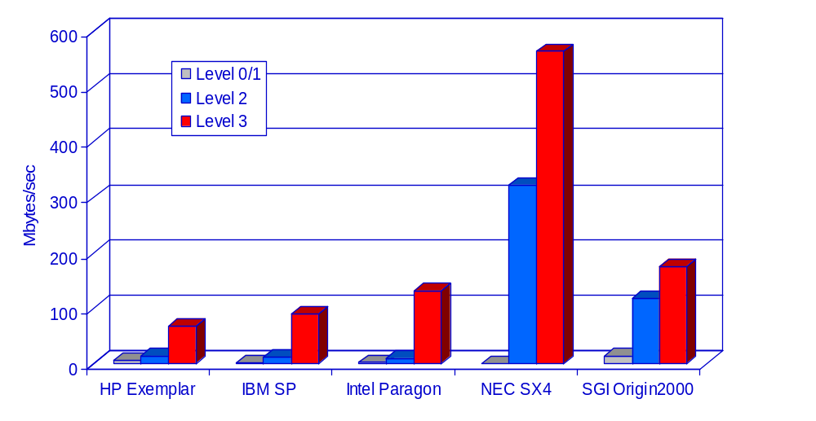
Distributed Array Access:
Read Bandwidth
64 procs
64 procs
256 procs
8 procs
32 procs
Array size: 512 x 512 x 512

Slide 93
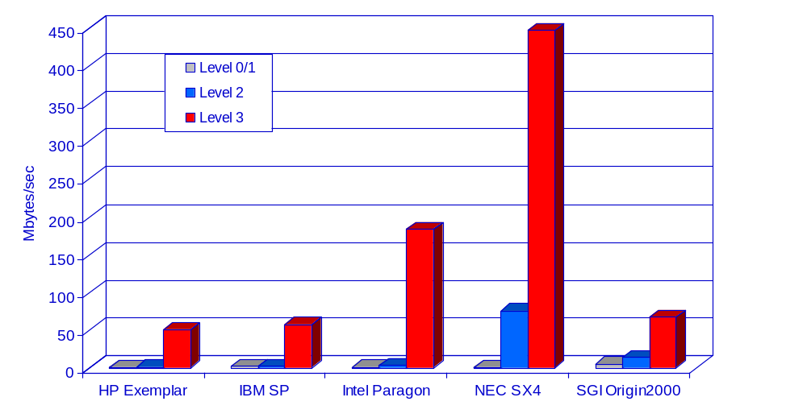
Distributed Array Access:
Write Bandwidth
64 procs
64 procs
256 procs
8 procs
32 procs
Array size: 512 x 512 x 512

Slide 94
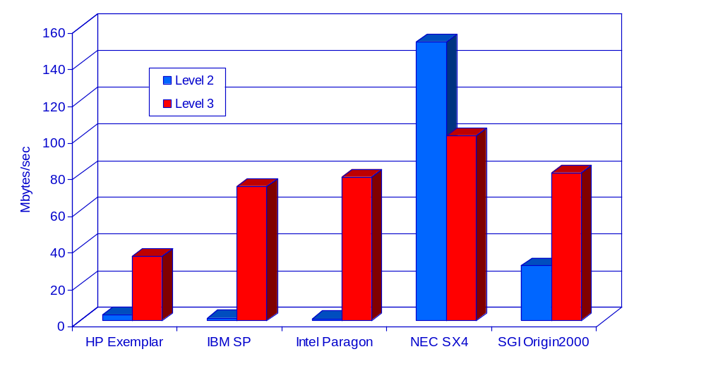
Unstructured Code:
Read Bandwidth
64 procs
64 procs
256 procs
8 procs
32 procs

Slide 95
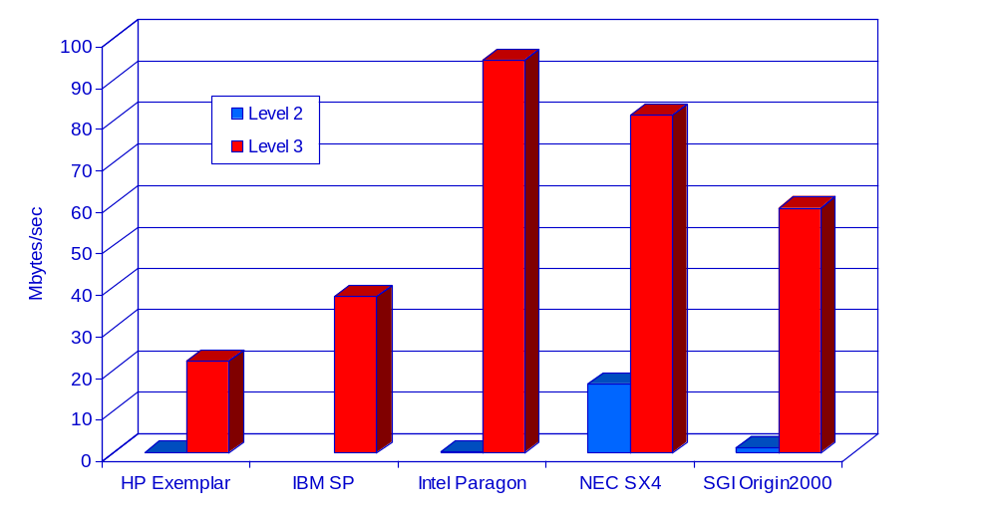
Unstructured Code:
Write Bandwidth
64 procs
64 procs
256 procs
8 procs
32 procs

Slide 96
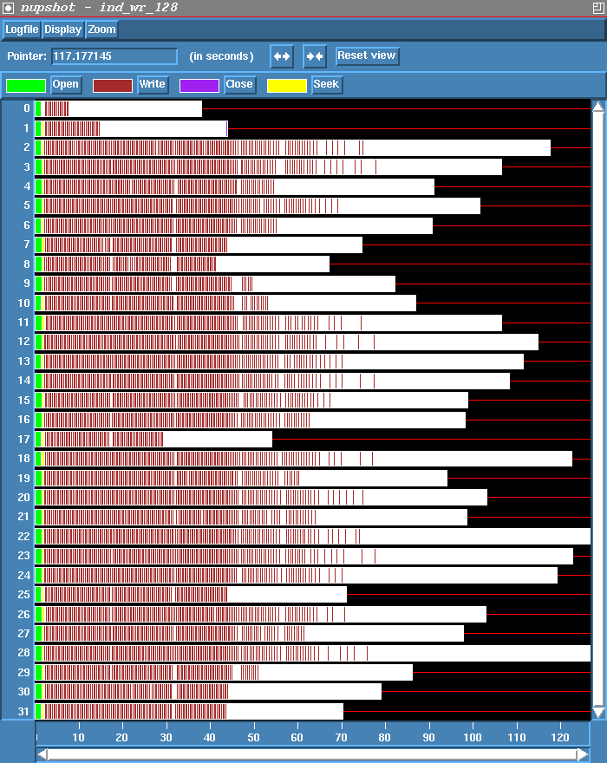
Independent Writes
On Paragon
Lots of seeks and small writes
Time shown =
130 seconds

Slide 97
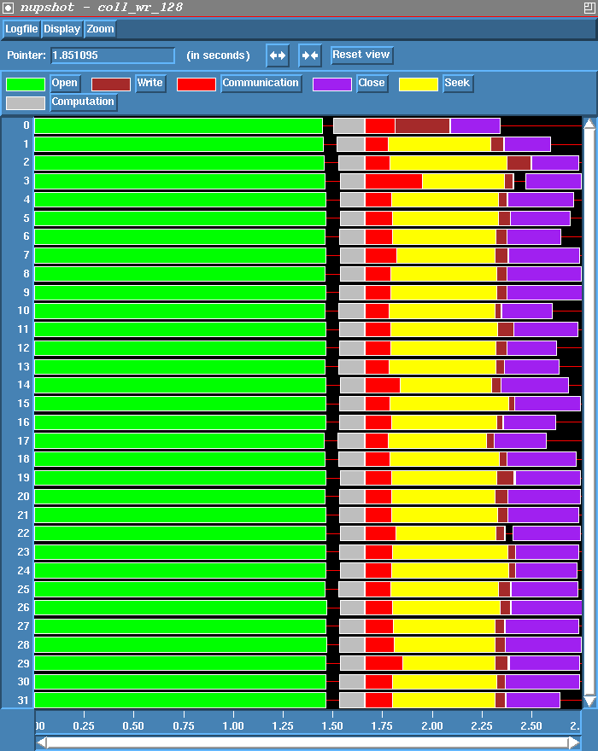
Collective Write
On Paragon
Computation and communication precede seek and write
Time shown =
2.75 seconds

Slide 98
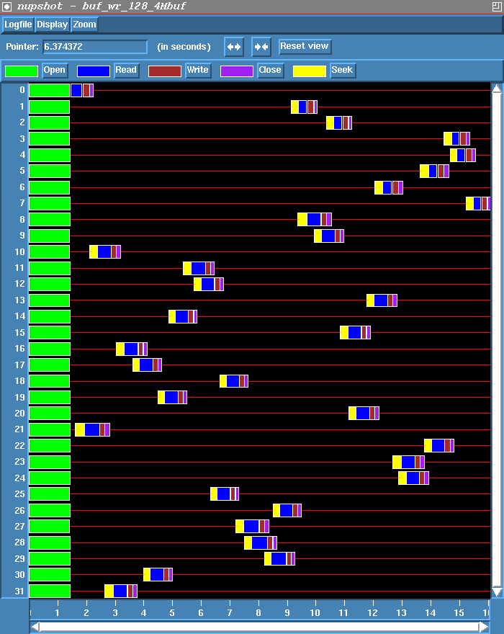
Independent Writes with
Data Sieving
On Paragon
Access data in large “blocks” and extract needed data
Requires lock, read, modify, write, unlock for writes
4 MB blocks
Time = 16 sec.

Slide 99
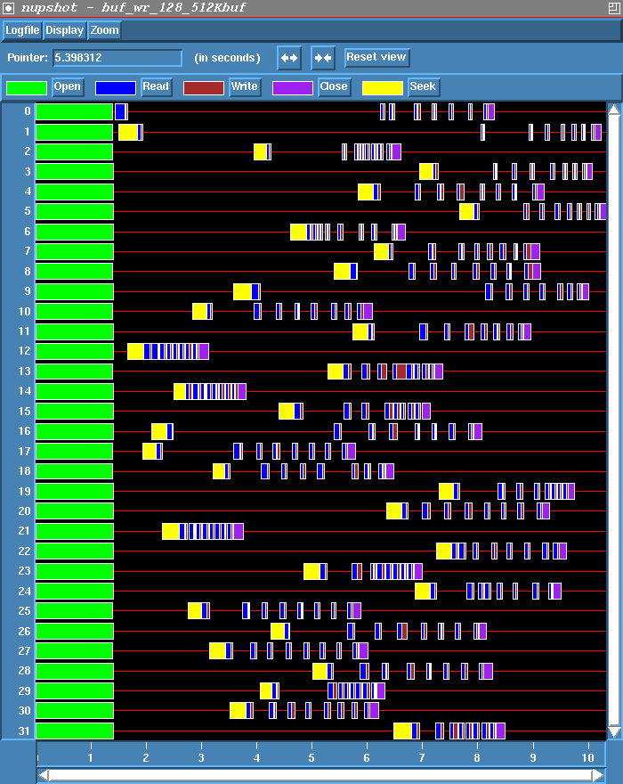
Changing the Block Size
Smaller blocks mean less contention, therefore more parallelism
512 KB blocks
Time = 10.2 seconds

Slide 100
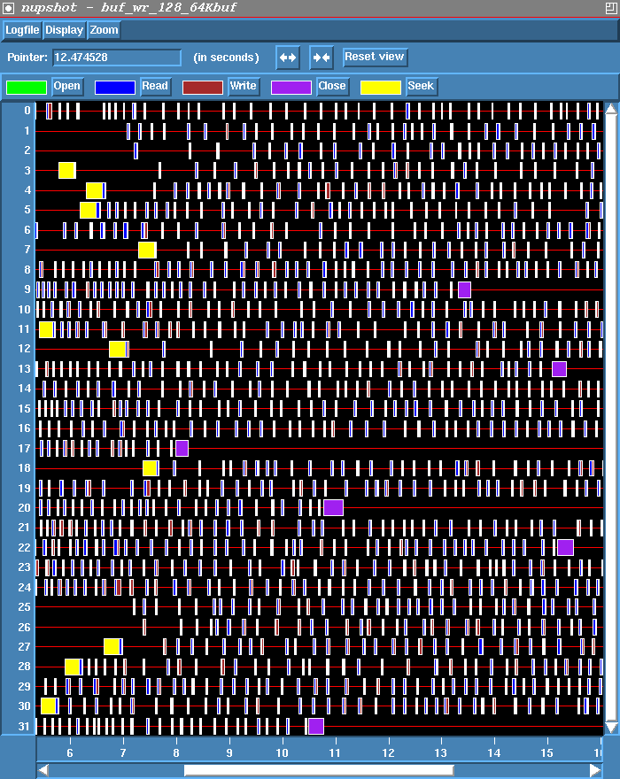
Data Sieving with Small Blocks
If the block size is too small, however, the increased parallelism doesn’t make up for the many small writes
64 KB blocks
Time = 21.5 seconds

Slide 101
File Interoperability
Users can optionally create files with a portable binary data representation
“datarep” parameter to MPI_File_set_view
native - default, same as in memory, not portable
internal - impl. defined representation providing an impl. defined level of portability
external32 - a specific representation defined in MPI, (basically 32-bit big-endian IEEE format), portable across machines and MPI implementations

Slide 102
Common Errors
Not defining file offsets as MPI_Offset in C and integer (kind=MPI_OFFSET_KIND) in Fortran (or perhaps integer*8 in Fortran 77)
In Fortran, passing the offset or displacement directly as a constant (e.g., 0) in the absence of function prototypes (F90 mpi module)
Using darray datatype for a block distribution other than the one defined in darray (e.g., floor division)
filetype defined using offsets that are not monotonically nondecreasing, e.g., 0, 3, 8, 4, 6. (happens in irregular applications)

Slide 103
I/O Consistency Semantics
The consistency semantics specify the results when multiple processes access a common file and one or more processes write to the file
MPI guarantees stronger consistency semantics if the communicator used to open the file accurately specifies all the processes that are accessing the file, and weaker semantics if not
The user can take steps to ensure consistency when MPI does not automatically do so

Slide 104
Example 1
File opened with MPI_COMM_WORLD. Each process writes to a separate region of the file and reads back only what it wrote.
Process 0
Process 1
MPI_File_open(MPI_COMM_WORLD,…)
MPI_File_write_at(off=0,cnt=100)
MPI_File_read_at(off=0,cnt=100)
MPI_File_open(MPI_COMM_WORLD,…)
MPI_File_write_at(off=100,cnt=100)
MPI_File_read_at(off=100,cnt=100)
MPI guarantees that the data will be read correctly

Slide 105
Example 2
Same as example 1, except that each process wants to read what the other process wrote (overlapping accesses)
In this case, MPI does not guarantee that the data will automatically be read correctly
Process 0
Process 1
/* incorrect program */
MPI_File_open(MPI_COMM_WORLD,…)
MPI_File_write_at(off=0,cnt=100)
MPI_Barrier
MPI_File_read_at(off=100,cnt=100)
/* incorrect program */
MPI_File_open(MPI_COMM_WORLD,…)
MPI_File_write_at(off=100,cnt=100)
MPI_Barrier
MPI_File_read_at(off=0,cnt=100)
In the above program, the read on each process is not guaranteed to get the data written by the other process!

Slide 106
Example 2 contd.
The user must take extra steps to ensure correctness
There are three choices:
  set atomicity to true
  close the file and reopen it
  ensure that no write sequence on any process is concurrent with any sequence (read or write) on another process

Slide 107
Example 2, Option 1
Set atomicity to true
Process 0
Process 1
MPI_File_open(MPI_COMM_WORLD,…)
MPI_File_set_atomicity(fh1,1)
MPI_File_write_at(off=0,cnt=100)
MPI_Barrier
MPI_File_read_at(off=100,cnt=100)
MPI_File_open(MPI_COMM_WORLD,…)
MPI_File_set_atomicity(fh2,1)
MPI_File_write_at(off=100,cnt=100)
MPI_Barrier
MPI_File_read_at(off=0,cnt=100)

Slide 108
Example 2, Option 2
Close and reopen file
Process 0
Process 1
MPI_File_open(MPI_COMM_WORLD,…)
MPI_File_write_at(off=0,cnt=100)
MPI_File_close
MPI_Barrier
MPI_File_open(MPI_COMM_WORLD,…)
MPI_File_read_at(off=100,cnt=100)
MPI_File_open(MPI_COMM_WORLD,…)
MPI_File_write_at(off=100,cnt=100)
MPI_File_close
MPI_Barrier
MPI_File_open(MPI_COMM_WORLD,…)
MPI_File_read_at(off=0,cnt=100)

Slide 109
Example 2, Option 3
Ensure that no write sequence on any process is concurrent with any sequence (read or write) on another process
a sequence is a set of operations between any pair of open, close, or file_sync functions
a write sequence is a sequence in which any of the functions is a write operation

Slide 110
Example 2, Option 3
Process 0
Process 1
MPI_File_open(MPI_COMM_WORLD,…)
MPI_File_write_at(off=0,cnt=100)
MPI_File_sync
MPI_Barrier
MPI_File_sync /*collective*/
MPI_File_sync /*collective*/
MPI_Barrier
MPI_File_sync
MPI_File_read_at(off=100,cnt=100)
MPI_File_close
MPI_File_open(MPI_COMM_WORLD,…)
MPI_File_sync /*collective*/
MPI_Barrier
MPI_File_sync
MPI_File_write_at(off=100,cnt=100)
MPI_File_sync
MPI_Barrier
MPI_File_sync /*collective*/
MPI_File_read_at(off=0,cnt=100)
MPI_File_close

Slide 111
Example 3
Same as Example 2, except that each process uses MPI_COMM_SELF when opening the common file
The only way to achieve consistency in this case is to ensure that no write sequence on any process is concurrent with any write sequence on any other process.

Slide 112
Example 3
Process 0
Process 1
MPI_File_open(MPI_COMM_SELF,…)
MPI_File_write_at(off=0,cnt=100)
MPI_File_sync
MPI_Barrier
MPI_Barrier
MPI_File_sync
MPI_File_read_at(off=100,cnt=100)
MPI_File_close
MPI_File_open(MPI_COMM_SELF,…)
MPI_Barrier
MPI_File_sync
MPI_File_write_at(off=100,cnt=100)
MPI_File_sync
MPI_Barrier
MPI_File_read_at(off=0,cnt=100)
MPI_File_close

Slide 113
Summary
MPI-IO has many features that can help users achieve high performance
The most important of these features are the ability to specify noncontiguous accesses, the collective I/O functions, and the ability to pass hints to the implementation
Users must use the above features!
In particular, when accesses are noncontiguous, users must create derived datatypes, define file views, and use the collective I/O functions

Slide 114
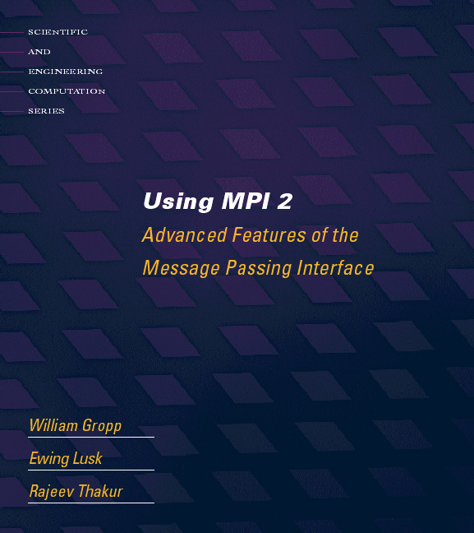

Tutorial Material
http://www.mcs.anl.gov/mpi/usingmpi2

Slide 115
Example Programs
On DataStar, look in the directory ~ux454174/mpi-io-examples

Slide 116
Tuning Application I/O (1)
Have realistic goals:
  What is the peak I/O rate?
  What other testing has been done?
Describe as much as possible to the I/O system:
  Open with appropriate mode
  Use collective calls when available
  Describe data movement with fewest possible operations
Match file organization to process partitioning if possible
  Order dimensions so relatively large blocks are contiguous with respect to data decomposition

Slide 117
Tuning Application I/O (2)
Know what you can control:
  What I/O components are in use?
  What hints are accepted?
Consider system architecture as a whole:
  Is storage network faster than comm. network?
  Do some nodes have better storage access than others?
These guide our selection of hints

Slide 118
Controlling I/O Stack Behavior
Most systems accept hints through one mechanism or another
  Parameters to file “ open” calls
  Proprietary POSIX ioctl calls
  MPI_Info
  HDF5 transfer templates
These allow the programmer to:
  Explain more about the I/O pattern
  Specify particular optimizations
  Impose resource limitations
Generally pass information that is used only during a particular set of accesses (between open and close, for example)

Slide 119
Helping I/O Experts Help You
Scenarios
  Explaining logically what you are doing
  Separate the conceptual structures from their representation on storage
  Common vs. infrequent patterns
  Possible consistency management simplifications
Application I/O kernels
  Simple codes exhibiting similar I/O behavior
  Easier for I/O group to work with
  Useful for acceptance testing!
  Needs to be pretty close to the real thing...

Slide 120
THE END

