Slide 1
前两次作业汇总
张涛
2013.4.17

Slide 2
第一次作业
critical：通过临界区机制来完成并行的；
locked：是通过锁机制完成的并行；
reduction：是通过规约操作完成的并行；
atomic：是通过原子操作完成的并行；
no_wait：是通过重新划分循环，使用no_wait子句完成的并行；
manual：是通过手动解决数据竞争问题来完成的并行

Slide 3
第二次作业
问题
报告中没有测试方案的内容，无法判断测试正确与否；
只测试一次，波动较大；
相同CPU内，相同节点不同CPU的测试方案错误；
程序写错，如调用两次sendrecv，pingping在Isend后加wait；
大规模测试没有用bsub

Slide 4
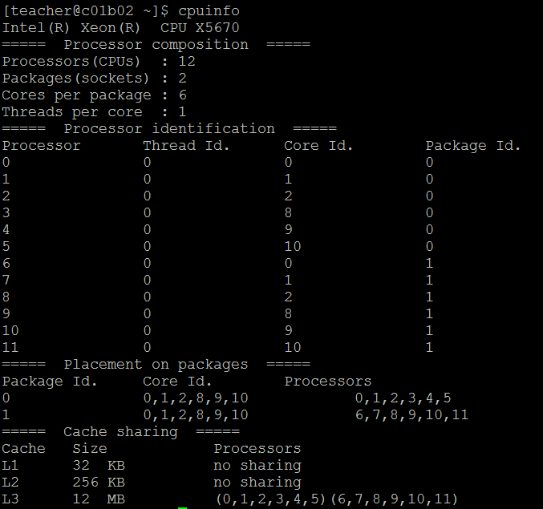
测试方案
同一CPU内测试
mpiexec I_MPI_PIN_PROCESSOR_LIST 0,1 -n 2 ./exe
相同节点不同CPU测试
mpiexec I_MPI_PIN_PROCESSOR_LIST 0,11 -n 2 ./exe
不同节点测试
mpiexec -n 1 -host c01b02 ./exe : -n 1 -host c01b03 ./exe
bsub -a intelmpi -R "span[ptile=1]" -q short -o output -n 2
mpirun.lsf ./exe

Slide 5
pingpong
MPI_Barrier(c_info->communicator);
t1 = MPI_Wtime();
for(i=0;i<ITERATIONS->n_sample;i++)
{
ierr = MPI_Send((char*)c_info->s_buffer+i%ITERATIONS->s_cache_iter*ITERATIONS->s_offs,
s_num,c_info->s_data_type,dest,
s_tag,c_info->communicator);
MPI_ERRHAND(ierr)
ierr = MPI_Recv((char*)c_info->r_buffer+i%ITERATIONS->r_cache_iter*ITERATIONS->r_offs,
r_num,c_info->r_data_type,source,
r_tag,c_info->communicator,&stat);
MPI_ERRHAND(ierr);
} /*for*/
t2 = MPI_Wtime();
*time=(t2 - t1)/ITERATIONS->n_sample;

Slide 6
pingping
MPI_Barrier(c_info->communicator);
t1 = MPI_Wtime();
for(i=0;i< ITERATIONS->n_sample;i++)
{
ierr= MPI_Isend((char*)c_info->s_buffer+i%ITERATIONS->s_cache_iter*ITERATIONS->s_offs,
s_num,c_info->s_data_type,dest,s_tag,c_info->communicator,&request);
MPI_ERRHAND(ierr);
ierr = MPI_Recv((char*)c_info->r_buffer+i%ITERATIONS->r_cache_iter*ITERATIONS->r_offs,
r_num,c_info->r_data_type,source,r_tag,c_info->communicator,&stat);
MPI_ERRHAND(ierr);
ierr = MPI_Wait(&request, &stat);
MPI_ERRHAND(ierr);
}
t2 = MPI_Wtime();
*time=(t2 - t1)/ITERATIONS->n_sample;

Slide 7
sendrecv
MPI_Barrier(c_info->communicator);
t1 = MPI_Wtime();
for(i=0;i< ITERATIONS->n_sample;i++)
{
ierr= MPI_Sendrecv((char*)c_info->s_buffer+i%ITERATIONS->s_cache_iter*ITERATIONS->s_offs,
s_num,c_info->s_data_type, dest,s_tag,
(char*)c_info->r_buffer+i%ITERATIONS->r_cache_iter*ITERATIONS->r_offs,
r_num,c_info->r_data_type,source,r_tag,c_info->communicator,&stat);
MPI_ERRHAND(ierr);
}
t2 = MPI_Wtime();
*time=(t2 - t1)/ITERATIONS->n_sample;

Slide 8
Exchange
MPI_Barrier(c_info->communicator);
t1 = MPI_Wtime();
for(i=0; i< ITERATIONS->n_sample; i++)
{
ierr= MPI_Isend((char*)c_info->s_buffer+i%ITERATIONS->s_cache_iter*ITERATIONS->s_offs,
s_num,c_info->s_data_type,right,s_tag,c_info->communicator,&request[0]);
MPI_ERRHAND(ierr);
ierr= MPI_Isend((char*)c_info->s_buffer+size+i%ITERATIONS->s_cache_iter*ITERATIONS->s_offs,
s_num,c_info->s_data_type,left ,s_tag,c_info->communicator,&request[1]);
MPI_ERRHAND(ierr);
ierr= MPI_Recv( (char*)c_info->r_buffer+i%ITERATIONS->r_cache_iter*ITERATIONS->r_offs,
r_num,c_info->r_data_type,left ,r_tag,c_info->communicator,stat);
MPI_ERRHAND(ierr);
ierr= MPI_Recv( (char*)c_info->r_buffer+i%ITERATIONS->r_cache_iter*ITERATIONS->r_offs,
r_num,c_info->r_data_type,right,r_tag,c_info->communicator,stat);
MPI_ERRHAND(ierr);
ierr= MPI_Waitall(2,request,stat);
MPI_ERRHAND(ierr);
}
t2 = MPI_Wtime();
*time=(t2 - t1)/ITERATIONS->n_sample;

