Slide 1
Forecasting induced seismicity in Oklahoma
Using statistical methods to find the factors that contribute to anthropogenic earthquakes

Slide 2
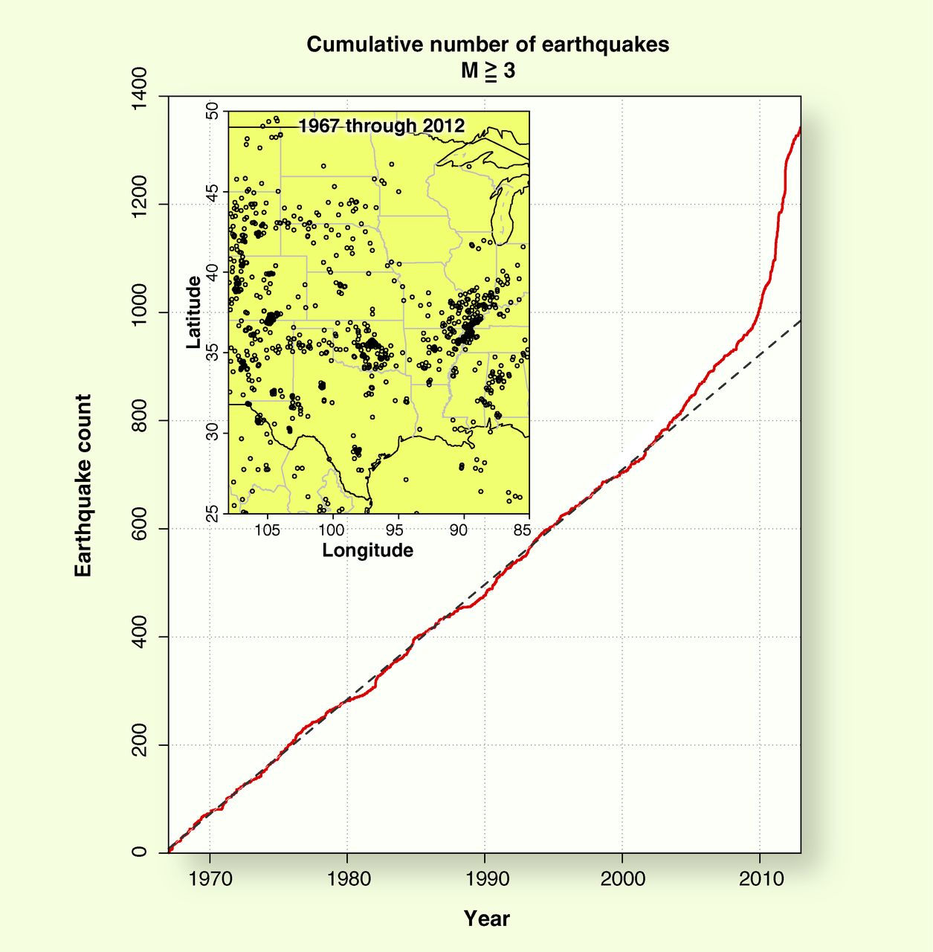
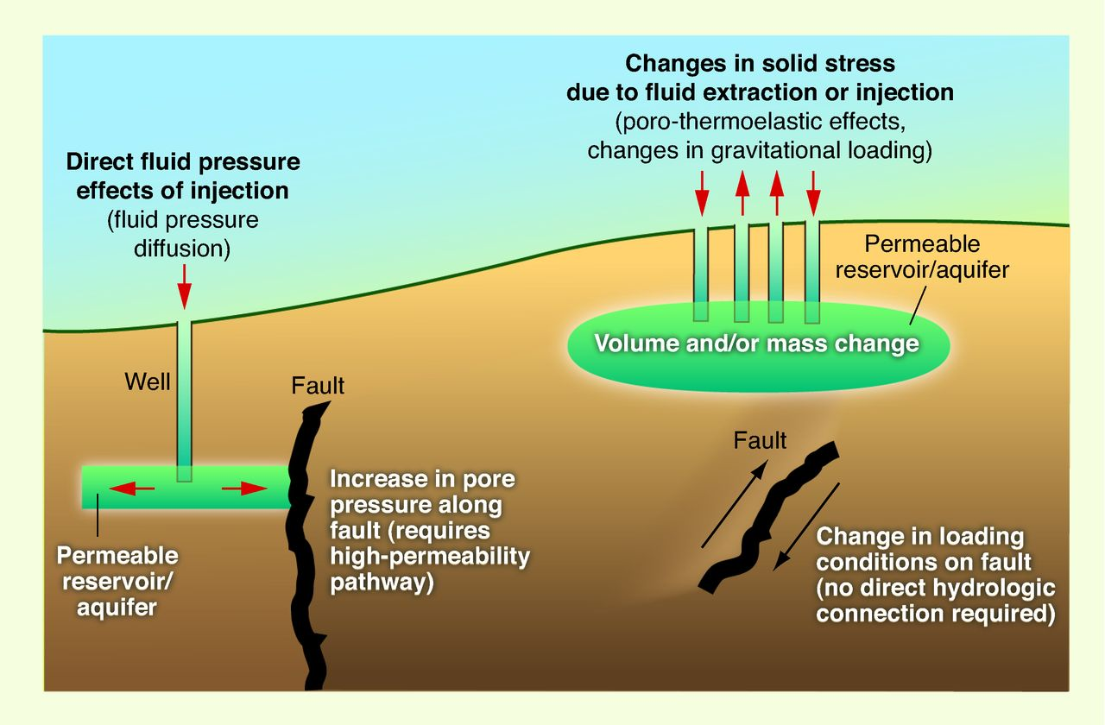
Background
Large increase in seismicity in Oklahoma since 2010. Believed to be related to fluid injection increasing stress on pre-existing geological faults.
Ellsworth. Science 12 Jul 2013: Vol. 341, Issue 6142, 1225942 DOI: 10.1126/science.1225942
Although a causal relationship between fluid injection and earthquakes is established, it is still not known why some areas are more susceptible to induced earthquakes. Answering this question requires a big-data, statistical approach. This is your job in this project!

Slide 3
Getting started
Recommended to use Python. Jupyter Notebooks are a great way to start!
Read in data using Pandas.
Plot all the well locations on a map to find the spatial extent of your data.
Convert geographic coordinates (“Surface Latitude”; ”Surface Longitude”) to projected coordinate reference system – e.g. UTM. Use e.g. geopandas.
Focus on injections to start with.
Resolution -> What is the dependency on grid spacing used?
Time dependence.

Slide 4
Well and Production data
Well data contains metadata for all wells in the area of interest
Production data contains annual and monthly fluid extraction and injection volumes.
Spatial extent:
You may want to start investigating water injection volumes/rates since that is believed to be a major contributor to seismicity in Oklahoma.
If things are progressing well, you can look at a larger dataset later in the project, if you like.

Slide 5
Earthquake catalogue
From Oklahoma geological survey http://www.ou.edu/ogs/research/earthquakes.
Reference: Walter, J. I., P. Ogwari, A. Thiel, F. Ferrer, I. Woelfel, J. C. Chang, A. P. Darold, and A. A. Holland (2020), The Oklahoma Geological Survey Statewide Seismic Network, Seismol. Res. Lett., 91 (2A): 611–621, doi:10.1785/0220190211.
Magnitude > 2 earthquakes

Slide 6
Potential parameters to investigate correlations with earthquake activity(研究与地震活动相关性的潜在参数)
Injection volume
Well depth
Geological formation being injected into.
Suggested examples:
Correlate earthquake occurrence within a given area with injection volume
Correlate maximum earthquake magnitude within a given area with injection volume
Correlate earthquake rate (seismic moment rate) within a given area with injection volume

Slide 7
Suggested approaches to start
Logistic regression
Linear regression
But, always good to look at parameter correlations / collinearity before trying lots of unsupervised methods!

