Slide 1
MODE COLLAPSE UNDER GRPO
When eight samples
become eight copies
1
2
3
4
5
6
7
8
Measuring—and retaining—verified outcome support in binary-reward RL
8 nominal attempts
1 mode
THESIS Correctness can rise while useful proposal support collapses.
ModeBench + ReplayDr.GRPO
Anonymous Authors
Notes:
Source: Paper abstract and Figure 1

Slide 2
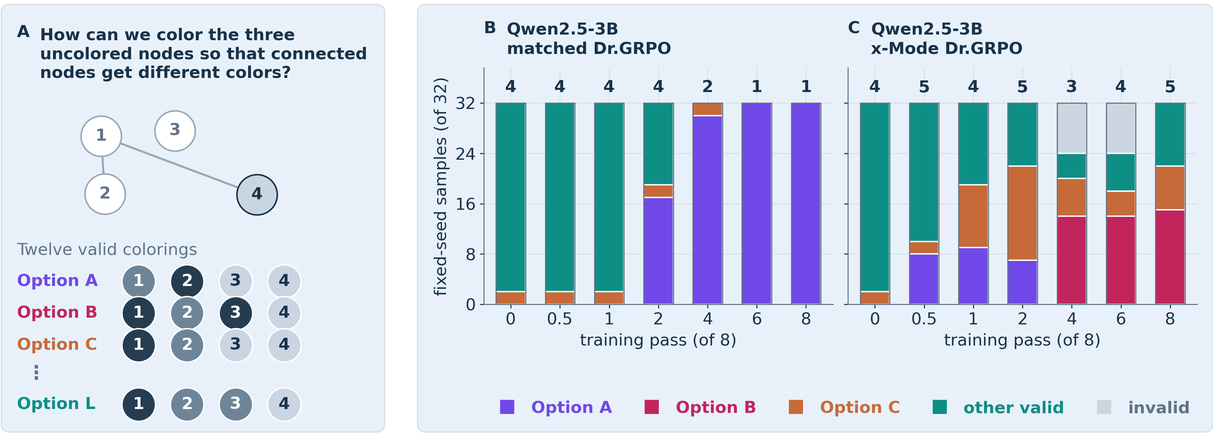
MODE COLLAPSE UNDER GRPO
02
Accuracy can look perfect while support disappears
A mechanically selected Qwen2.5-3B Graph Coloring pair: both arms remain 32/32 correct.
Matched Dr.GRPO: 4 → 1 observed modes ReplayDr.GRPO: 4 → 5 observed modes
Source: paper Figure 1 · fixed-seed illustration; registered paired estimates follow later
Notes:
Source: paper/figures/modecollapse_story.png

Slide 3
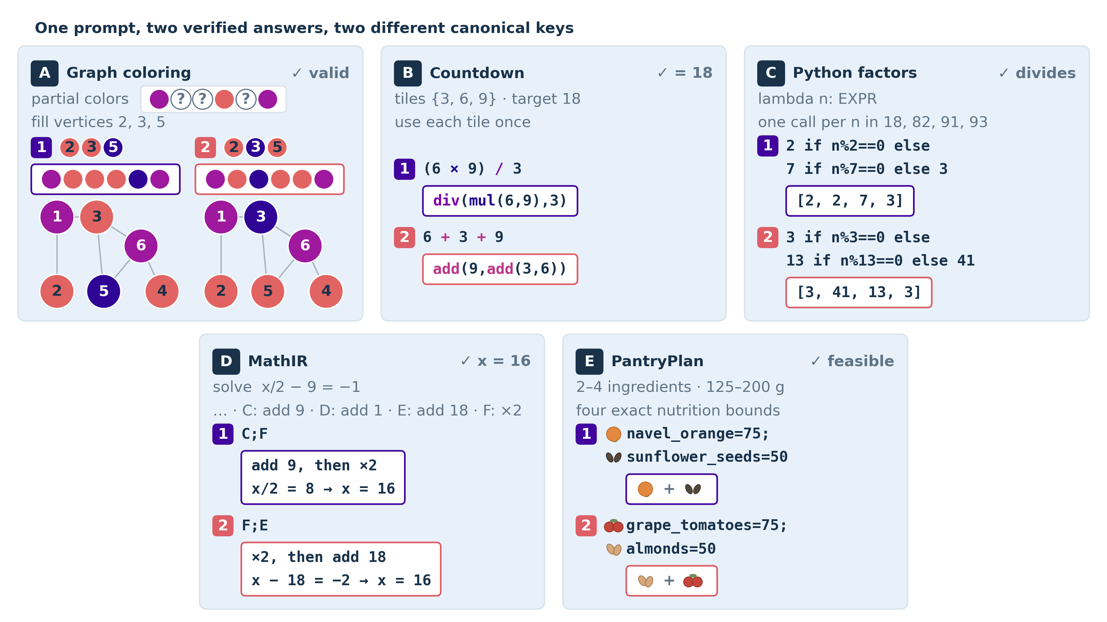
MODE COLLAPSE UNDER GRPO
03
Binary correctness hides answer identity
ModeBench executes each answer twice: once for validity, once for a canonical outcome key.
Two metrics,
two questions
pass@8
Did any sample
succeed?
distinct@8
How many different
verified outcomes?
Token entropy cannot answer the second question.
Source: paper Figure 2 · execution-defined keys; no text clustering or gold mode catalogue
Notes:
Source: paper/figures/modebench_examples.png

Slide 4
MODE COLLAPSE UNDER GRPO
04
Why GRPO concentrates correct modes
Equal binary reward does not imply equal learning pressure across correct outcomes.
ON-POLICY BINARY REWARD
RECURRENT VERIFIED REPLAY
Sampled winners get reinforced
Every banked mode keeps a gradient
A
B
C
A
B
C
A
A
B
C
A correct mode absent from the sampled group receives no update.
Post-discovery guarantee: recurrent positive replay prevents banked-mode extinction.
Theory boundary: fixed-bank categorical assumptions; protects discovered, verified, retained modes only
Notes:
Source: Paper Section 2 and Appendix A

Slide 5
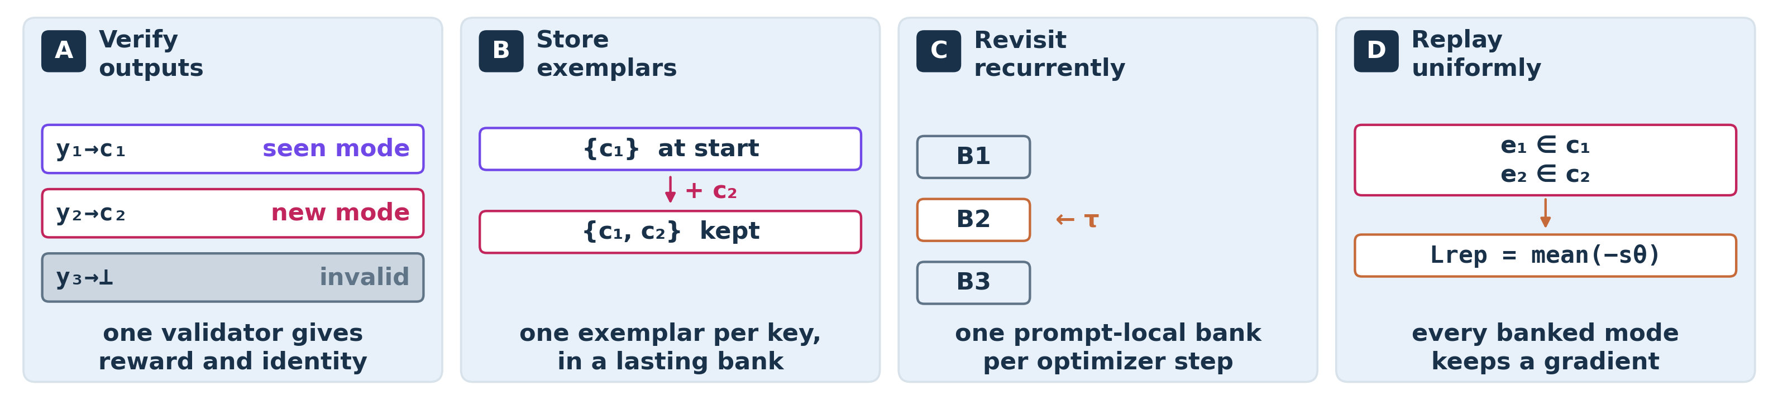
MODE COLLAPSE UNDER GRPO
05
Replay adds one operation: revisit every discovered mode
One policy-generated, validator-positive exemplar per canonical key; uniform teacher-forced likelihood.
Matched control: same bank maintenance, traversal, scoring, and backward pass | intervention: replay derivative 0 → λ = .10
No unseen-mode oracle. No gold catalogue. No cross-prompt mode matching.
Source: method figure and clean comparison contract in paper/README.md
Notes:
Source: paper/figures/verified_replay_mechanism.png

Slide 6
MODE COLLAPSE UNDER GRPO
06
The clean test is a 3 × 5 × 5 paired design
No model or domain pooling; every headline estimate is a within-seed matched comparison.
3
5 executable domains
5 paired seeds
models
Graph
1
2
3
Qwen2.5-0.5B
×
Countdown
×
4
5
Falcon3-1B
Python
MathIR
75
Qwen2.5-3B
Pantry
paired terminal comparisons
Same prompts · data · bank maintenance · schedule · evaluation | Only the replay gradient changes
Design: 3 model rows × 5 domains × 5 registered seeds; terminal pass 8
Notes:
Source: paper/results/core_terminal_endpoints.json and cross-scale endpoint JSON

Slide 7
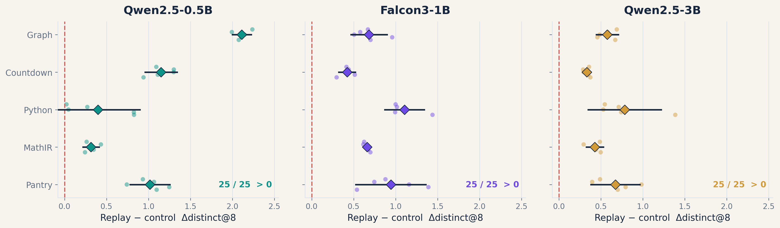
MODE COLLAPSE UNDER GRPO
07
Replay raises verified breadth in all 75 / 75 paired runs
Raw terminal distinct@8 is higher for every paired seed at every model scale.
Source: cross_scale_terminal_endpoint_effects.json · no domain pooling; paired n=5 within each cell
Notes:
Source: paper/figures/cross_scale_terminal_endpoint_effects.json

Slide 8
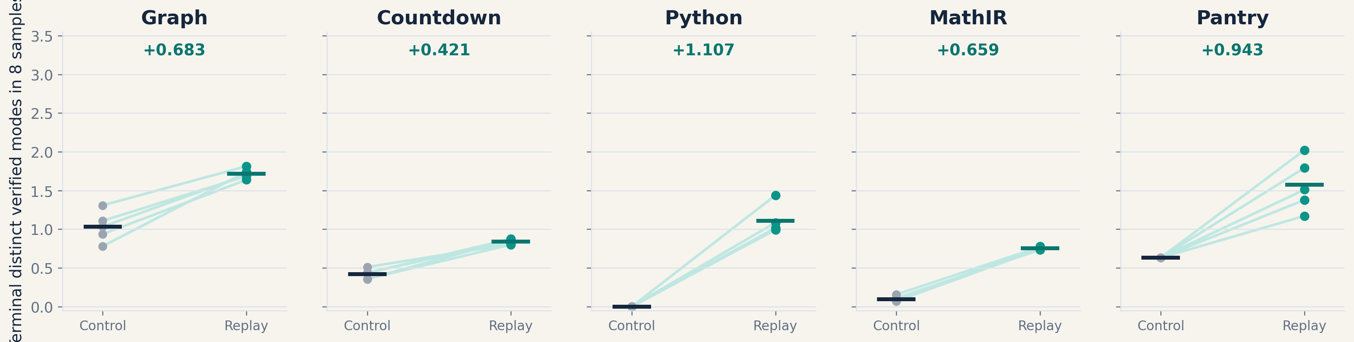
MODE COLLAPSE UNDER GRPO
08
The Falcon replication makes the effect concrete
A second model family; five domains; every paired seed moves upward.
Falcon3-1B terminal pass 8 · mean raw gains: +.683, +.421, +1.107, +.659, +.943
Notes:
Source: paper/figures/cross_scale_terminal_endpoint_effects.json

Slide 9
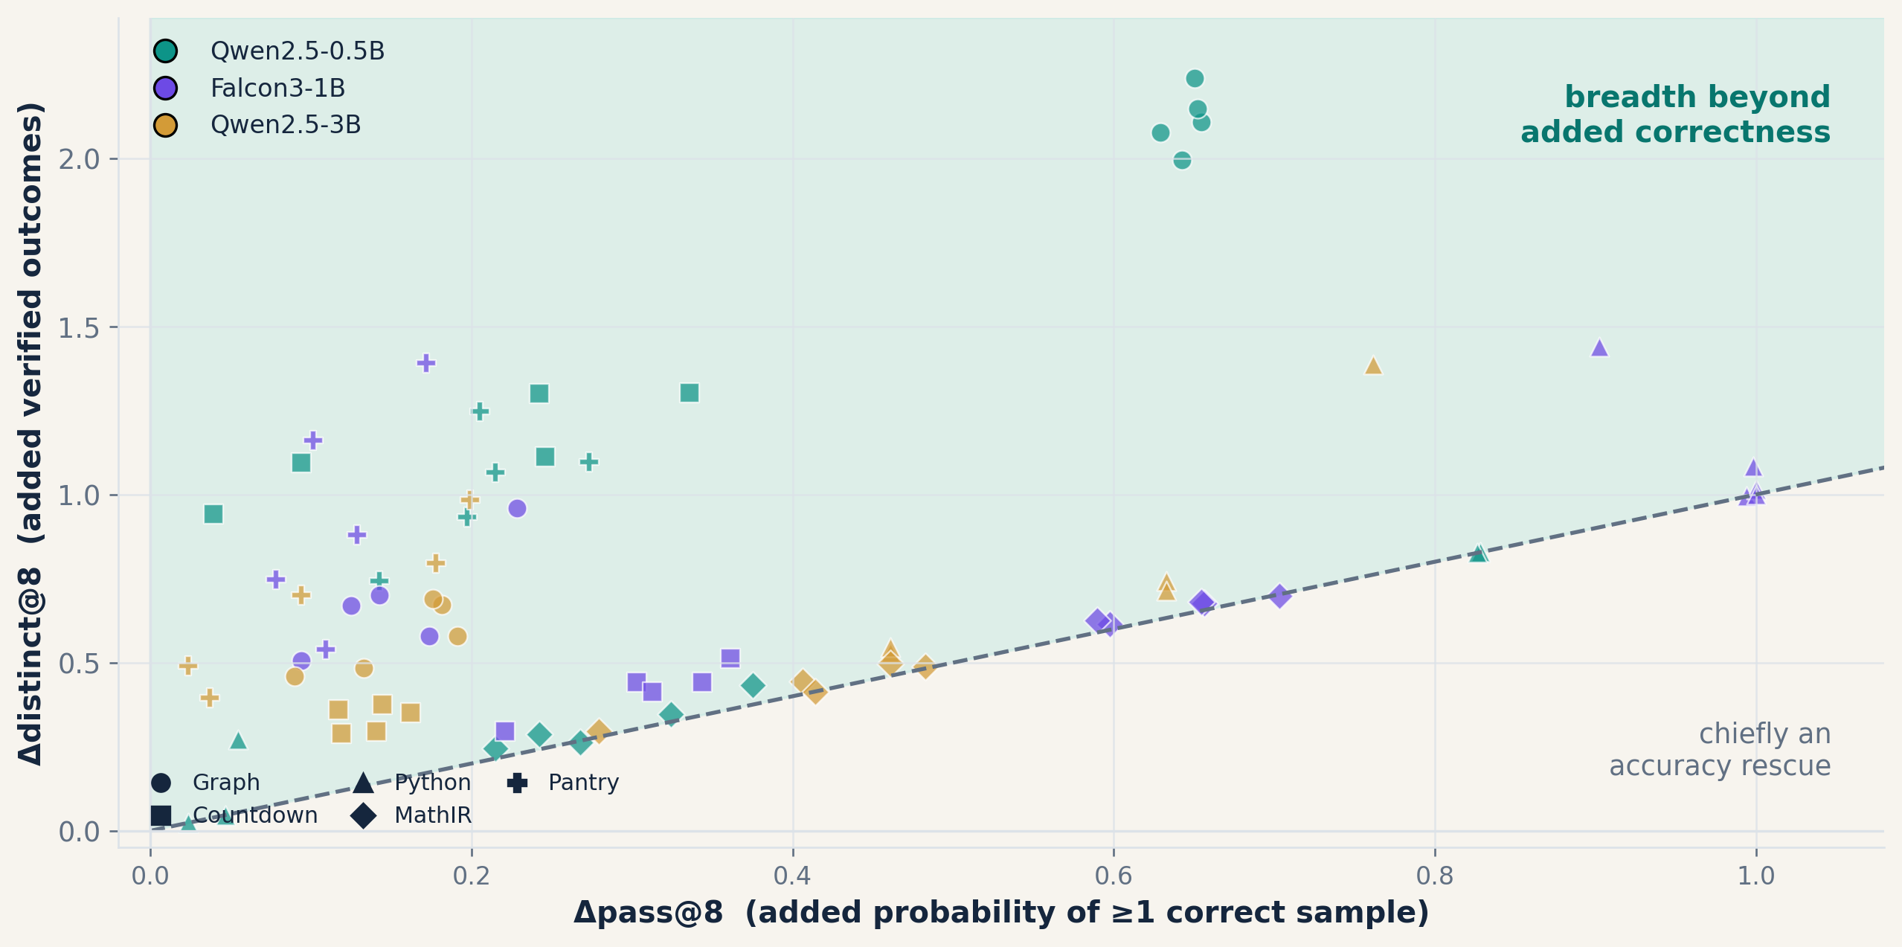
MODE COLLAPSE UNDER GRPO
09
Breadth gains can be accuracy rescues—or extra support
Distance above the diagonal is correctness-adjusted breadth: Δdistinct@8 − Δpass@8.
RAW RESULT
75 / 75
paired runs have
more distinct outcomes
CAUSAL BOUNDARY
pass@K depends on
per-draw correctness—
not how correct mass
is split across modes
Interpretation: support retention is the headline claim; downstream utility needs a secondary selector/task
Notes:
Source: paper/figures/cross_scale_terminal_endpoint_effects.json

Slide 10
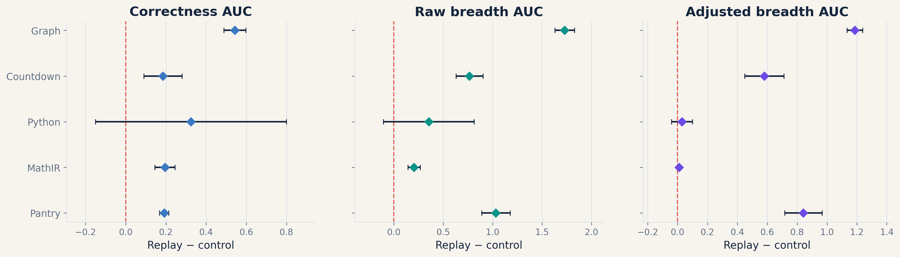
MODE COLLAPSE UNDER GRPO
10
The excess-breadth effect persists through training where it is present
Qwen2.5-0.5B full-trajectory normalized AUC; five paired seeds per domain.
Graph, Countdown, and Pantry adjusted-breadth AUC intervals exclude zero; Python and MathIR chiefly track accuracy rescue
Notes:
Source: paper/figures/sustained_auc_effects_qwen05b.json

Slide 11
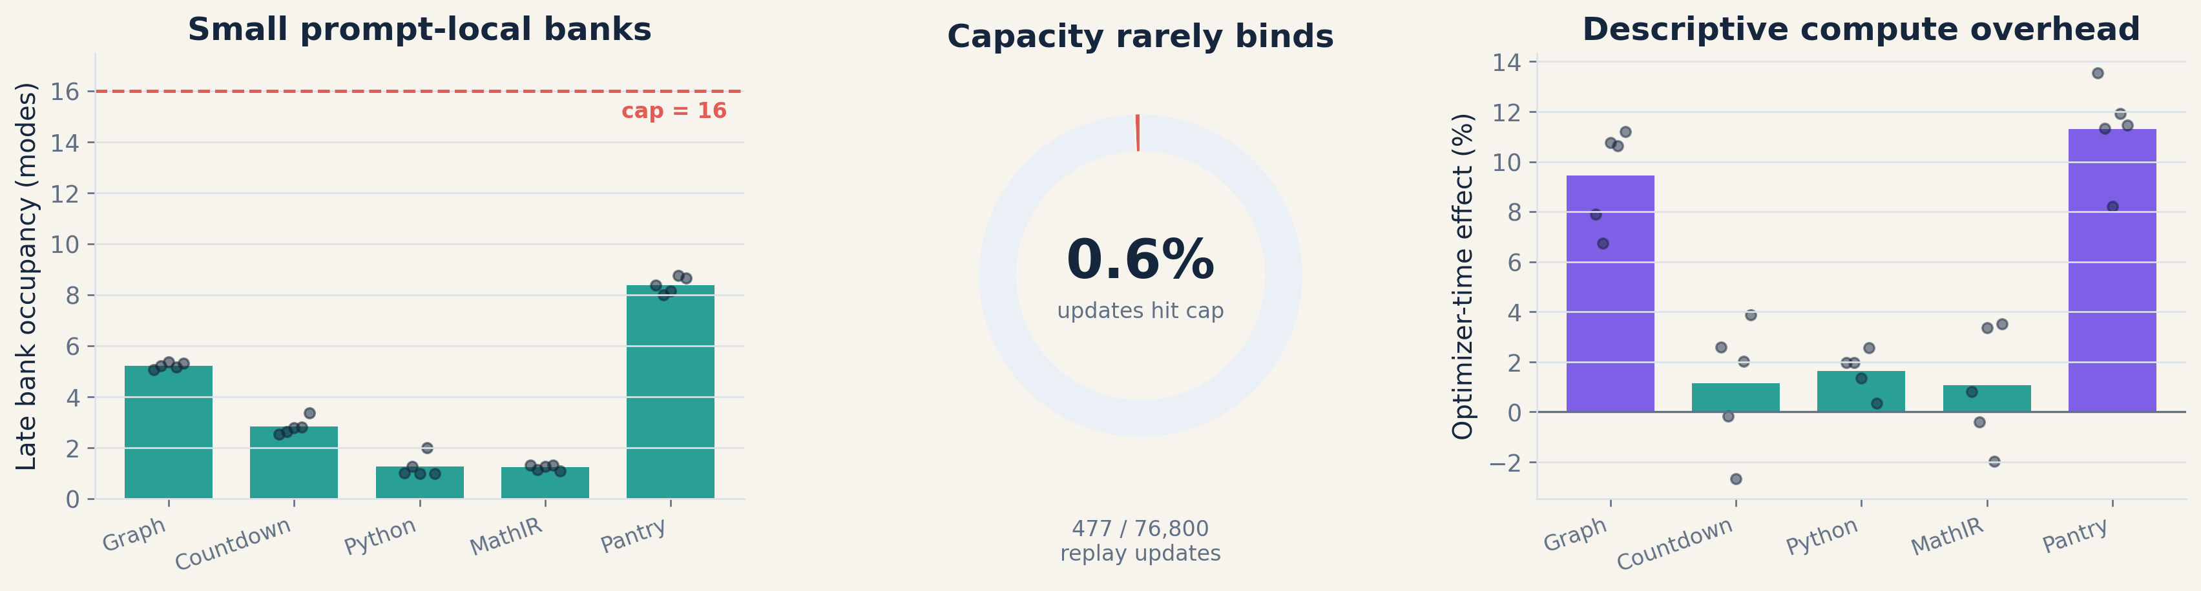
MODE COLLAPSE UNDER GRPO
11
The mechanism is small, recurrent, and measurable
The bank is not a giant offline corpus—it is prompt-local, validator-positive, and continuously revisited.
Qwen2.5-0.5B telemetry · 25 replay + 25 exact-zero control logs · timing is descriptive
Notes:
Source: paper/figures/replay_mechanism_telemetry_qwen05b.json

Slide 12
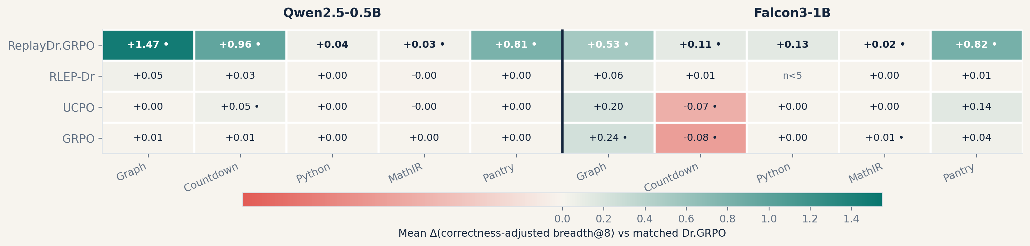
MODE COLLAPSE UNDER GRPO
12
Generic alternatives do not show uniform retention
Complete smaller-model correctness-adjusted breadth effects against the same matched Dr.GRPO baseline.
GRPO, UCPO, and RLEP-Dr are heterogeneous; RLEP-Dr Falcon Python is n=2 and omitted from the n=5 heatmap
Notes:
Source: paper/figures/direct_comparator_endpoint_effects.json

Slide 13
MODE COLLAPSE UNDER GRPO
13
The clean claim
A narrow, defensible result is more memorable than a catalogue of experiments.
ESTABLISHED
OPEN / NOT CLAIMED
● ModeBench measures execution-defined verified support.
● ReplayDr.GRPO protects discovered banked modes post-discovery.
● Replay is broader in all 75 / 75 primary paired runs.
● The evidence separates raw breadth, correctness, and excess breadth.
● No automatic utility gain: breadth needs a secondary selector.
● No unseen-mode recovery: replay protects only discovered modes.
● No broad natural-task claim: current tasks are synthetic exact-mode domains.
● No Semantic-MaxEnt efficacy claim: mechanism validation is separate.
Binary reward can solve the task—and still destroy the proposal set. Retain modes you may need later.
Bottom line: support retention—not pooled efficacy, model-size scaling, or downstream utility
Notes:
Source: Paper conclusion and evidence policy

