Slide 1
VERIFIED MODE SUPPORT IN RLVR
When eight samples
become eight copies
1
2
3
4
5
6
7
8
Measuring—and preserving—the support hidden by binary correctness
8 nominal attempts
1 mode
THESIS Correctness can rise while useful proposal support collapses.
Measure → Retain → Discover
Anonymous Authors
Notes:
Opening: Binary-reward RL can solve the task while silently erasing the set of solutions we may need at inference time.

Slide 2
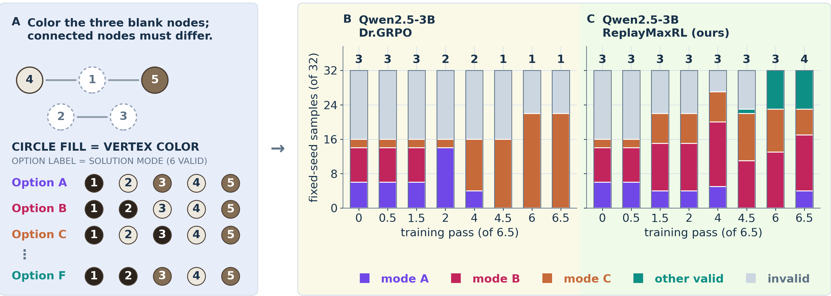
MODE COLLAPSE UNDER GRPO
02
Accuracy can look perfect while support disappears
A mechanically selected Qwen2.5-3B Graph Coloring pair: both arms remain 32 / 32 correct.
Matched Dr.GRPO: 4 → 1 observed modes ReplayDr.GRPO: 4 → 5 observed modes
Source: paper Figure 1 · fixed-seed illustration; registered paired estimates follow
Notes:
Say: Both terminal policies are 32/32 correct. Binary evaluation calls them equal; executed mode identity reveals that one collapsed to a single solution.

Slide 3
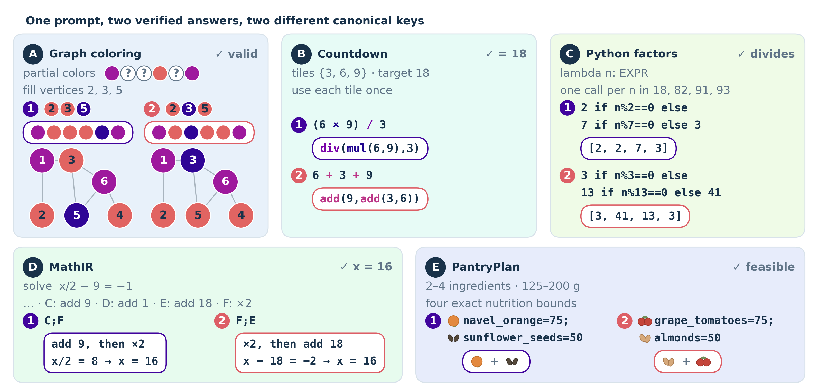
MODE COLLAPSE UNDER GRPO
03
Binary correctness hides answer identity
ModeBench uses the accepting execution to return a canonical outcome key.
Two metrics,
two questions
pass@8
Did any sample
succeed?
distinct@8
How many different
verified outcomes?
Token entropy cannot answer the second question.
Source: paper Figure 2 · execution-defined keys; no text clustering or gold mode catalogue
Notes:
Transition: To train against collapse, the evaluator must identify which successful execution occurred—not merely whether the answer passed.

Slide 4
MODE COLLAPSE UNDER GRPO
04
Why GRPO concentrates correct modes
Equal binary reward does not imply equal learning pressure across correct outcomes.
ON-POLICY BINARY REWARD
RECURRENT VERIFIED REPLAY
Sampled winners get reinforced
Every banked mode keeps a gradient
A
B
C
A
B
C
A
A
B
C
A correct mode absent from the sampled group receives no update.
Post-discovery guarantee: recurrent positive replay prevents banked-mode extinction.
Theory boundary: fixed-bank categorical assumptions; protects discovered, verified, retained modes only
Notes:
Say: Equal reward does not produce equal pressure. Frequent correct modes appear in more sampled updates; absent modes receive no gradient. Replay changes that asymmetry after discovery.

Slide 5
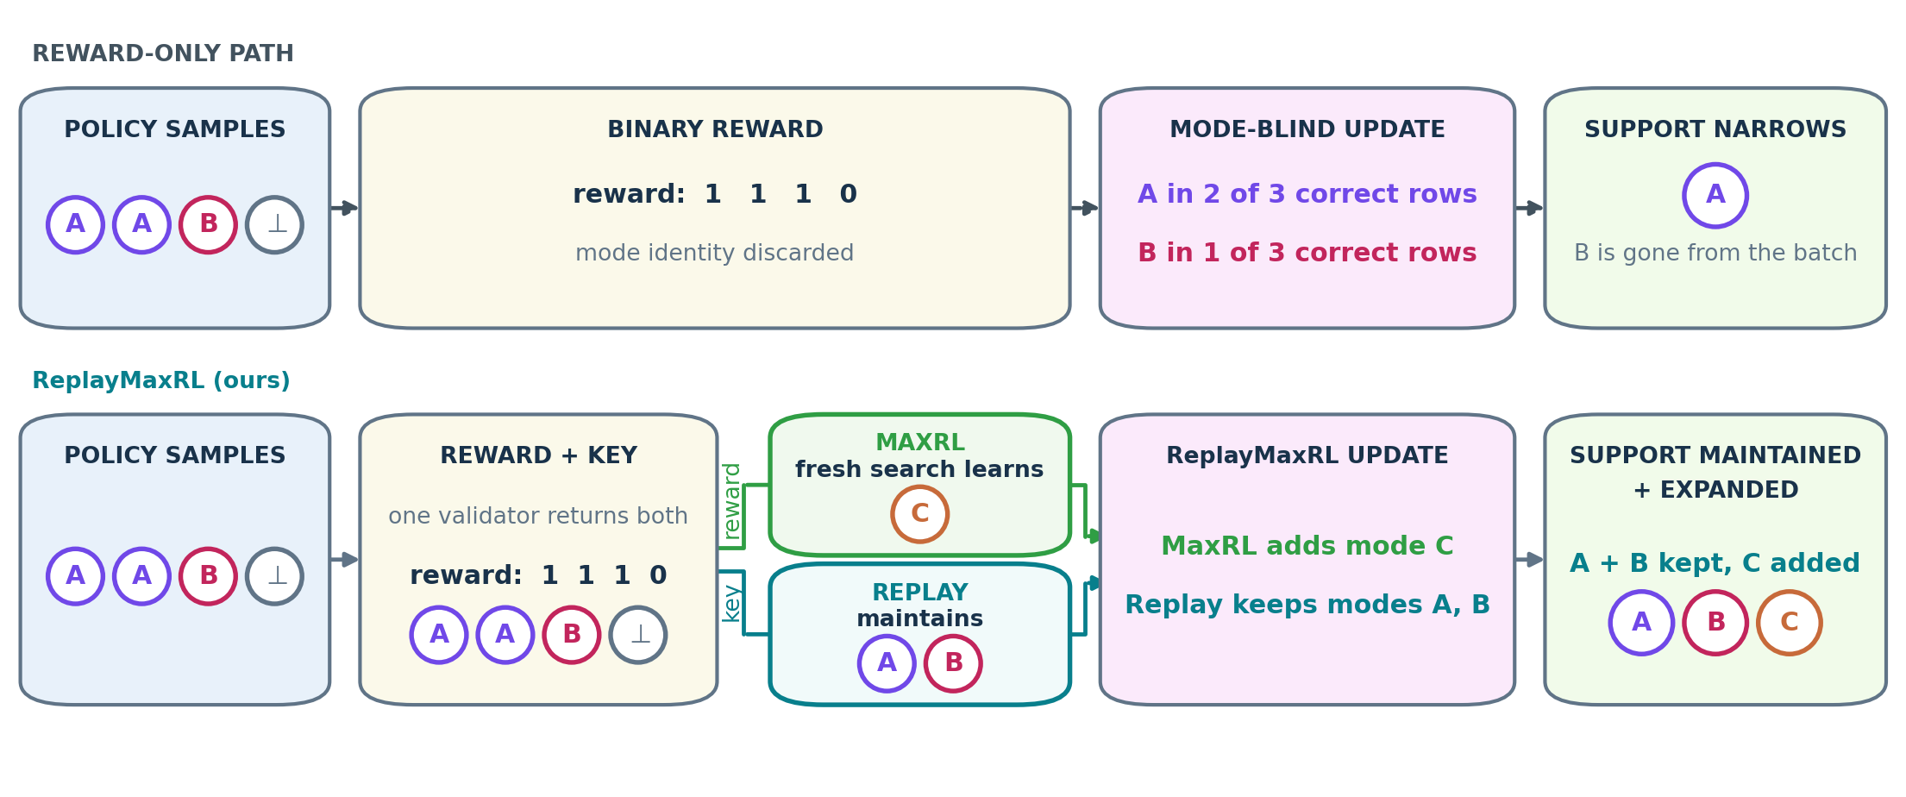
MODE COLLAPSE UNDER GRPO
05
One execution key repairs two different failures
Retain what the policy has found; add verified pressure toward what it still misses.
RETENTION one exemplar per key + uniform replay DISCOVERY verified proposals + bounded rarity credit
Both paths use validator-confirmed keys · no unseen-mode oracle or gold support catalogue
Notes:
Say: Retention and discovery are distinct bottlenecks. Replay revisits known keys uniformly; verified-support Semantic-MaxEnt creates bounded pressure toward rare validator-confirmed support.

Slide 6
MODE COLLAPSE UNDER GRPO
06
Two questions, two matched tests
The deck keeps the confirmatory retention result separate from the exploratory discovery extension.
RETENTION · CONFIRMATORY
74
3 models × 5 domains × 5 registered seeds
Does uniform mode replay preserve what was found?
admissible pairs
ReplayDr.GRPO − matched Dr.GRPO
14 complete blocks; Falcon Countdown n=4
DISCOVERY · EXPLORATORY BUNDLE
49
2 scales × 5 domains
Can verified discovery add support beyond replay?
matched endpoints
Semantic-MaxEnt + replay − replay
15 / 15 invariant-valid · 11 / 15 complete the full mechanism chain
Same prompts and paired initialization · report pass@8, distinct@8, and distinct@8 − pass@8 · no pooled inference
74 admissible retention pairs; Falcon Countdown seed59 excluded; discovery exploratory
Notes:
Say: The retention test is complete and confirmatory. The discovery test is a smaller exploratory bundled contrast. Keeping those evidential roles separate is central to the clean story.

Slide 7
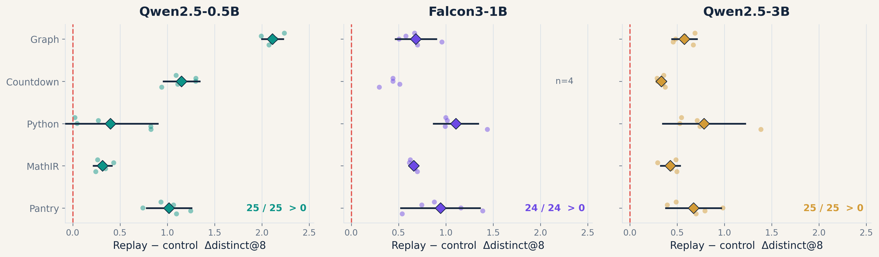
MODE COLLAPSE UNDER GRPO
07
Retention: 74 / 74 admissible pairs improve
Replay raises terminal distinct@8 for every paired seed at every model scale.
Source: audited core endpoints · 14 five-seed blocks with intervals; Falcon Countdown n=4, raw seeds only
Notes:
Say: This is the clean headline. Every paired seed at every scale and domain has more raw verified outcomes under replay than under the matched control. Do not pool across domains.

Slide 8
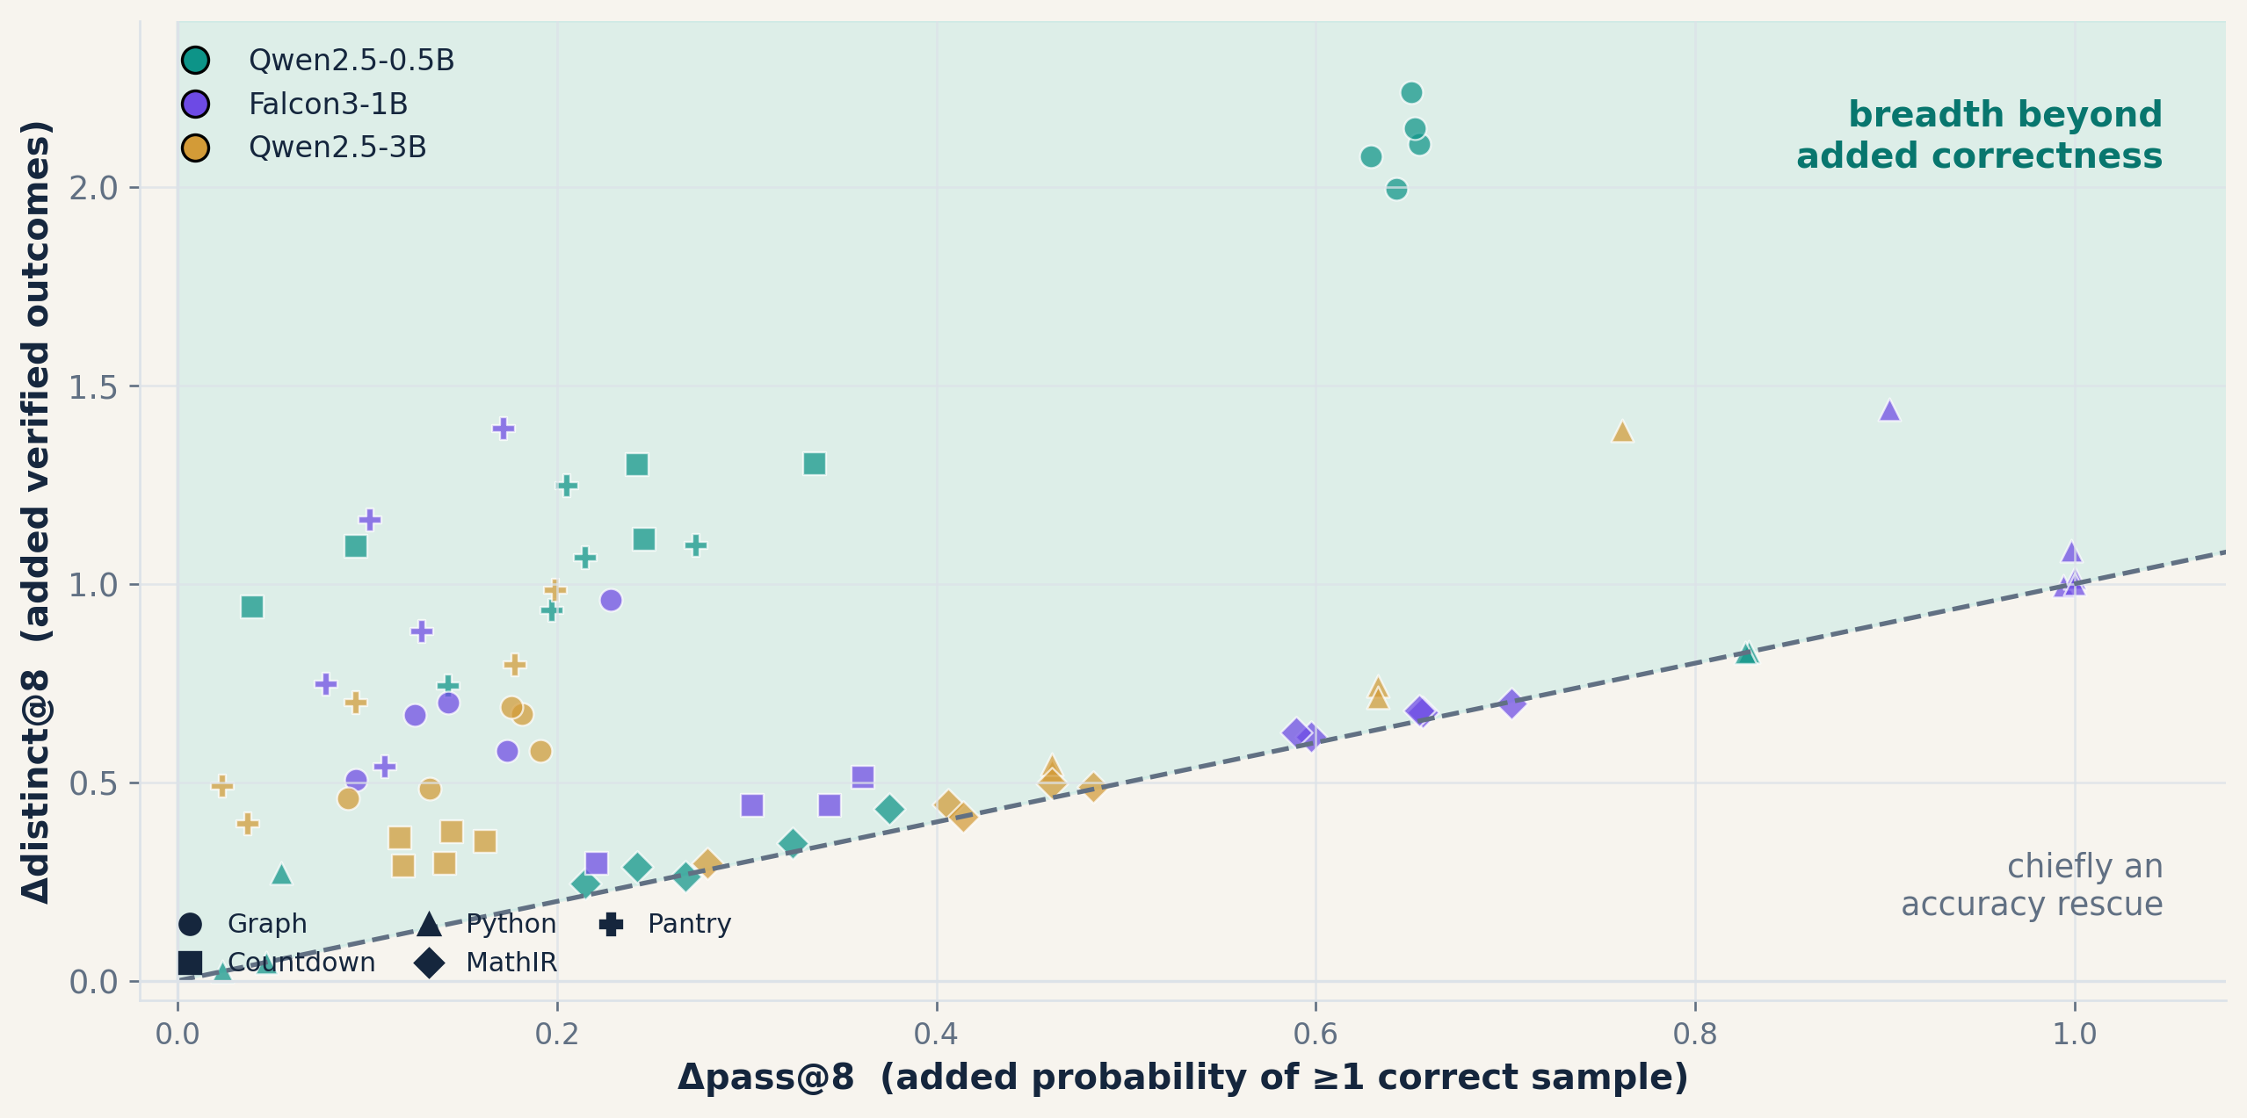
MODE COLLAPSE UNDER GRPO
08
The honest split: extra support vs. accuracy rescue
Distance above the diagonal is Δdistinct@8 − Δpass@8: verified modes beyond the first success.
RAW BREADTH
74 / 74
admissible pairs improve
BEYOND ACCURACY
Graph · Countdown · Pantry
positive domain intervals
at both Qwen scales
Python adjusted effects are unresolved; MathIR gains are small and scale-dependent.
Interpretation: replay reliably retains raw modes; independent excess breadth is domain-dependent
Notes:
Say: Raw breadth is uniformly higher, but not every gain is independent of correctness. Distance above the diagonal is the extra-support effect. This distinction makes the claim defensible.

Slide 9
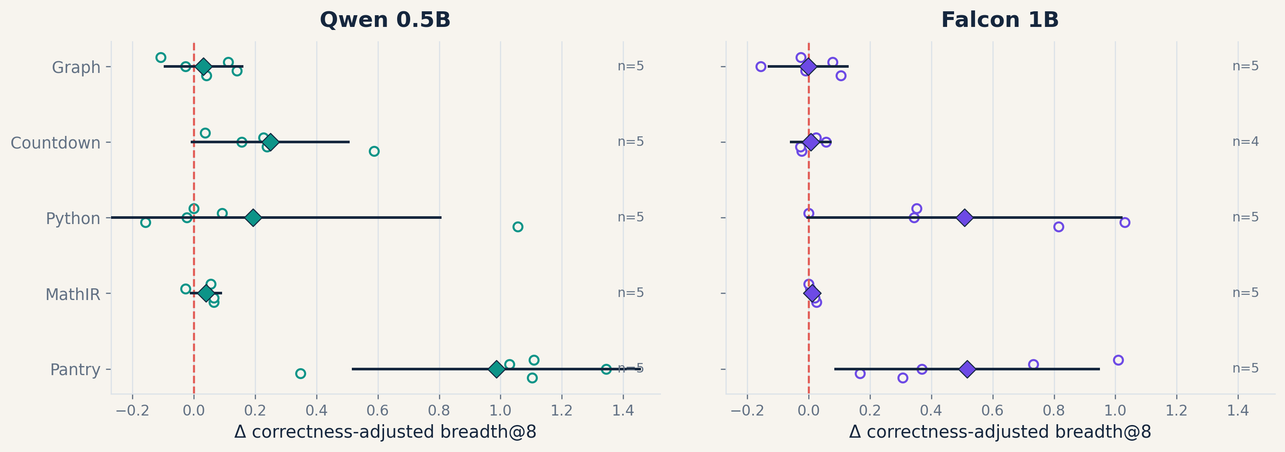
MODE COLLAPSE UNDER GRPO
09
Discovery adds breadth beyond replay—unevenly
Verified-support Semantic-MaxEnt + replay versus replay alone; correctness-adjusted breadth after eight passes.
EXPLORATORY BUNDLE
49
matched endpoints
Mean Δ adjusted breadth
Qwen 0.5B +0.300
Falcon 1B +0.217
11 / 15
cells complete proposal →
pressure → replay
Bundled contrast · Qwen3B not analyzed · most domain intervals cross zero
Source: 49 integrity-valid smaller-model pairs; Falcon Countdown n=4, all other cells n=5
Notes:
Say: This is a bundled exploratory extension, separate from the 74-pair core. Mean adjusted breadth is positive at both analyzed scales, driven most clearly by Pantry and Falcon Python; most domain intervals cross zero.

Slide 10
MODE COLLAPSE UNDER GRPO
10
Three takeaways—and the boundary
The narrow version of the claim is the memorable—and defensible—version.
01
MEASURE
02
RETAIN
03
DISCOVER
Executable keys reveal support collapse that binary correctness and token entropy miss.
Uniform verified replay raises raw breadth in 74 / 74 admissible pairs; excess breadth is domain-dependent.
Verified-support pressure adds positive mean adjusted breadth at two scales in an exploratory 49-endpoint bundle.
CLAIM Executed mode identity exposes hidden collapse; verified replay retains discovered modes.
BOUNDARY No automatic utility · replay cannot recover unseen modes · synthetic exact-mode tasks · discovery is bundled and exploratory
Stop here for the core talk · the remaining slides are backup
Notes:
Close: The contribution is not an experiment catalogue. It is one execution key used to expose collapse, retain discovered support, and test a verified discovery extension.

Slide 11
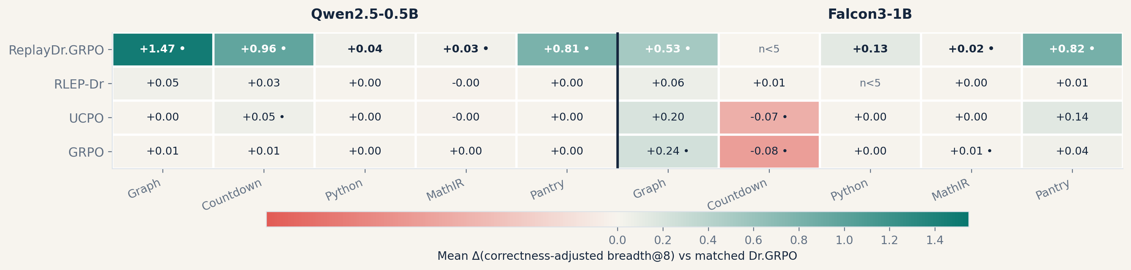
BACKUP · DIRECT ALTERNATIVES
11
Only replay is uniform; alternatives are local
Complete smaller-model correctness-adjusted breadth effects against matched Dr.GRPO.
GRPO, UCPO, and RLEP-Dr are heterogeneous; Falcon Python RLEP-Dr is n=2 and omitted from the n=5 heatmap
Notes:
Backup: Use if asked whether ordinary GRPO, UCPO, or generic verified-success replay reproduces the effect. Complete smaller-model adjusted-breadth blocks are heterogeneous.

Slide 12
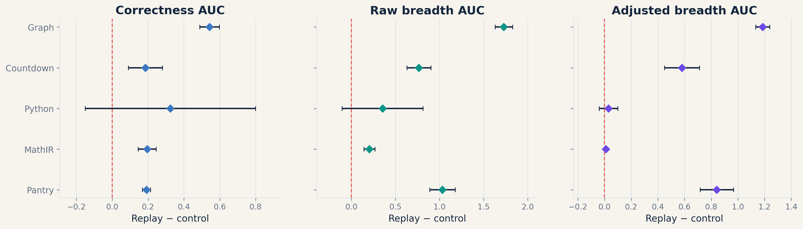
BACKUP · TRAJECTORY
12
Where excess breadth appears, it persists through training
Qwen2.5-0.5B normalized trajectory AUC; five paired seeds per domain.
Graph, Countdown, and Pantry adjusted-breadth AUC intervals exclude zero; Python and MathIR track accuracy rescue
Notes:
Backup: Full-trajectory normalized AUC confirms that Graph, Countdown, and Pantry effects are not terminal-checkpoint accidents at Qwen2.5-0.5B.

Slide 13
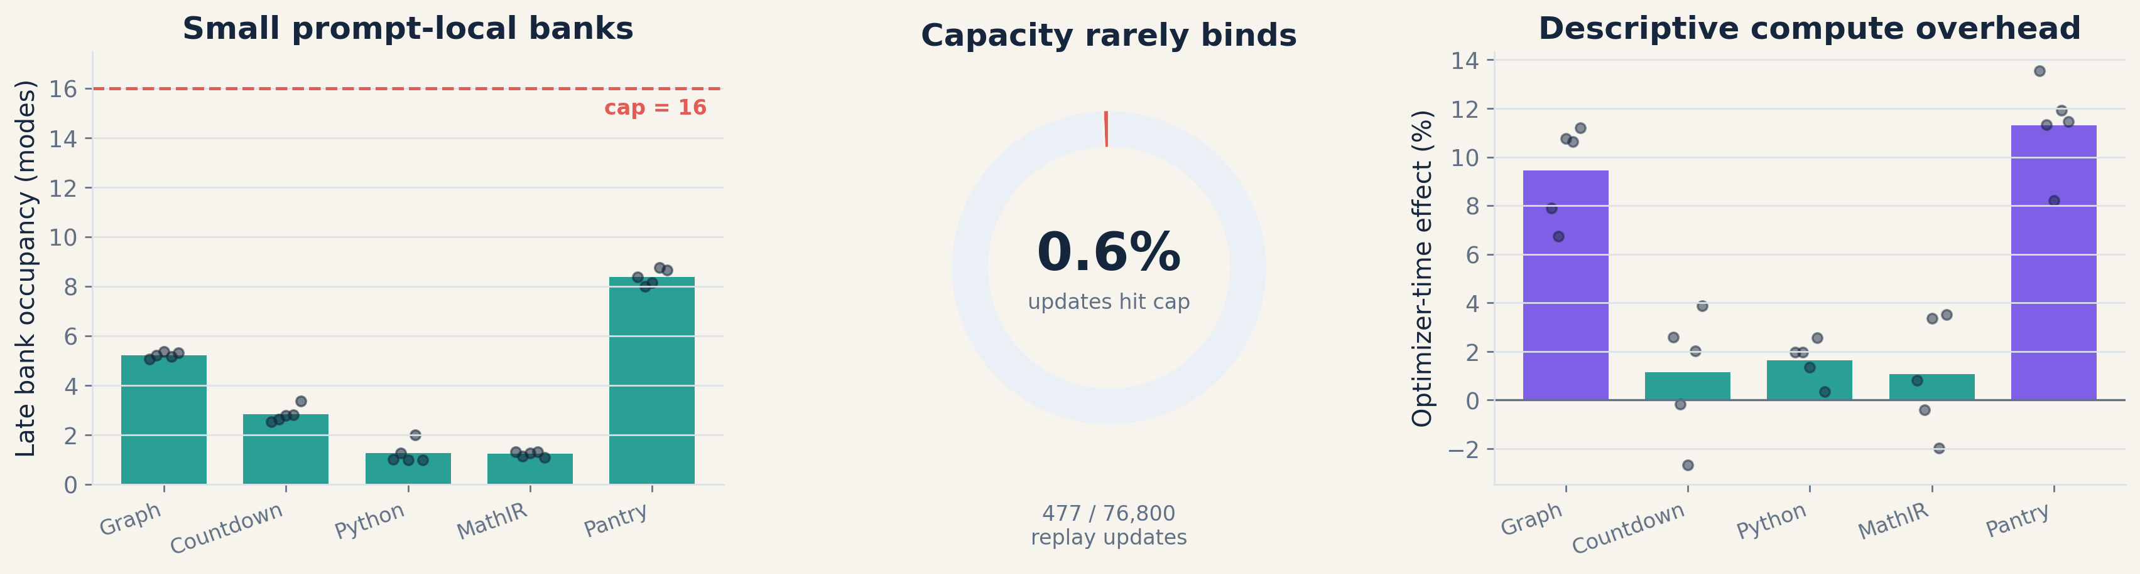
BACKUP · MECHANISM TELEMETRY
13
The retention mechanism is small and measurable
Prompt-local banks are continuously revisited; they are not a giant offline replay corpus.
Qwen2.5-0.5B telemetry · 25 replay + 25 exact-zero control logs · timing is descriptive
Notes:
Backup: The replay bank is prompt-local and small. Capacity rarely binds. Optimizer timing is descriptive, not an inferential compute claim.

Slide 14
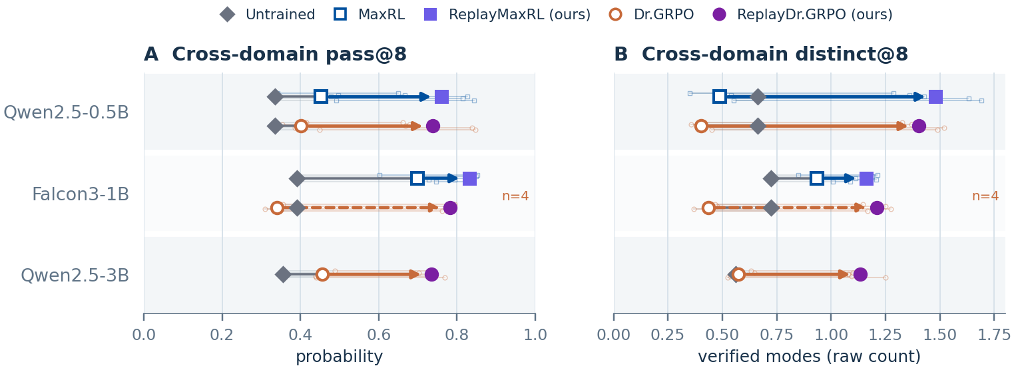
UPDATED RESULTS · SEPTEMBER 8
14
Replay also improves MaxRL
All five domains at Qwen-0.5B and Falcon-1B; the Qwen-3B Python factorial is also complete.
Cross-domain tracks are descriptive · Qwen3B main track is Dr.GRPO/replay only · exact incomplete MaxRL coverage in the appendix
Notes:
Updated evidence: 11 complete MaxRL/replay blocks. Larger-model incomplete domains remain descriptive; there is no Qwen3B MaxRL macro-average.

Slide 15
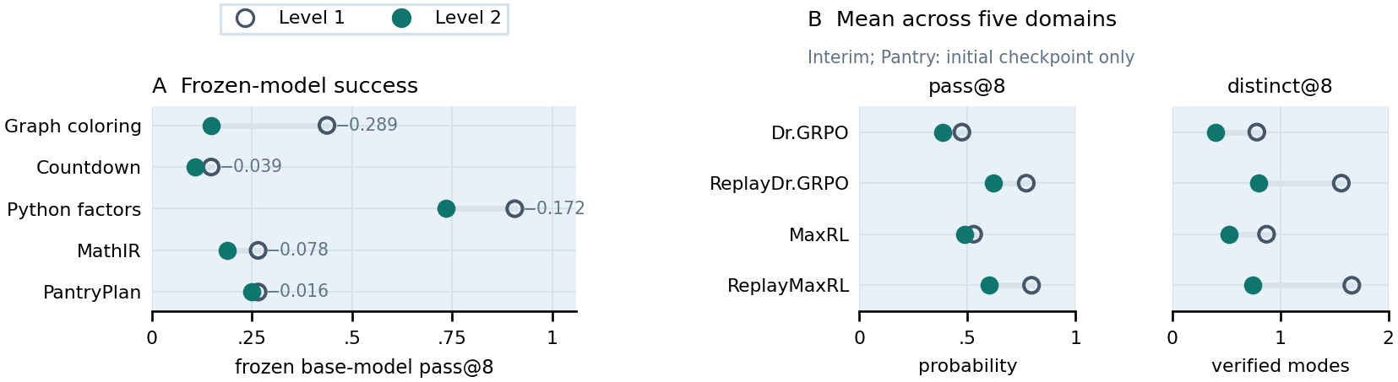
UPDATED RESULTS · SEPTEMBER 8
15
Level 2 now has three complete domain blocks
Graph, Python and MathIR are complete; Countdown and Pantry remain partial.
New Python/MathIR pass@8 and distinct@8 intervals include zero. The five-domain comparison remains descriptive and interim.
Latest admitted endpoints and exact paired denominators: latest_results_20260908.json; descriptive domain average, no imputation
Notes:
Graph, Python and MathIR each have all five four-method seeds. Newly completed Python/MathIR pass@8 and distinct@8 intervals include zero. Panel B matches progress within every level-method-seed cell and remains interim.

