Slide 1
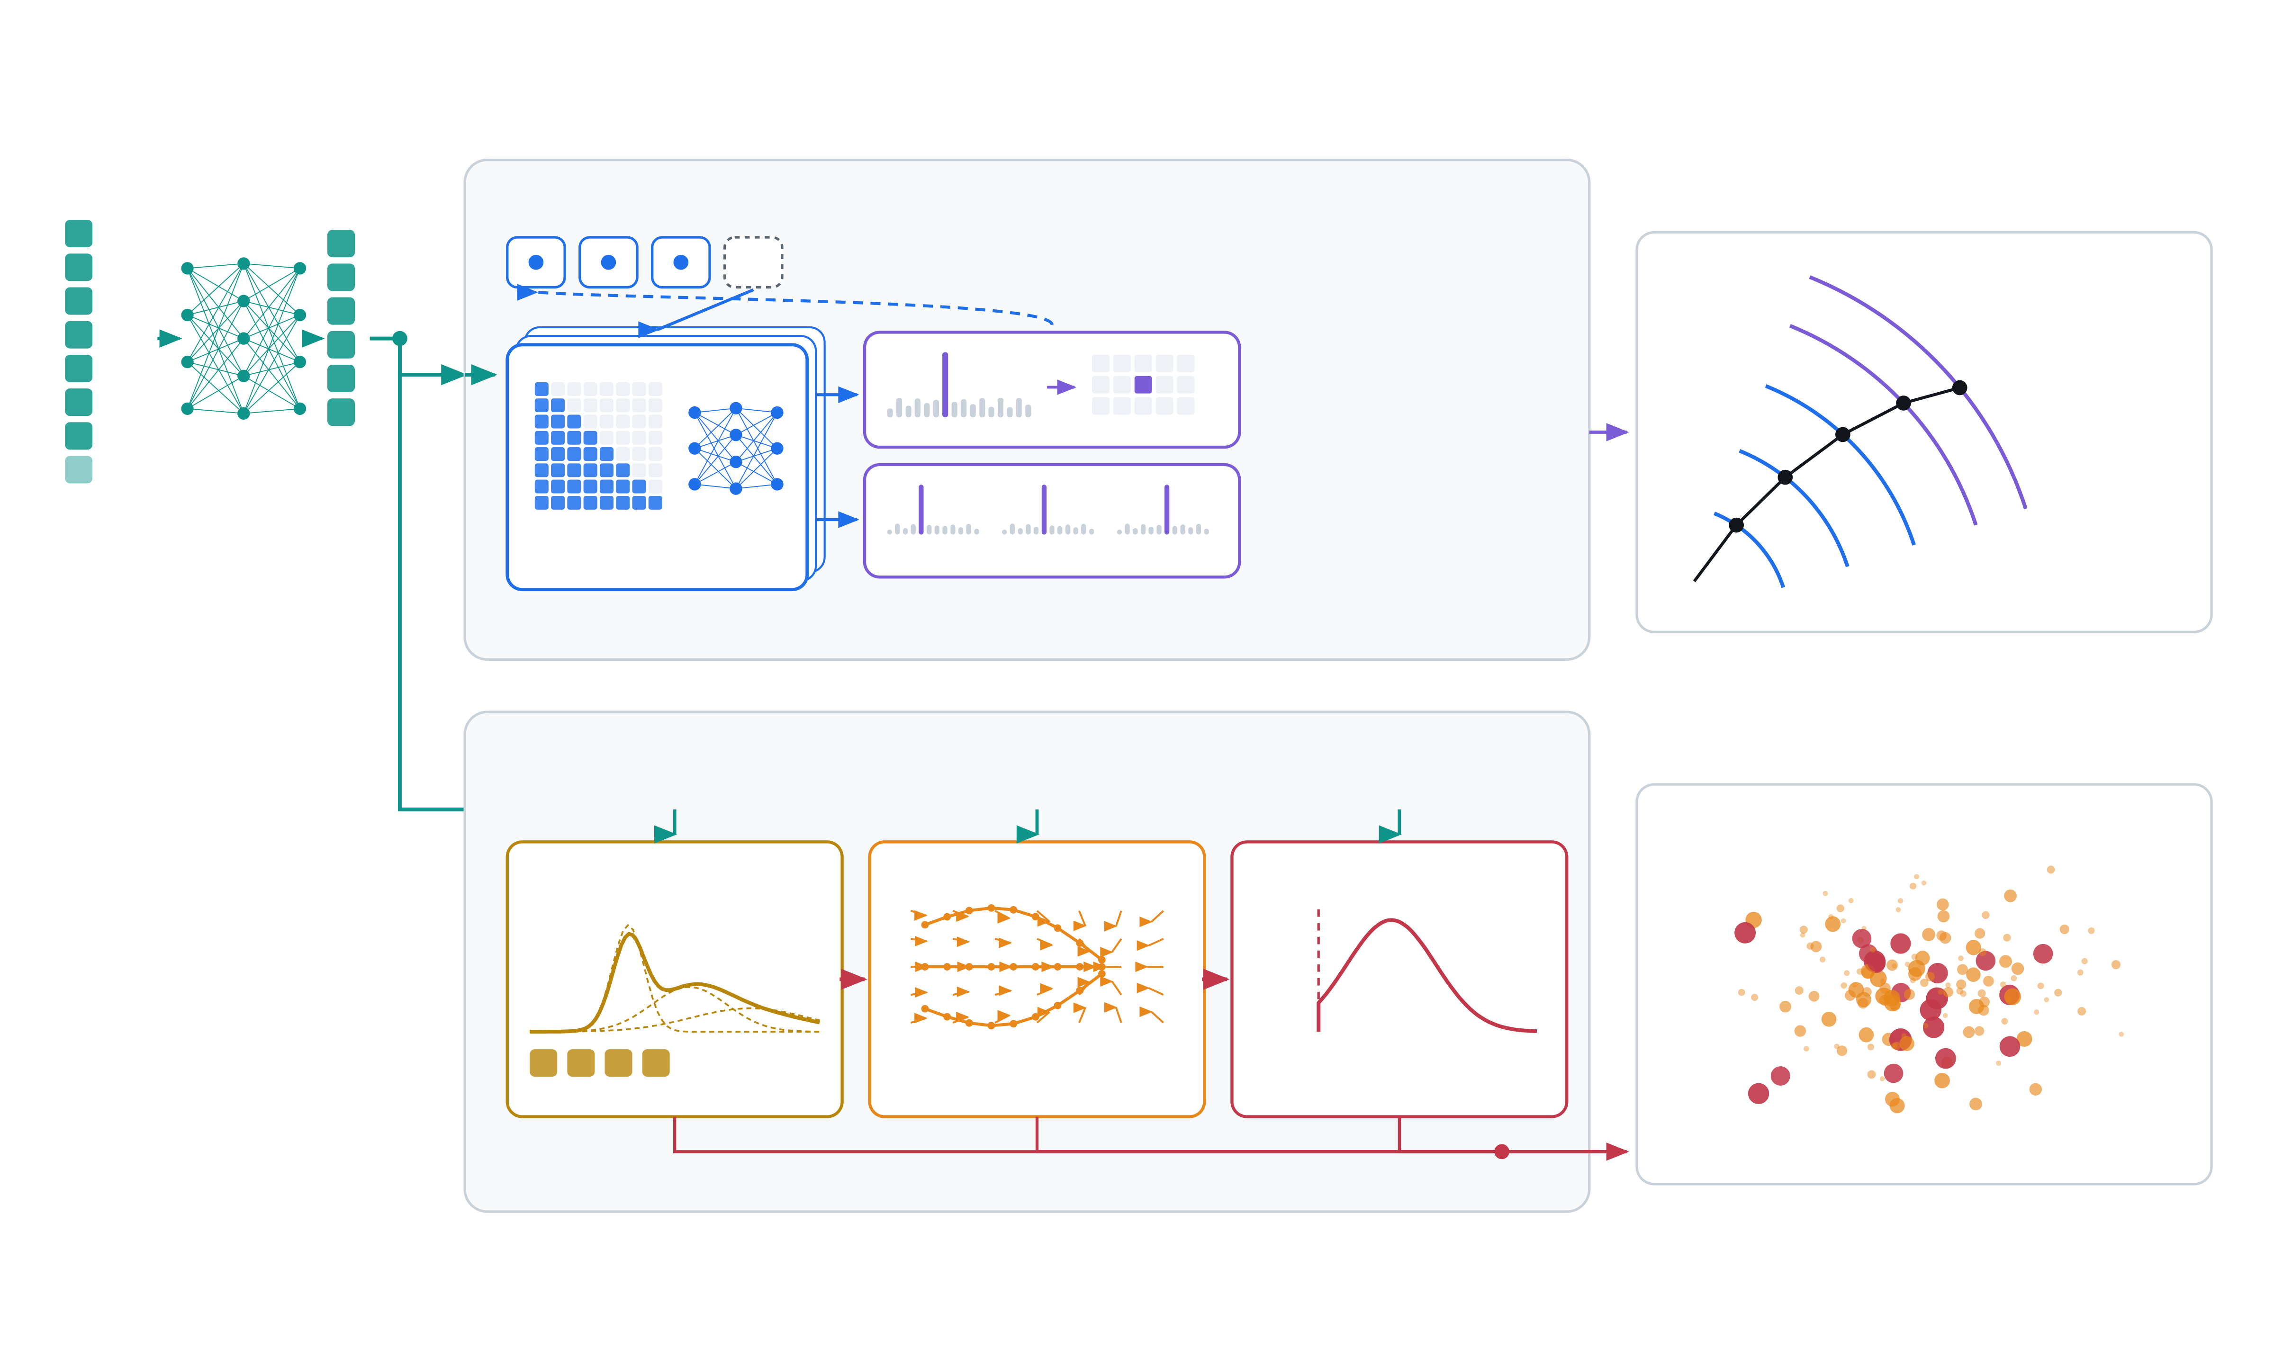
Two generative heads on one shared conditioning
tracker: autoregressive transformer · calorimeter: flow matching · the detector is only the output
truth particle
c
TRACKER HEAD
autoregressive transformer
output
log pT
closest published model: arXiv:2512.24254
η
hits, inner → outer
log E
sampled hit fed back in
q
m
2 heads
vr
vz
layer (48) → surface
PDG
MLP
local x, y, z · 512 bins
causal self-attention ×4
CALORIMETER HEAD
conditional flow matching
3 heads, no sequence
closest published model: CaloClouds II, arXiv:2309.05704
energy deposits — a point cloud,
how big
where
how bright
NOT projected onto detector cells
velocity field, 50 Euler steps
Gaussian mixture over log E,
mixture → total E, N points, core
noise → all points at once
truncated at the 50 keV cut
each head also sees the one before it: globals → positions → energy
flow matching: Lipman et al. arXiv:2210.02747 · OT-CFM: Tong et al. arXiv:2302.00482 · point-cloud calorimeter: CaloClouds arXiv:2305.04847, CaloClouds II arXiv:2309.05704
tracker sequence model: arXiv:2512.24254 · data + geometry: ColliderML / OpenDataDetector arXiv:2512.15230

Slide 2
