Slide 1
Blood Bank Management System
Team members:
  Nandhakumar
  Albin Nelson
  Gokul Rajesh
  Priyadharshini
  Sudharson

Slide 2
Introduction
The Blood Bank Management System is a Java-based application designed to efficiently manage the storage, availability, and distribution of blood units in hospitals or blood banks. The system helps doctors and patients interact with the blood bank through a simple command-line interface.
It ensures that blood donation and request processes are accurate, fast, and safe, eliminating manual record-keeping and reducing human error.

Slide 3
Objective of the Project
To automate the process of managing blood units.
To allow doctors to add, remove, and monitor blood availability.
To allow patients to view and request specific blood groups.
To ensure reliability, accuracy, and speed in blood management.
To build a portable Java application that works on any operating system.

Slide 4
About the Project
The Blood Bank Management System is a standalone console-based Java application.
It focuses on two main users:
  Doctors – who manage blood stock and requests.
  Patients – who can check available blood and make requests.
  The system uses Java Collections (HashMap) to store and retrieve data efficiently. It handles invalid inputs gracefully and can be easily extended or upgraded due to its modular design.

Slide 5
Project Details
Project Title: Blood Bank Management System
Platform: Java
Technologies: Core Java, HashMap, Exception Handling, OOPs
Type: Console-based
Team Size: 5

Slide 6
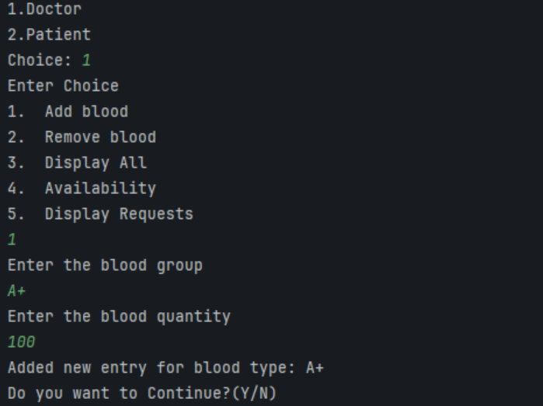
Major Modules
1. Doctor Module
  Add or remove blood units.
  View available blood groups and quantities.
  Approve or reject patient blood requests.

Slide 7
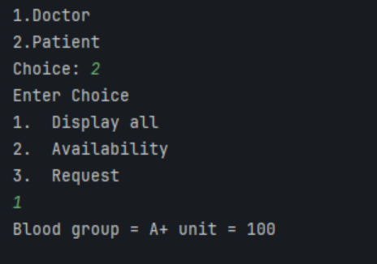
2. Patient Module
  View available blood groups and stock levels.
  Request specific blood groups for medical purposes.

Slide 8
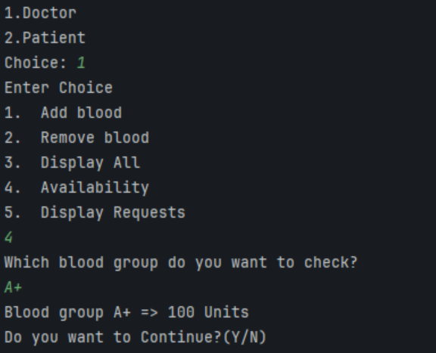
3. Availability Module
  Displays all current blood stocks (group → quantity).
  Updates automatically when doctors add or dispatch blood.

Slide 9
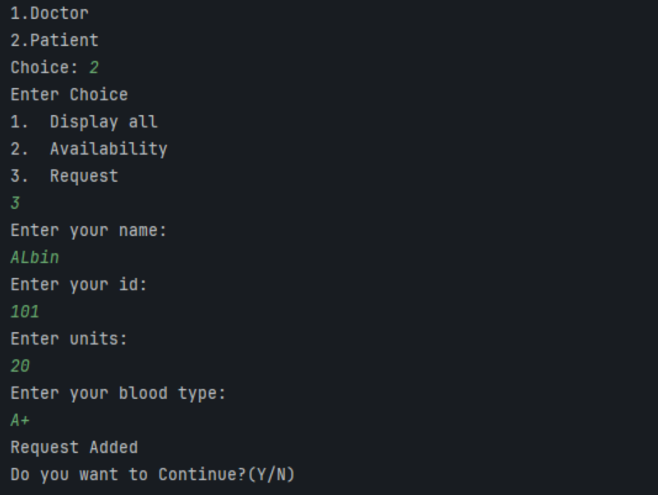
4. Request Module
  Handles patient blood requests.
  Checks stock availability and updates records.

Slide 10
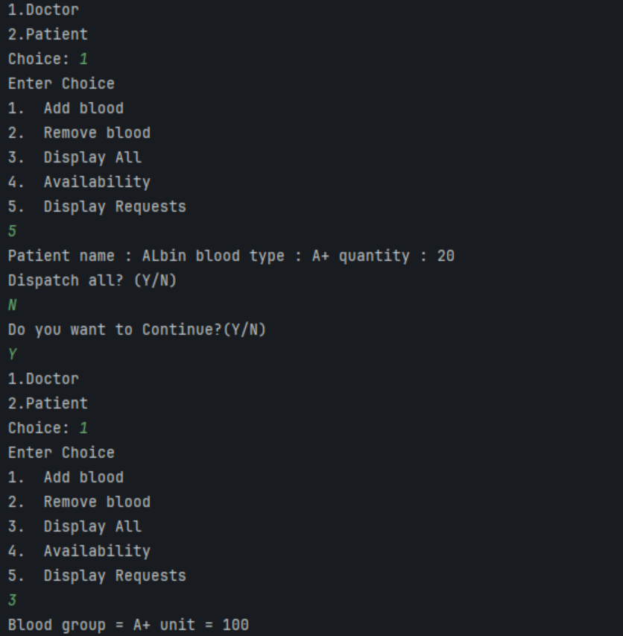
5. Reports Module
  Generates summaries such as total stock, requests processed, and blood issued.

Slide 11
Roles
Nandhakumar- Dispatch, Integration
Albin Nelson - Menu, Collection framework, Integration
Priyadharshini – Availability, Request
Gokul Rajesh –Adding reports , Displaying reports
Sudharson – Patient request, removing .

Slide 12
Duration
Project Start Date: 02/11/2025
Project End Date: 03/11/2025
Total Duration:2 days

Slide 13
Approach
Requirement Analysis
System Design
Implementation
Testing
Deployment
Reporting

Slide 14
Reports
Requirement Analysis: Studied how blood banks operate and identified user needs (doctors, patients).
System Design: Planned structure using Java classes (Blood, patient Request).
Implementation: Developed modules using OOP and HashMap for data handling.
Testing: Verified all functions, handled invalid input, and ensured stability.
Documentation: Created SRS, report, and presentation.

Slide 15
Conclusion
The Blood Bank Management System automates the process of managing blood units efficiently.
It ensures accurate data handling, quick access, and error-free transactions for doctors, and patients.

Slide 16
Thank You!

