Slide 1
ENERGY METERS

Slide 2
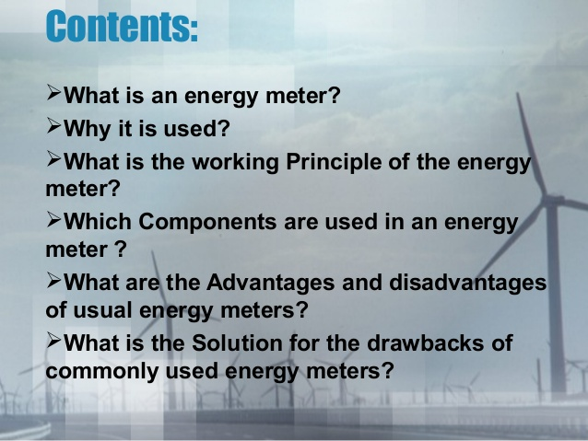

Slide 3
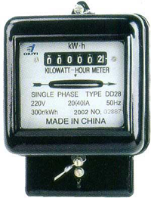
A ‘Made-in-China’ Sample

Slide 4
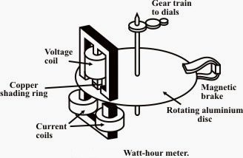
CONSTRUCTION

Slide 5
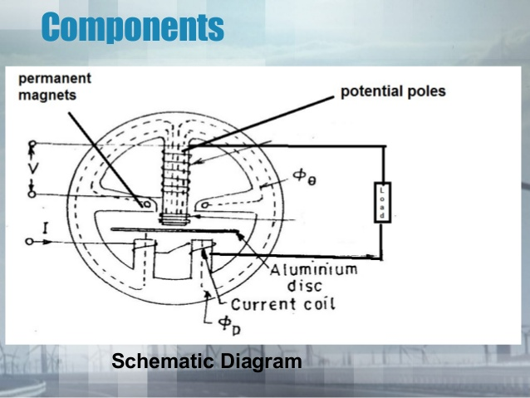

Slide 6
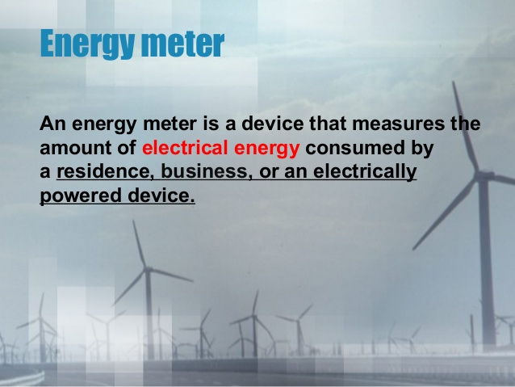

Slide 7
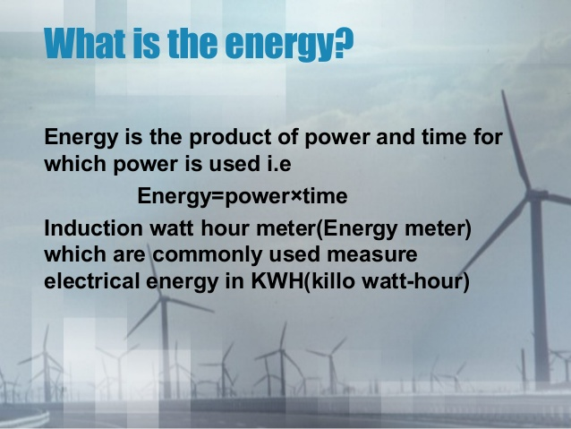

Slide 8
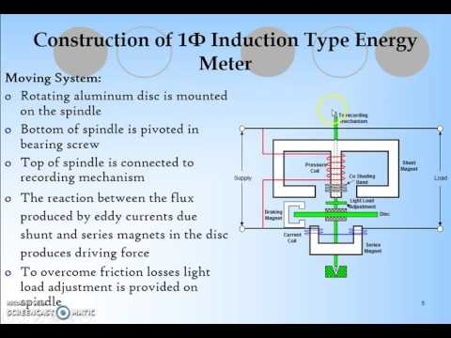

Slide 9
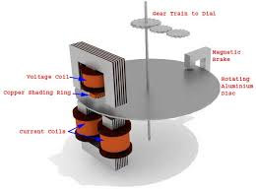

Slide 10
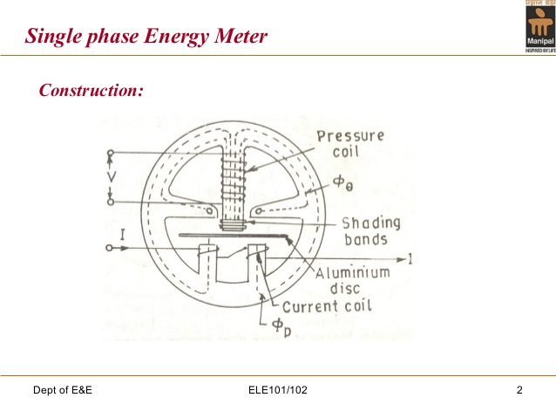
CONSTRUCTION

Slide 11
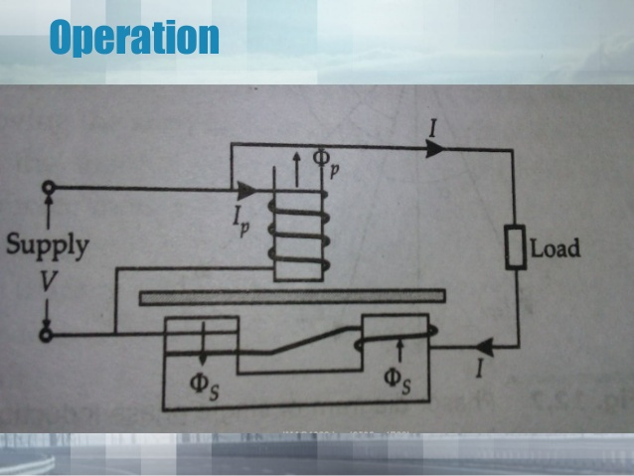

Slide 12
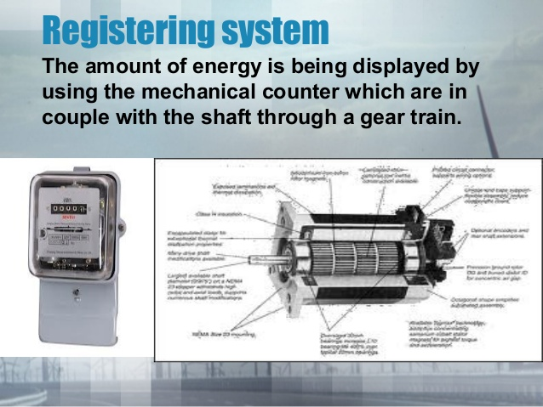

Slide 13
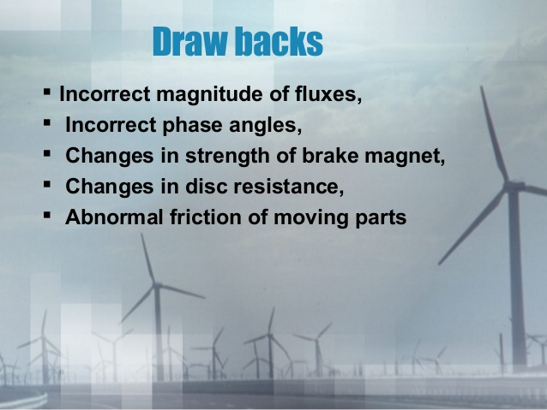

Slide 14
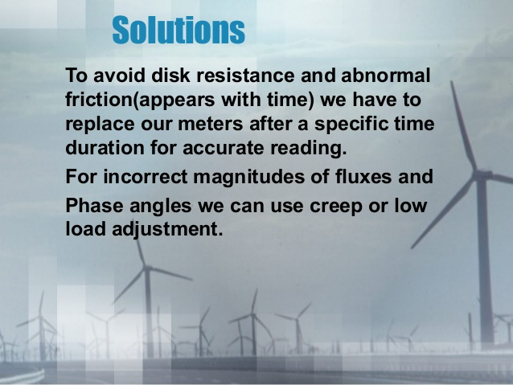

Slide 15
Smart Energy Meters
A smart meter is a new kind of electricity meter that can digitally send meter readings to your energy supplier for more accurate energy bills.

Slide 16
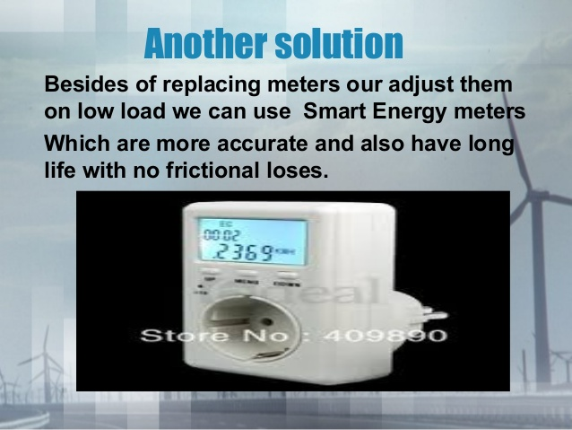

Slide 17
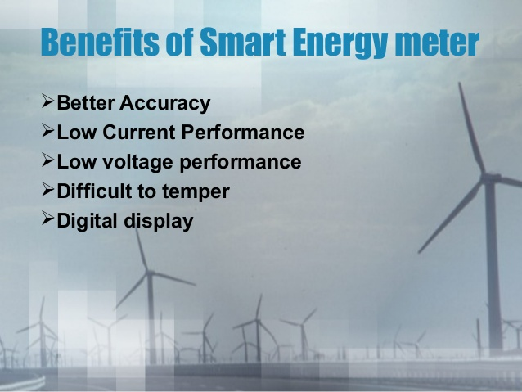

Slide 18
Tariff Types
The tariff is the rate at which the electrical energy is sold.
Simple Tariff
Flat Rate Tariff
Block Rate Tariff
Two-Part Tariff
Maximum-Demand Tariff
Power-Factor Tariff
Three-Part Tariff

Slide 19
SIMPLE TARIFF or UNIFORM-RATE TARIFF
When there is a fixed rate per unit of energy consumed, it is known as simple tariff (Uniform Rate Tariff).
This is the simplest of all tariff.
In this type, the price charged per unit is constant.
In other words, the price will not vary with increase or decrease in number of units used.
Disadvantages:
The cost per unit delivered is high.
There is no discrimination among various types of consumers.

Slide 20
Flat Rate Tariff
When different types of consumers are charged at different uniform per unit rates, it is said to be Flat Rate Tariff.
In this type, the consumers are grouped into different classes.
Each class is charged at different uniform rate.
The different classes of consumers may be taken into account based on their diversity and load factors.
Since this type of tariff varies according to the way of supply used, separate meters are required for lighting load, power load, etc.

Slide 21
Block-Rate Tariff
When a given block of energy is charged at a specified rate and the succeeding blocks of energy are charged at progressively reduced rates, it is called as block rate tariff.
In this type, the energy consumption is divided into many blocks and price per unit is fixed in each block.

Slide 22
Two-Part Tariff
When the rate of electrical energy is charged on the basis of maximum demand of the consumer and the units consumed it is called two-part tariff.
In this type, the total charge to be made from the consumer is split into two components, i.e., fixed charges and running charges.
The fixed charges depend upon the number of units consumed by the customer. Thus the consumer is charged at a certain amount per kW of maximum demand + a certain amount per kWh of energy consumed.
Total charges = Rs (X x kW + Y x kWh)
It is easily understood by the consumer.
It recovers fixed charges which depend upon the maximum demand of the consumer independent of the units consumed.
Disadvantages
Consumer has to pay the fixed charges irrespective of the fact whether he has consumed energy or not.
There is always error in assessing the maximum demand of the consumer.

Slide 23
Maximum-Demand Tariff
Maximum demand tariff is similar to two-part tariff. The only difference is the maximum demand of the consumer is calculated by installing a maximum demand meter at his premises. This type of tariff is mostly applied to the bulk consumers.

Slide 24
Power-Factor Tariff
The tariff in which the power factor of the consumers is taken into account is known as power factor tariff.

Slide 25
Three part Tariff:
When the total charges to be made from the consumer are split into three parts, namely, fixed charge, semifixed charge and running charge, it is known as three-part tariff.
This type of tariff is applied to big consumers. The principle objection of this type of tariff is the charges are split into three components (fixed charge, charge per kW of maximum demand, charge per kWh of energy consumed).

