Slide 1
Electricity and Circuits
Developed by Dr. Rhett Davis (NCSU) and Shodor

Slide 2
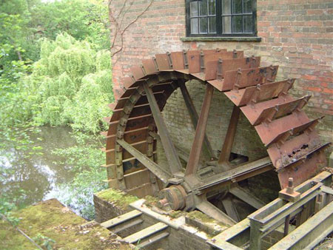
What Do Engineers Do?
Study the forces of nature
Apply them to do useful things
Example:
Water Wheel
  What are the forces?
  How is it useful?

Slide 3
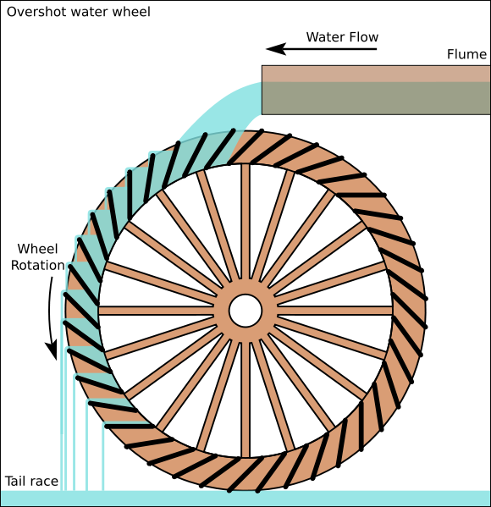

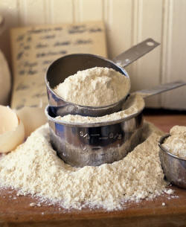
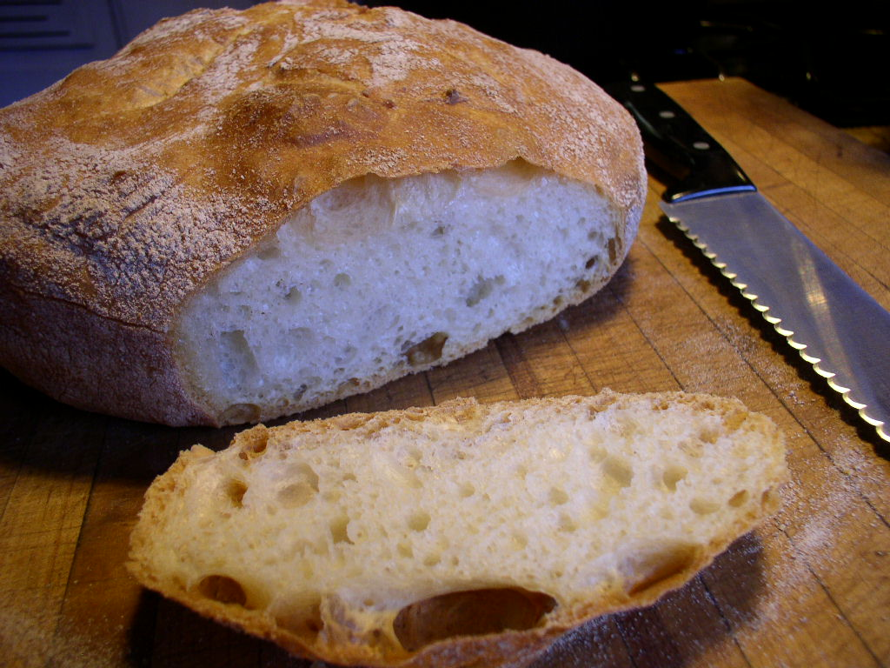
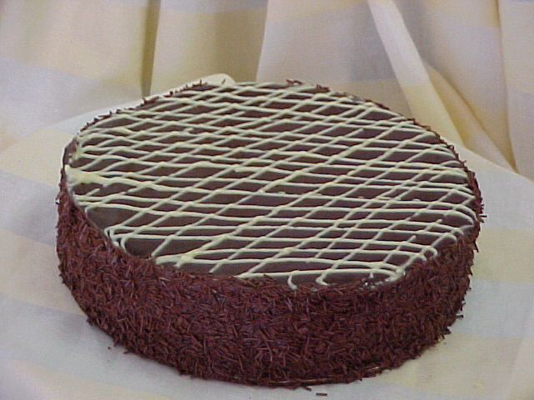
Water Wheels
+
=
Water-wheels are Mechanical Engineering
Today, we’ll look at Electrical Engineering

Slide 4
What do you need to make a Water Wheel Work?
Water – Makes everything work
River – Source of flowing water
Pipes – To direct the water where you want it to go and regulate the flow
Wheel – To convert the force of the flowing water into force to grind the wheat

Slide 5
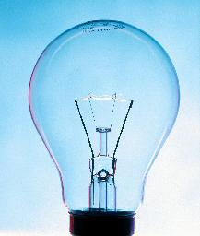
What’s a similar Electrical Engineering Problem?
Turn on a light
  Water → Electricity
  River → Battery
  Pipes → Resistors, Wires
  Wheel → Light Bulb

Slide 6
What do you need to make a Light Bulb Work?
Electricity – Makes everything work
Battery – Source of flowing Electricity
Resistors, Wires – To direct the electricity where you want it to go and regulate the flow
Light Bulb – To convert the force of the flowing electricity into light

Slide 7
Terminology
Electric Potential – like the height of the water
  Symbol (V)
  Units (Volts - V)
Current – like the number of gallons of water that flow every second
  Symbol (I)
  Units (Amperes – A)
Power – like the amount of wheat that can be ground each second, or brightness of light
  Symbol (P)
  Units (Watts – W)
  NOTE: P=I*V

Slide 8
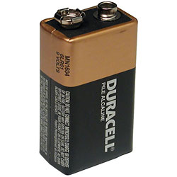
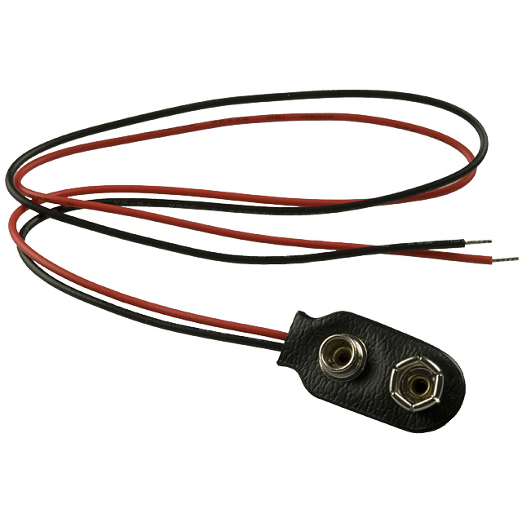
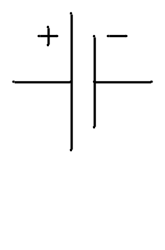
Battery
Source of constant potential (9 V)
+ lead (red wire) – outflow from high potential
- lead (black wire) – inflow to low potential

Slide 9
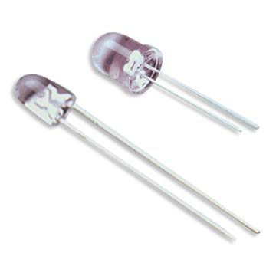
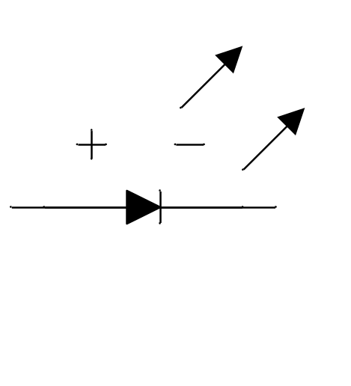
Light-Emitting Diode (LED)
Emits light when current flows through it
Current can only flow in one direction, from + to - (like a water wheel that won’t go in reverse)
  Long lead (+)
  Short lead (-)

Slide 10
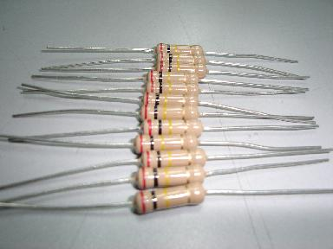
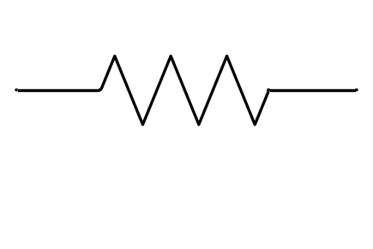
Resistor
New term:
  Resistance – how easy is it for current to flow
  Symbol (R)
  Unit (Ohm – Ω)
  NOTE: V=I*R
New circuit element
  Resistor
  Regulates the flow of current
  Like a pipe for electric current to flow
  Resistance ~ 1/cross-section-area
A wire is like a resistor with a very low Resistance

Slide 11
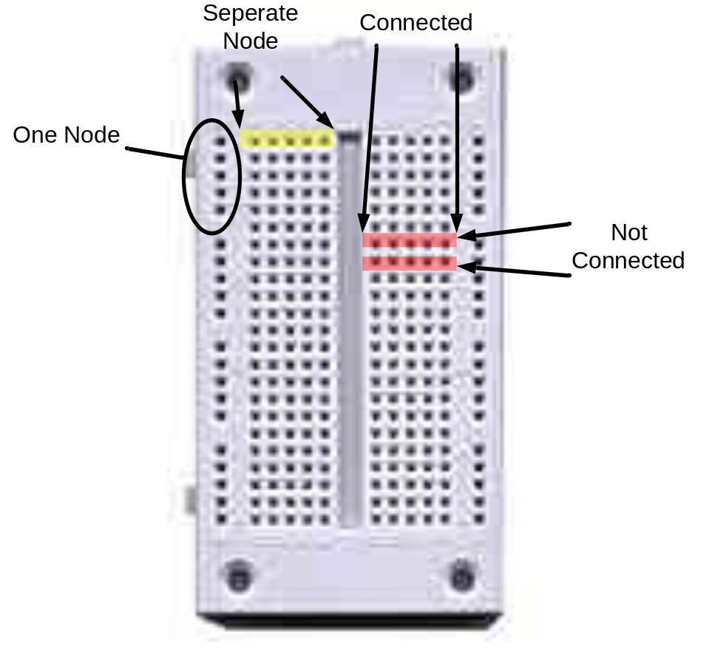
Breadboard
Breadboards are used to connect things quickly
You can proto-type circuits quickly

Slide 12
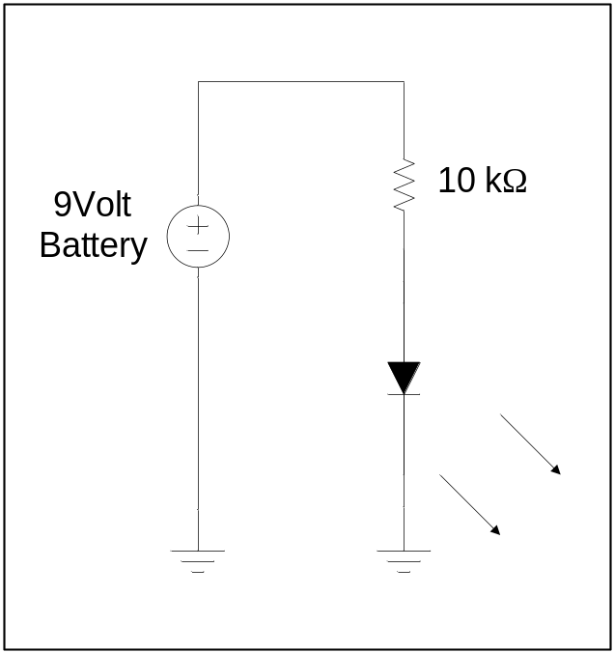
Exercise
Use the battery, the breadboard, the resistor, and the LED to make the LED turn on.
Follow the “LED Circuit” in your handout.
Why is the resistor necessary?

Slide 13
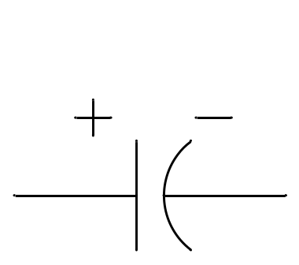
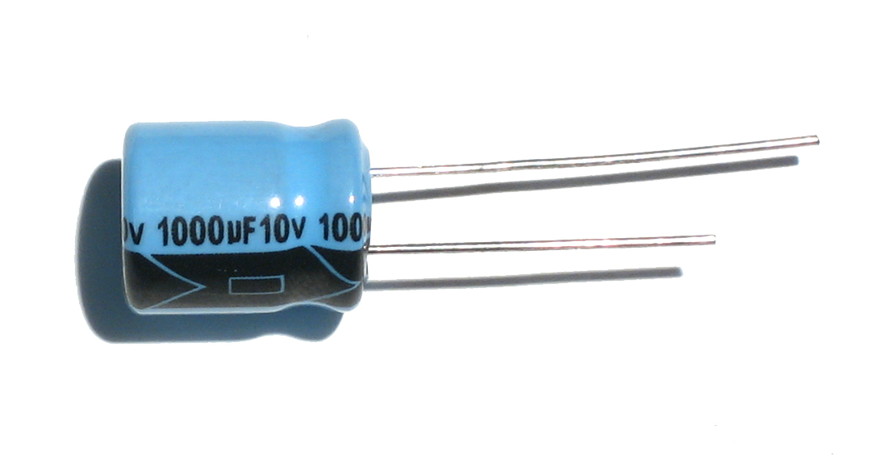
Capacitor
Like a glass that holds water
  Top of glass (+) long lead (no stripe), should always be at high potential
  Bottom of glass (-) short lead (with stripe), should always be at low potential
The more electricity flows in, the higher the voltage (water level)
A large capacitor is like a wide glass
  Needs more water (electricity) to get to the same height (voltage)

Slide 14
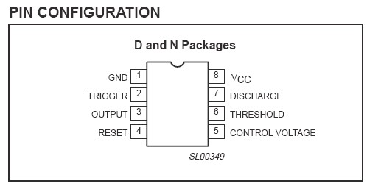
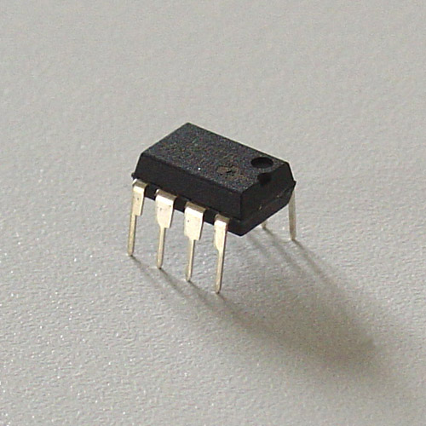
555 Timer Chip
Used to oscillate between a high (Vcc) and low (GND) voltages
Stays high until Threshold rises above 2/3 Vcc, then switches low and lets current flow in through Discharge pin
Stays low until Trigger falls below 1/3 Vcc, then switches high and stops letting current flow in through Discharge pin

Slide 15
Exercise
Go to http://falstad.com/circuit/
Choose Circuits → 555 Timer Chip → Square Wave Generator
Build the circuit shown
Use the output to power the LED Circuit from first exercise
“555 Timer Circuit” in your handout gives the circuit, for convenience
Question: Which capacitor makes the LED blink faster? Why?

Slide 16
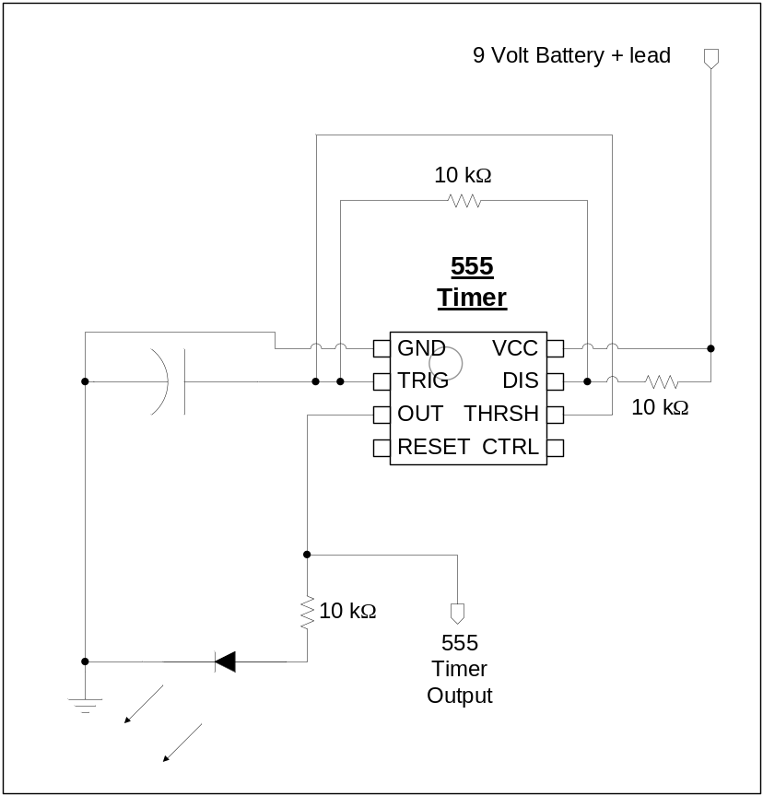
555 Timer Circuit
Tips:
  Follow the rough layout shown here on your bread-board
  Use the black wire and left rails for ground
  Use the red wire and right rails for the 9V battery + lead

Slide 17
Digital Circuits
Analog Circuits
  What we’ve seen up to now
  can have any voltage
  (in our case, anything between 0V and 9V)
  Useful for interfacing to the “real world”
Digital Circuits
  can have only two voltages: high & low
  (in our case, only 0V and 5V)
  Useful for processing information reliably

Slide 18
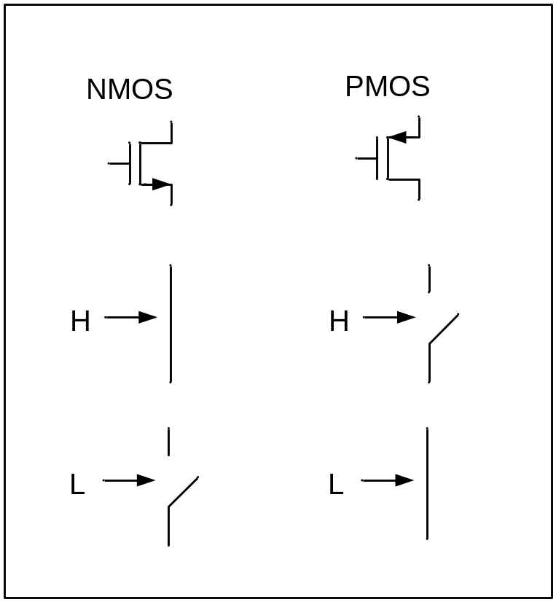
Transistors
Basically a switch
Two types that we will look at
  NMOS – closed when input is high
  PMOS – closed when input is low
Exercise
  Go to http://falstad.com/circuit
  Choose Circuits → Logic Families → CMOS → CMOS Inverter
  Click to toggle input. What happens to the output?

Slide 19
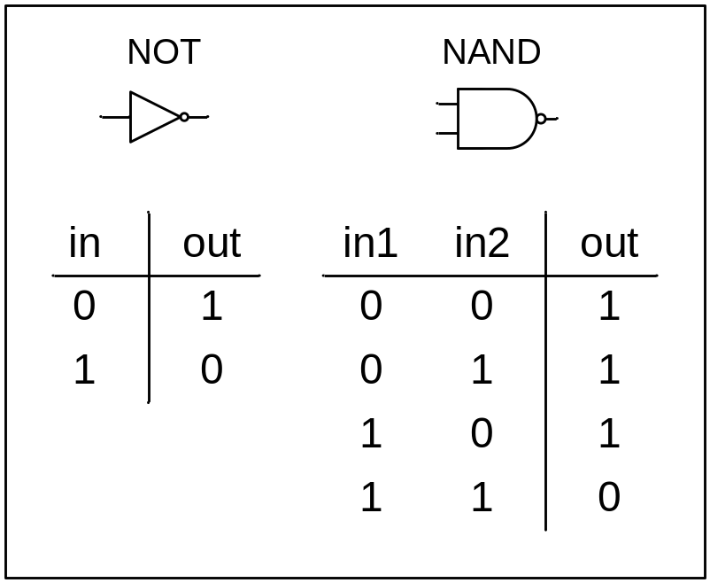
Logic Gates
Can be used to build up complex functions
Exercise
  Go to http://falstad.com/circuit
  Choose Circuits → Logic Families → CMOS → CMOS NAND
  Click to toggle inputs. What happens to the output?
Notes:
Output follows the truth-table for the NAND gate above

Slide 20
Flip-Flops
Used to implement “memory” in a circuit
Allows behavior to change over time
Exercise
  Go to http://falstad.com/circuit
  Choose Circuits → Sequential Logic → Flip-Flops → Master-Slave Flip-Flop
  Click to toggle input “D”. When does the output “Q” change?
Notes:
Changes on the falling edge

Slide 21
Counters
Counts up from zero to a certain number and starts over
Binary arithmetic is used
An example of a more complex digital circuit
Exercise
  Go to http://falstad.com/circuit
  Choose Circuits → Sequential Logic → Counters → 4-bit Ripple Counter
  Watch the output change. What is the highest count value?
  What is the input “CLK”? What does it remind you of?
Notes:
Highest count value is 15
CLK is an input “clock” that determines how long each “cycle” lasts. They are necessary for all digital circuits.
CLK looks kind of like the output of the 555 timer

Slide 22
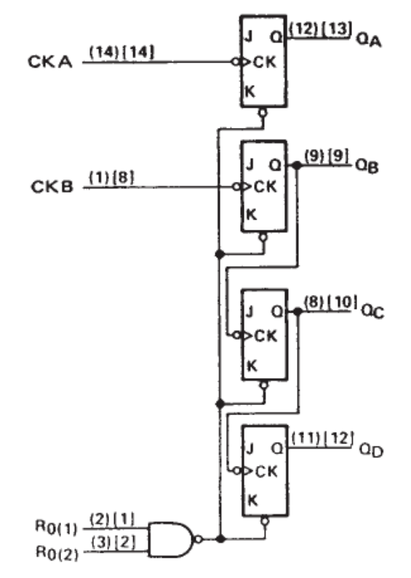
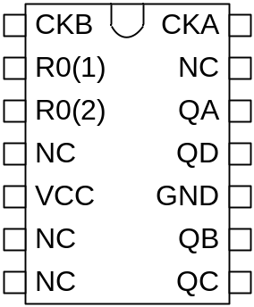
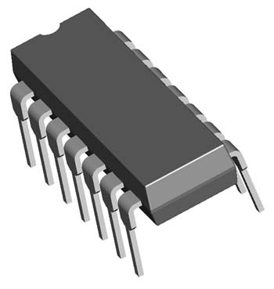
7493 Counter Chip
Combines all that we have discussed into one easy-to-use package
Refer to the 7493 Counter Circuit in your handout

Slide 23
The Need for Voltage Regulators
Most Digital Logic runs on 5V or less!
The 7493 Counter Chip won’t work with our 9V battery
To make it work, we need to “regulate” the voltage from 9V to 5V

Slide 24
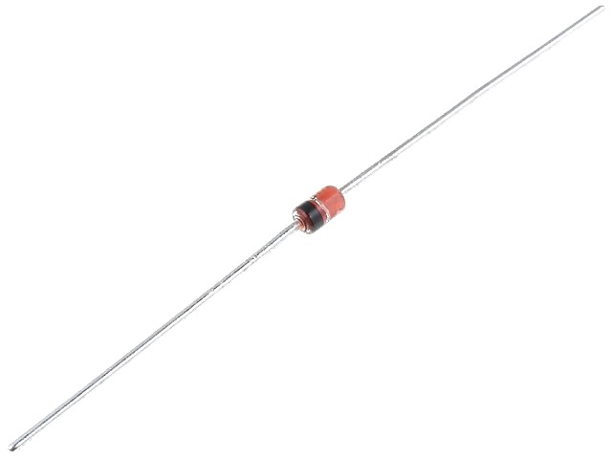
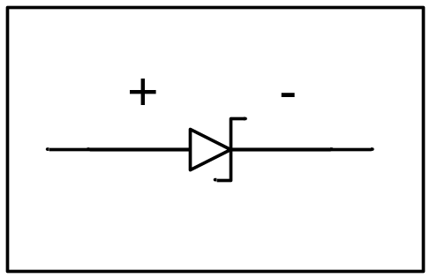
Zener Diode
Current flowing from + to - is clamped at 0.8 V
Current flowing from - to + is clamped at -5.1 V
  lead w/o stripe (+)
  lead with stripe (-)

Slide 25
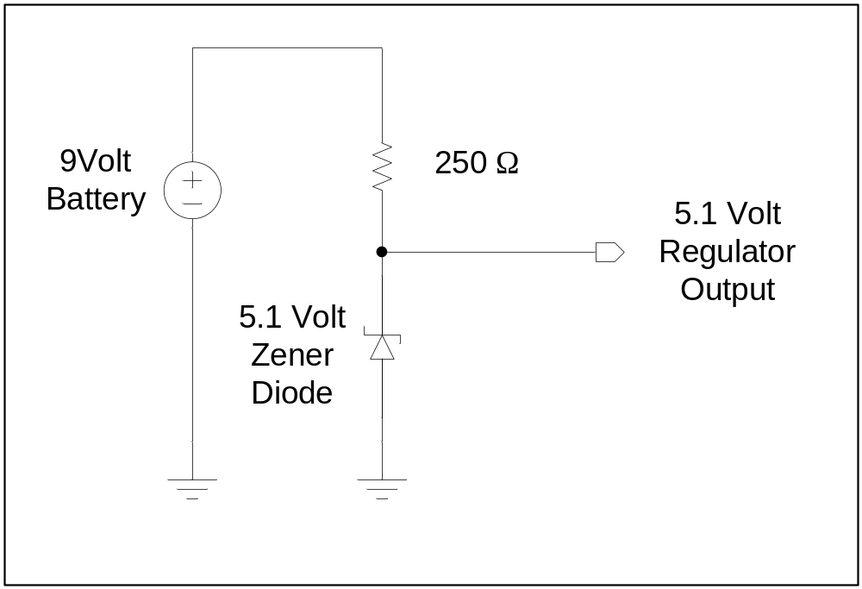
Voltage Regulator Circuit
Note!
Opposite
direction
from the LED!

Slide 26
Exercise
Go to http://falstad.com/circuit
Choose Circuits → Diodes → Zener Diodes → Voltage Reference
Right click on voltage source → Edit →
DC Offset = 9V
Right click on 600 Ω resistor → Edit →
resistance = 250 Ω
Right click on zener diode → Edit →
Zener voltage = 5.1 V
What is the lowest value of resistance for the second resistor that keeps the voltage at 5V? What does this mean?
Notes:
Lowest resistance value is about 460 ohms
Every circuit that we connect to this voltage source effectively “lowers” this resistance. I designed this circuit specifically so that it would support a 460 ohm resistance, allowing us to power both the 555 timer circuit and the 7493 counter circuit, along with 4 LEDs.

Slide 27
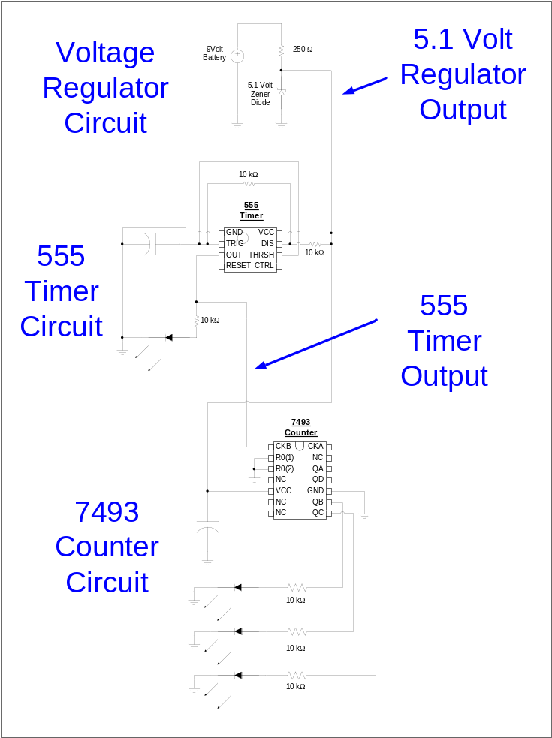
Putting it all together
Tips
  Follow the rough layout shown here on your bread-board
  Use the black wire and left rails for ground
  Use the red wire and one right rail for the 9V battery + lead
  Use the orange wire and the other right rail for the 5.1V Regulator Output

