Slide 1
Blazor 基础

Slide 2
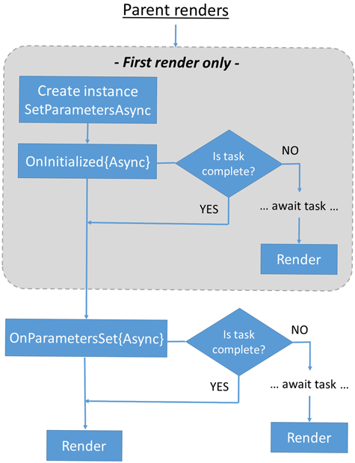
Razor component lifecycle
SetParametersAsync sets parameters supplied by the component's parent in the render tree or from route parameters.
OnInitialized and OnInitializedAsync are invoked when the component is initialized after having received its initial parameters in SetParametersAsync.
OnParametersSet or OnParametersSetAsync are called:
After the component is initialized in OnInitialized or OnInitializedAsync.
When the parent component rerenders and supplies:
Known primitive immutable types when at least one parameter has changed.
Complex-typed parameters. The framework can't know whether the values of a complex-typed parameter have mutated internally, so the framework always treats the parameter set as changed when one or more complex-typed parameters are present.
Notes:
OnParametersSet{Async} 组件初始化时触发 或者 父组件参数改变（简单参数会进行判断，复杂参数不进行判断，默认修改
）

Slide 3
protected override async Task OnAfterRenderAsync(bool firstRender)
{
if (firstRender)
{
module = await JS.InvokeAsync<IJSObjectReference>("import", "./js/script.js");
await module.InvokeVoidAsync("generateTOC","blog-markdown-body","blog-markdown-toc");
}
}
OnAfterRender and OnAfterRenderAsync are called after a component has finished rendering. Element and component references are populated at this point. Use this stage to perform additional initialization steps with the rendered content, such as JS interop calls that interact with the rendered DOM elements.
The firstRender parameter for OnAfterRender and OnAfterRenderAsync:
Is set to true the first time that the component instance is rendered.
Can be used to ensure that initialization work is only performed once.
Notes:
firstRender 区分是否第一次初始化，保证某些操作只在初始化时执行一次。

