Slide 1
VRP系统管理(2)

Slide 2

前言
为了满足企业业务对网络的需求，网络设备中的系统文件需要不断进行升级。另外，网络设备中的配置文件也需要时常进行备份，以防设备故障或其他灾害给业务带来损害。在升级和备份系统文件或配置文件时，经常会使用FTP和SFTP来传输文件。
Page <number>

Slide 3

学习目标
学完本课程后，您应该能：
    掌握路由器作为FTP Server
    掌握路由器作为SFTP Server
Page <number>

Slide 4
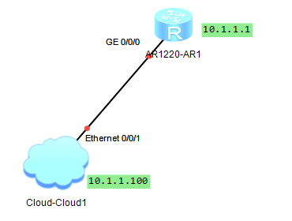
路由器作为FTP Server
Page <number>

Slide 5
AR1上的命令
<Huawei> system-view
[Huawei] ftp server enable
Info: Succeeded in starting the FTP server
[Huawei] aaa
[Huawei-aaa] local-user AR password cipher huawei
info: A new user added
[Huawei-aaa] local-user AR ftp-directory flash:
[Huawei-aaa] local-user AR service-type ftp
[Huawei-aaa] local-user AR privilege level 15
Page <number>

Slide 6
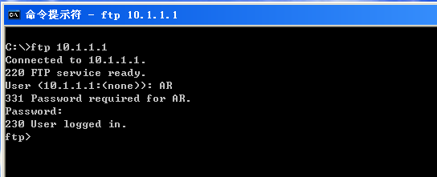
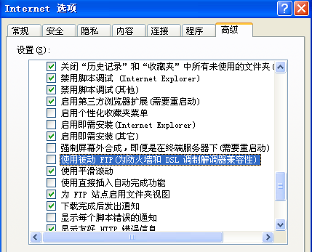
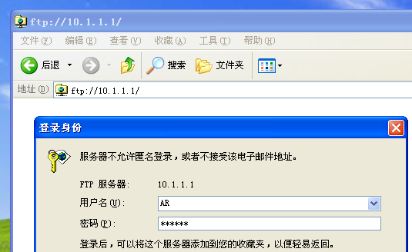
Winxp
Page <number>

Slide 7
路由器作为SFTP Server
Page <number>

Slide 8
AR1上的命令
[Huawei] display rsa local-key-pair public
[Huawei] rsa local-key-pair create
[Huawei] user-interface vty 0 4
[Huawei-ui-vty0-4] authentication-mode aaa
[Huawei-ui-vty0-4]protocol inbound ssh
[Huawei] aaa
[Huawei-aaa] local-user AR password cipher huawei
[Huawei-aaa] local-user AR ftp-directory flash:/
[Huawei-aaa] local-user AR service-type ssh
[Huawei-aaa] local-user AR privilege level 15
[Huawei]ssh user AR authentication-type password
[Huawei]sftp server enable
Page <number>

Slide 9
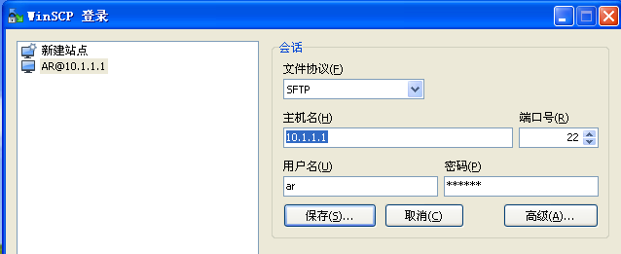
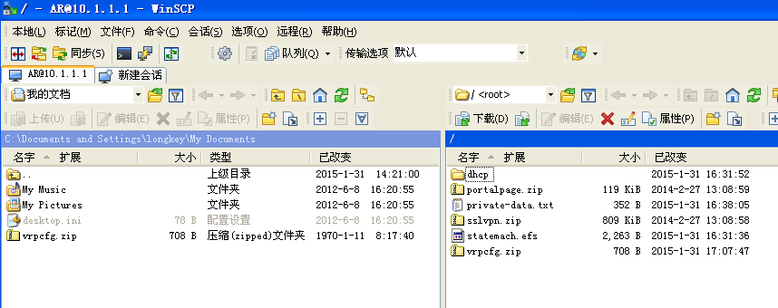
WinXP
Page <number>

