Slide 1
Defrosted Sugar: Reanalysis of Thawed Permafrost Influence on Microbial Community Changes
My Name: Blessing Sokoya
The central research question my project will address: "Does the amount of soil carbon differ across a thaw progression gradient and correlate with beta diversity across sites?"

Slide 2
Motivation and Background
“The changes in microbial communities may be related to altered soil C sources by thaw progression.”
No visual for % C in soil by site coupled with which taxa are found at each site.

Slide 3
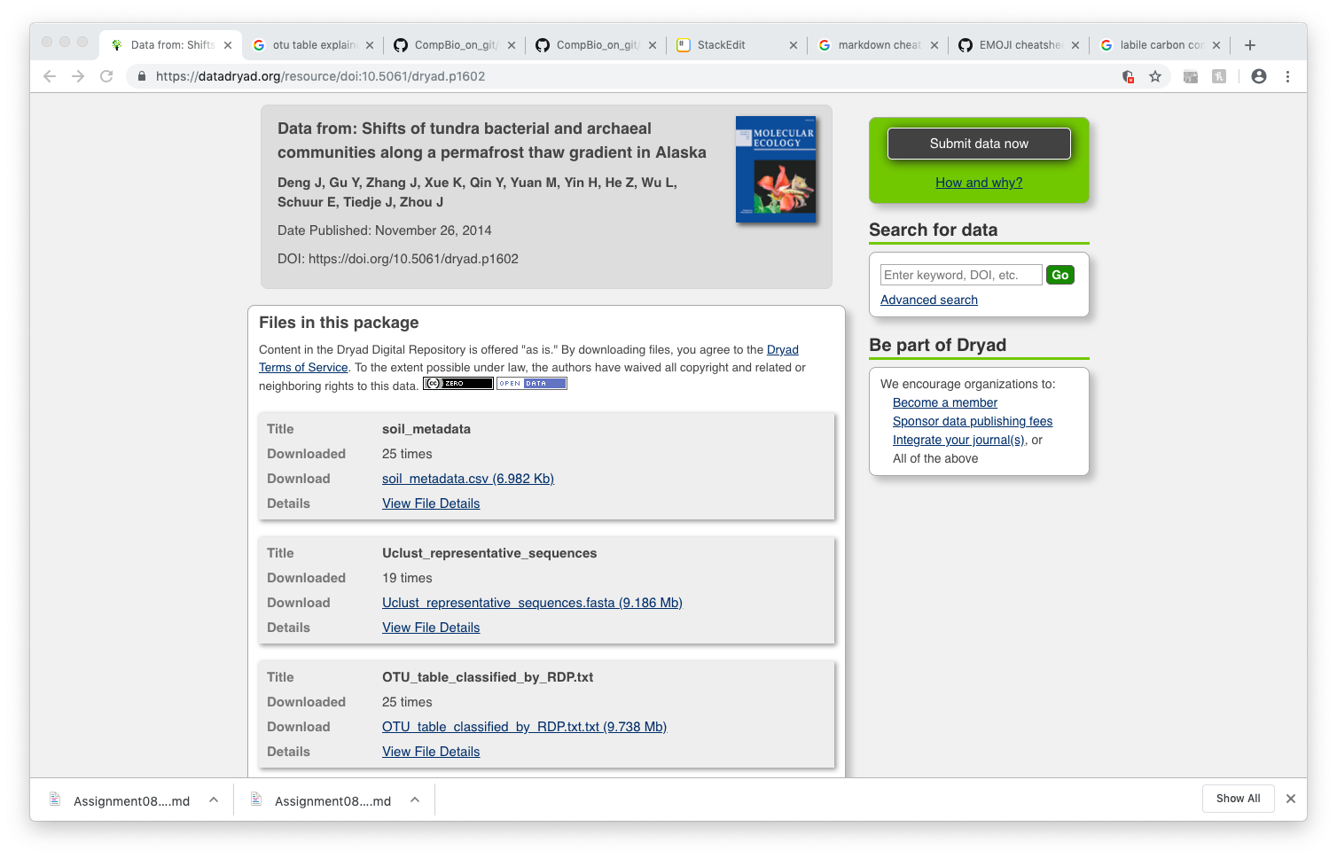
Approach
Measured soil physiochemical properties such as %C, %N, soil moisture, pH, etc. of each soil sample
Amplicon/barcode sequencing: 16S specific for microbes

Slide 4
About the Data
Metadata
What properties define each soil sample
The more detailed, the better
OTU Table
Which sequences found in each soil sample
Sequences correspond to whose there: which specific microbes are present in that soil sample
Taxonomic identification: which microbes are there. Lowest taxonomic level = genus
Can be big af
COMBINED: Show how soil properties shape community composition

Slide 5
Anticipated Details
Part 1: Data Wrangling
Part 2: Normalization of Reads
Exploratory Analysis
Inference Analysis

Slide 6
Anticipated Results
Different microbes metabolize different substrates, some use C: does the amount of C influence community composition?
Probably. Maybe. Depends.

