Slide 1



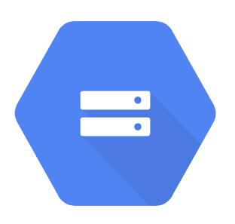

QField: mobile data collection
QGIS: project creation
Shiny dashboard:
Sync, visualise, and analyse data
Google Cloud Storage: secure data storage
Express.js server app to handle uploads and downloads

