Slide 1
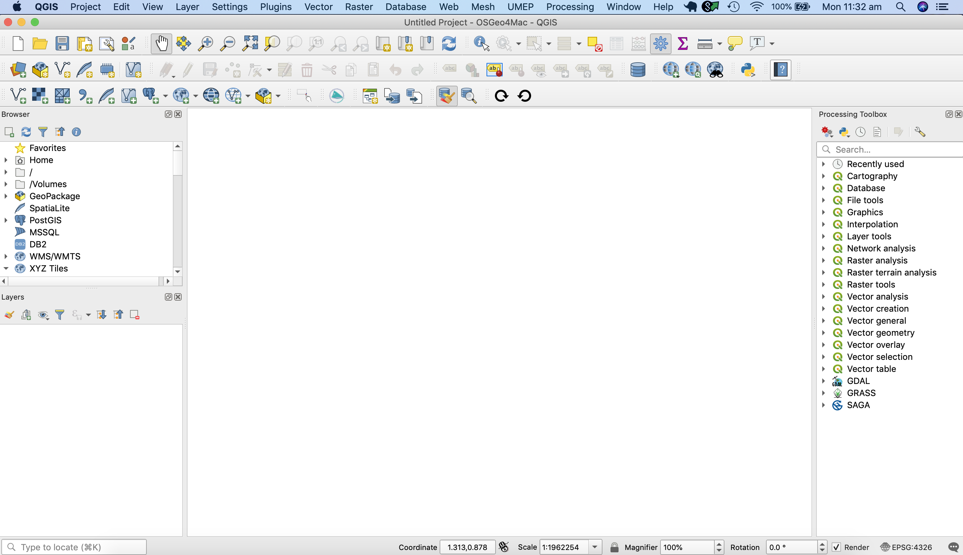
Toolbars
Browser Panel
Map Canvas
Layers Panel
Geoprocessing Toolbox

