Slide 1
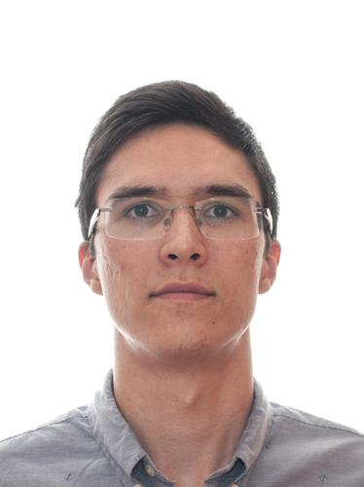
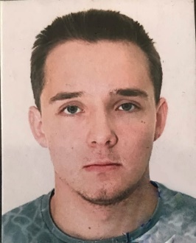

SPEEDING UP WAVE PROPAGATION MODEL
Team ZASA
Sayranov Danil
Moscow Institute of Physics and Technologies (M. Sc.)
Huawei Research Center
Key Research Interests: Machine Learning, Gradient-free methods, SNN.
Zasko Grigory
Moscow Institute of Physics and Technologies (M. Sc.)
Marchuk Institute of Numerical Mathematics of Russian Academy of Science
Key Research Interests: Matrix Analysis, Numerical Math.,
Stability Analysis, LTT, Turbulent Flows.

Slide 2




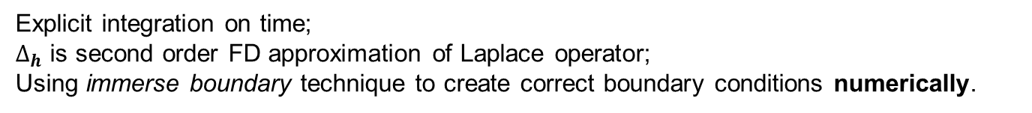
Main Problem:
2D wave prop. model with point source:
domain:
with reflecting boundary condition for p on the edges of domain
Numerical model:
Uniform rectangular grid with step h on spatial coordinates;
Uniform grid with step $τ$ on time;
Explicit integration on time;
$∆_{h}$ is second order FD approximation of Laplace operator;
Using immerse boundary technique to create correct boundary conditions numerically.
The main restriction:

Slide 3
Traditional solution:
Numerical
Solver:
(explicit) cheap forward step
strong restriction on Courant number = a lot of forward iterations
Our Main Goal:
Neural Network
Solver:
(explicit) not so expensive forward step
no restriction on Courant number

Slide 4
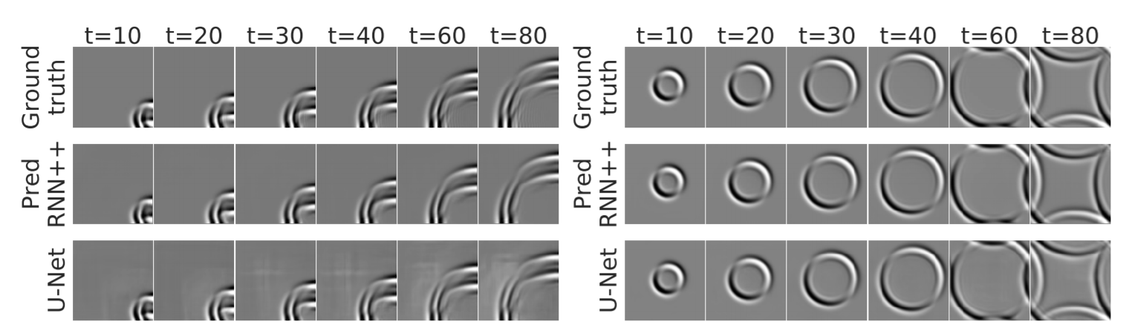
Actual researches
Comparing recurrent and convolutional neural networks for predicting wave propagation. https://arxiv.org/pdf/2002.08981.pdf
Approximating the solution to wave propagation using deep neural networks. https://arxiv.org/pdf/1812.01609.pdf

Slide 5
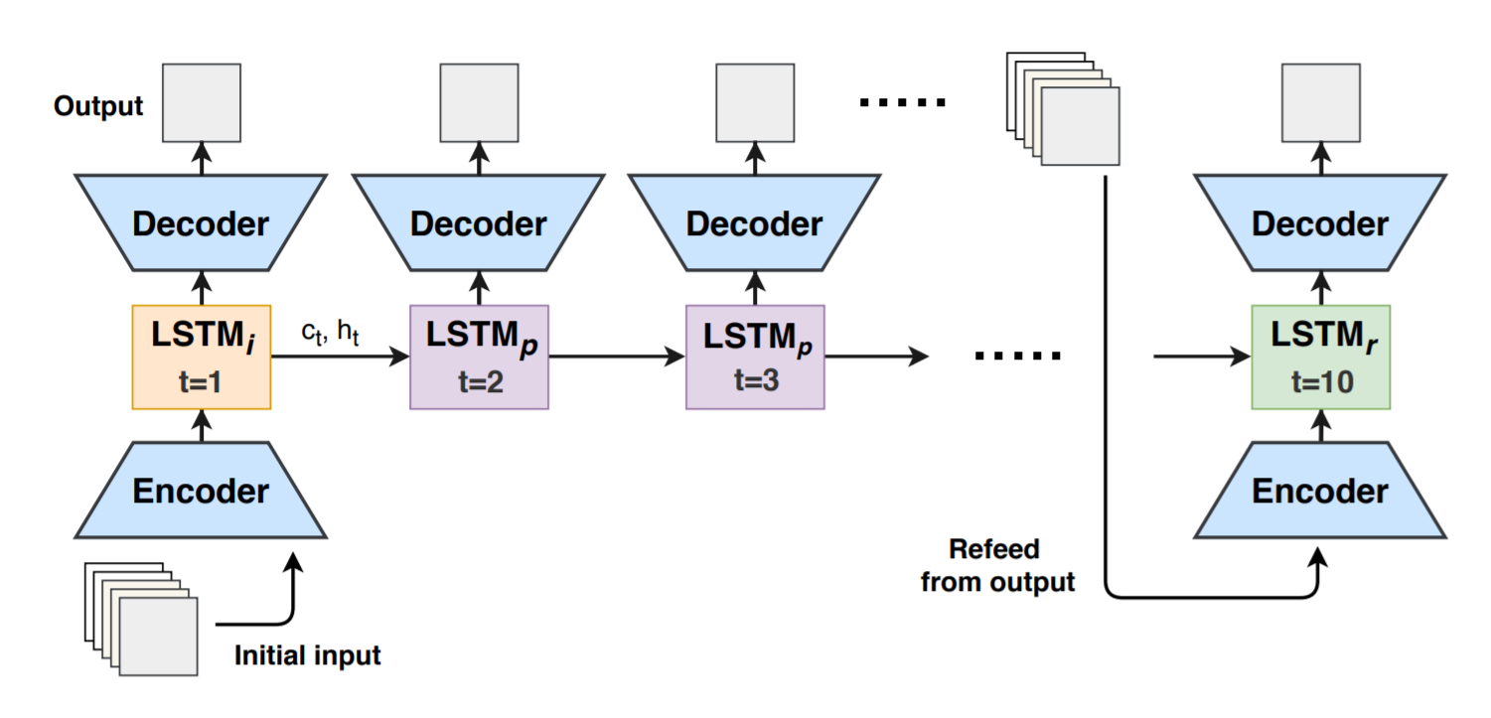
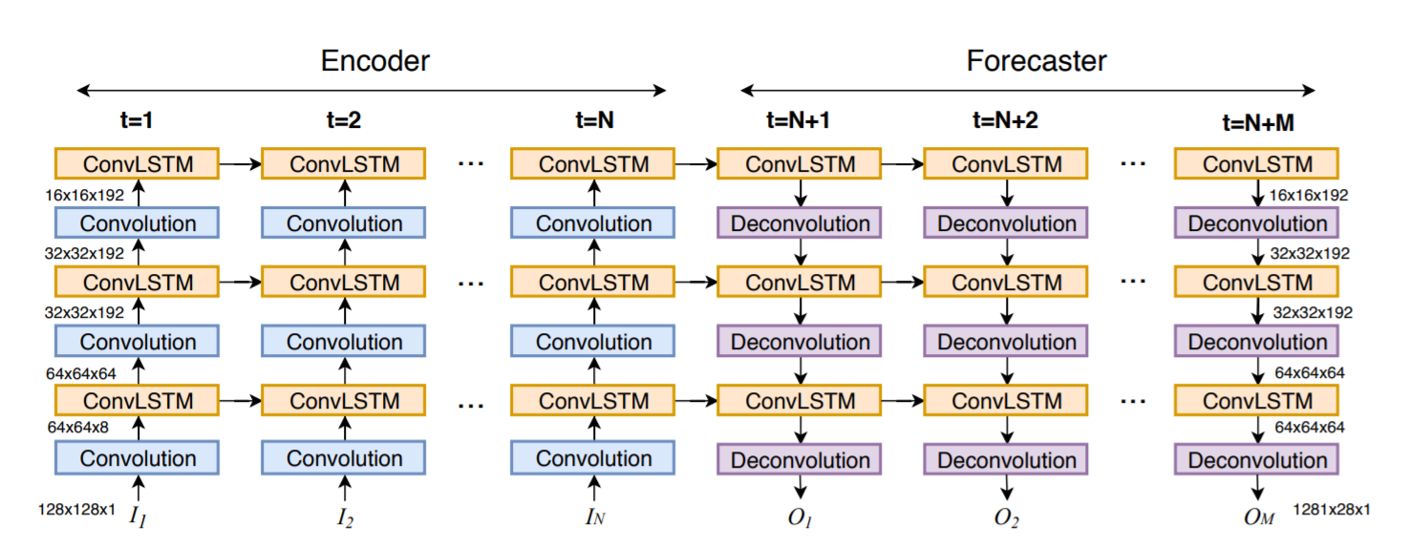
Actual researches
EncDec-LSTM
ConvLSTM

Slide 6
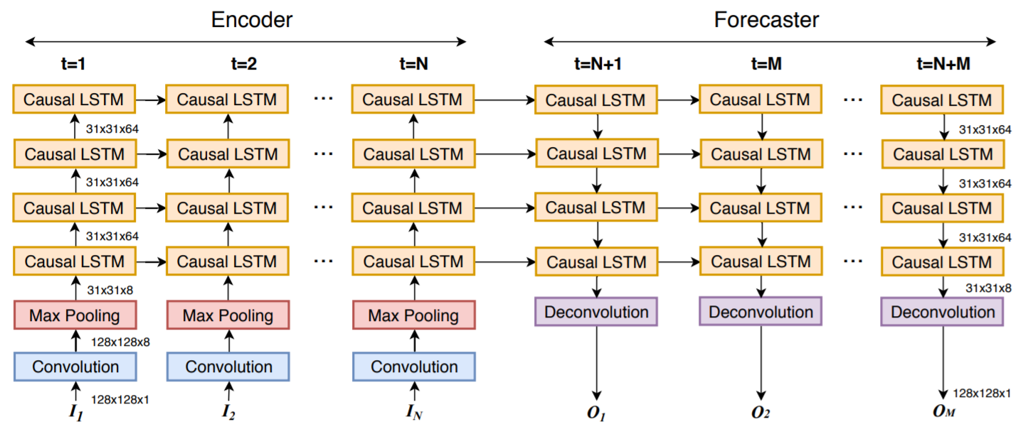
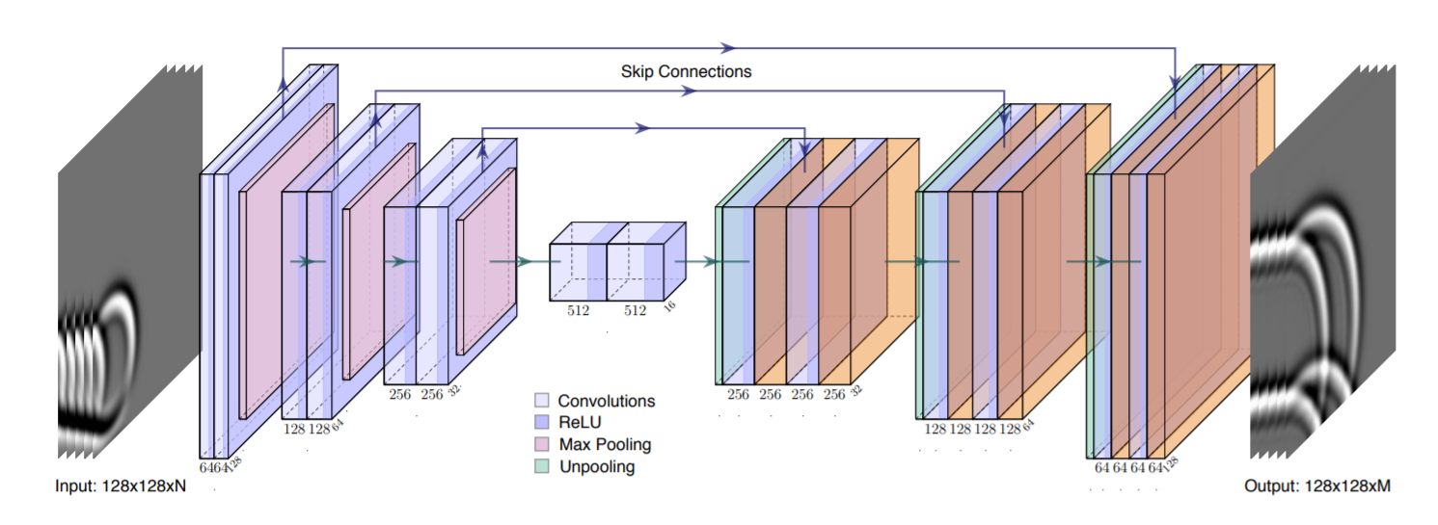
Actual researches
PredRNN++
U-Net

Slide 7
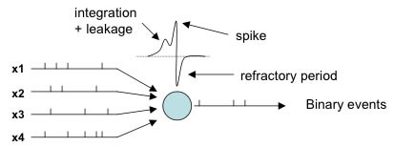
Spiking Neural Networks
From Wikipedia:
Spiking neural networks (SNNs) are artificial neural networks that more closely mimic natural neural networks. In addition to neuronal and synaptic state, SNNs incorporate the concept of time into their operating model. The idea is that neurons in the SNN do not transmit information at each propagation cycle (as it happens with typical multi-layer perceptron networks), but rather transmit information only when a membrane potential – an intrinsic quality of the neuron related to its membrane electrical charge – reaches a specific value, called the threshold. When the membrane potential reaches the threshold, the neuron fires, and generates a signal that travels to other neurons which, in turn, increase or decrease their potentials in response to this signal. A neuron model that fires at the moment of threshold crossing is also called a spiking neuron model.

Slide 8
Base ideas for training procedure:
Using at least 2 previous field snapshots for forecasting next one
Consider only interior grid nodes for training
(because boundary conditions doesn’t depend on time
and are described by different model)
Using different source wavelet configurations on training.
(According to tests in the TriFlow package)
4+) Using image method (geometric interpretation)

