Slide 1
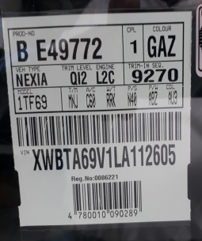
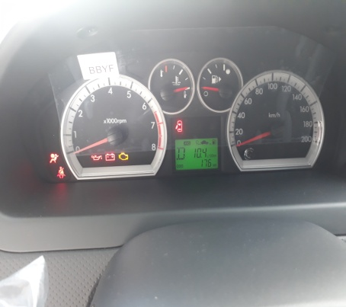
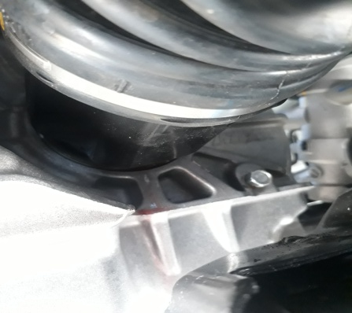
Warranty Report
Model | T250 |  | VIN | XWBTA69V1LA112605 |  | TUN | 617KCSR0167B7001
Part Name | TRANSAXLE ASM - AUTO |  | Issue Date | 08/09/2020 |  | Part Number |  | 24258381
Problem Identification & Definition | Standard |  |  | Frequency | 1 Vehicle | Photo (Detail)
 | Description: Leakage from zone where is assembled SHAFT ASM – FRT WHL DRV HAL to TRANSAXLE ASM – AUTO (LH).
Diagnosis at WARRANTY | Dealer’s action: Dealer has changed oil seal, but problem not solved. |  |  |  |  | Photo (Distant)
Repair / Fix Description
Remarks

