Slide 1
Thermal Fuse Open
[ Resistor ASM - GSVEM HVAC ]
UzECC

Slide 2
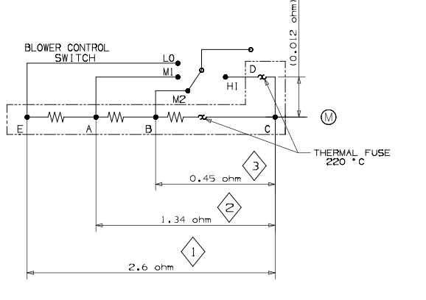
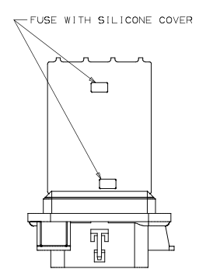
Thermal Fuse Open in Resistor ASM(52429971)
Issue
Blower motor does not work at speed # 4 in vehicle condition.
Root Cause
Thermal fuse was opened to protect system
It’s from electric shock in vehicle condition
This one is for speed #4
This one is for speed #1,2,3

Slide 3
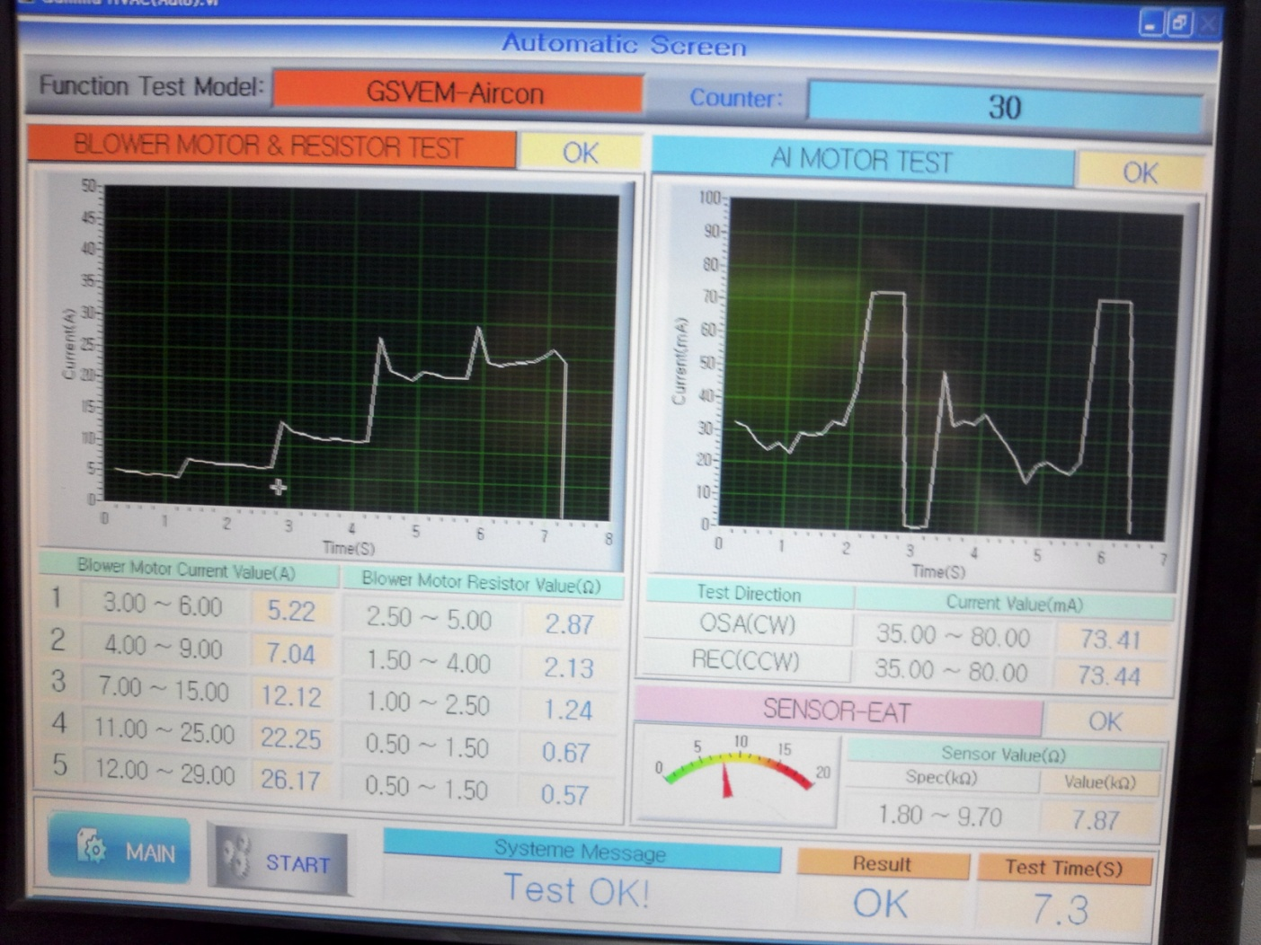
UzECC Process
Test 100% with function tester
Check ampere and resistance with connecting resistor and blower motor for each speed

