Slide 1
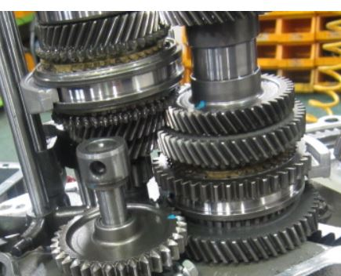
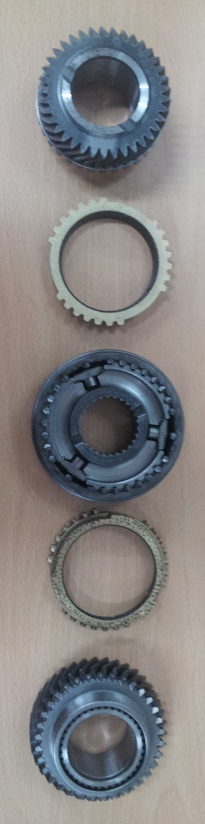
Warranty Report
Model | M300 |  | VIN | XWBMF48NELA553287
Part Name | TRANSAXLE ASM-MAN |  | Issue Date | 09.10.2020 |  | Part Number | 25186889
Problem Identification & Definition | Standard |  |  | Frequency | 1 Vehicle | Photo (Detail)
 | Description: Transaxle Asm Manual- Abnormal noise. Vehicle mileage is 2082 km TUN: T2200970A15X0020
Diagnosis at WARRANTY | The suspected cause is the noise of the synchronizers. |  |  |  |  | Photo (Distant)
Repair / Fix Description
Remarks | At this time, the problem TRANSAXLE ASM-MAN is in the vehicle.
4th
3rd
Syn. ring
2nd
1st
Syn. ring

