Slide 1
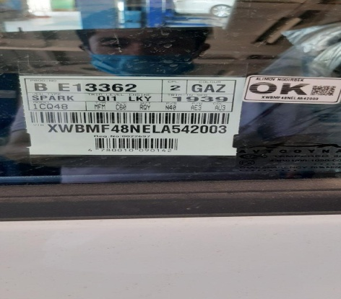
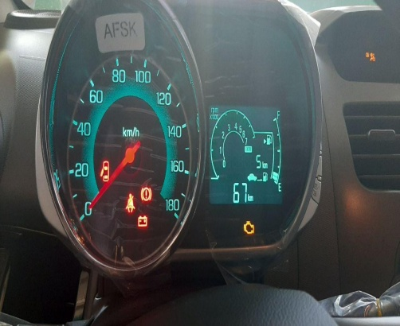
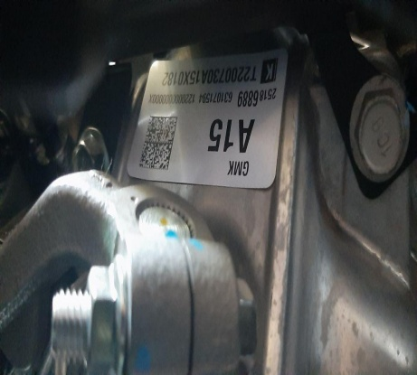
Warranty Report
Model | M300 |  | VIN | XWBMF48NELA542003
Part Name | TRANSAXLE ASM-MAN |  | Issue Date | 26,06,2020 |  | Part Number | 25186889
Problem Identification & Definition | Standard |  |  | Frequency | 1 Vehicle | Photo (Detail)
 | Description: TRANSAXLE ASM-MAN – Noise. Abnormal noise is detected when the vehicle is driven at the 1th shift. When driving in other shifts, this noise does not come out. Vehicle mileage is 5 km TUN: T2200730A15X0182
Diagnosis at WARRANTY |  |  |  |  |  | Photo (Distant)
Repair / Fix Description | At this time this car has not yet been sold, it is at the dealer.
Remarks | The dealer is waiting for our recommendation.

