Slide 1
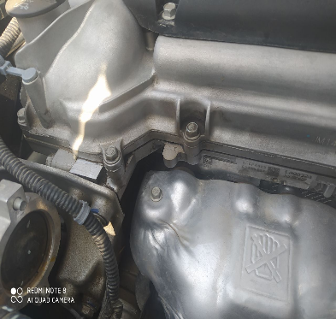

Warranty
Model: Nexia R3
Failure mode: Oil leak from cam cover B1.5
EUN: 13201992DJDX0063
VIN: XWBTF69V1LA061057
Mileage: 9156 km
Root cause: Cam cover was reworked by supplier
Corrective actions:
Do not use reworked parts from supplier
Stopped rework process
BP: 4 Sep 2020
EUN: 13202537GRXX0173

Slide 2
