Slide 1
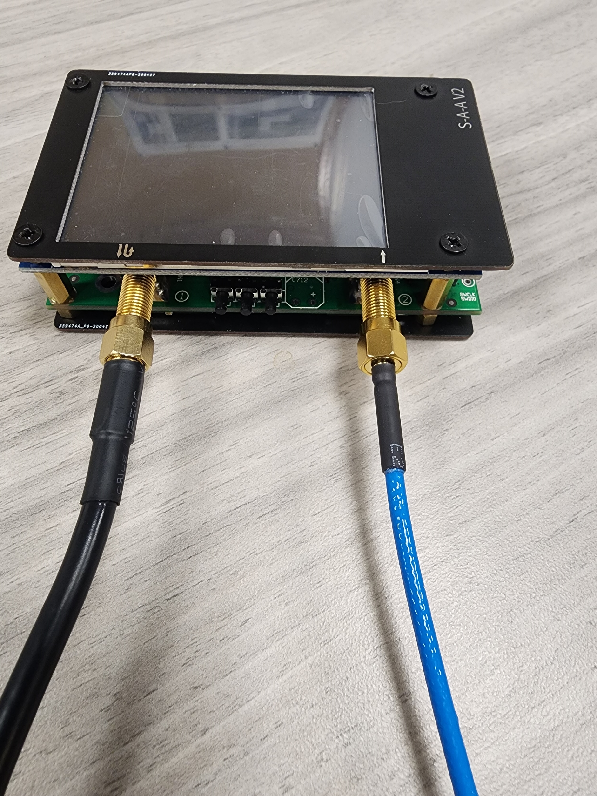
On/Off switch
Touch Screen Display
Input Buttons
(Left, Enter, Right)
Ch 0: Source/
Reflection
Ch 1:
Transmission
SMA Cable

Slide 2
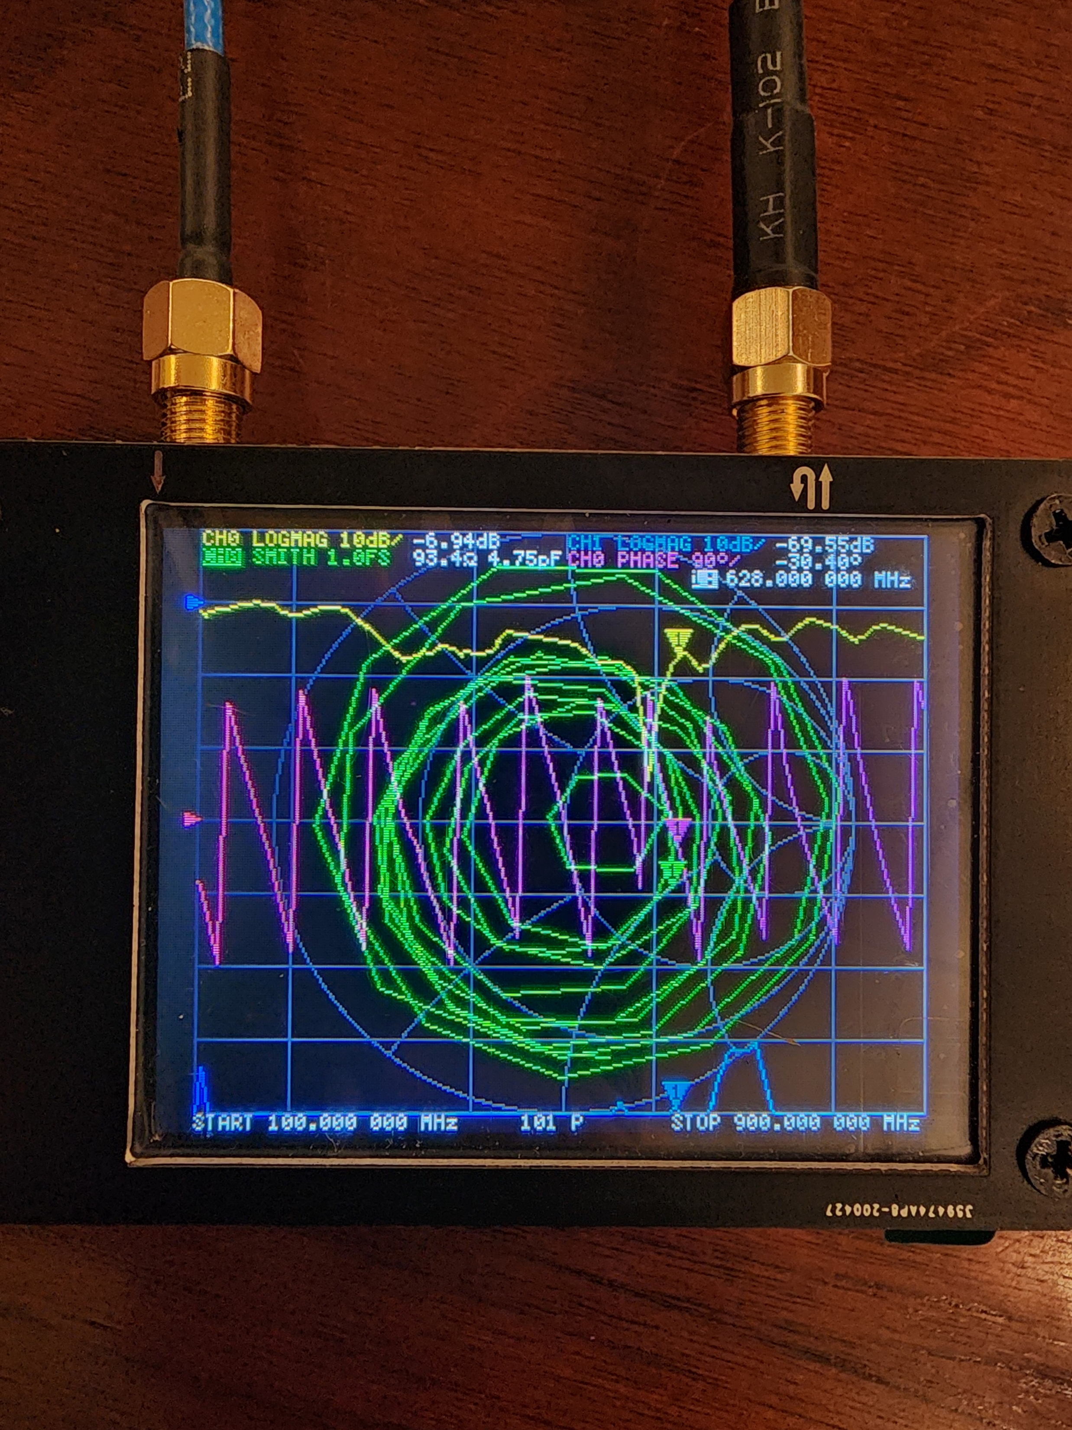
Marker 1 y-value
Selected Marker x-position

Slide 3
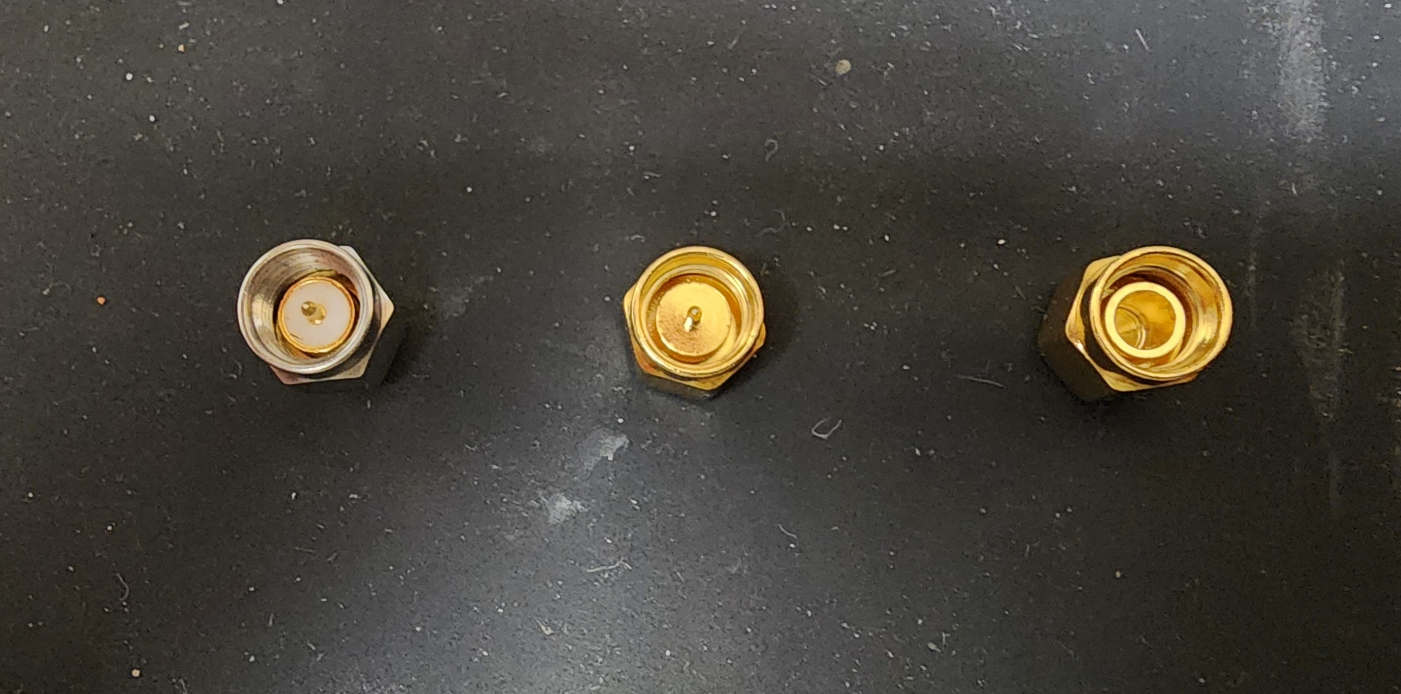
Load
Short
Open

