Slide 1
Intro to Machine Learning in Python
Russel Mahmud @PyCon Dhaka 2014

Slide 2




Who am I ?
Software Engineer @NewsCred
Passionate about Big Data, Analytics and ML
#LiveWithPython
https://github.com/livewithpython/sklearn-pycon-2014
Machine Learning
in Bangladesh

Slide 3
Agenda
Machine Learning Basics
Introduction to Scikit-learn
A simple example
Conclusion
Q&A

Slide 4
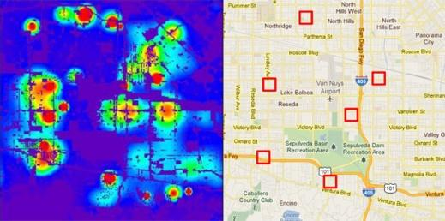
Story 1 : PredPol (Predictive Policing)
Predict crime at real time.
`

Slide 5
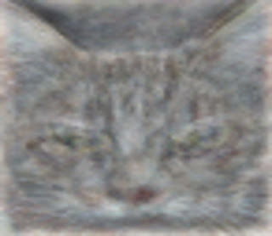
Story 2 : YouTube Neuron
Google’s artificial brain learns to find Cat

Slide 6
What is Machine Learning?
Field of study that gives computers the ability to learn without being explicitly programmed.
- Arthur Samuel
A computer program is said to learn from experience E with respect to some class of tasks T and performance measure P, if its performance at tasks in T, as measured by P, improves with experience E.
- Tom M. Mitchell

Slide 7
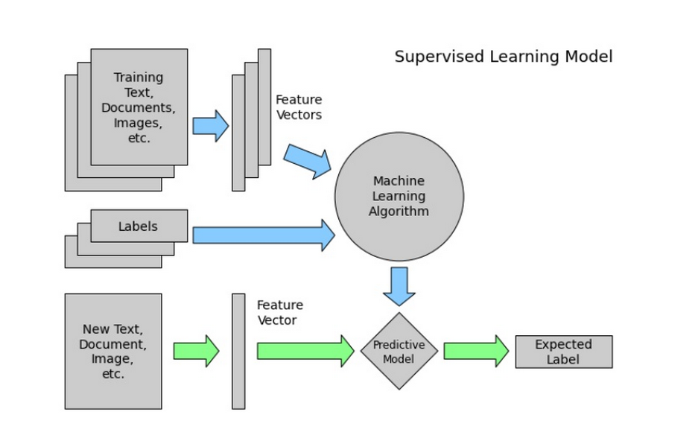
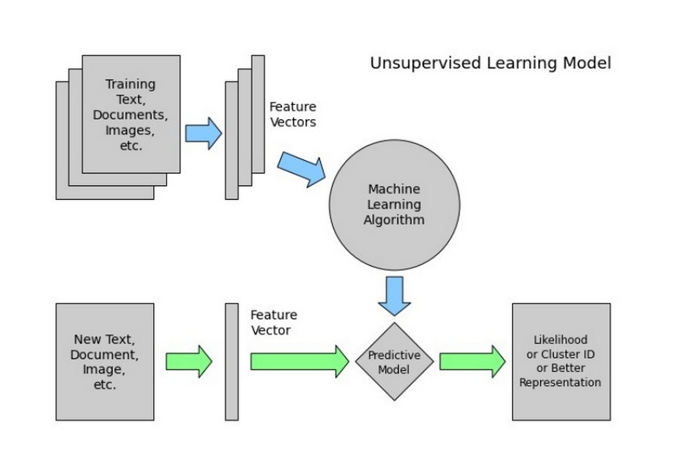
Algorithm types
Supervised Learning
Unsupervised Learning

Slide 8
Python Tools for Machine Learning
Scikit-learn
Statsmodels
PyMC
Shogun
Orange
...

Slide 9

Scikit-learn
Simple and efficient for data mining and data analysis
Open source, commercially usable
It’s much faster than other libraries
It’s built on numpy, scipy and matplotlib

Slide 10
Scikit-learn
Simple and consistent API
Instantiate the model
m = Model ()
Fit the model
m.fit(train_data, target) or
m.fit(train_data)
Predict
m.predict(test_data)
Evaluate
m.score(train_data, target)

Slide 11
Example : Web Traffic Prediction
Current limit : 100,000 hits/hours
Predict the right time to allocate sufficient resources

Slide 12
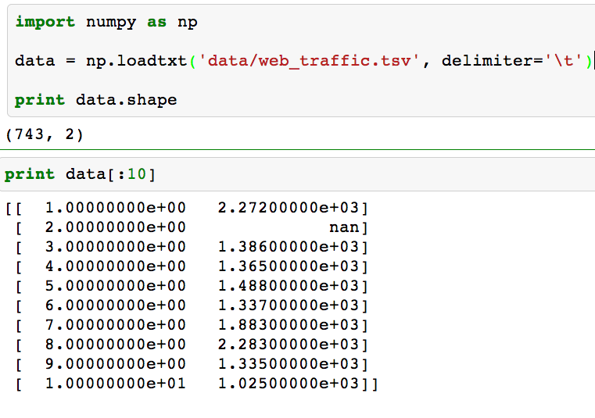
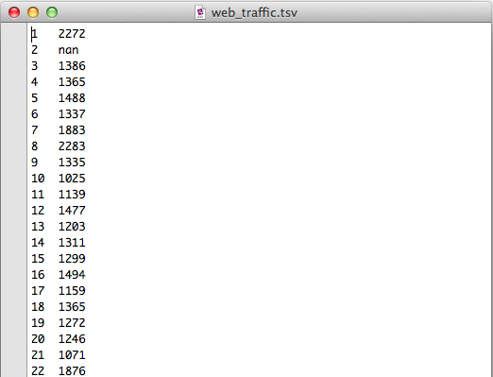
Reading in the data

Slide 13
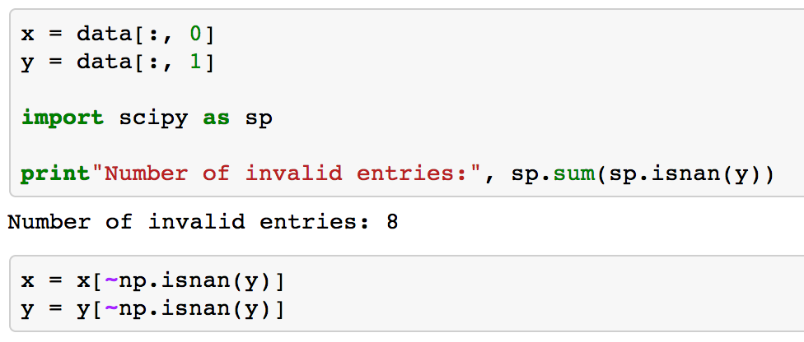
Preparing the data

Slide 14
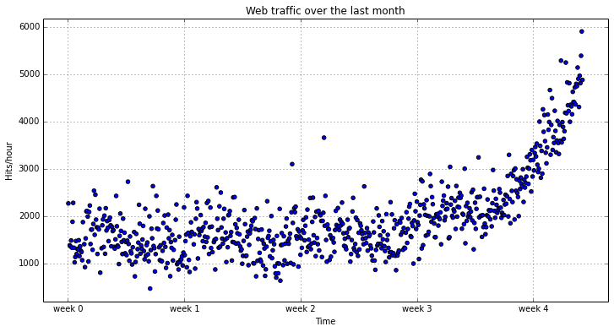
Taking a peek

Slide 15
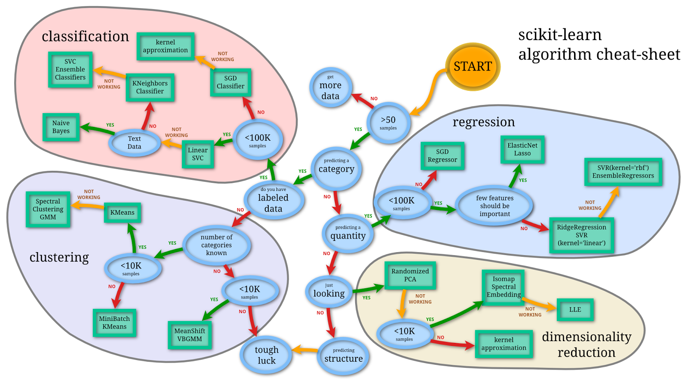
Model Selection

Slide 16
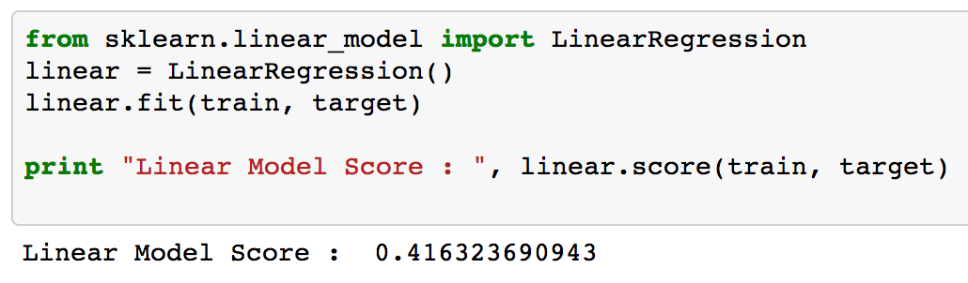
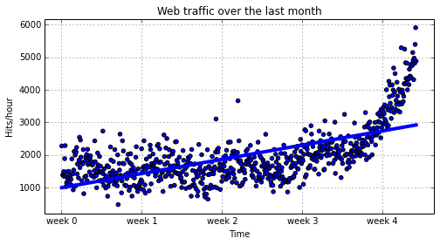
Simple Model

Slide 17
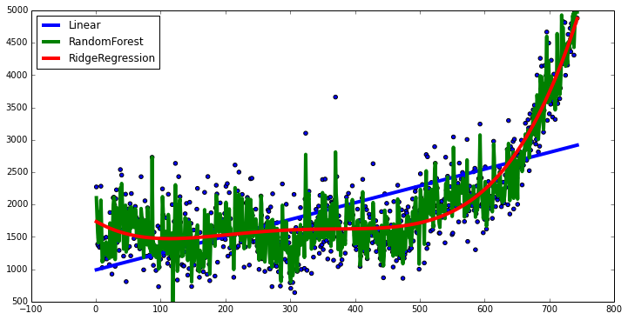
Playing around
Residual Score
Linear 0.4163
RandomForest 0.952
RidgeRegression 0.7665

Slide 18
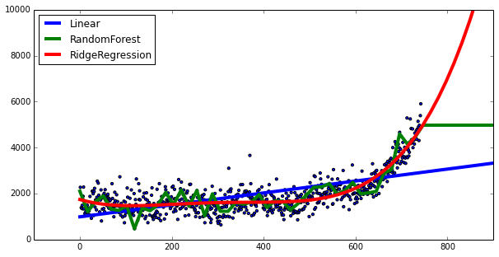
Taking a closer look

Slide 19
Underfitting and Overfitting
aka high bias
model is very simple
aka high variance
model is excessively complex

Slide 20
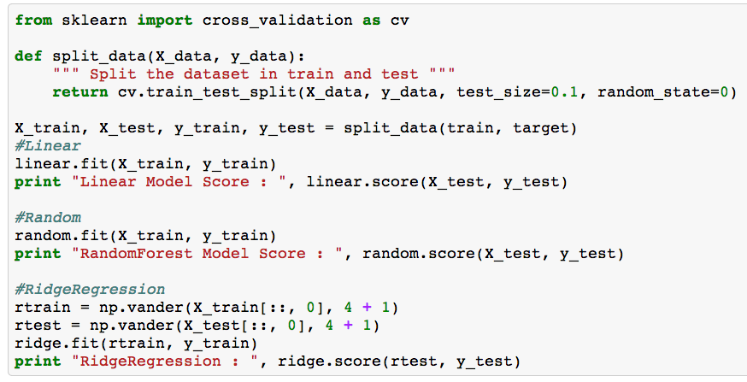
Evaluation
Measure performance with using cross-validation
Cross Validation Score
Linear 0.4450
RandomForest 0.6519
RidgeRegression 0.7256

Slide 21
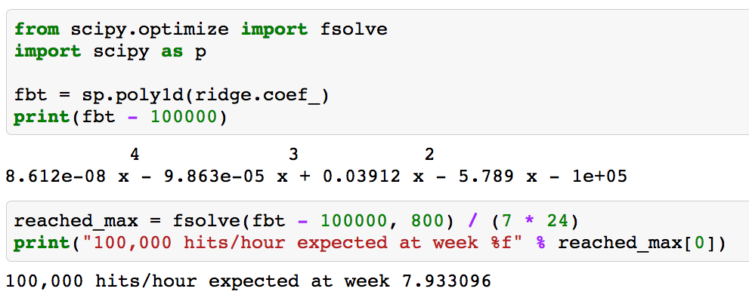
Example : Solution

Slide 22
Conclusion
Python is Awesome
Scikit-learn makes it more Awesome

Slide 23
References
http://www.predpol.com/
http://en.wikipedia.org/wiki/Machine_learning
http://scikit-learn.org/
http://www.cbinsights.com/blog/python-tools-machine-learning
http://googleblog.blogspot.com/2012/06/using-large-scale-brain-simulations-for.html
http://www.kaggle.com/

Slide 24
Q&A

