Slide 1

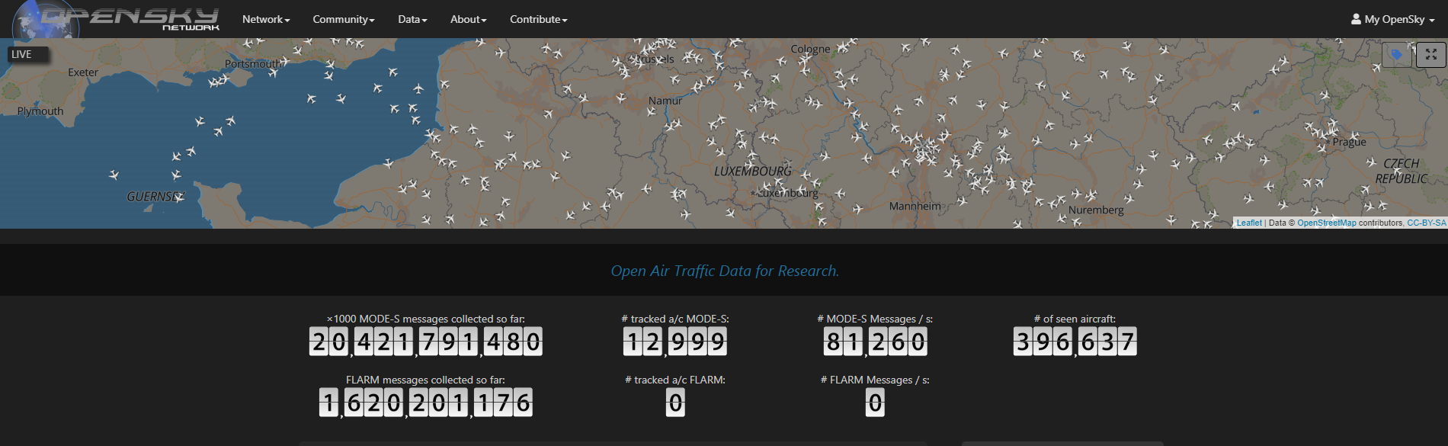
https://github.com/livgeni/NayaDE-Final-Project.git
איל הרשקוביץ
יבגני ליבשיץ

Slide 2
השאלה העסקית
איסוף מידע על תנועות טיסות בינלאומיות
שמירת המידע לטובת ניתוחים עתידיים
הנגשת המידע לניתוחים מיידים, ב Impala, ברמה יומית / שעתית
העשרת המידע הגיאוגרפי, במידע לגבי אזור הטיסה: ארץ / עיר
הצגת מסלולים ומפות חום
מתן התראות על חריגות:
זע"ט בעייתי
טיסה שחודרת למרחב של מדינה מסוימת

Slide 3
תיאור הדאטה
מיקומי מטוסים בעולם ע"ב רשת מקלטים ציבורית
שימוש ב python API קיים של האתר
פעם ב-10 שניות מקבלים רשימת כלל המיקומים (~6000)
icao24 - Mode-s Unique identifier
callsign - Identifies a specific flight
longitude - WGS-84
latitude - WGS-84
geo_altitude - AGL in meters
baro_altitude - ASL in meters
squawk - transponder code
on_ground – true / false
velocity - over ground in m/s.

Slide 4
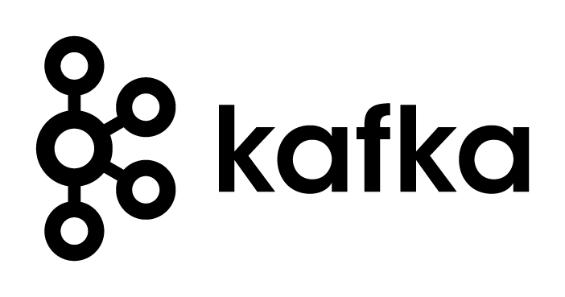

Architecture:
Alerts Engine
Basic Alerts - RT
MySQL
https://opensky-network.org/
Geo. Alerts
Topic #1: real-time-states0
Topic #2: sparse states
Topic #3: geo-enriched
TelegramBot
OpenSkyApi.get_states()
OpenskyApgenerator
Hadoop HDFS
Producer
Structured Streaming
JSON Raw
Enrich location
Add geo info
Archive
Parquet backup
Impala
Append to tables
Drop last hour/day
Partitions :
Impala
By
hour/day
Parquet
By hour
Logger

Slide 5
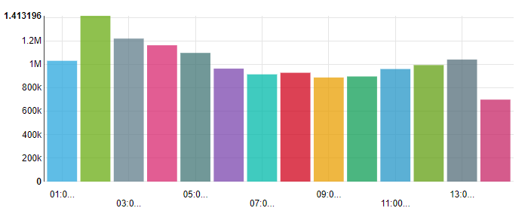
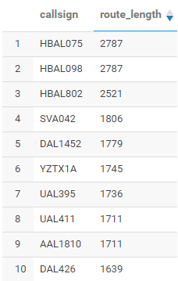
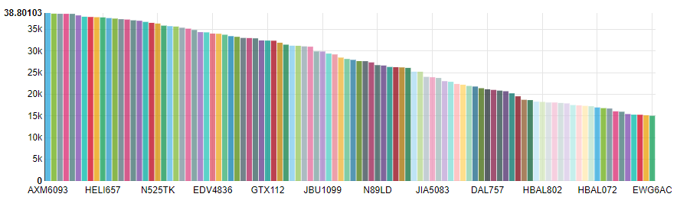
דו"חות לדוגמה
Signals count by hour for last day
Longest routes
Max altitude by flight (100)

Slide 6
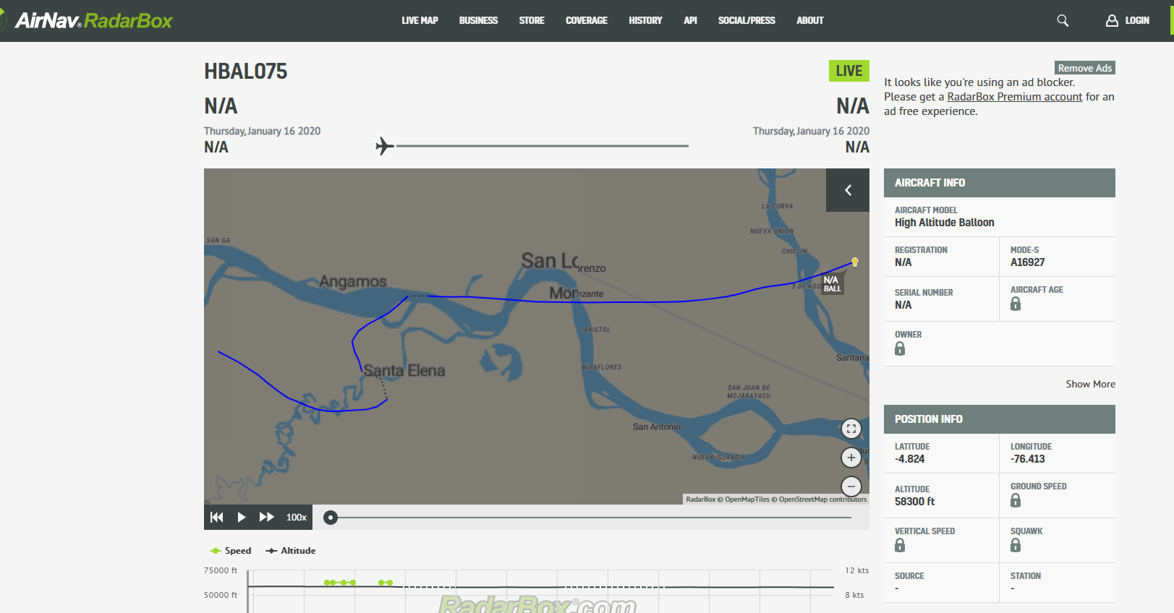
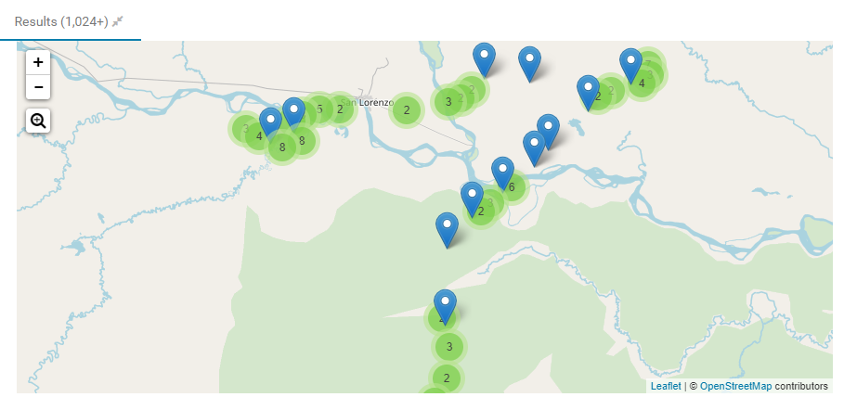

Slide 7
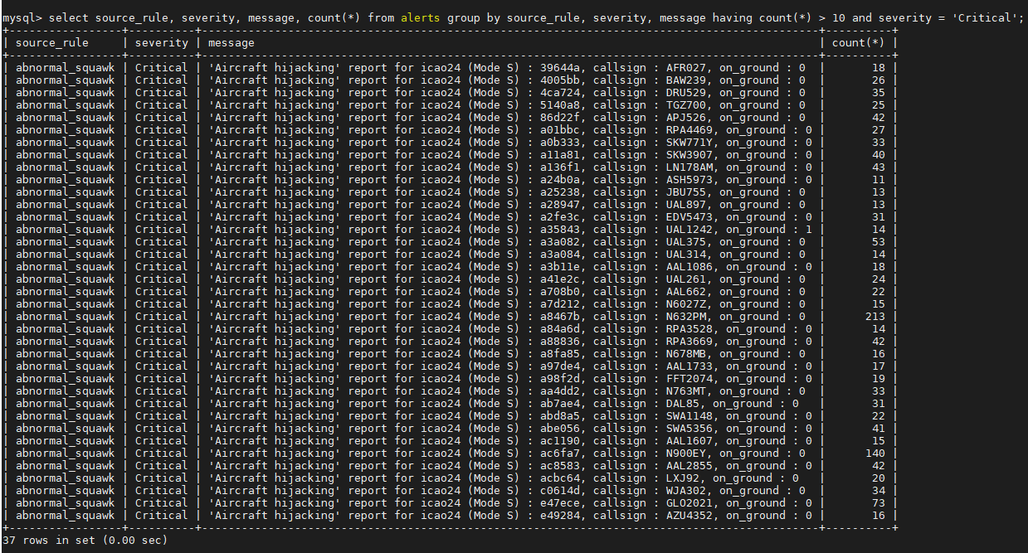
טבלת ההתראות

Slide 8
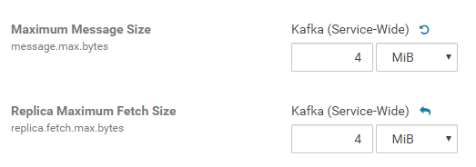
Points of Interest
Kafka has default max message size of 1MB – can be configured
Kafka configuration + config when creating the producer
Notes:
Saving raw JSON in hdfs requires space more than 10 times of same data saved in paruqet format
Spark Structured Streaming and Bool values: in python bool is True / False, in Spark Types, boolean is 0 / 1
It probably would be smarter to send each state vector sas a seperate message and not all together in the list each cycle. Because later when it is turned into a dataframe it's harder to turn it back into array of json's again and send the entire batch

Slide 9


Points of Interest
Saving raw JSON in hdfs vs parquet fromat
Spark Structured Streaming and Bool values
After changing replication level and deleting
Notes:
Saving raw JSON in hdfs requires space more than 10 times of same data saved in paruqet format
Spark Structured Streaming and Bool values: in python bool is True / False, in Spark Types, boolean is 0 / 1
It probably would be smarter to send each state vector sas a seperate message and not all together in the list each cycle. Because later when it is turned into a dataframe it's harder to turn it back into array of json's again and send the entire batch

Slide 10
Points of Interest
Spark Structured Streaming and Bool values
Notes:
Saving raw JSON in hdfs requires space more than 10 times of same data saved in paruqet format
Spark Structured Streaming and Bool values: in python bool is True / False, in Spark Types, boolean is 0 / 1
It probably would be smarter to send each state vector sas a seperate message and not all together in the list each cycle. Because later when it is turned into a dataframe it's harder to turn it back into array of json's again and send the entire batch

Slide 11
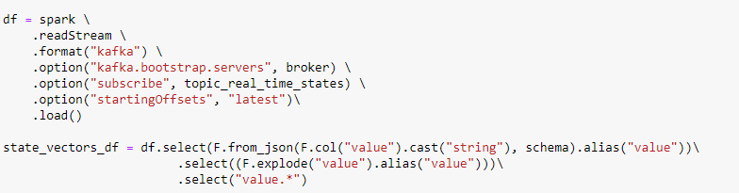
Points of Interest
Each record -> kafka message vs batch of records -> kafka message
Or array of JSONs to DataFrame and back to array of JSONs
Notes:
Saving raw JSON in hdfs requires space more than 10 times of same data saved in paruqet format
Spark Structured Streaming and Bool values: in python bool is True / False, in Spark Types, boolean is 0 / 1
It probably would be smarter to send each state vector sas a seperate message and not all together in the list each cycle. Because later when it is turned into a dataframe it's harder to turn it back into array of json's again and send the entire batch

