Slide 1

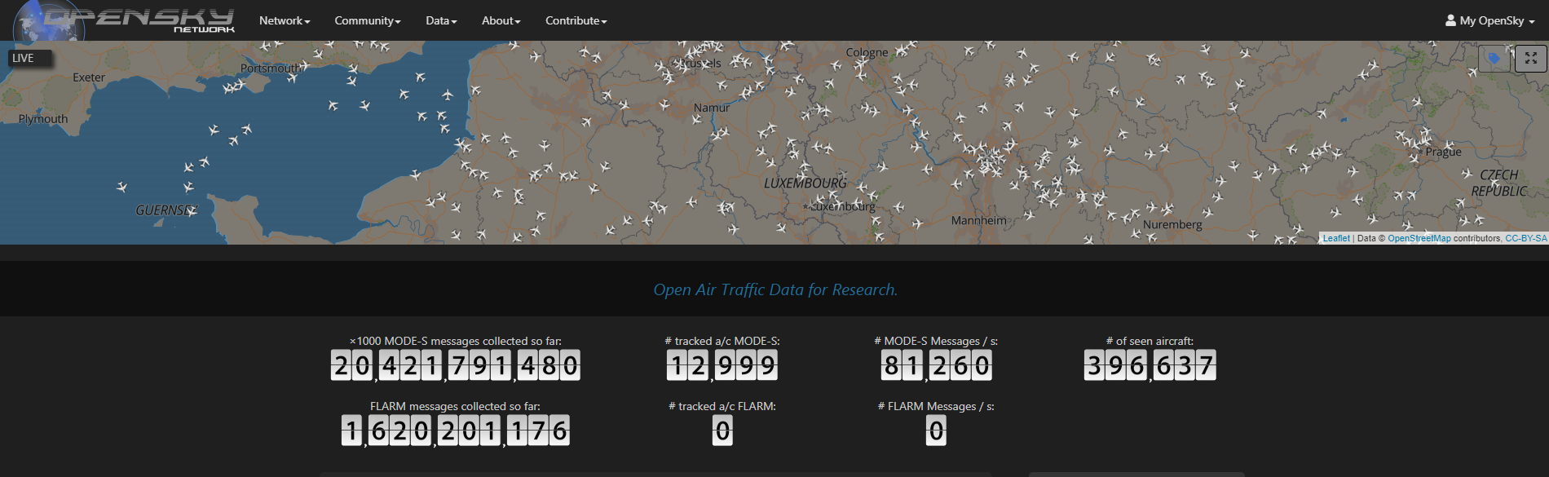
https://github.com/livgeni/NayaDE-Final-Project.git
איל הרשקוביץ
יבגני ליבשיץ

Slide 2
השאלה העסקית
איסוף מידע על תנועות טיסות בינלאומיות
שמירת המידע לטובת ניתוחים עתידיים
הנגשת המידע לניתוחים מיידים, ב Impala, ברמה יומית / שעתית
העשרת המידע הגיאוגרפי, במידע לגבי אזור הטיסה: ארץ / עיר
הצגת מסלולים ומפות חום
מתן התראות על חריגות:
זע"ט בעייתי
טיסה שחודרת למרחב של מדינה מסוימת

Slide 3
תיאור הדאטה
מיקומי מטוסים בעולם ע"ב רשת מקלטים ציבורית
שימוש ב python API קיים של האתר
פעם ב-10 שניות מקבלים רשימת כלל המיקומים (~6000)
icao24 - Mode-s Unique identifier
callsign - Identifies a specific flight
longitude - WGS-84
latitude - WGS-84
geo_altitude - AGL in meters
baro_altitude - ASL in meters
squawk - transponder code
on_ground – true / false
velocity - over ground in m/s.

Slide 4
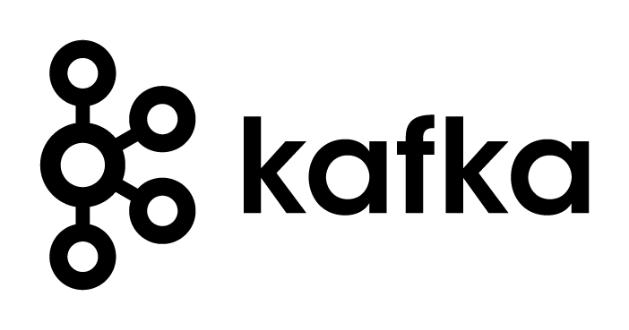

Architecture:
Alerts Engine
Basic Alerts - RT
MySQL
https://opensky-network.org/
Geo. Alerts
Topic #1: real-time-states0
Topic #2: sparse states
Topic #3: geo-enriched
TelegramBot
OpenSkyApi.get_states()
OpenskyApgenerator
Hadoop HDFS
Producer
Structured Streaming
JSON Raw
Enrich location
Add geo info
Archive
Parquet backup
Impala
Append to tables
Drop last hour/day
Partitions :
Impala
By
hour/day
Parquet
By hour
Logger

Slide 5
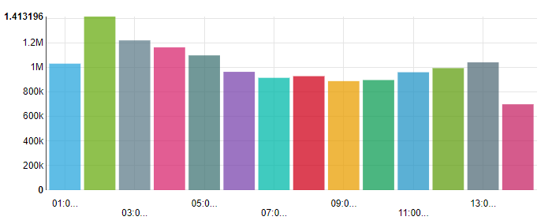
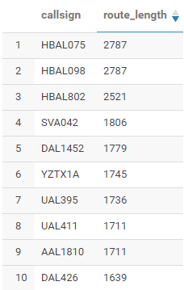
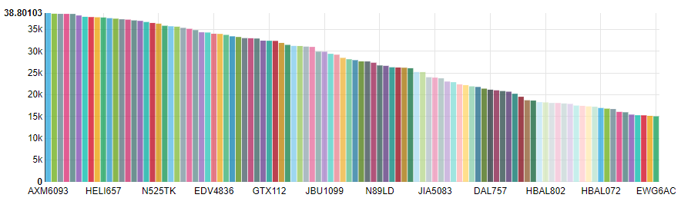
דו"חות לדוגמה
Signals count by hour for last day
Longest routes
Max altitude by flight (100)

Slide 6
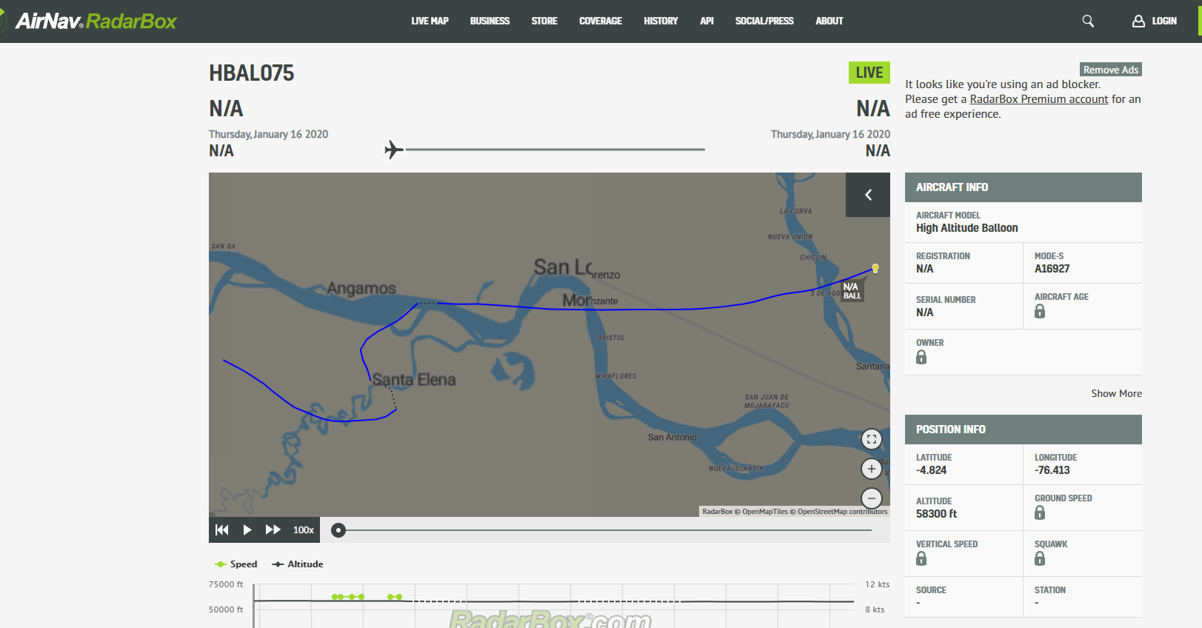
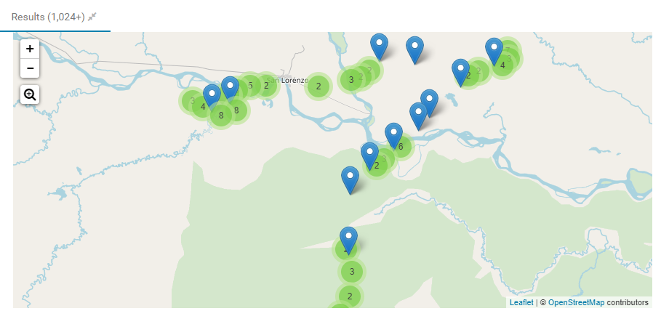

Slide 7
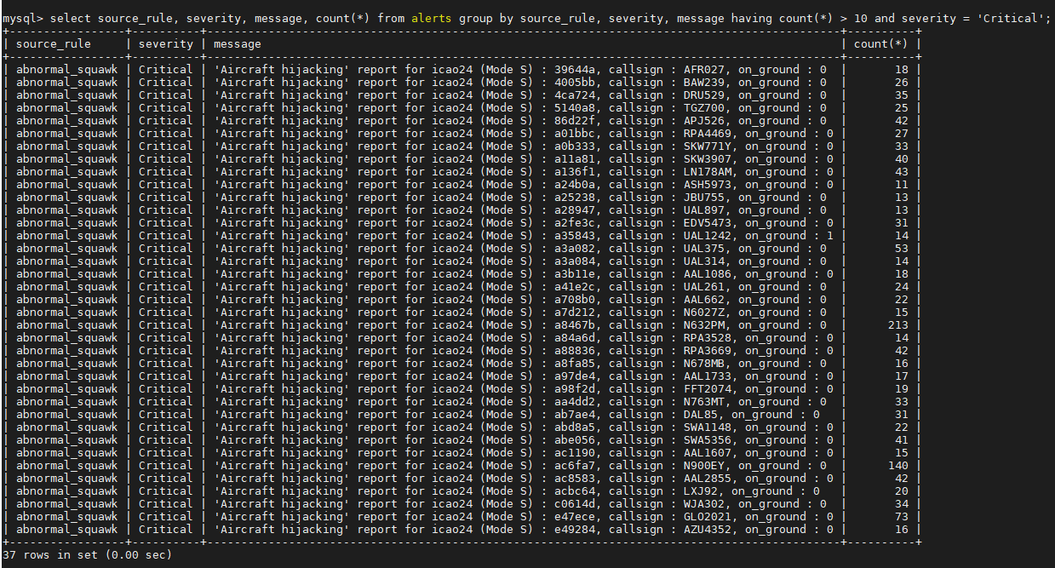
טבלת ההתראות

Slide 8
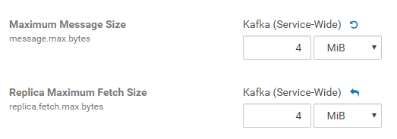
Points of Interest
Kafka has default max message size of 1MB – can be configured
Kafka configuration + config when creating the producer
Notes:
Saving raw JSON in hdfs requires space more than 10 times of same data saved in paruqet format
Spark Structured Streaming and Bool values: in python bool is True / False, in Spark Types, boolean is 0 / 1
It probably would be smarter to send each state vector sas a seperate message and not all together in the list each cycle. Because later when it is turned into a dataframe it's harder to turn it back into array of json's again and send the entire batch

Slide 9


Points of Interest
Saving raw JSON in hdfs vs parquet fromat
Spark Structured Streaming and Bool values
After changing replication level and deleting
Notes:
Saving raw JSON in hdfs requires space more than 10 times of same data saved in paruqet format
Spark Structured Streaming and Bool values: in python bool is True / False, in Spark Types, boolean is 0 / 1
It probably would be smarter to send each state vector sas a seperate message and not all together in the list each cycle. Because later when it is turned into a dataframe it's harder to turn it back into array of json's again and send the entire batch

Slide 10
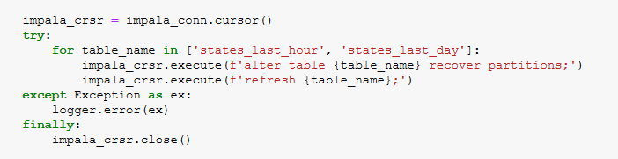
Points of Interest
Spark Structured Streaming and Bool values
Append data directly into hdfs as parquet -> then update Impala tables
Notes:
Saving raw JSON in hdfs requires space more than 10 times of same data saved in paruqet format
Spark Structured Streaming and Bool values: in python bool is True / False, in Spark Types, boolean is 0 / 1
It probably would be smarter to send each state vector sas a seperate message and not all together in the list each cycle. Because later when it is turned into a dataframe it's harder to turn it back into array of json's again and send the entire batch

Slide 11
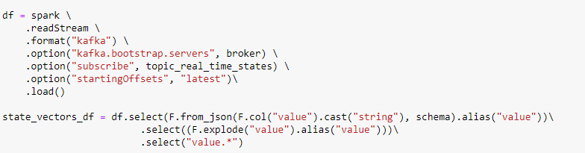
Points of Interest
Each record -> kafka message vs batch of records -> kafka message
Or array of JSONs to DataFrame and back to array of JSONs
Notes:
Saving raw JSON in hdfs requires space more than 10 times of same data saved in paruqet format
Spark Structured Streaming and Bool values: in python bool is True / False, in Spark Types, boolean is 0 / 1
It probably would be smarter to send each state vector sas a seperate message and not all together in the list each cycle. Because later when it is turned into a dataframe it's harder to turn it back into array of json's again and send the entire batch

