Slide 1
EEG-Based Eye State Classification & Cognitive Monitoring

Slide 2
INTRODUCTION
Unlike cameras, EEG works in poor lighting, is privacy-preserving
and measures brain activity directly.
Why it Matters: This technology is critical for monitoring driver
fatigue, improving human-computer interaction, and neurofeedback systems.

Slide 3
PROJECT GOAL
Analyze: Understand EEG signal patterns and data quality.
Preprocess: Clean the data using outlier detection and scaling.
Classify: Build and compare 6 different Machine Learning models (LR, KNN, DT, RF, SVM, MLP).
Monitor: Calculate real-world metrics like Blink Rate, Attention Score, and Fatigue Index.

Slide 4
TECHNICAL PIPELINE
Load dataset (Pandas)
Outlier removal (IQR)
Rolling feature extraction
StandardScaler normalization
Train-test split (80-20)
Model training (sklearn)
Evaluation and Monitoring (metrics)

Slide 5
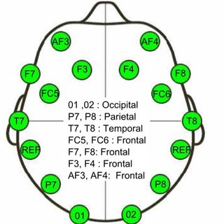
DATASET OVERVIEW
The system uses EEG (Electroencephalography) data to monitor brain activity in real-time:
Input Features(x): 14 EEG Channels: AF3, F7, F3, FC5, T7, P7, O1, O2, P8, T8, FC6, F4, F8, AF4.
Preprocessing: Data was cleaned using the Interquartile Range (IQR) method to remove noise, resulting in 10,848 clean samples.
Feature Engineering: Rolling Window Statistics (Mean and Standard Deviation) were calculated to capture the brain's rhythm over time rather than just static points.
Target Labels(y):
Binary classification: 0 for "Eyes Open" and 1 for "Eyes Closed."
Slightly imbalanced Class Distribution but acceptable for binary classification : Eyes Open: 6005 samples (55.4%), Eyes Closed: 4843 samples (44.6%)

Slide 6
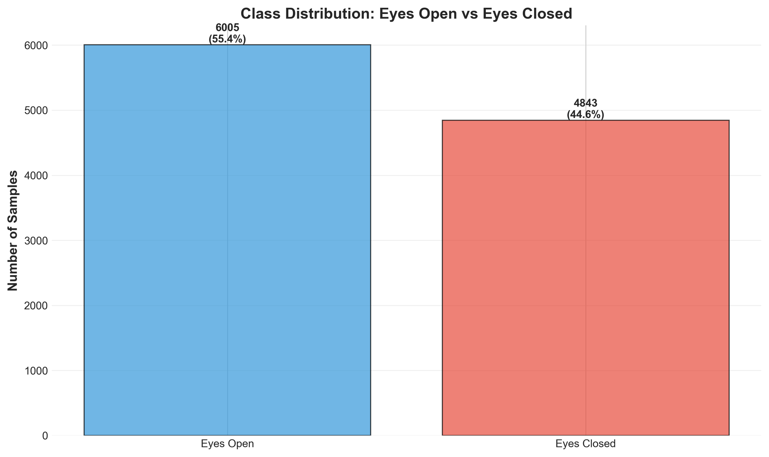

Slide 7
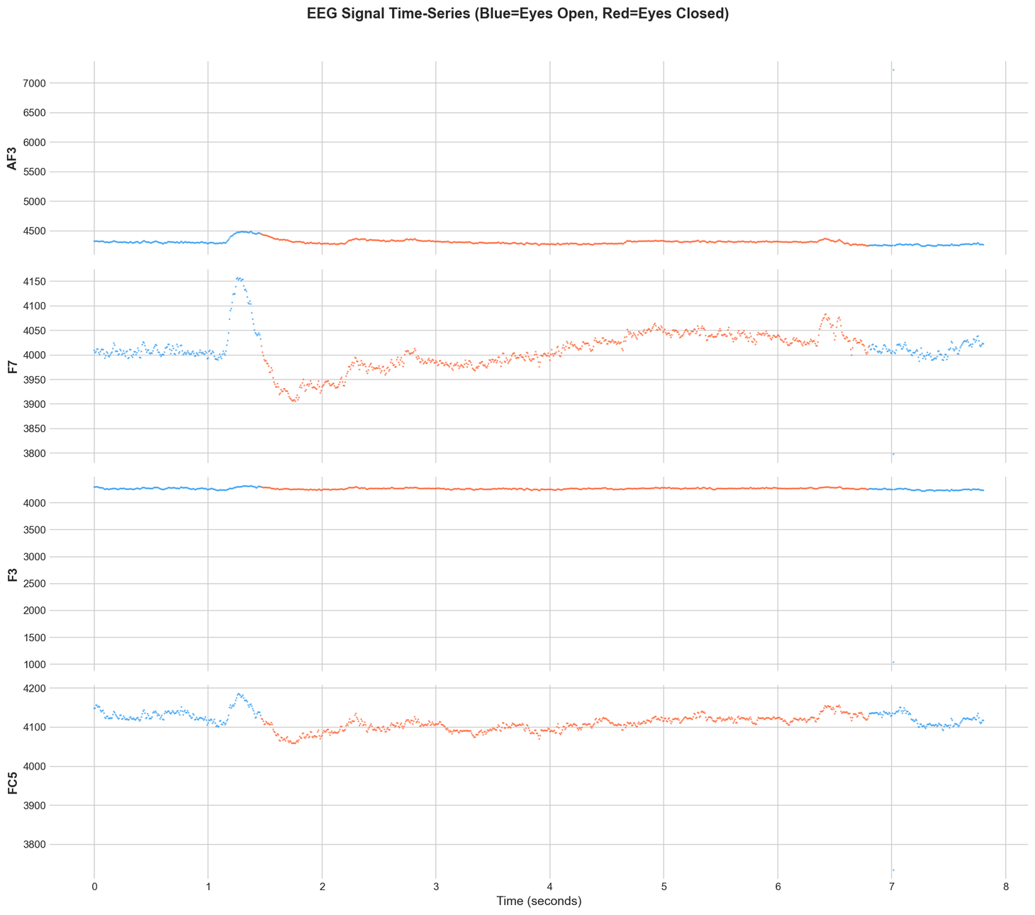

Slide 8
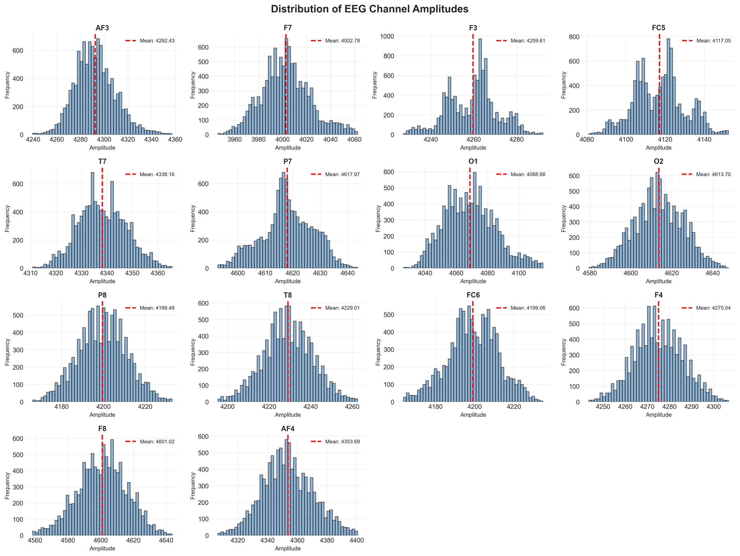
Eye-State changes are temporal events not a single-point event.
Rolling window size = 10
Mean, Std, Min, Max per channel
14 original + 56 rolling = 70 features

Slide 9
MODEL DEFINITION
The six models were chosen to represent different machine learning paradigms, allowing a comprehensive evaluation of the EEG feature space.
The goal was not just to find the best model, but to:
Compare linear vs non-linear decision boundaries
Compare parametric vs non-parametric methods
Compare single models vs ensemble models
Compare classical ML vs neural networks

Slide 10
1. Logistic Regression
Type: Linear classifier
Why used: Baseline model
Finds linear decision boundary
Works well when classes are linearly separable
Fast and interpretable
2. K-Nearest Neighbors (KNN)
Type: Distance-based classifier
Why used: Captures local structure
Classifies based on nearest samples
Sensitive to scaling - StandardScaler required
Works well with structured feature spaces
3 .Decision Tree
Type: Non-linear tree-based model
Why used: Interpretability
Splits data using feature thresholds
Captures non-linear relationships
Risk of overfitting (controlled via depth)
4. Random Forest
Type: Ensemble of Decision Trees
Why used: Robust non-linear modeling
Reduces overfitting
Provides feature importance
Strong performance on structured data
5. Support Vector Machine (SVM)
Type: Margin-based classifier
Why used: Handles complex boundaries
Maximizes margin between classes
Kernel trick enables non-linear separation
Effective for high-dimensional data
6.Multi-Layer Perceptron (MLP)
Type: Feed Forward Neural Network
Why used: Capture complex patterns
Layer Types
Input layer (70 features)
Hidden layers
Output layer (binary classification)

Slide 11
TRAINING
The training stage was carefully designed to prevent data leakage, ensure model generalization, maintain reproducibility and enable fair model comparison.
Train-Test Split
80% training
20% testing
Stratified split (preserves label distribution)
Feature Scaling
StandardScaler applied
Zero mean
Unit variance
Necessary for:
KNN
SVM
Logistic Regression
MLP
Neural Network (MLP) Training
The MLP was the most important training process.
Optimized with Adam optimizer to handle high-dimensional EEG feature spaces efficiently.
Architecture:
Input layer: 70 features
Hidden layer 1: approx. 100 neurons
Hidden layer 2: approx 50 neurons
Output layer: 1 neuron
Activation Functions
Hidden layers - ReLU (Avoids vanishing gradient, fast computation,sparse activation)
Output layer- Sigmoid

Slide 12
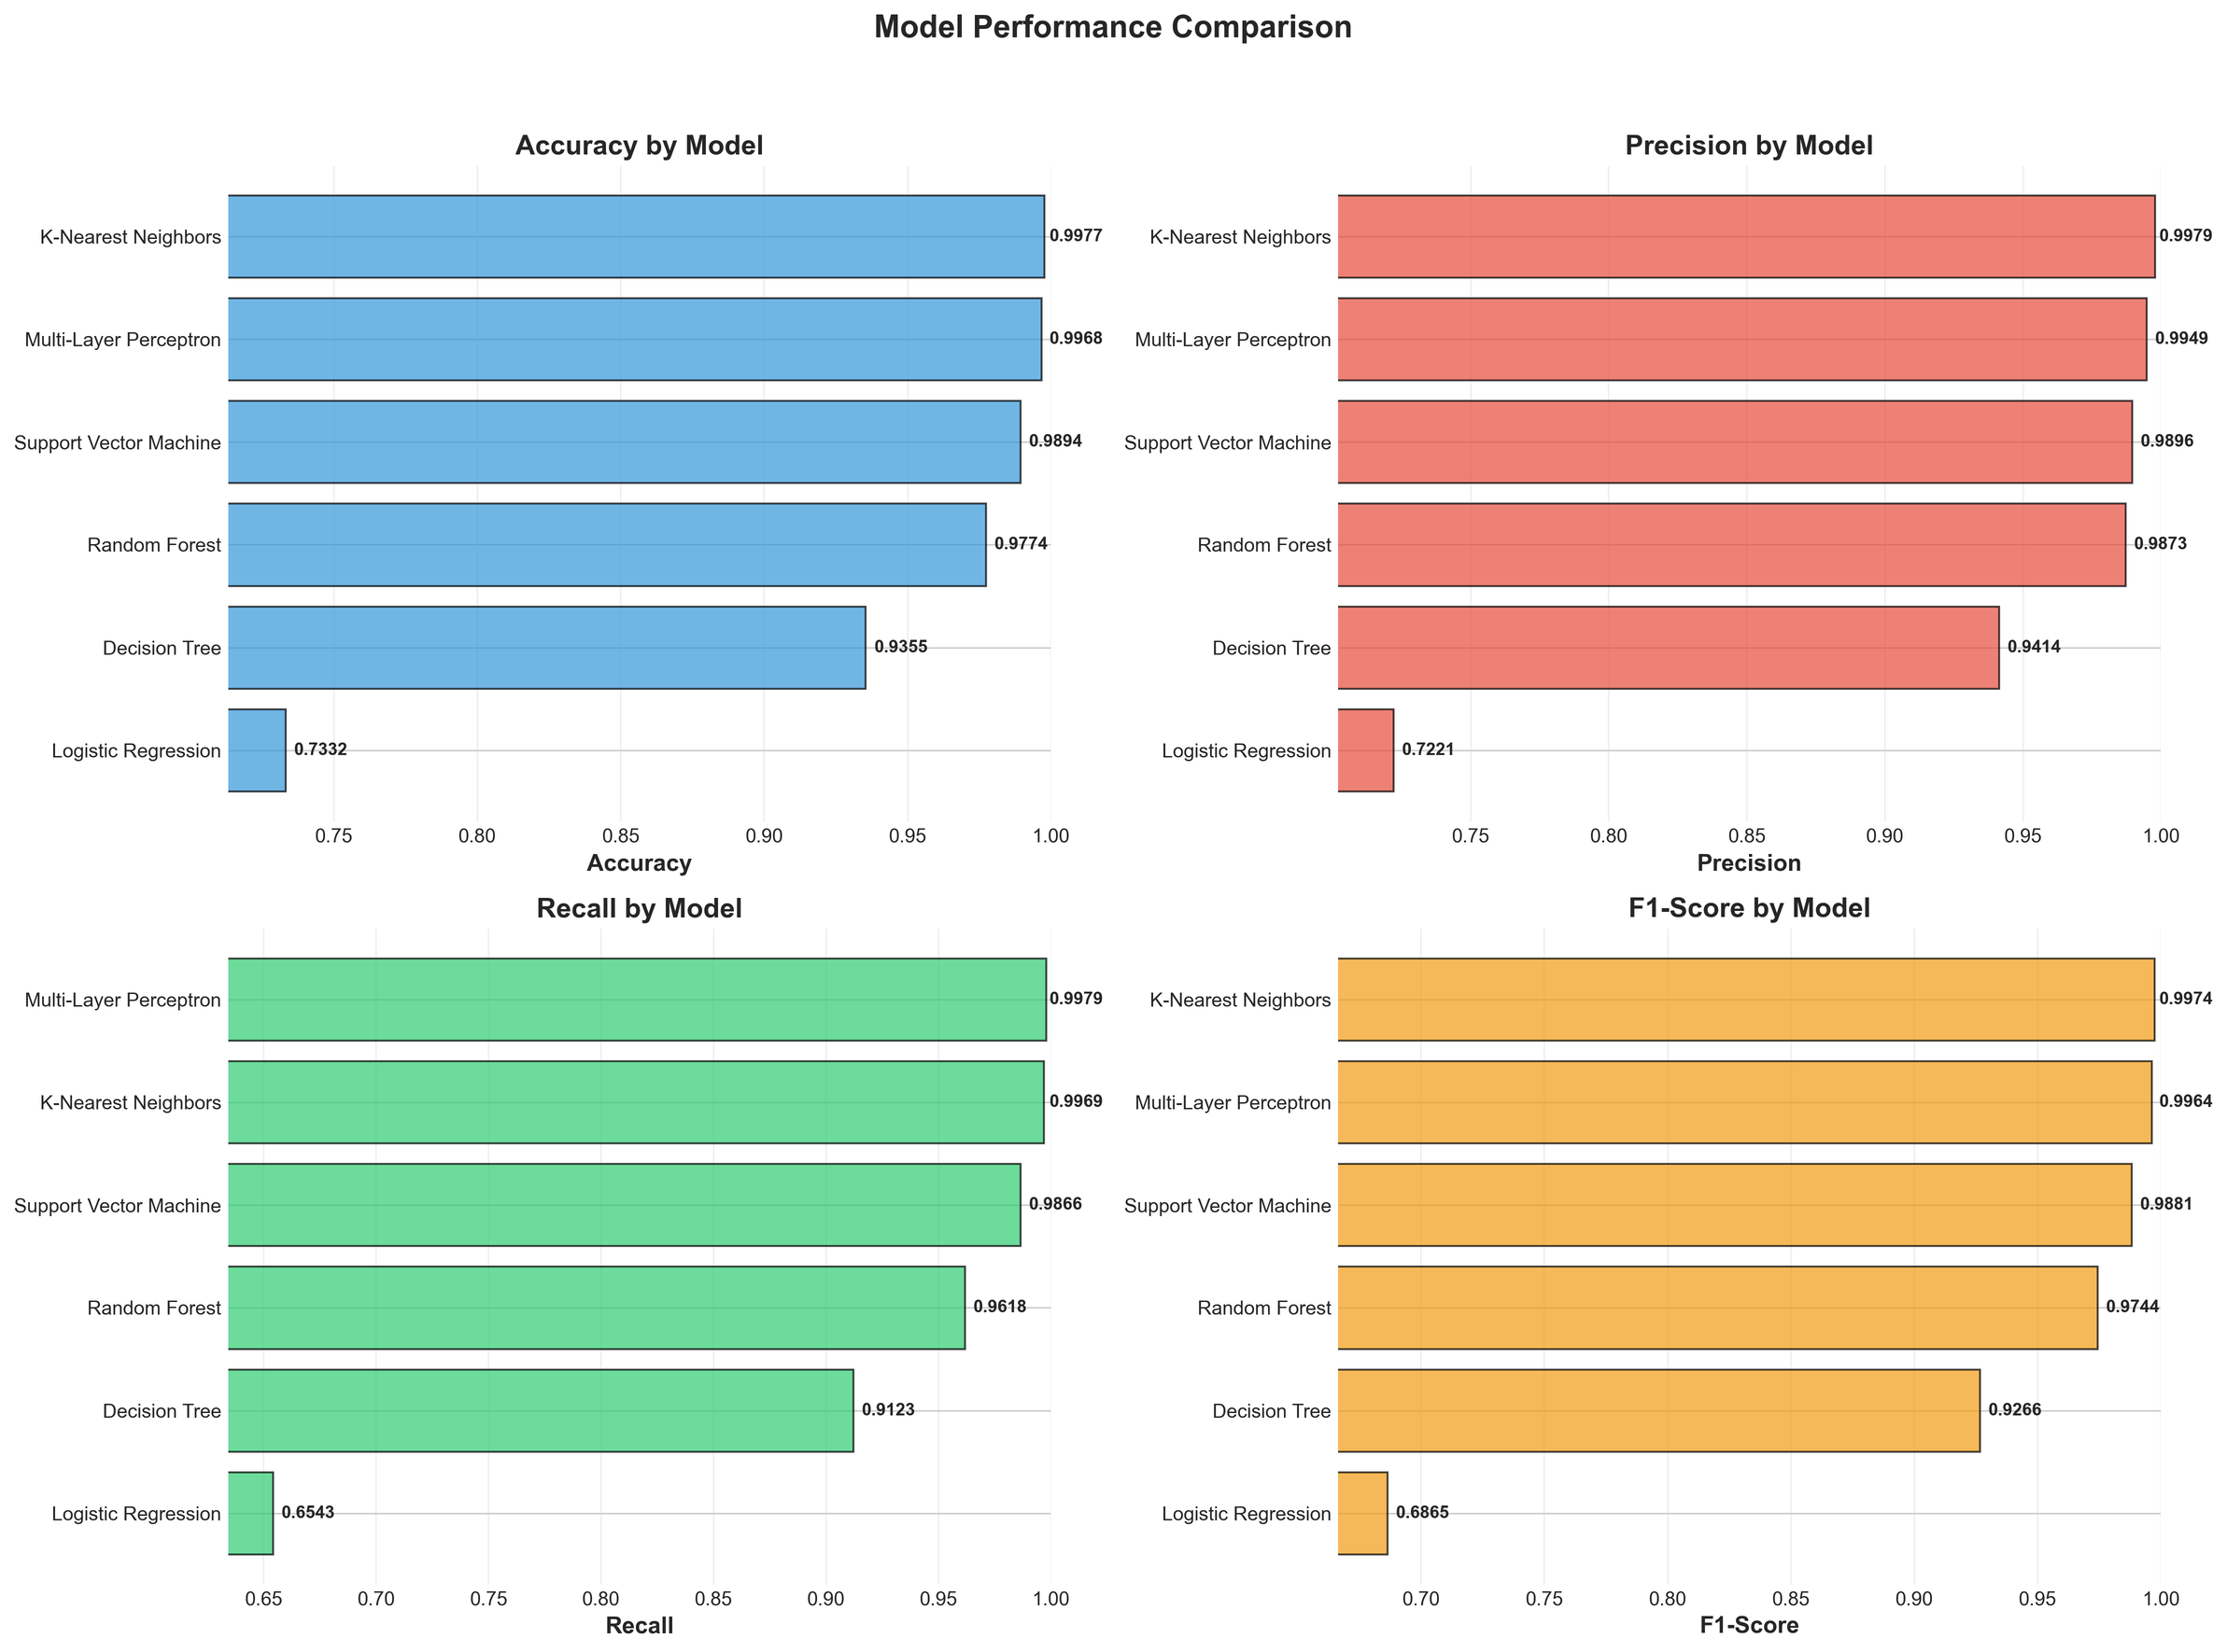

Slide 13
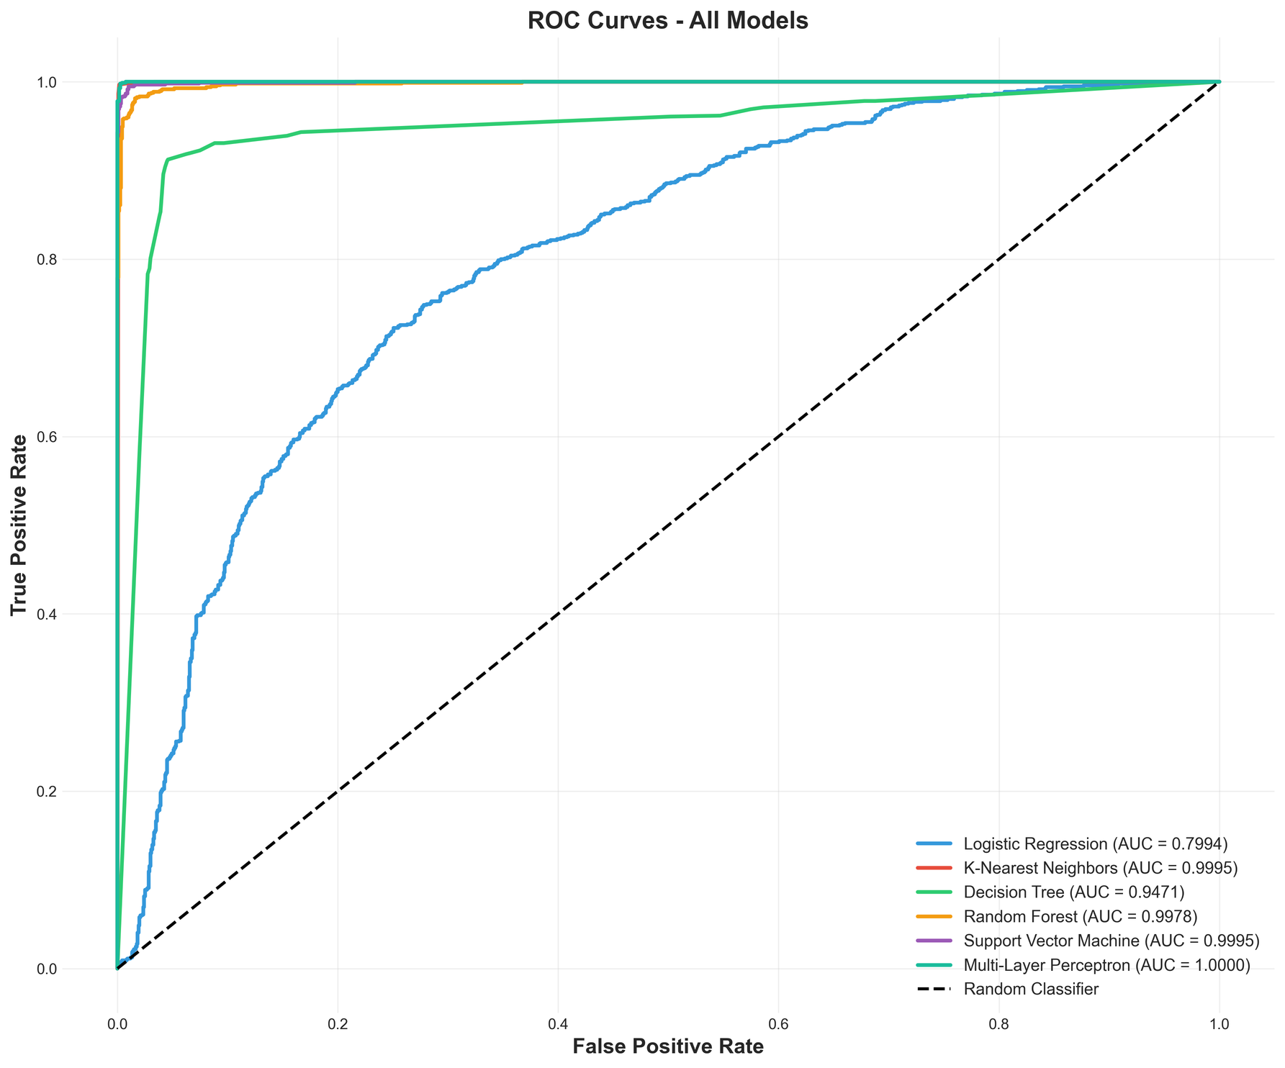

Slide 14
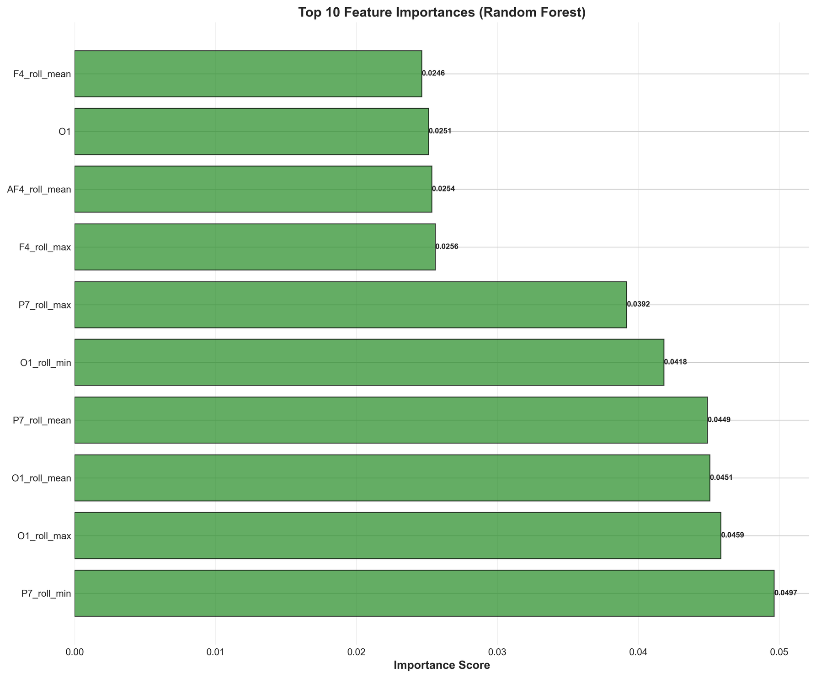
The model relies primarily on rolling statistics from occipital electrodes, which are physiologically linked to eye closure. It tells us which input variables contribute most to the model’s decision:
Rolling (temporal) features dominate
Occipital (O1) and Parietal (P7) regions are dominant, which aligns with known alpha activity changes during eye closure.
Short-term extrema and variability matter more than raw amplitude.

Slide 15
COGNITIVE MONITORING
Cognitive metrics show the high average attention, intermittent fatigue spikes, moderate blink rate
Blink Analysis: a fatigue indicator, blink = transition 0 - 1 - 0
Computed :blink count, rate and duration
Attention Score: lower blink rate-higher attention
Fatigue Index: % eye-closed samples per 1000-sample window, alert threshold: 40%

Slide 16
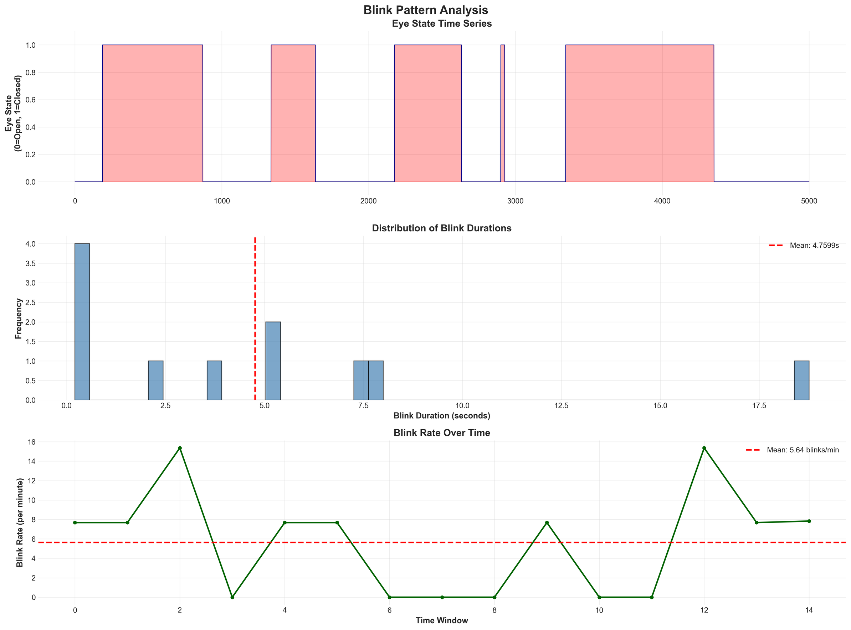

Slide 17
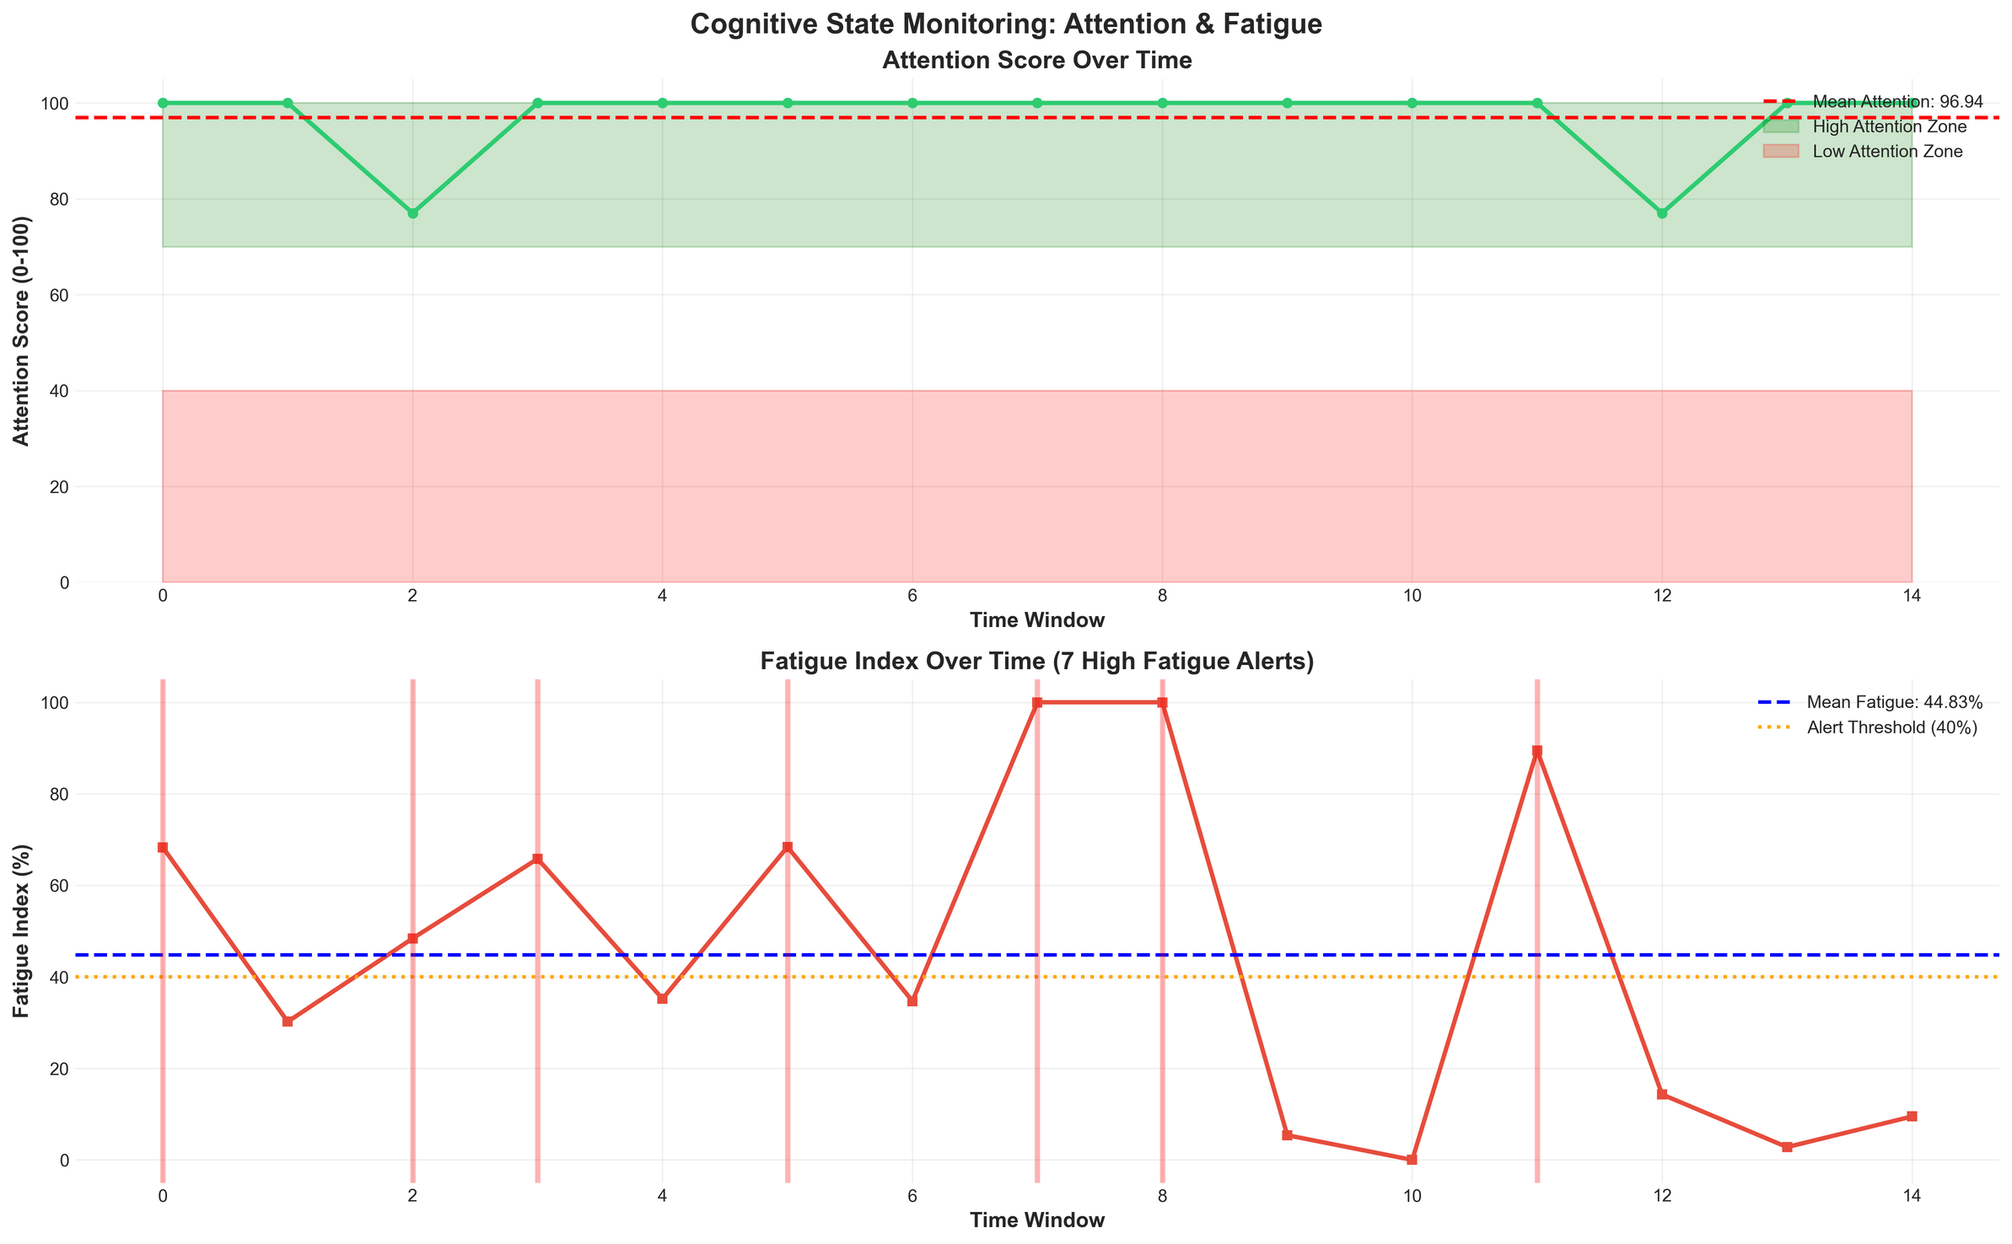

Slide 18
CONCLUSION
Nonlinear models outperform linear
Rolling features are crucial
MLP provides best generalization
Real-time monitoring is feasible

Slide 19
Thank You

