Slide 1
Advanced Spatial Database Methods
Pirate Island
Callum Crawford, Livia Jakob, Marco Pizzolato and Martin Ewart

Slide 2
Presentation Outline
Team Structure
Software Used
Database Structure
Oracle Spatial contextualisation
Demonstration

Slide 3
Team Structure
JavaScript and Graphics | Spatial Database Structure
Framework and Spatial Calculations | Python and Interface Design
Livia Jakob
Callum Crawford
Martin Ewart
Marco Pizzolato

Slide 4









Software Used

Slide 5
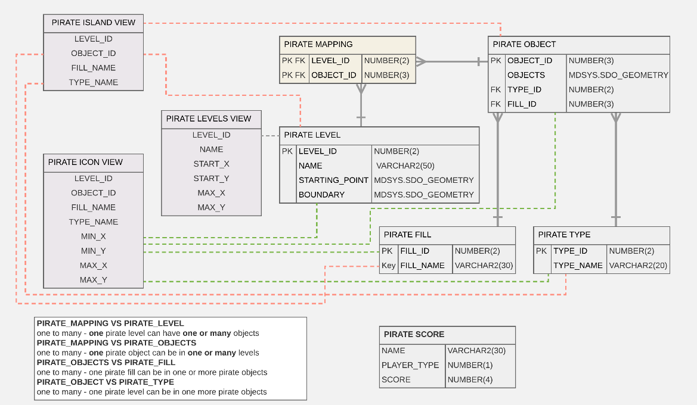
Database Structure

Slide 6
Database Software Connections

Slide 7
Oracle Spatial Functions
Intersect
Distance
Polygons
Points
Lines
Get Vertices
Partition by / Order By
Views

Slide 8
Demonstration
(Enter the Game Image and Hyperlink)

