Slide 1
Lívia Máté
GitHub username: liviam8
liviamate8@gmail.com
06705004148
Notes:
Line spacing + Page numbers

Slide 2
Introduction
Pázmány Péter Catholic University Information Technology and Bionics
Small Hungarian company
My lucky year 2019
Why am I here?
Notes:
Experience as support engineer.
We were in the middle of different platforms – we were the connector

Slide 3
Bookstore exercise
01 Create the database
02 Create the endpoint
03 Check it with postman
05 Show the fetched data in table
06 Create a search/filter function
04 Create tables in HTML

Slide 4
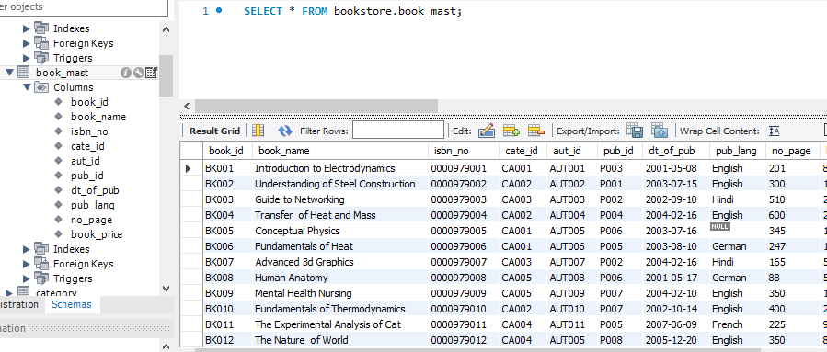
Create the database

Slide 5
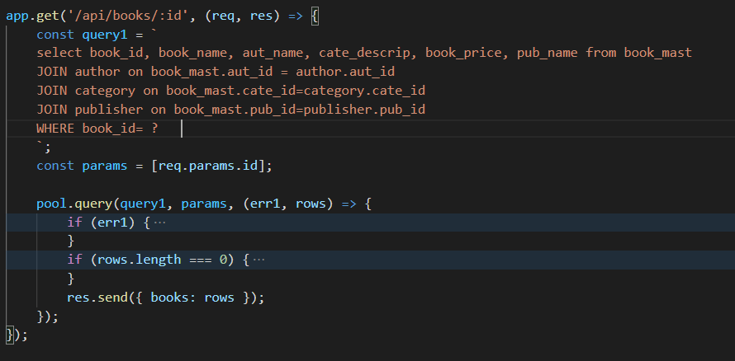
Create the endpoint

Slide 6

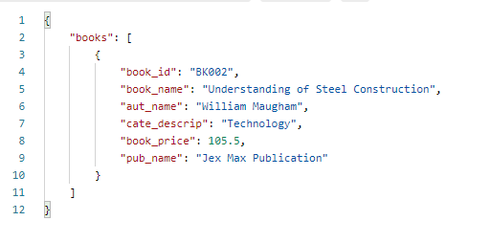
Check it with postman

Slide 7
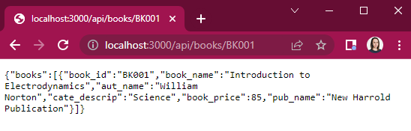
Check it in browser

Slide 8
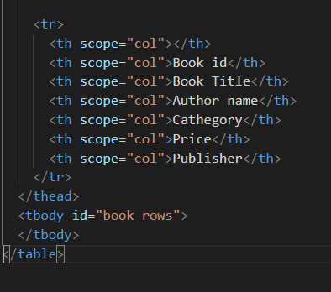
Create the tables in HTML

Slide 9

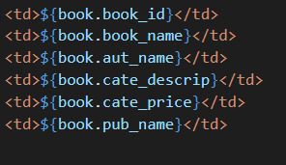
Show the fetched data

Slide 10
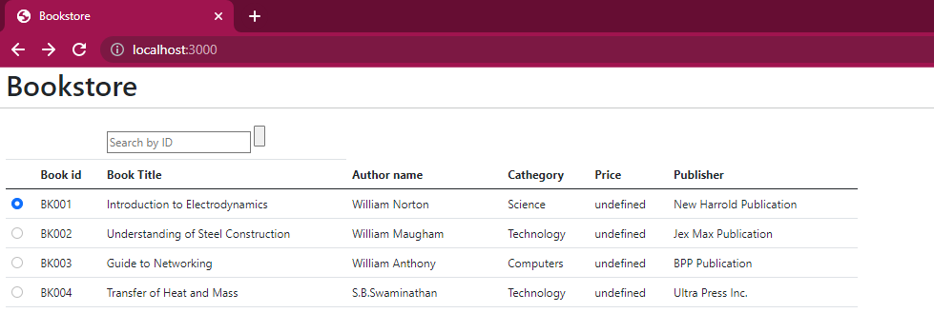
Show the fetched data

Slide 11

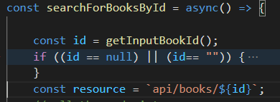
Create the filter
First a search box is required(index.html) :
Then to catch the input data(index.js)
Notes:
To DEMO
ANY Questions ?

Slide 12
Areas for improvement
To create the filter described by the task exactly
To make a proper “enter” button
To fix the price
Sleep more

