Slide 1
Intro to Programming
Class 15, 21 Oct 2016

Slide 2
Go over Assessment

Slide 3
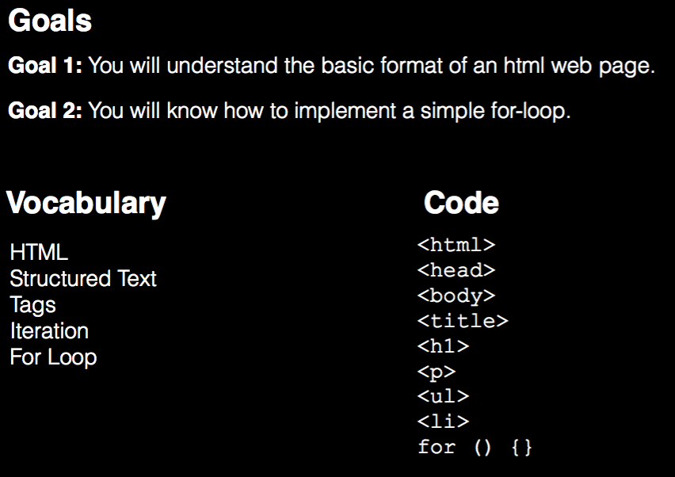

Slide 4
Changes for Unit 3
Random Partners:
What is one goal you’d like to accomplish in your lifetime?
New Partners
-

Slide 5
What is HTML?
Hyper Text Markup Language
A way to STRUCTURE text.

Slide 6
STRUCTURE
With
<TAGS>
<title></title>
<p></p>
<script></script>
<img>

Slide 7
basicStructure.html
<!doctype html>
<html>
<head>
<title>My Title</title>
</head>
<body>
<h1>This is a header</h1>
<p>This is a paragraph</p>
<script>
// My javascript code goes here
</script>
</body>
</html>

Slide 8
basicStructure.html
<!doctype html>
<html>
<head>
<title>My Title</title>
</head>
<body>
<h1>This is a header</h1>
<p>This is a paragraph</p>
<script>
// My javascript code goes here
</script>
</body>
</html>
TAGS!!!!!

Slide 9
basicStructure.html
<!doctype html>
<html>
<head>
<title>My Title</title>
</head>
<body>
<h1>This is a header</h1>
<p>This is a paragraph</p>
<script>
// My javascript code goes here
</script>
</body>
</html>

Slide 10
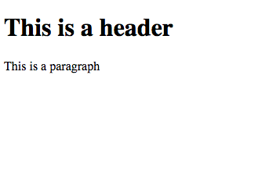
basicStructure.html
<!doctype html>
<html>
<head>
<title>My Title</title>
</head>
<body>
<h1>This is a header</h1>
<p>This is a paragraph</p>
<script>
// My javascript code goes here
</script>
</body>
</html>

Slide 11
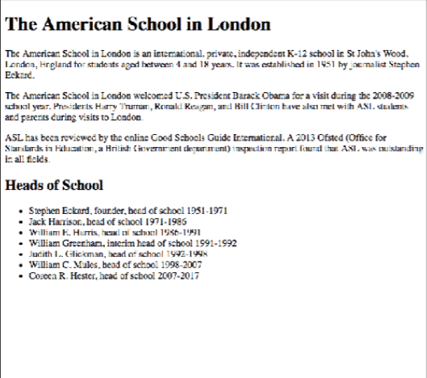
Make your own HTML Page
Sync github repo
Open unstructuredText.txt
Turn it into a structured HTML document
You will need to use: http://www.w3schools.com/tags/
<doctype>
<html>
<body>
<head>
<title>
<p>
<h1>
<h2>
<ul>
<li>

Slide 12
Loops (aka iteration)
Three key parts of a programming language (so far):
Storage (variables)
Selection (conditionals)
Iteration (loops)
Ingredients of an algorithm

Slide 13
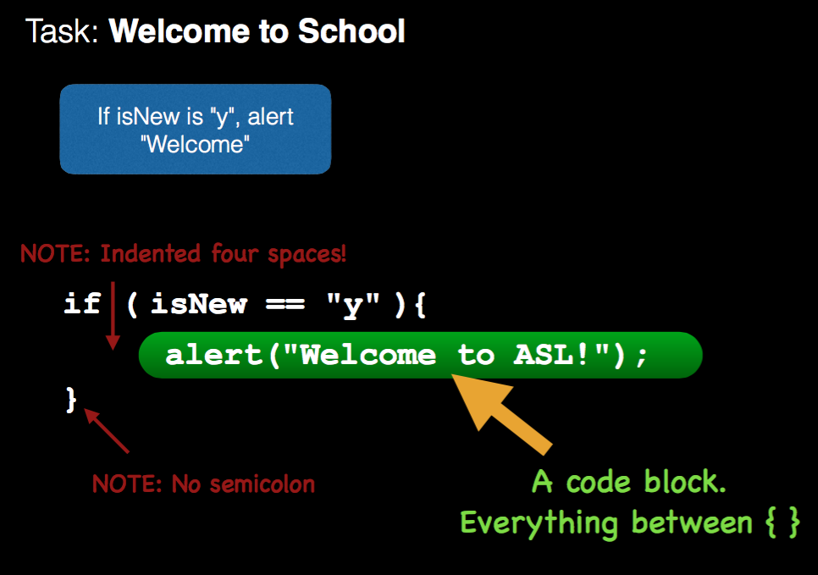

Slide 14
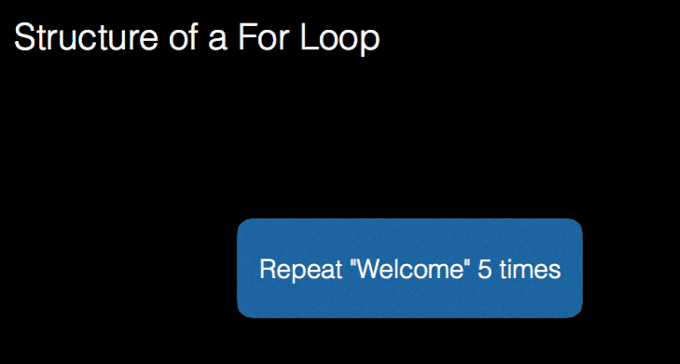

Slide 15
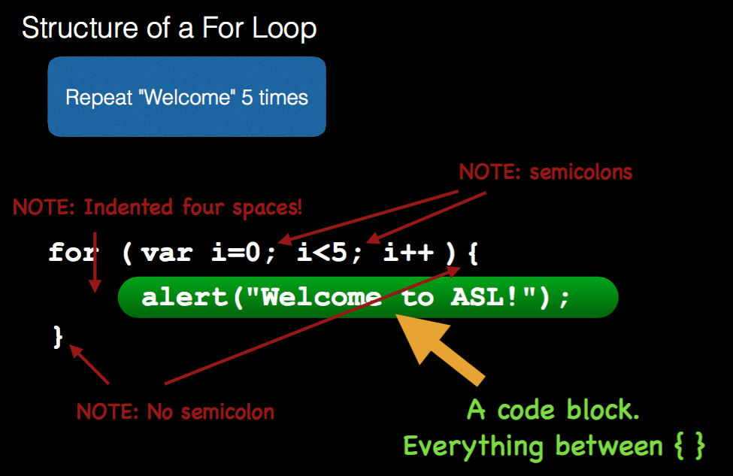

Slide 16
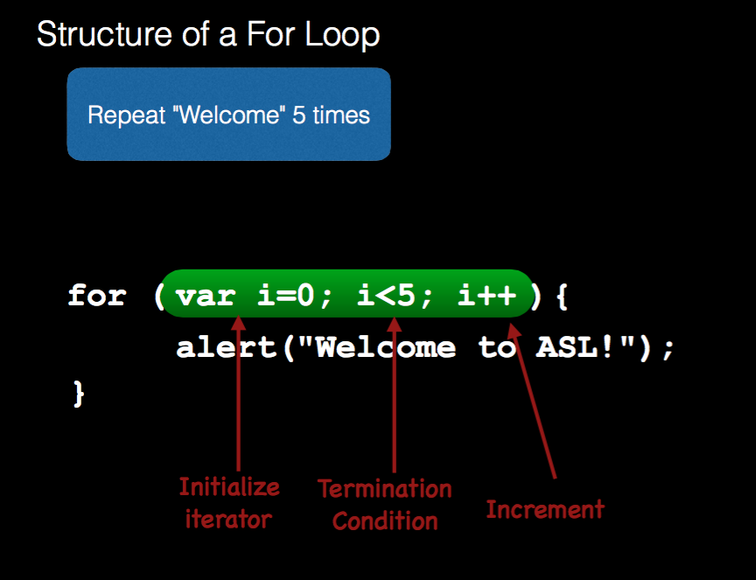

Slide 17
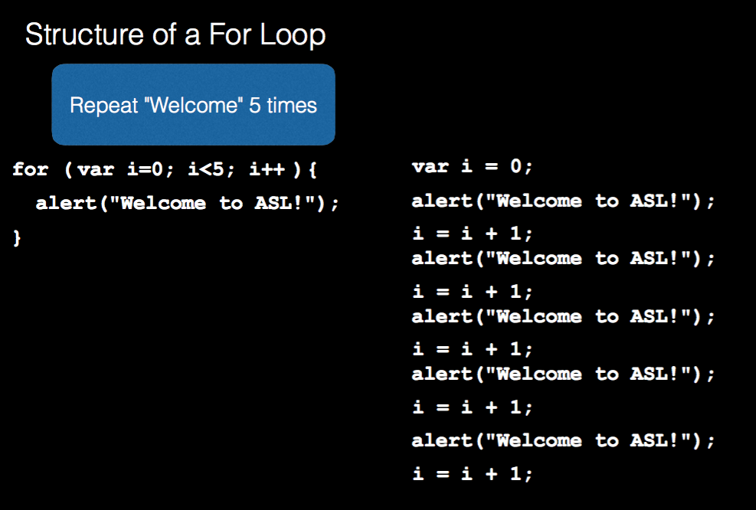

Slide 18
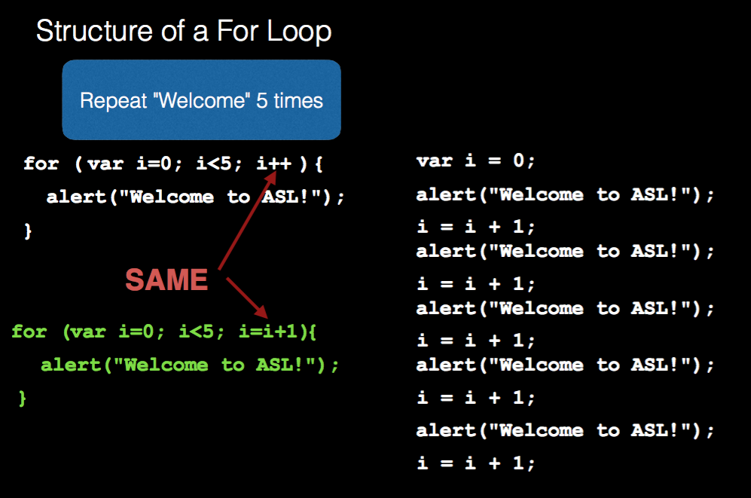

Slide 19
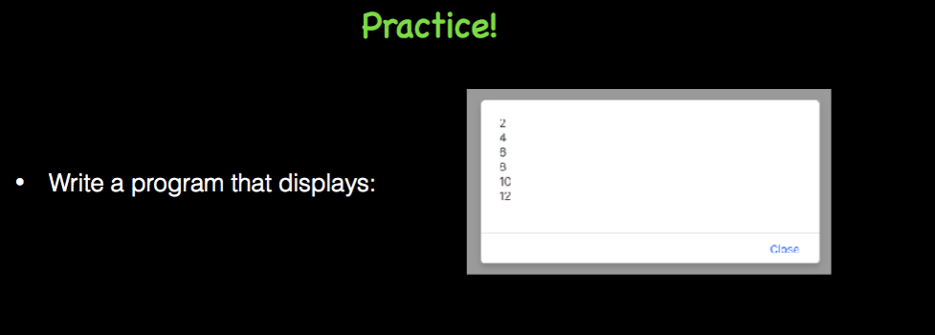

Slide 20
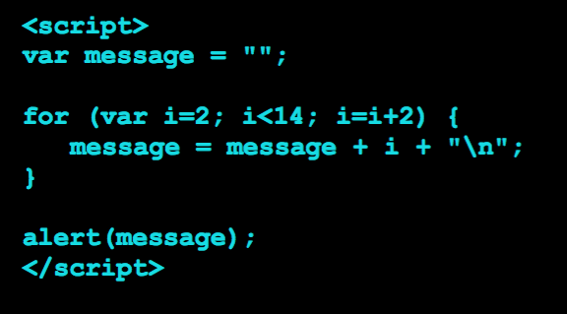

Slide 21
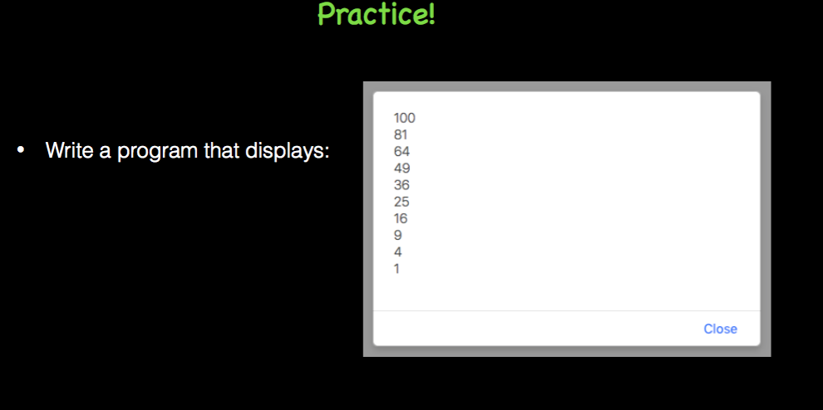

Slide 22
