Slide 1
Intro to Programming
Class 15, 21 Oct 2016

Slide 2
Go over Assessment

Slide 3
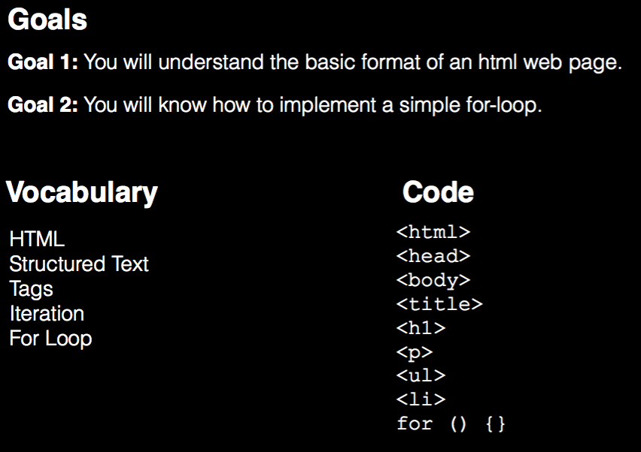

Slide 4
Changes for Unit 3
Random Partners:
Pick someone you haven’t worked with before.
New Partners
Quinn and Daya
Anna and Diego
Rohan and Christina
Amaan and Dev
Alex and Jonah
Tucker and Tyler
Ayse and Kathryn

Slide 5
What is HTML?
Hyper Text Markup Language
A way to STRUCTURE text.

Slide 6
STRUCTURE
With
<TAGS>
<title></title>
<p></p>
<script></script>
<img>

Slide 7
basicStructure.html
<!doctype html>
<html>
<head>
<title>My Title</title>
</head>
<body>
<h1>This is a header</h1>
<p>This is a paragraph</p>
<script>
// My javascript code goes here
</script>
</body>
</html>

Slide 8
basicStructure.html
<!doctype html>
<html>
<head>
<title>My Title</title>
</head>
<body>
<h1>This is a header</h1>
<p>This is a paragraph</p>
<script>
// My javascript code goes here
</script>
</body>
</html>
TAGS!!!!!

Slide 9
basicStructure.html
<!doctype html>
<html>
<head>
<title>My Title</title>
</head>
<body>
<h1>This is a header</h1>
<p>This is a paragraph</p>
<script>
// My javascript code goes here
</script>
</body>
</html>

Slide 10
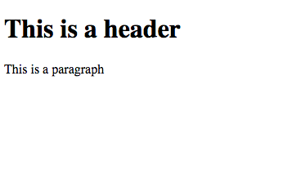
basicStructure.html
<!doctype html>
<html>
<head>
<title>My Title</title>
</head>
<body>
<h1>This is a header</h1>
<p>This is a paragraph</p>
<script>
// My javascript code goes here
</script>
</body>
</html>

Slide 11
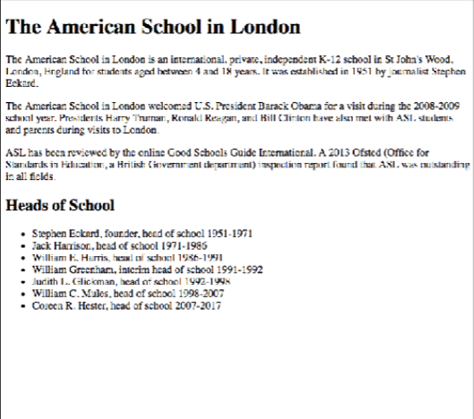
Make your own HTML Page
Sync github repo
Open unstructuredText.txt
Turn it into a structured HTML document
You will need to use: http://www.w3schools.com/tags/
<doctype>
<html>
<body>
<head>
<title>
<p>
<h1>
<h2>
<ul>
<li>

Slide 12
Loops (aka iteration)
Three key parts of a programming language (so far):
Storage (variables)
Selection (conditionals)
Iteration (loops)
Ingredients of an algorithm

Slide 13
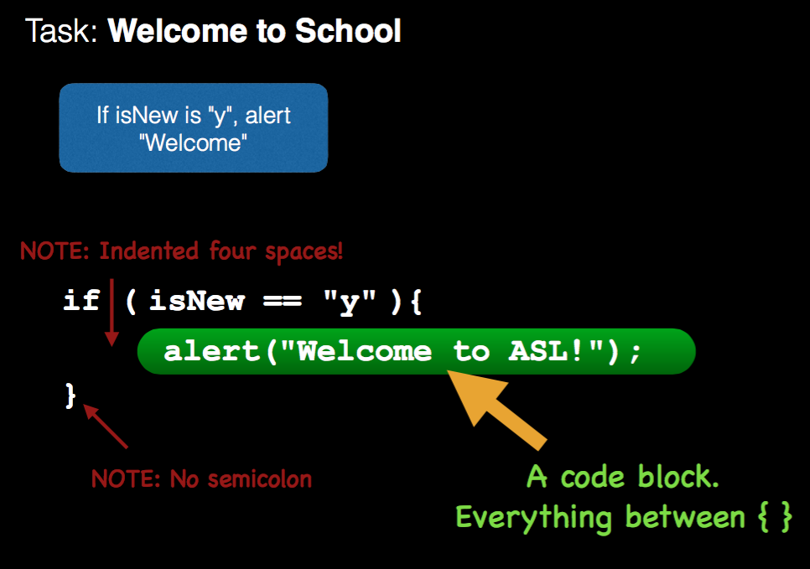

Slide 14
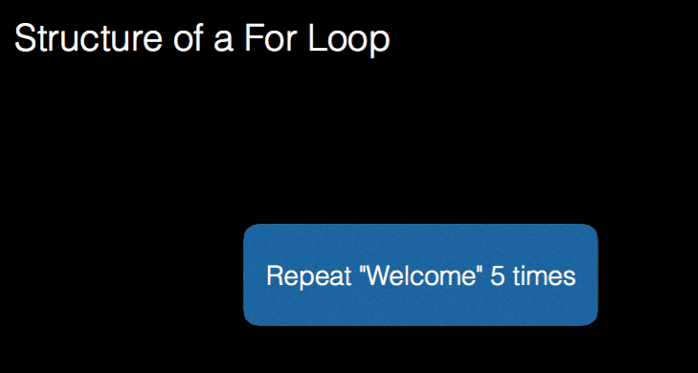

Slide 15
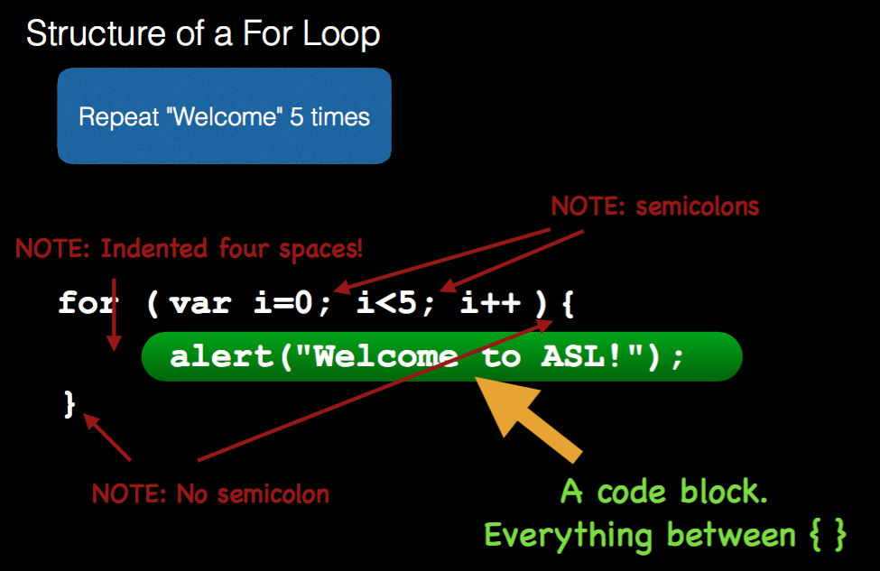

Slide 16
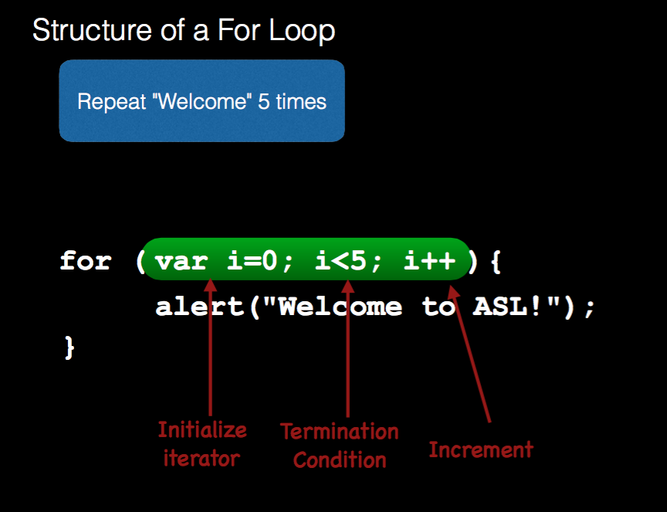

Slide 17
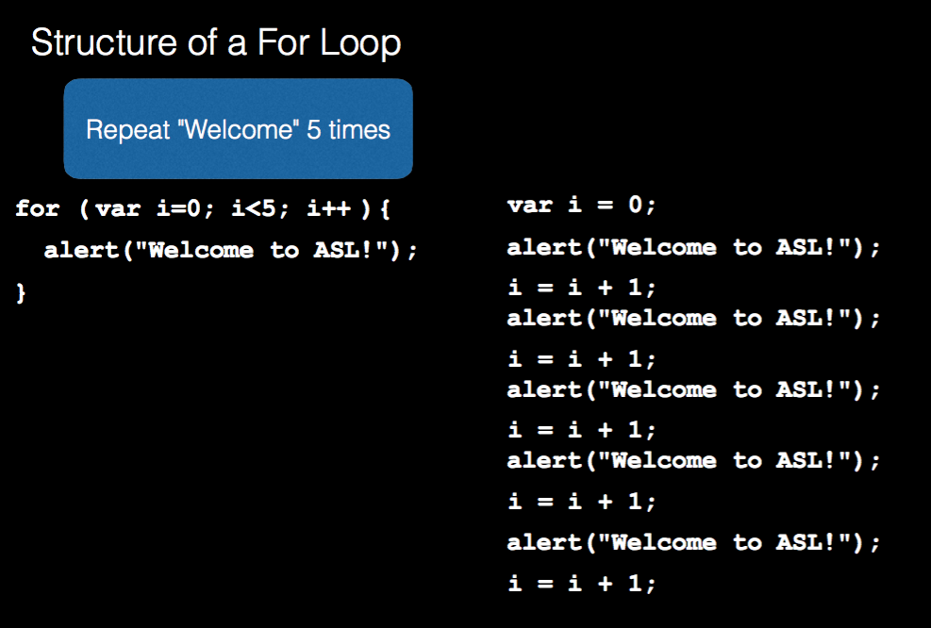

Slide 18
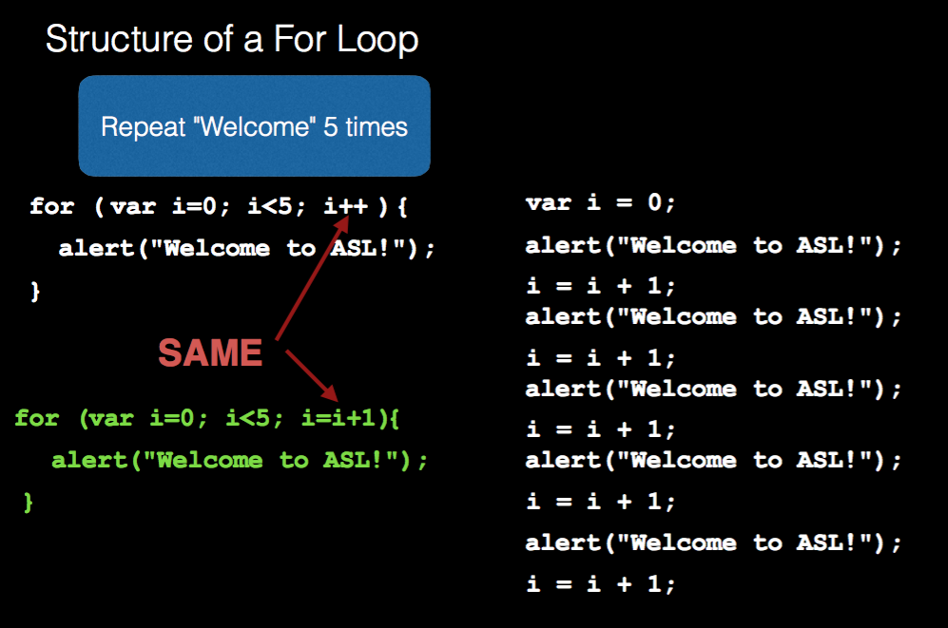

Slide 19
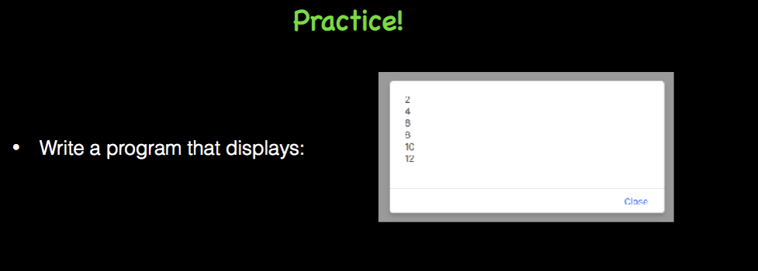

Slide 20
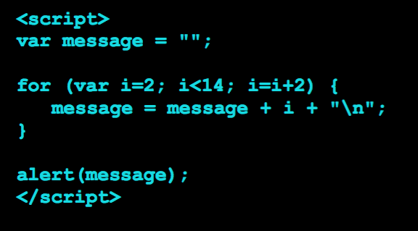

Slide 21
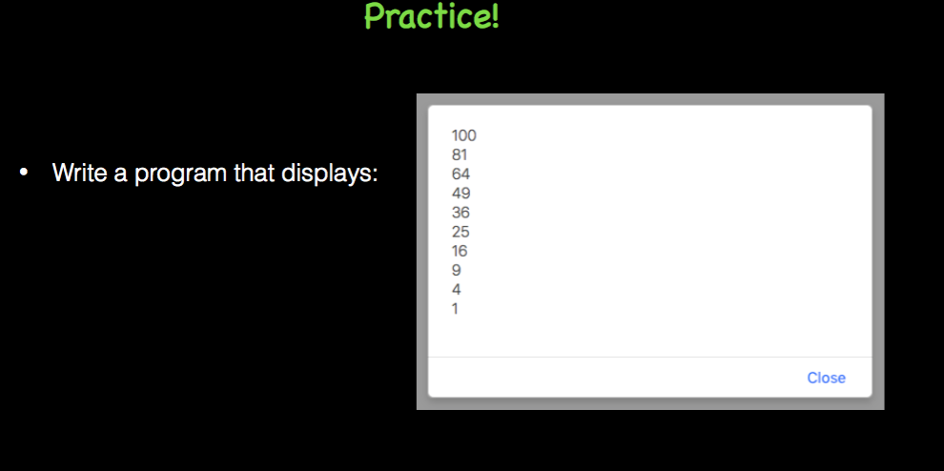

Slide 22
