Slide 1
Intro to Programming
Class 16, 24 Oct 2016

Slide 2
Changes for Unit 3
New Partners
Quinn and Daya
Anna and Amaan
Rohan and Christina
Tyler and Kathryn
Alex and Jonah
Tucker and Dev
Ayse and Diego

Slide 3
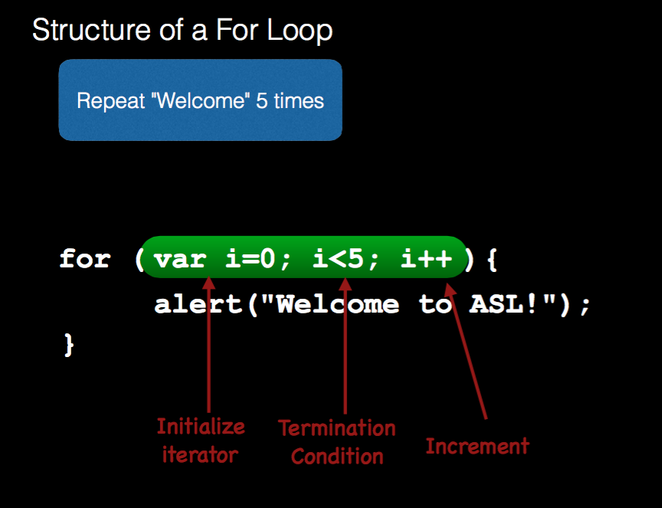
Review For Loops:

Slide 4
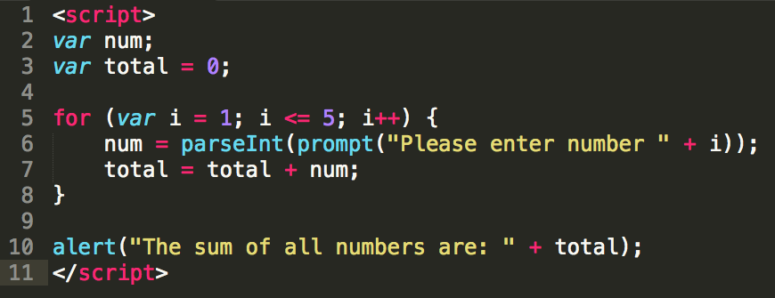
Coding Snippets Worksheet and Try: H28 – AddingNumbers.html

Slide 5
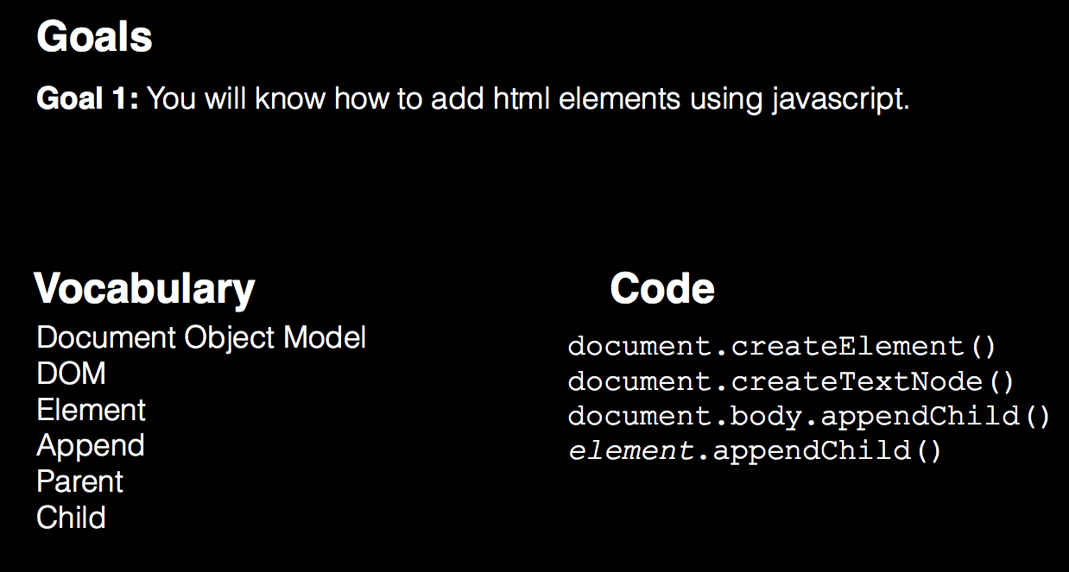

Slide 6
basicStructure.html
<!doctype html>
<html>
<head>
<title>My Title</title>
</head>
<body>
<h1>This is a header</h1>
<p>This is a paragraph</p>
<script>
// My javascript code goes here
</script>
</body>
</html>

Slide 7
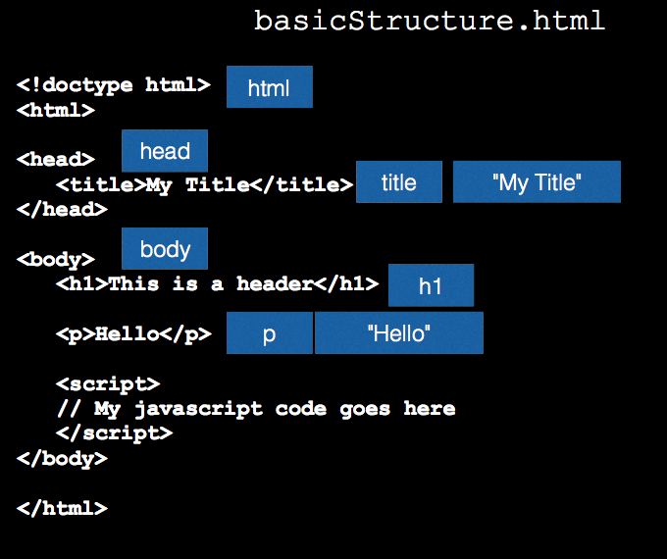

Slide 8
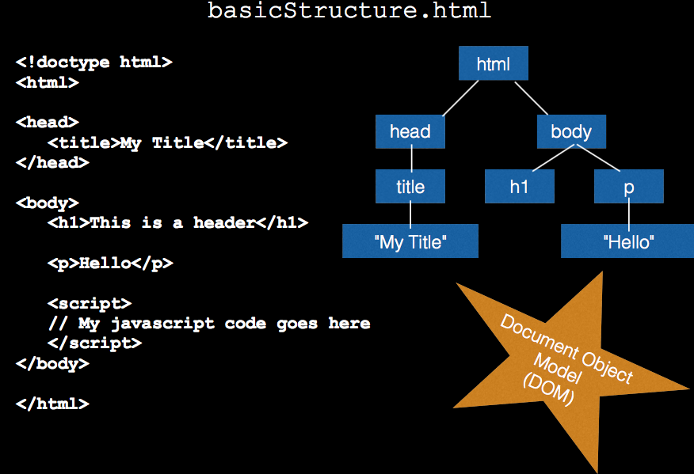

Slide 9
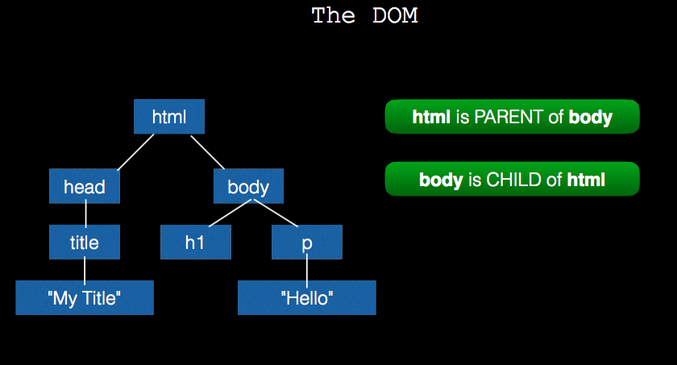

Slide 10
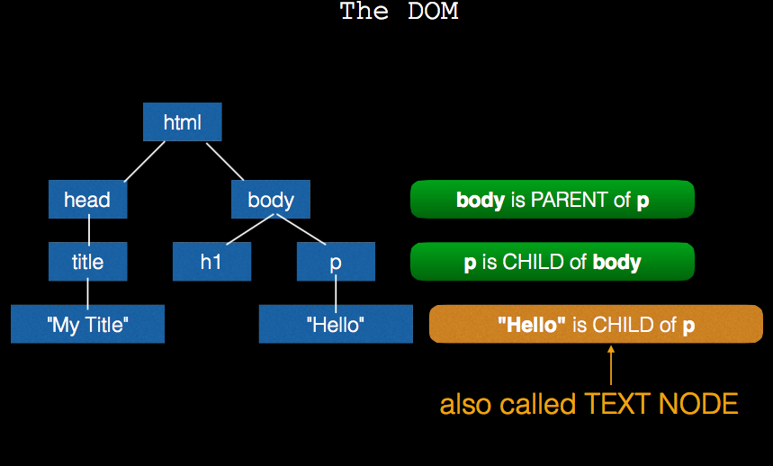

Slide 11
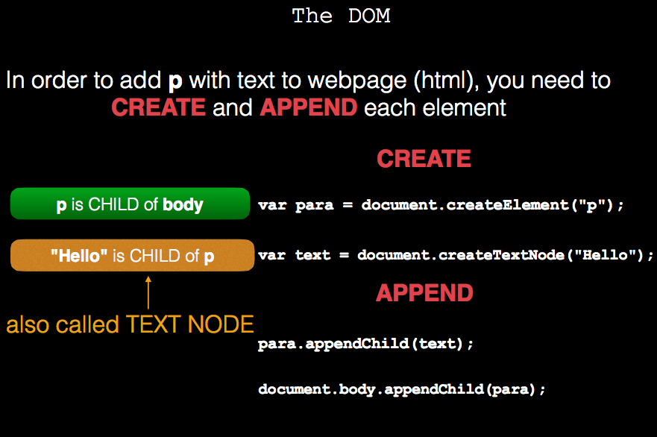

Slide 12
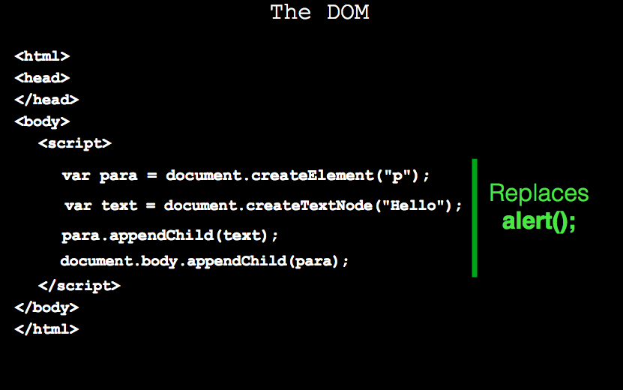

Slide 13
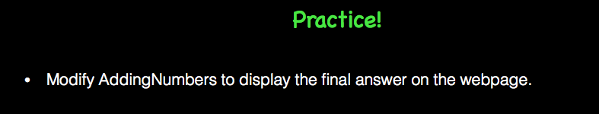
Together!

Slide 14
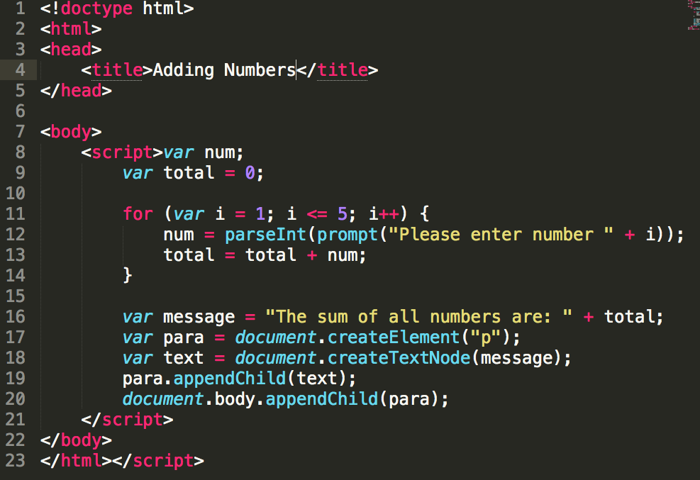

Slide 15

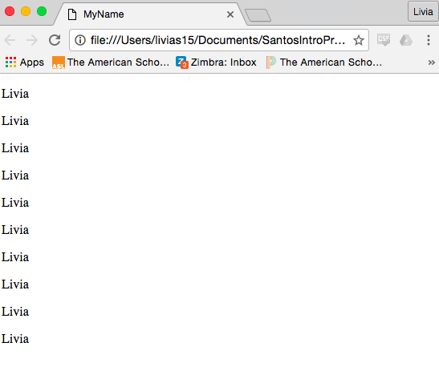
On your own

Slide 16
<!doctype html>
<html>
<head>
<title>MyName</title>
</head>
<body>
<script>
var name = prompt("What's your name?");
var timesStr = prompt("How many times would you like to see it?");
times = parseInt(timesStr);
for (var i=0; i<times; i++) {
var para = document.createElement("p");
var text = document.createTextNode(name);
para.appendChild(text);
document.body.appendChild(para);
}
</script>
</body>
</html>

Slide 17
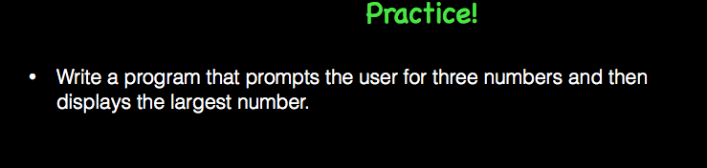
With your partner create a flowchart, algorithm, or pseudo-code, show me and then you can open your computer to program.

Slide 18
<!doctype html>
<html>
<head>
<title>Largest Number</title>
</head>
<body>
<script>
var maxNum = -100000000;
for (var i=0; i<3; i++) {
var userNumberStr = prompt("Please enter a number.");
userNumber = parseInt(userNumberStr);
if (userNumber > maxNum) {
maxNum = userNumber;
}
}
var message = "The largest number is " + maxNum;
var para = document.createElement("p");
var text = document.createTextNode(message);
para.appendChild(text); document.body.appendChild(para);
</script>
</body>
</html>

