Slide 1


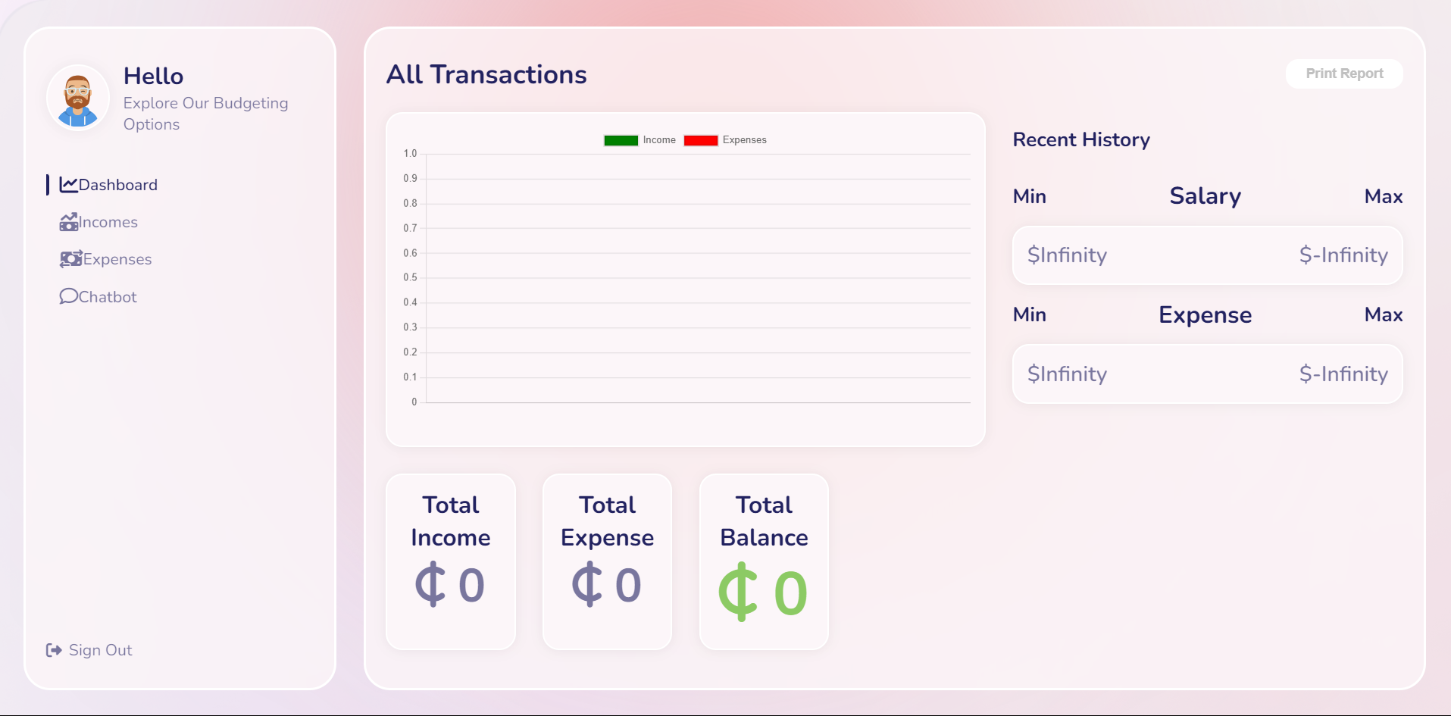

AI-Powered Personal Finance Management
Managing personal finances can be a complex and overwhelming task, often leading to overspending and financial stress when not approached with the right tools and strategies. While there are numerous financial management solutions available, many of them lack the advanced features necessary to truly empower users in understanding and controlling their spending habits. Key functionalities, such as predictive analytics and anomaly detection, are often missing, leaving users without the deeper insights that could significantly improve their financial well-being. By incorporating these advanced technologies, a more comprehensive approach can be taken, offering users not just a snapshot of their current financial situation but also proactive guidance on how to optimize their spending and avoid common pitfalls. This level of insight can be transformative, helping individuals achieve greater financial stability and peace of mind.
by Ishmael Matey Azu

Slide 2

Project Aim
Empowerment
To develop a comprehensive budgeting and expense management web application using React, we aim to leverage the power of AI to provide users with advanced financial insights.
Proactive Guidance
By integrating predictive analytics, the application will forecast future spending trends, enabling users to anticipate financial needs and avoid potential pitfalls.
Financial Health
Additionally, the implementation of anomaly detection will identify unusual spending patterns, alerting users to possible financial risks or fraudulent activities.
User-Friendly Interface
The application will not only offer a user-friendly interface but also ensure that users have access to real-time data and personalized recommendations, making it an essential tool for anyone looking to take control of their finances with confidence.

Slide 3

Project Justification
This project aims to address the growing need for a more innovative and insightful approach to personal finance management. By equipping users with advanced tools such as predictive analytics and anomaly detection, it empowers them to take proactive control of their financial health. These features go beyond basic budgeting, offering deeper insights that help users not only track their spending but also anticipate future financial needs and detect potential issues early on. This innovative approach is designed to provide users with the clarity and confidence needed to make informed financial decisions, ultimately leading to better long-term financial stability.

Slide 4

Project Motivation
The motivation for this project stems from the increasing complexity of personal finances and the potential of AI to simplify and enhance financial management. As individuals face more intricate financial decisions, there is a growing need for tools that can offer more than just basic tracking. Additionally, the rising demand for digital personal finance tools, particularly those designed for budgeting, highlights the need for solutions that can help users make informed decisions with greater confidence and ease. By harnessing the power of AI, this project aims to meet these needs, providing a smarter, more effective way for users to manage their finances.

Slide 5
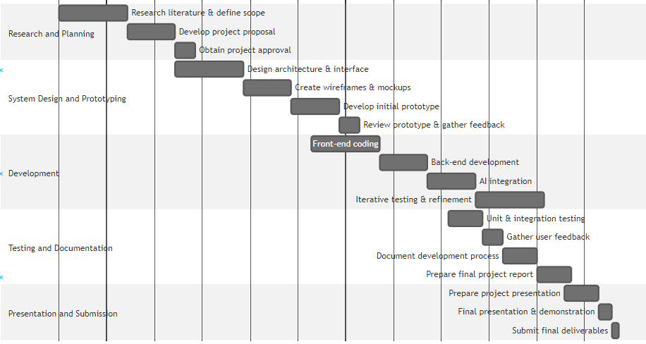
Project methodology
1
Requirement Specification
Primary Stakeholders:
End-Users: Individuals managing personal finances; use the system for tracking finances, budgeting, and gaining insights through predictive analytics and anomaly detection.
Financial Advisors: Utilize the system to provide clients with advanced financial guidance and reporting tools, enhancing their ability to advise on budget optimization and risk management.
Developers: Responsible for scalable, secure, and user-friendly system design, integrating external AI APIs to keep the platform advanced and effective.
2
Requirement Gathering Process
Approaches Used:
Interviews: Conducted with end-users and financial advisors to gather qualitative data on user needs and pain points.
Surveys: Distributed widely to collect quantitative data on user preferences and identify trends in financial management challenges.
Literature Reviews: Reviewed academic and industry reports to establish best practices and incorporate the latest advancements in financial technology.
3
Outcomes
These methods ensured a comprehensive understanding of user needs, shaping a system that is well-informed, user-centric, and aligned with industry standards.

Slide 6
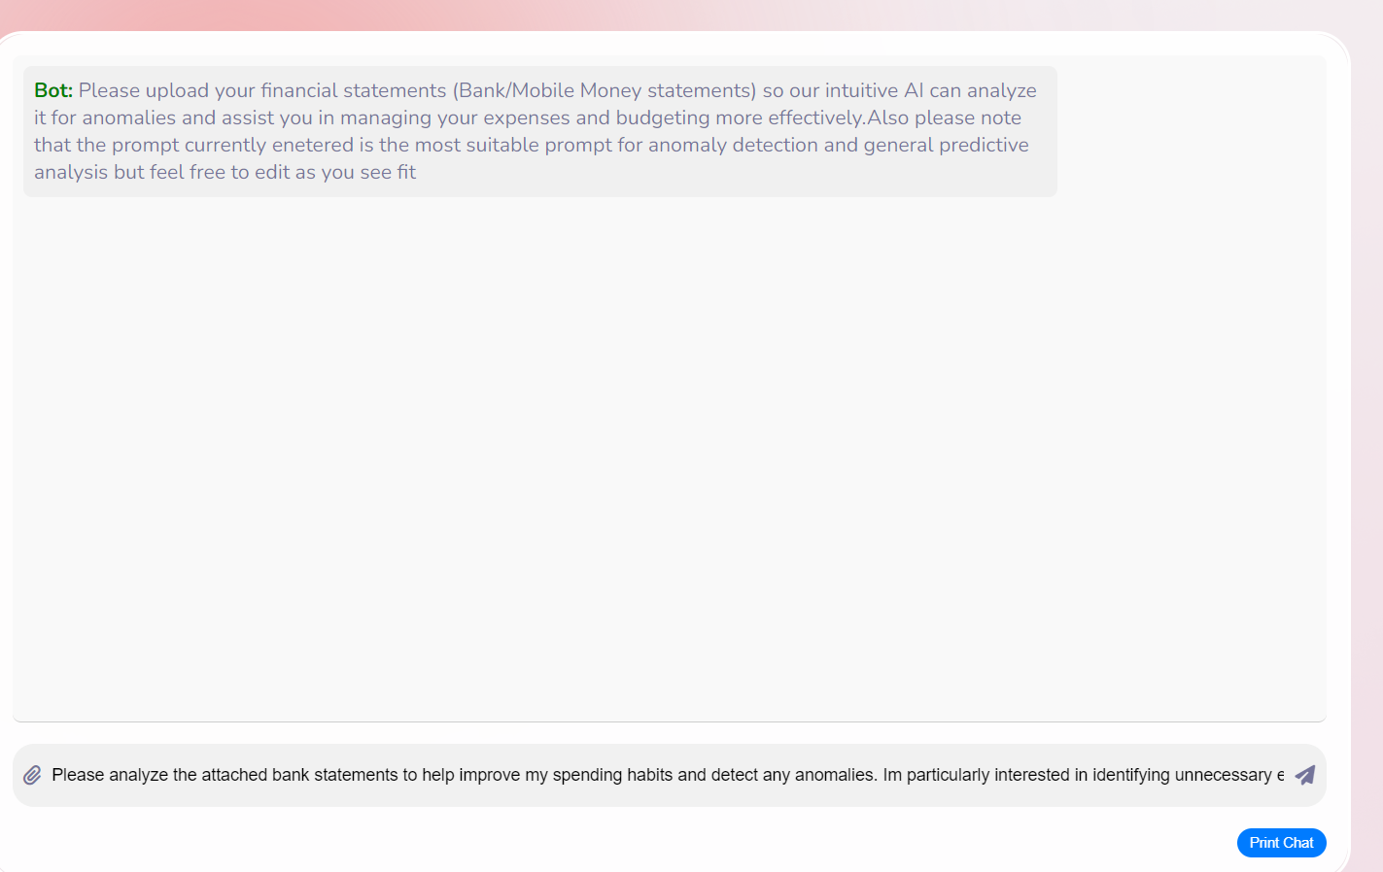
Results From Testing Phase
1
Effectiveness of AI Chatbot:
The AI chatbot has proven to be highly effective in assisting users with managing their f inances. It provides quick and reliable advice, which has significantly contributed to users' confidence in understanding their financial situation. The high engagement levels suggest that the chatbot is perceived as a valuable tool for budgeting and financial health checks.
2
Improving Performance:
While the app performs well overall, there is a need to improve its ability to handle large amounts of data, particularly during periods of high user activity. Enhancing the system's performance will ensure a consistently smooth user experience, even under heavy load conditions.
3
User Interface Improvements:
Although the app is generally user-friendly, feedback indicates that some aspects of the interface could be more intuitive, especially for users who are less tech-savvy. Simplifying certain UI elements could further enhance the user experience and broaden the app's appeal

Slide 7

Project Scope
This project will focus on the comprehensive development of a web application tailored to address the complexities of personal finance management. Key aspects of the project include the integration of AI-driven components designed to provide advanced analytics, such as predictive spending forecasts and anomaly detection. These features will empower users with deeper insights into their financial behaviours, allowing for more informed decision-making. Additionally, significant emphasis will be placed on creating a user-friendly interface that ensures accessibility and ease of use for individuals with varying levels of financial literacy. The user interface design will prioritize intuitive navigation and a visually appealing layout, making it simple for users to track their income, expenses, and savings goals. Each element of the interface will be crafted with the end-user in mind, ensuring that complex financial data is presented in a clear and understandable manner. While the project will deliver a robust and feature-rich web-based solution, it is important to note that the scope will specifically exclude the development of a mobile application. The focus will remain on optimizing the web experience to provide a solid foundation that can later be expanded upon if mobile capabilities are required in the future.

Slide 8

Project Beneficiaries
Individuals
This project is designed to cater to individuals who are looking to gain more control over their financial lives. By offering advanced tools like predictive analytics and anomaly detection, the web application will empower users to better understand their spending habits, set realistic financial goals, and make informed decisions that lead to improved financial health.
Financial Advisors
The application will also be highly beneficial for financial advisors who need sophisticated tools to help their clients manage their finances. With features that provide deep insights into spending patterns and future financial trends, advisors will be able to offer more precise and personalized guidance, ultimately enhancing the value they provide to their clients.

Slide 9
Project Limitations
Data Quality
Model Updates
The accuracy of predictive analytics may vary depending on the quality of the input data. Since the system relies on an API from an existing AI model, the effectiveness of the predictions will be closely tied to the data provided by users.
The system will require continuous updates to improve the AI models, even though the underlying AI is sourced from an external API. Regular updates and optimizations will be necessary to keep the models aligned with evolving user needs and financial trends, ensuring that the application remains relevant and effective over time.

Slide 10
Conclusions
In conclusion, this project has provided valuable insights into the development and deployment of a f inance tracking application with AI capabilities. While challenges were encountered, the lessons learned have paved the way for future improvements and innovations. We would like to extend our sincere thanks to everyone who contributed to the success of this project, including the development team, stakeholders, and users who provided invaluable feedback. Your support and collaboration have been instrumental in bringing this project to fruition.

