Slide 1



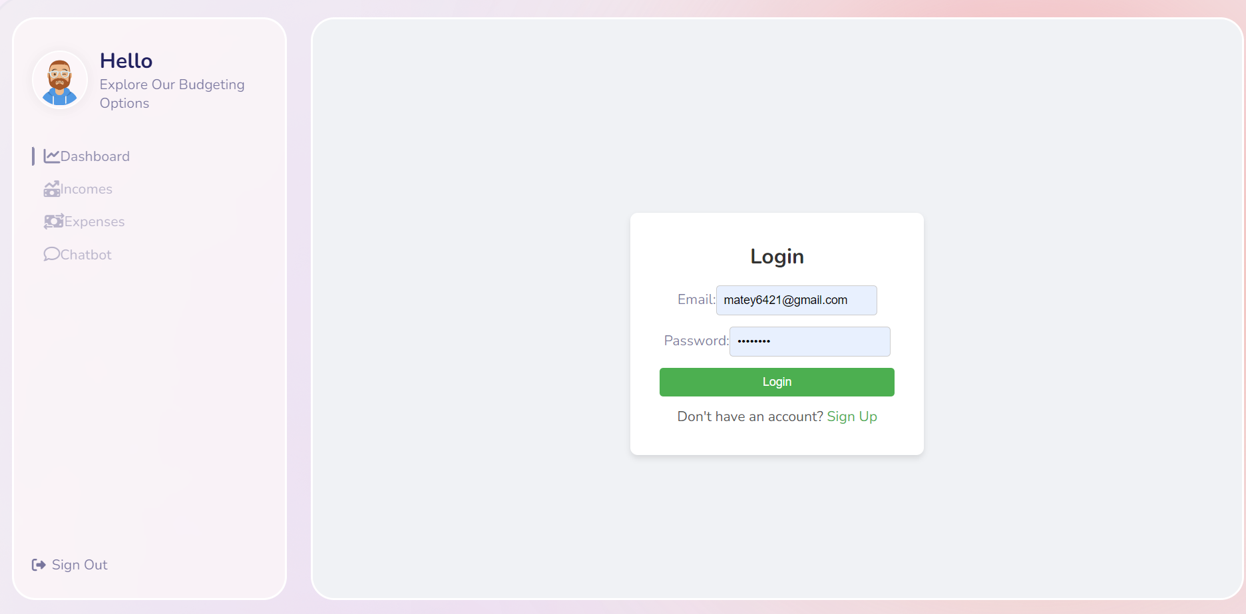
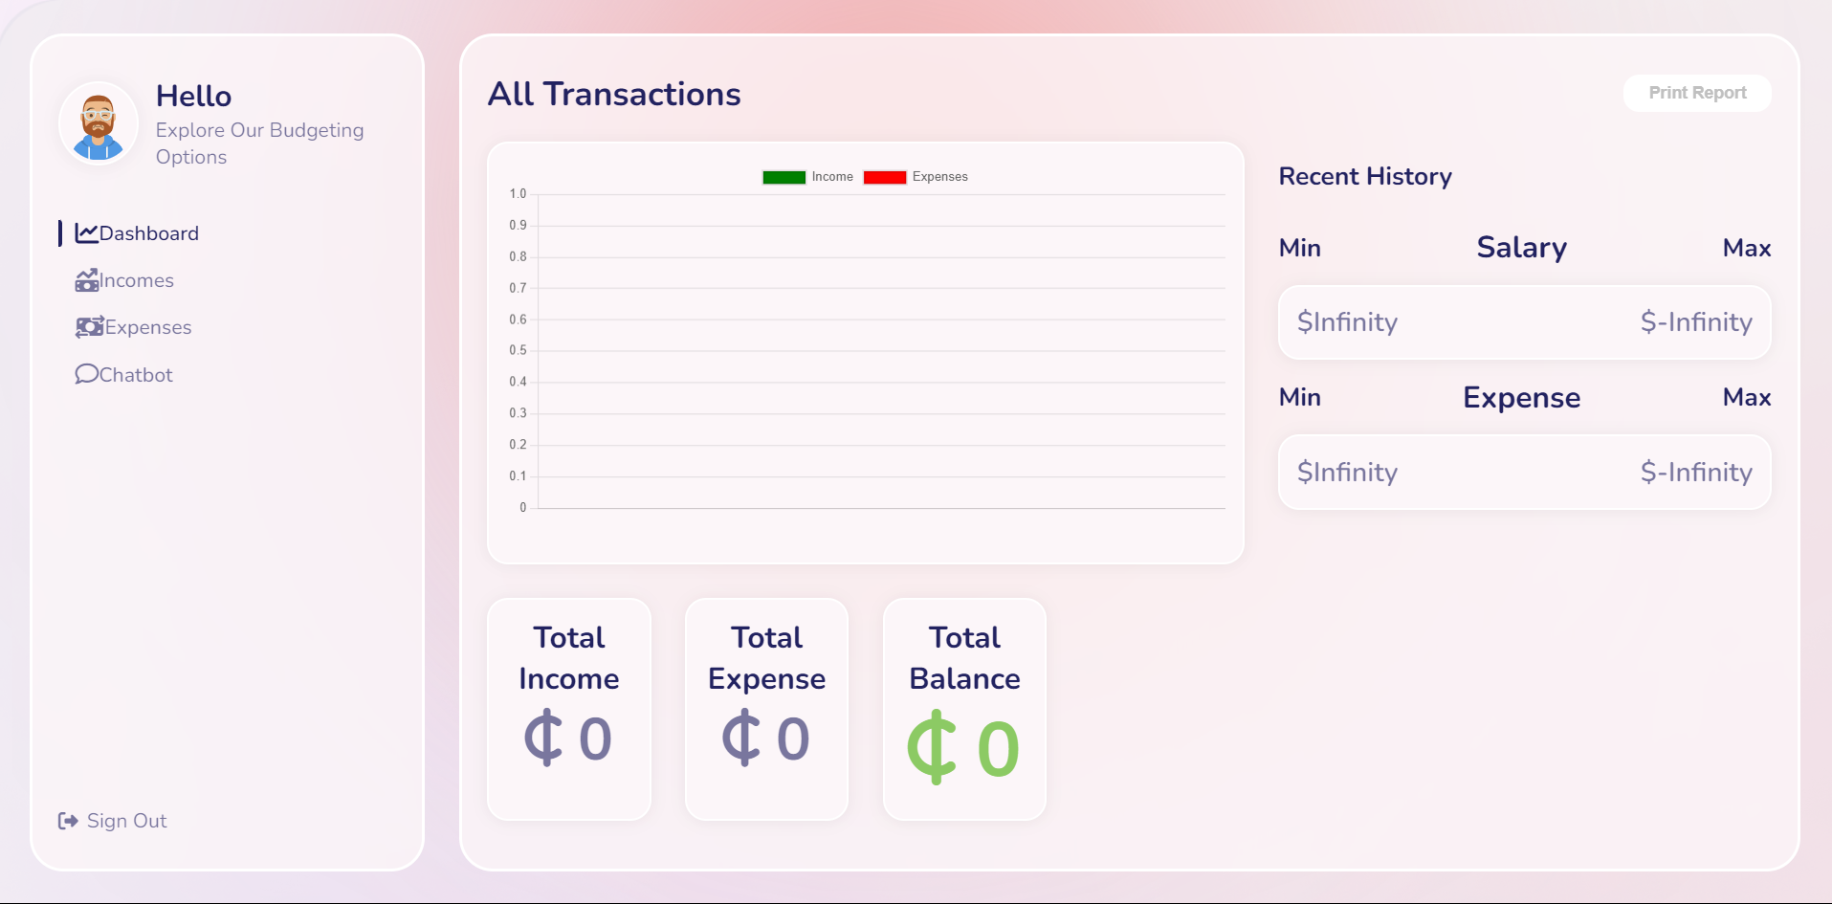
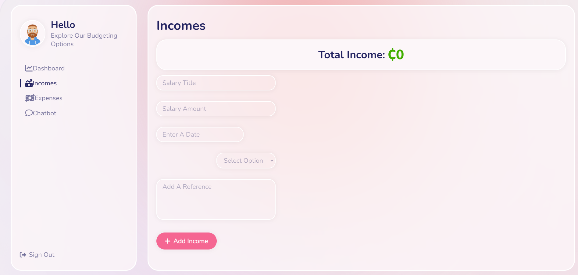
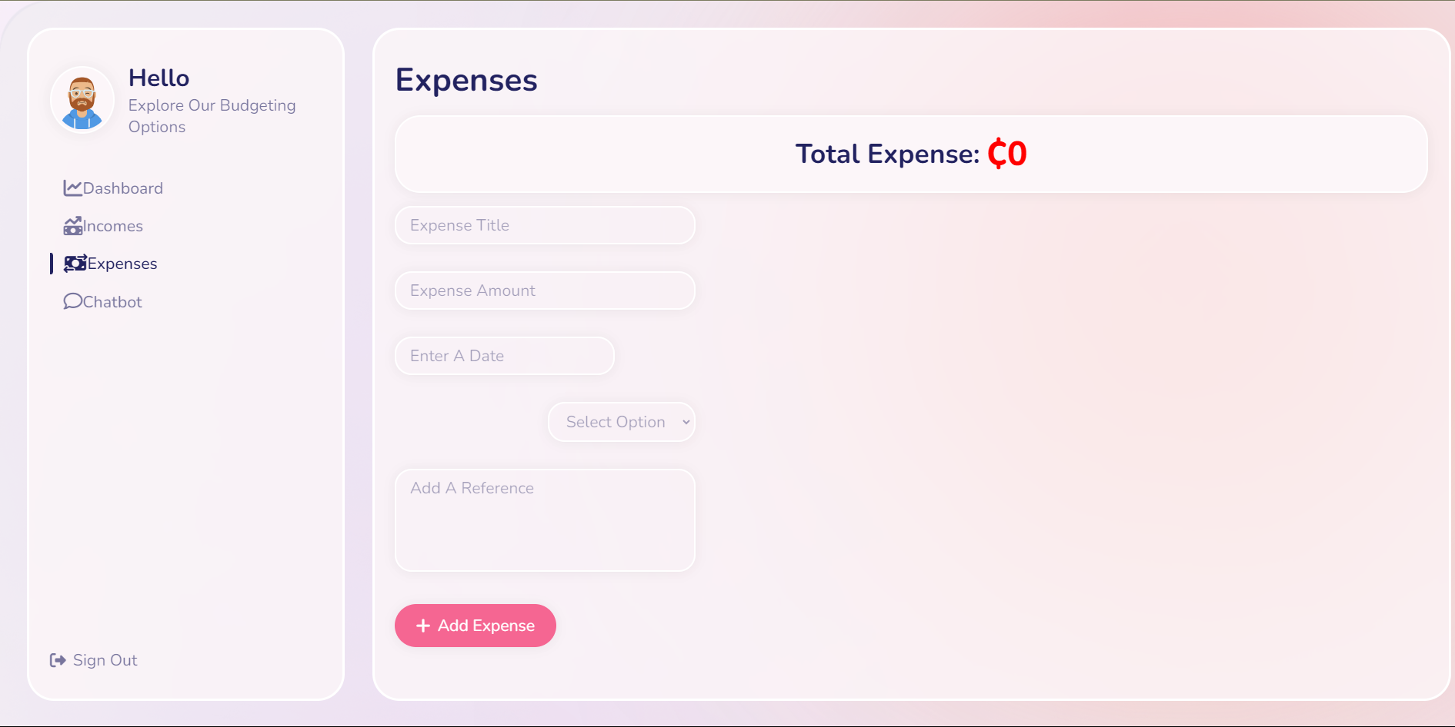
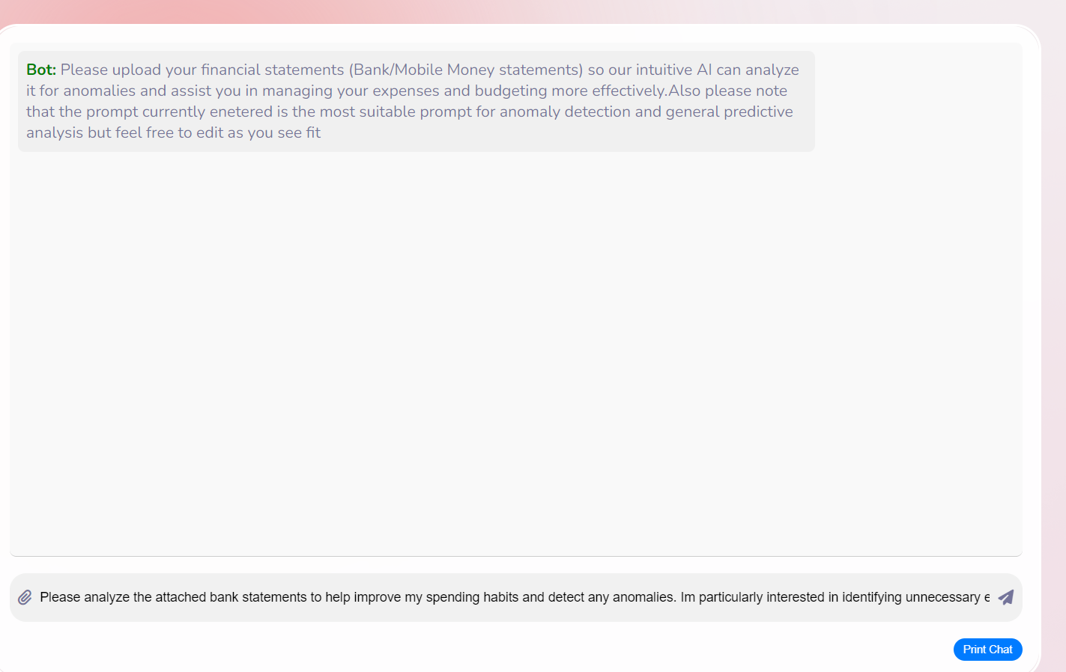
DESIGN AND IMPLEMENTATION OF BUDGETING AND EXPENSE MANAGEMENT WEBAPP
Ishmael Matey Azu.
SUPERVISOR : Dr. Rose Gyening.
ABSTRACT
AIMS AND OBJECTIVES
RESULT ANALYSIS
The project Poster outlines the development of a Budgeting and expense Management WebApp aimed at enhancing personal finance management through advanced technological features. The primary objective is to create a user-friendly web application that integrates artificial intelligence to provide predictive analytics and anomaly detection thereby empowering users to make informed financial decisions .
The Project aims to develop a comprehensive budgeting and expense management application using react this application will leverage AI to forecast Spending trends and detect unusual financial patterns providing users with actionable insights to improve their financial health
User-Friendly Interface: Develop an intuitive web interface for tracking income and expenses
Predictive Analytics: Implement features to forecast future spending and identify savings opportunities.
Functionality: The application successfully integrates advanced features such as predictive analytics and anomaly detection. Users can track their income and expenses in real-time, receive alerts for unusual spending patterns, and benefit from forecasts of future financial trends.
User Interface: A user-friendly interface was developed, allowing for seamless navigation and interaction. The design focuses on accessibility, ensuring that users of varying financial literacy levels can effectively utilize the application.
Testing Outcomes: The testing plan included unit testing and system integration testing, which confirmed that all components functioned as intended. Feedback from a small user group indicated high satisfaction with the application's usability and the value of its AI-driven insights.
Performance Metrics: The application demonstrated reliable performance in processing data and generating insights, with the AI components effectively identifying spending anomalies and providing accurate predictive analytics.
User Engagement: Initial user engagement metrics showed a positive trend, with users actively utilizing the budgeting and tracking features, indicating the application's effectiveness in helping them manage their finances better.
INTRODUCTION
METHODOLOGY AND PROJECT TOOLS
Managing personal finances can be a complex and overwhelming task, often leading to overspending and financial stress when not approached with the right tools and strategies. While there are numerous financial management solutions available, many of them lack the advanced features necessary to truly empower users in understanding and controlling their spending habits. Key functionalities, such as predictive analytics and anomaly detection, are often missing, leaving users without the deeper insights that could significantly improve their financial well-being. By incorporating these advanced technologies, a more comprehensive approach can be taken, offering users not just a snapshot of their current financial situation but also proactive guidance on how to optimize their spending and avoid common pitfalls. This level of insight can be transformative, helping individuals achieve greater financial stability and peace of mind.
Software Process Model:
The project followed an iterative software process model, allowing for continuous improvement and adaptation based on user feedback. This approach enabled the development team to quickly respond to changing requirements and deliver incremental releases with enhanced functionality.
Developmental Tools:
The project leveraged the following tools for development:
React.js: A JavaScript library for building user interfaces, used for developing the application's frontend.
Node.js: A JavaScript runtime environment, used for building the backend server-side functionality.
React Router: A library for handling client-side routing in React applications.
Anthropic's Claude AI: An AI model accessed via an API, used for implementing anomaly detection and predictive analytics features.
These tools were chosen for their scalability, performance, and ability to integrate with each other, ensuring a seamless development process and a robust final product.
PROBLEM STATEMENT
Managing personal finances is often complex, leading to overspending and financial stress. Existing financial management tools frequently lack advanced features necessary for in-depth financial insights, leaving users without the ability to proactively manage their finances.
CONCLUSION
Enhanced Financial Management: The application successfully integrates advanced features such as predictive analytics and anomaly detection, empowering users to take control of their finances. By providing real-time insights and alerts, the application enables users to make informed decisions, ultimately leading to improved financial health.
User Satisfaction: Feedback from user testing indicated high satisfaction levels with the application's usability and functionality. Users appreciated the intuitive interface and the value of AI-driven insights, which facilitated better tracking of income and expenses.
Robust Performance: The application demonstrated reliable performance throughout testing, effectively processing data and generating accurate predictions. The integration of Anthropic's Claude AI via API ensured that the predictive analytics and anomaly detection features were both effective and up-to-date.
Scalability and Future Development: The modular architecture of the application allows for future enhancements and scalability. This flexibility ensures that the application can adapt to evolving user needs and incorporate additional features as required.
Challenges and Limitations: The project faced challenges related to data quality and the need for continuous updates to the AI models. Ensuring high-quality input data is crucial for the accuracy of predictive analytics, and ongoing improvements will be necessary to maintain the application's relevance.
Recommendations for Future Work: Future iterations of the application could explore the development of a mobile version to reach a broader audience. Additionally, incorporating user feedback mechanisms could further enhance the application's capabilities and user experience.
IMPLEMENTATION AND TESTING
The application was developed using React for the frontend and Node.js for the backend, ensuring a robust architecture. Key features were integrated through an API from Anthropic's Claude AI, enabling advanced functionalities like anomaly detection and predictive analytics. This integration allowed the application to leverage existing AI capabilities, streamlining development and ensuring high performance.
Testing
A comprehensive testing plan was executed, which included:
Unit Testing: Each component was tested individually to ensure functionality.
Integration Testing: Components were tested together to verify interactions.
System Testing: The entire application was assessed to confirm it met overall requirements.
User Acceptance Testing: Feedback was gathered from a select group of users to evaluate usability and functionality.
Results
The testing confirmed that the application functioned as intended, with users expressing high satisfaction regarding its usability and AI-driven insights. The predictive analytics effectively forecasted spending trends, while the anomaly detection feature successfully identified unusual spending patterns, enhancing users' financial management capabilities.
USER INTERFACE

