Slide 1
g-FET Fluidic Automation Development
01/30/2025
Michael Cato
Research Engineer
Georgia Tech Research Institute (GTRI)
Electro-Optical Systems Laboratory (EOSL)
michael.cato@gtri.gatech.edu | 404-407-7225
Student Interns
-Ian Boraks (GT)
-David Reynolds (GT)

Slide 2
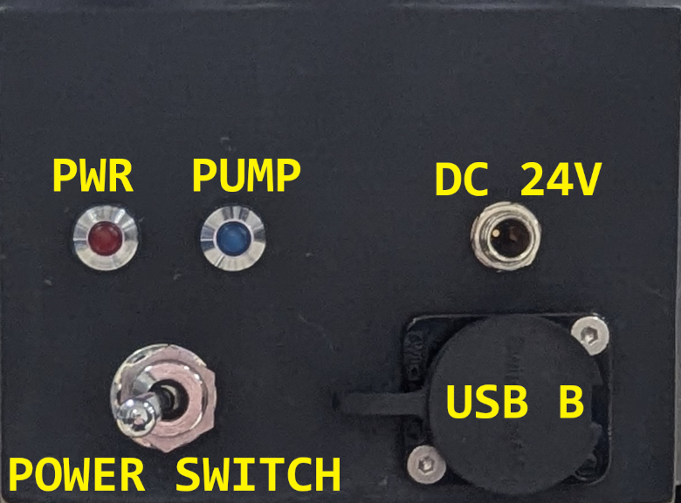
Front Panel Inputs and Outputs

Slide 3
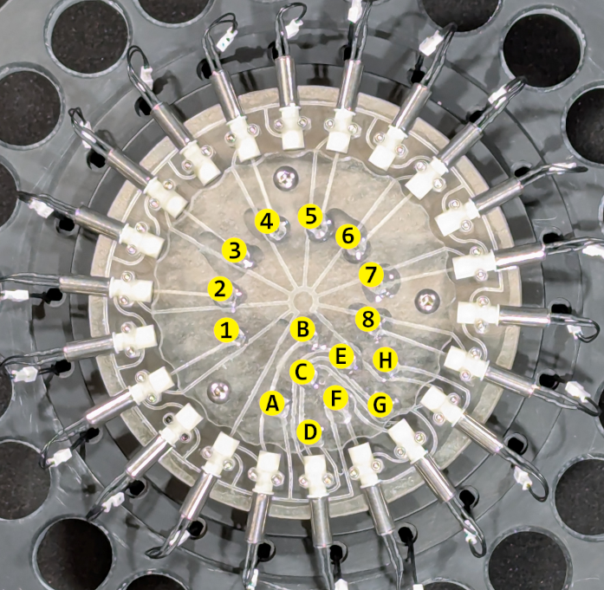
Fluidic Device Inputs and Outputs
# Label Direction
A Wash IN
B Vent IN
C gFet IN
D gFet OUT
E Pump IN
F Collection OUT
G Waste OUT
H Pump OUT
1-8 Reagents IN

Slide 4
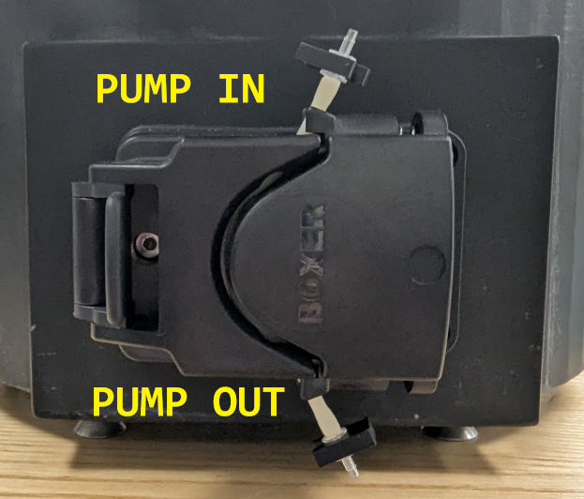
Loading the Pump

Slide 5
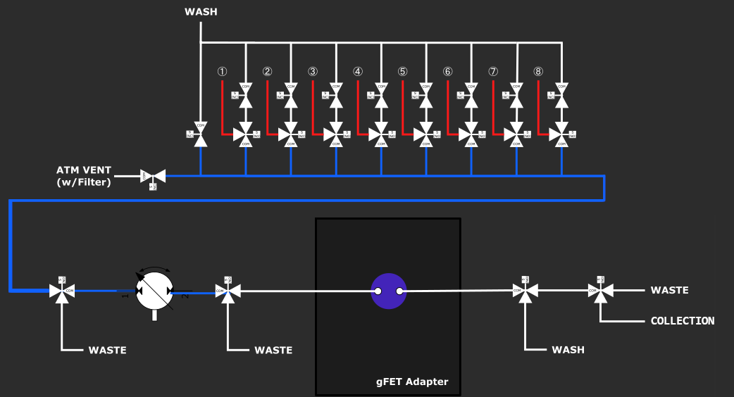
Fluidic Diagram

Slide 6
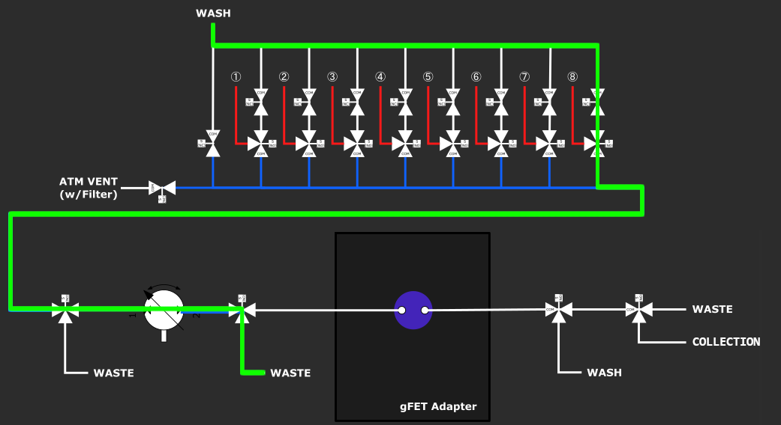
PRIME CHEM_WASH
PRIME CHEM_WASH 8 -T ## -R ##

Slide 7
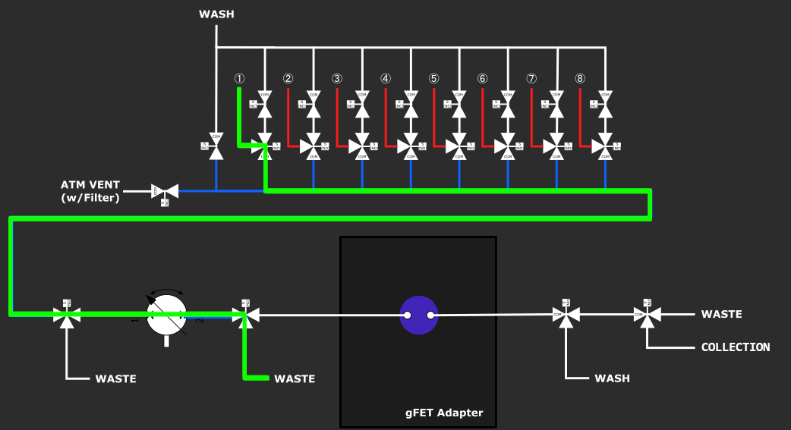
PRIME -C
PRIME -C 1 -T ## -R ##

Slide 8
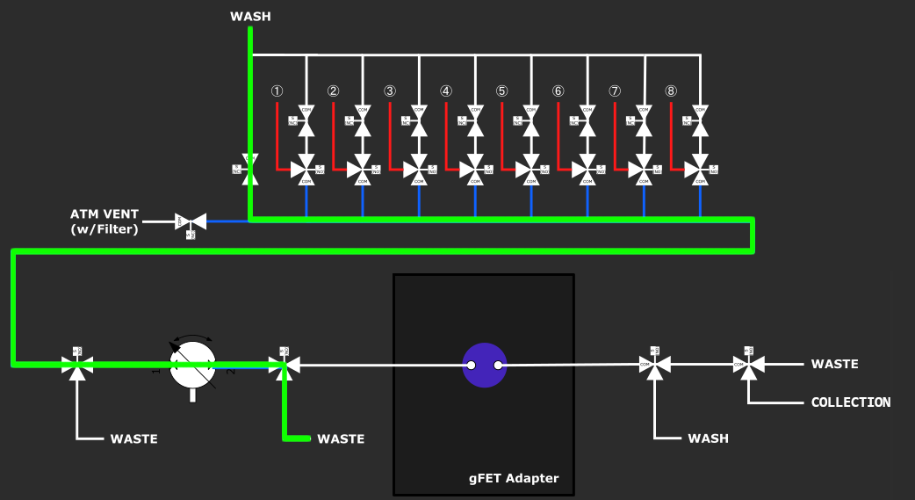
WASH COMMON
WASH COMMON 0 -T ## -R ##

Slide 9
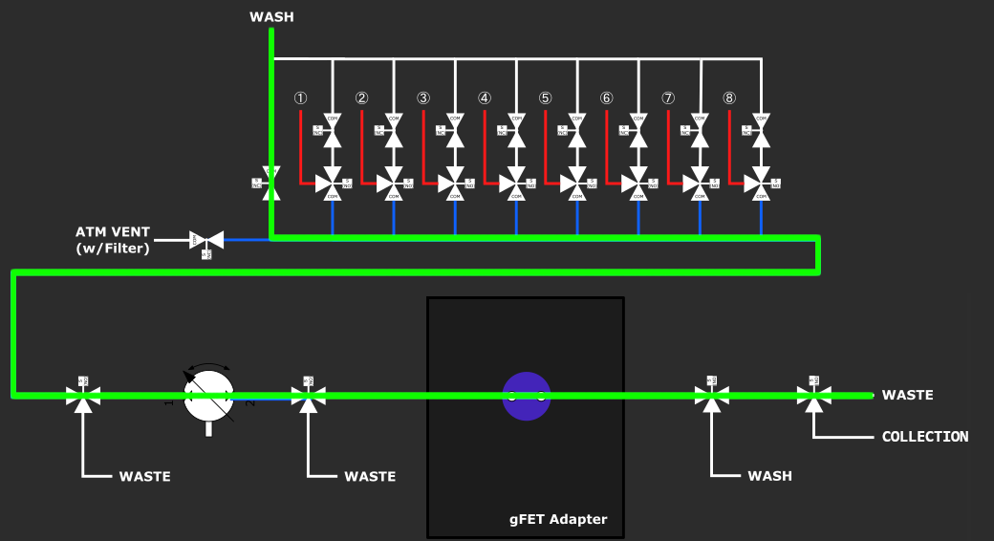
WASH COLLECT
WASH COLLECT 0 -T ## -R ##

Slide 10
WASH -C
WASH -C 8 -T ## -R ##

Slide 11
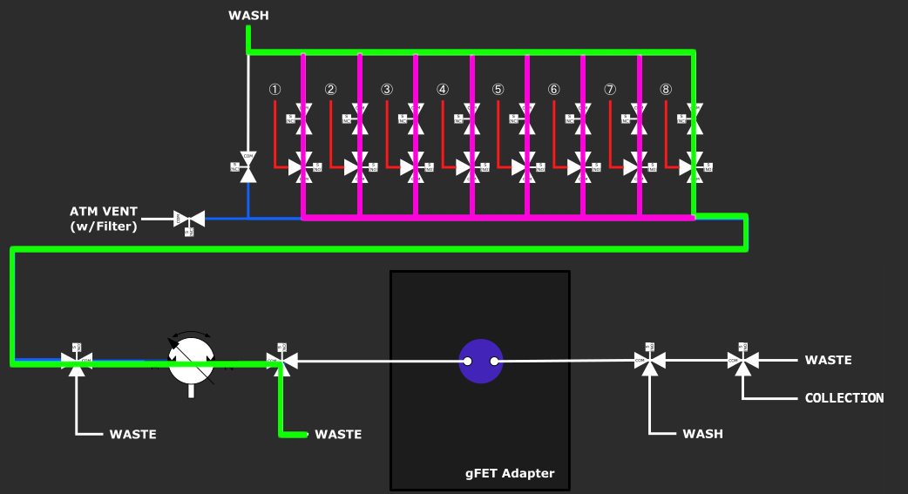
WASH CHEM_WASH
WASH CHEM_WASH 0 -T ## -R ##
Washes channel 8 to 1 sequentially.

Slide 12
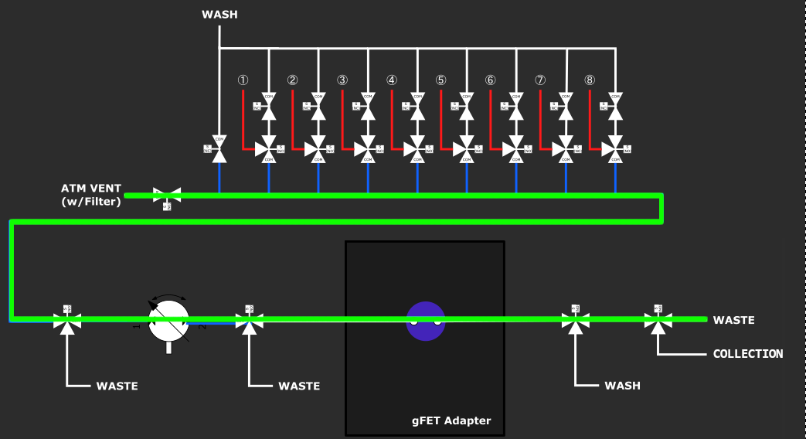
PURGE ALL
PURGE ALL 0 -T ## -R ##

Slide 13
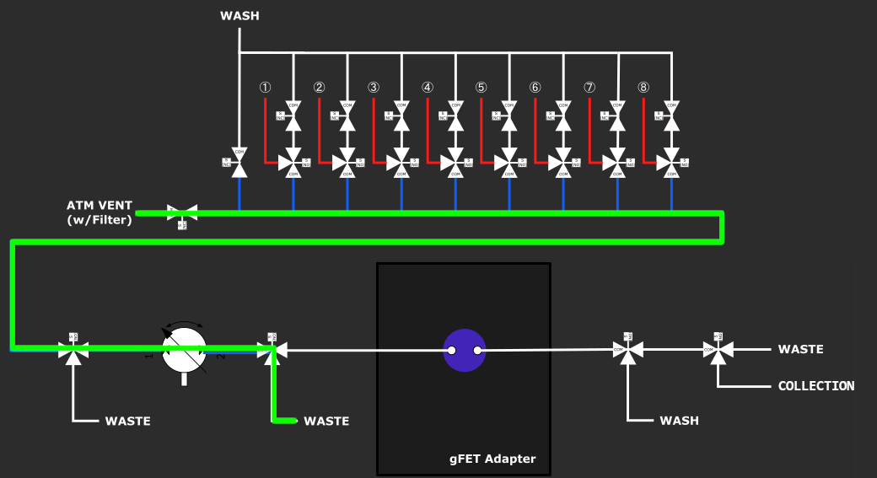
PURGE COMMON
PURGE COMMON 0 -T ## -R ##

Slide 14
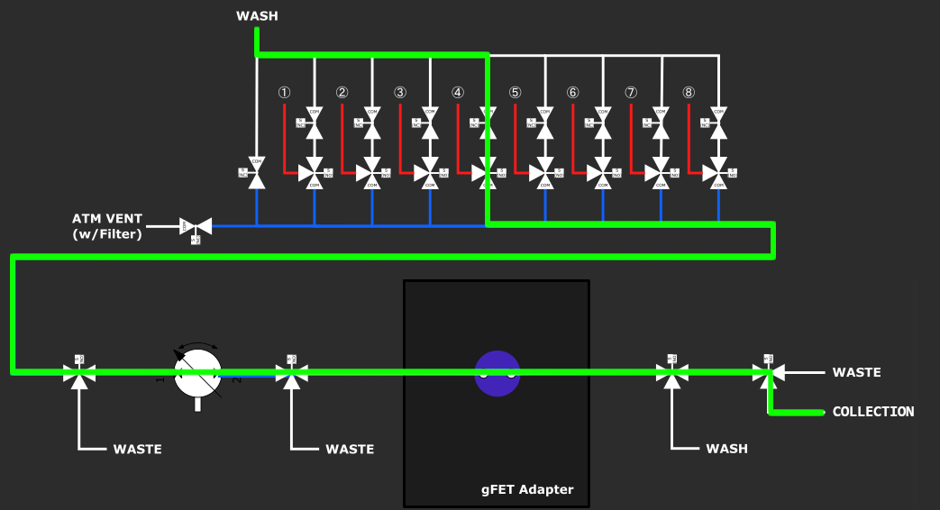
COLLECT
COLLECT -C 4 -T ## -R ##

Slide 15
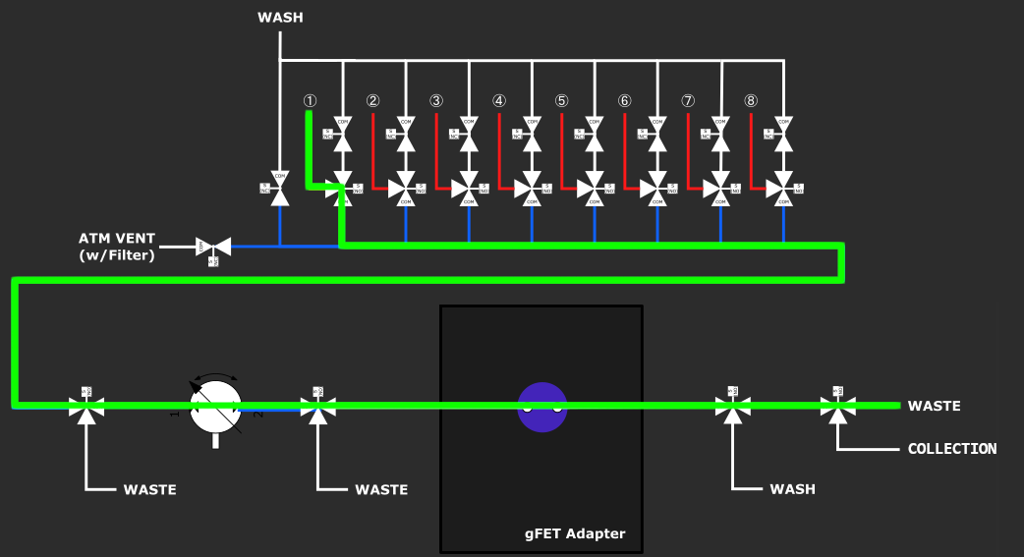
PUMP -C
PUMP -C 1 -T ## -R ##

