Slide 1
The Battle of Neighborhoods Presentation

Slide 2
Introduction/Business Problem
As of 2020,City of San Francisco has the highest salaries, disposable income, and median home prices in the world at $1.7 million, as well as the highest median rents. San Francisco Bay Area in Northern California serves as a global center for high technology, innovation, venture capital, and social media.
Business Problem
Given high median rents and salaries, San Francisco will attract lot of people expecting good food and entertainement. The high consumer spending capacity calls for need of niche and high quality product experience. This will open opportunities for entrepreneurs to setup a restuarant/food chain.
Suitable Restaurant and Location
Since lots of restaurants exist in San Francisco, we will try to detect locations that are not already crowded with restaurants. We are also particularly interested in areas with no Italian or sushi restaurants in vicinity. We would also prefer locations as close to city center as possible, assuming that first two conditions are met.
Target Audience
Anyone looking to open a restaurant in San Fransisco Bay area. The objective is to locate and recommend to the target audience which neighborhood of San Francisco city will be best choice to start a itlaian/sushi restaurant.

Slide 3
Data
Boroughs and Neighbourhood data
Google Maps API
Restaurants and Profile data – FoureSquare

Slide 4
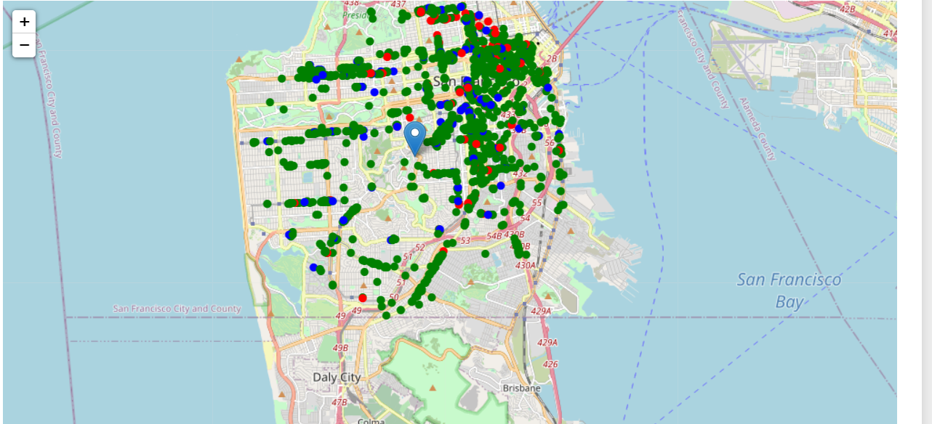
Methodology
Focus on restaurants in San Francisco center – Corbett Ave
Calculate restaurant density
Cluster the areas based on restaurant density and profiles

Slide 5
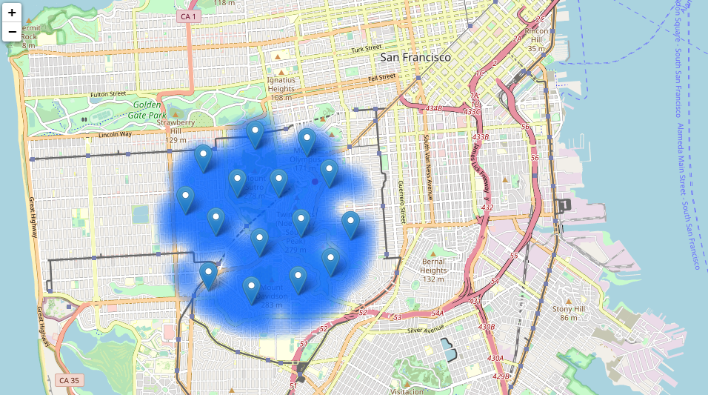
Results

Slide 6
Conclusion
Final decission on optimal restaurant location will be made by stakeholders based on specific characteristics of neighborhoods and locations in every recommended zone, taking into consideration additional factors like attractiveness of each location (proximity to park or water), levels of noise / proximity to major roads, real estate availability, prices, social and economic dynamics of every neighborhood etc.

