Slide 1
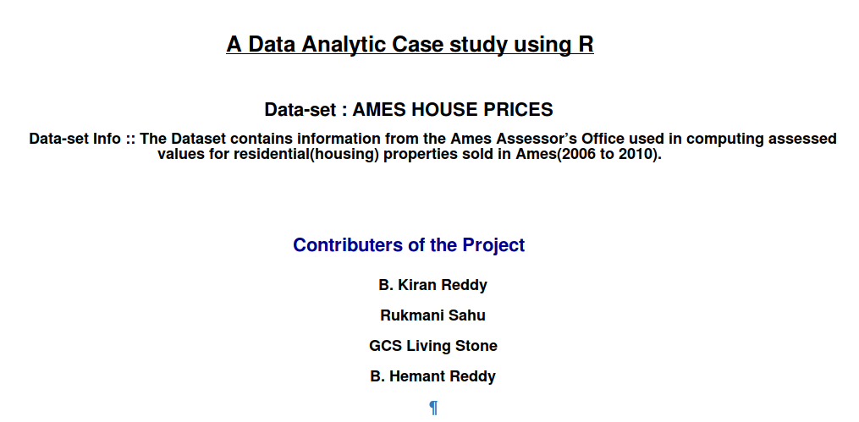
Data Analysis using R programming
Notes:
<number>

Slide 2
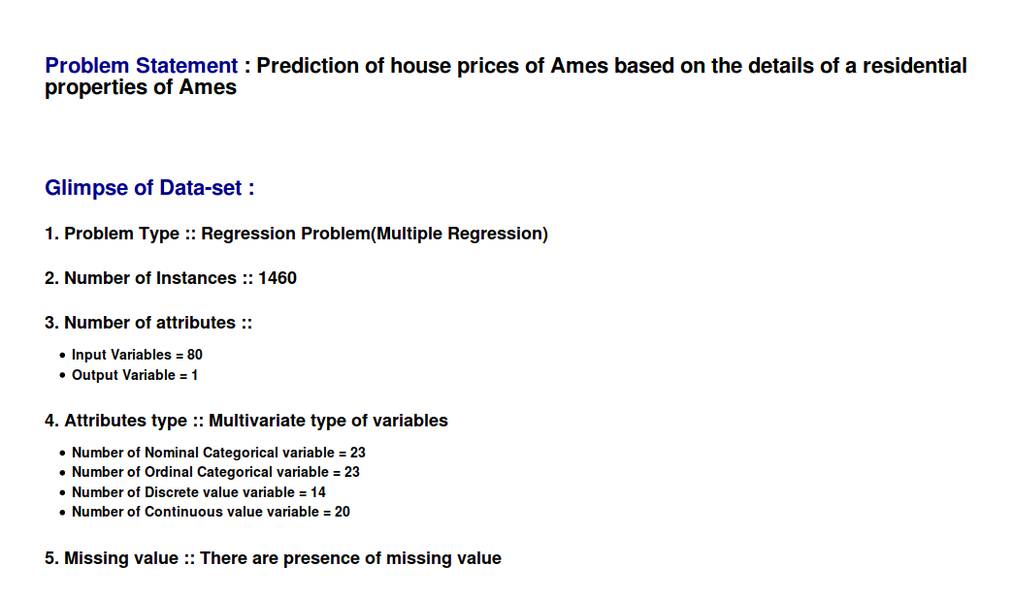
Data Analysis using R programming
Notes:
<number>

Slide 3
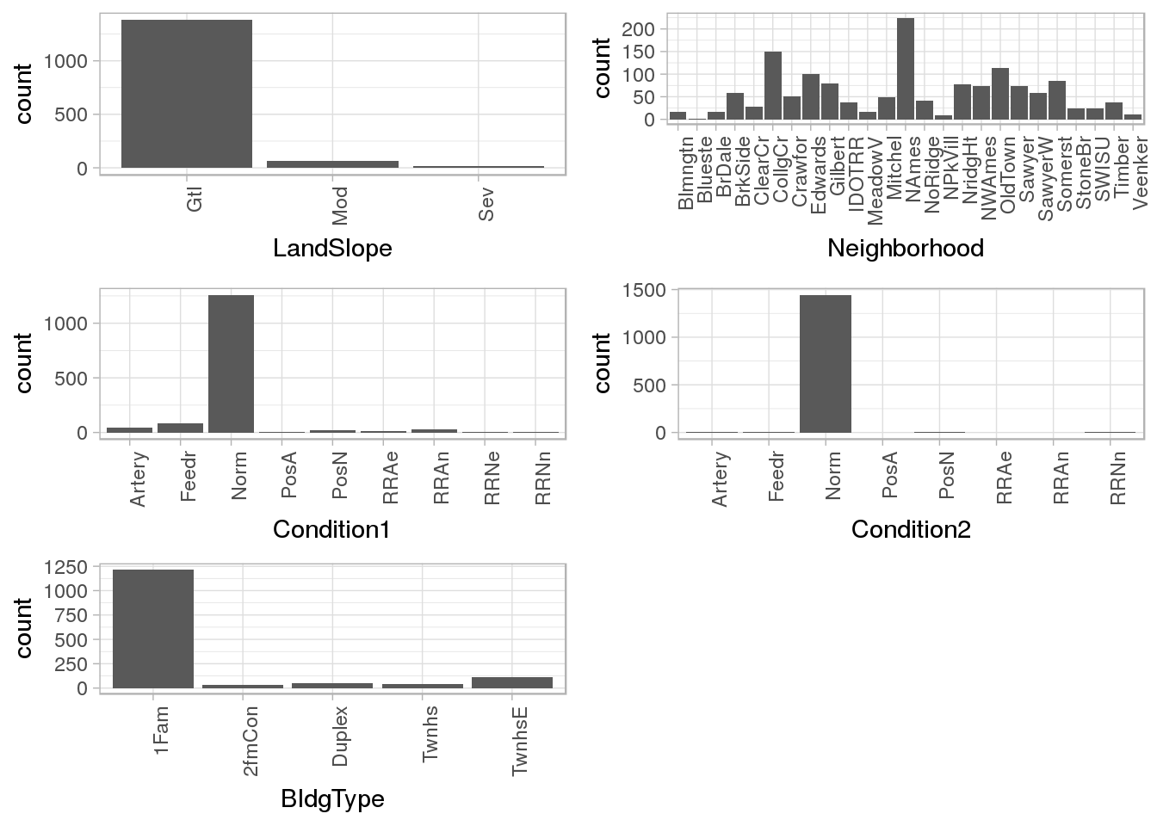
Data Analysis using R programming
Basic frequency count of instances with respect to some attributes
Notes:
<number>

Slide 4
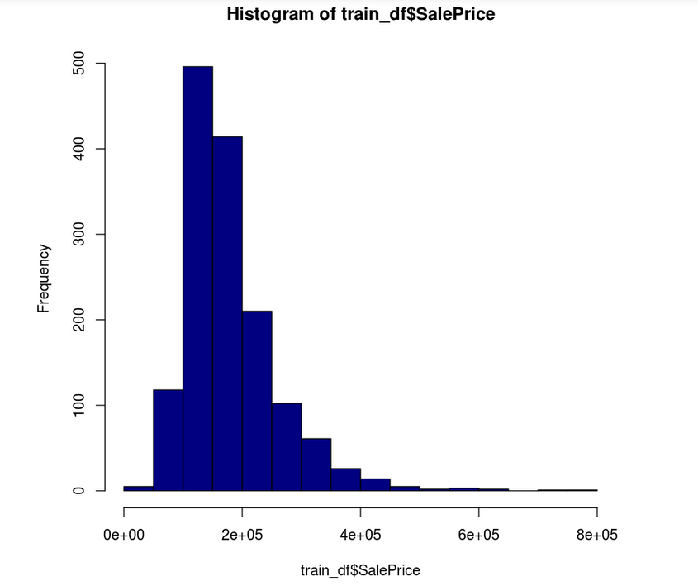
Data Analysis using R programming
Skewness in distribution:
Notes:
<number>

Slide 5
Data Analysis using R programming
Applications in the real world
Some of the application of regression technique
Predicting/Forecasting in buisness domains(Eg:Real Estate)
Corelational analysis(Eg: b)
Economical Status of a country’s property
Optimization of resources
Notes:
<number>

Slide 6
Data Analysis using R programming
Model selection ??
Model will be selected after data has been explored well.
Though More likely to be used:
Random Forest : Underthehood CART
Notes:
<number>

Slide 7
DATA EXPLORATION
Variable Identification
Type Of Variable | Data Type | Variable Category
Predictor Variable Lot Area Street Lot Frontage Year Built Sale Type Sale condition House style Roof Style Fence Target Variable Sale Price | Integer Lot Area Lot Frontage Year Built Sale Price Factor Street Sale Type Sale condition House Style Fence Roof style | Categorical Street Sale type Sale condition Fence Roof Style Continuous Lot area Lot frontage Year built Sale price
Notes:
(
<number>

Slide 8
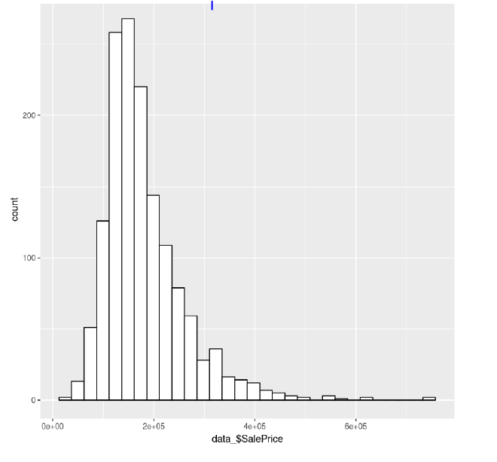
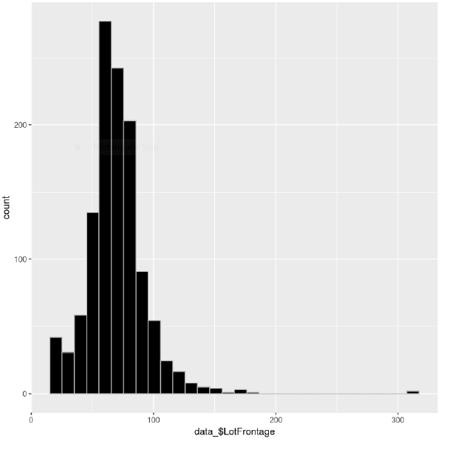
DATA EXPLORATION
Univariate Analysis
Analysis of sale price
Analysis of Lot frontage

Slide 9
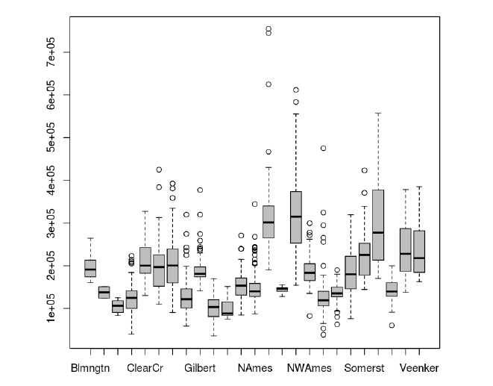
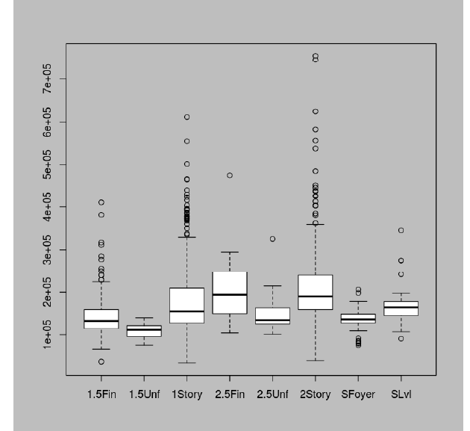
Univariate Analysis
DATA EXPLORATION
DATA EXPLORATION
DATA EXPLORATION
Box plot representation of neighborhood
Box plot representation of House style
House style

Slide 10
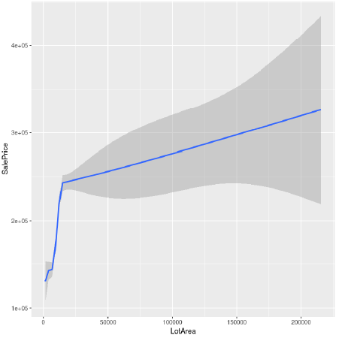
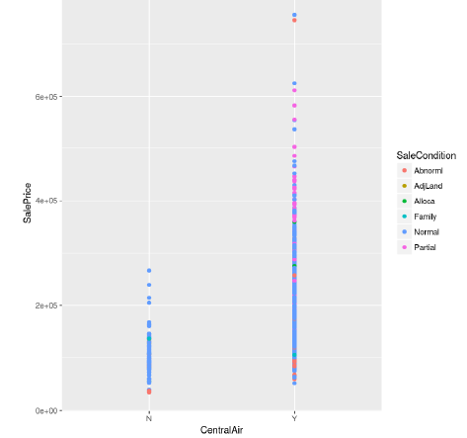
DATA EXPLORATION
Bi-variate Analysis

Slide 11
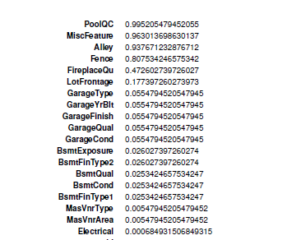
DATA EXPLORATION
Missing Value Treatment
The following columns has missing values :
1:We have deleted columns whose no. of missing value is more than 80%.
2:All other columns which has missing value we will use mean or mode imputation method.

Slide 12
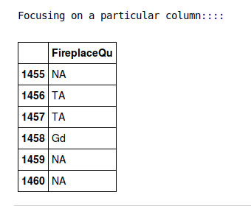
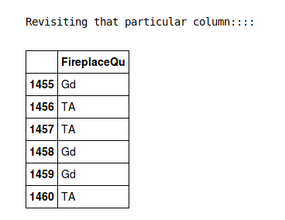
DATA EXPLORATION
Missing Value Treatment

Slide 13
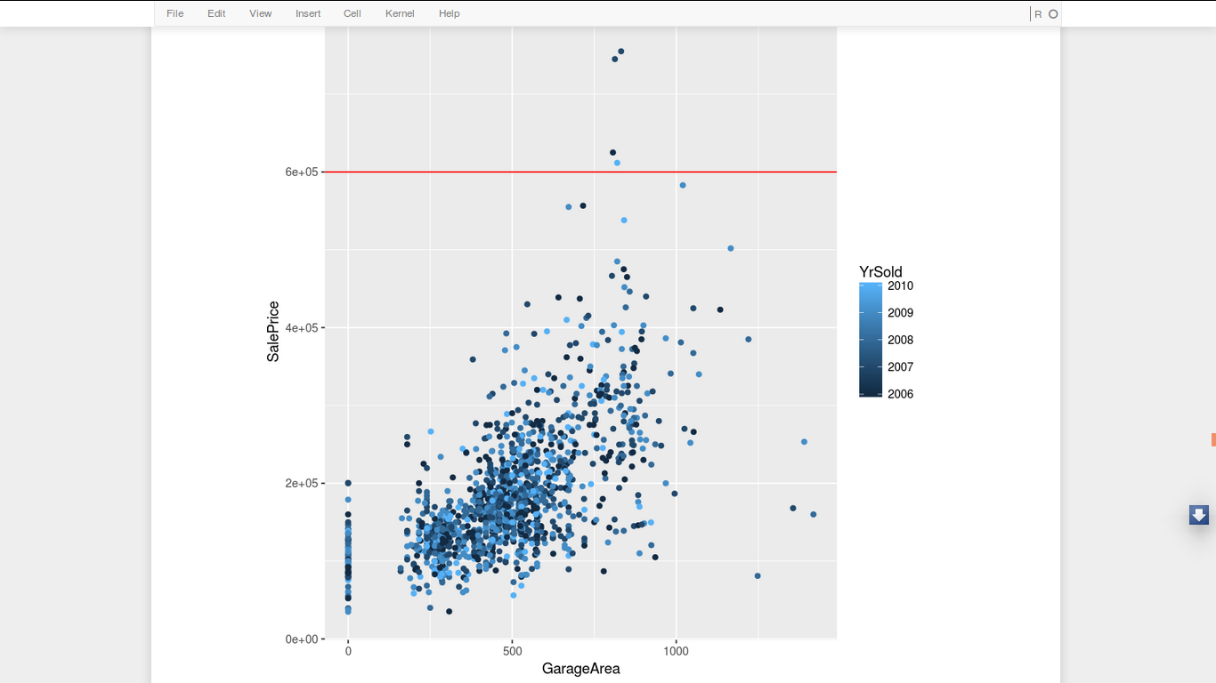
DATA EXPLORATION
Outlier Detection

Slide 14
DATA EXPLORATION
Random Forest Model
Random Forest Model
Random Forest Model
It has been applied on
two variant
Of the same dataset:
1.Plain imputed data
2. Modelled data

Slide 15
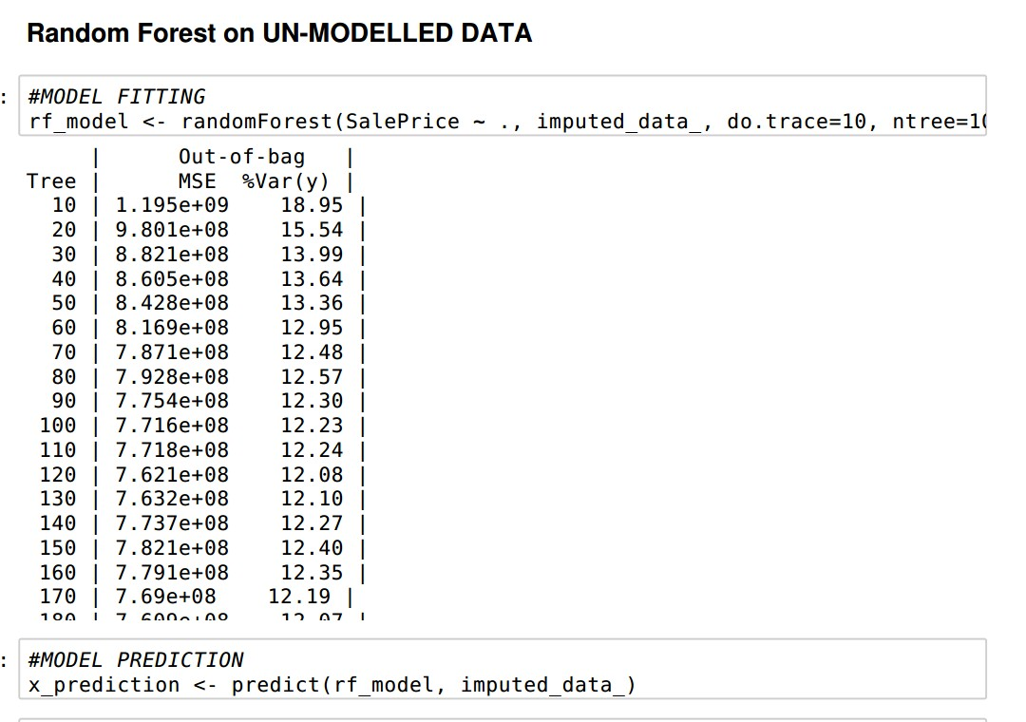
DATA EXPLORATION

Slide 16
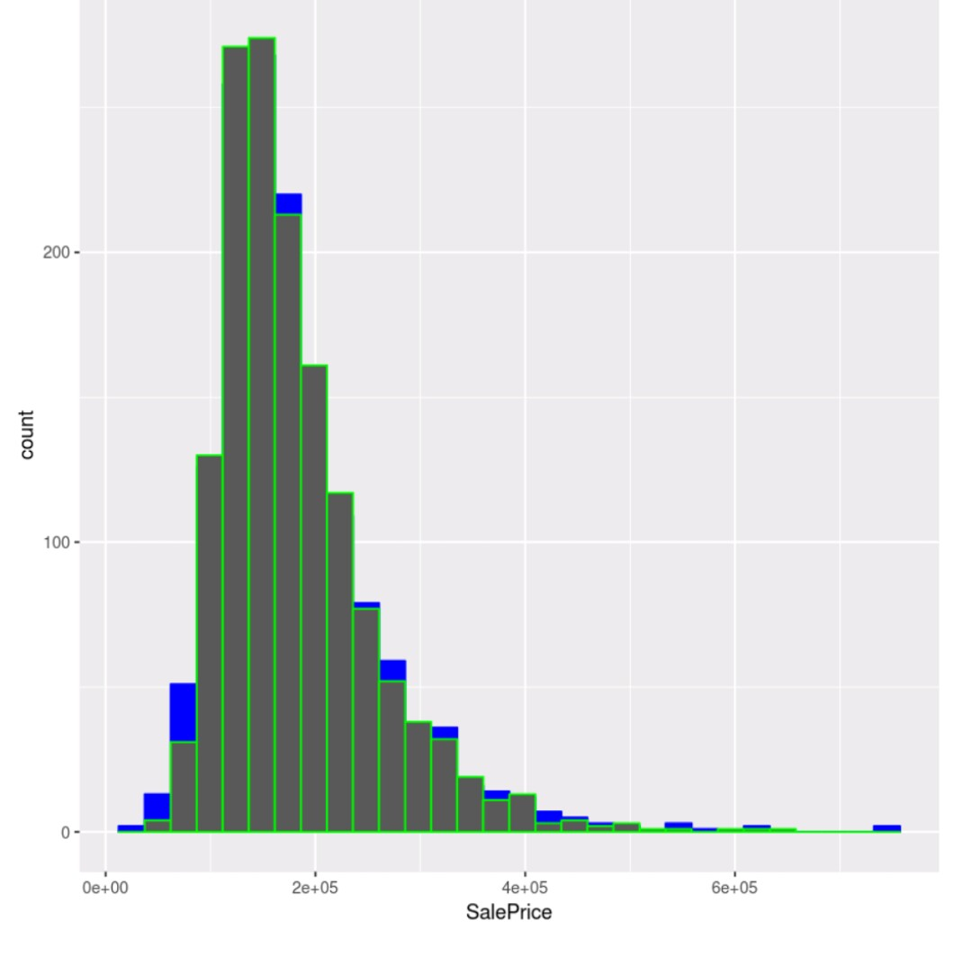
Distribution original vs predicted
DATA EXPLORATION

Slide 17
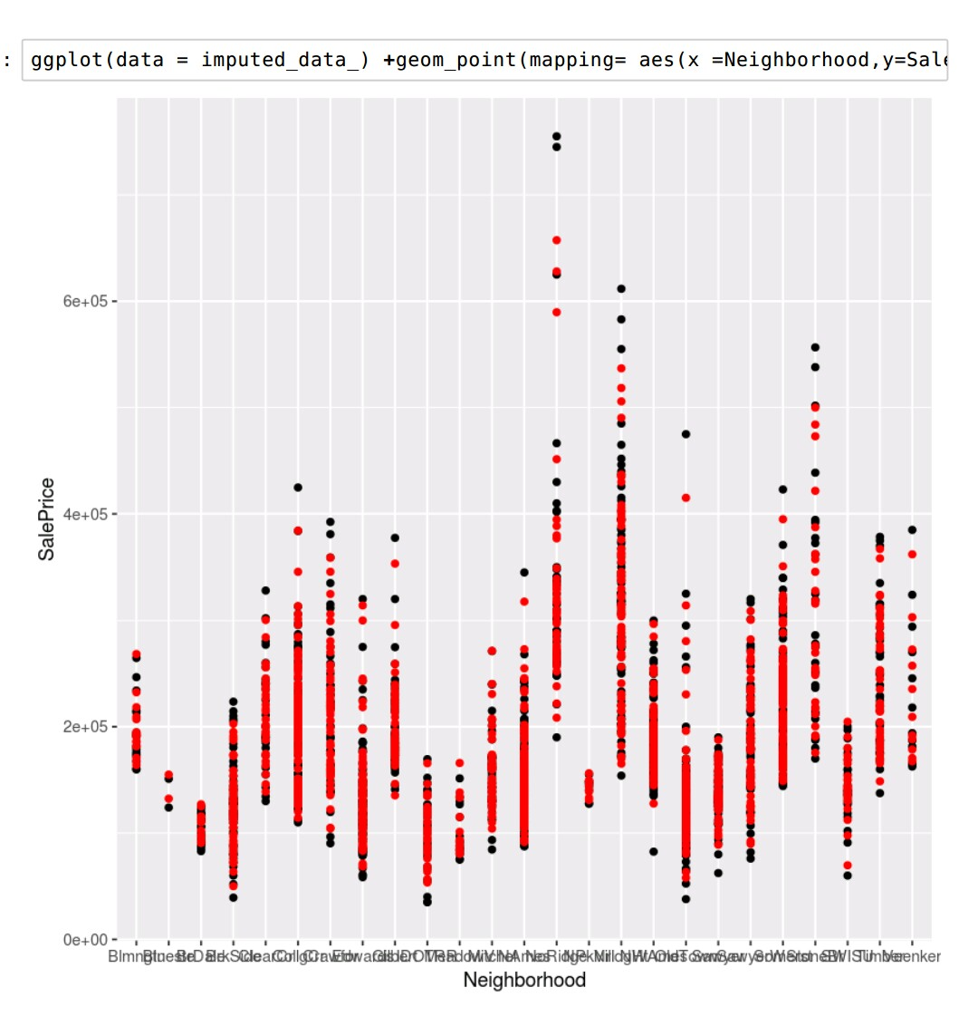
Remember Neighborhood??
DATA EXPLORATION
DATA EXPLORATION

Slide 18
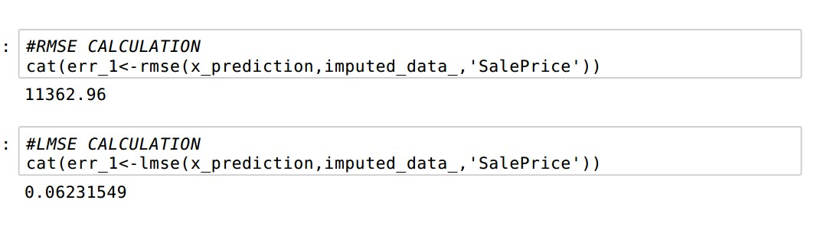
Results :::::::
DATA EXPLORATION
RMSE Vs RMSE(of Log)
DATA EXPLORATION

Slide 19
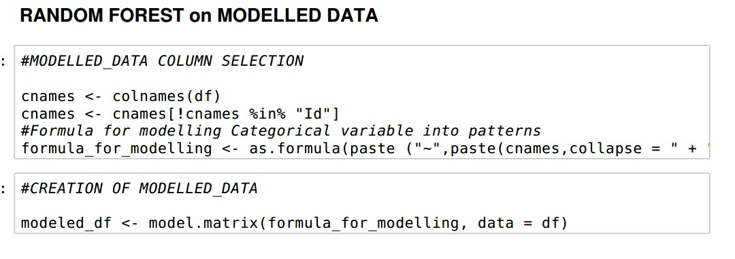
DATA EXPLORATION
Let’s Check the result
DATA EXPLORATION

Slide 20
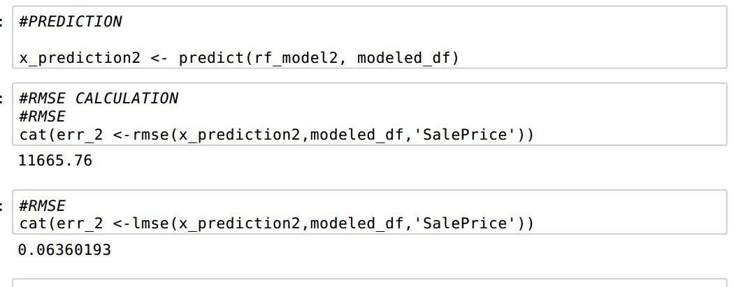
Results of after modelling::
DATA EXPLORATION
Difference between both??
DATA EXPLORATION

Slide 21
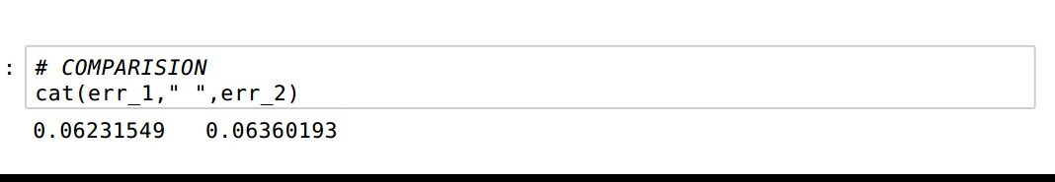
Results Comparision:
DATA EXPLORATION
Difference between both??
DATA EXPLORATION

Slide 22
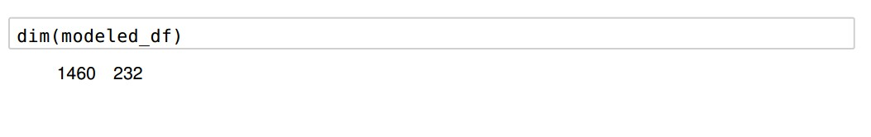
Results Comparision:
DATA EXPLORATION
Difference between both??
REASON : Attributes to instance Ratio is high
DATA EXPLORATION

Slide 23
OUR APPROACH:
DATA EXPLORATION
Why dump all the attributes??
DATA EXPLORATION

Slide 24
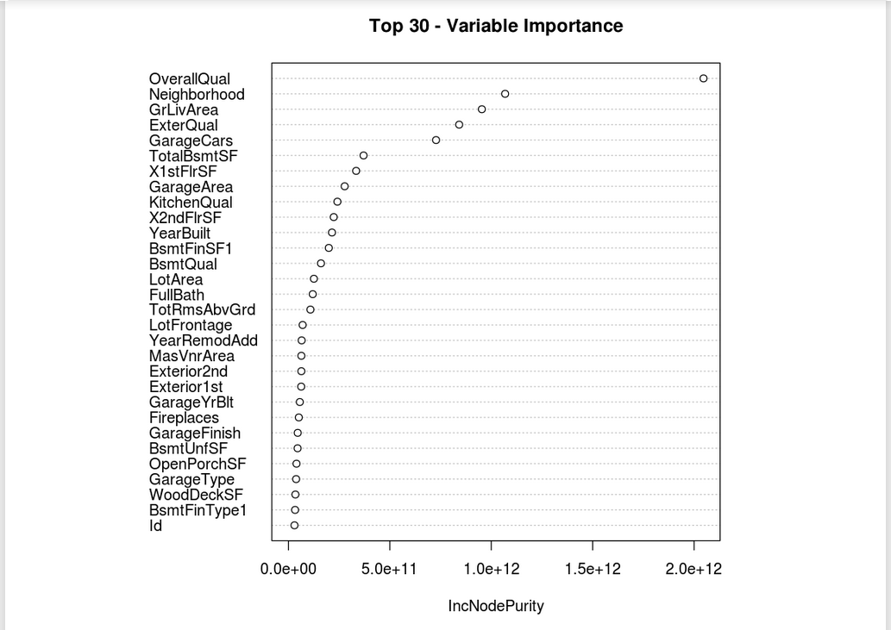
Why dump all the attributes??
DATA EXPLORATION
DATA EXPLORATION

Slide 25
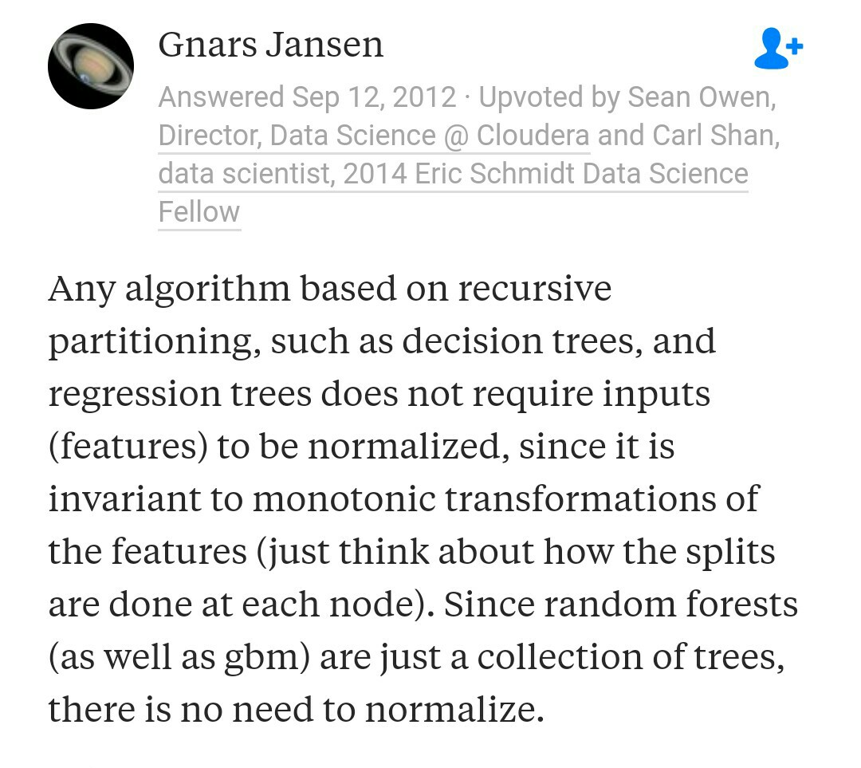
How good the results has been?
DATA EXPLORATION
Wait where is normalization??
DATA EXPLORATION

Slide 26

How good the results has been?
DATA EXPLORATION
DATA EXPLORATION

Slide 27
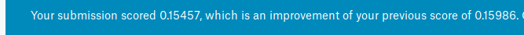
How good the results has been?
DATA EXPLORATION
Good enough to start with a place in the leaderboard above the 30% of people in kaggle competition....!!!
Top score :: 0.10567
Team score :: 0.15457
DATA EXPLORATION

Slide 28
DATA EXPLORATION
THANK YOU...!!!
DATA EXPLORATION

