Slide 1
Configurable Solar Tracking
Senior Design Team #1
Mike Case, Graeme Danforth, Brad Huber, Josh Minneti, Glen Nicholls
Customer: Anthony Andriano
Advisor: Leslie Tekamp
3/23/18

Slide 2
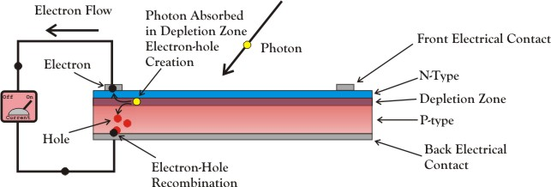
Photovoltaic Cell
http://www.imagesco.com/articles/photovoltaic/photovoltaic-pg4.html
Photovoltaics: Converting light into electricity.

Slide 3
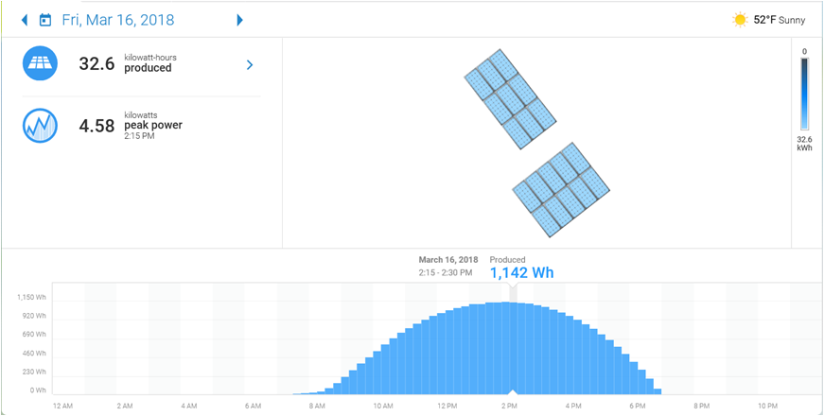
Solar Production from Fixed Solar Array
- Faces 135 degree
- Roof angle 18 degree
- 5.4 kW Max power production capability
- 4.58 peak production
- 20% – 24% production increase with dual axis tracking

Slide 4
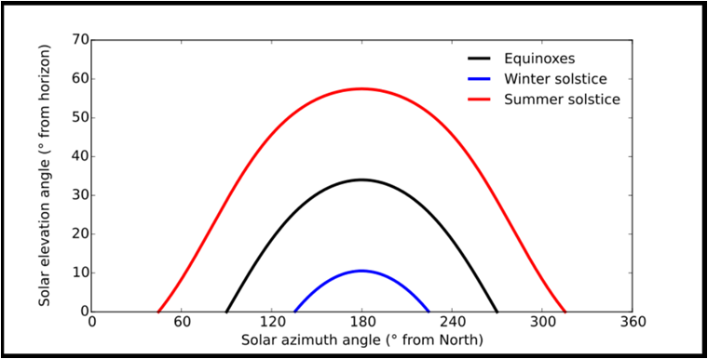
Annual Sun Position
- 240 degree horizontal slew, 120 degree on either side of the north-south line
- 0 – 60 degree elevation angle
- Sun elevation changes by .25 degree per day
Sun angles observed at Lat. 56 N

Slide 5
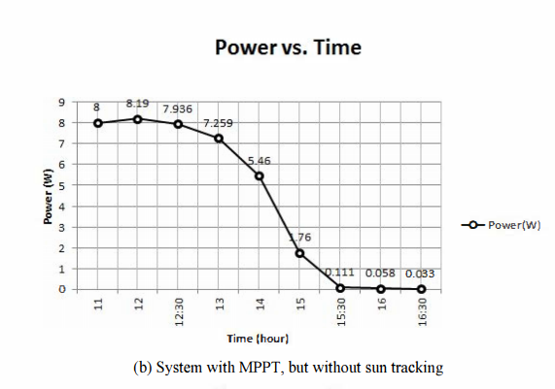
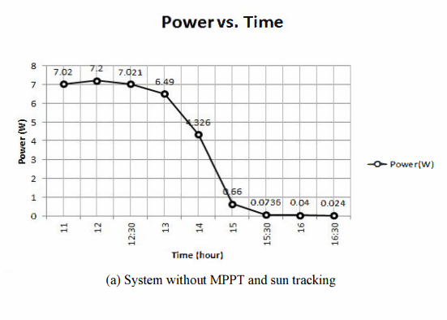
Benefits of Sun Tracking and MPPT
A low-cost P&O based maximum power point tracking, combined with two-degree sun tracker - IEEE Conference Publication
[1]

Slide 6
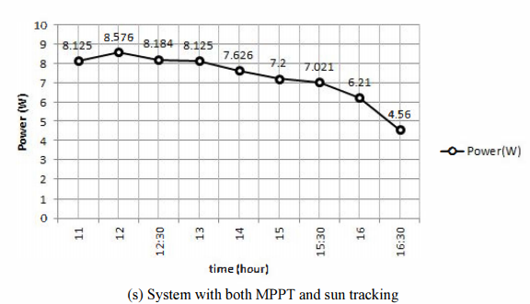
Benefits of Sun Tracking and MPPT
[1]

Slide 7
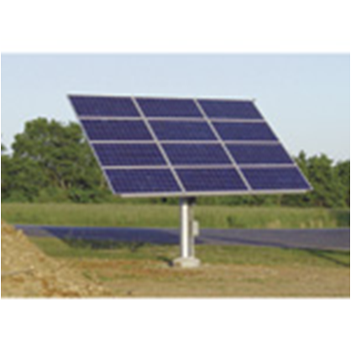
Pier Mounted Sun Tracking Solar Array
- Dual axis active tracking
- Electronic motor control
- Scalable from 1 to 18 photo-voltaic panels
- 2 degree tracking accuracy
- $5000 - $10,000

Slide 8
Core Requirements
Sun Tracking Algorithm
Panel Dependence?
Interface
Available Inputs?
Proof of Concept
Degree of Accuracy?
Mechanical Design?

Slide 9
Design Aspects Not Currently In-Scope
Fully Enclosed, Operational Unit
Size of Array
Weight
Motor Size
Specific Mounting Scheme (roof, ground, wall)

Slide 10
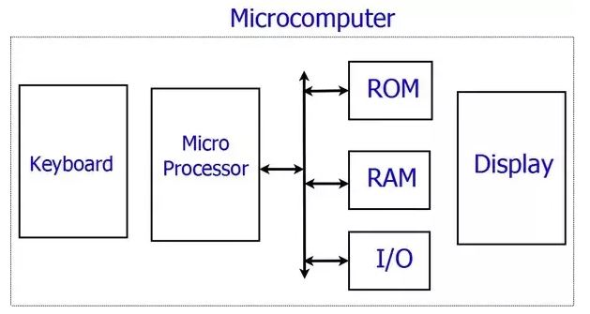
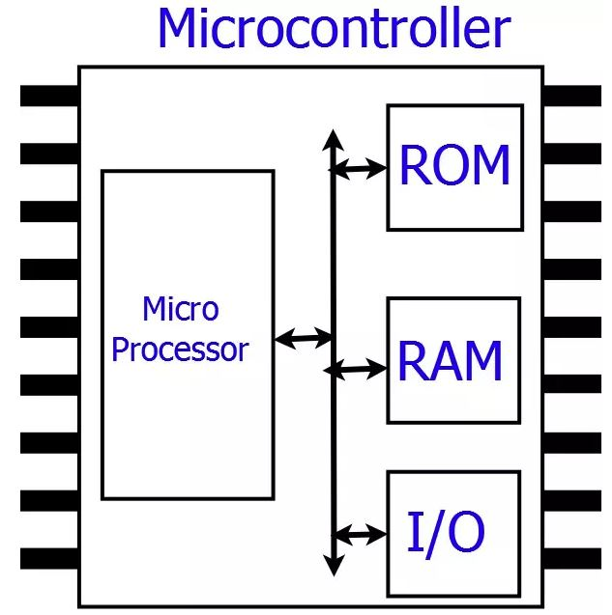
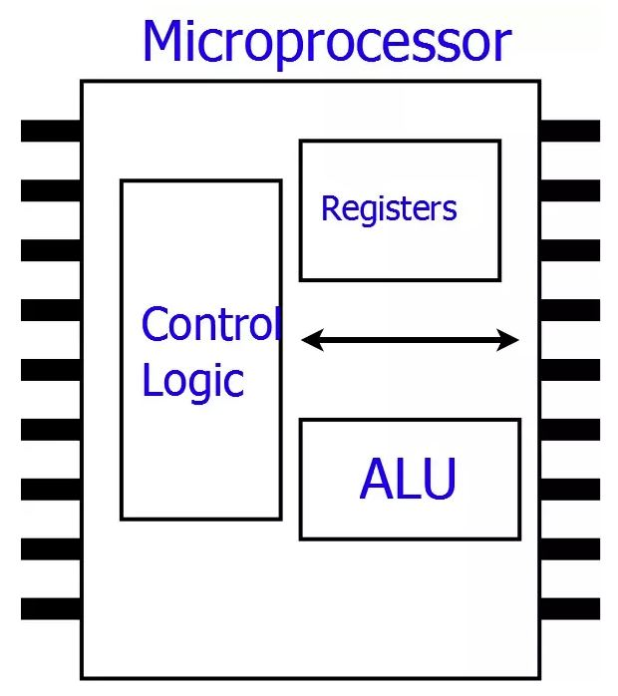
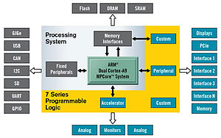
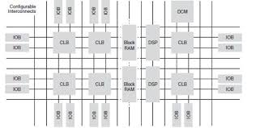
Processing Systems

Slide 11
FPGA vs CPU
FPGA
CPU
Advantages
- Highly parallelizable (real-time)
- Low power (application specific)
- Reconfigurable hardware (time- proof)
Disadvantages
- Harder to debug
- Verification process
- Slice/LE architecture is fixed
- Floating point math
Advantages
- Easy to debug
- Instruction set (Software!!!)
- Open source tools
Disadvantages
- Fixed hardware
- Processing overhead (sequential)
- Processing time can vary

Slide 12
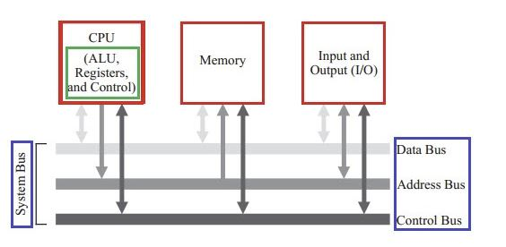
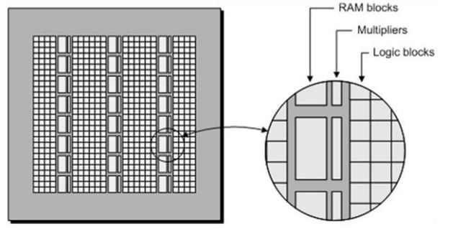
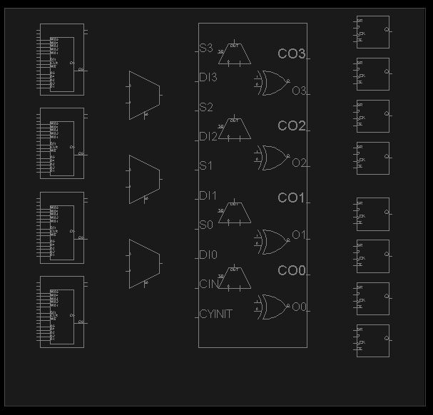
FPGA vs CPU
FPGA
CPU

Slide 13
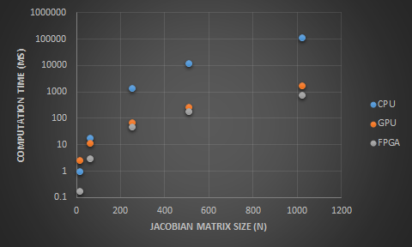
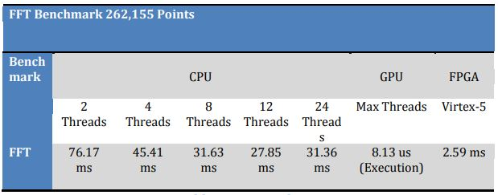
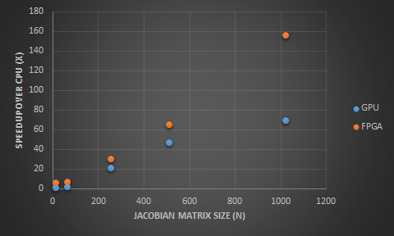
Processing Systems: Speed
FFT
Matrix
- 262,155 Point FFT
- Jacobian Matrix Computation

Slide 14
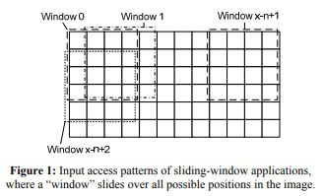
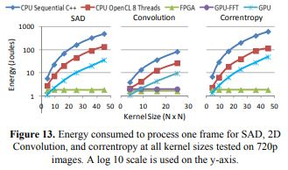
Processing Systems: Power
- Sliding Window Application (Image Processing
- Sum of Absolute Differences (SAD)
- Content based image retrieval
- Correntropy
- Measure of relative similarity
- Convolution
- Reverse, shift, multiply, sum (Average)
- Kernel is arbitrary nxm input to search for

Slide 15
Next Steps
Tracking System Design
Algorithm Hypothesis
Continuing Research
Sensing
Tracking
"Be an engineer, NOT a moron.“ - Tony

Slide 16
References
[1] “A low-cost P&O based maximum power point tracking, combined with two-degree sun tracker” - IEEE Conference Publication: Abolfazl Halvaei Niasar, Zahra Zare, Fahimeh Rabei Far

