Slide 1
Probabilistic Programming
Marius Popescu
popescunmarius@gmail.com
2022 - 2023

Slide 2

A More Elaborate “Hello World!”
Your most humble servant and most faithful friend

Slide 3
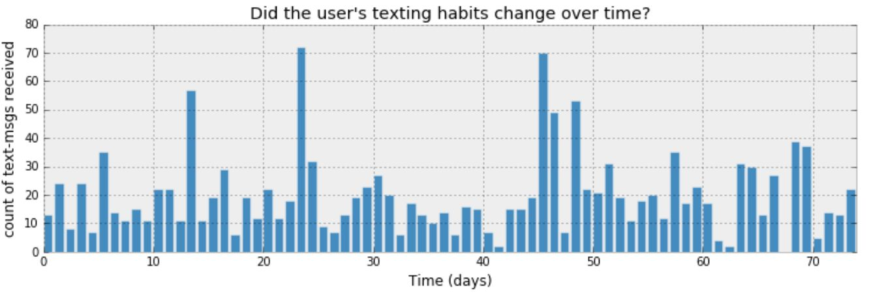
Inferring behaviour from text-message data

Slide 4

How can we start to model this?
Denoting day i's text-message count by $C_{i}$
$C$is a random variable
What can be the distribution of $C$ ?

Slide 5
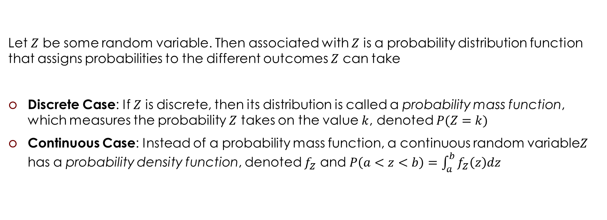
Probability Distributions (Memento)
Let $Z$ be some random variable. Then associated with $Z$ is a probability distribution function that assigns probabilities to the different outcomes $Z$ can take
Discrete Case: If $Z$ is discrete, then its distribution is called a probability mass function, which measures the probability $Z$ takes on the value $k$, denoted $P(Z=k)$
Continuous Case: Instead of a probability mass function, a continuous random variable$Z$ has a probability density function, denoted $f_{Z}$ and $P\left(a<z<b\right)=\int_{a}^{b}{f_{Z}\left(z\right)dz}$

Slide 6
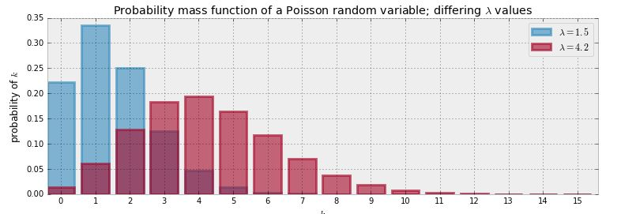

Poisson Distribution (Memento)
$$Z\sim \text{Poi}(λ)$$
$$P\left(Z=k\right)=\frac{λ^{k}e^{−λ}}{k!}, k=0,1,2,…, λ∈ℝ_{>0}$$
$$E\left(Z | λ\right)=\sum_{k=0}^{∞}{kP(Z=k)}= λ$$

Slide 7
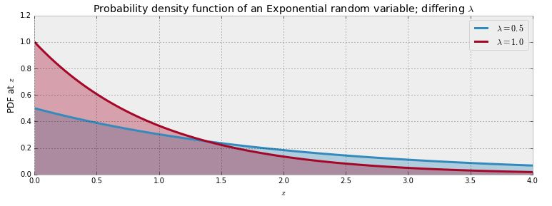

Exponential Distribution (Memento)
$$Z\sim \text{Exp}(λ)$$
$$f_{Z}\left(z | λ\right)=λe^{−λz}, z≥0$$
$$E\left(Z | λ\right)=\int_{−∞}^{∞}{zf_{Z}\left(z | λ\right)dz}=\frac{1}{λ}$$

Slide 8
Modeling

Slide 9

How can we start to model this?
Denoting day i's text-message count by $C_{i}$
$C$is a random variable
What can be the distribution of $C$ ?
A Poisson random variable is a very appropriate model for this type of count data
$$C\sim \text{Poi}(λ)$$

Slide 10
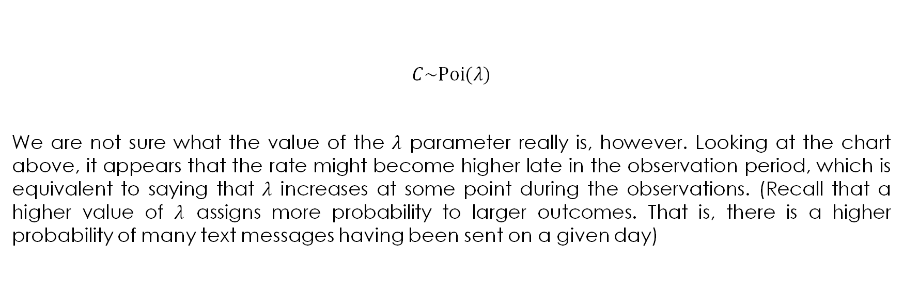
Inferring behaviour from text-message data: prior distributions
$$C\sim \text{Poi}(λ)$$
We are not sure what the value of the $λ$ parameter really is, however. Looking at the chart above, it appears that the rate might become higher late in the observation period, which is equivalent to saying that $λ$ increases at some point during the observations. (Recall that a higher value of $λ$ assigns more probability to larger outcomes. That is, there is a higher probability of many text messages having been sent on a given day)

Slide 11
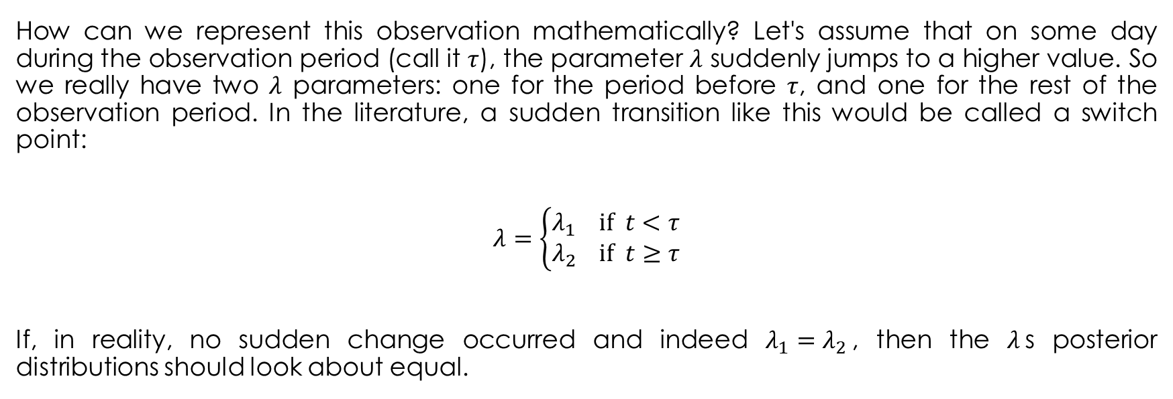
Inferring behaviour from text-message data: prior distributions
How can we represent this observation mathematically? Let's assume that on some day during the observation period (call it $τ$), the parameter $λ$ suddenly jumps to a higher value. So we really have two $λ$ parameters: one for the period before $τ$, and one for the rest of the observation period. In the literature, a sudden transition like this would be called a switch point:
$$λ=\left\{\begin{aligned}λ_{1} \text{if} t<τ \\ λ_{2} \text{if} t≥τ\end{aligned}\right.$$
If, in reality, no sudden change occurred and indeed $λ_{1}=λ_{2}$, then the $λ$s posterior distributions should look about equal.

Slide 12
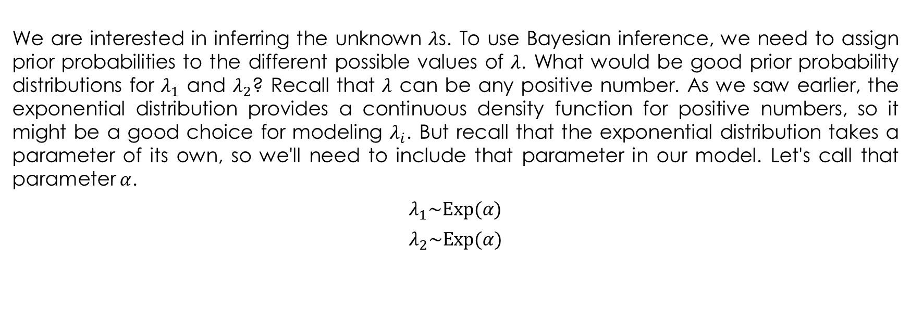
Inferring behaviour from text-message data: prior distributions
We are interested in inferring the unknown $λ$s. To use Bayesian inference, we need to assign prior probabilities to the different possible values of $λ$. What would be good prior probability distributions for $λ_{1}$ and $λ_{2}$? Recall that $λ$ can be any positive number. As we saw earlier, the exponential distribution provides a continuous density function for positive numbers, so it might be a good choice for modeling $λ_{i}$. But recall that the exponential distribution takes a parameter of its own, so we'll need to include that parameter in our model. Let's call that parameter $α$.
$$λ_{1}\sim \text{Exp}(α)$$
$$λ_{2}\sim \text{Exp}(α)$$

Slide 13
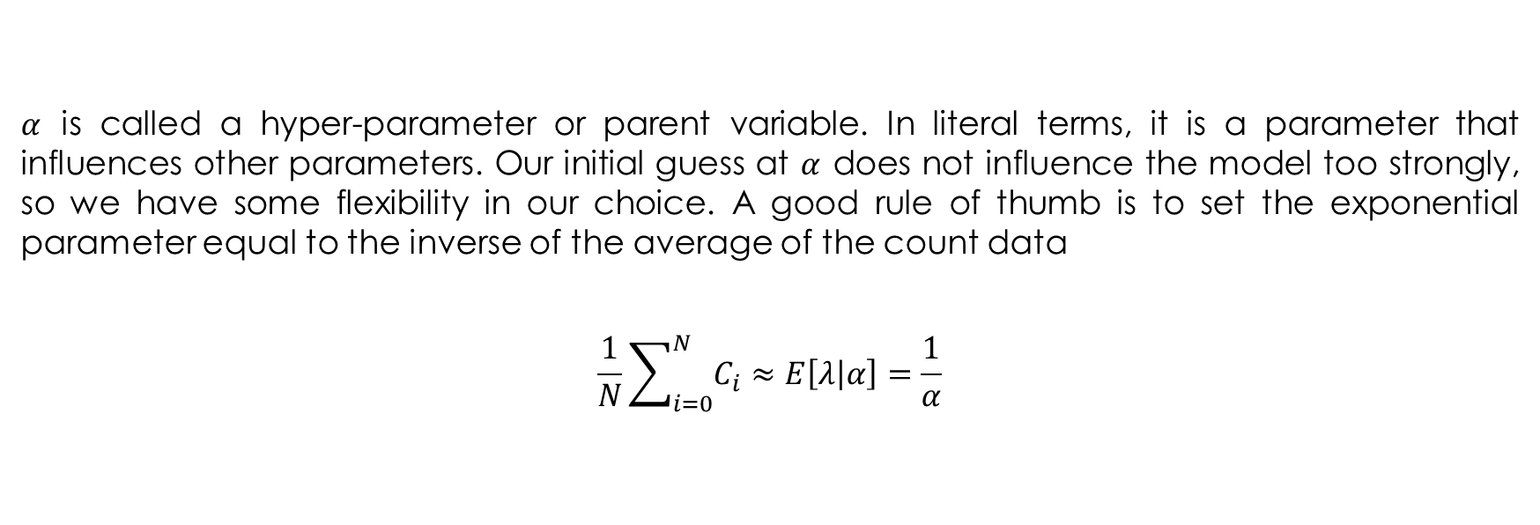
Inferring behaviour from text-message data: prior distributions
$α$ is called a hyper-parameter or parent variable. In literal terms, it is a parameter that influences other parameters. Our initial guess at $α$ does not influence the model too strongly, so we have some flexibility in our choice. A good rule of thumb is to set the exponential parameter equal to the inverse of the average of the count data
$$\frac{1}{N}\sum_{i=0}^{N}{C_{i}}≈E\left[λ | α\right]=\frac{1}{α}$$

Slide 14
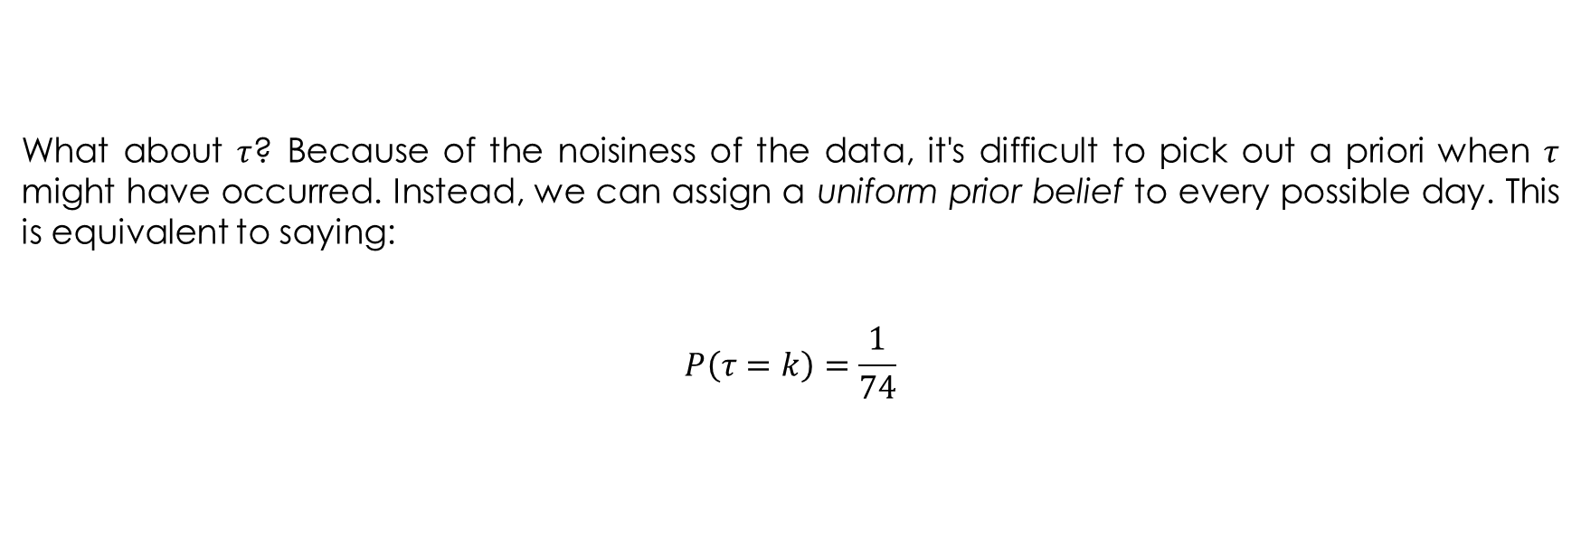
Inferring behaviour from text-message data: prior distributions
What about $τ$? Because of the noisiness of the data, it's difficult to pick out a priori when $τ$ might have occurred. Instead, we can assign a uniform prior belief to every possible day. This is equivalent to saying:
$$P\left(τ=k\right)=\frac{1}{74}$$

Slide 15
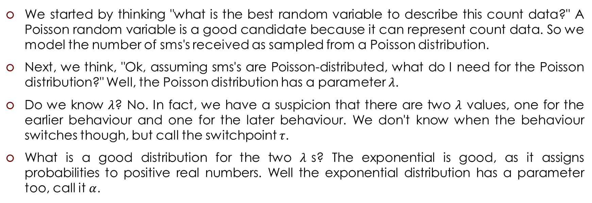
Bayesian modeling is to think about how your data might have been generated
We started by thinking "what is the best random variable to describe this count data?" A Poisson random variable is a good candidate because it can represent count data. So we model the number of sms's received as sampled from a Poisson distribution.
Next, we think, "Ok, assuming sms's are Poisson-distributed, what do I need for the Poisson distribution?" Well, the Poisson distribution has a parameter $λ$.
Do we know $λ$? No. In fact, we have a suspicion that there are two $λ$ values, one for the earlier behaviour and one for the later behaviour. We don't know when the behaviour switches though, but call the switchpoint $τ$.
What is a good distribution for the two $λ$s? The exponential is good, as it assigns probabilities to positive real numbers. Well the exponential distribution has a parameter too, call it $α$.

Slide 16
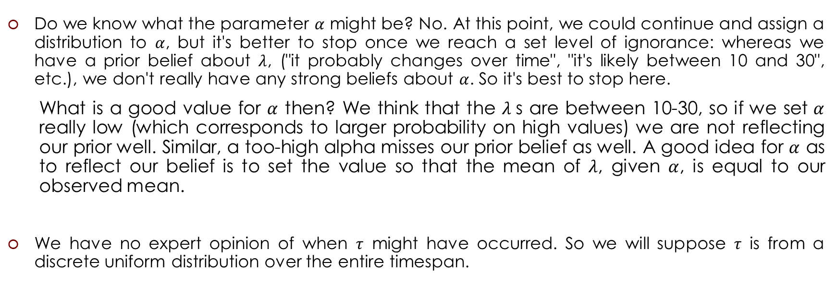
Bayesian modeling is to think about how your data might have been generated
Do we know what the parameter $α$ might be? No. At this point, we could continue and assign a distribution to $α$, but it's better to stop once we reach a set level of ignorance: whereas we have a prior belief about $λ$, ("it probably changes over time", "it's likely between 10 and 30", etc.), we don't really have any strong beliefs about $α$. So it's best to stop here.
What is a good value for $α$ then? We think that the $λ$s are between 10-30, so if we set $α$ really low (which corresponds to larger probability on high values) we are not reflecting our prior well. Similar, a too-high alpha misses our prior belief as well. A good idea for $α$ as to reflect our belief is to set the value so that the mean of $λ$, given $α$, is equal to our observed mean.
We have no expert opinion of when $τ$ might have occurred. So we will suppose $τ$ is from a discrete uniform distribution over the entire timespan.

Slide 17
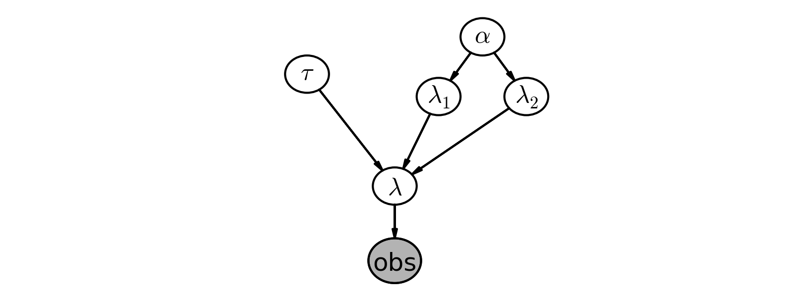
The Model

Slide 18
Generative Models
Generative models are statistical models that describe a joint distribution over three types of random variables:
The “observed” random variables (often the “input space”), which are the random variables we have data for.
The “latent” random variables, which are the random variables that play a role in the statistical model, but which are never observed (in the Bayesian setting, these are usually, at the very least, the parameters of the model).
The “predicted” random variables, which are the random variables that represent the target predictions.
This categorization for the random variables in the joint distribution is not mutually exclusive
(though observed random variables are never latent). For example, the predicted random
variables can be also latent, such as in the unsupervised setting

Slide 19
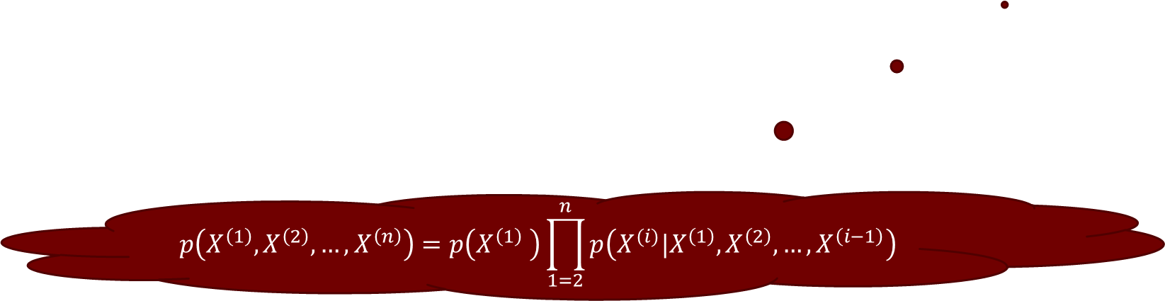
Generative Stories
A generative stories identify a joint distribution over the variables in the model, where this joint distribution is a product of several factors.
The generative story picks an ordering for the random variables, and the chain rule is applied using that order to yield the joint distribution.
Each factor can theoretically condition on all possible random variables that were generated before, but the independence assumptions in the model make some of these variables unnecessary to condition on.
$$p\left(X^{\left(1\right)},X^{\left(2\right)},…,X^{\left(n\right)}\right)=p\left(X^{\left(1\right)} \right)\prod_{1=2}^{n}{p\left(X^{(i)}|X^{\left(1\right)},X^{\left(2\right)},…,X^{\left(i−1\right)}\right)}$$

Slide 20
The Model
“predicted” variable
“hyperparameter” (not random)
usually estimated by maximum likelihood (empirical Bayes)
“latent” variables
“observed” variables

Slide 21
Gen Modeling
using DelimitedFiles
using PyPlot
using Statistics
using Gen
count_data = readdlm("txtdata.csv", '\t', Float64, '\n')
n_count_data = size(count_data, 1)
count_data = vec(count_data)
alpha = 1.0 / mean(count_data) # Recall count_data is the
# variable that holds our txt counts

Slide 22
Gen Modeling
@gen function switch_point_model(n_count_data::Integer, alpha::Real)
lambda_1 ~ exponential(alpha) # syntactic sugar for:
# lambda_1 = {:lambda_1} ~ exponential(alpha)
lambda_2 ~ exponential(alpha)
tau ~ uniform_discrete(0, n_count_data)
cnt_data = Float64[]
for i = 1:n_count_data
if i < tau
push!(cnt_data, {(:cnt_data, i)} ~ poisson(lambda_1))
else
push!(cnt_data, {(:cnt_data, i)} ~ poisson(lambda_2))
end
end
cnt_data
end

Slide 23
Simulation

Slide 24
Gen Simulation
n_count_data = 80
alpha = 1.0 / 20.0
count_data = switch_point_model(n_count_data, alpha)
bar(1:n_count_data, count_data, color="#348ABD")
xlabel("Time (days)")
ylabel("count of text-msgs received")
title("Artificial dataset")
xlim(0, n_count_data)
plt[:show]()

Slide 25
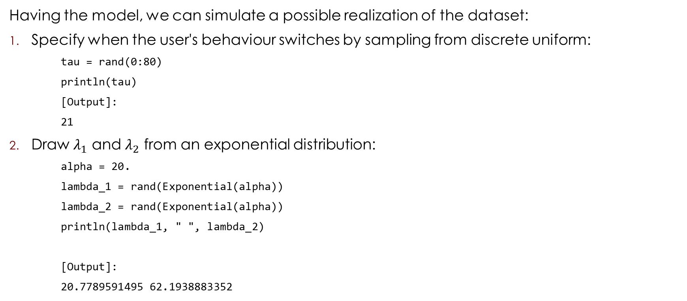
Simulation without Gen (using Distributions)
Having the model, we can simulate a possible realization of the dataset:
Specify when the user's behaviour switches by sampling from discrete uniform:
tau = rand(0:80)
println(tau)
[Output]:
21
Draw $λ_{1}$ and $λ_{2}$ from an exponential distribution:
alpha = 20.
lambda_1 = rand(Exponential(alpha))
lambda_2 = rand(Exponential(alpha))
println(lambda_1, " ", lambda_2)
[Output]:
20.7789591495 62.1938883352

Slide 26
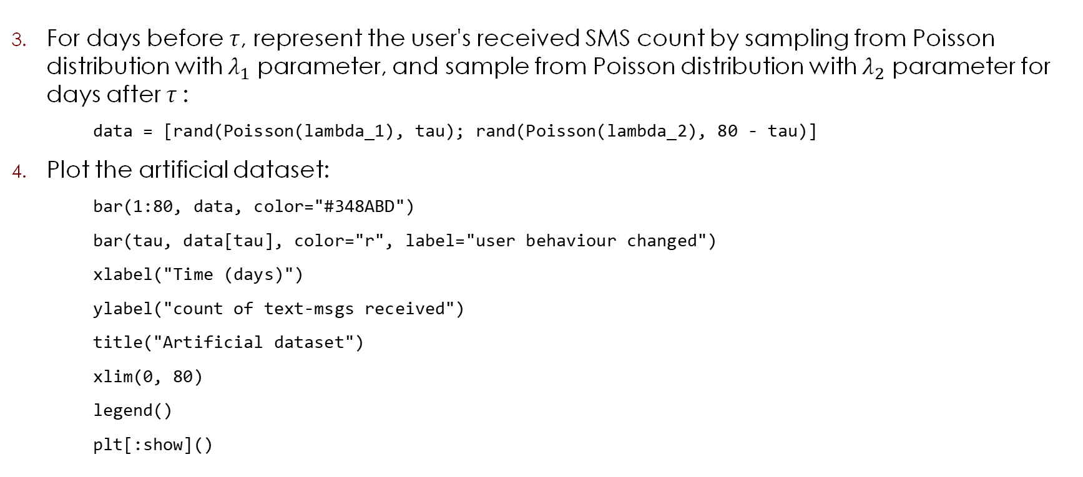
Simulation without Gen (using Distributions)
For days before $τ$, represent the user's received SMS count by sampling from Poisson distribution with $λ_{1}$ parameter, and sample from Poisson distribution with $λ_{2}$ parameter for days after $τ$:
data = [rand(Poisson(lambda_1), tau); rand(Poisson(lambda_2), 80 - tau)]
Plot the artificial dataset:
bar(1:80, data, color="#348ABD")
bar(tau, data[tau], color="r", label="user behaviour changed")
xlabel("Time (days)")
ylabel("count of text-msgs received")
title("Artificial dataset")
xlim(0, 80)
legend()
plt[:show]()

Slide 27
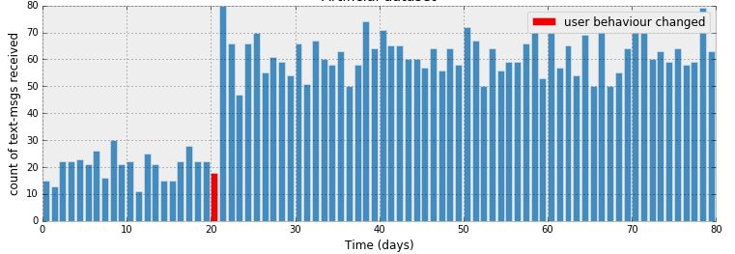
Artificial Dataset

Slide 28
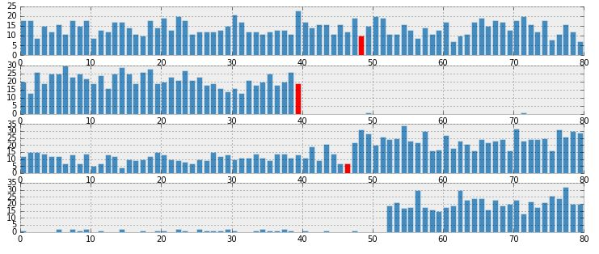
More Examples of Artificial Datasets

Slide 29
Inference

Slide 30
Gen Inference
function make_constraints(ys::Vector{Float64})
constraints = Gen.choicemap()
for i=1:length(ys)
constraints[(:cnt_data, i)] = ys[i]
end
constraints
end;
function block_resimulation_update(tr)
# Block 1: Update tau
latent_variable = select(:tau)
(tr, _) = mh(tr, latent_variable)
# Block 2: Update lambda_1
latent_variable = select(:lambda_1)
(tr, _) = mh(tr, latent_variable)
# Block 3: Update lambda_2
latent_variable = select(:lambda_2)
(tr, _) = mh(tr, latent_variable)
tr
end

Slide 31
Gen Inference
function block_resimulation_inference(n_count_data, alpha, count_data, n_burnin, n_samples)
observations = make_constraints(count_data)
(tr, _) = generate(switch_point_model, (n_count_data, alpha), observations)
for iter=1:n_burnin
tr = block_resimulation_update(tr)
end
trs = []
for iter=1:n_samples
tr = block_resimulation_update(tr)
push!(trs, tr)
end
trs
end;
trs = block_resimulation_inference(n_count_data, alpha, count_data, 10000, 30000)
tau_samples = [trs[i][:tau] for i=1:30000]
lambda_1_samples = [trs[i][:lambda_1] for i=1:30000]
lambda_2_samples = [trs[i][:lambda_2] for i=1:30000]

Slide 32
Criticism of the Model

Slide 33
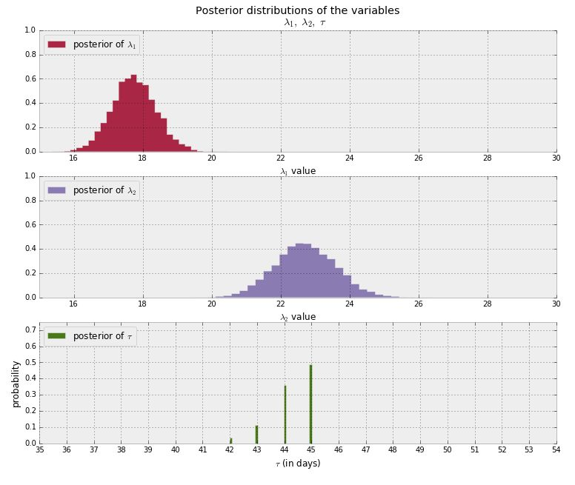
Inferring behaviour from text-message data: posterior distributions

Slide 34
Expected number of texts per day
# tau_samples, lambda_1_samples, lambda_2_samples contain
# N samples from the corresponding posterior distribution
N = length(tau_samples)
expected_texts_per_day = zeros(n_count_data)
for day = 1:n_count_data
# ix1 and ix2 are bool indexes of all tau samples corresponding to
# the switchpoint occurring before or after of the value of 'day'
ix1 = findall(x -> day < x, tau_samples)
ix2 = findall(x -> day >= x, tau_samples)
# Each posterior sample corresponds to a value for tau.
# for each day, that value of tau indicates whether we're "before"
# (in the lambda1 "regime") or
# "after" (in the lambda2 "regime") the switchpoint.
# by taking the posterior sample of lambda1/2 accordingly, we can average
# over all samples to get an expected value for lambda on that day.
# As explained, the "message count" random variable is Poisson distributed,
# and therefore lambda (the poisson parameter) is the expected value of
# "message count".
expected_texts_per_day[day] = (sum(lambda_1_samples[ix1])
+ sum(lambda_2_samples[ix2])) / N
end

Slide 35
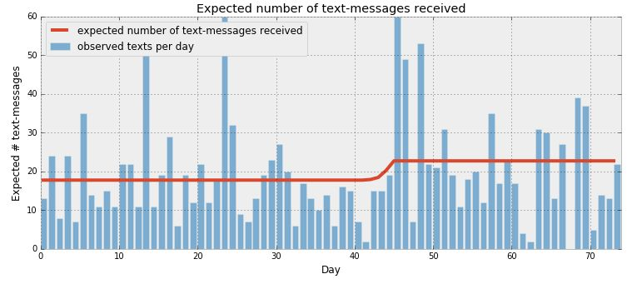
Expected number of texts per day

Slide 36
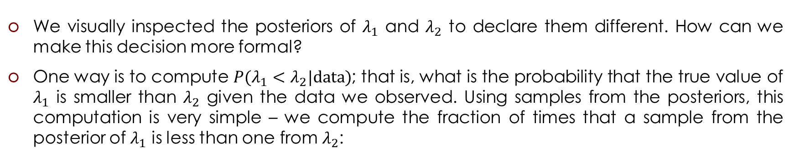
Determining statistically if the two λs are indeed different
We visually inspected the posteriors of $λ_{1}$ and $λ_{2}$ to declare them different. How can we make this decision more formal?
One way is to compute ${P(λ_{1}<λ}_{2}|\text{data})$; that is, what is the probability that the true value of $λ_{1}$ is smaller than $λ_{2}$ given the data we observed. Using samples from the posteriors, this computation is very simple – we compute the fraction of times that a sample from the posterior of $λ_{1}$ is less than one from $λ_{2}$:
println(mean([lambda_1_samples[i] < lambda_2_samples[i] for i=1:30000]))
[Output]:
0.9998

Slide 37
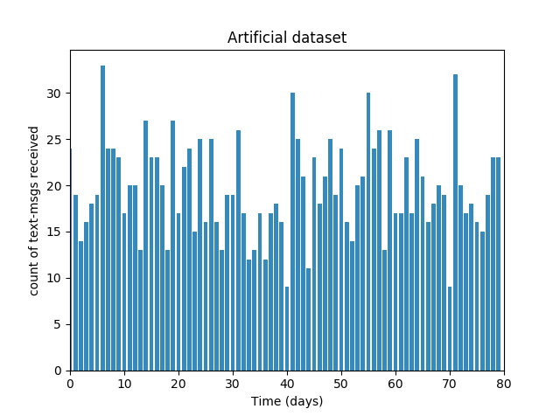

Artificial Dataset
Artificial data set was generated from
a Poisson distribution with $λ=19.255$

Slide 38
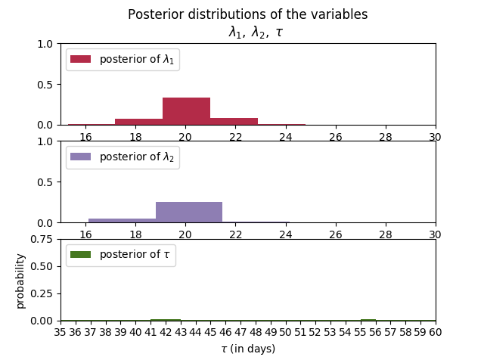
Inferring behaviour from artificial data: posterior distributions

Slide 39
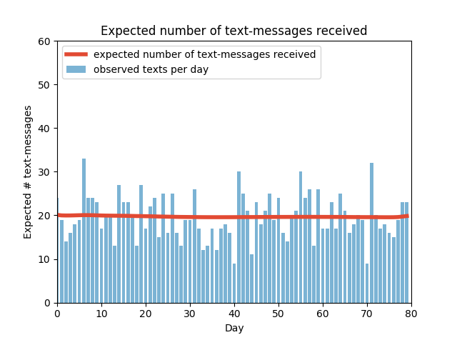
Expected number of texts per day

Slide 40
Determining statistically if the two λs are indeed different
println(mean([lambda_1_samples[i] < lambda_2_samples[i] for i=1:30000]))
[Output]:
0.3962

Slide 41
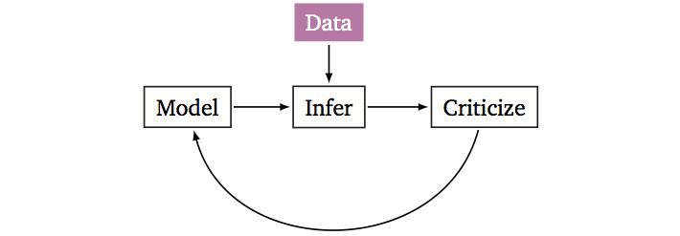
Probabilistic Modeling
Build a probabilistic model of the phenomena.
Reason about the phenomena given model and data.
Criticize the model, revise and repeat.

