Slide 1
Probabilistic Programming
Marius Popescu
popescunmarius@gmail.com
2022 - 2023

Slide 2
Gen
An open-source stack for generative modeling and probabilistic inference

Slide 3
Generative Functions
Generative functions are used to represent a variety of different types of probabilistic computations including generative models, inference models, custom proposal distributions, and variational approximations.
Generative functions are represented by the following abstract type:
GenerativeFunction{T,U <: Trace}
Abstract type for a generative function with return value type T and trace type U
There are various kinds of generative functions, which are represented by concrete subtypes of GenerativeFunction.
Users can also extend Gen by implementing their own Custom generative function types

Slide 4
Built-in Modeling Language
The language uses a syntax that extends Julia's syntax for defining regular Julia functions, and is also referred to as the Dynamic Modeling Language.
Generative functions in the modeling language are identified using the @gen keyword in front of a Julia function definition
@gen function foo(prob::Float64=0.1)
z1 = @trace(bernoulli(prob), :a)
z2 = @trace(bernoulli(prob), :b)
return z1 || z2
end
After running this code, foo is a Julia value of type DynamicDSLFunction:
DynamicDSLFunction{T} <: GenerativeFunction{T,DynamicDSLTrace}

Slide 5
Generative Functions
Generative functions behave like Julia functions in some respects. For example, we can call a generative function foo on arguments and get an output value using regular Julia call syntax:
retval::Bool = foo(0.5)
However, generative functions are distinct from Julia functions because they support additional behaviors, For example, we can also trace its execution:
(trace, _) = generate(foo, (0.5,))

Slide 6
Making Random Choices
Random choices are made by calling a probability distribution on some arguments:
val::Bool = bernoulli(0.5)
In the body of a @gen function, wrapping a call to a random choice with an @trace expression associates the random choice with an address, and evaluates to the value of the random choice. The syntax is:
@trace(<distribution>(<args>), <addr>)
Addresses can be any Julia value. Here, we give the Julia symbol address :z to a Bernoulli random choice.
val::Bool = @trace(bernoulli(0.5), :z)
Not all random choices need to be given addresses. An address is required if the random choice will be observed, or will be referenced by a custom inference algorithm.

Slide 7
Traces
An execution trace (or just trace) is a record of an execution of a generative function. Traces are the primary data structures manipulated by Gen inference programs. There are various methods for producing, updating, and inspecting traces. Traces contain:
the arguments to the generative function
the choice map
the return value
auxiliary state
other implementation-specific state that is not exposed to the caller or user of the generative function, but is used internally to facilitate e.g. incremental updates to executions and automatic differentiation
any necessary record of the non-addressable randomness

Slide 8
Traces
Different concrete types of generative functions use different data structures and different Julia types for their traces, but traces are subtypes of Gen.Trace — Abstract Type.
The concrete trace type that a generative function uses is the second type parameter of the GenerativeFunction abstract type. For example, the trace type of DynamicDSLFunction is DynamicDSLTrace

Slide 9
Traces
There are various methods for inspecting traces, including:
get_args (returns the arguments to the function)
get_retval (returns the return value of the function)
get_choices (returns the choice map)
get_score (returns the log probability that the random choices took the values they did)
get_gen_fn (returns a reference to the generative function)
We can also read the value of a random choice directly from the trace, without having to use get_choices first using the address: trace[:z]
We can access the return value directly from the trace via the syntactic sugar: trace[]

Slide 10
Traces
Suppose we have a trace (trace) of bar
Gen.get_choices(trace)
│
├── :a : false
│
├── :b : true
│
├── :c : false
│
└── :e : true
Note that address :d is not present because the branch in which :d is sampled was not taken because random choice :b had value true.
@gen function bar()
val = @trace(bernoulli(0.3), :a)
if @trace(bernoulli(0.4), :b)
val = @trace(bernoulli(0.6), :c) && val
else
val = @trace(bernoulli(0.1), :d) && val
end
val = @trace(bernoulli(0.7), :e) && val
return val
end

Slide 11
Obtaining Traces
trace = simulate(gen_fn, args)
Execute the generative function and return the trace.
(trace::U, weight) = generate(gen_fn::GenerativeFunction{T,U}, args::Tuple)
Return a trace of a generative function.
(trace::U, weight) = generate(gen_fn::GenerativeFunction{T,U}, args::Tuple, constraints::ChoiceMap)
Return a trace of a generative function that is consistent with the given constraints on the random choices.

Slide 12
Sample space and support of random choices
Each Distribution is associated with two sets of values:
The sample space of the distribution, which does not depend on the arguments.
The support of the distribution, which may depend on the arguments, and is the set of values that has nonzero probability (or probability density). It may be the entire sample space, or it may be a subset of the sample space.
A generative function can be disciplined or not. In a disciplined generative function, the support of random choices at each address must be fixed. That is, for each address a there must exist a set S that is a subset of the sample space such that for all executions of the generative function, if a occurs as the address of a choice in the execution, then the support of that choice is exactly S. Violating this discipline will cause NaNs, errors, or undefined behavior in some inference programs.

Slide 13
Tilde syntax
As a short-hand for @trace expressions, the tilde operator ~ can also be used to make random choices and traced calls to generative functions:
{:x} ~ normal(0, 1) is equivalent to: @trace(normal(0, 1), :x)
One can also conveniently assign random values to variables using the syntax:
x ~ normal(0, 1) which is equivalent to: x = @trace(normal(0, 1), :x)
Finally, one can make traced calls using a shared address namespace with the syntax:
{*} ~ foo(0.5) which is equivalent to: @trace(foo(0.5))

Slide 14
Calling Generative Functions
@gen functions can invoke other generative functions in three ways:
Untraced call: If foo is a generative function, we can invoke foo from within the body of a @gen function using regular call syntax. The random choices made within the call are not given addresses in our trace, and are therefore untraced random choices:
val = foo(0.5)
Traced call with a nested address namespace: We can include the traced random choices made by foo in the caller's trace, under a namespace, using @trace:
val = @trace(foo(0.5), :x)
Now, all random choices made by foo are included in our trace, under the namespace :x. For example, if foo makes random choices at addresses :a and :b, these choices will have addresses :x => :a and :x => :b in the caller's trace.
Traced call with shared address namespace: We can include the traced random choices made by foo in the caller's trace using @trace:
val = @trace(foo(0.5))
Now, all random choices made by foo are included in our trace. The caller must guarantee that there are no address collisions.

Slide 15
Composite Addresses
In Julia, Pair values can be constructed using the => operator. For example, :a => :b is equivalent to Pair(:a, :b) and :a => :b => :c is equivalent to Pair(:a, Pair(:b, :c)). A Pair value (e.g. :a => :b => :c) can be passed as the address field in an @trace expression, provided that there is not also a random choice or generative function called with @trace at any prefix of the address:
@trace(normal(0, 1), :a => :b => :c)
@trace(normal(0, 1), :a => :b)
This example is invalid because :a => :b is a prefix of :a => :b => :c
@trace(normal(0, 1), :a => :b)
@trace(normal(0, 1), :a => :c)
This example is valid because :a => :b and :a => :c are not prefixes of one another

Slide 16
Generative Function Combinators
Generative function combinators are Julia functions that take one or more generative functions as input and return a new generative function. Generative function combinators are used to express patterns of repeated computation that appear frequently in generative models:
gen_fn = Map(kernel::GenerativeFunction)
Return a new generative function that applies the kernel independently for a vector of inputs.
gen_fn = Unfold(kernel::GenerativeFunction)
Return a new generative function that applies the kernel in sequence, passing the return value of one application as an input to the next.
Others: recurse combinator, switch combinator

Slide 17
Probability Distributions
Gen provides a library of built-in probability distributions, and three ways of defining custom distributions

Slide 18
Built-In Distributions

Slide 19
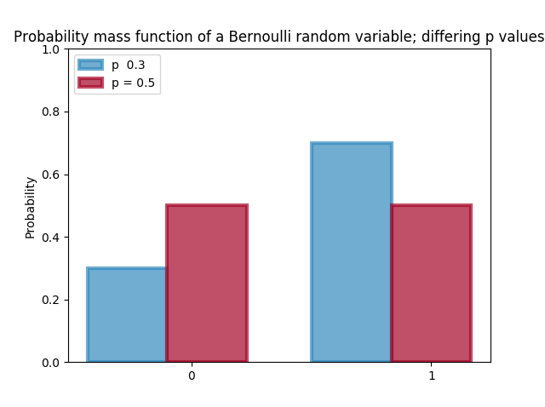

Bernoulli Distribution
$$Z\sim \text{Ber}(p)$$
$$P\left(Z=k\right)=p^{k}{(1−p)}^{1−k}, k=0,1$$
$$E\left(Z | p\right)=\sum_{k=0}^{1}{kP(Z=k)}=p$$
Z ~ bernoulli(p)

Slide 20
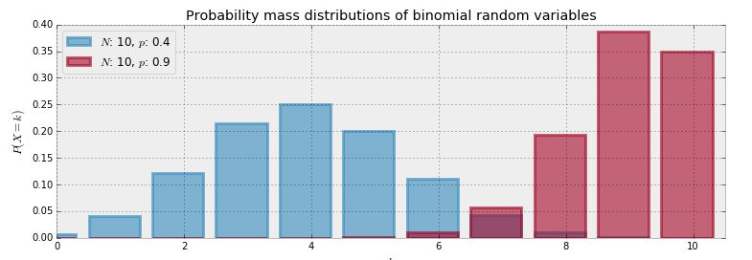
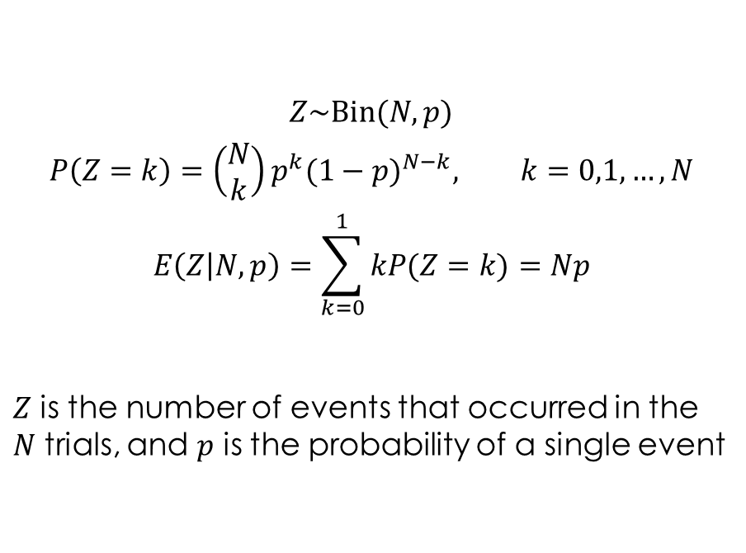
Binomial Distribution
$$Z\sim \text{Bin}(N,p)$$
$$P\left(Z=k\right)={\left(\begin{aligned}N \\ k\end{aligned}\right)p}^{k}{(1−p)}^{N−k}, k=0,1, …, N$$
$$E\left(Z | N,p\right)=\sum_{k=0}^{1}{kP(Z=k)}=Np$$
$Z$ is the number of events that occurred in the $N$ trials, and $p$ is the probability of a single event
Z ~ binom(N, p)

Slide 21
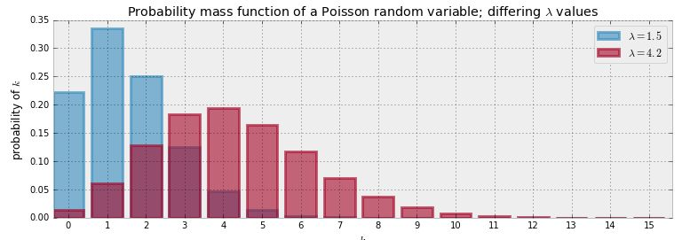
Poisson Distribution
$$Z\sim \text{Poi}(λ)$$
$$P\left(Z=k\right)=\frac{λ^{k}e^{−λ}}{k!}, k=0,1,2,…, λ∈ℝ_{>0}$$
$$E\left(Z | λ\right)=\sum_{k=0}^{∞}{kP(Z=k)}= λ$$
Z ~ poisson(lambda)

Slide 22
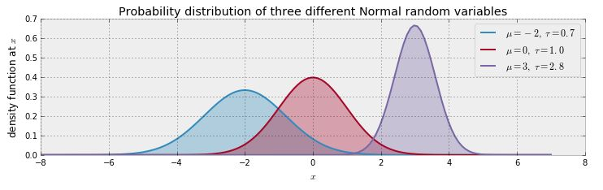

Normal Distribution
$$Z\sim N\left(μ, σ^{2}\right)$$
$$f_{Z}\left(z | μ,σ\right)=\frac{1}{σ\sqrt{2π}}e^{−\frac{1}{2}{\left(\frac{z−μ}{σ}\right)}^{2}}, σ>0$$
$$E\left(Z | μ,σ\right)=\int_{−∞}^{∞}{zf_{Z}\left(z | μ,σ\right)dz}=μ$$
Z ~ normal(mu, sigma)

Slide 23
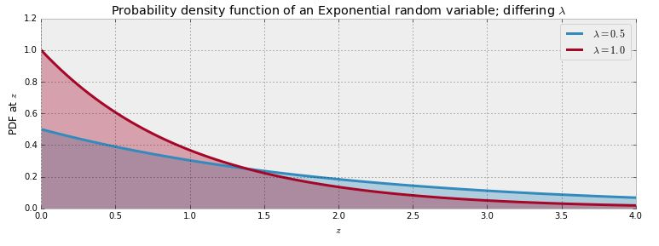
Exponential Distribution
$$Z\sim \text{Exp}(λ)$$
$$f_{Z}\left(z | λ\right)=λe^{−λz}, z≥0$$
$$E\left(Z | λ\right)=\int_{−∞}^{∞}{zf_{Z}\left(z | λ\right)dz}=\frac{1}{λ}$$
Z ~ exponential(lambda_)

Slide 24
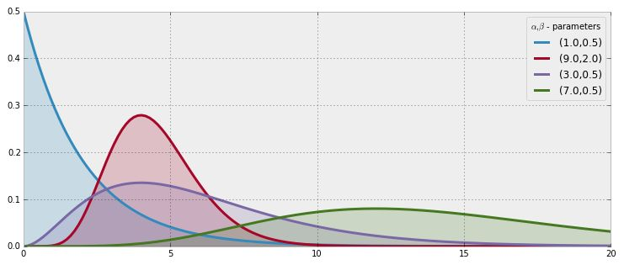
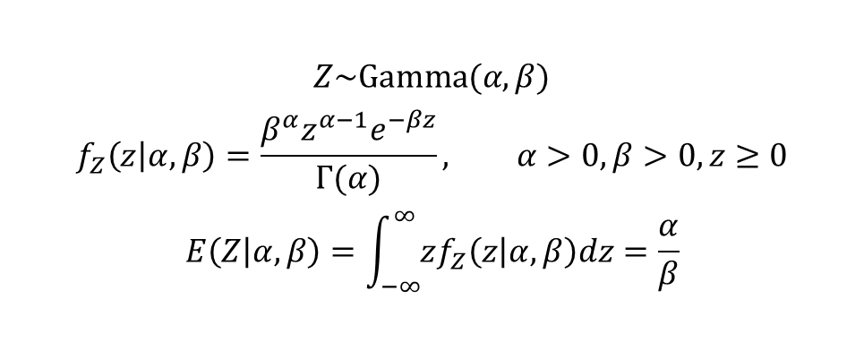
Gamma Distribution
$$Z\sim \text{Gamma}(α,β)$$
$$f_{Z}\left(z | α,β\right)=\frac{β^{α}z^{α−1}e^{−βz}}{Γ(α)}, α>0, β>0, z≥0$$
$$E\left(Z | α,β\right)=\int_{−∞}^{∞}{zf_{Z}\left(z | α,β\right)dz}=\frac{α}{β}$$
Z ~ gamma(alpha, beta)

Slide 25
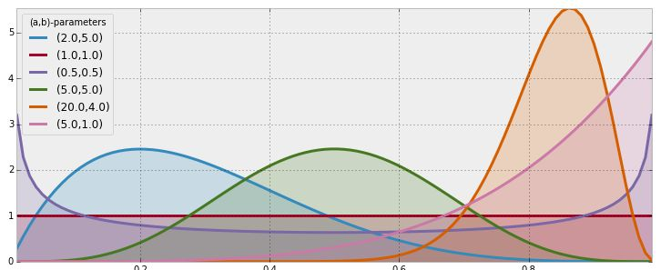
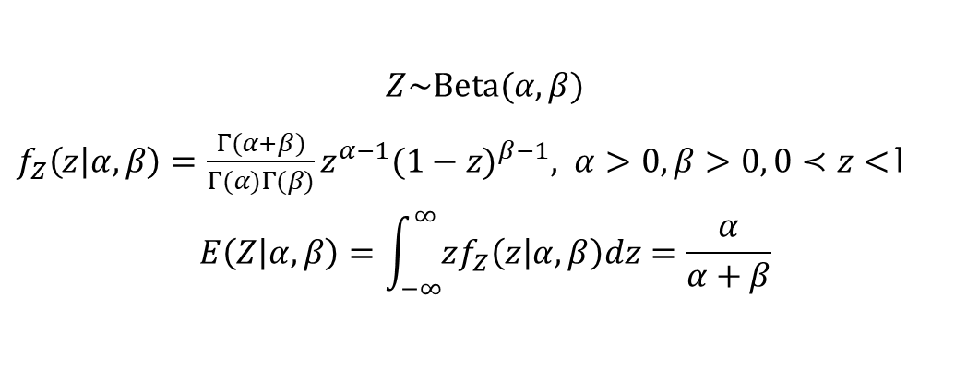
Beta Distribution
$$Z\sim \text{Beta}(α,β)$$
$f_{Z}\left(z | α,β\right)=\frac{Γ(α+β)}{Γ(α)Γ(β)}z^{α−1}{(1−z)}^{β−1}, α>0, β>0, 0≺z<$1
$$E\left(Z | α,β\right)=\int_{−∞}^{∞}{zf_{Z}\left(z | α,β\right)dz}=\frac{α}{α+β}$$
Z ~ beta(alpha, beta)

Slide 26
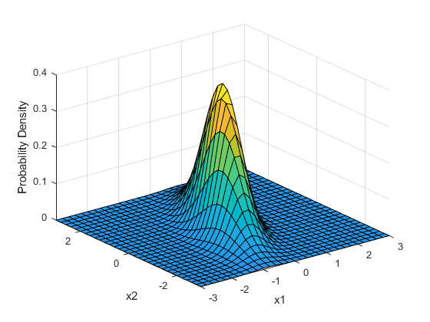

Multivariate Normal Distribution
$$Z\sim N\left(μ, Σ\right)$$
$$f_{Z}\left(z | μ,τ\right)=\frac{1}{\sqrt{{(2π)}^{k}\left|Σ\right|}}e^{−\frac{1}{2}{\left(z−μ\right)}^{′}Σ^{−1}(z−μ)}$$
@gen function foo()
Z ~ mvnormal([2.,4., 6.], Matrix{Float64}(I, 3, 3))
end
println(foo())
[Output]:
[ 2.66051582, 4.46602181, 6.6511556 ]

Slide 27
There Are More
https://www.gen.dev/dev/ref/distributions/

Slide 28
Custom Distributions

Slide 29
Three Ways of Defining Custom Distributions
The @dist constructor, for a distribution that can be expressed as a simple deterministic transformation (technically, a pushforward) of an existing distribution.
The HeterogeneousMixture and HomogeneousMixture constructors for distributions that are mixtures of other distributions.
An API for defining arbitrary custom distributions in plain Julia code.

Slide 30
Defining New Distributions Inline with the @dist DSL
The @dist DSL allows the user to concisely define a distribution, as long as that distribution can be expressed as a certain type of deterministic transformation of an existing distribution. The syntax of the @dist DSL:
@dist name(arg1, arg2, ..., argN) = body
or
@dist function name(arg1, arg2, ..., argN)
body
end
Here body is ordinary Julia code, with the constraint that body must contain exactly one random choice. The value of the @dist expression is then a Gen.Distribution object called name, parameterized by arg1, ..., argN, representing the distribution over return values of body.

Slide 31
Defining New Distributions Inline with the @dist DSL
DSL is designed to address the issue that sometimes, values stored in the trace do not correspond to the most natural physical elements of the model state space, making inference programming and querying more taxing than necessary. For example, suppose we have a model of classes at a school, where the number of students is random, with mean 10, but always at least 3. Rather than writing the model as
@gen function class_model()
n_students = @trace(poisson(7), :n_students_minus_3) + 3
...
end
and thinking about the random variable :n_students_minus_3, you can use the @dist DSL to instead write
@dist student_distr(mean, min) = poisson(mean-min) + min
@gen function class_model()
n_students = @trace(student_distr(10, 3), :n_students)
...
end
and think about the more natural random variable :n_students. This leads to more natural inference programs, which can constrain and propose directly to the :n_students trace address.

Slide 32
Mixture Distribution Constructors
HomogeneousMixture(distribution::Distribution, dims::Vector{Int})
Define a new distribution that is a mixture of some number of instances of single base distributions. The first argument defines the base distribution of each component in the mixture. The second argument must have length equal to the number of arguments taken by the base distribution. A value of 0 at a position in the vector an indicates that the corresponding argument to the base distribution is a scalar, and integer values of i for i >= 1 indicate that the corresponding argument is an i-dimensional array.
mixture_of_normals = HomogeneousMixture(normal, [0, 0])
# The resulting distribution can then be used like the built-in distributionS
x ~ mixture_of_normals([0.4, 0.6], [-1.0, 1.0], [0.1, 10.0])
# mixture of two normal distributions with means -1.0 and 1.0 and standard deviations 0.1 and 10.0
# the first normal distribution has weight 0.4; the second has weight 0.6

Slide 33
Mixture Distribution Constructors
HeterogeneousMixture(distributions::Vector{Distribution{T}})
Define a new distribution that is a mixture of a given list of base distributions. The argument is the vector of base distributions, one for each mixture component. Note that the base distributions must have the same output type.
uniform_beta_mixture = HeterogeneousMixture([uniform, beta])
x ~ uniform_beta_mixture([0.4, 0.6], lower, upper, a, b)
# mixure of a uniform distribution on the interval [`lower`, `upper`]
# and a beta distribution with alpha parameter `a` and beta parameter `b`
# the uniform as weight 0.4 and the beta has weight 0.6

Slide 34
Defining New Distributions From Scratch
users can define a custom distribution by defining an (ordinary Julia) subtype of Gen.Distribution and implementing the methods of the Distribution API:
random
logpdf
has_output_grad
logpdf_grad
has_argument_grads

Slide 35
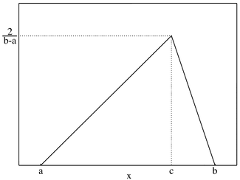
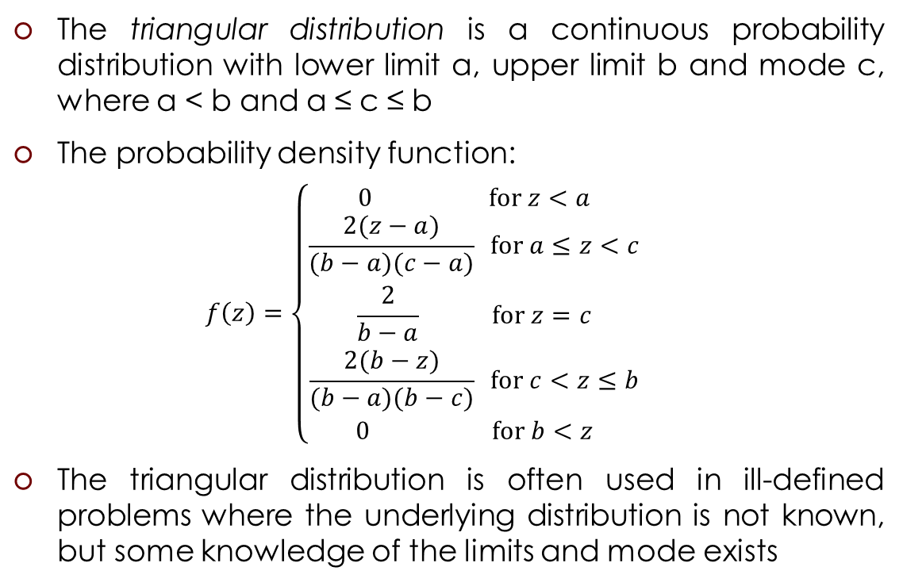
Example: Triangular Distribution
The triangular distribution is a continuous probability distribution with lower limit a, upper limit b and mode c, where a < b and a ≤ c ≤ b
The probability density function:
$$f\left(z\right)=\left\{\begin{aligned}0 \text{for} z<a \\ \frac{2(z−a)}{(b−a)(c−a)} \text{for} a≤z<c \\ \frac{2}{b−a} \text{for} z=c \\ \frac{2(b−z)}{(b−a)(b−c)} \text{for} c<z≤b \\ 0 \text{for} b<z\end{aligned}\right.$$
The triangular distribution is often used in ill-defined problems where the underlying distribution is not known, but some knowledge of the limits and mode exists

Slide 36
Example: Triangular Distribution
using Distributions
using Gen
struct Triangular <: Gen.Distribution{Real} end
const triangular = Triangular()
function logpdf(::Triangular, x::Real, low::Real, high::Real, mod::Real
if low <= x < mod
return log((2. * (x - low)) / ((high - low) * (mod - low)))
elseif x == c
return log(2. / (high - low))
elseif c < x <= b
return log((2. * (high - x)) / ((high - low) * (high - mod)))
end
return log(0)
end
(::Triangular)(low, high, mod) = random(Triangular(), low, high, mod)
function random(::Triangular, low::Real, high::Real, mod::Real)
rand(Distributions.TriangularDist(low, high, mod))
end
has_output_grad(::Triangular) = false
has_argument_grads(::Triangular) = (false, false, false)
function logpdf_grad(::Triangular, x::Real, low::Real, high::Real, mod::Real)
(nothing, nothing, nothing, nothing)
end
(::Triangular)(low, high, mod) = random(Triangular(), low, high, mod)

Slide 37
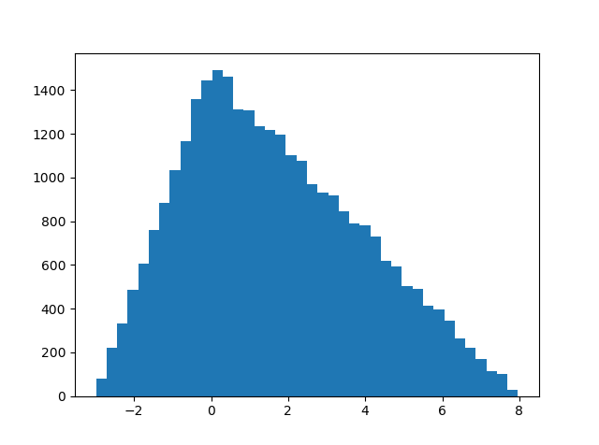
Example: Triangular Distribution
using PyPlot
using Gen
include("Triangular.jl")
@gen function triangular_model()
# z ~ triangular(-3, 8, 0) INVALID
z = triangular(-3, 8, 0)
end
traces = [Gen.simulate(triangular_model, ()) for _=1:30000];
z_samples = [traces[i][] for i=1:30000]
hist(z_samples, bins = 40)
plt[:show]()

Slide 38
Example: Triangular Distribution
using PyPlot
using Gen
include("Triangular.jl")
@gen function triangular_model()
z = triangular(-3, 8, 0)
end
@gen function wrapper_model()
z = @trace(triangular_model(), :z)
end
traces = [Gen.simulate(wrapper_model, ()) for _=1:30000];
z_samples = [traces[i][:z] for i=1:30000]
hist(z_samples, bins = 40)
plt[:show]()

Slide 39
Not covered yet
Trainable Parameters, Differentiable Programming
Standard Inference Library: MCMC, Variational Inference, …

Slide 40
Example: How to Conduct Embarrassing Polls
Cheating among Students

Slide 41
Differential Privacy

Slide 42
“ANONYMIZED DATA ISN’T”

Slide 43
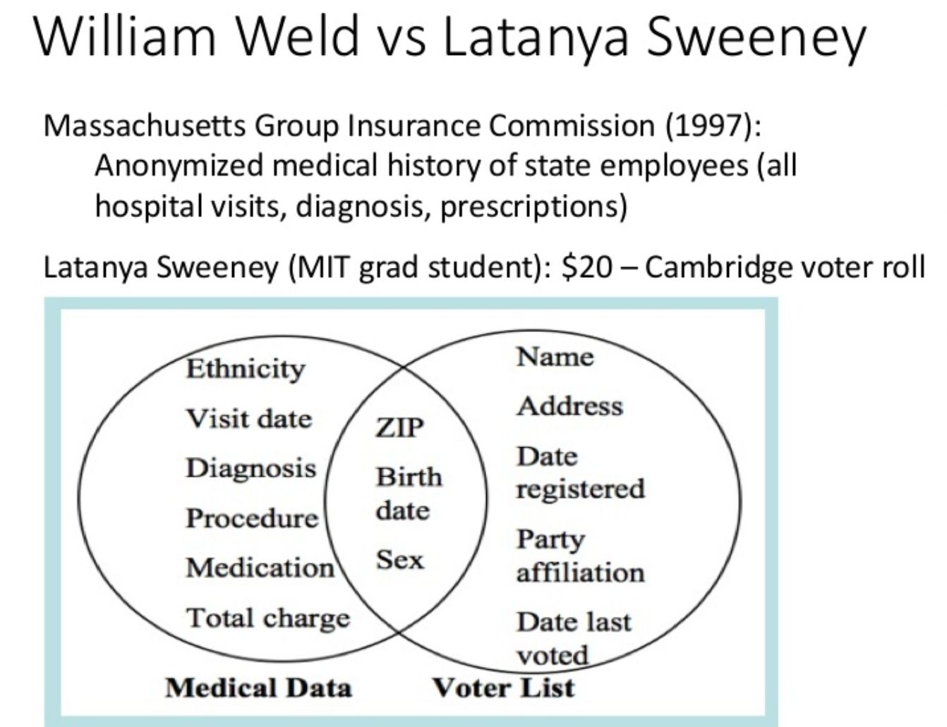

Samarati, Pierangela; Sweeney, Latanya (1998). "Protecting privacy when disclosing information: k-anonymity and its enforcement through generalization and suppression". Harvard Data Privacy Lab.
L. Sweeney. k-anonymity: a model for protecting privacy. International Journal on Uncertainty, Fuzziness and Knowledge-based Systems, 10 卌, 2002; 557-570.

Slide 44
Differential Privacy
Differential privacy requires that adding or removing the data record of a single individual not change the probability of any outcome by “much”. It requires this of an algorithm even in the worst case, no matter what records the other individuals have provided and no matter how unusual the added or removed data is.
It guarantees that no matter what your data is, and no matter what thing you are concerned about occurring because of the use of your data, that thing becomes (almost) no more likely if you allow your data to be included in the study, compared to if you do not.

Slide 45
Differential Privacy
Differential privacy is a mathematical formalization of the foregoing idea—that we should be comparing what someone might learn from an analysis if any particular person’s data was included in the dataset with what someone might learn if it was not.
Differential privacy uses randomness to deliberately add noise to computations, in a way that promises that any one person’s data cannot be reverse-engineered from the results.

Slide 46
Privacy Algorithm
In the interview process for each student, the student flips a coin, hidden from the interviewer. The student agrees to answer honestly if the coin comes up heads. Otherwise, if the coin comes up tails, the student (secretly) flips the coin again, and answers "Yes, I did cheat" if the coin flip lands heads, and "No, I did not cheat", if the coin flip lands tails. This way, the interviewer does not know if a "Yes" was the result of a guilty plea, or a Heads on a second coin toss. Thus privacy is preserved and the researchers receive honest answers.
Warner, S. L. (March 1965). "Randomised response: a survey technique for eliminating evasive answer bias". Journal of the American Statistical Association.

Slide 47
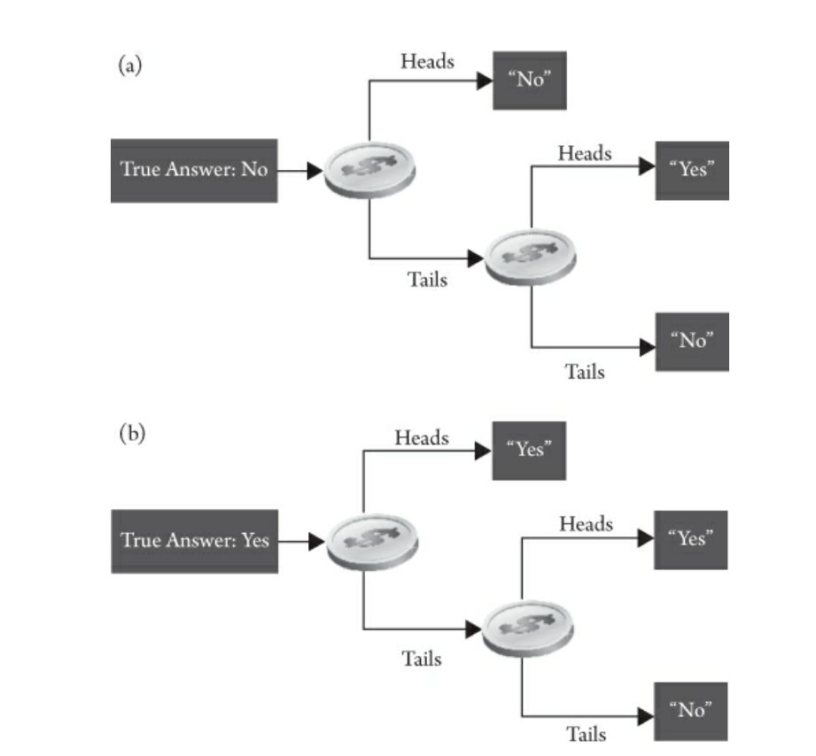

Slide 48
Randomized Response Differential Privacy

Slide 49
Using Gen to dig through this noisy model
Suppose 100 students are being surveyed for cheating, and we wish to find freq_cheating, the proportion of cheaters
Since we are quite ignorant about freq_cheating, we will assign it a Uniform(0,1) prior
N = 100
freq_cheating ~ uniform(0, 1)

Slide 50
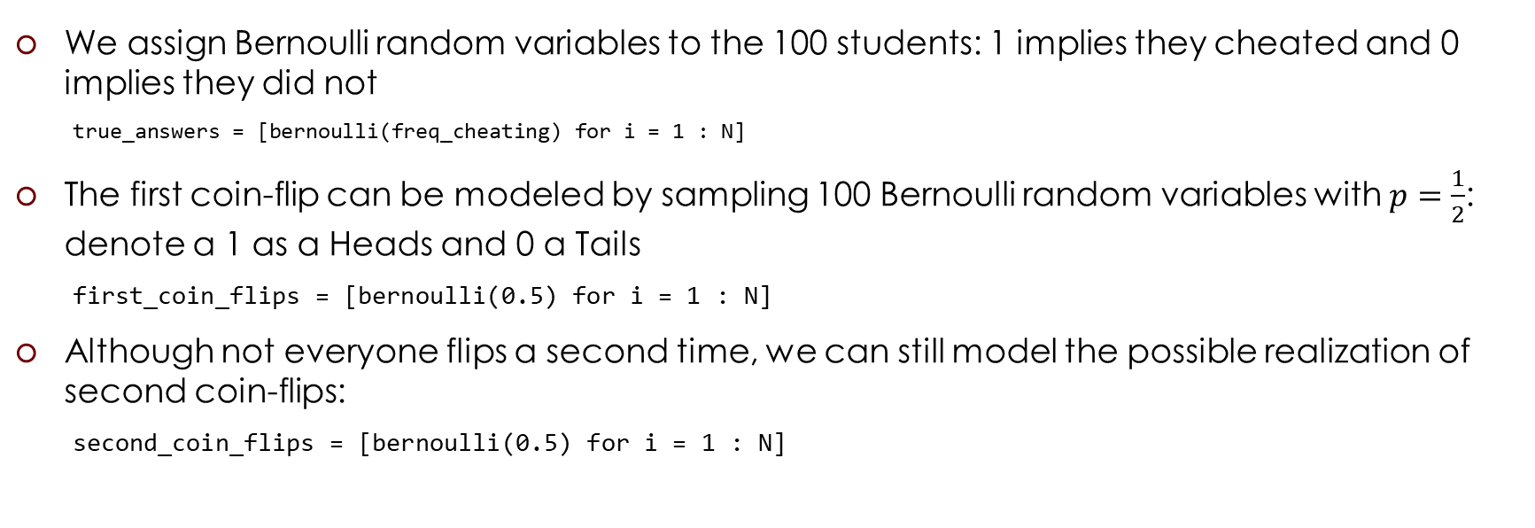
Using Gen to dig through this noisy model
We assign Bernoulli random variables to the 100 students: 1 implies they cheated and 0 implies they did not
true_answers = [bernoulli(freq_cheating) for i = 1 : N]
The first coin-flip can be modeled by sampling 100 Bernoulli random variables with $p=\frac{1}{2}$: denote a 1 as a Heads and 0 a Tails
first_coin_flips = [bernoulli(0.5) for i = 1 : N]
Although not everyone flips a second time, we can still model the possible realization of second coin-flips:
second_coin_flips = [bernoulli(0.5) for i = 1 : N]

Slide 51
Using Gen to dig through this noisy model
Using previous variables, we can return a possible realization of the observed proportion of "Yes" responses
observed_proportion = sum(first_coin_flips .* true_answers .+
(1 .- first_coin_flips) .* second_coin_flips) / N
The researchers observe a Binomial random variable, with N (number of trials) and p (probability of success in each trial) = observed_proportion :
obs ~ binom(N, observed_proportion)

Slide 52
Using Gen to dig through this noisy model
Suppose that after performing our coin-flipped interviews the researchers received 35 "Yes" responses. The researchers observe a Binomial random variable, with N = 100 and p = observed_proportion with value = 35:
X = 35
function make_constraints()
constraints = Gen.choicemap()
constraints[:obs] = X
constraints
end;

Slide 53
Using Gen to dig through this noisy model
The inference:
trs = block_resimulation_inference(15000, 35000)
freq_cheating_samples = [trs[i][:freq_cheating] for i=1:35000]
hist(freq_cheating_samples, histtype="stepfilled", density=true, alpha=0.85, bins=30,
label="posterior distribution", color="#348ABD")
vlines([.05, .35], [0, 0], [5, 5], alpha=0.3)
xlim(0, 1)
legend()
plt[:show]()

Slide 54
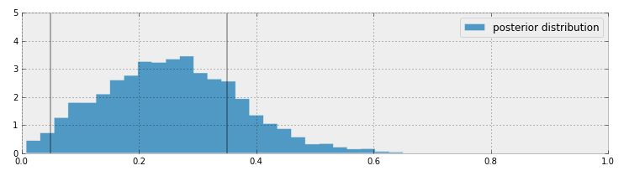
Posterior Distribution

Slide 55

Alternative Simplified Model
Given a value for $p$ we can find the probability the student will answer yes:
$P\left(\text{Yes}\right)=P\left(\text{Heads} \text{on} \text{first} \text{coin}\right)P\left(\text{cheater}\right)+$ $P\left(\text{Tail}\text{s} \text{on} \text{first} \text{coin}\right)$ $P\left(\text{Heads} \text{on} \text{second} \text{coin}\right)=\frac{1}{2}p+\frac{1}{2}\frac{1}{2}=\frac{p}{2}+\frac{1}{4}$
@gen function freq_cheating_model()
freq_cheating ~ uniform(0, 1)
p_skewed = 0.5 * freq_cheating + 0.25
obs ~ binom(N, p_skewed)
end

Slide 56
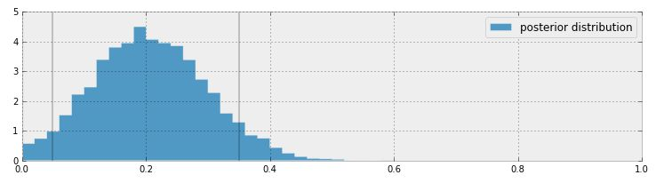
Posterior Distribution

Slide 57

Google
https://static.googleusercontent.com/media/research.google.com/en//pubs/archive/42852.pdf

