Slide 1
Probabilistic Programming
Marius Popescu
popescunmarius@gmail.com
2022 - 2023

Slide 2
Bayesian Regression with Gen
Logistic | Linear | Ridge | LASSO

Slide 3
The Bayesian Perspective
Unlike in the ordinary regression case, we don't get a single regression line - we get a probability distribution on the space of all such lines. The width of this posterior represents the uncertainty in our estimate.
Why to use it?
Although computationally it's a LOT harder than ordinary least squares, one can easily formulate and solve a very flexible model that addresses most of the problems with ordinary least squares: extreme sensitivity to outliers, inability to incorporate priors, and little ability to quantify uncertainty.
When to use it?
The distribution of errors is not normal or close to it
Don’t have enough data

Slide 4
Bayesian Logistic Regression

Slide 5

Challenger Space Shuttle Disaster
On January 28, 1986, the twenty-fifth flight of the U.S. space shuttle program ended in disaster when one of the rocket boosters of the Shuttle Challenger exploded shortly after lift-off, killing all seven crew members. The presidential commission on the accident concluded that it was caused by the failure of an O-ring in a field joint on the rocket booster, and that this failure was due to a faulty design that made the O-ring unacceptably sensitive to a number of factors including outside temperature. Of the previous 24 flights, data were available on failures of O-rings on 23, (one was lost at sea), and these data were discussed on the evening preceding the Challenger launch, but unfortunately only the data corresponding to the 7 flights on which there was a damage incident were considered important and these were thought to show no obvious trend.

Slide 6

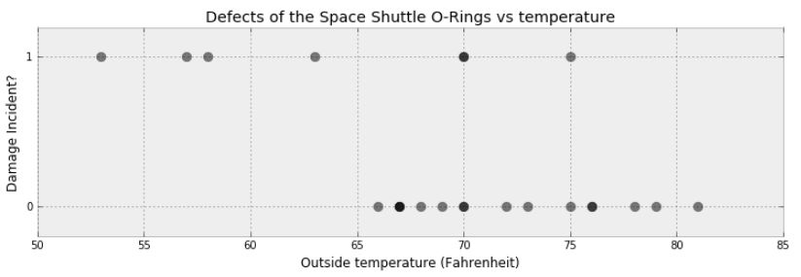
The Data

Slide 7
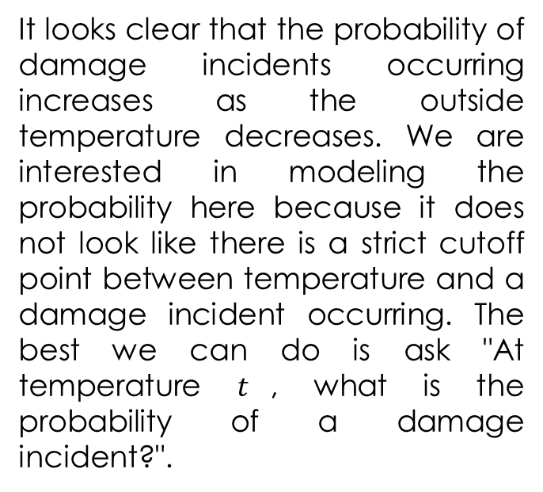
The Problem
It looks clear that the probability of damage incidents occurring increases as the outside temperature decreases. We are interested in modeling the probability here because it does not look like there is a strict cutoff point between temperature and a damage incident occurring. The best we can do is ask "At temperature $t$, what is the probability of a damage incident?".

Slide 8
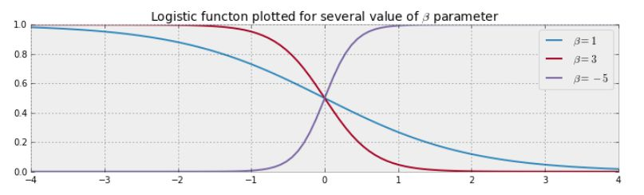
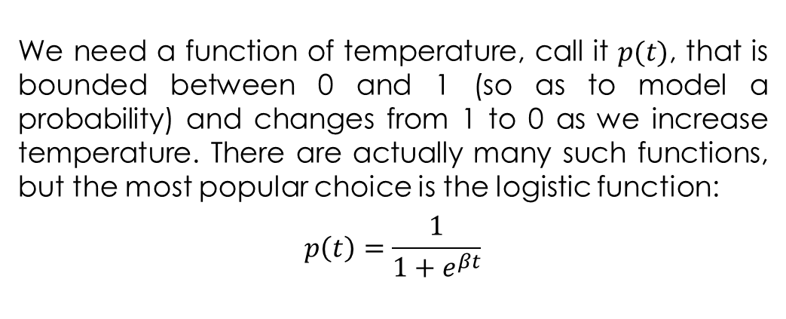
Modeling
We need a function of temperature, call it $p(t)$, that is bounded between 0 and 1 (so as to model a probability) and changes from 1 to 0 as we increase temperature. There are actually many such functions, but the most popular choice is the logistic function:
$$p\left(t\right)=\frac{1}{1+e^{βt}}$$

Slide 9
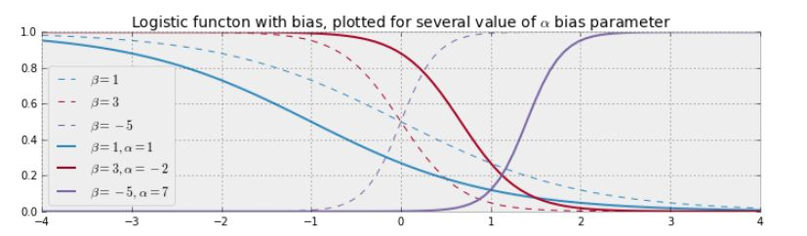
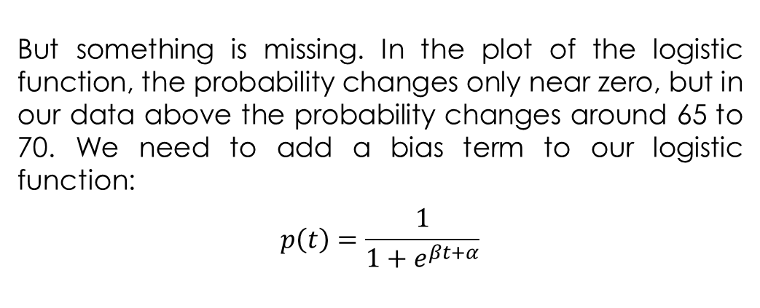
Modeling
But something is missing. In the plot of the logistic function, the probability changes only near zero, but in our data above the probability changes around 65 to 70. We need to add a bias term to our logistic function:
$$p\left(t\right)=\frac{1}{1+e^{βt+α}}$$

Slide 10
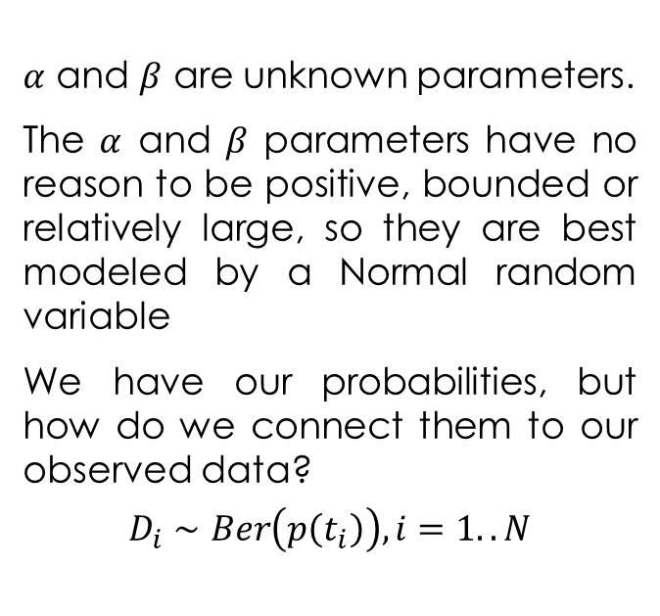
Modeling
challenger_data = readdlm("challenger_clean_data.csv", ',', Int64, '\n')
temperature = challenger_data[:, 1]
D = challenger_data[:, 2] # defect or not?
n_count_data = length(D)
function logistic(x, beta, alpha)
return 1.0 / (1.0 + exp(beta * x + alpha))
end
@gen function logreg_model()
beta ~ normal(0, 50)
alpha ~ normal(0, 50)
obs = Int64[]
for i = 1:n_count_data
push!(obs, {(:obs, i)} ~ bernoulli(logistic(temperature[i], beta, alpha)))
end
obs
end
$α$ and $β$ are unknown parameters.
The $α$ and $β$ parameters have no reason to be positive, bounded or relatively large, so they are best modeled by a Normal random variable
We have our probabilities, but how do we connect them to our observed data?
$$D_{i}∼Ber\left(p\left(t_{i}\right)\right), i=1..N$$

Slide 11
Inference
function block_resimulation_inference(n_burnin, n_samples, thin)
observations = make_constraints(D)
(tr, _) = generate(logreg_model, (), observations)
tr = map_optimize(tr, select(:beta, :alpha))
for iter=1:n_burnin
tr = block_resimulation_update(tr)
println(iter)
end
trs = []
for iter=1:n_samples
for itert = 1:thin
tr = block_resimulation_update(tr)
end
push!(trs, tr)
println(iter)
end
trs
end;
trs = block_resimulation_inference(120000, 50000, 2)
beta_samples = [trs[i][:beta] for i=1:50000]
alpha_samples = [trs[i][:alpha] for i=1:50000]
function make_constraints(ys::Vector{Int64})
constraints = Gen.choicemap()
for i=1:length(ys)
constraints[(:obs, i)] = D[i]
end
constraints
end;
function block_resimulation_update(tr)
# Block 1: Update beta
latent_variable = select(:beta)
(tr, _) = mh(tr, latent_variable)
# Block 2: Update alpha
latent_variable = select(:alpha)
(tr, _) = mh(tr, latent_variable)
tr
end

Slide 12
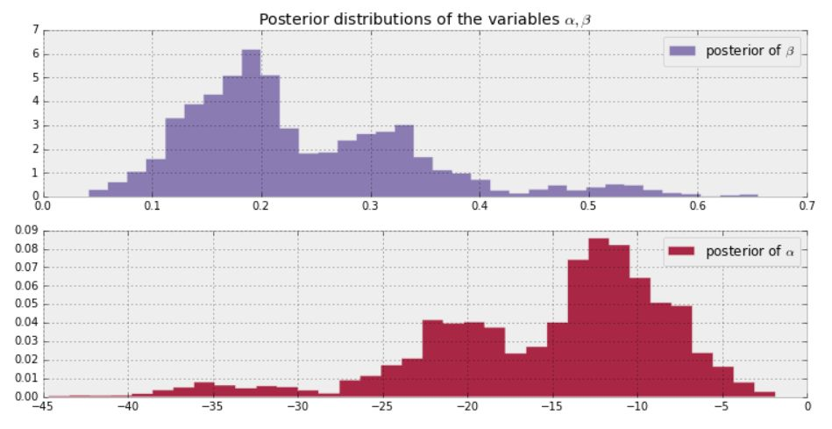
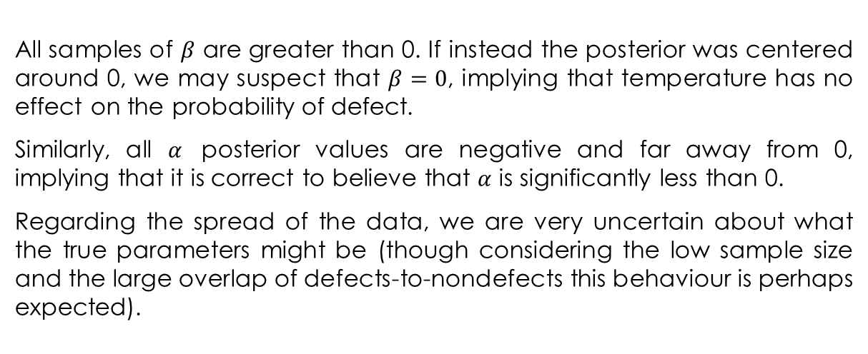
The Results
All samples of $β$ are greater than 0. If instead the posterior was centered around 0, we may suspect that $β=0$, implying that temperature has no effect on the probability of defect.
Similarly, all $α$ posterior values are negative and far away from 0, implying that it is correct to believe that $α$ is significantly less than 0.
Regarding the spread of the data, we are very uncertain about what the true parameters might be (though considering the low sample size and the large overlap of defects-to-nondefects this behaviour is perhaps expected).

Slide 13
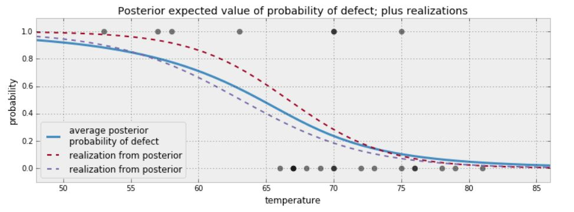
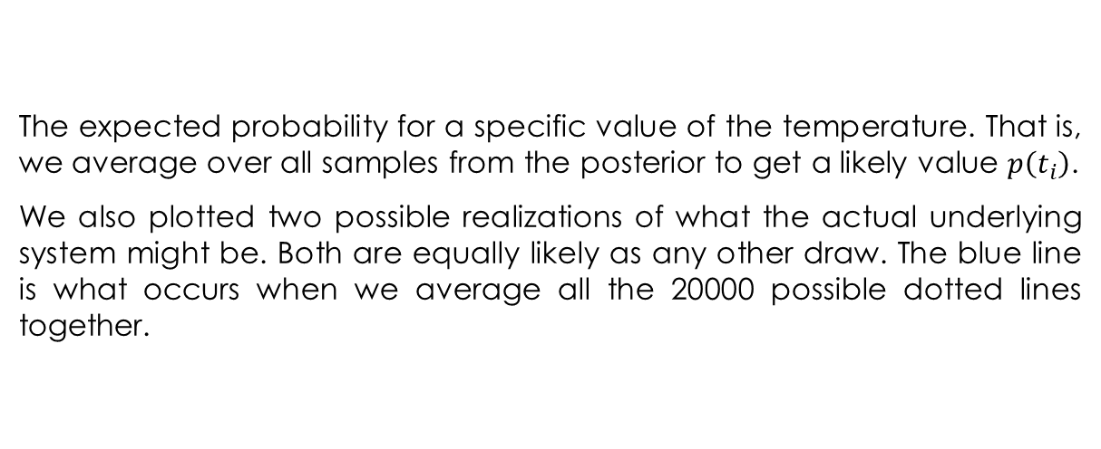
The Results
The expected probability for a specific value of the temperature. That is, we average over all samples from the posterior to get a likely value $p\left(t_{i}\right)$.
We also plotted two possible realizations of what the actual underlying system might be. Both are equally likely as any other draw. The blue line is what occurs when we average all the 20000 possible dotted lines together.

Slide 14
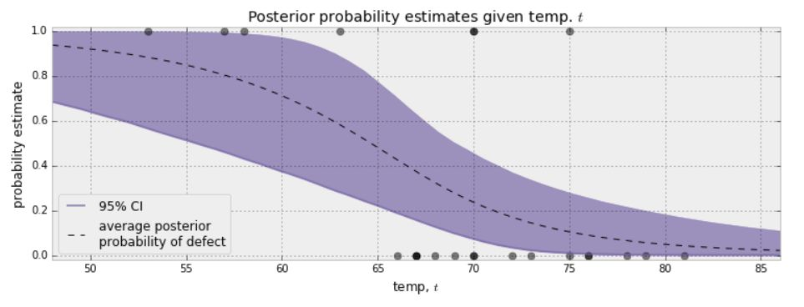
The Results
An interesting question to ask is for what temperatures are we most uncertain about the defect-probability? Below we plot the expected value line and the associated 95% intervals for each temperature.
The 95% credible interval, or 95% CI, painted in purple, represents the interval, for each temperature, that contains 95% of the distribution. For example, at 65 degrees, we can be 95% sure that the probability of defect lies between 0.25 and 0.75.

Slide 15
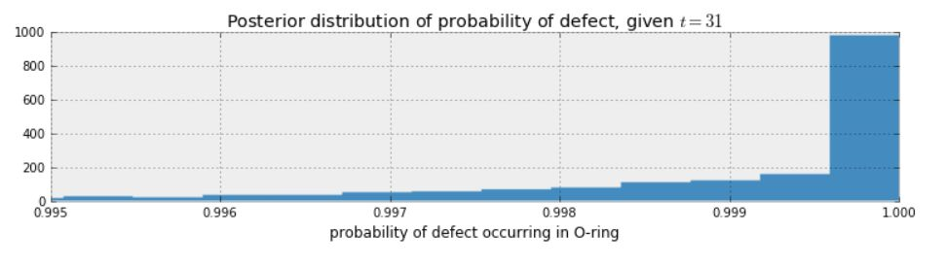
What about the day of the Challenger disaster?
prob_31 = [logistic(31, beta_samples[i], alpha_samples[i]) for i = 1:50000]
println(prob_31[1:10])
plt.xlim(0.9, 1.1)
plt.hist(prob_31, bins=50, histtype="stepfilled", density=true)
plt.title("Posterior distribution of probability of defect, given \$t = 31\$")
plt.xlabel("probability of defect occurring in O-ring")
plt.show()

Slide 16
Bayesian Linear Regression

Slide 17

Based on Three Tutorials from: https://www.gen.dev/tutorials/
Introduction to Modeling in Gen
Basics of Iterative Inference in Gen
Scaling with Combinators and the Static Modeling Language

Slide 18
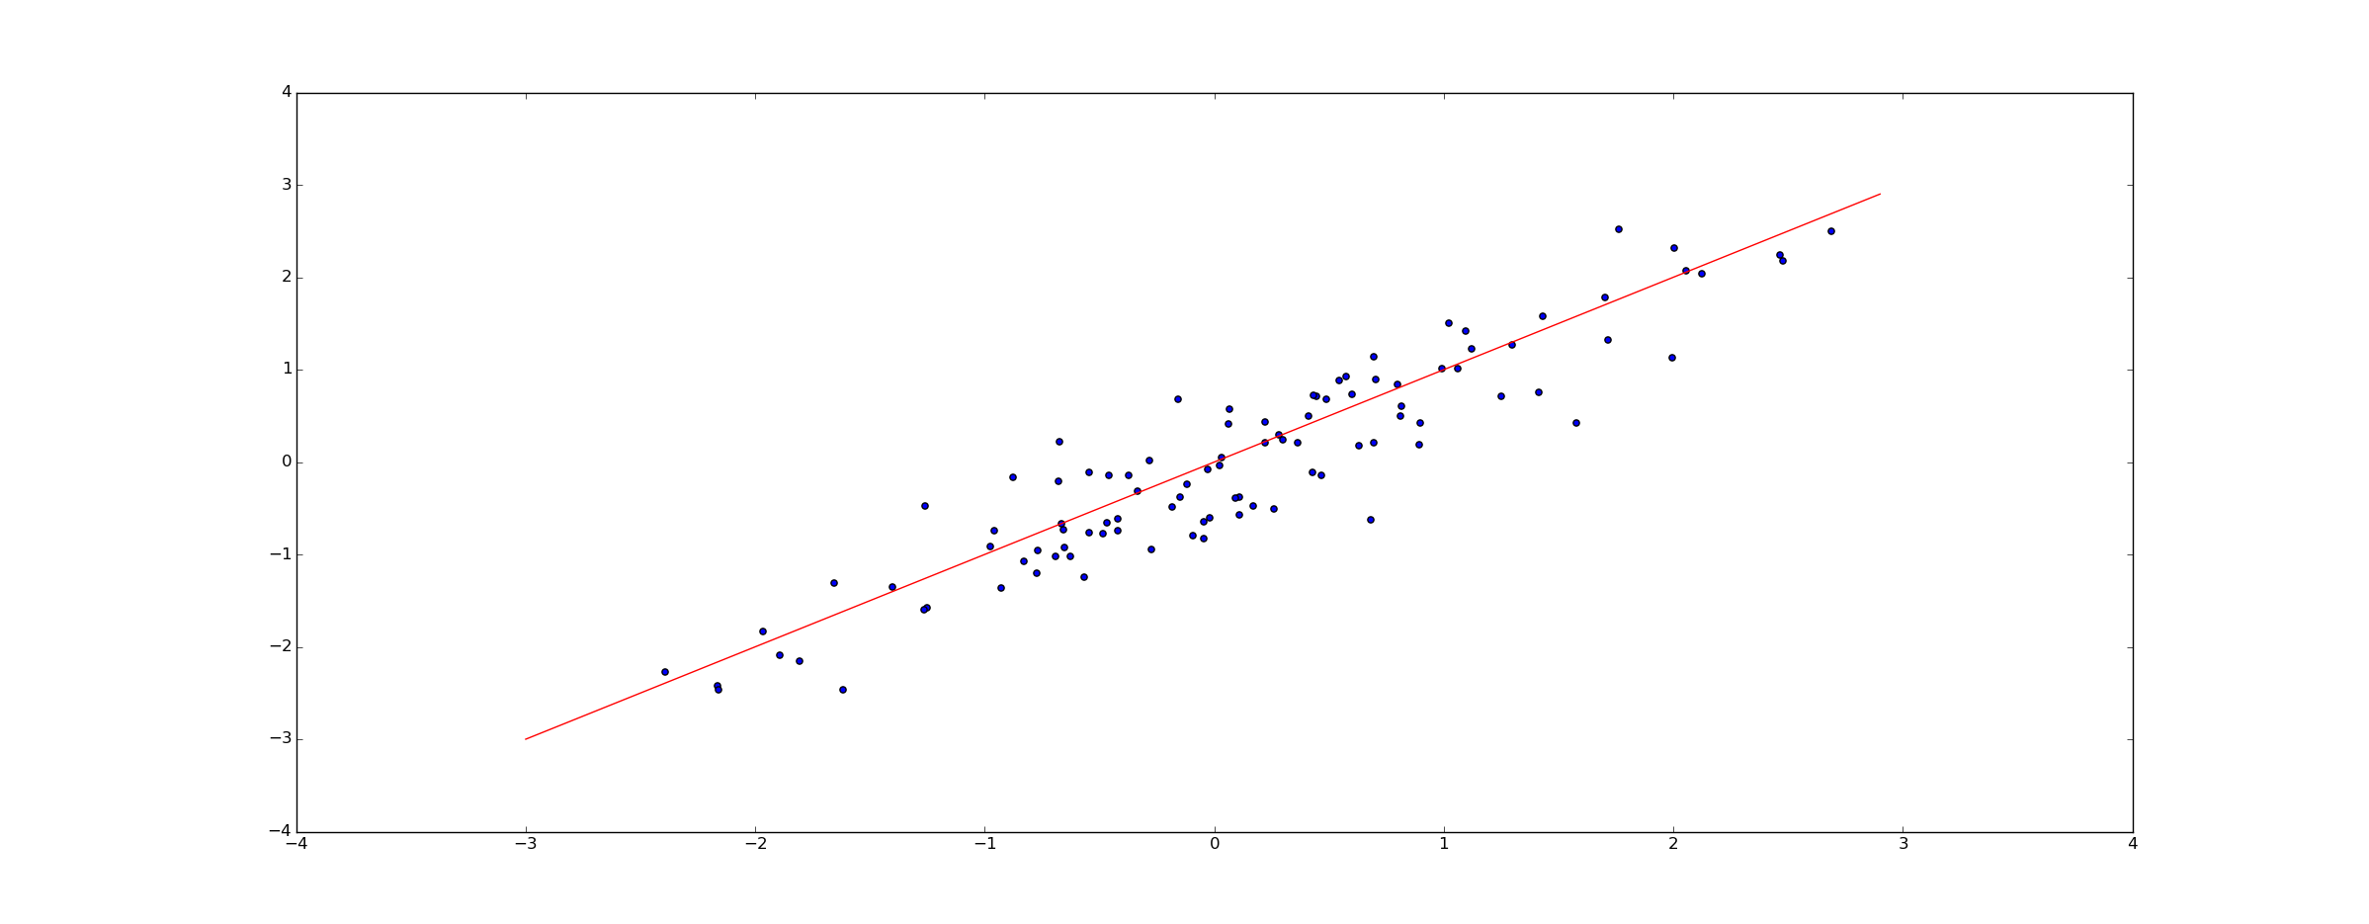
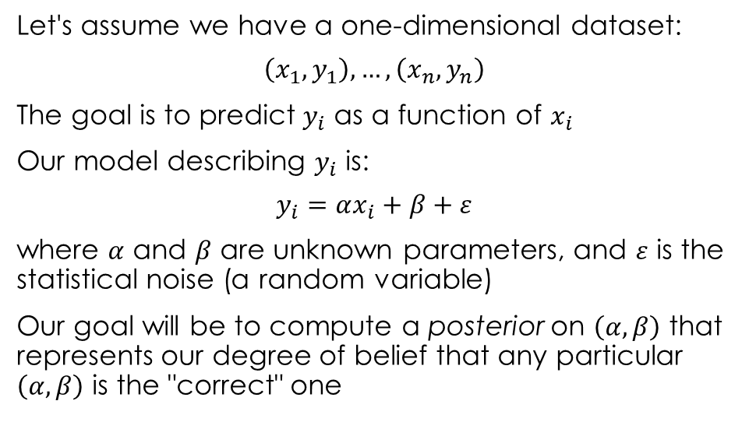
Simple Linear Regression
Let's assume we have a one-dimensional dataset:
$$\left(x_{1},y_{1}\right), …,\left(x_{n},y_{n}\right)$$
The goal is to predict $y_{i}$ as a function of $x_{i}$
Our model describing $y_{i}$ is:
$$y_{i}=αx_{i}+β+ε$$
where $α$ and $β$ are unknown parameters, and $ε$ is the statistical noise (a random variable)
Our goal will be to compute a posterior on $\left(α,β\right)$ that represents our degree of belief that any particular $\left(α,β\right)$ is the "correct" one

Slide 19
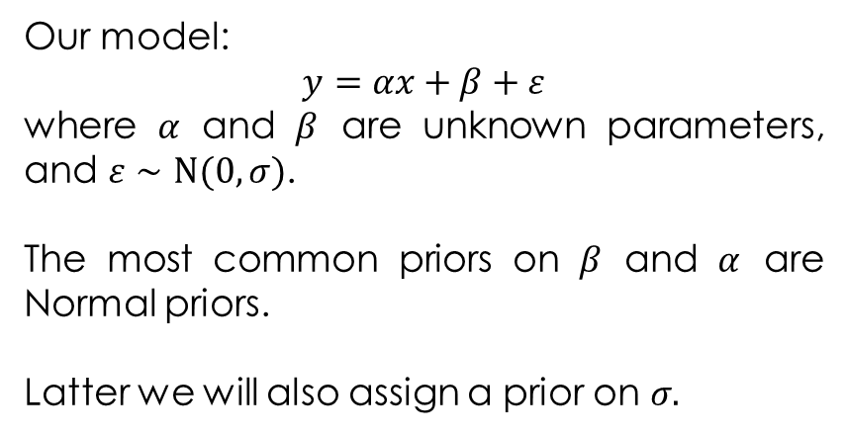
Simple Linear Regression
@gen function line_model(xs::Vector{Float64})
# We begin by sampling a slope and intercept for the line.
# Before we have seen the data, we don't know the values of
# these parameters, so we treat them as random choices. The
# distributions they are drawn from represent our prior beliefs
# about the parameters: in this case, that neither the slope nor the
# intercept will be more than a couple points away from 0.
slope = ({:slope} ~ normal(0, 1)) # alpha
intercept = ({:intercept} ~ normal(0, 2)) # beta
# We define a function to compute y for a given x
function y(x)
return slope * x + intercept
end
# Given the slope and intercept, we can sample y coordinates
# for each of the x coordinates in our input vector.
for (i, x) in enumerate(xs)
# Note that we name each random choice in this loop
# slightly differently: the first time through,
# the name (:y, 1) will be used, then (:y, 2) for
# the second point, and so on.
({(:y, i)} ~ normal(y(x), 0.1))
end
# Most of the time, we don't care about the return
# value of a model, only the random choices it makes.
# It can sometimems be useful to return something
# meaningful, however; here, we return the function `y`.
return y
end;
Our model:
$$y=αx+β+ε$$
where $α$ and $β$ are unknown parameters, and $ε∼N(0,σ)$.
The most common priors on $β$ and $α$ are Normal priors.
Latter we will also assign a prior on $σ.$

Slide 20
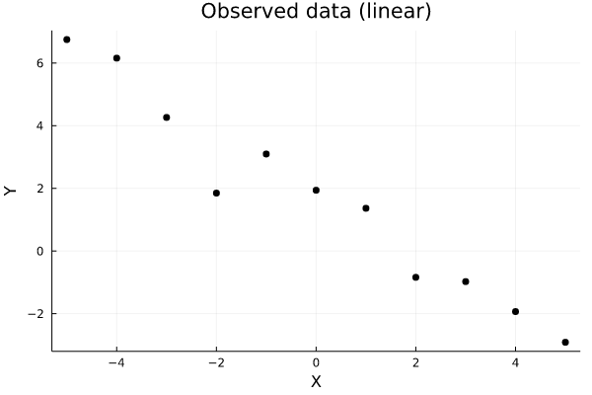
Observed Data
xs = [-5., -4., -3., -2., -1., 0., 1., 2., 3., 4., 5.]
ys = [6.75003, 6.1568, 4.26414, 1.84894, 3.09686, 1.94026,
1.36411, -0.83959, -0.976, -1.93363, -2.91303];
display(scatter(xs, ys, color="black", label=nothing, title="Observed data (linear)", xlabel="X", ylabel="Y"))
readline()

Slide 21
Importance (Re)Sampling
Importance sampling is a Bayesian estimation technique which estimates a parameter by drawing from a specified importance function rather than a posterior distribution.
Importance sampling is useful when the area we are interested in may lie in a region that has a small probability of occurrence. In these cases, other sampling techniques may fail to even draw from that area.
Importance sampling overcomes this issue by sampling from a distribution which weights the region of interest.

Slide 22
Gen.importance_resampling(…)
function do_inference(model, xs, ys, amount_of_computation)
# Create a choice map that maps model addresses (:y, i)
# to observed values ys[i]. We leave :slope and :intercept
# unconstrained, because we want them to be inferred.
observations = Gen.choicemap()
for (i, y) in enumerate(ys)
observations[(:y, i)] = y
end
# Call importance_resampling to obtain a likely trace consistent
# with our observations.
(trace, _) = Gen.importance_resampling(model, (xs,), observations, amount_of_computation);
return trace
end;
trace = do_inference(line_model, xs, ys, 100)

Slide 23
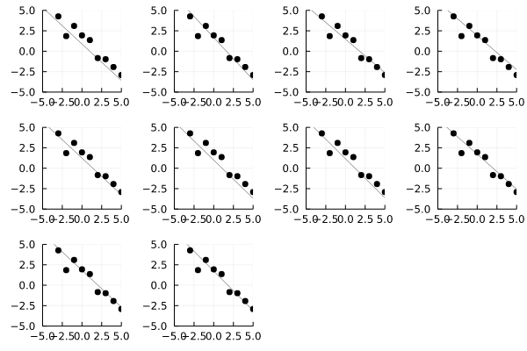
A Sample of Regression Lines
traces = [do_inference(line_model, xs, ys, 100) for _=1:10]
display(grid(render_trace, traces))
readline()
function render_trace(trace; show_data=true)
# Pull out xs from the trace
xs, = get_args(trace)
xmin = minimum(xs)
xmax = maximum(xs)
# Pull out the return value, useful for plotting
y = get_retval(trace)
# Draw the line
test_xs = collect(range(-5, stop=5, length=1000))
fig = plot(test_xs, map(y, test_xs), color="black", alpha=0.5, label=nothing,
xlim=(xmin, xmax), ylim=(xmin, xmax))
if show_data
ys = [trace[(:y, i)] for i=1:length(xs)]
# Plot the data set
scatter!(xs, ys, c="black", label=nothing)
end
return fig
end;
function grid(renderer::Function, traces)
Plots.plot(map(renderer, traces)...)
end;

Slide 24
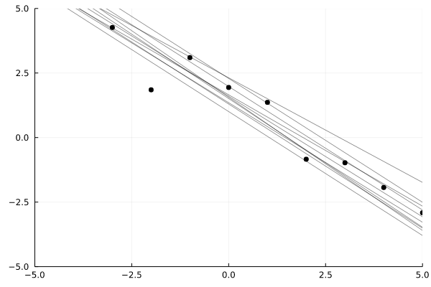
A Sample of Regression Lines (n = 10)
traces = [do_inference(line_model, xs, ys, 100) for _=1:10];
overlay(render_trace, traces)
function overlay(renderer, traces; same_data=true, args...)
fig = renderer(traces[1], show_data=true, args...)
xs, = get_args(traces[1])
xmin = minimum(xs)
xmax = maximum(xs)
for i=2:length(traces)
y = get_retval(traces[i])
test_xs = collect(range(-5, stop=5, length=1000))
fig = plot!(test_xs, map(y, test_xs), color="black", alpha=0.5, label=nothing,
xlim=(xmin, xmax), ylim=(xmin, xmax))
end
return fig
end;

Slide 25
Predicting New Data
We will use the ability to run constrained executions of a generative function to predict the value of the y-coordinates at new x-coordinates by running new executions of the model generative function in which the random choices corresponding to the parameters have been constrained to their inferred values:
function predict_new_data(model, trace, new_xs::Vector{Float64}, param_addrs)
# Copy parameter values from the inferred trace (`trace`)
# into a fresh set of constraints.
constraints = Gen.choicemap()
for addr in param_addrs
constraints[addr] = trace[addr]
end
# Run the model with new x coordinates, and with parameters
# fixed to be the inferred values.
(new_trace, _) = Gen.generate(model, (new_xs,), constraints)
# Pull out the y-values and return them.
ys = [new_trace[(:y, i)] for i=1:length(new_xs)]
return ys
end;
predict_new_data(line_model, trace, [1., 2., 3.], [:slope, :intercept])

Slide 26
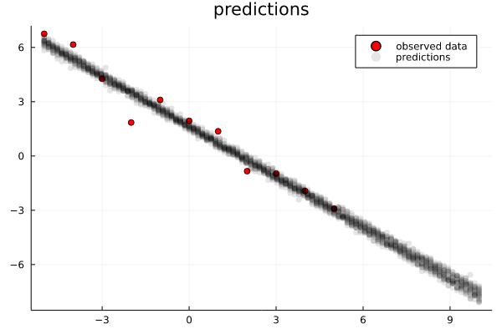
Predicting New Data
We will use the inferred values of the parameters to predict y-coordinates for x-coordinates in the interval 5 to 10 from which data was not observed. We will also predict new data within the interval -5 to 5, and we will compare this data to the original observed data. Predicting new data from inferred parameters, and comparing this new data to the observed data is the core idea behind posterior predictive checking.
new_xs = collect(range(-5, stop=10, length=100));
pred_ys = infer_and_predict(line_model, xs, ys, new_xs, [:slope, :intercept], 20, 1000)
plot_predictions(xs, ys, new_xs, pred_ys)
The results look reasonable, both within the interval of observed data and in the extrapolated predictions on the right.

Slide 27
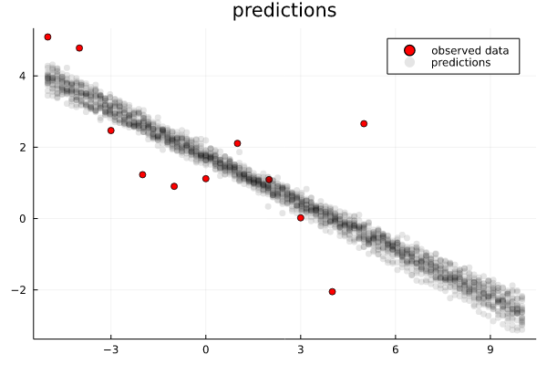
Modeling the Noise
Now consider the same experiment run with the following data set, which has significantly more noise.
ys_noisy = [5.092, 4.781, 2.46815, 1.23047, 0.903318,
1.11819, 2.10808, 1.09198, 0.0203789, -2.05068, 2.66031]
pred_ys = infer_and_predict(line_model, xs, ys_noisy,
new_xs, [:slope, :intercept], 20, 1000)
plot_predictions(xs, ys_noisy, new_xs, pred_ys)
It looks like the generated data is less noisy than the observed data in the regime where data was observed, and it looks like the forecasted data is too overconfident. This is a sign that our model is mis-specified. In our case, this is because we have assumed that the noise has value 0.1. However, the actual noise in the data appears to be much larger.

Slide 28
Modeling the Noise
We can correct this by making the noise a random choice as well and inferring its value along with the other parameters.
We first write a new version of the line model that samples a random choice for the noise from a gamma(1, 1) prior distribution.
@gen function line_model_fancy(xs::Vector{Float64})
slope = ({:slope} ~ normal(0, 1))
intercept = ({:intercept} ~ normal(0, 2))
function y(x)
return slope * x + intercept
end
noise = ({:noise} ~ gamma(1, 1))
for (i, x) in enumerate(xs)
{(:y, i)} ~ normal(slope * x + intercept, noise)
end
return y
end;

Slide 29
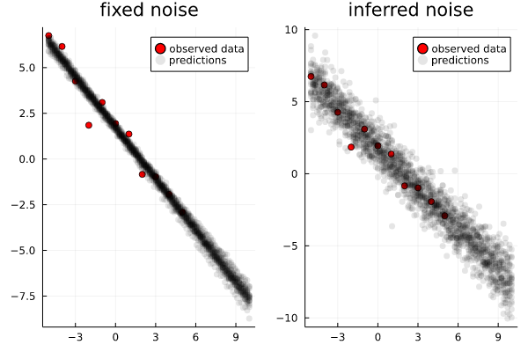
We compare the predictions using inference of the unmodified and modified models on the ys data set:
Notice that there is more uncertainty in the predictions made using the modified model.

Slide 30
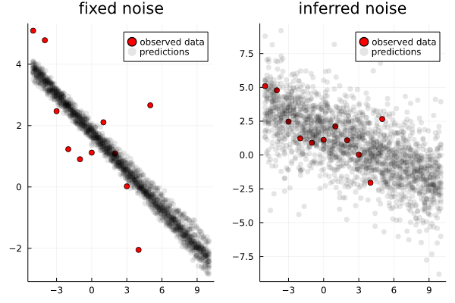
We also compare the predictions using inference of the unmodified and modified models on the ys_noisy data set:
Notice that while the unmodified model was very overconfident, the modified model has an appropriate level of uncertainty, while still capturing the general negative trend.

Slide 31
Bayesian Perspective of Penalized Linear Regressions

Slide 32
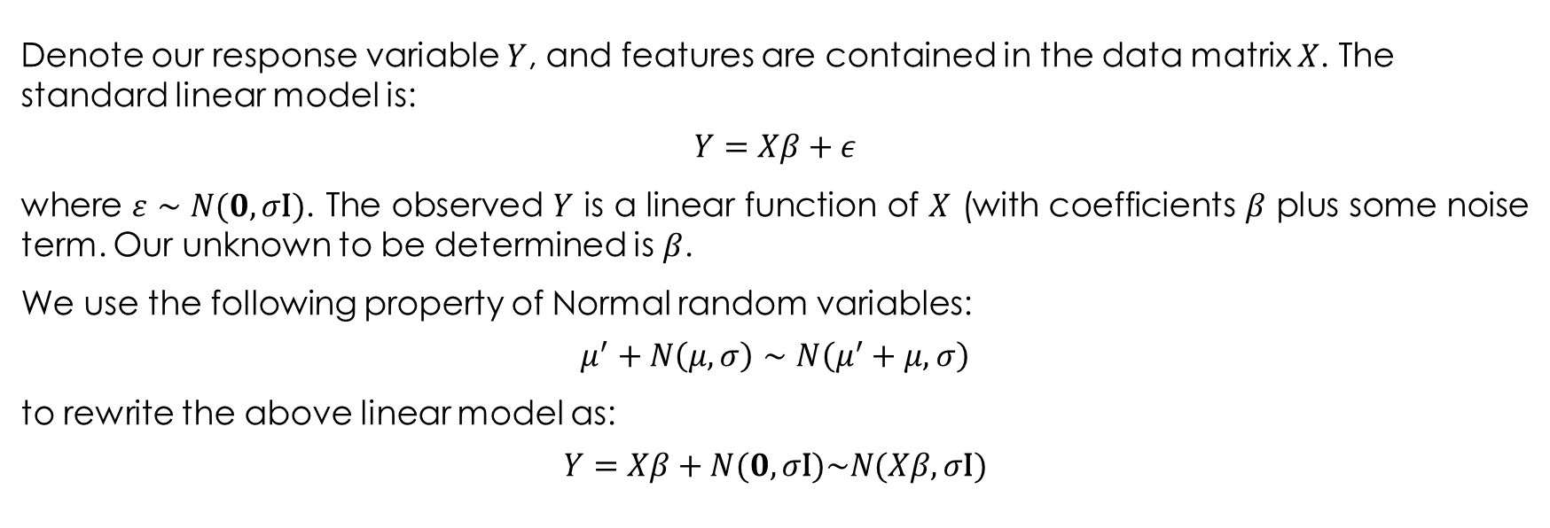
The Probabilistic Interpretation of Least-Squares Linear Regression
Denote our response variable $Y$, and features are contained in the data matrix $X$. The standard linear model is:
$$Y=Xβ+ε$$
where $ε∼N(0,σ\text{I})$. The observed $Y$ is a linear function of $X$ (with coefficients $β$ plus some noise term. Our unknown to be determined is $β$.
We use the following property of Normal random variables:
$$μ^{′}+N\left(μ,σ\right)∼N\left(μ^{′}+μ,σ\right)$$
to rewrite the above linear model as:
$$Y=Xβ+N(0,σ\text{I})\sim N(Xβ,σ\text{I})$$

Slide 33
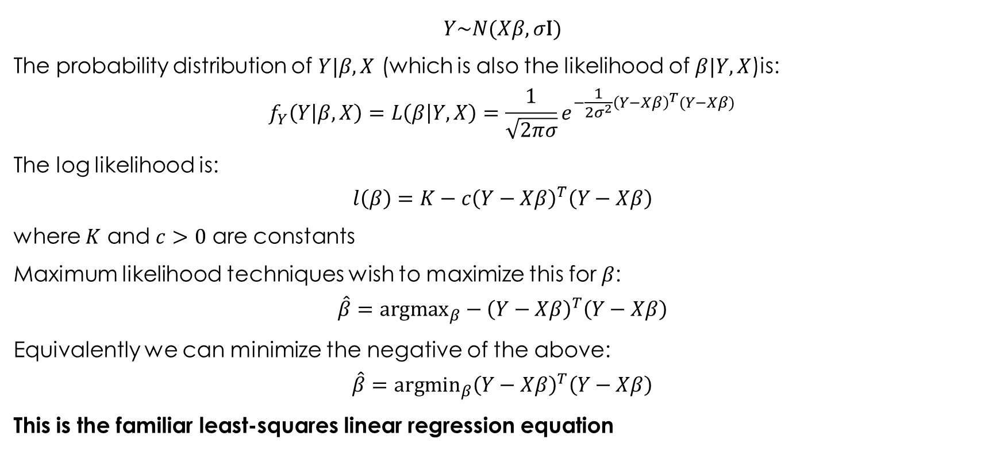
The Probabilistic Interpretation of Least-Squares Linear Regression
$$Y\sim N(Xβ,σ\text{I})$$
The probability distribution of $Y|β,X$ (which is also the likelihood of $β|Y,X$)is:
$$f_{Y}\left(Y | β,X\right)=L\left(β | Y,X\right)=\frac{1}{\sqrt{2πσ}}e^{−\frac{1}{2σ^{2}}{\left(Y−Xβ\right)}^{T}(Y−Xβ)}$$
The log likelihood is:
$$l\left(β\right)=K−c{\left(Y−Xβ\right)}^{T}\left(Y−Xβ\right)$$
where $K$ and $c>0$ are constants
Maximum likelihood techniques wish to maximize this for $β$:
$$\hat{β}={\text{argmax}}_{β}−{\left(Y−Xβ\right)}^{T}\left(Y−Xβ\right)$$
Equivalently we can minimize the negative of the above:
$$\hat{β}={\text{argm}\text{in}}_{β}{\left(Y−Xβ\right)}^{T}\left(Y−Xβ\right)$$
This is the familiar least-squares linear regression equation

Slide 34
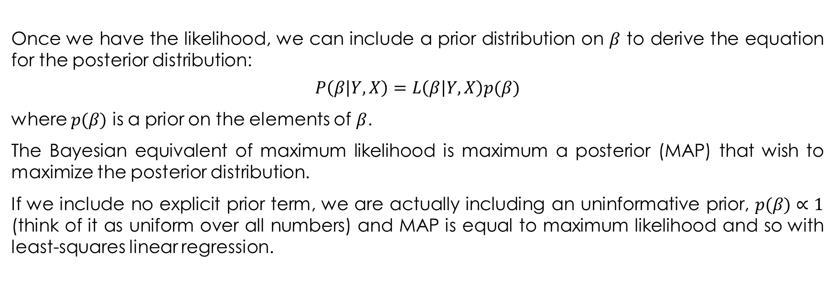
The Bayesian Perspective
Once we have the likelihood, we can include a prior distribution on $β$ to derive the equation for the posterior distribution:
$$P\left(β | Y,X\right)=L\left(β | Y,X\right)p(β)$$
where $p(β)$ is a prior on the elements of $β$.
The Bayesian equivalent of maximum likelihood is maximum a posterior (MAP) that wish to maximize the posterior distribution.
If we include no explicit prior term, we are actually including an uninformative prior, $p(β)∝1$ (think of it as uniform over all numbers) and MAP is equal to maximum likelihood and so with least-squares linear regression.

Slide 35
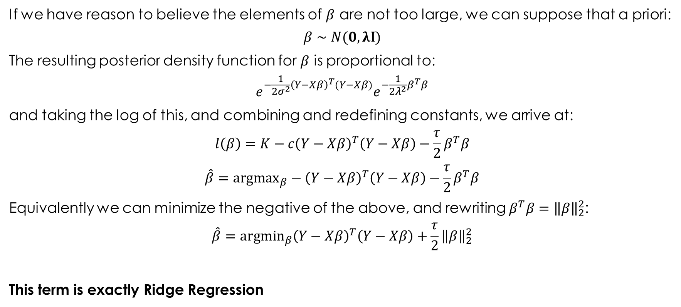
Ridge Regression
If we have reason to believe the elements of $β$ are not too large, we can suppose that a priori:
$$β∼N(0,λ\text{I})$$
The resulting posterior density function for $β$ is proportional to:
$$e^{−\frac{1}{2σ^{2}}{\left(Y−Xβ\right)}^{T}(Y−Xβ)}e^{−\frac{1}{2λ^{2}}β^{T}β}$$
and taking the log of this, and combining and redefining constants, we arrive at:
$$l\left(β\right)=K−c{\left(Y−Xβ\right)}^{T}\left(Y−Xβ\right)−\frac{τ}{2}β^{T}β$$
$$\hat{β}={\text{argmax}}_{β}−{\left(Y−Xβ\right)}^{T}\left(Y−Xβ\right)−\frac{τ}{2}β^{T}β$$
Equivalently we can minimize the negative of the above, and rewriting $β^{T}β={\left\|β\right\|}_{2}^{2}$:
$$\hat{β}={\text{argmin}}_{β}{\left(Y−Xβ\right)}^{T}\left(Y−Xβ\right)+\frac{τ}{2}{\left\|β\right\|}_{2}^{2}$$
This term is exactly Ridge Regression

Slide 36

LASSO
Similarly, if we assume a Laplace prior on $β$:
$$f_{β}(β)∝e^{−λ{\left\|β\right\|}_{1}}$$
and following the same steps as above, we recover:
$$\hat{β}={\text{argmin}}_{β}{\left(Y−Xβ\right)}^{T}\left(Y−Xβ\right)+λ{\left\|β\right\|}_{1}$$
which is LASSO regression

Slide 37
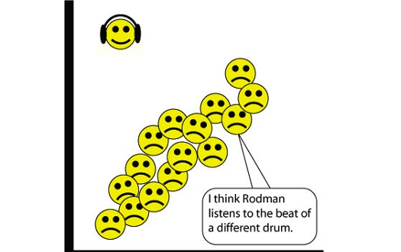
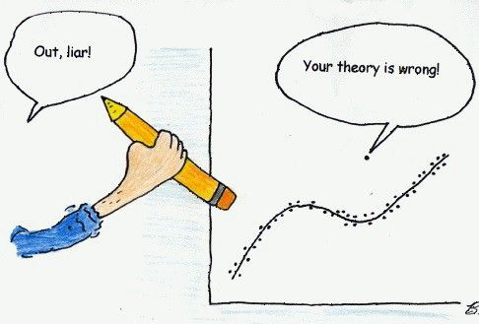
Incorporating Priors - Handling Outliers
In statistics, an outlier is an observation point that is distant from other observations. An outlier may be due to variability in the measurement or it may indicate experimental error;. An outlier can cause serious problems in statistical analyses.
Outliers are often treated as data points which need to be specially handled - often ignored - because they don't fit the model and can heavily skew results.

Slide 38
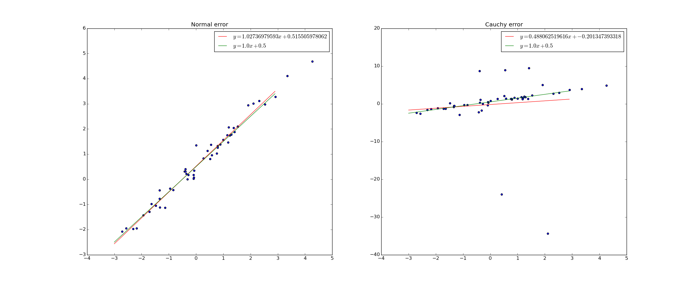
Changing the distribution of $ε$
50 data points were generated. In the left graph, the $y$-values were chosen according to the rule $y=x+0.5+ε$ where $ε$ is drawn from a normal distribution. In the right graph, the $y$-values were chosen according to the same rule, but with $ε$ drawn from a Cauchy distribution.
The Cauchy distribution is actually pretty pathological - it's variance is infinite. The result of this is that "outliers" are not actually uncommon at all - extremely large deviations from the mean are perfectly normal.
The red line in the graph the best possible least squares fit line, while the green line is the true relation.

Slide 39
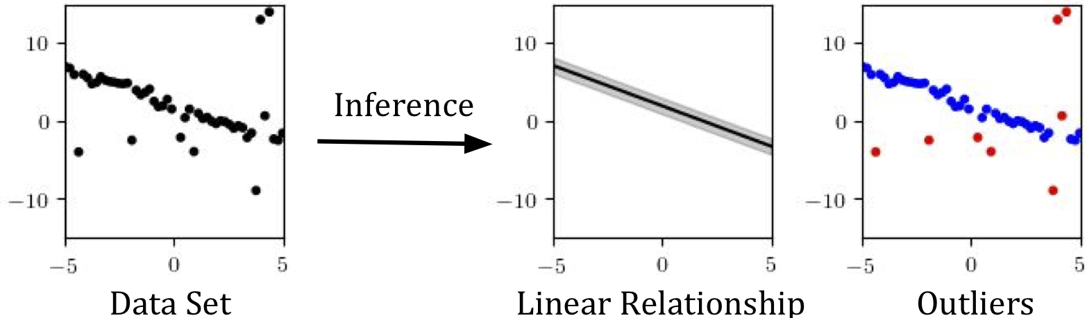
Curve-Fitting with Outliers
Suppose we have a dataset of points in the plane that is mostly explained by a linear relationship, but which also has several outliers. Our goal will be to automatically identify the outliers, and to find a linear relationship (a slope and intercept, as well as an inherent noise level) that explains rest of the points:

Slide 40
The Model
@gen function regression_with_outliers(xs::Vector{<:Real})
# First, generate some parameters of the model. We make these
# random choices, because later, we will want to infer them
# from data. The distributions we use here express our assumptions
# about the parameters: we think the slope and intercept won't be
# too far from 0; that the noise is relatively small; and that
# the proportion of the dataset that don't fit a linear relationship
# (outliers) could be anything between 0 and 1.
slope ~ normal(0, 2)
intercept ~ normal(0, 2)
noise ~ gamma(1, 1)
prob_outlier ~ uniform(0, 1)

Slide 41
The Model
# Next, we generate the actual y coordinates.
n = length(xs)
ys = Float64[]
for i = 1:n
# Decide whether this point is an outlier, and set
# mean and standard deviation accordingly
if ({:data => i => :is_outlier} ~ bernoulli(prob_outlier))
(mu, std) = (0., 10.)
else
(mu, std) = (xs[i] * slope + intercept, noise)
end
# Sample a y value for this point
push!(ys, {:data => i => :y} ~ normal(mu, std))
end
ys
end;

Slide 42
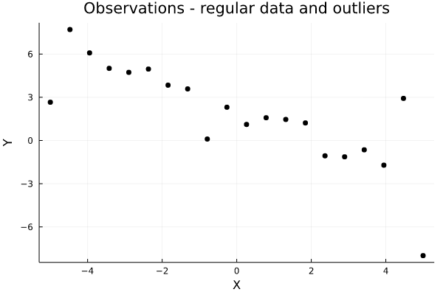
A synthetic dataset to do inference about:

Slide 43
The problem with generic importance sampling
traces = [first(Gen.importance_resampling(regression_with_outliers, (xs,), observations, 2000)) for i in 1:9]
log_probs = [get_score(t) for t in traces]
println("Average log probability: $(logmeanexp(log_probs))")
Plots.plot([visualize_trace(t) for t in traces]...)
Average log probability: -51.8570956904098

Slide 44
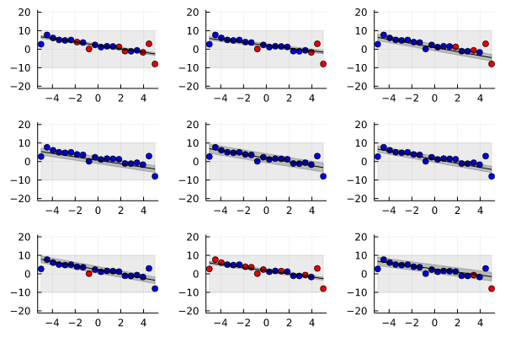
The Results
We see here that importance resampling hasn’t completely failed: it generally finds a reasonable position for the line. But the details are off: there is little logic to the outlier classification, and the inferred noise around the line is too wide. The problem is that there are just too many variables to get right, and so sampling everything in one go is highly unlikely to produce a perfect hit.

Slide 45
MCMC Inference: MH
Block Resimulation MH Algorithm:
Block 1: slope, intercept, and noise. These parameters determine the linear relationship; resimulating them is like picking a new line. We know from our importance sampling experiment above that before too long, we’re bound to sample something close to the right line.
Blocks 2 through N+1: Each is_outlier, in its own block. One problem we saw with importance sampling in this problem was that it tried to sample every outlier classification at once, when in reality the chances of a single sample that correctly classifies all the points are very low. Here, we can choose to resimulate each is_outlier choice separately, and for each one, decide whether to use the resimulated value or not.
Block N+2: prob_outlier. Finally, we can propose a new prob_outlier value; in general, we can expect to accept the proposal when it is in line with the current hypothesized proportion of is_outlier choices that are set to true.

Slide 46
Block Resimulation
function block_resimulation_update(tr)
# Block 1: Update the line's parameters
line_params = select(:noise, :slope, :intercept)
(tr, _) = mh(tr, line_params)
# Blocks 2-N+1: Update the outlier classifications
(xs,) = get_args(tr)
n = length(xs)
for i=1:n
(tr, _) = mh(tr, select(:data => i => :is_outlier))
end
# Block N+2: Update the prob_outlier parameter
(tr, _) = mh(tr, select(:prob_outlier))
# Return the updated trace
tr
end;

Slide 47
The Results
MH Block Resimulation
Importance Sampling
scores = Vector{Float64}(undef, 10)
for i=1:10
@time tr = block_resimulation_inference(xs, ys, observations)
scores[i] = get_score(tr)
end
println("Log probability: ", logmeanexp(scores))
0.773126 seconds (11.47 M allocations: 677.525 MiB, 13.19% gc time)
0.549964 seconds (10.81 M allocations: 641.426 MiB, 14.86% gc time)
0.558047 seconds (10.81 M allocations: 641.426 MiB, 15.35% gc time)
0.549738 seconds (10.81 M allocations: 641.426 MiB, 15.25% gc time)
0.541699 seconds (10.81 M allocations: 641.426 MiB, 14.85% gc time)
0.538167 seconds (10.81 M allocations: 641.426 MiB, 14.75% gc time)
0.556597 seconds (10.81 M allocations: 641.426 MiB, 15.09% gc time)
0.536488 seconds (10.81 M allocations: 641.426 MiB, 14.92% gc time)
0.541546 seconds (10.81 M allocations: 641.426 MiB, 16.01% gc time)
0.539004 seconds (10.81 M allocations: 641.426 MiB, 14.95% gc time)
Log probability: -50.78536994535881
scores = Vector{Float64}(undef, 10)
for i=1:10
@time (tr, _) = importance_resampling(regression_with_outliers,
(xs,), observations, 17000)
scores[i] = get_score(tr)
end
println("Log probability: ", logmeanexp(scores))
0.596626 seconds (12.53 M allocations: 882.477 MiB, 18.17% gc time)
0.603205 seconds (12.53 M allocations: 882.477 MiB, 19.11% gc time)
0.609832 seconds (12.53 M allocations: 882.477 MiB, 19.07% gc time)
0.595268 seconds (12.53 M allocations: 882.477 MiB, 18.82% gc time)
0.605643 seconds (12.53 M allocations: 882.477 MiB, 18.94% gc time)
0.587700 seconds (12.53 M allocations: 882.477 MiB, 17.79% gc time)
0.582221 seconds (12.53 M allocations: 882.477 MiB, 18.52% gc time)
0.582921 seconds (12.53 M allocations: 882.477 MiB, 18.71% gc time)
0.585478 seconds (12.53 M allocations: 882.477 MiB, 18.99% gc time)
0.567708 seconds (12.53 M allocations: 882.477 MiB, 17.21% gc time)
Log probability: -53.7625847077635

Slide 48
MCMC Inference: Custom Proposal
Resimulation MH:
(tr, did_accept) = mh(tr, select(:address1, :address2, ...))
This update is incremental in that it only proposes changes to part of a trace (the selected addresses). But when computing what changes to propose, it ignores the current state completely and resimulates all-new values from the model. That wholesale resimulation of values is often not the best way to search for improvements.
Gen also offers a more general flavor of MH:
(tr, did_accept) = mh(tr, custom_proposal, custom_proposal_args)
A “custom proposal” is just what it sounds like: whereas before, we were using the default resimulation proposal to come up with new values for the selected addresses, we can now pass in a generative function that samples proposed values however it wants.

Slide 49
Gaussian Drift MH
A custom proposal that takes in a current trace, and proposes a new slope and intercept by randomly perturbing the existing values:
@gen function line_proposal(current_trace)
slope ~ normal(current_trace[:slope], 0.5)
intercept ~ normal(current_trace[:intercept], 0.5)
end;
This is often called a “Gaussian drift” proposal, because it essentially amounts to proposing steps of a random walk. (What makes it different from a random walk is that we will still use an MH accept/reject step to make sure we don’t wander into areas of very low probability.)
To use the proposal, we write:
(tr, did_accept) = mh(tr, line_proposal, ())

Slide 50
Studying the scaling behavior of the inference program
Let’s see how the running time of the inference program changes as we increase the number of data points. We don’t expect the running time to depend too much on the actual values of the data points, so we just construct a random data set for each run:
ns = [1, 3, 7, 10, 30, 70, 100]
times = []
for n in ns
xs = rand(n)
ys = rand(n)
start = time_ns()
tr = block_resimulation_inference(model, xs, ys)
push!(times, (time_ns() - start) / 1e9)
end

Slide 51
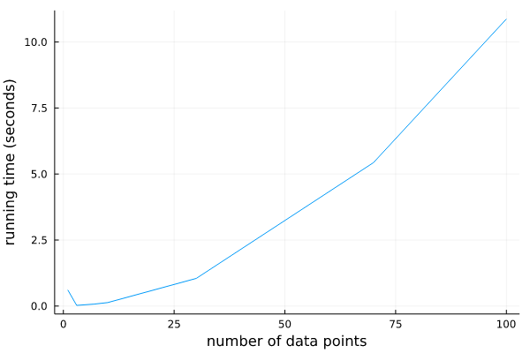
Running Time Versus the Number of Data Points:

Slide 52
Map Combinator
@gen function generate_single_point(x::Float64, prob_outlier::Float64, noise::Float64,
slope::Float64, intercept::Float64)
is_outlier ~ bernoulli(prob_outlier)
mu = is_outlier ? 0. : x * slope + intercept
std = is_outlier ? 10. : noise
y ~ normal(mu, std)
return y
end;
generate_all_points = Map(generate_single_point);
@gen function model_with_map(xs::Vector{Float64})
slope ~ normal(0, 2)
intercept ~ normal(0, 2)
noise ~ gamma(1, 1)
prob_outlier ~ uniform(0, 1)
n = length(xs)
data ~ generate_all_points(xs, fill(prob_outlier, n), fill(noise, n), fill(slope, n), fill(intercept, n))
return data
end;

Slide 53
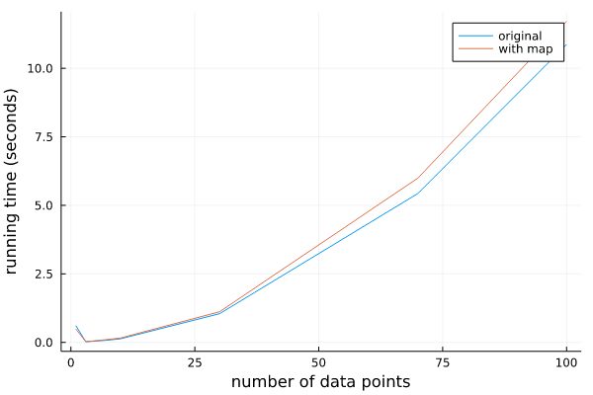
Running Time Versus the Number of Data Points:

Slide 54
Combining the map combinator with the static modeling language
@gen function generate_single_point(x::Float64, prob_outlier::Float64, noise::Float64,
slope::Float64, intercept::Float64)
is_outlier ~ bernoulli(prob_outlier)
mu = is_outlier ? 0. : x * slope + intercept
std = is_outlier ? 10. : noise
y ~ normal(mu, std)
return y
end;
generate_all_points = Map(generate_single_point);
@gen (static) function static_model_with_map(xs::Vector{Float64})
slope ~ normal(0, 2)
intercept ~ normal(0, 2)
noise ~ gamma(1, 1)
prob_outlier ~ uniform(0, 1)
n = length(xs)
data ~ generate_all_points(xs, fill(prob_outlier, n), fill(noise, n), fill(slope, n), fill(intercept, n))
return data
end;
Gen.@load_generated_functions

Slide 55
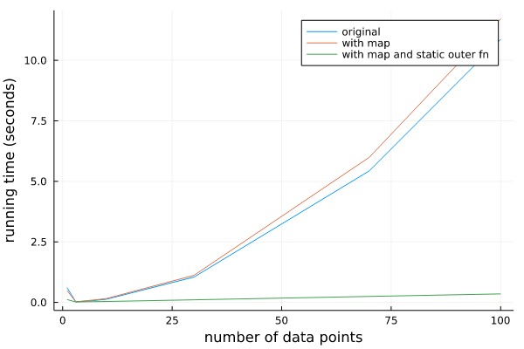
Running Time Versus the Number of Data Points:

Slide 56
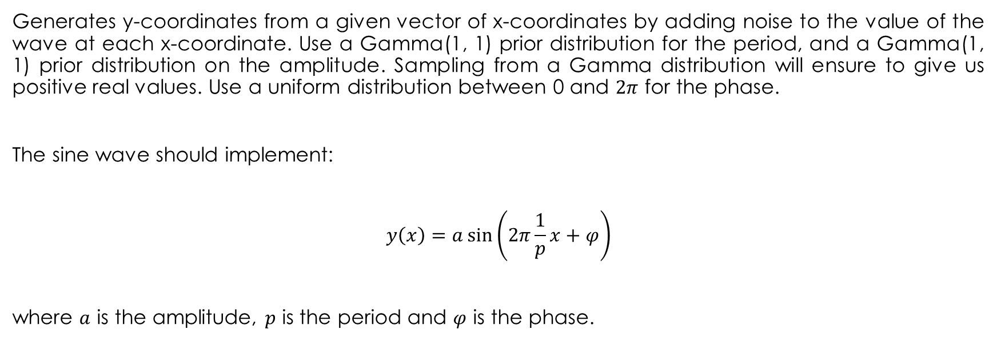
A sine wave with random phase, period and amplitude
Generates y-coordinates from a given vector of x-coordinates by adding noise to the value of the wave at each x-coordinate. Use a Gamma(1, 1) prior distribution for the period, and a Gamma(1, 1) prior distribution on the amplitude. Sampling from a Gamma distribution will ensure to give us positive real values. Use a uniform distribution between 0 and $2π$ for the phase.
The sine wave should implement:
$$y\left(x\right)=a\sin\left(2π\frac{1}{p}x+φ\right)$$
where $a$ is the amplitude, $p$ is the period and $φ$ is the phase.

Slide 57
A model that generates a sine wave with random phase, period and amplitude
@gen function sine_model_fancy(xs::Vector{Float64})
# < your code here >
for (i, x) in enumerate(xs)
{(:y, i)} ~ normal(0., 0.1)
# < edit this line >
end
return nothing
end;
amplitude = ({:amplitude} ~ gamma(1, 1))
period = ({:period} ~ gamma(1, 1))
phase = ({:phase} ~ uniform(0, 2*pi))
function y(x)
return amplitude * sin(2*pi*(1/period)*x + phase)
end
noise = ({:noise} ~ gamma(1, 1))
{(:y, i)} ~ normal(amplitude * sin(2*pi*(1/period)*x + phase),noise)

Slide 58
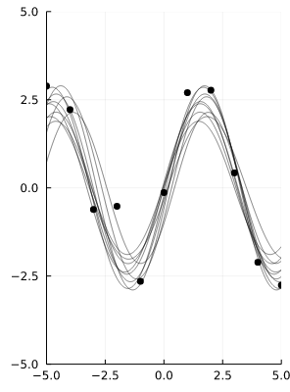
A Sample of Regression Waves (n = 10)

Slide 59
Model Selection
we will write a probabilistic model that combines the line model and the sine model. This model is able to explain data using either model, and which model is chosen will depend on the data. This is called model selection.

Slide 60
A generative function that combines the line and sine models
@gen function combined_model(xs::Vector{Float64})
if ({:is_line} ~ bernoulli(0.5))
# Call line_model_fancy on xs, and import
# its random choices directly into our trace.
return ({*} ~ line_model_fancy(xs))
else
# Call sine_model_fancy on xs, and import
# its random choices directly into our trace
return ({*} ~ sine_model_fancy(xs))
end
end;

Slide 61
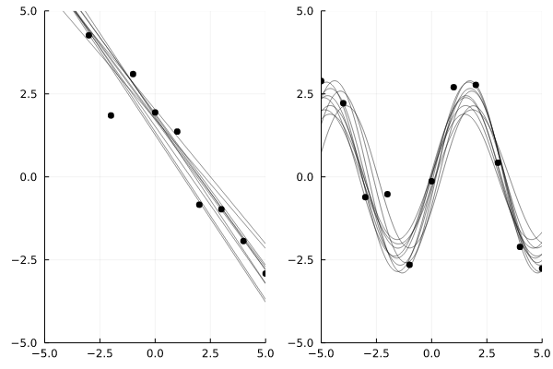
Inference using this combined model on the ys data set and the ys_sine data set
traces = [do_inference(combined_model, xs, ys, 10000) for _=1:10];
linear_dataset_plot = overlay(render_trace, traces)
traces = [do_inference(combined_model, xs, ys_sine, 10000) for _=1:10];
sine_dataset_plot = overlay(render_trace, traces)
Plots.plot(linear_dataset_plot, sine_dataset_plot)

Slide 62
Bayesian Nonparametric Models
Gen’s built-in modeling language can be used to express models that use an unbounded number of parameters, models of data that does not a-priori specify an upper bound on the complexity of the model, but instead infers the complexity of the model as well as the parameters. This is a simple example of a Bayesian nonparametric model.

Slide 63
Two Data sets:
xs_dense = collect(range(-5, stop=5, length=50))
ys_simple = fill(1., length(xs_dense)) .+ randn(length(xs_dense)) * 0.1
ys_complex = [Int(floor(abs(x/3))) % 2 == 0 ? 2 : 0 for x in xs_dense] .+ randn(length(xs_dense)) * 0.1;
simple_plot = scatter(xs_dense, ys_simple, color="black", label=nothing, title="ys-simple", ylim=(-1, 3))
complex_plot = scatter(xs_dense, ys_complex, color="black", label=nothing, title="ys-complex", ylim=(-1, 3))
Plots.plot(simple_plot, complex_plot)

Slide 64
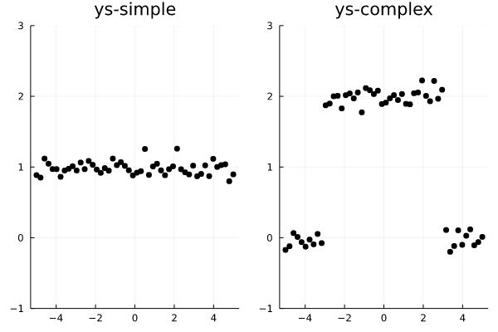
Two Data sets:
The data set on the left appears to be best explained as a constant function with some noise.
The data set on the right appears to include two changepoints, with a constant function in between the changepoints.

Slide 65
The Model
We want a model that does not a-priori choose the number of changepoints in the data.
To do this, we will recursively partition the interval into regions.
We define a Julia data structure that represents a binary tree of intervals; each leaf node represents a region in which the function is constant.
struct Interval
l::Float64
u::Float64
End
abstract type Node end
struct InternalNode <: Node
left::Node
right::Node
interval::Interval
end
struct LeafNode <: Node
value::Float64
interval::Interval
end

Slide 66
The Model
We now write a generative function that randomly creates such a tree. Note the use of recursion in this function to create arbitrarily large trees representing arbitrarily many changepoints. Also note that we assign the address namespaces :left and :right to the calls made for the two recursive calls to generate_segments.
@gen function generate_segments(l::Float64, u::Float64)
interval = Interval(l, u)
if ({:isleaf} ~ bernoulli(0.7))
value = ({:value} ~ normal(0, 1))
return LeafNode(value, interval)
else
frac = ({:frac} ~ beta(2, 2))
mid = l + (u - l) * frac
# Call generate_segments recursively!
# Because we will call it twice -- one for the left
# child and one for the right child -- we use
# addresses to distinguish the calls.
left = ({:left} ~ generate_segments(l, mid))
right = ({:right} ~ generate_segments(mid, u))
return InternalNode(left, right, interval)
end
end;

Slide 67
The Model
Now that we have a generative function that generates a random piecewise-constant function, we write a model that adds noise to the resulting constant functions to generate a data set of y-coordinates. The noise level will be a random choice.
@gen function changepoint_model(xs::Vector{Float64})
node = ({:tree} ~ generate_segments(minimum(xs), maximum(xs)))
noise = ({:noise} ~ gamma(0.5, 0.5))
for (i, x) in enumerate(xs)
{(:y, i)} ~ normal(get_value_at(x, node), noise)
end
return node
end;

Slide 68
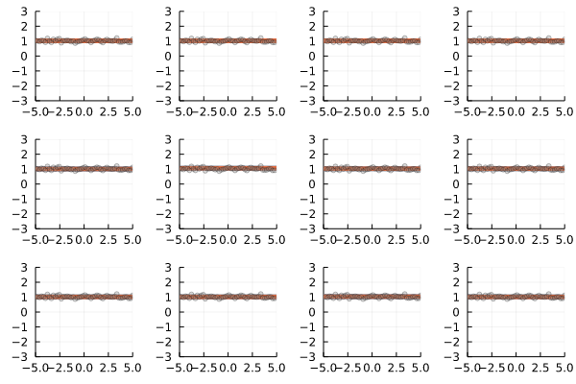
Inference for the simple data set:
traces = [do_inference(changepoint_model, xs_dense, ys_simple, 10000) for _=1:12];
grid(render_changepoint_model_trace, traces)

Slide 69
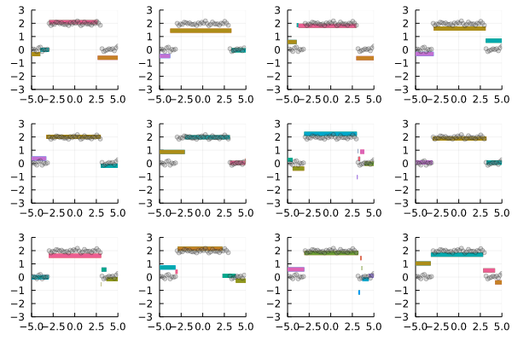
Inference for the complex data set:
traces = [do_inference(changepoint_model, xs_dense, ys_complex, 100000) for _=1:12];
grid(render_changepoint_model_trace, traces)

