Slide 1
Liviu Bălan
Workshop PHP

Slide 2


Slide 3
Time management
4 hours/day
50 minutes session + 10 minutes break
3 days
Theory and practice
You can come up with ideas

Slide 4
Some languages
Pascal, Delphi
C/C++, Java, Prolog
PHP, JavaScript, Bash
R, Python, Julia
Libraries and frameworks

Slide 5
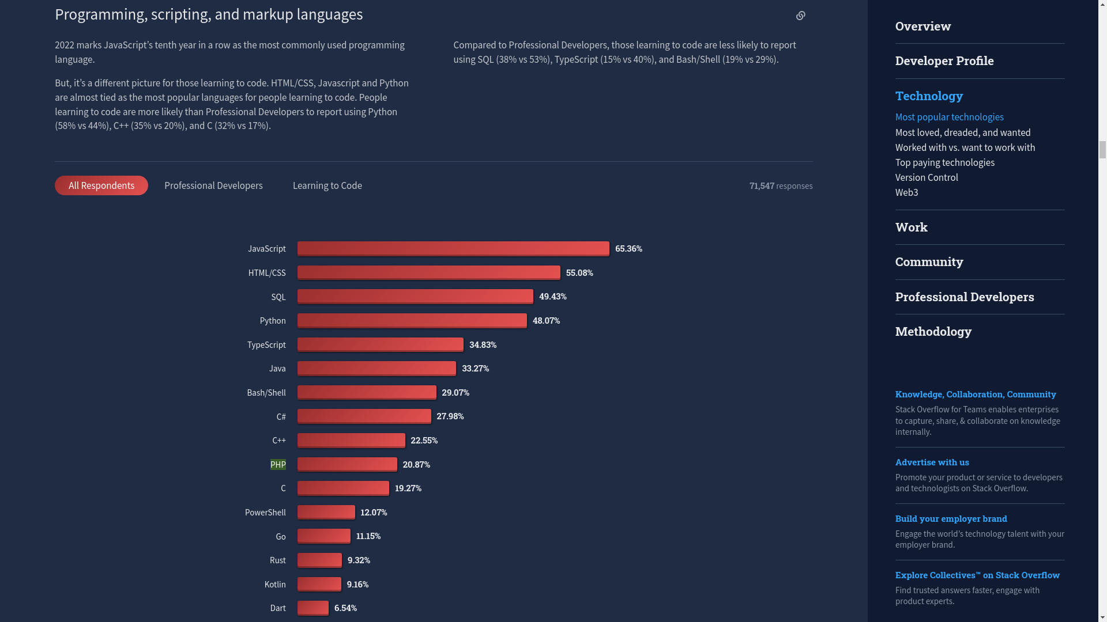

Slide 6
What is PHP?
PHP is a general-purpose scripting language
Geared toward web development
First appeared June 8, 1995 (27 years ago)
Implementation language: C
Designed by: Rasmus Lerdorf

Slide 7
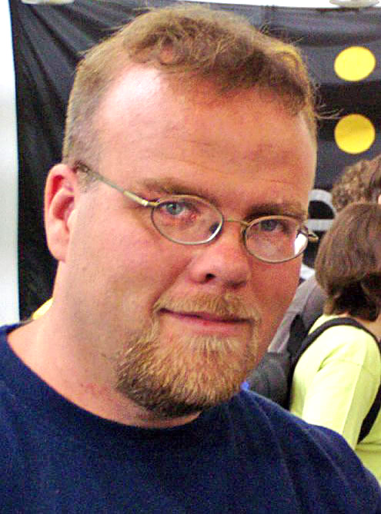
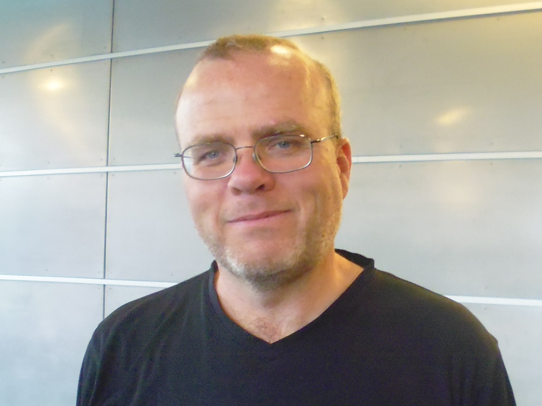
Rasmus Lerdorf

Slide 8
Market share
The most used server-side scripting language
More than 77% market share overall

Slide 9
PHP
Originally an abbreviation of Personal Home Page
Now stands for the recursive PHP: Hypertext Preprocessor
Usually processed on a web server (NGINX, Apache) by a PHP interpreter

Slide 10
What Can PHP Do?
Generate dynamic page content
Create, open, read, write, delete, and close files on the server
Collect form data
Send and receive cookies
Add, delete, modify data in your database
Be used to control user-access
Encrypt data

Slide 11
Machine
Solution stack (WAMP, XAMPP)
VM (Vagrant, Docker)
OpenStack (core.emag.network)
Web hosting (infinityfree.net – account, up to 72 hours for DNS changes to apply)

Slide 12
Why PHP?
Runs on various platforms (Windows, Linux, Unix, Mac OS X, etc.)
Is compatible with almost all servers used today (Apache, IIS, etc.)
Supports a wide range of databases
Is free. Download it from the official resource: www.php.net
Is easy to learn and runs efficiently on the server side

Slide 13
Good to know
HTML
CSS
JavaScript

Slide 14
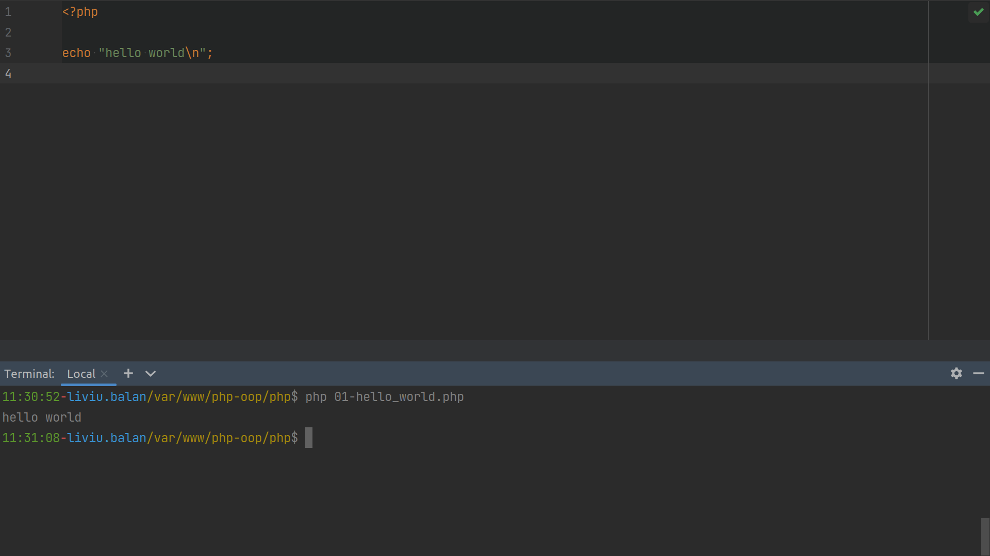
PHP: CLI

Slide 15
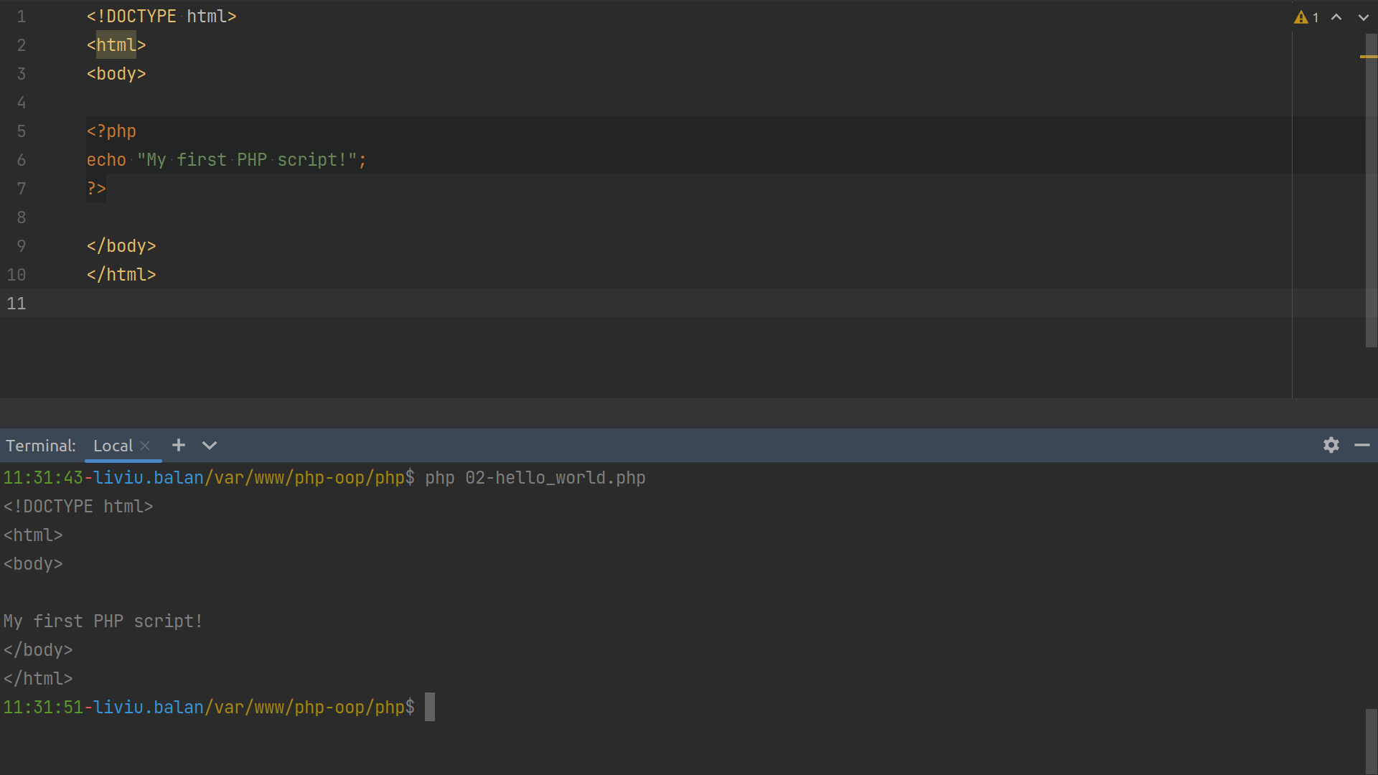

Slide 16
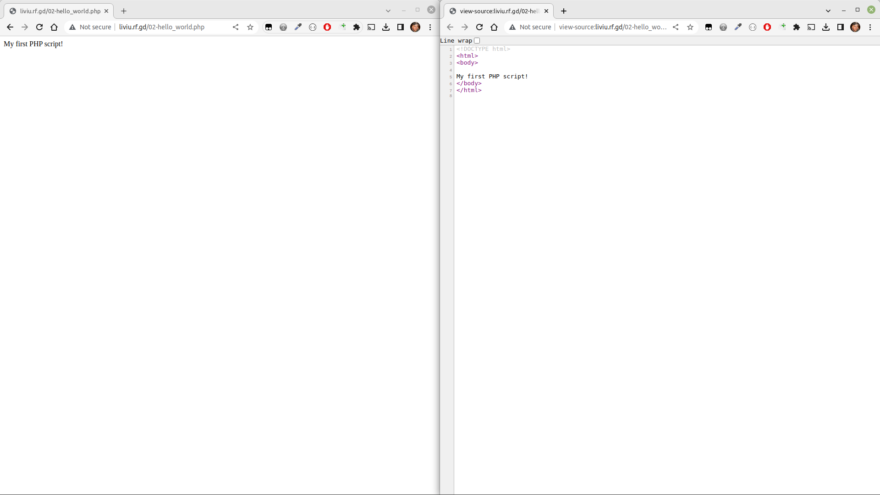

Slide 17
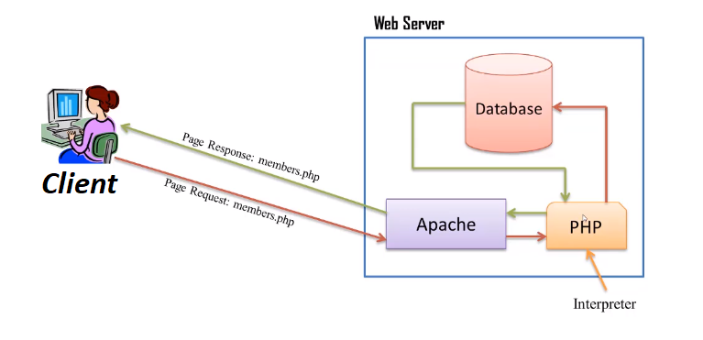
Client Server

Slide 18
Variables
Variables are containers for storing information
Start with the $ sign, followed by the name/identifier
Created when you first assign a value to it

Slide 19
Identifiers
must start with a letter or the underscore character
cannot start with a number
can only contain alpha-numeric characters and underscores (A-z, 0-9, and _ )
case-sensitive ($age and $AGE are two different variables)

Slide 20
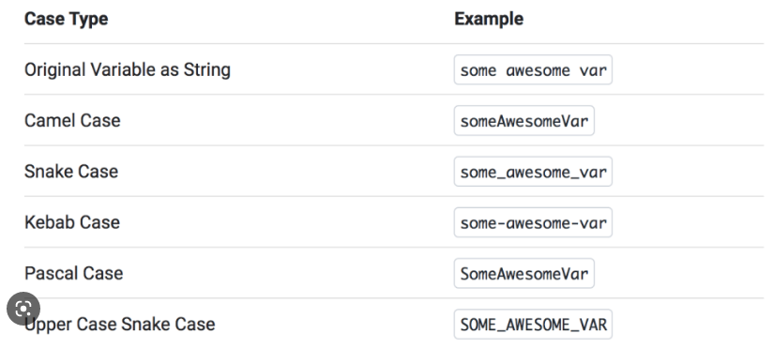
Naming conventions

Slide 21
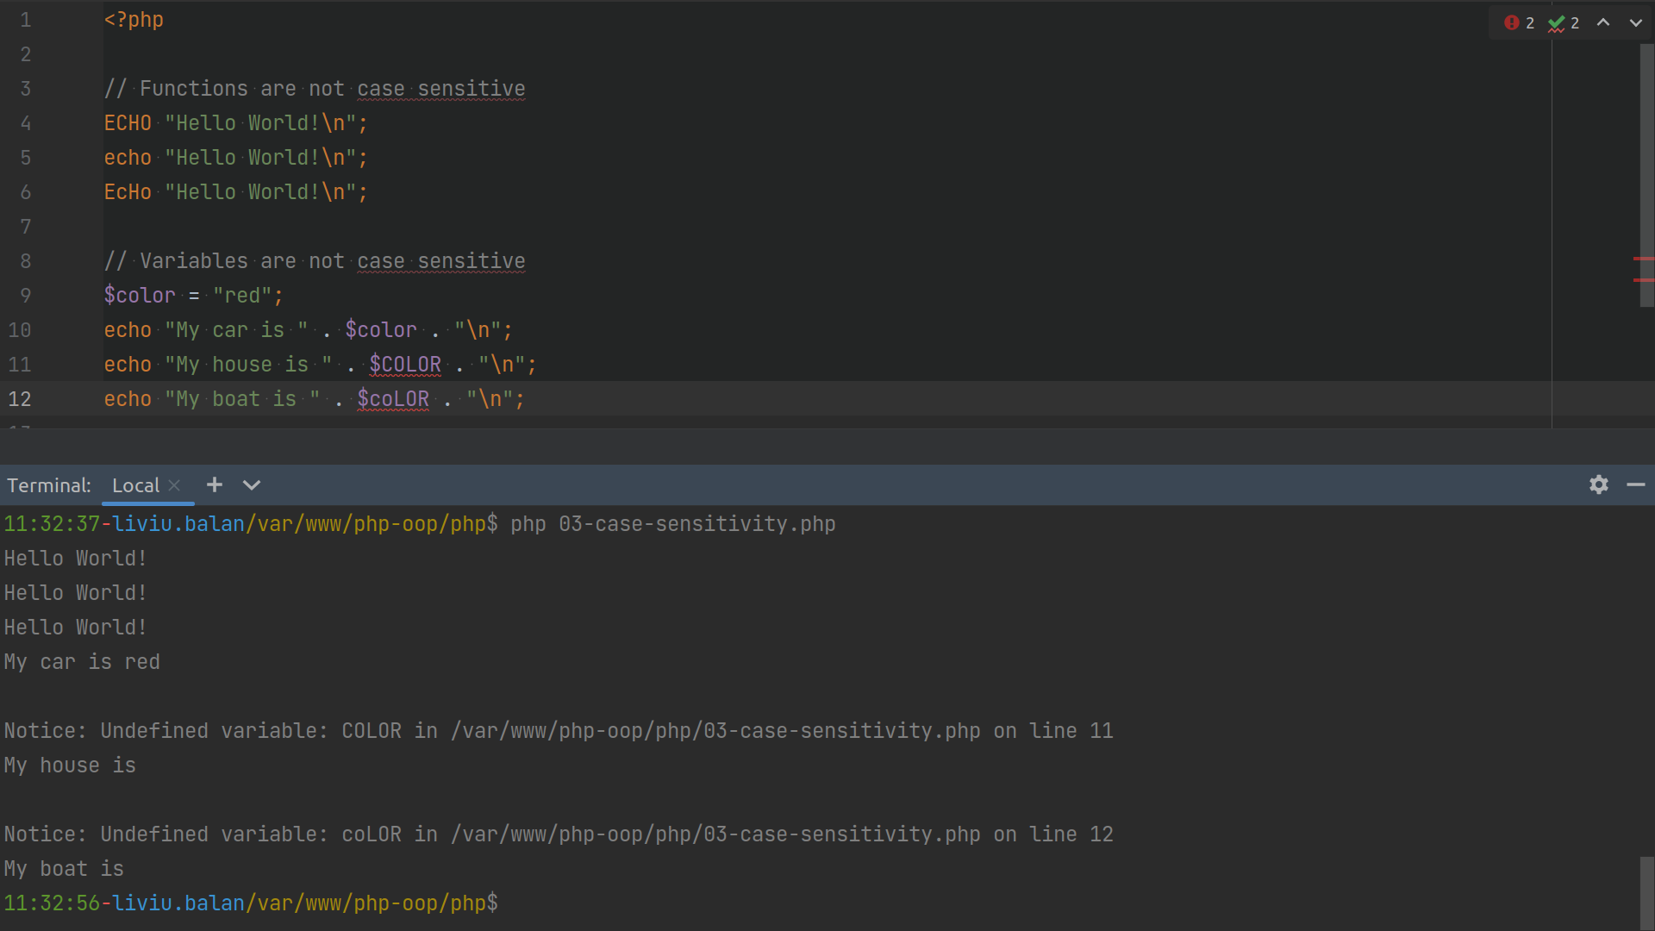

Slide 22
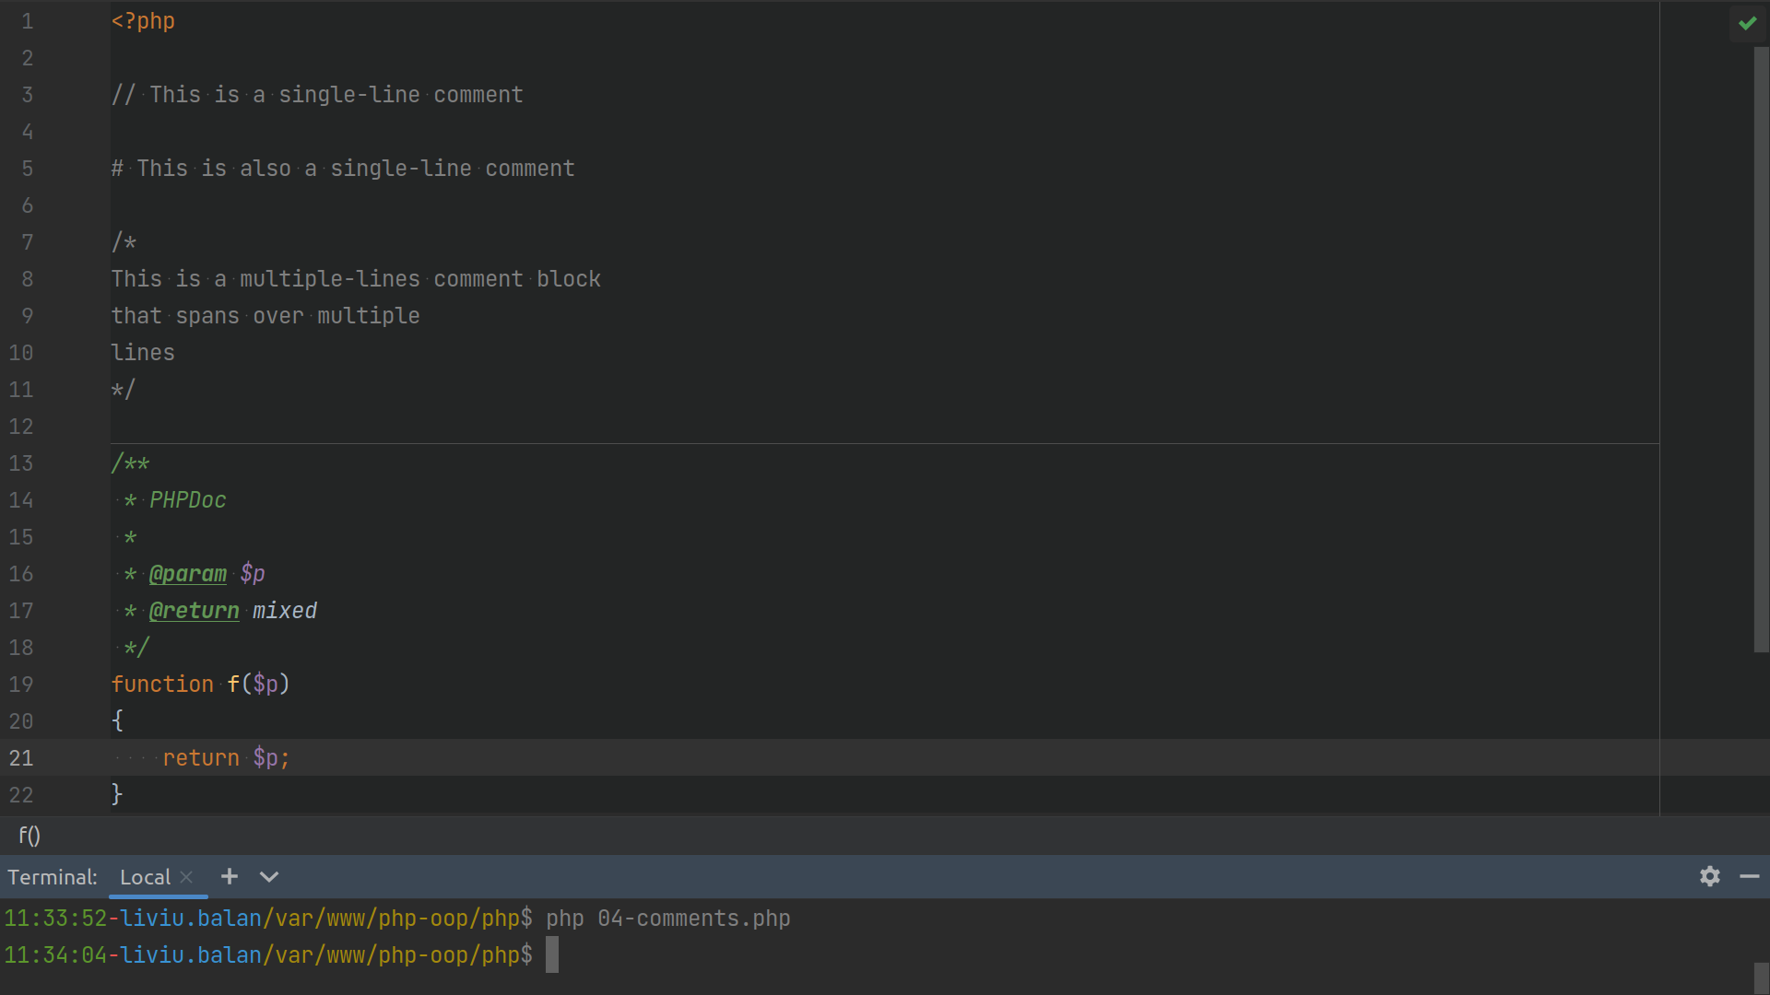

Slide 23
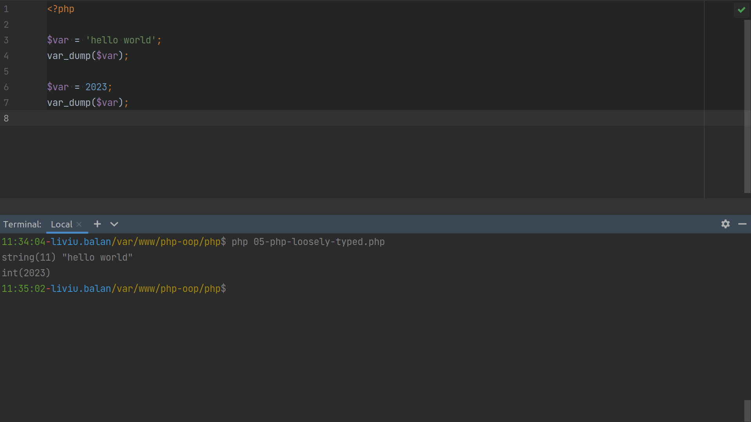

Slide 24
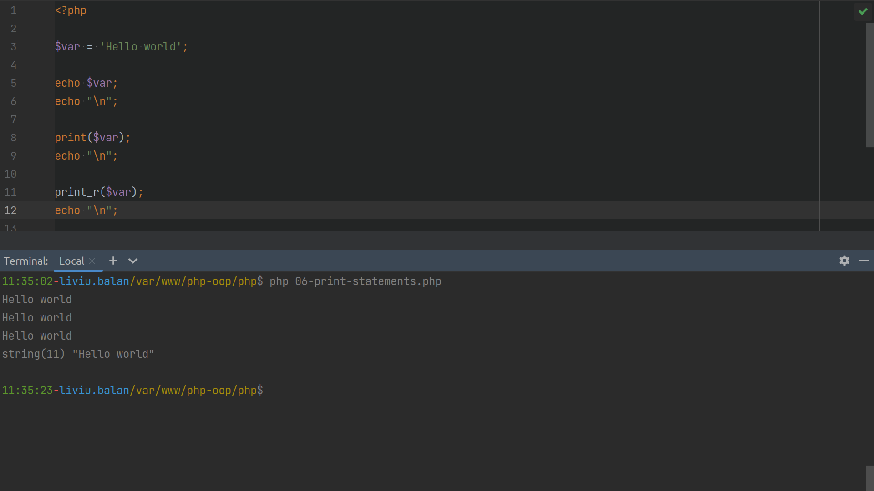

Slide 25
Data Types
String
Integer
Float (floating point numbers - also called double)
Boolean
Array
Object
NULL
Resource

Slide 26
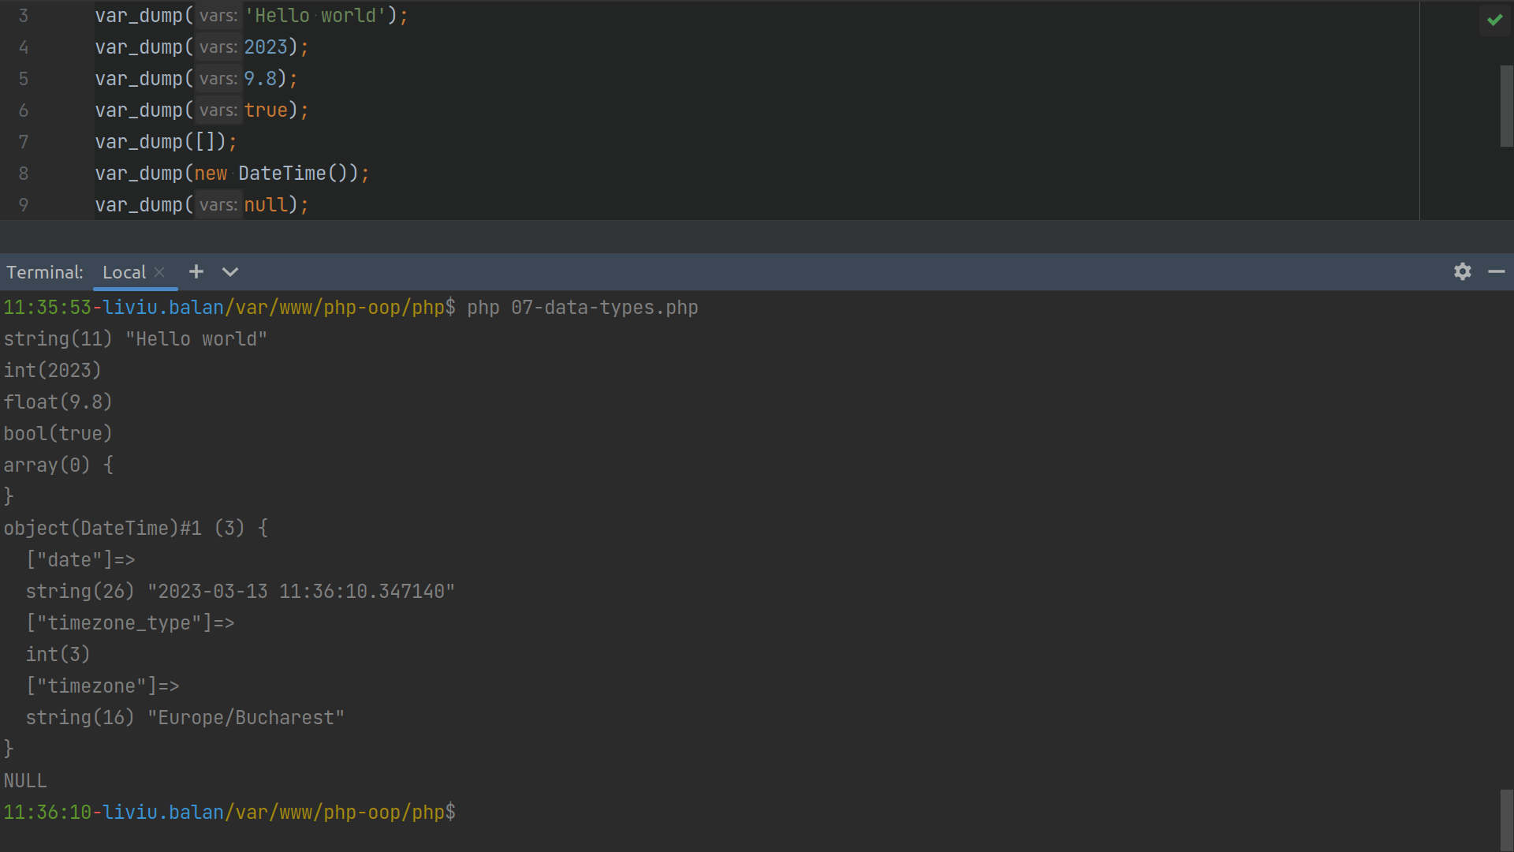

Slide 27
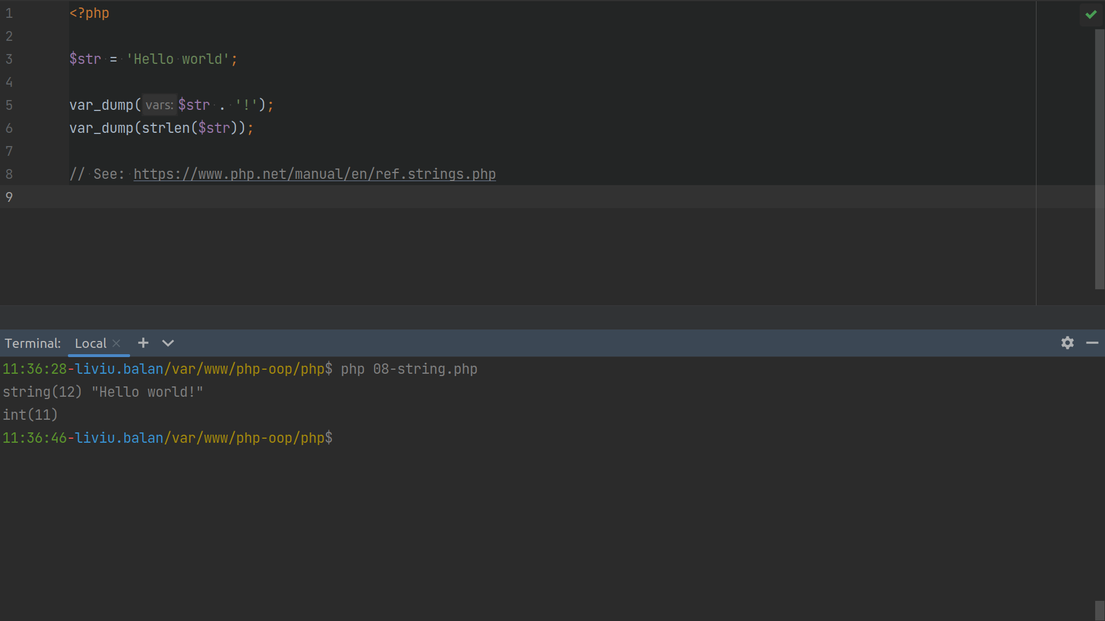

Slide 28
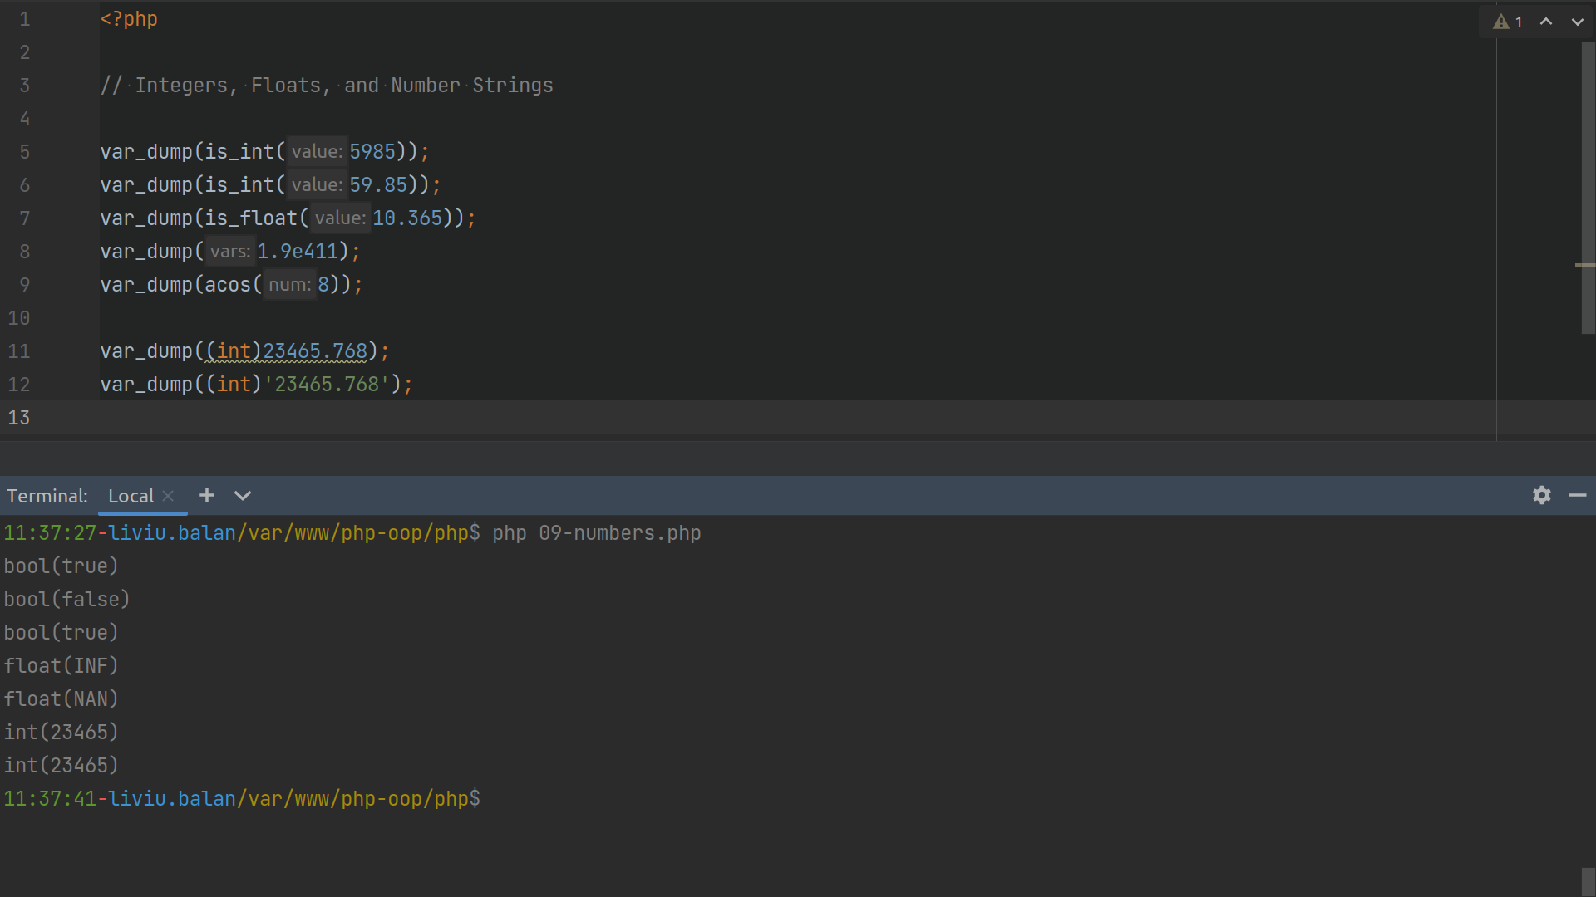

Slide 29
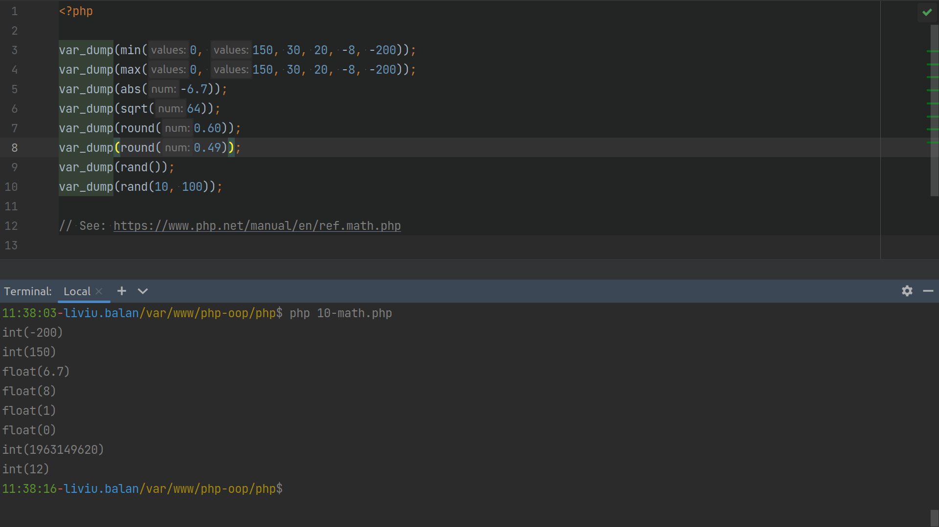

Slide 30
Constants
Constants are like variables except that once they are defined they cannot be changed or undefined
Unlike variables, constants are automatically global across the entire script

Slide 31
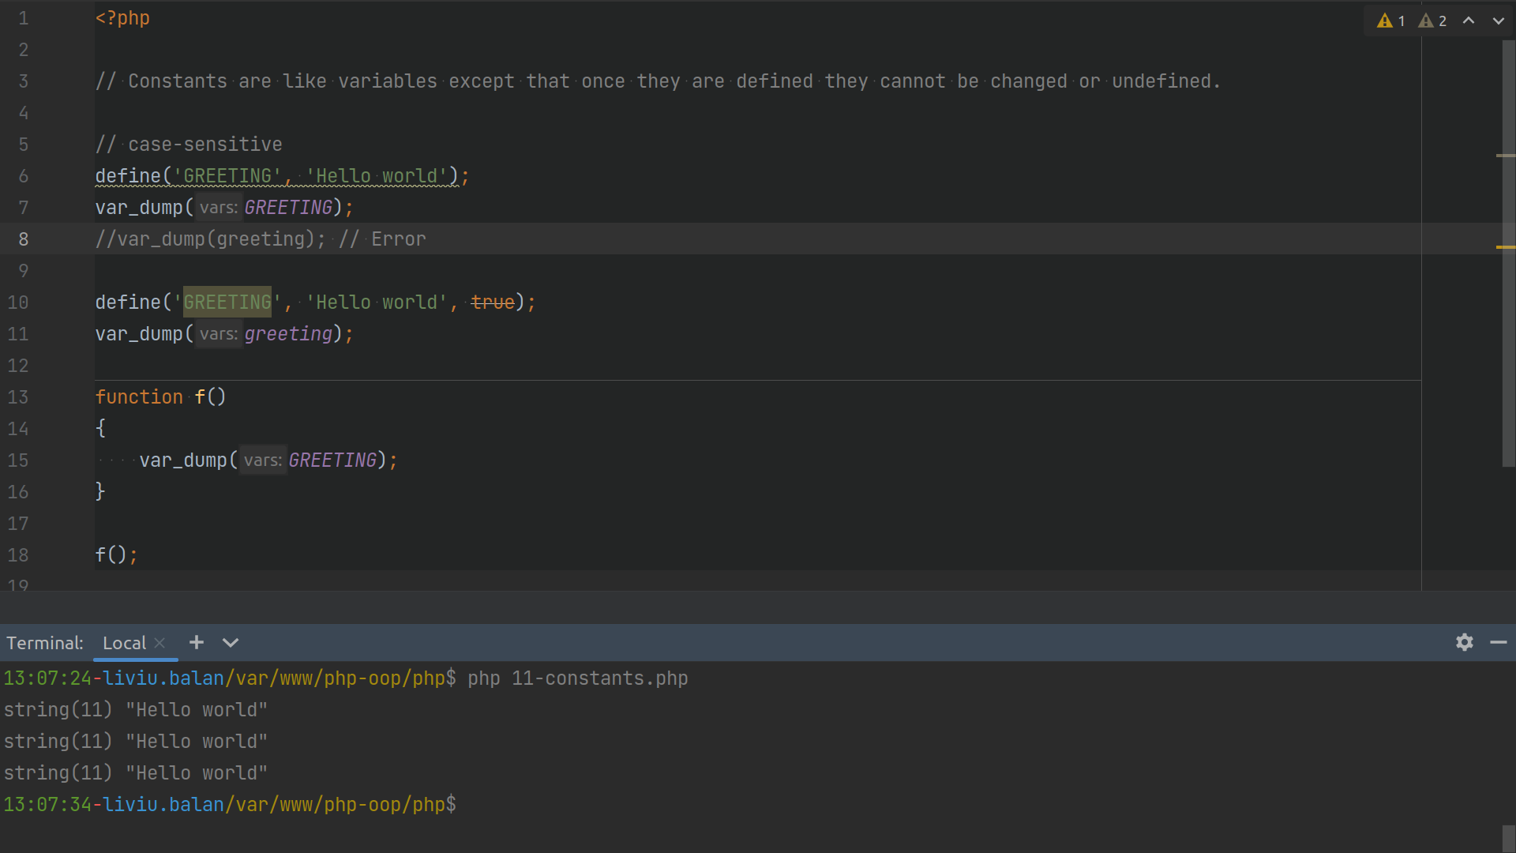

Slide 32
Operators
Arithmetic operators
Assignment operators
Comparison operators
Increment/Decrement operators
Logical operators
String operators
Array operators
Conditional assignment operators

Slide 33
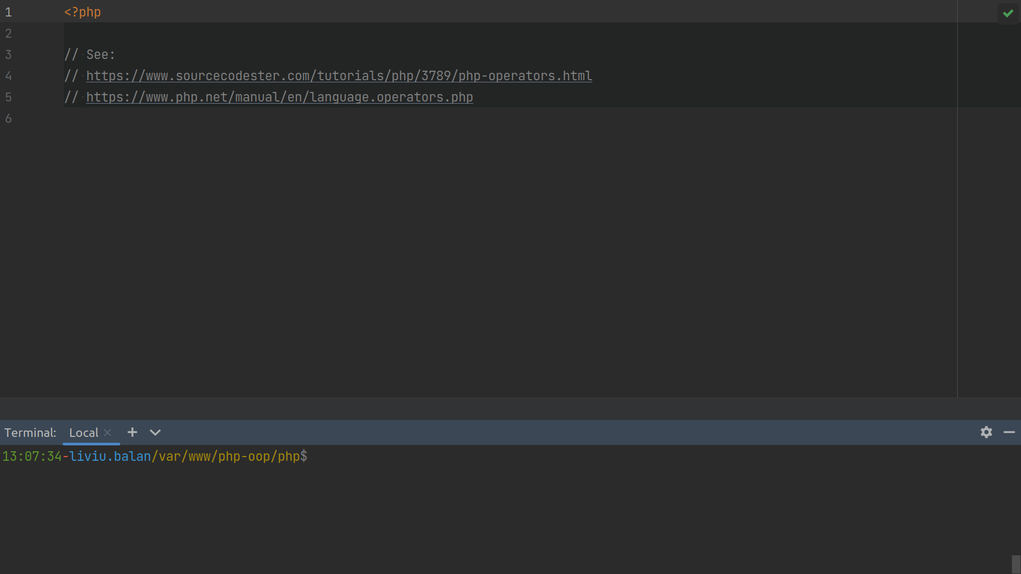

Slide 34
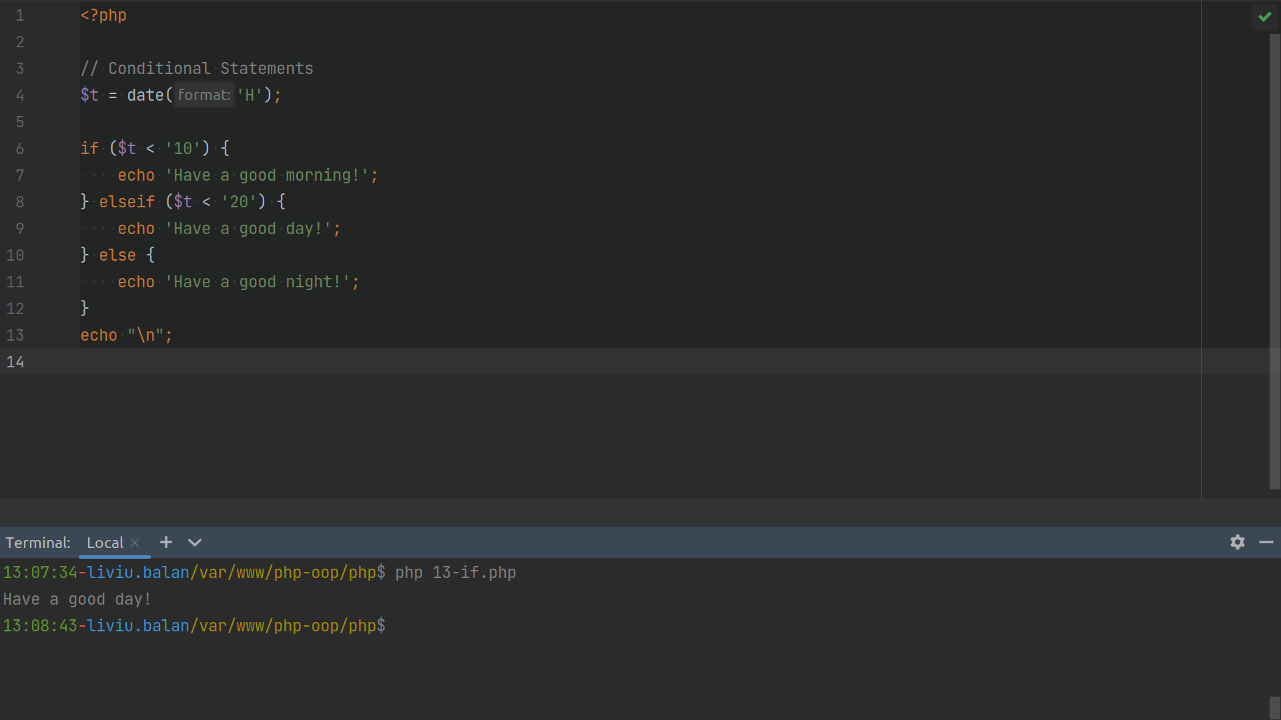

Slide 35
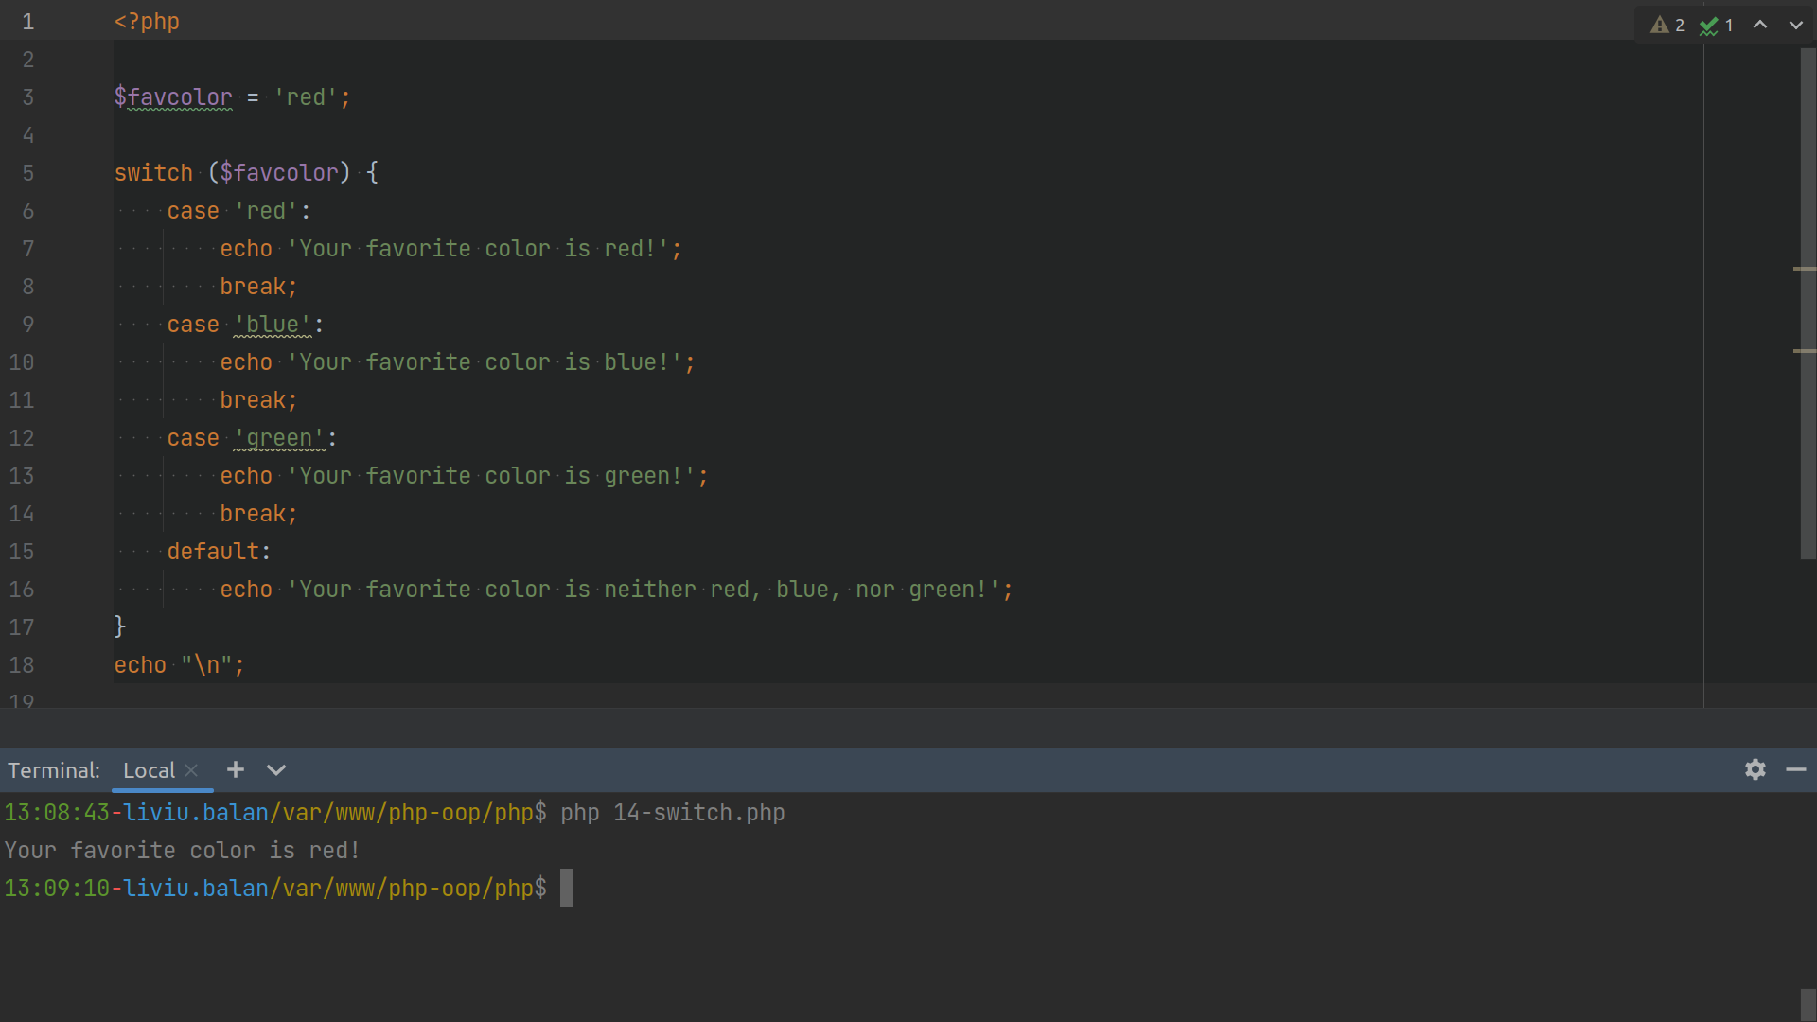

Slide 36
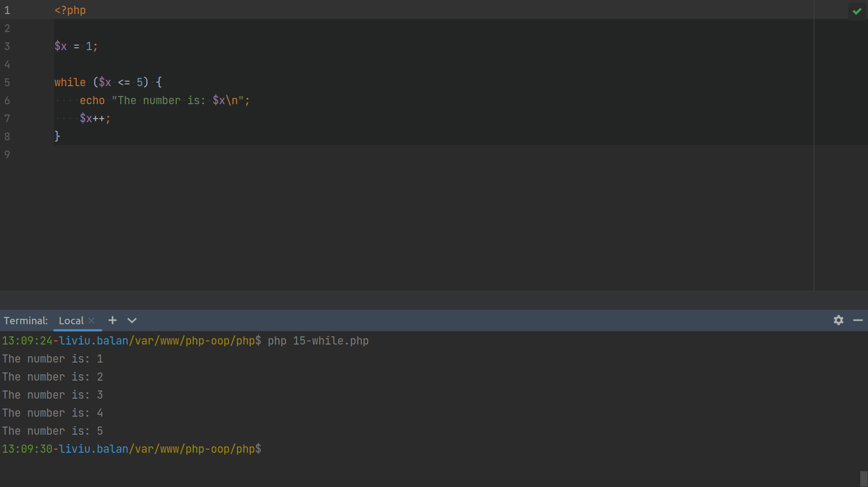

Slide 37
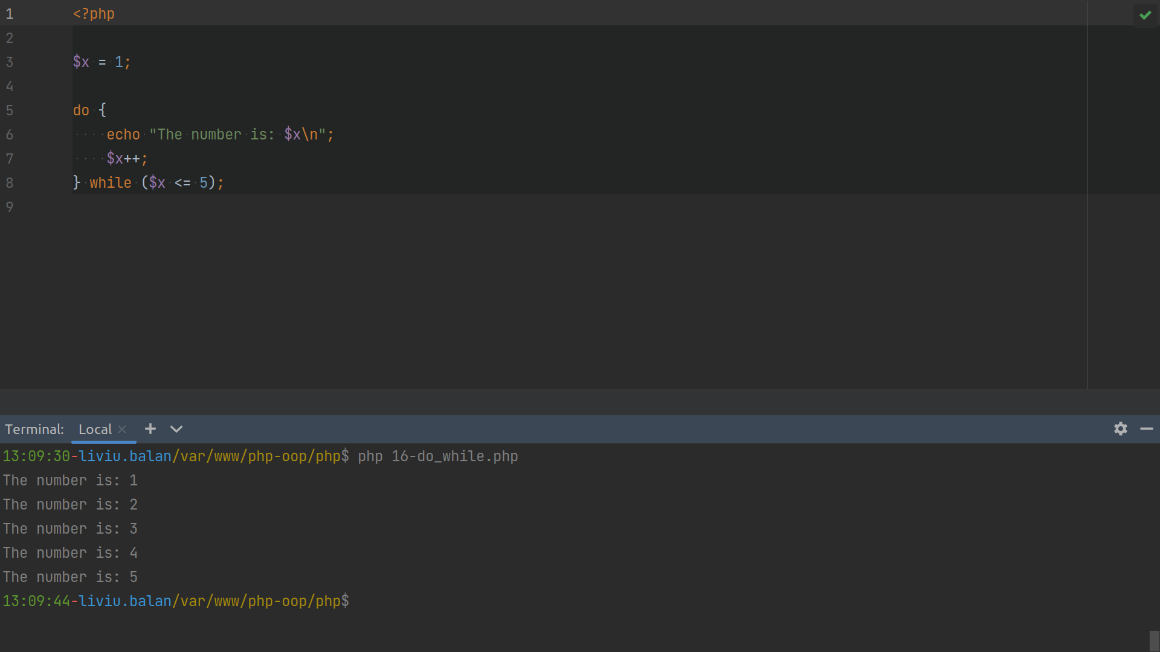

Slide 38
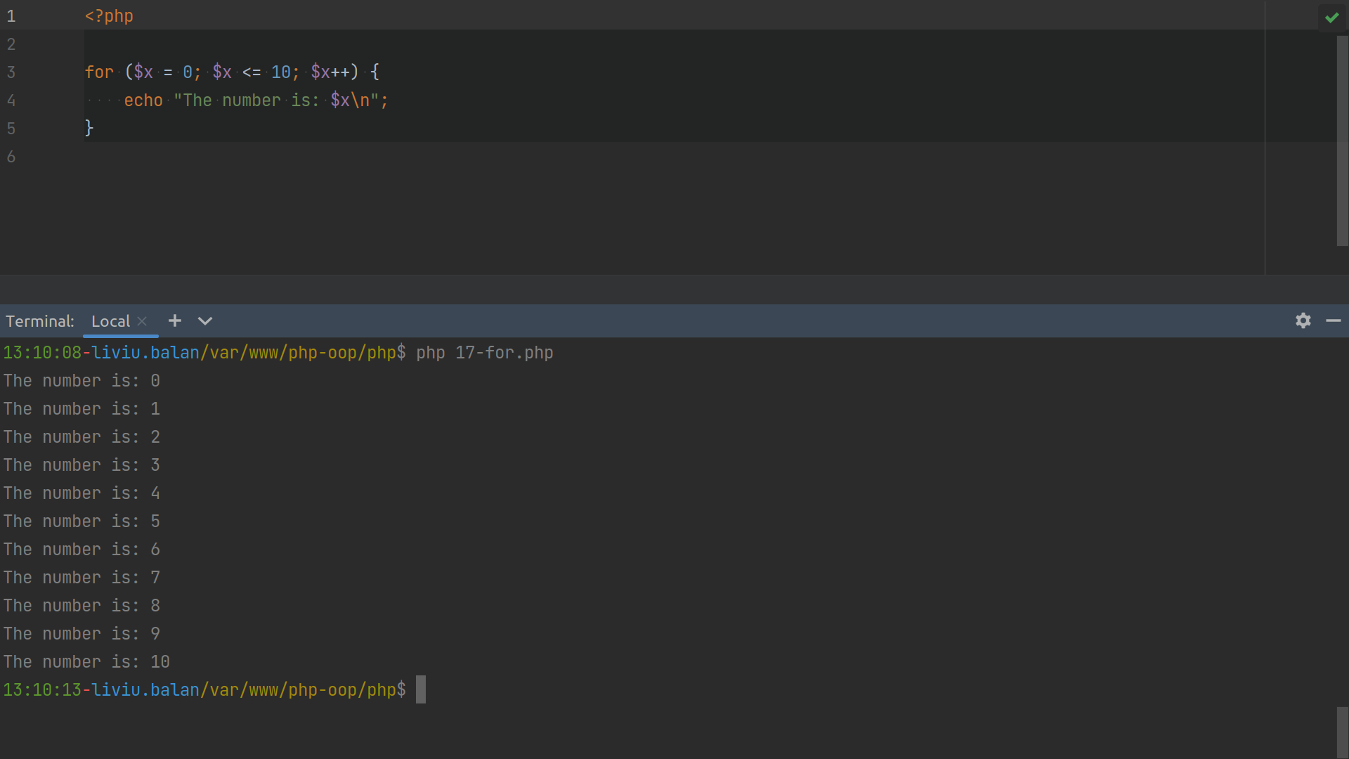

Slide 39
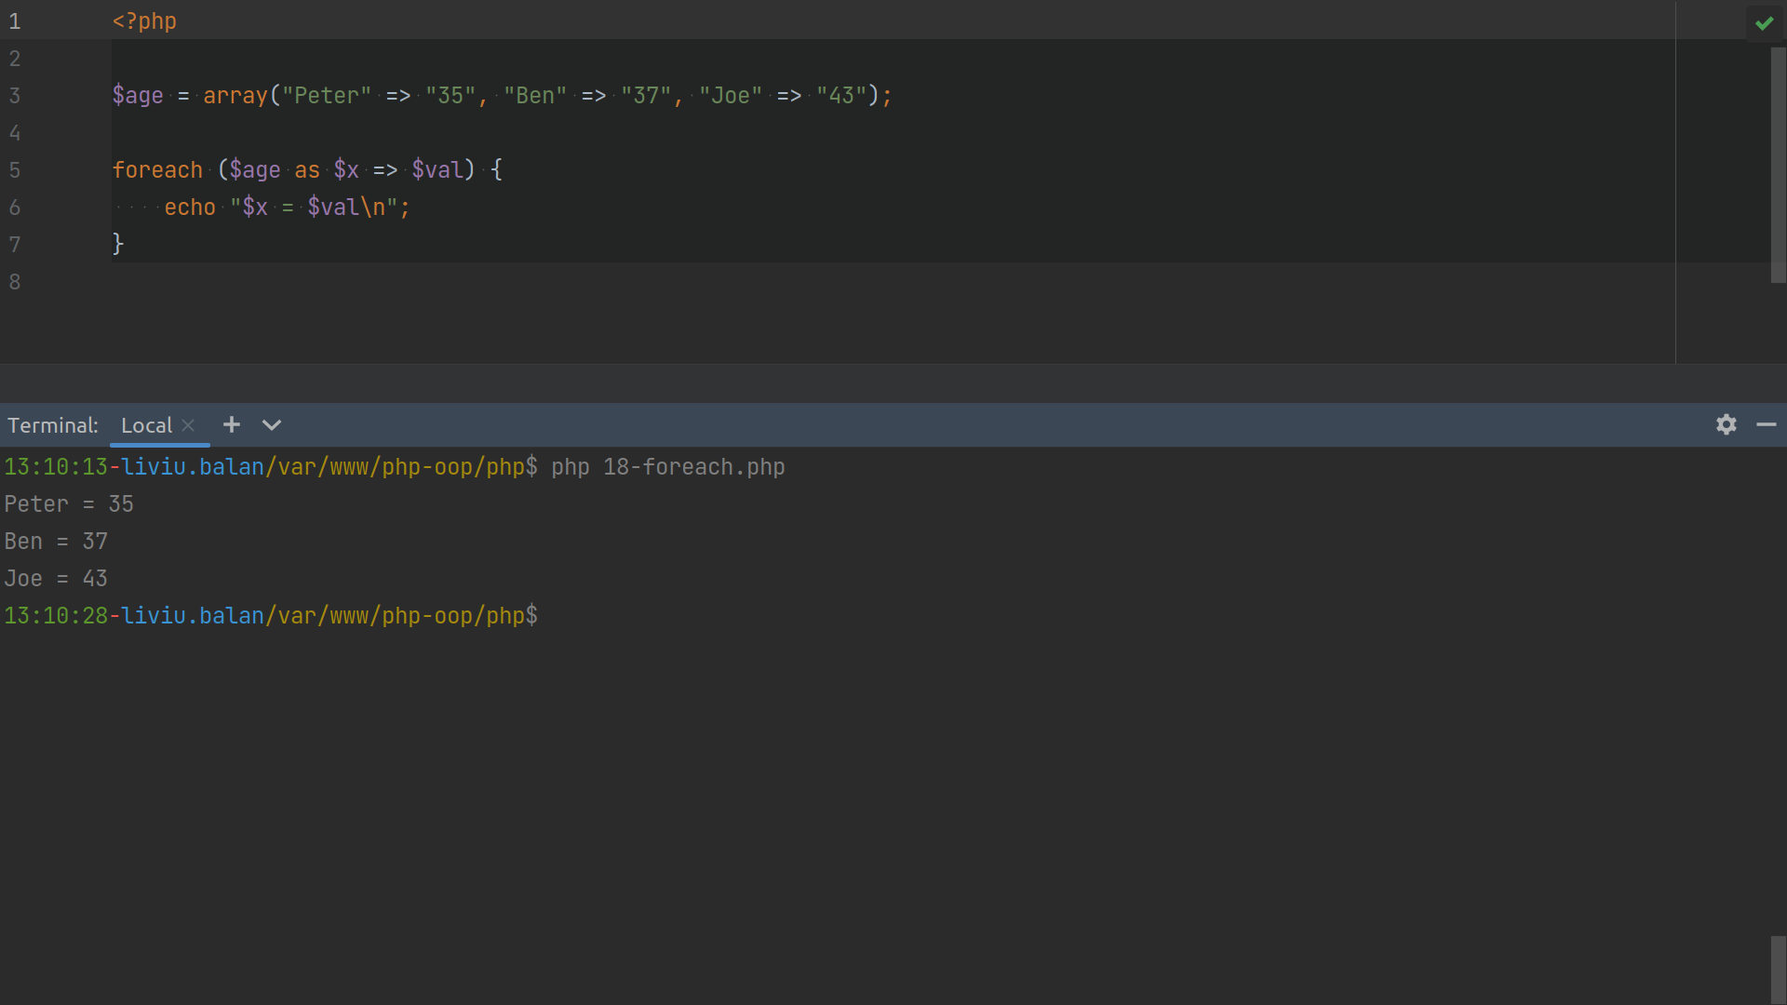

Slide 40
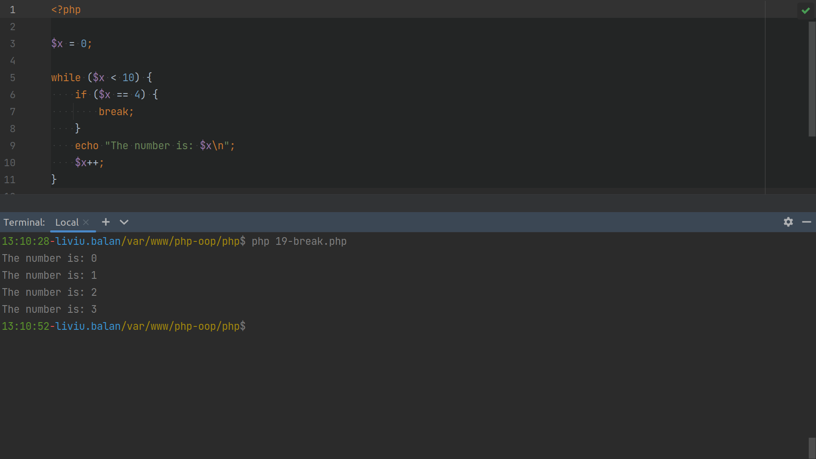

Slide 41
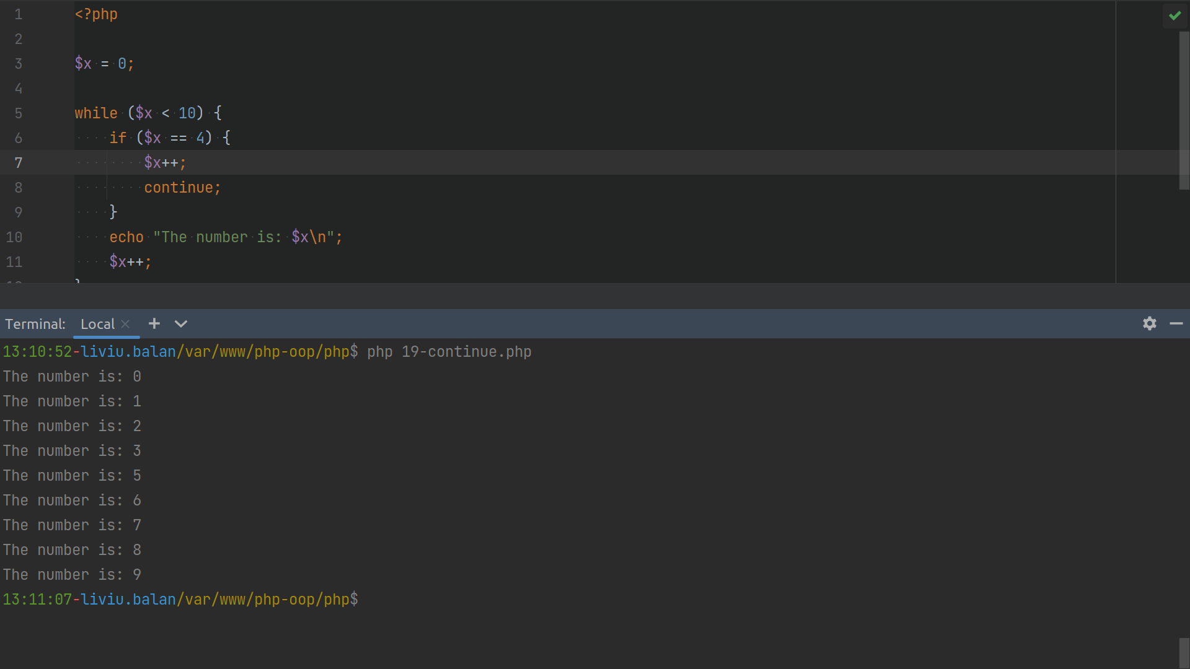

Slide 42
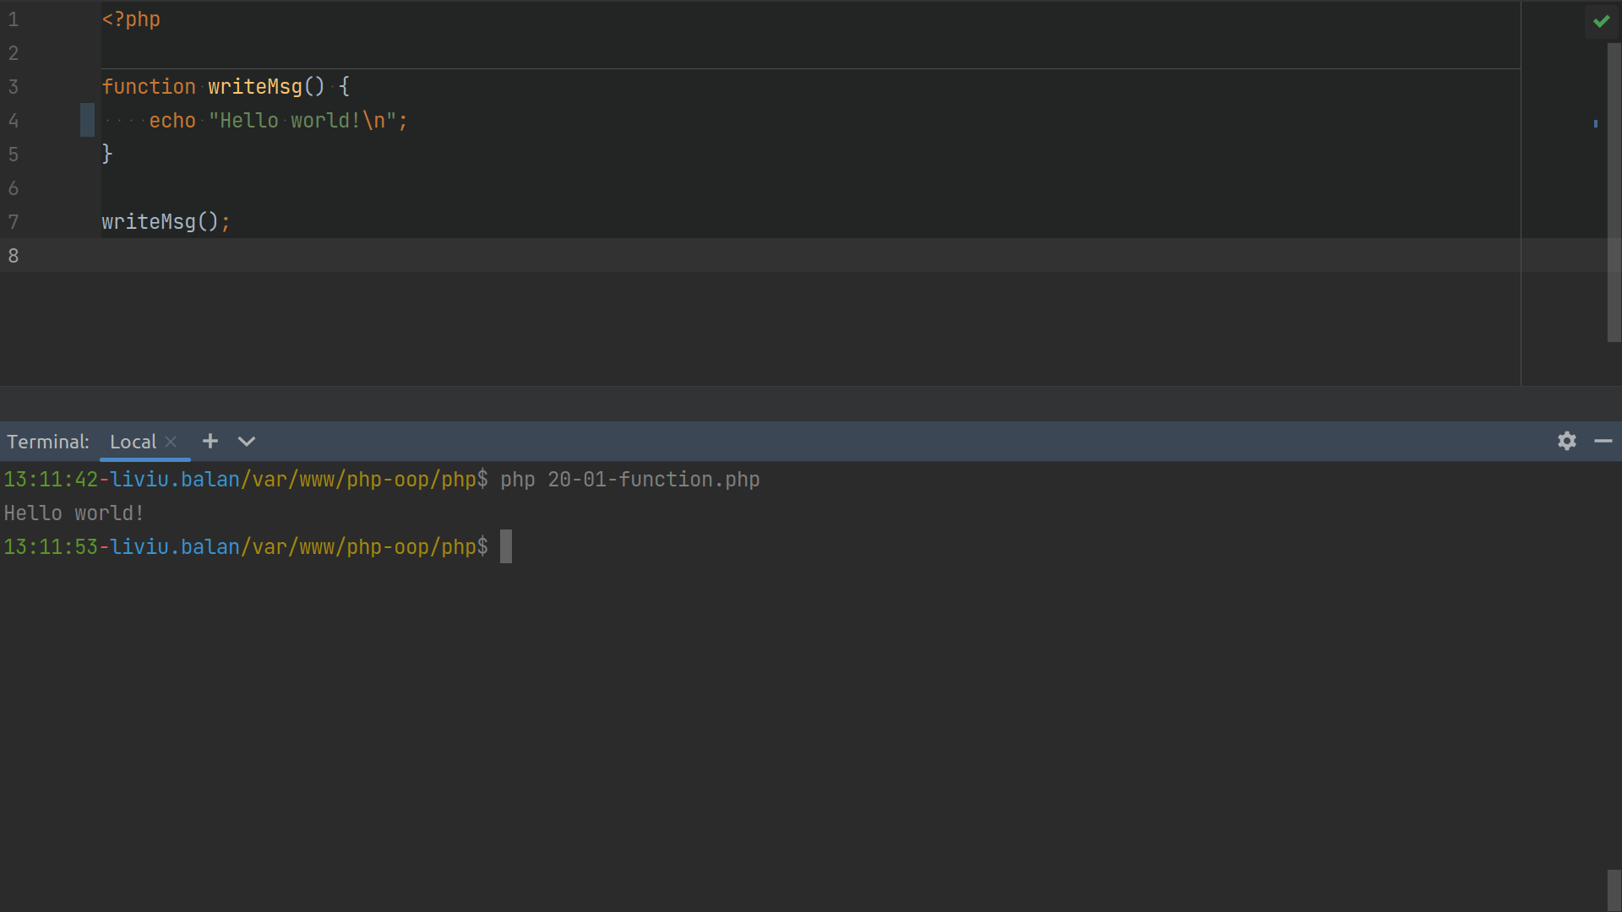

Slide 43
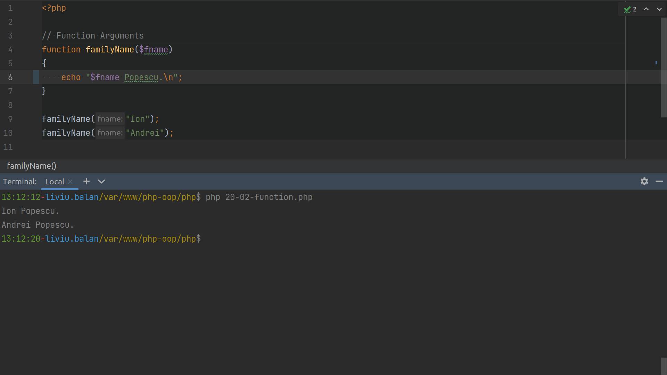

Slide 44
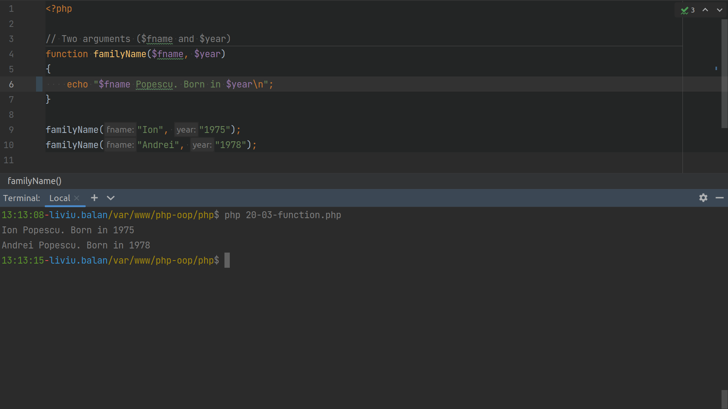

Slide 45
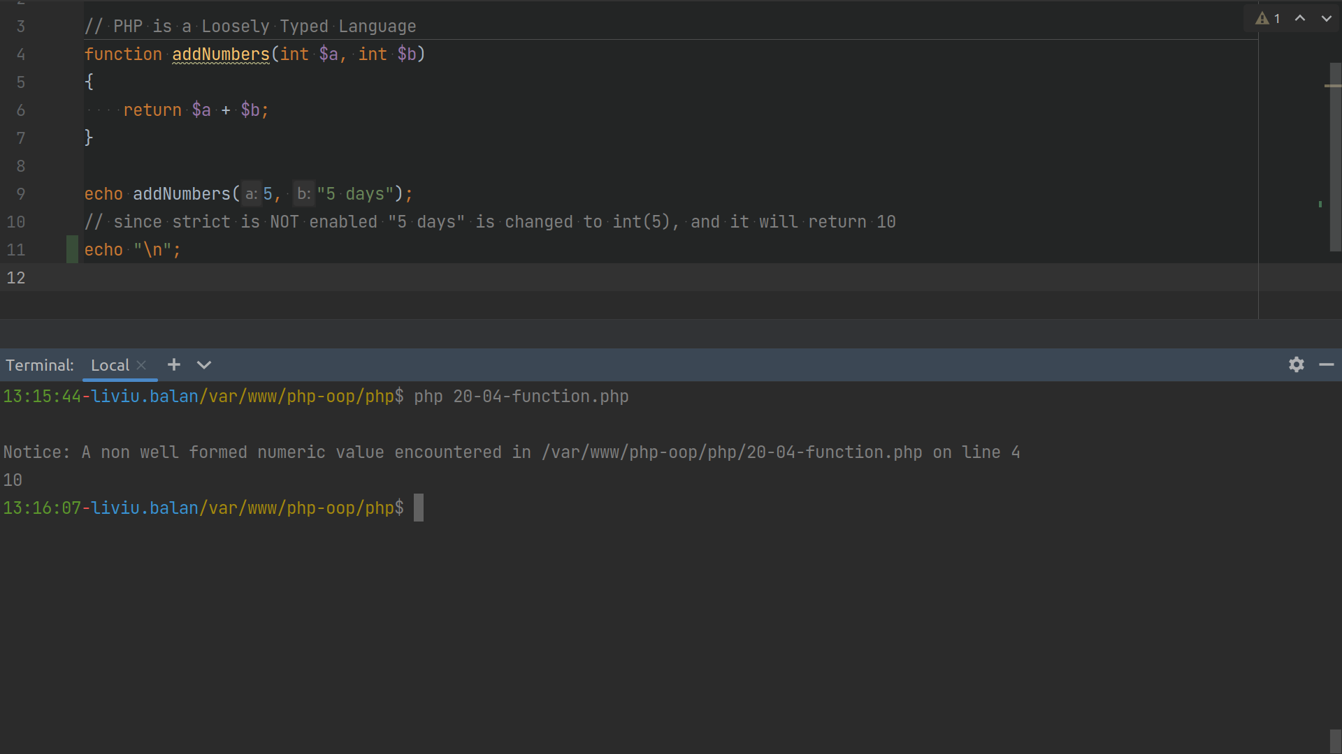

Slide 46
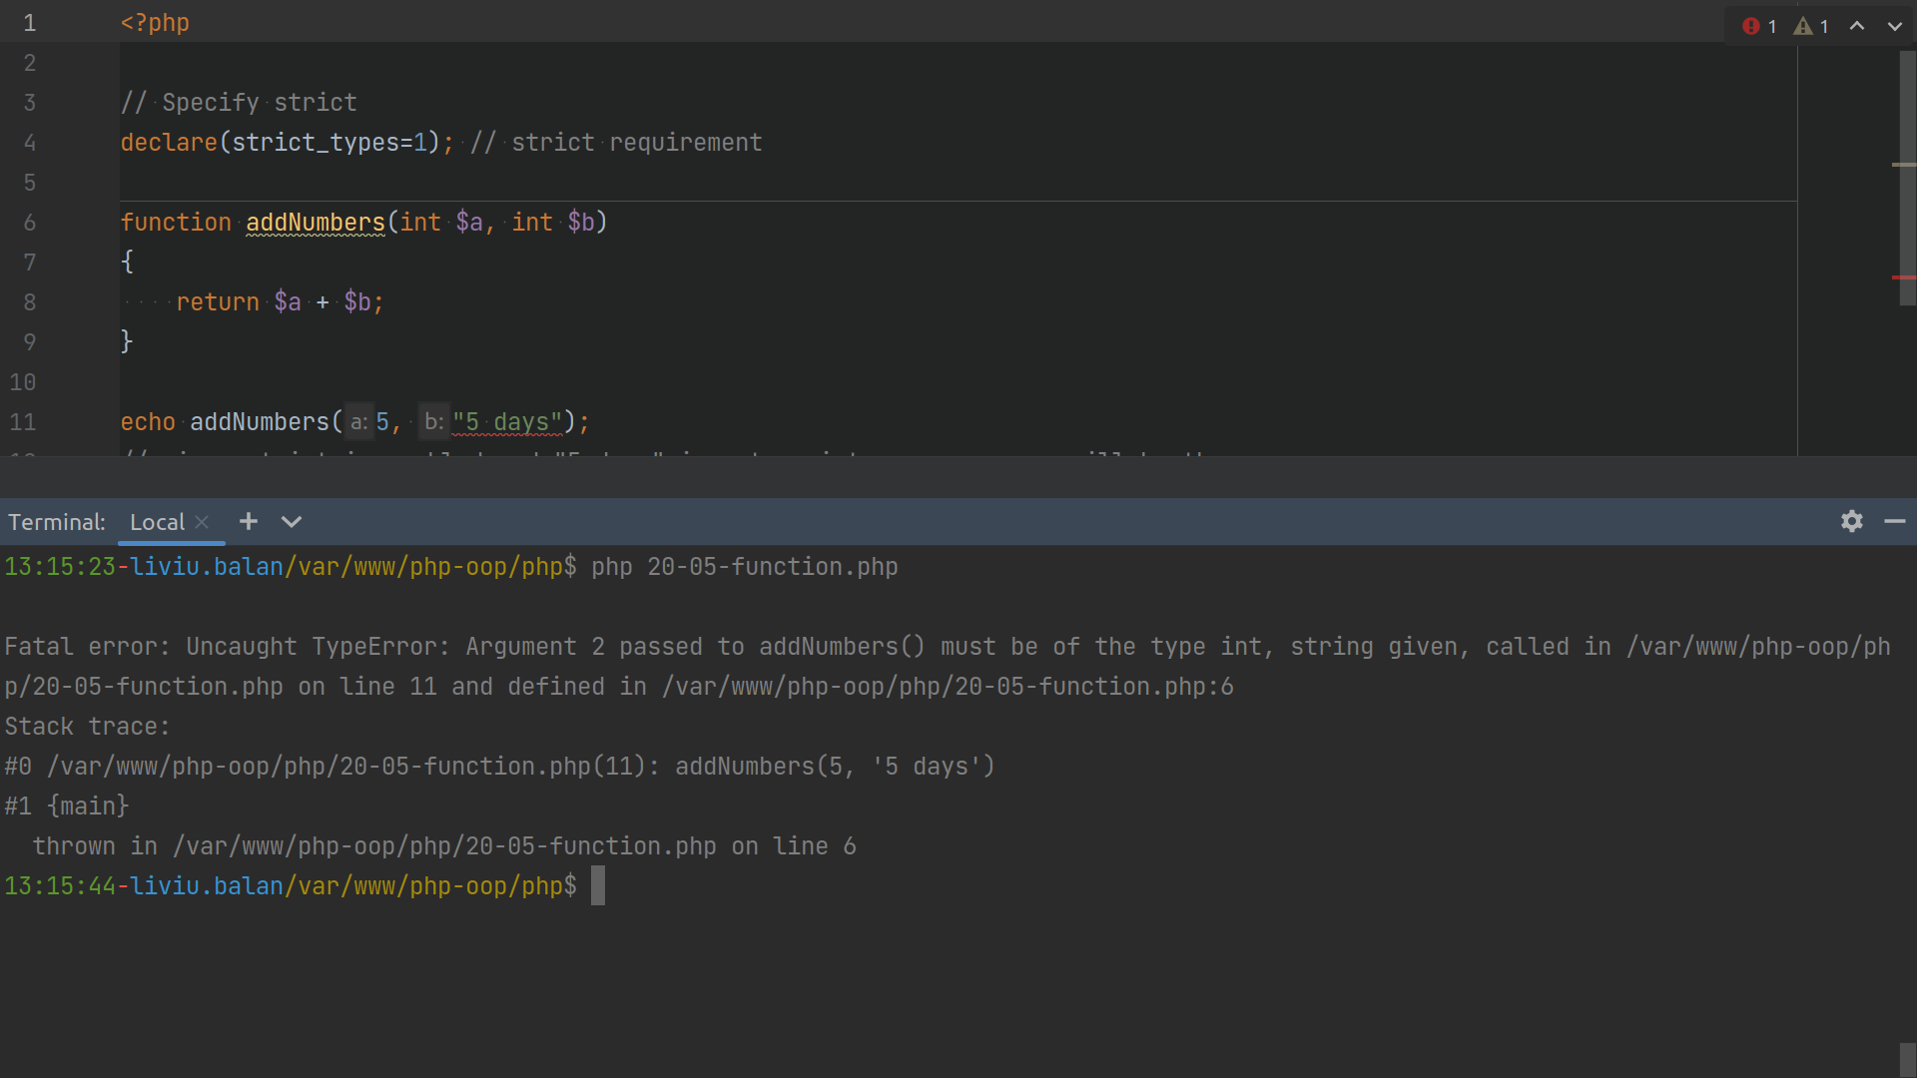

Slide 47
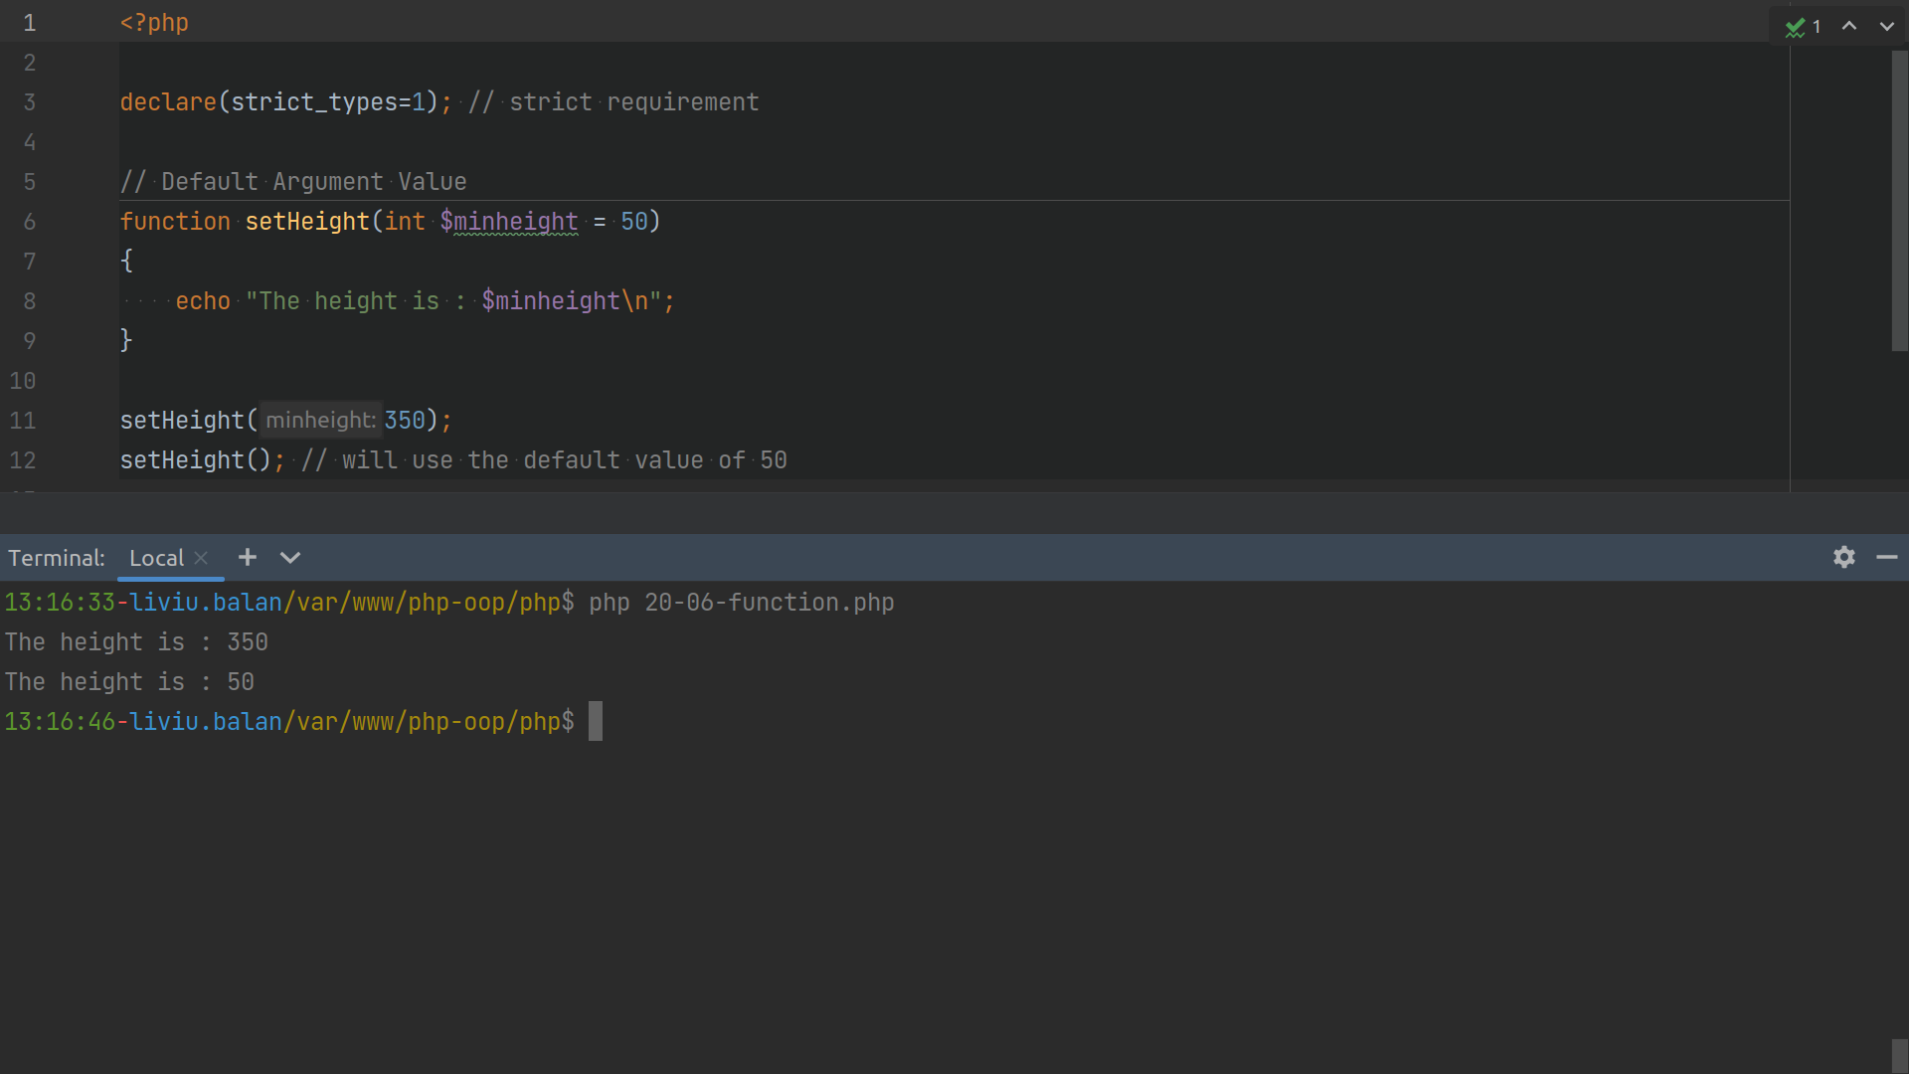

Slide 48
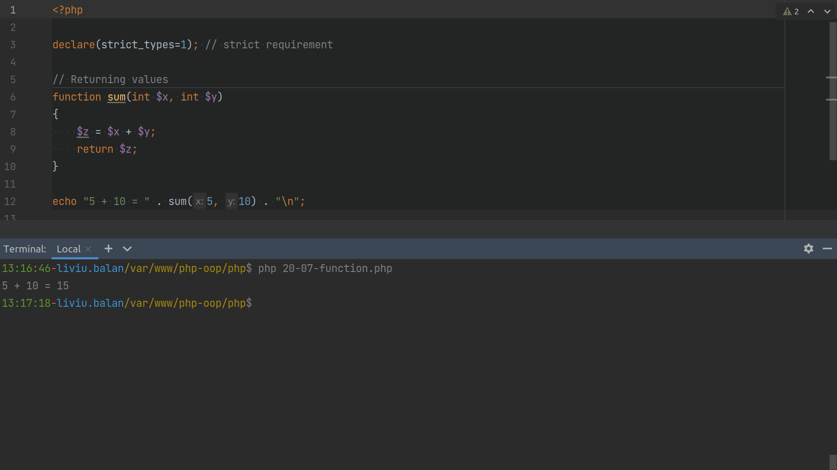

Slide 49
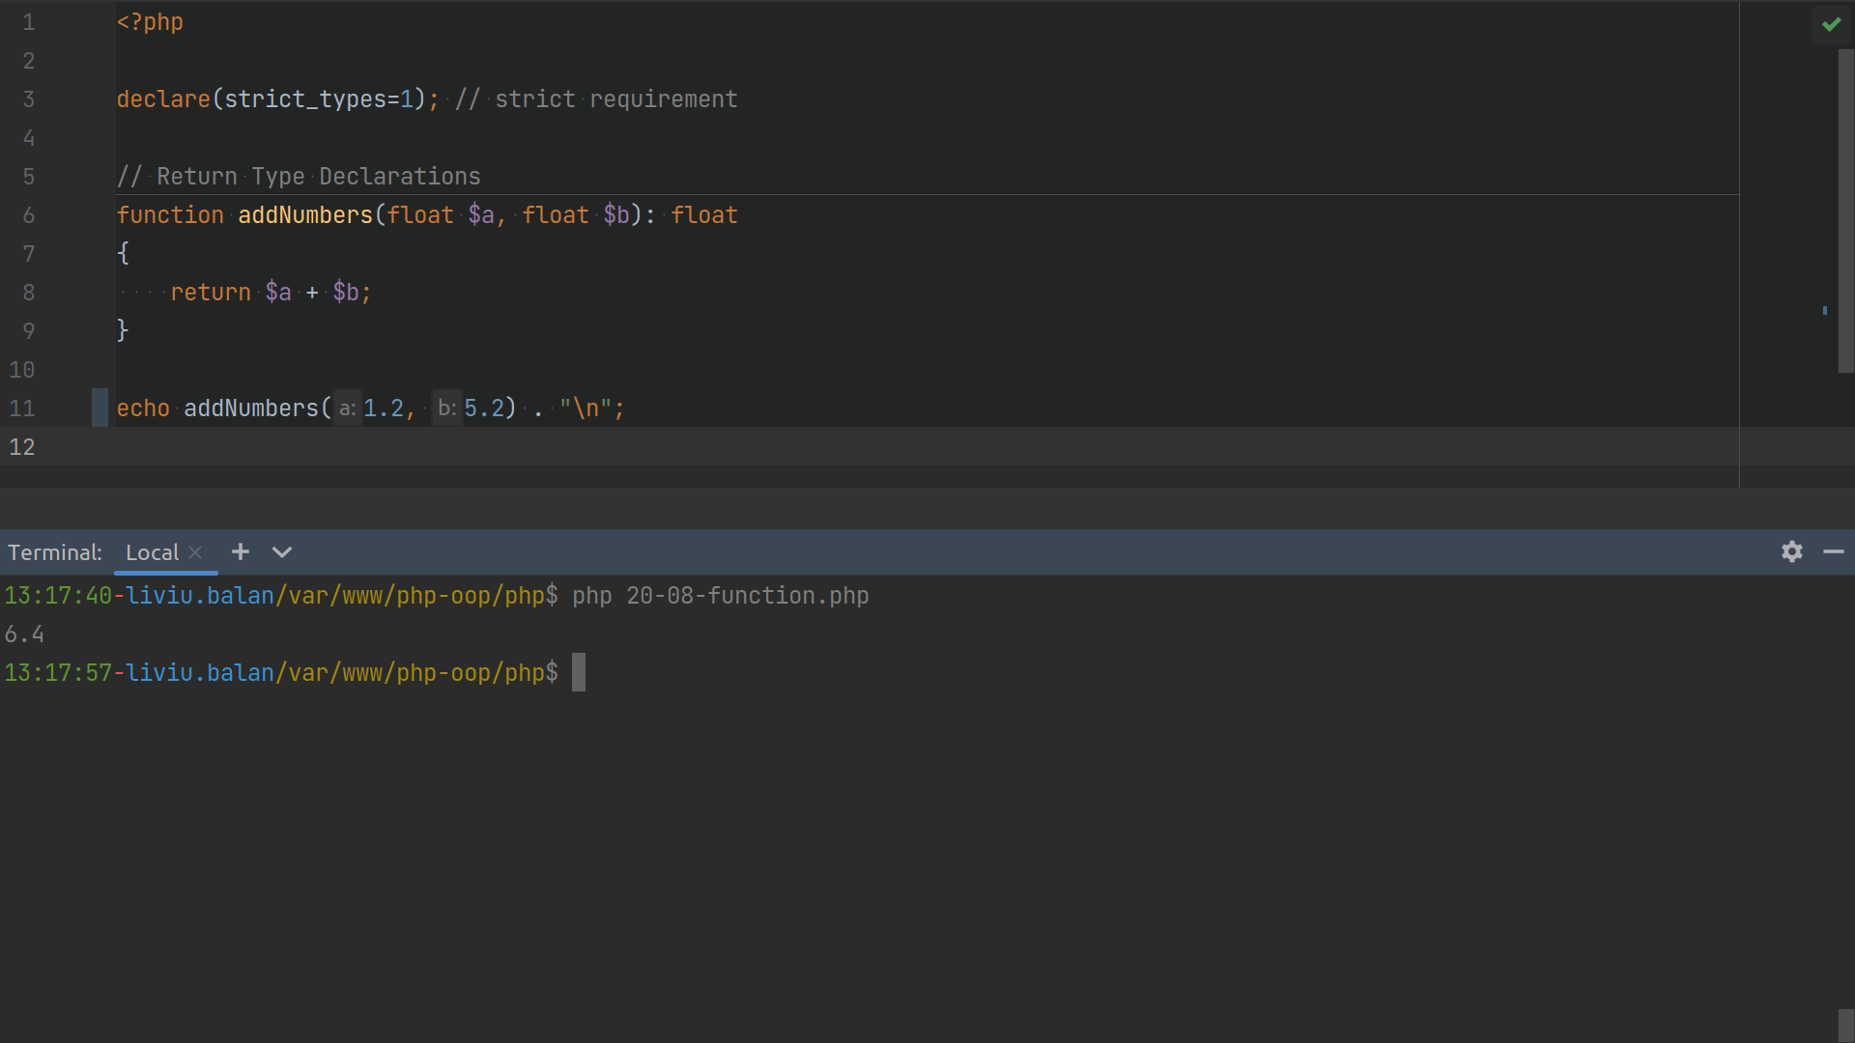

Slide 50
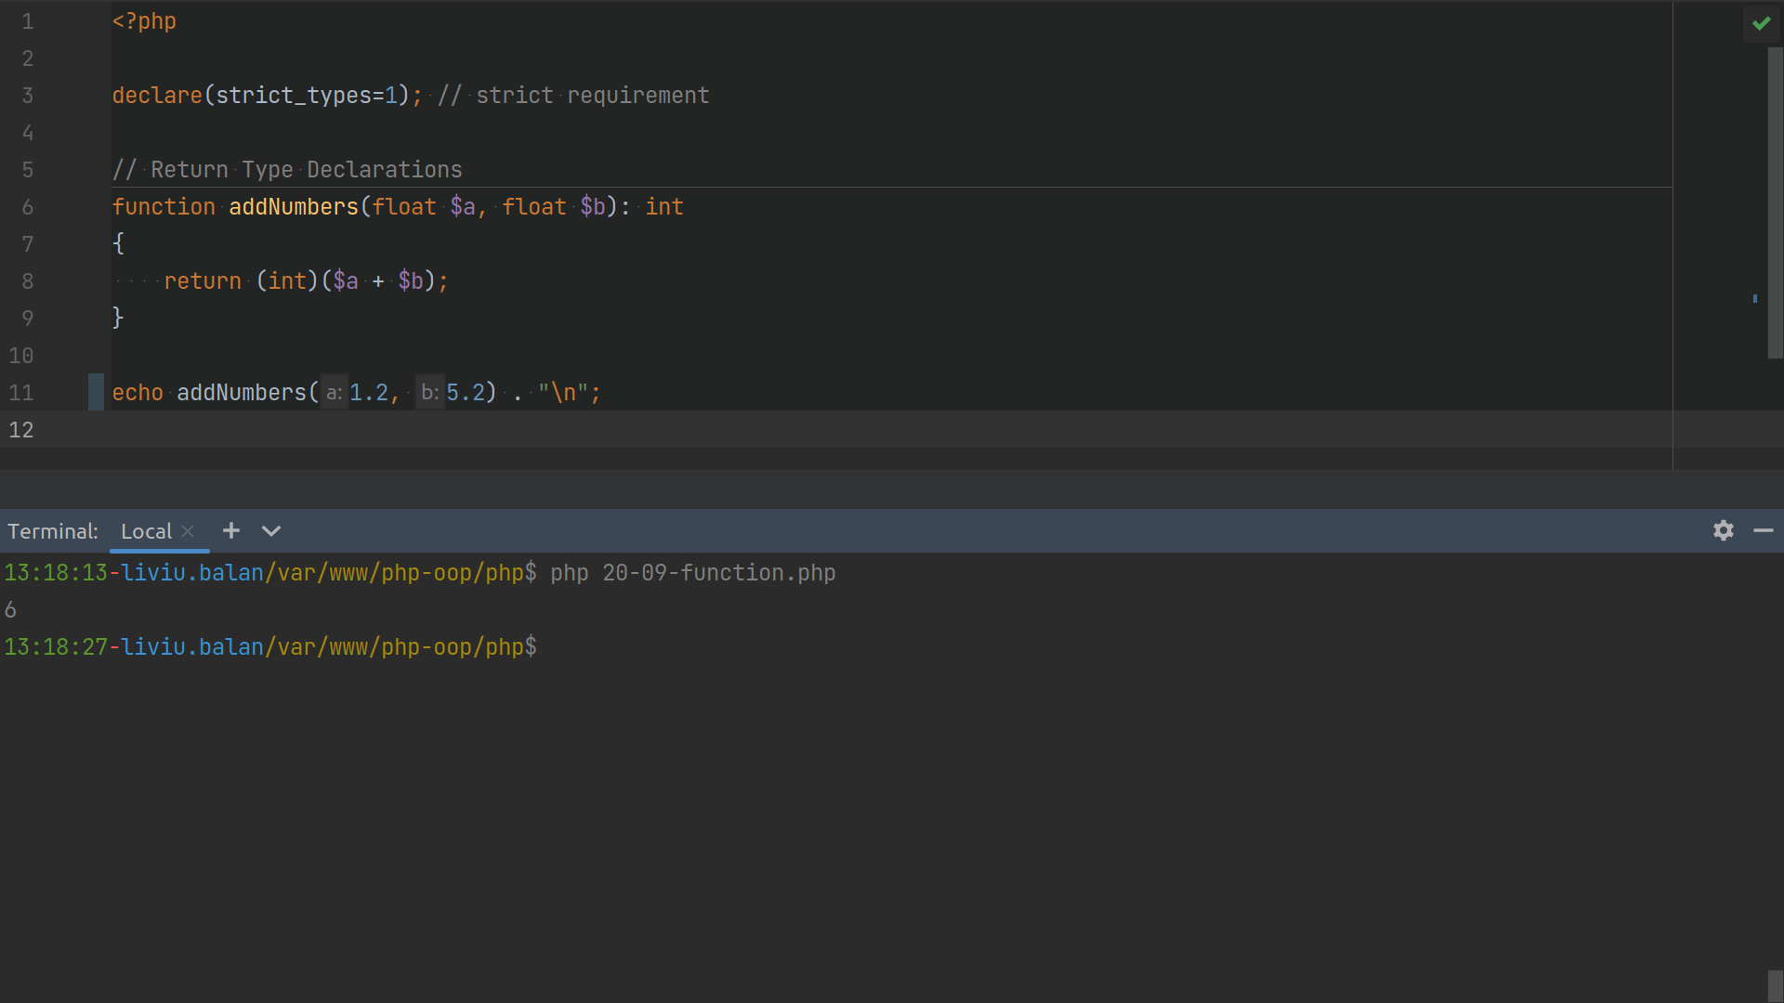

Slide 51
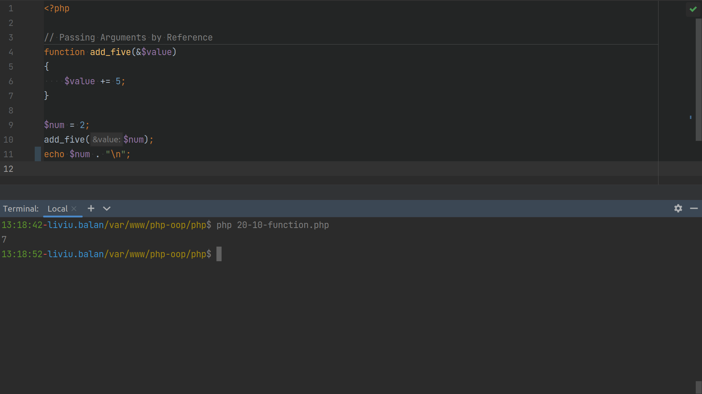

Slide 52
Superglobals Variables
$GLOBALS
$_SERVER
$_REQUEST
$_POST
$_GET
$_FILES
$_ENV
$_COOKIE
$_SESSION

Slide 53
Q&A

Slide 54
Practice

