Slide 1
Liviu Bălan
Workshop PHP
Part 3

Slide 2
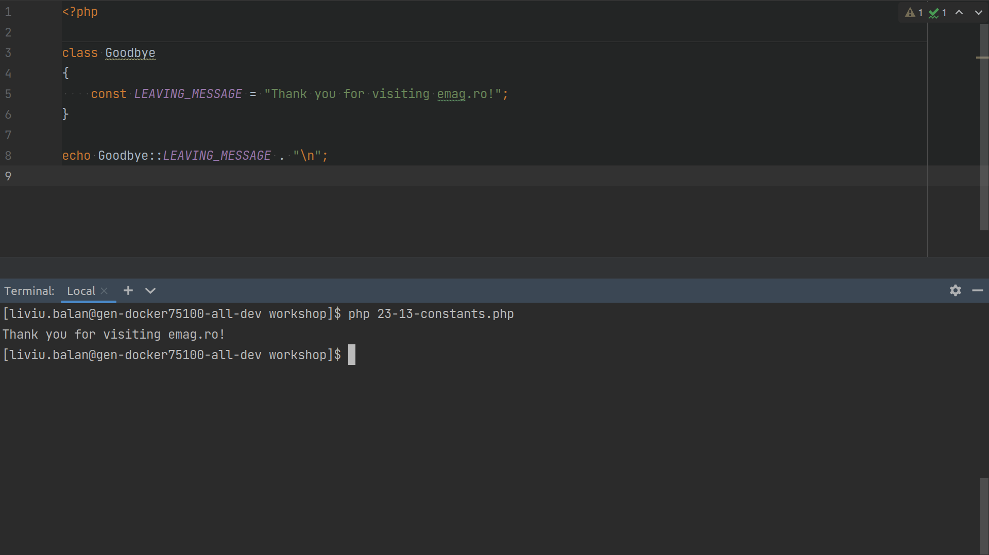

Slide 3
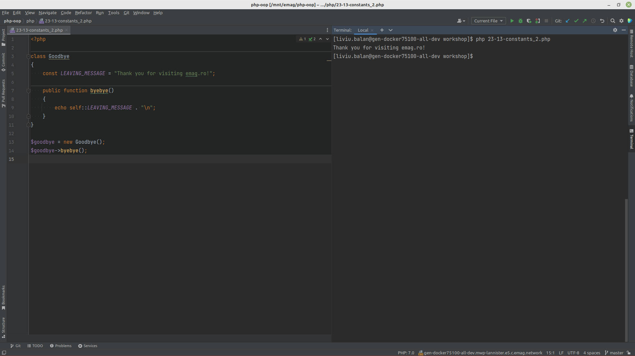

Slide 4
Interfaces vs. Abstract Classes
Interfaces cannot have properties, while abstract classes can
All interface methods must be public, while abstract class methods is public or protected
All methods in an interface are abstract, so they cannot be implemented in code and the abstract keyword is not necessary
Classes can implement an interface while inheriting from another class at the same time

Slide 5
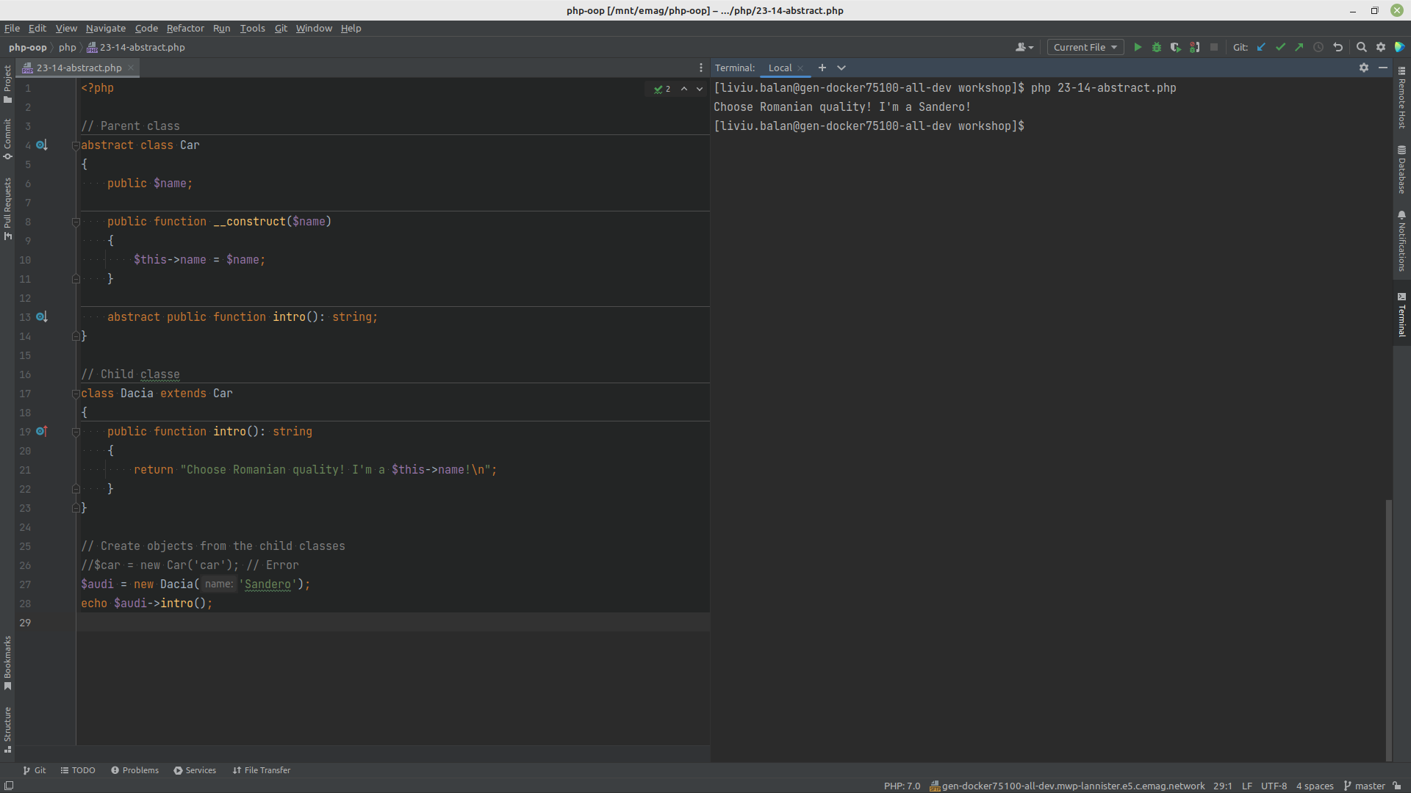

Slide 6
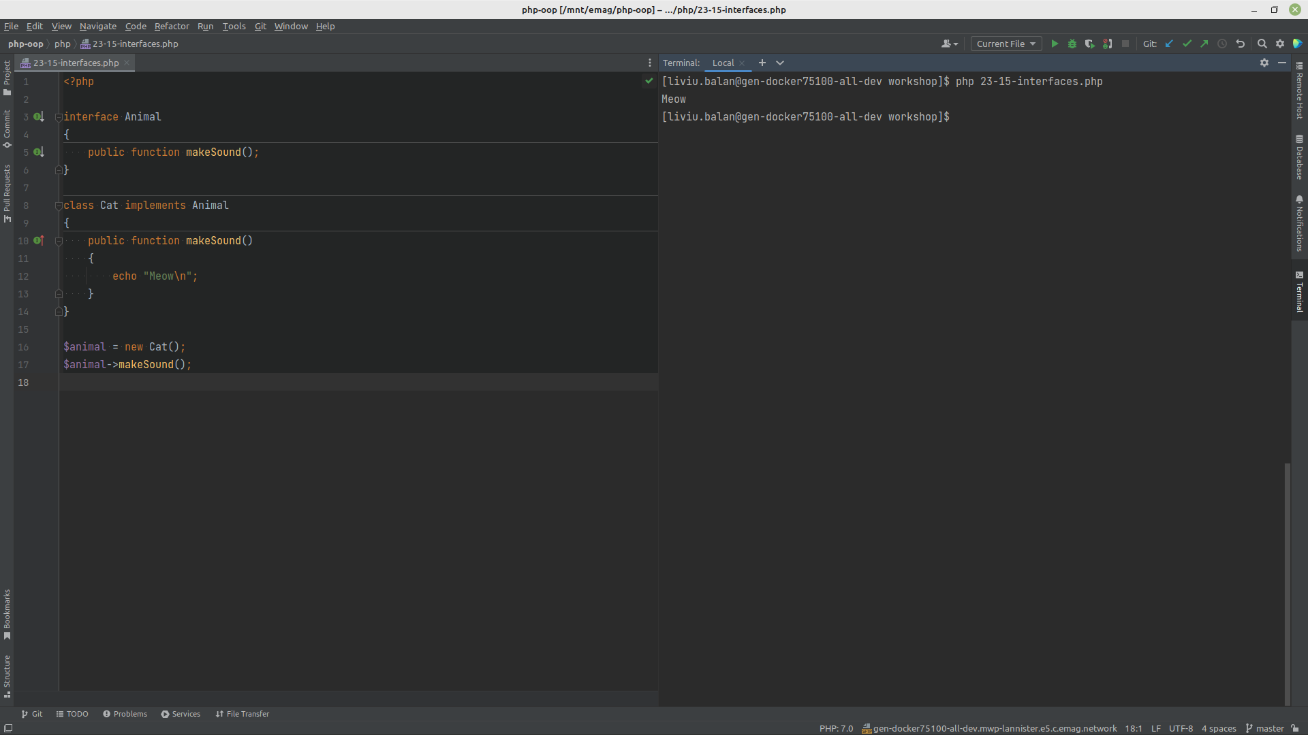

Slide 7
Traits
PHP only supports single inheritance: a child class can inherit only from one single parent.
What if a class needs to inherit multiple behaviors? OOP traits solve this problem.
Traits are used to declare methods that can be used in multiple classes.
Traits can have methods and abstract methods that can be used in multiple classes, and the methods can have any access modifier (public, private, or protected).

Slide 8
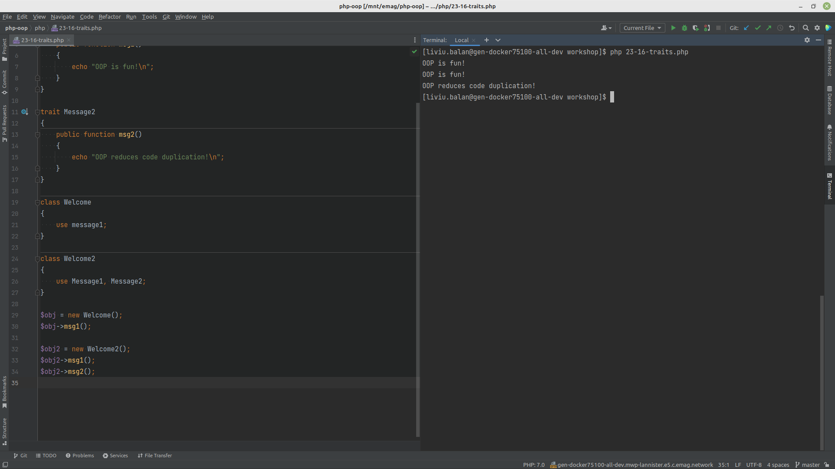

Slide 9
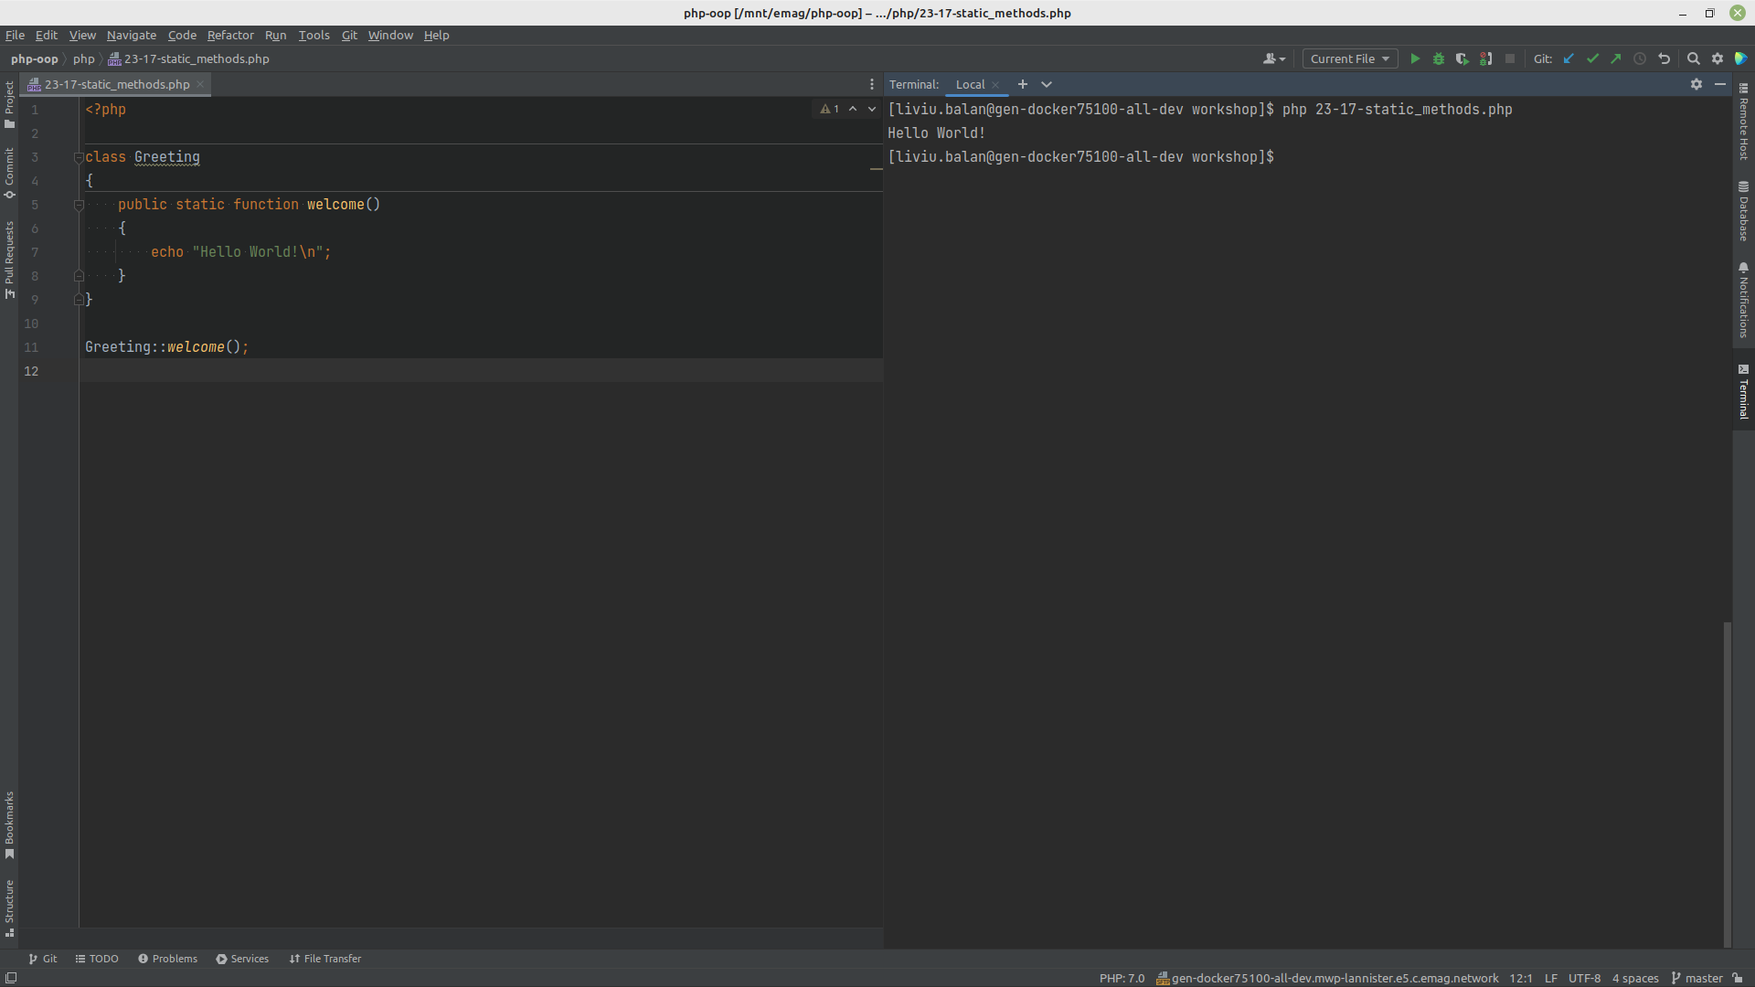

Slide 10
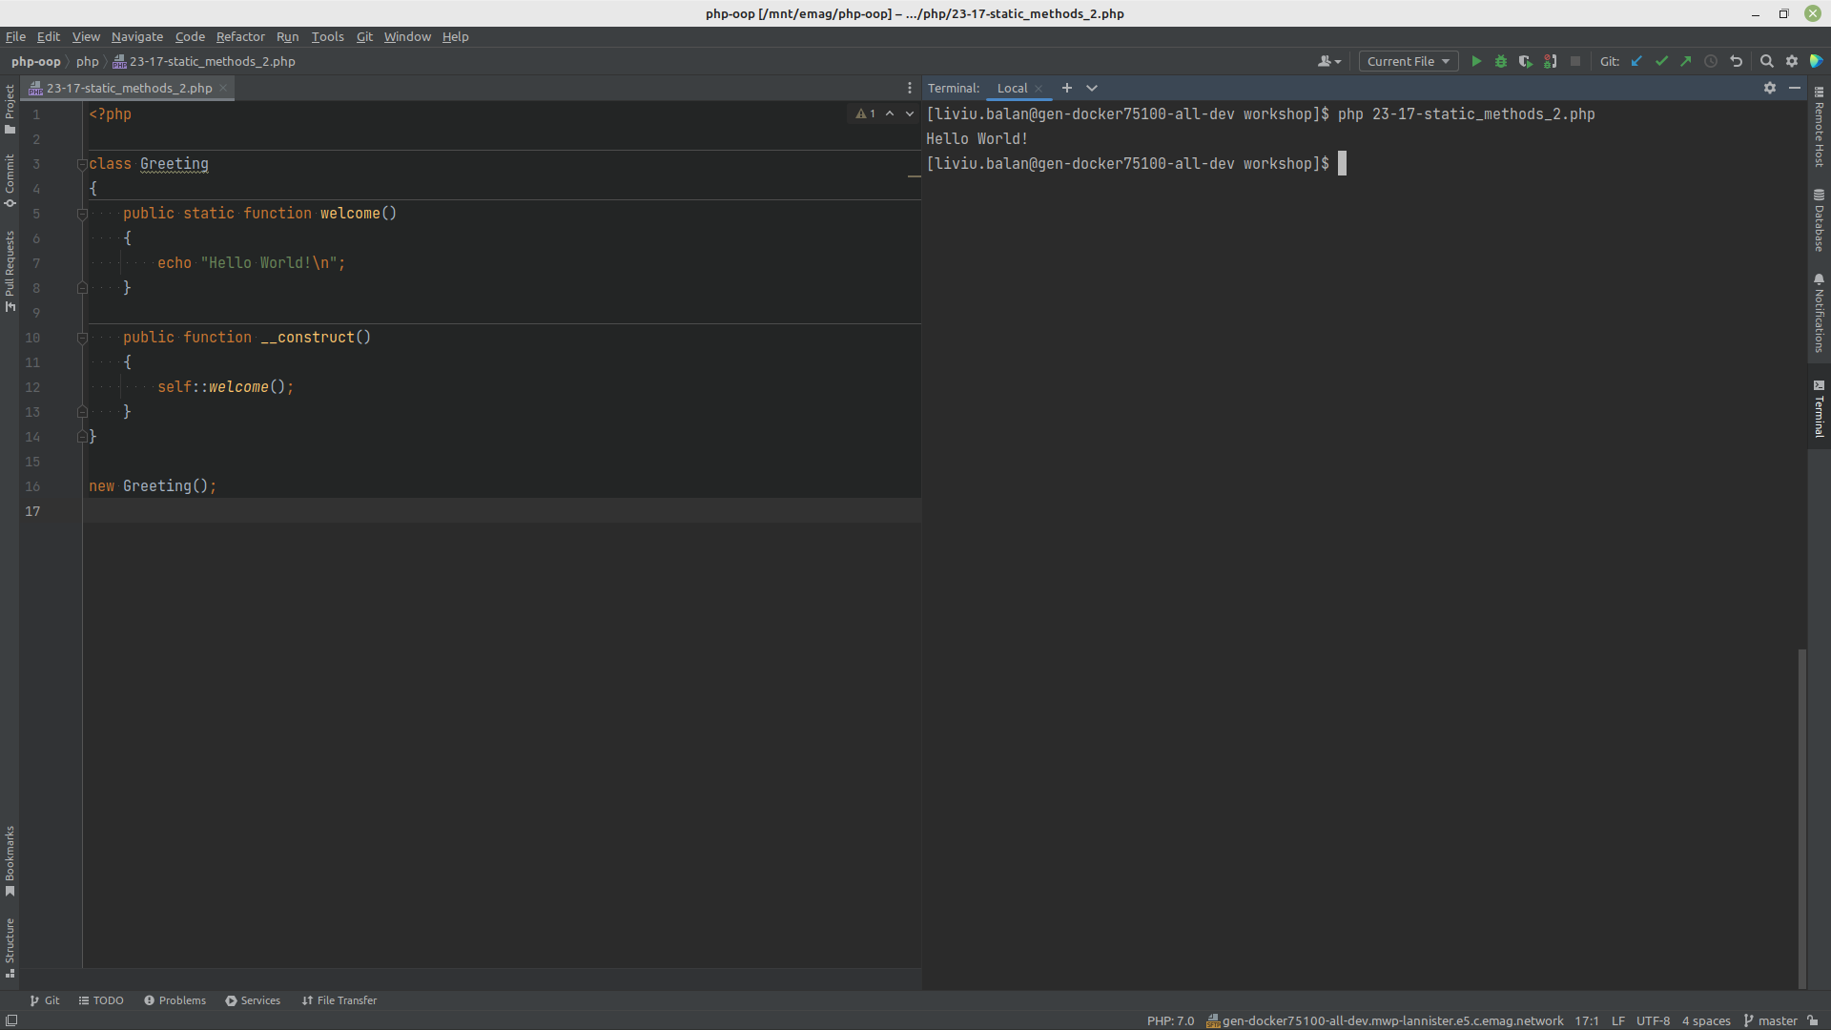

Slide 11
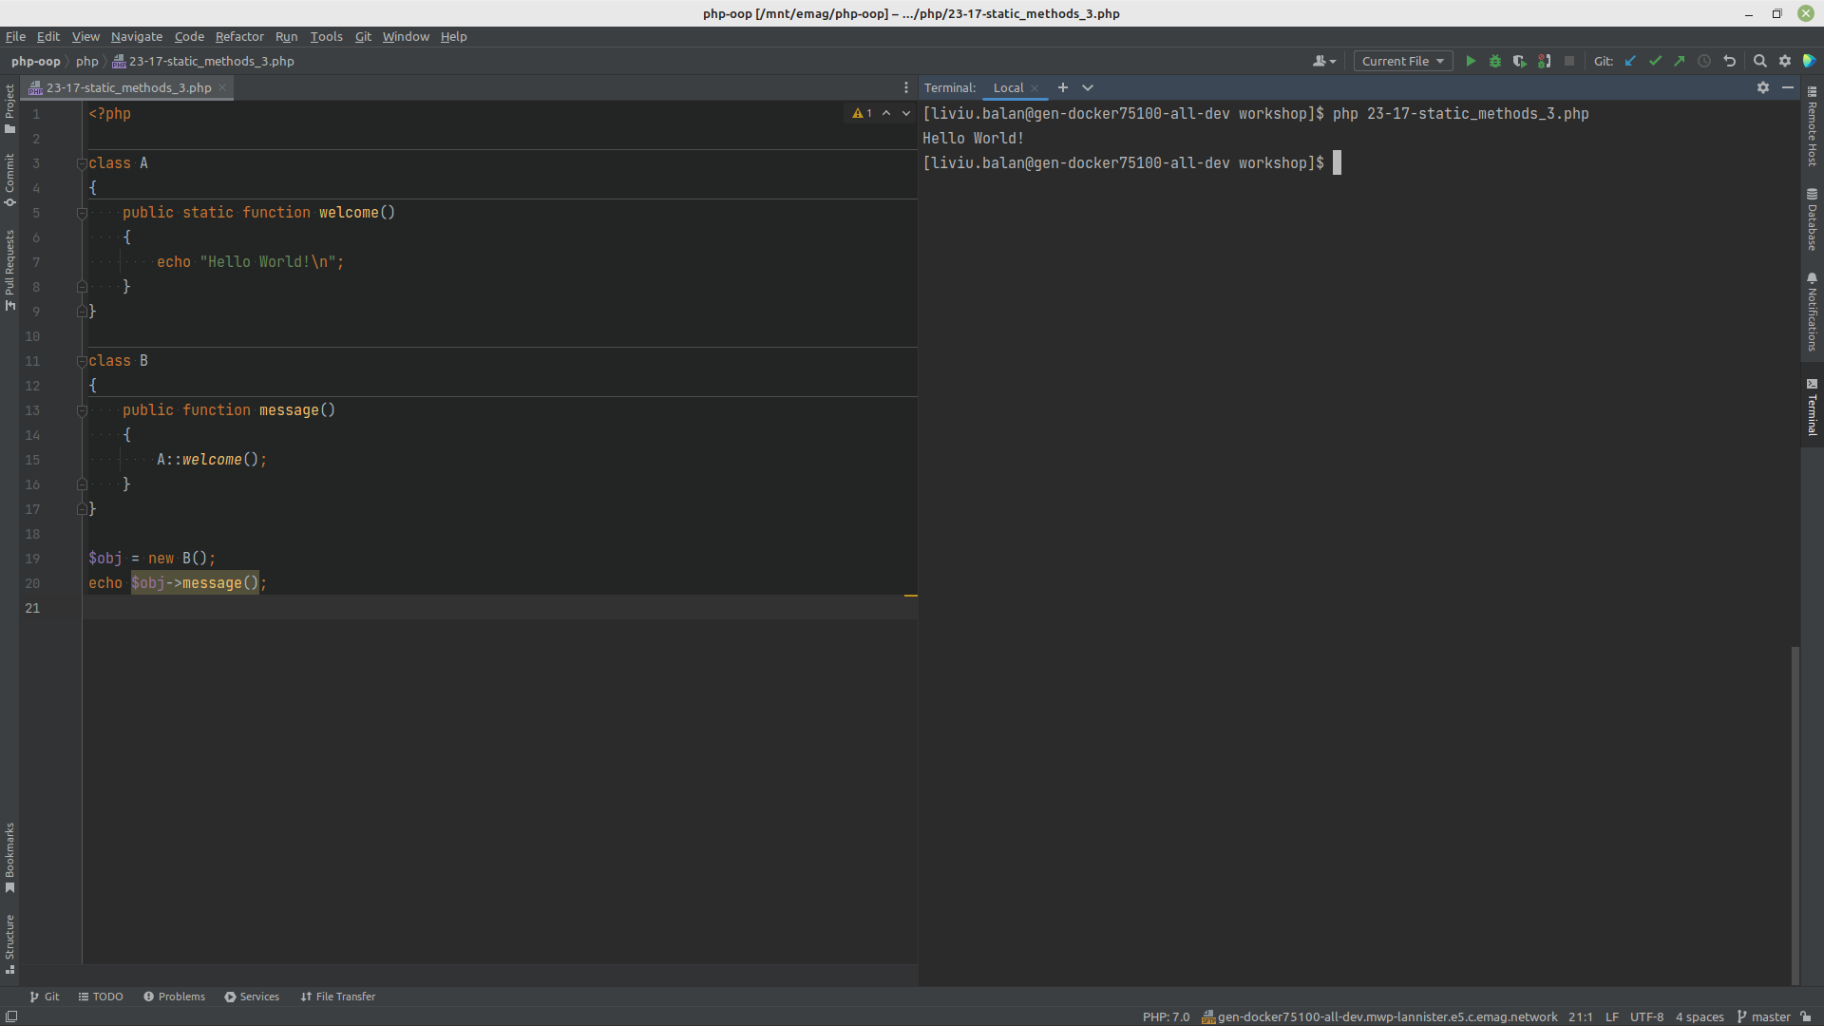

Slide 12
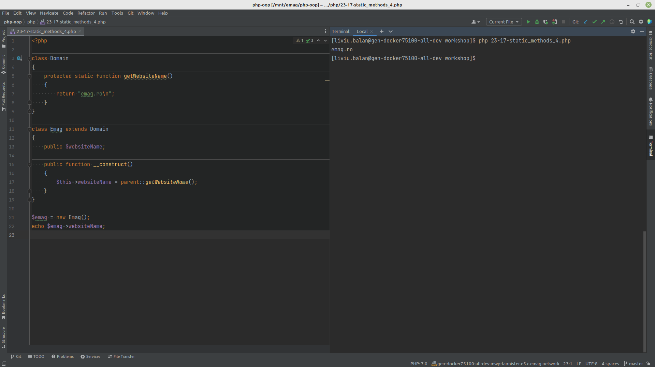

Slide 13
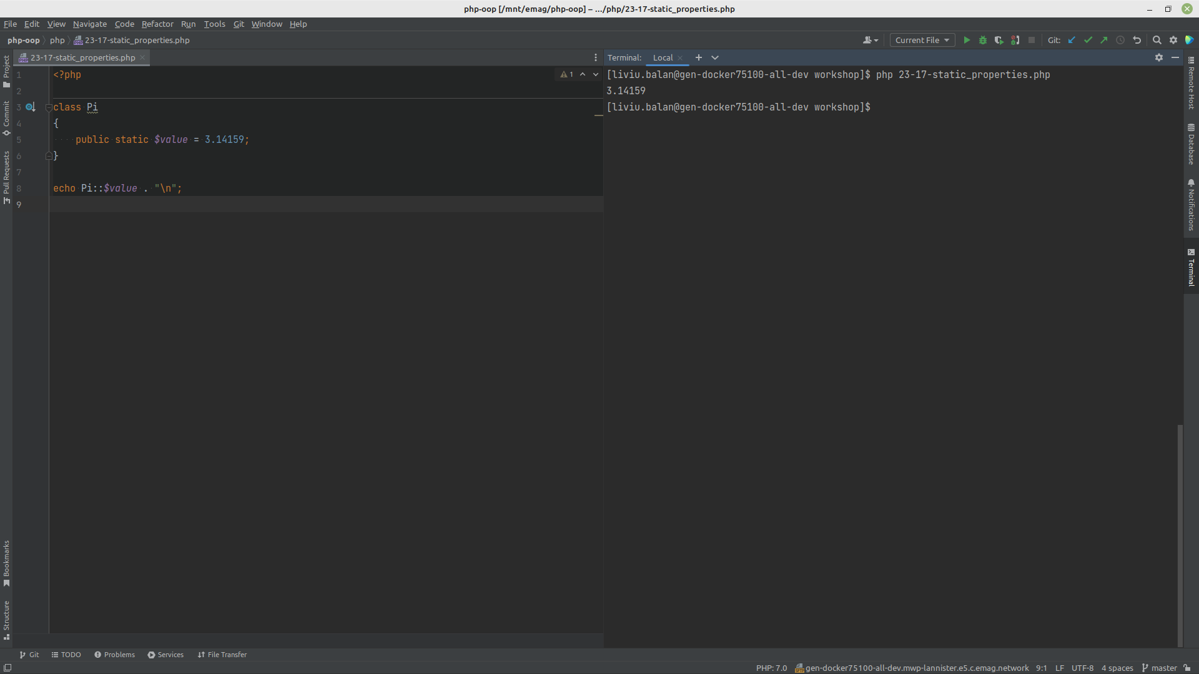

Slide 14
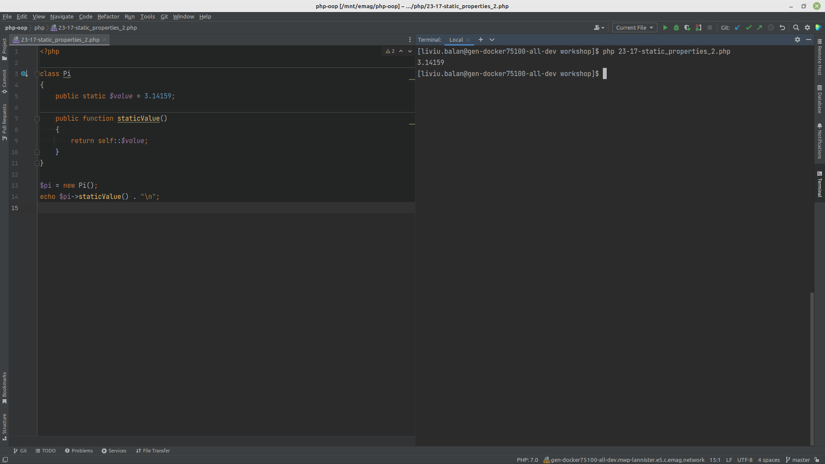

Slide 15
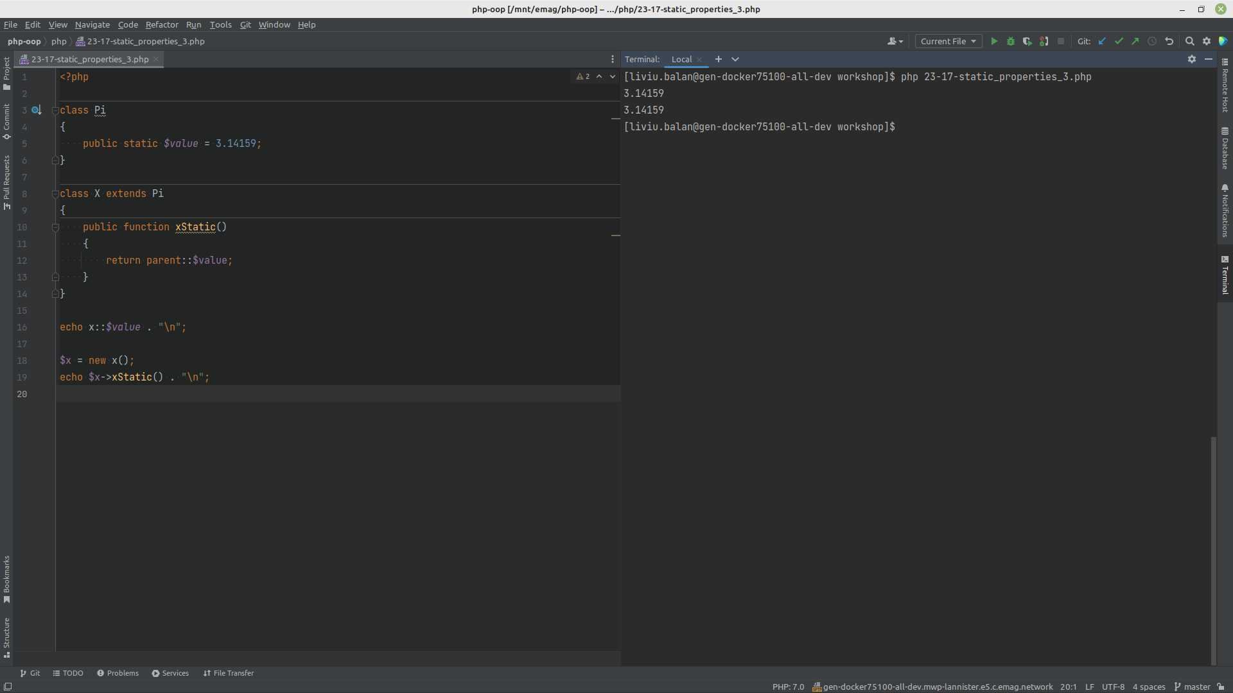

Slide 16
Creating Iterables
All arrays are iterables
Any object that implements the Iterator interface can be used as an argument of a function that requires an iterable

Slide 17
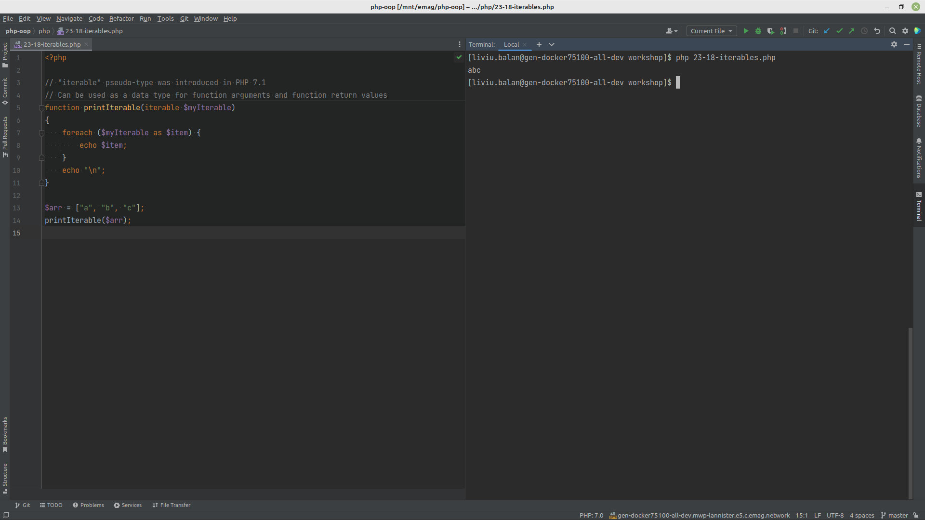

Slide 18
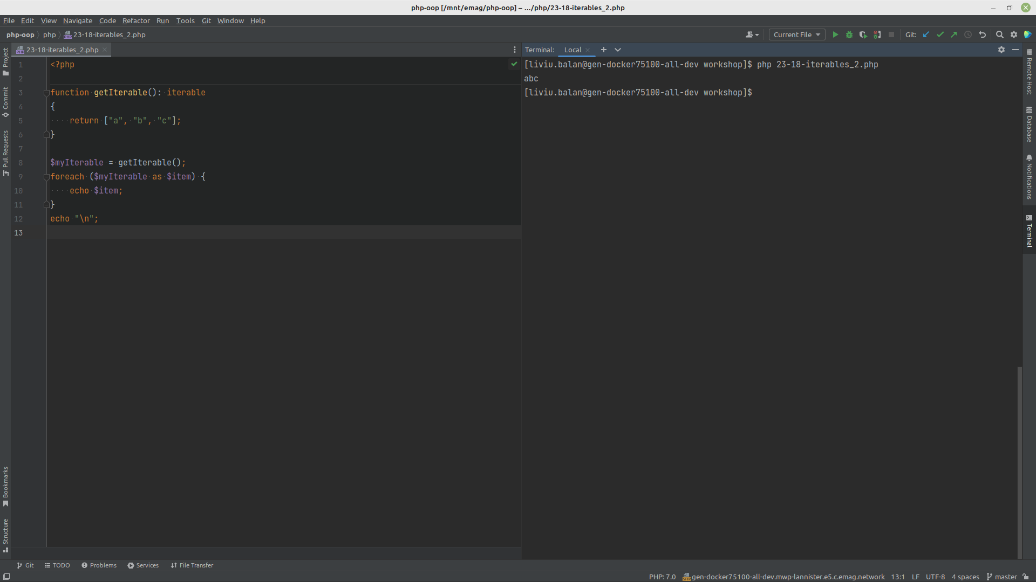

Slide 19
Iterator methods
current() - Returns the element that the pointer is currently pointing to. It can be any data type
key() Returns the key associated with the current element in the list. It can only be an integer, float, boolean or string
next() Moves the pointer to the next element in the list
rewind() Moves the pointer to the first element in the list
valid() If the internal pointer is not pointing to any element (for example, if next() was called at the end of the list), this should return false. It returns true in any other case

Slide 20
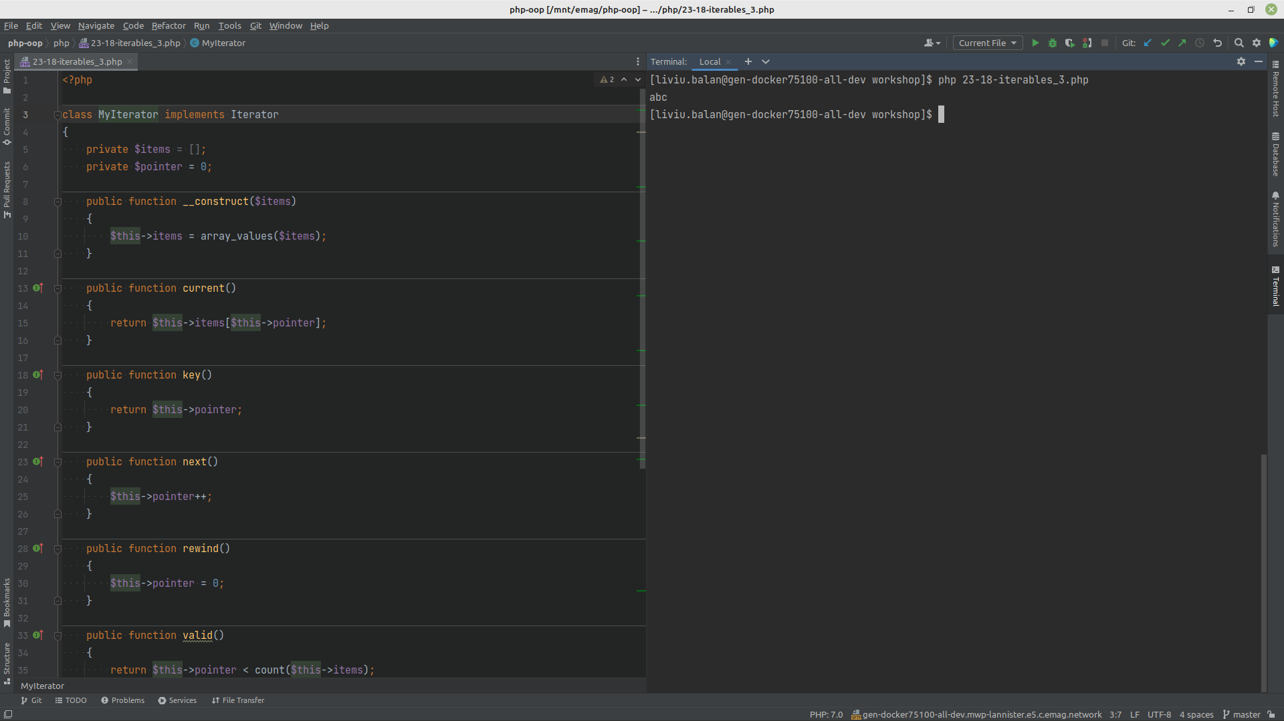

Slide 21
Design patterns
https://refactoring.guru/design-patterns/php

Slide 22


Slide 23
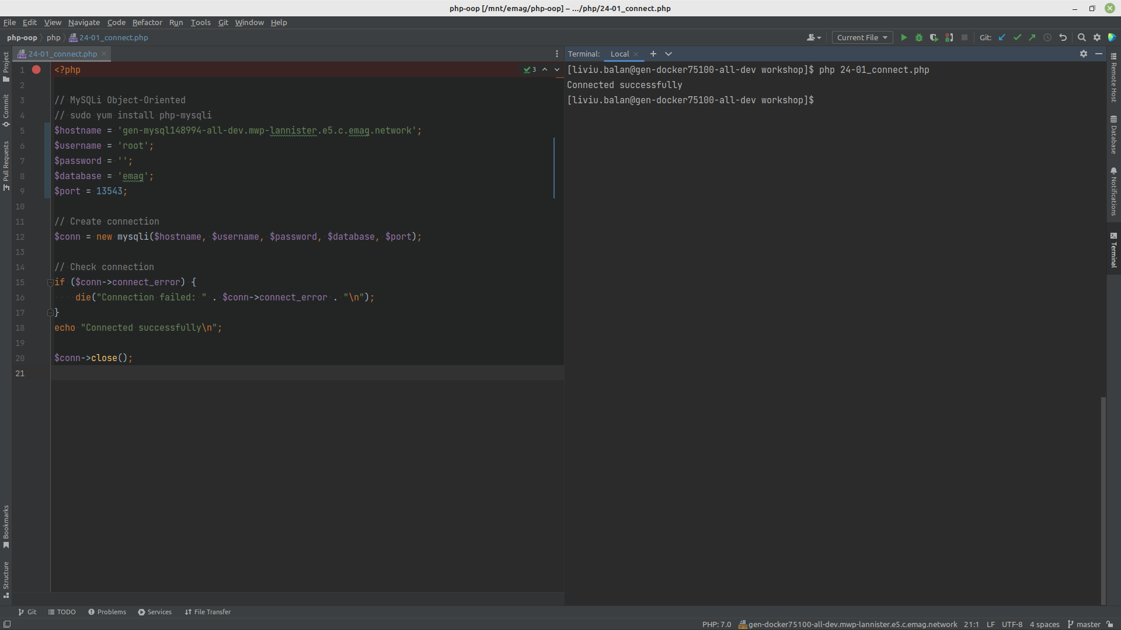

Slide 24
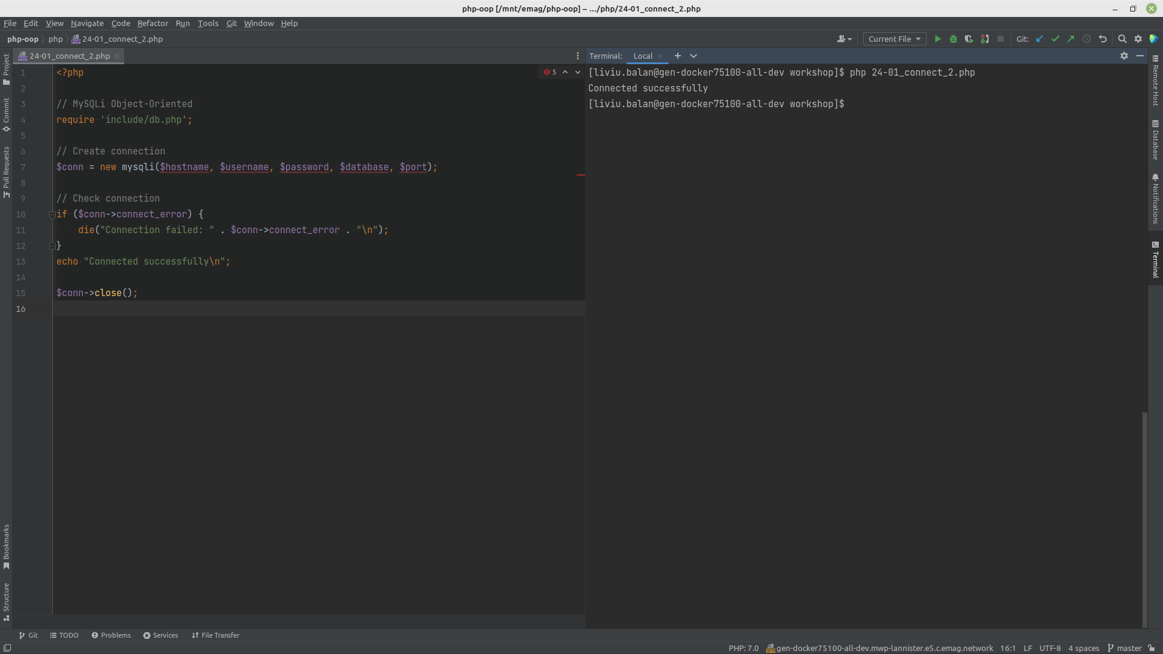

Slide 25
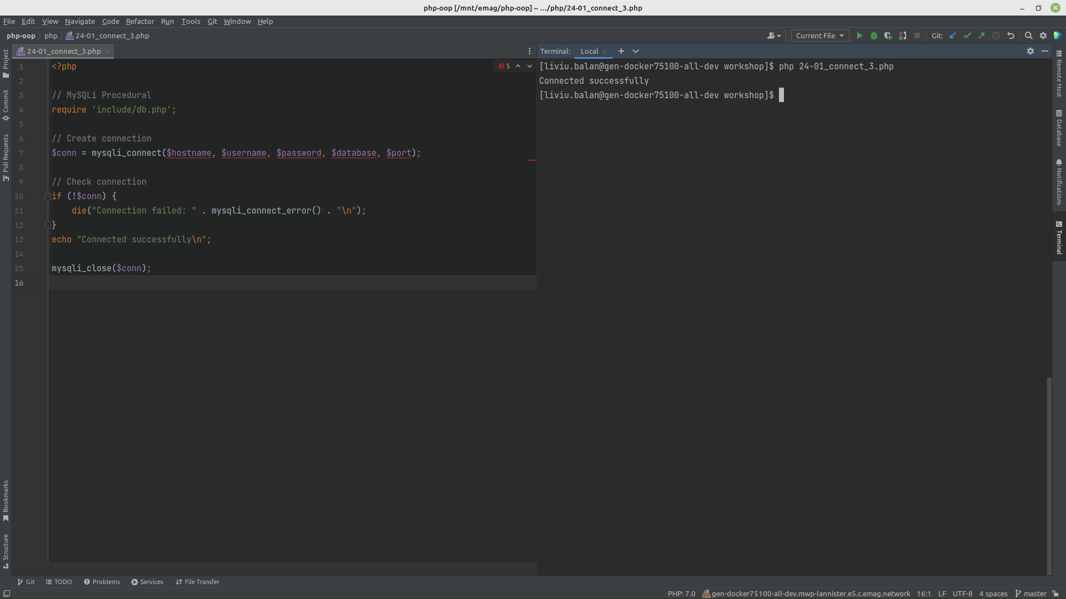

Slide 26
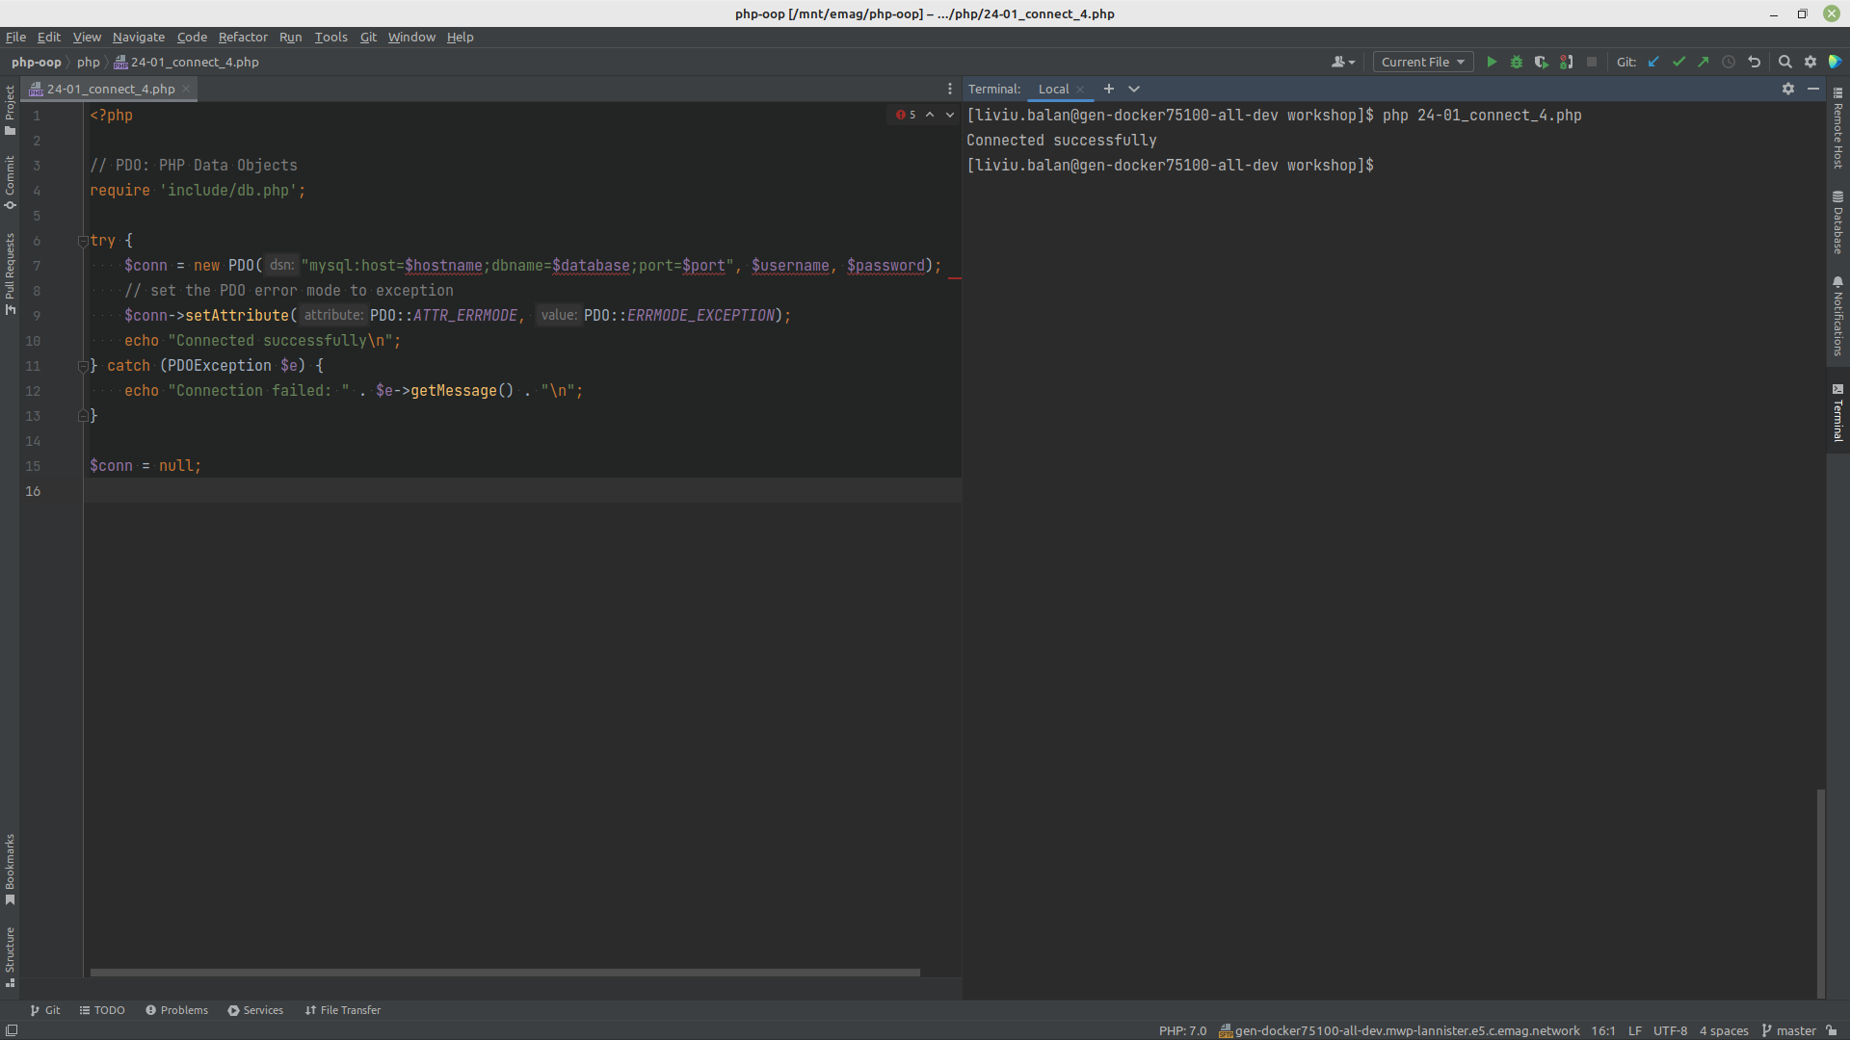

Slide 27
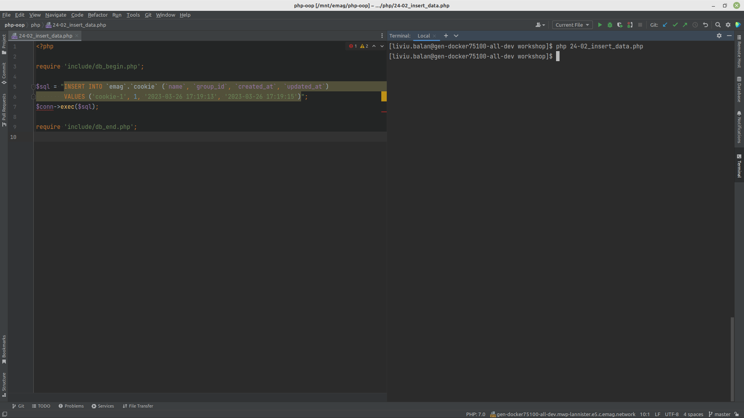

Slide 28
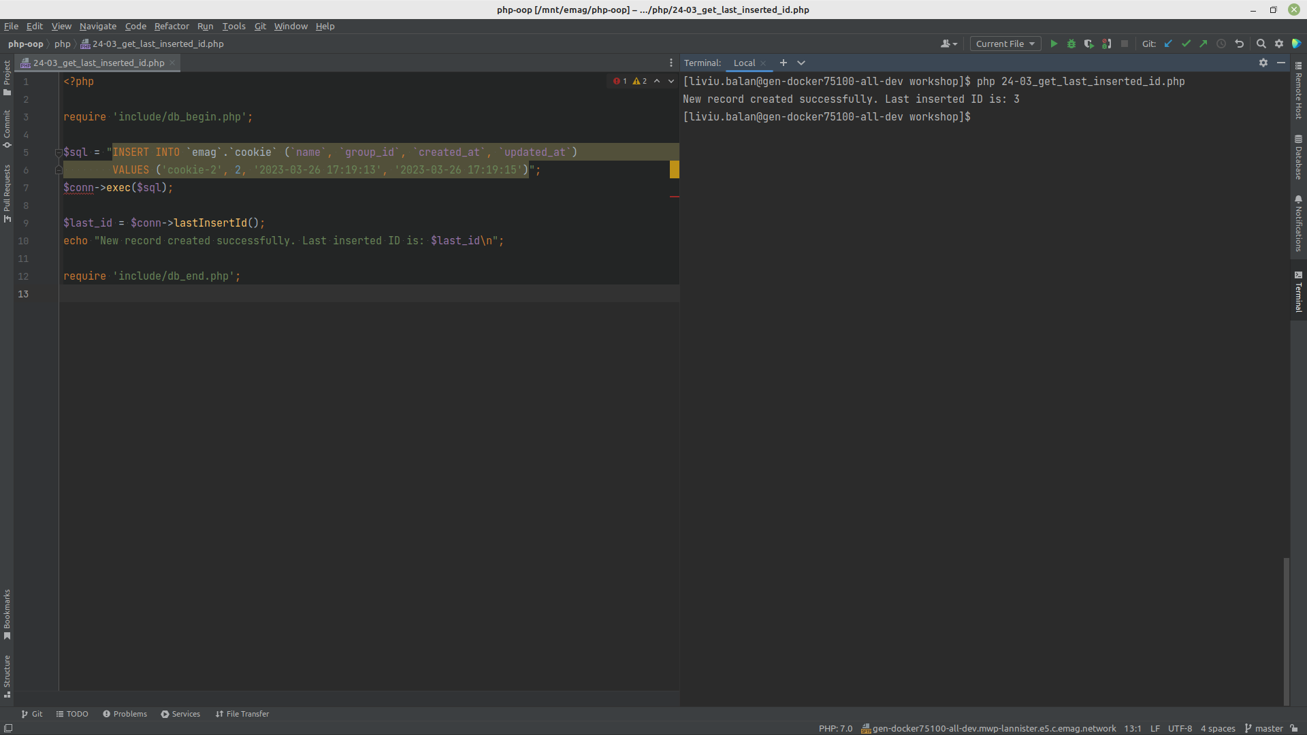

Slide 29
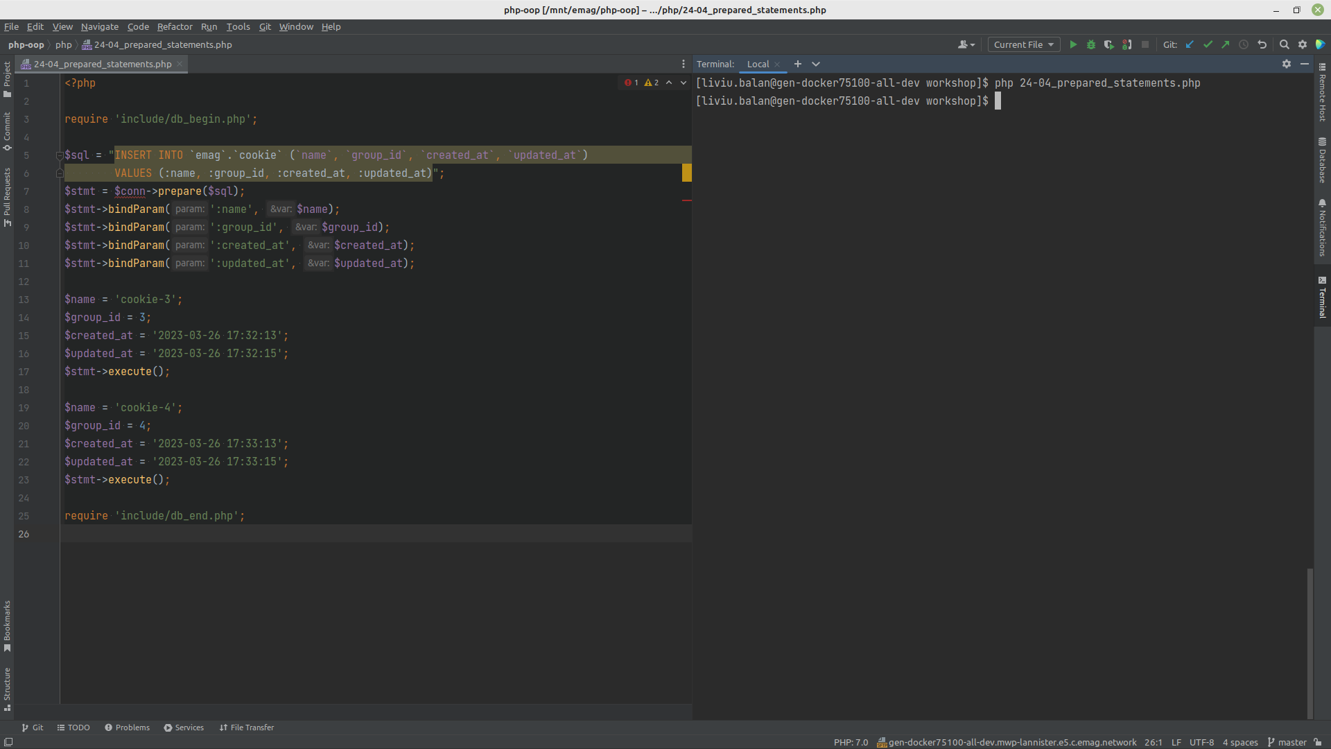

Slide 30
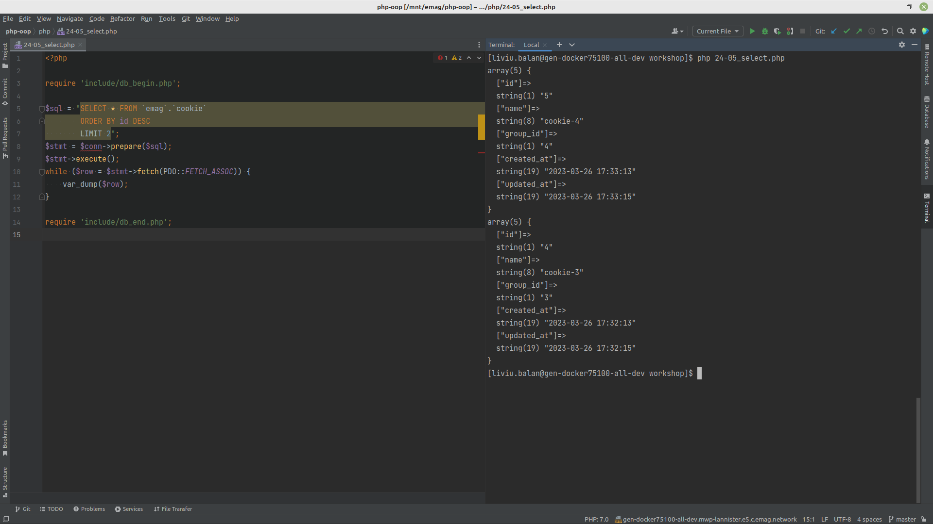

Slide 31
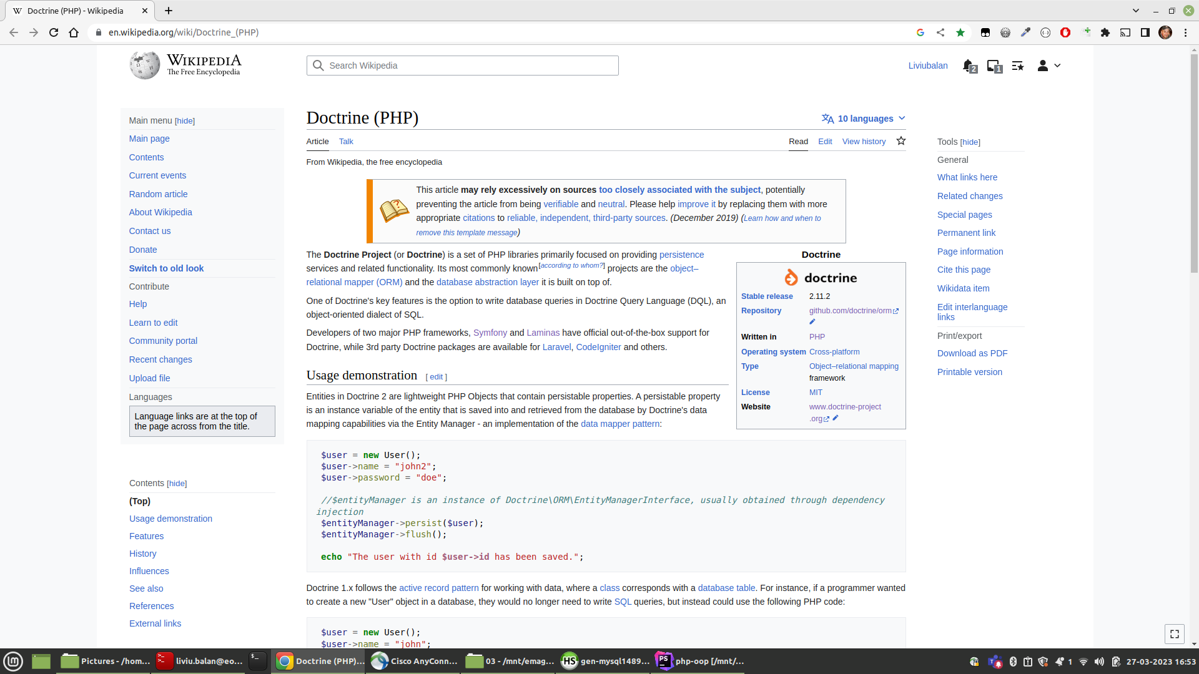

Slide 32
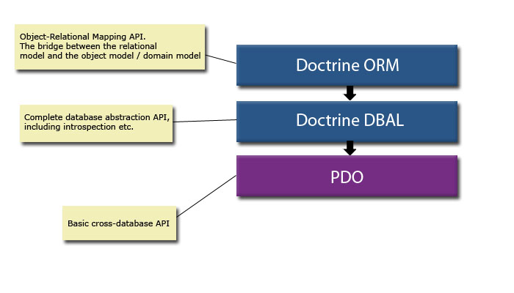

Slide 33
Q&A

Slide 34
Practice

