Slide 1
Please connect to either WiFi: GeekconX-Hugo GeekconX-Hugo-5GHz

Slide 2
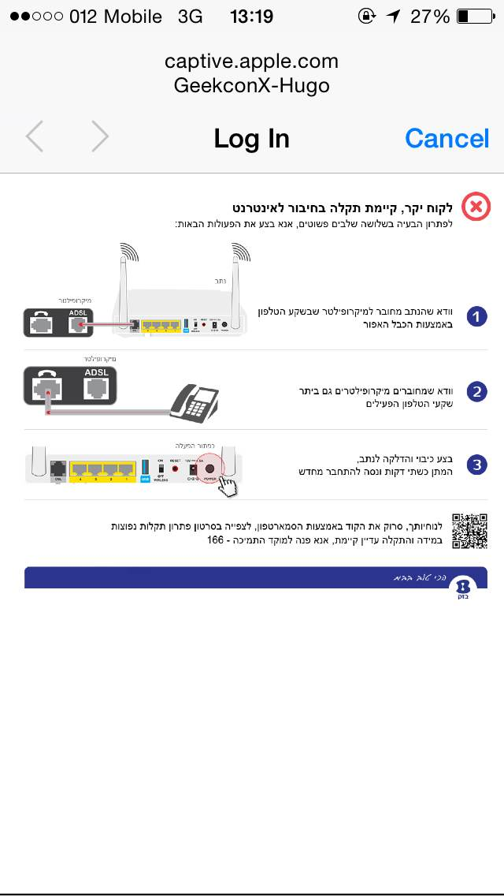
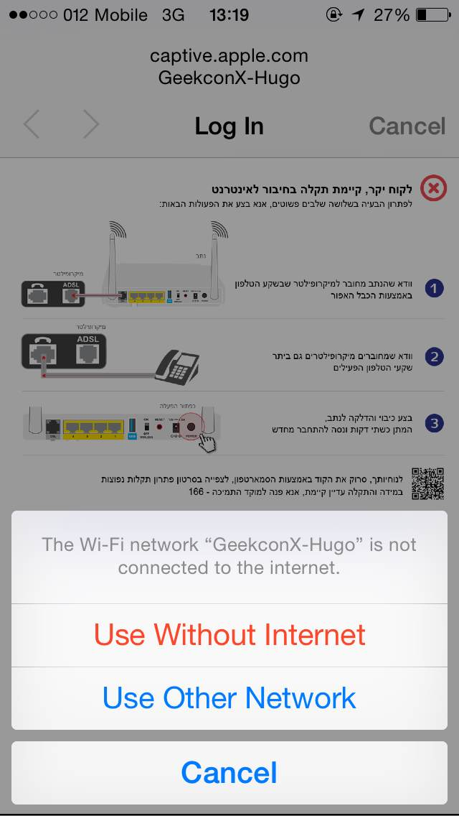

Slide 3
10.0.0.1

Slide 4
Endless Adventure
Team:
Tanya Yakovleva – Art Director
Inbar Goldberg – Character Design and HR
Hovav Moseri – Mechanics and Special Effects
Alon Levi – Sys Admin, Wiz kid
Tal Ater – Frontend and MVP protector
Jonathan Livni – Backend and CHO
Yuval Adam – LAN GOD

